Slide 1
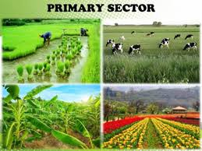
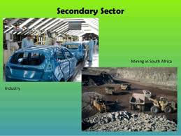
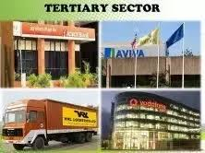
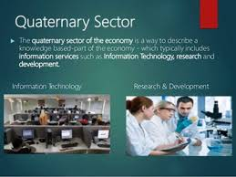
FYBBI-SEMESTER-I-FOUNDATION COURSE
ENVIRONMENTAL SCIENCE
Unit 3-Environment & Economic Activities
SYLLABUS AT A GLANCE
ECONOMIC ACTIVITIES :-Sectors :- Primary.Secondary,Tertiary,Quaternary & Quinary
THE THREE SECTOR THEORY :- Stages of Development
ENVIRONMENTAL PROBLEMS ASSOCIATED WITH ECONOMIC ACTIVITIES :-
Primary Sector
Secondary Sector
Tertiary Sector

Slide 2
INTRODUCTION
ECONOMIC ACTIVITIES :- Human activities which generate income are called as ‘Economic Activities’
The modern economy can be divided into three sectors which reflect economic development of that society.
It can be broadly grouped into-Primary,Secondary & Tertiary Activities.
Higher services under Tertiary Sector Activities are again classified into-Quaternary & Quinary Activities.
ECONOMIC ACTIVITIES
PRIMARY SECTOR
TERTIARY SECTOR
SECONDARY SECTOR
QUATERNARY SECTOR
QUINARY SECTOR

Slide 3
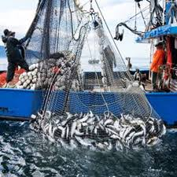
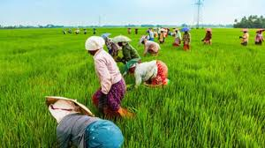
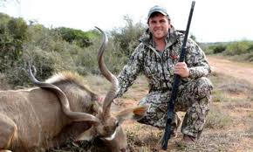
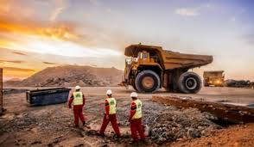
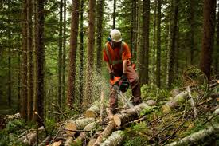
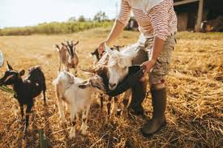
PRIMARY SECTOR
Primary Sector of Economy extracts or harvests products from earth.It includes production of raw material & basic foods.
Packaging & processing of raw material associated with this sector is also considered as a part of the sector.
FISHING
AGRICULTURE
HUNTING
MINING
ACTIVITIES ASSOCIATED WITH PRIMARY SECTOR
FORESTRY
ANIMAL FARMING

Slide 4
TOP RANKERS-PRIMARY SECTOR ACTIVITIES
China is the country with Rank 1 for-Pig Farming.
Newzealand is no.1 country for export of- Beef
Australia is no.1 exporter of raw wool.
Denmark is no.1 exporter of-Milk & Milk Products.

Slide 5
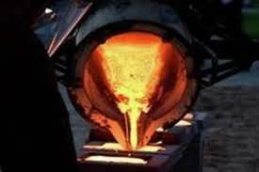
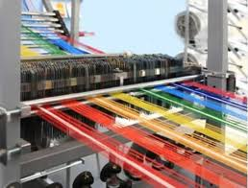
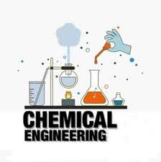
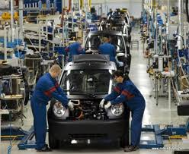
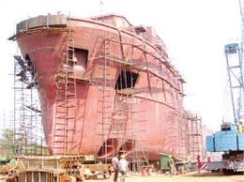
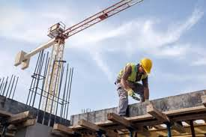

SECONDARY SECTOR
Secondary Sector of Economy manufactures secondary goods.All the manufacturing,processing & construction lies in secondary sector.
METAL SMELTING
TEXTILE MAKING
AUTOMOBILE MAKING
ACTIVITIES ASSOCIATED WITH SECONDARY SECTOR
SHIP BUILDING
AEROSPACE MANUFACTURING
CONSTRUCTION

Slide 6
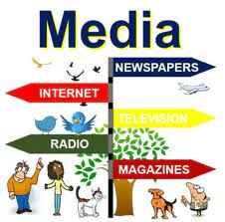


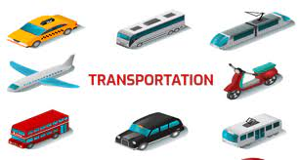
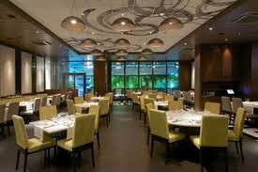

TERTIARY SECTOR
The Tertiary Sector of Economy is the Service Industry,which provides services to –General Population & Business.
In most developed & developing nations, a growing population of workers are involved in Tertiary Sector activities.
In US,more than 80% of labour force belongs to-Tertiary Sector.
CLERICAL SERVICES
ACTIVITIES IN TERTIARY SECTOR
RESTAURENTS

Slide 7

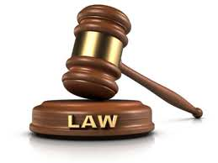



ACTIVITIES IN TERTIARY SECTOR

Slide 8






QUATERNARY SECTOR
It consists of-Intellectual Activities.
Education
CULTURE
ACTIVITIES IN QUATERNARY SECTOR
Scientific Research
LIBRARIES

Slide 9
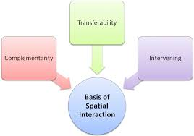
SPATIAL INTERACTION
All the sectorial activities are part of the phenomena-
“Spatial Interaction”.
It’s components are-
Complimentarity
Transferability
Intervening Opportunity

Slide 10
QUINARY SECTOR
A branch of the Quaternary Sector is called as-Quinary Sector.
It includes highest level of decision making in a society or economy.
This sector includes top executives or officials in such field as-Government,Science,Universities,Non-Profit,Health-Care,Culture,Media etc.

Slide 11
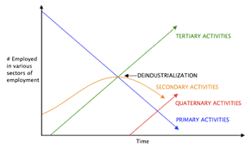
THE THREE-SECTOR THEORY
The Three-Sector theory is an economic theory,which divides economies into three sectors of activity;excretion of raw material (Primary),Manufacturing (Secondary) & Services (Tertiary)
According to this theory,the main focus of Economic Activity,shifts from-Primary,through the secondary & finally to Tertiary Sector.
It took place in twentieth century,when economies went through transition.
It resulted into-Increase in quality of life,Social Security,Education & Culture,Higher Level of Qualification,Humanisation of work & avoidance of –Unemployment.

Slide 12
STAGES OF DEVELOPMENT
Countries with low per capita income are in an early stage of development.The main part of their national income is achieved through production in Primary Sector.
Countries in more advanced state of development,with a medium National Income,generate their income mostly in Secondary Sector.
In highly developed countries,with high income,Tertiary Sector dominates the total output of economy.

Slide 13
PHASES OF DEVELOPMENT
PHASE-1
Under this,Traditional Civilizations are included.
Workforce quotas are :-
Primary Sector :- 65 %
Secondary Sector :- 20%
Tertiary Sector :- 15 %
This phase represents a society,which is not yet developed scientifically,with a negligible machinery use.
The stage of development corresponds to that of-European Countries in early-middle ages,or that of modern-day developing country.

Slide 14
SECOND PHASE
This phase represents transitional duration.
The workforce quotas are :-
Primary Sector :- 40%
Secondary Sector :- 40%
Tertiary Sector :- 20%
More machinery is deployed in the Primary Sector,which reduces the number of workers needed.
As a result,demand for machinery production in secondary sector increases.
The transitional way or phase begins with an event which can be identified with the industrialisation.
More automation takes place.
Tertiary Sector begins to develop, as do the financial & power sectors of the state.

Slide 15
THIRD PHASE
This phase is called as- ‘Tertiary Civilization’
The workforce Quotas are :-
Primary Sector :- 10%
Secondary Sector :- 20%
Tertiary Sector :- 70%
Primary & Secondary Sectors are increasingly dominated by-Automation & demand for workforce number reduces in these sectors.
It is replaced by growing demands of the tertiary sector.
The situation now corresponds to modern –day industrial societies & the society of future,the service or post-industrial society.
Today, the tertiary sector has grown to such an enormous size,that it sometimes further divided into an-Information-based Quaternary Sector, & even a-Quinary Sector,based on-Human Services.

Slide 16
ENVIRONMENTAL PROBLEMS ASSOCIATED WITH ECONOMIC ACTIVITIES
PRIMARY SECTOR
CLIMATE CHANGE
DEFORESTATION
POLLUTANTS
ENVIRONMENTAL IMPACT OF AGRICULTURE
GENETIC ENGINEERING
SOIL DEGRADATION
WASTE
OVERIRRIGATION

Slide 17
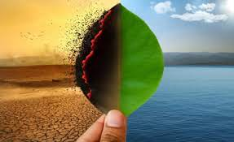
CLIMATE CHANGE
Agriculture has significant effects on climate change,primarily through production & release of Greenhouse Gases suchas-Carbon Dioxide,Methane & Nitrous Oxide.
Agriculture that practices tillage,fertilization & pesticide releases Ammonia,Nitrate,Phosphorus & many other pesticides.
It affects-Quality of-Air,Water,Soil & Biodiversity.
Land use change,such as-Deforestation & Desertification,use of fossil fuels are the major sources of-Carbon Dioxide.
Agriculture itself is the major contributor to increasing Methane & Nitrous Oxide concentration in Atmosphere.

Slide 18
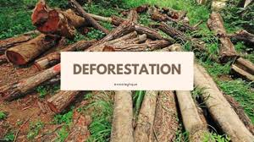
Deforestation is-Clearing earth forests on a large scale worldwide.One of the cause of deforestation is to clear land for pasture or crops.
Deforestation causes loss of habitat for millions of species & is also a driver of-Climate change.
Trees act as a Carbon Sink,in which they absorb Carbon Dioxide,an unwanted Greenhouse Gas,out of Atmosphere.
By removing trees,Carbon Dioxide is released into atmosphere & there are less trees to absorb increasing amount of Carbon Dioxide in Air.
In this way, deforestation triggers Climate Change.
With no trees,landscape which had trees once,becomes a barren desert.
Removal of trees,also causes extreme fluctuations in temperature.

Slide 19

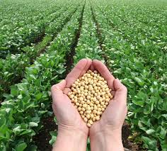
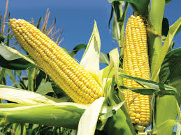
GENETIC ENGINEERING
SOYBEAN
MAIZE CROP
Genetically engineered crops become pest tolerant & their overuse makes plast pest resistant to pesticides & thus their eradication becomes challenging.
Seed contamination is another problem of genetic engineering,which occurs from blown wind from genetically engineered crops to normal crops.
About 50% of Corn & Soyabean samples were found to be contaminated by Monsanto Genes,A Genetic Engineering Company.

Slide 20
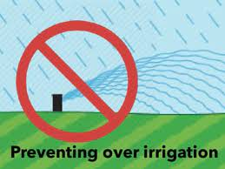
Over irrigation causes problem of Soil Salinity.Excess water run off from fields leaves field with salts.
Irrigation with saline or high Sodium Water can damage Soil Structure leading to formation of-Alkaline Soil.

Slide 21
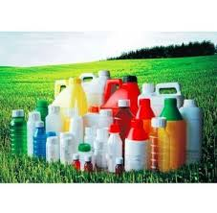
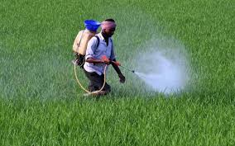
POLLUTANTS
Synthetic pesticides are the most widespread method of controlling pests in agriculture.
They can leach through the soil & enter groundwater,as well as in food products resulting into-Death of Humans
They can also target Non-target-Plants,Animals,birds,fishes & rest of wildlife.
Pollutants from agriculture have huge impact on water quality of-Lakes,rivers,wetlands,estuaries & groundwater.
Pollutants from farming,include- Sediments,Nutrients,Pathogens,Pesticides,Metals & Salts

Slide 22
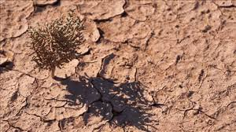
SOIL DEGRADATION
Soil Degradation is – “Decline in soil quality which could be as a result of wrong agricultural methods.”
Common attributes to Soil Degradation are-Salting,Water Logging,Compaction,Pesticide Contamination,Decline in Soil Structure Quality,loss of fertility,Alkalinity,Salinity & Erosion.
Soil Degradation also has huge impact on-Biological Degradation , that affects microbial community in soil

Slide 23
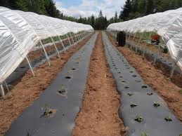
WASTES-PLASTICULTURE
Plasticulture is the use of-Plastic in Agriculture.
Farmers use plastic sheets as much as to cover 50%-70% of soil & allows them to use-Drip Irrigation system to have better control over soil nutrients & moisture.
Rain is non essential factor in it & farms that use plasticulture are built to encourage fastest rain run off.
Use of Pesticides with Plasticulture allows pesticides to get transported easily, which affects water quality & aquatic animals.

Slide 24
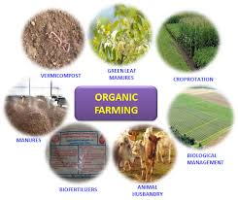
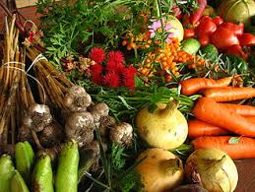
SUSTAINABLE AGRICULTURE-ORGANIC FARMING
Organic Farming is Multifaceted Sustainable Agriculture set of practices which can have a lower impact on environment at the small scale.

Slide 25
WATER POLLUTION
IMPACT OF MINE POLLUTION ON HUMANS
ACID ROCK DRAINAGE
ENVIRONMENTAL IMPACTS OF MINING
IMPACT ON BIODIVERSITY
IMPACT ON ANIMALS
IMPACT ON AQUATIC CREATURES
IMPACT ON AGRICULTURE

Slide 26
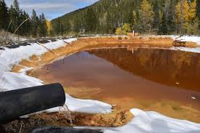
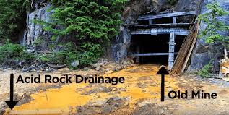
Water Pollution :- Mining can have bad effects on surrounding surface & ground water,if protective measures are not taken.
Result can be unnaturally high concentration of some chemicals such as-Arsenic,Sulphuric Acid & Mercury over surface or subsurface.
Large amount of water produced from –Mine Drainage,mine cooling & other processes of mining increases the potential for these chemicals to contaminate-Surface & Ground Water.
2) Acid-Rock Drainage :- Dissolution & transport of heavy metals by run-off is another environmental Problem with mining.
For e.g Britannia Mine,a former copper mine near Vancouver,British Columbia.
Water in the mine containing dissolved heavy metals such as-Lead & Cadmium is leaked into local groundwater & contaminates it.

Slide 27
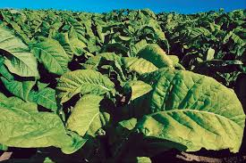
3) Effect of Mining Activity on Biodiversity :- Destruction of Habitat is the main cause behind loss of Biodiversity.
Direct poisoning is caused by mine extracted material & indirect poisoning through food & water that affects animals,Plants & microorganisms.
4)Effect on Aquatic Creatures :- Mining industry can have impact on Biodiversity via many ways.Direct poisoning is when contaminants are mobile in sediments.
5) Effect on Agriculture :- Agricultural crops grow on site contaminated due to mining activity,but yield is lower as compared to regular growing condition.Plants also tend to accumulate heavy metals leading to human intake via fruits & vegetables.Regular consumption causes health problems,for e.g.-Cigarettes made from Tobacco,growing on contaminated sites can have adverse effect on human population,as Tobacco tends to accumulate Cadmium & Zinc in it’s leaves.
6) Effect on Animals :-Habitat destruction is the main issue of mining activity.Huge areas of natural habitats get destroyed due to construction & extraction of mines.Animals get directly poisoned by mine products & residuals.
Bioaccumulation in plants or the smaller organisms,they eat,can also cause-Poisoning.For e.g.-Horses,Goats & Sheeps are exposed in certain areas to potentially toxic concentration of Copper & Lead in grass.Few number of ants,near copper mine area have been found with high Copper levels.
TOBACCO PLANT

Slide 28
7) Effect on Humans :- Metals are usually emmited in air as particles.There are number of occupational hazards related to mining.Most of the mine workers suffer from variety of respiratory & Skin diseases,like-Asbestosis,Black lung disease etc.
Using proper disposal methods for waste can reduce impact on Environment.

Slide 29
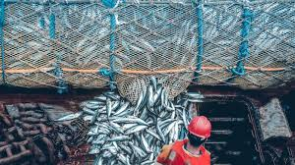
ENVIRONMENTAL IMPACT OF FISHING
The environmental impact of fishing includes issues such as-Availability of fish,overfishing,fisheries
management,by-catch etc.

Slide 30
Overfishing :-Overfishing has been one of the main environmental issues related to fishing as a result of growing number of consumers.It has led to breakdown of some marine ecosystems & several fishing industries whose catch has diminished.The extinction of many of the species has also taken place.
Ecological Disruption :- Fishing can disturb food webs by targeting specific,in demand species.Too much fishing of small fishes reduces food availability for big fishes.Thus entire food chainj can get disrupted.
By-Catch :- By-catch is the portion of catch which is actually not a target specie.These are either kept to be sold or discarded.It reduces overall number & quantity of fishes in water bodies.

Slide 31
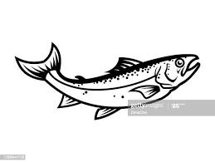
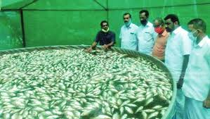
FISHERIES MANAGEMENT
Many government & intergovernmental bodies have implemented fisheries management policies designed to curb environmental impact of fishing.
Fishing conservation aims to control human activities which may totally decrease fish stock from aquatic environment.
Fish farming has been suggested as a more sustainable alternative to traditional fish catch.
FISH FARMING

Slide 32
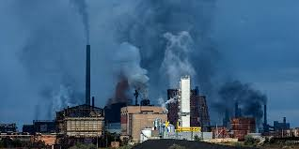
SECONDARY SECTOR :-ENVIRONMENTAL IMPACT OF INDUSTRIES
Any form of Pollution due to industrial activities is called as- ‘Industrial Pollution’.
Industries are major cause of Pollution.
Industrial pollution contaminates many sources of drinking water,releases unwanted toxins into air & reduces quality of soil allover the globe.
Environmental disasters are also caused by industries.
Industrialisation contributes major part for economic development & country prosperity.
On one hand,it provides employment opportunities & wealth generation but on other hand,it leads to variety of –Environmental Deterioration.

Slide 33
VARIOUS FORMS OF ENVIRONMENTAL DETERIORATIONS CAUSED BY INDUSTRIES
Water Pollution :- Most industries need tremendous amount of water supply in order to carry out workWhen involved in a series of processes,water comes in contact with heavy metals,harmful chemicals,Radioactive Waste & even Organic Sludge.
These are either dumped into open oceans or rivers.Due to this,many of our water resources are having high amount of industrial wastes in them ,which have serious impact on health of our ecosystem.The same water is then utilized by farmers for irrigation purpose,which affects quality of food that is being produced.
Water Pollution has already rendered many ground water resources useless for humans & wildlife.
It should be better recycled for further usage in industries.
Air-Pollution :-With so many small,middle & large scale industries coming up,Air Pollution has taken toll on the health of people & environment.
Extinction of Wildlife :- Habitats get lost,species are becoming extinct & it is harder for the environment to recover from each natural disaster.Major industrial accidents like-Oil Spills,fires,leakage of radioactive material & damage to property are harder to clean-uop,as they have a higher impact in shorter span of time.

Slide 34
Global Warming :- With rise in industrial pollution,Global Warming is increasing at a steady pace.Smoke & greenhouse gases are being released by industries into air which results in Global Warming.
Melting of Glaciers,extinction of Polar Bears,floods & hurricanes are some of the effects of-Global Warming.
Soil Pollution & Degradation of Land Quality :- Soil pollution increases due to industrial waste & effluents left in soil.It is creating problems in Agriculture & destroying local vegetation.It also causes chronic health issues to people who come daily in contact with such contaminated soil.
Other impacts :- It causes-
Acid Rain
Generation of Hazardous waste whose safe disposal is a big problem
Occupational hazards like-Silicosis,Pneumoconiosis,Tuberculosis,Skin Diseases & Deafness
Metallic contaminants like-Cadmium,Zinc,Mercury etc.,destroy bacteria & beneficial microorganisms in soil.
Industrial waste including toxins enter in food chain causing number of undesirable effects to living beings & animals
Industrial effluent damages natural biological purification mechanism of sewage treatment causing several soil & water borne diseases
Radioactive industrial pollutant causesundesirable diseases when food containing radioactive Substances is consumed by man

Slide 35
WAYS TO TACKLE INDUSTRIAL POLLUTION
Development of better technology for disposal of waste & recycling as much polluted water in industries as possible.
Organic methods are being used to clean soil & water,such as-Use of Microbes which naturally use heavy metals & waste,as feed.
Policies are being pushed into place to prevent further-Land Misuse.
But still,industrial pollution is rampant & will need many years to bring under control.

Slide 36

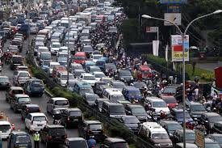
ENVIRONMENTAL IMPACTS OF TRANSPORT SECTOR
Environmental impact of transport is significant as it makes use of major energy sources & burns most of the petroleum of world,which creates Air Pollution including Nitrous Oxides & Particulates & it is also a significant contributor to-Global Warming-Via emission of-Carbon Dioxide.
Thus,transport sector is a fastest growing emission sector & road transport is the largest contributor to-Global Warming.
Other environmental problems of transport include-Traffic Congestion.
By reducing transportation emission globally,it is predicted that,there will be significant positive effect on-
Earth’s Air Quality
Acid Rain
Smog
Cilmate Change
Air Pollution also causes number of-Airborne Diseases like-Bronchitis,Asthma .

Slide 37
PROBLEMS ASSOCIATED WITH TRANSPORT SECTOR
Activities related to use of resources like-Large amount of oil base resource (Petroleum) needed for transport & extraction of infrastructure construction material,causes Pollution.
Emission of CO2 & other Global Warming gases leads to-Climate Change.
Outdated vehicles,fluids & tyres form a part of-Vehicular Waste.
Air Pollution is caused by-Local emission of-CO (Carbon Monoxide),PM (Particulate Matter),Lead, VOC’s (Volatile Organic Carbon Compounds),Hydrocarbons & NOx(N2O,NO,NO2 etc.)
Noise pollution related prolems are faced by people who reside near to highways,Airports & Railway Stations,Ports & Harbours
Habitat fragmentation of Wildlife takes place,as most amount of land is used for transport infrastructures
There is negative impact on water due to-Pollution from spillage & Run-Off.Change is induced in water system due to infrastructure.

Slide 38
As use of energy & emissions vary largely between modes of transport,thus transition from Air & Road to Rail & Water transport is a better option.
Other improvements like-Increased transport electrification & energy efficiency in vehicles.
Use of new technology is a way to suffice current level demands while reducing environmental impacts.
Current focus is on the move from system based on fossil fuels to the one based on Hydrogen or fuel cells.
As the supply of oil becomes uncertain & much more expensive,emphasis on alternatives will grow,as there will be demand for smaller vehicles,with lower costs.
Similarly,efforts to limit CO2 emissions from transport will drive development of new technologies,which are independent of Carbon Base.

Slide 39
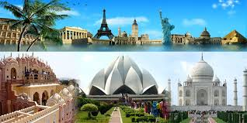
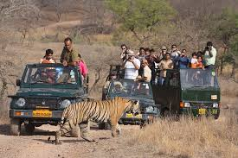
ENVIRONMENTAL IMPACTS RELATED TO- TOURISM SECTOR
Negative impacts from Tourism occur,when level of visitor use is greater than ability of Environment to cope with this use within acceptable limits of changes.
Uncontrolled conventional tourism puts an enormous pressure on an area & leads to impacts such as-Soil Erosion,increased level of pollution,increased pollutant discharges into seawater,loss of natural habitat,increased pressure on endangered species & increased vulnerability to forest fires.
It also puts a strain on water resources,forcing local population to compete for the use of-Critical Resources.

Slide 40
IMPACTS OF TOURISM ON ENVIRONMENT
Impact on Water Resources :- Tourism Industry generally overuses water resources for hotels,swimming pools,golf courses & personal use of water by tourists.It can result in water shortages & degradation of water supplies as well as generation of greater volume of wastewater.
Golf courses maintenance also depletes fresh water resources.In recent years,popularity of Golf Tourism has increased
& the number of Golf Courses have grown rapidly.Golf courses require an enormous amount of water every day & as with other causes of excessive extraction of water,this can result into water scarcity.Golf resorts are more often situated in or near protected areas or areas where resources are limited, showing their impacts.
Local Resources :- Tourism can create great pressure on local resources like-Energy,food & other raw materials which may already be in shortage.Greater extraction & transport of these resources further aggravates physical impacts associated with their exploitation.
Land Degradation :- Important land resources include-Minerals,fossil fuels,fertile soils,forests,wetlands & wildlife.
Increased construction of tourism & recreational facilities has increased pressure on these resources & on scenic landscapes.
Direct impact on natural resources,both renewable & non-renewable,in the provision of tourist facilities can be caused by the use of land for other kinds of accommodation purposes.

Slide 41
Pollution :- Tourism industry also causes same forms of pollution as any other industry,such as-Air Emissions,noise,oil & chemical pollution,architectural/visual pollution.Transport by-Air,Road & Rail is continuously increasing in response to the rising number of international air passengers worldwide,rising air emissions.Transport emissions are linked to-Acid Rains,Global Warming & Photochemical Pollution.
Solid Waste & Littering :- Those areas where there is high concentration of tourist activities & appealing natural attractions, there exists serious prpblem of waste disposal.Improper disposal can be a major dispolier of natural environment-Rivers,Scenic Areas & Roadsides.
For e.g. Cruise ships at Caribbean are estimated to produce more than 70,000 tonnes of waste each year.Solid Waste &
Littering can degrade physical appearance of water & shoreline & cause death of marine animals.In mountain areas,
Trekking tourists generate a great deal of waste.Tourists on expedition leave behind their garbage,Oxygen Cylinders &
even camping equipment,which is a totally degrading practice.
Physical System :- Ecosystems,which are most threatened with degradation are-Ecologically fragile areas such as-
Alpine Regions,Rain Forests,Wetlands,Mangroves,Coral Reefs & Sea-Grass bed.
The threats & pressures on these ecosystems are severe,as these places are too attractive for both-Developers & Tourists.

Slide 42
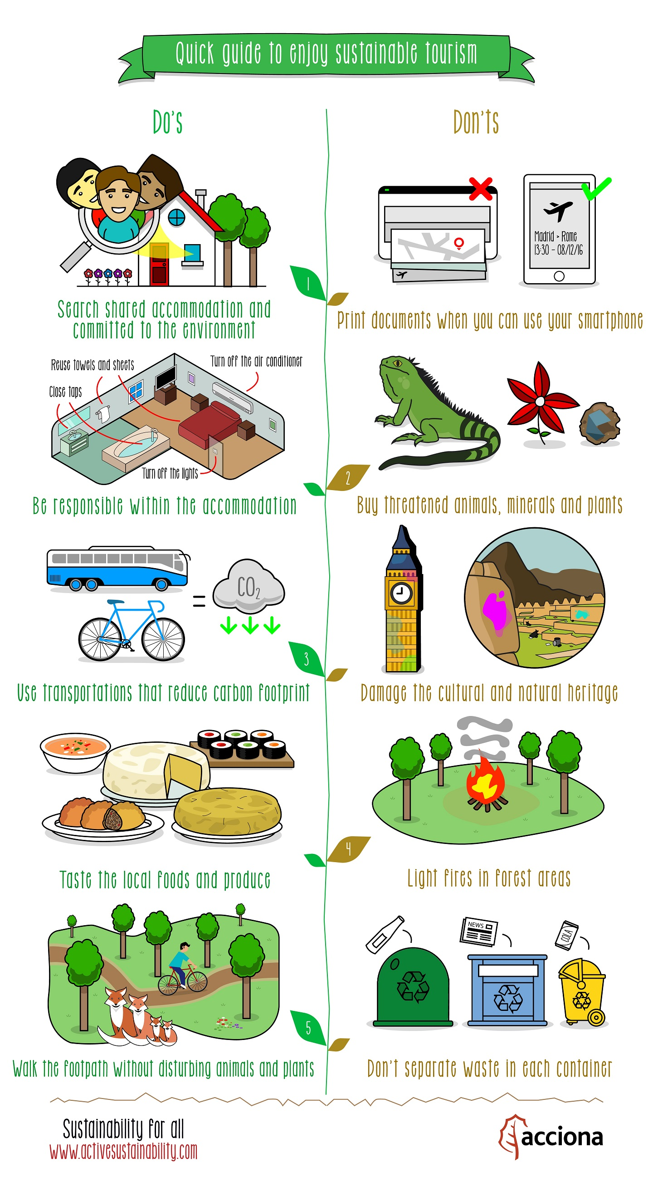
SUSTAINABLE TOURISM
The need for sustainable & responsible planning & management is imperative for tourism industry to survive as a whole.
Sustainable Tourism should maintain a high level of tourist satisfaction & ensure a meaningful experience to tourists,raising their awareness about sustainability issues & promoting responsible tourism practices amongst them.

Slide 43
SUSTAINABLE SOCITIES & COMMUNITIES
SUSTAINABLE AGRICULTURE
SUSTAINABLE ENVIRONMENT & NATURAL RESOURCES
COMPONENTS OF SUSTAINABLE TOURISM
SUSTAINABLE ECONOMIC SYSTEMS
SUSTAINABLE CONSERVATION

