Slide 1


Business Research Methods
Unit III – Data Analysis and Interpretation
Processing of Data
Analysis if Data
Interpretation of Data
Multivariate Analysis
Testing of Hypothesis

Slide 2
Raw Data
Conversion Process
Meaning Research Report

Slide 3
Processing of Data
The data, after collection, has to be prepared for analysis.
Collected data is raw and it must be converted the form that is suitable for the required analysis
The result of the analysis are affected a lot by the form of the data.
So, proper data preparation is must to get reliable result

Slide 4
Processing the data
Editing
Field Editing Central Editing
Coding
Classification Tabulation Graphing

Slide 5
Features of Data Processing
Collection of Quality Data
Preparation of Data
Input of Data
Processing of Data
Output and Interpretation of Data
Storage of Data

Slide 6

IMPORTANT STEPS
Questionnaire checking
Editing
Coding
Classification
Data adjusting
Data cleaning
Graphical
Representation
Tabulation

Slide 7

Questionnaire Check
When the data is collected through questionnaires, the first steps of data preparation process is to check the questionnaires if they are accepted or not.
NOT ACCEPTED IF:
Incomplete partially or fully.
Answered by a person who has inadequate knowledge
which gives the impression that the impression that the respondent could not understand the questions.

Slide 8
Questionnaire Checking
A questionnaire returned from the field may be unacceptable for several reasons.
Parts of the questionnaire may be incomplete.
The pattern of responses may indicate that the respondent did not understand or follow the instructions.
The responses show little variance.
One or more pages are missing.
The questionnaire is received after the pre-established cutoff date.
The questionnaire is answered by someone who does not qualify for participation.

Slide 9
Data Editing
The editing of data is a process of examining the raw data to detect errors and omissions and to correct them, if possible, so as to ensure legibility, completeness, consistency and accuracy.
The recorded data must be legible so that it could he coded later
The purpose of editing is to eliminate errors or known bias and to prepare for subsequent coding, tabulation and analysis

Slide 10
Types of Data Editing
Data Editing
Micro Editing
(editing at Field / record level)
Macro Editing
(Editing at office level)

Slide 11
Editing of Responses
Treatment of Unsatisfactory Results
Returning to the Field – The questionnaires with unsatisfactory responses may be returned to the field, where the interviewers re-contact the respondents.
Assigning Missing Values – If returning the questionnaires to the field is not feasible, the editor may assign missing values to unsatisfactory responses.
– Discarding Unsatisfactory Respondents – approach, the respondents with unsatisfactory responses are simply discarded.
In this

Slide 12
Reasons for Editing
CONSISTENCY
OMPLETENES
QUESTIONS ANSWERED OUT OF ORDER
C
S

Slide 13
Objectives of Data Editing
To ensure maximum accuracy of data for tabulation & conclusions
To ensure consistency of data
To ensure completeness of Data
To obtain best possible data for conclusions

Slide 14
Significance of Data Editing
To check accuracy of data by eliminate ceng errors and known biases
To bring consistency in information collected through interviews
To remove all possible errors and prepare the data for classification and tabulation
To improve the quality of data and correct conclusions can be made
It also evaluates the performance of the field staff and the soundness of questionnaire
Take uniform decisions on incorrect answer's

Slide 15
Data editing process
To ensure legibility off answer's editors deal with the following answer's
The incomplete answer
The incorrect answer
The inconsistent answer
The don't know answer
Answer's not available in standard format

Slide 16
Benefits of data editing
The data obtained is complete in all respects.
It is accurate in terms of information recorded and responses sought.
The response format is in the form that was instructed.
The data is structured in a manner that entering the information will not be a problem.

Slide 17
CODING
Coding refers to the process of assigning numerals or other symbols to answers so that responses can be put into limited number of categories or classes.
The process of classifying answer's to a question into a meaningful category
This refers to grouping various responses into categories for the purpose of classification
Large heterogeneous responses need to be put into different categories for the researcher to identify them
Symbols letters or codes are made for the purpose

Slide 18
Types of Codes
Numerical codes like 1, 2, 3
Alphabetical codes like Code A, Code B or M for Males and F for Females
Alpha numerical codes like Code A1, Code A2 etc.

Slide 19
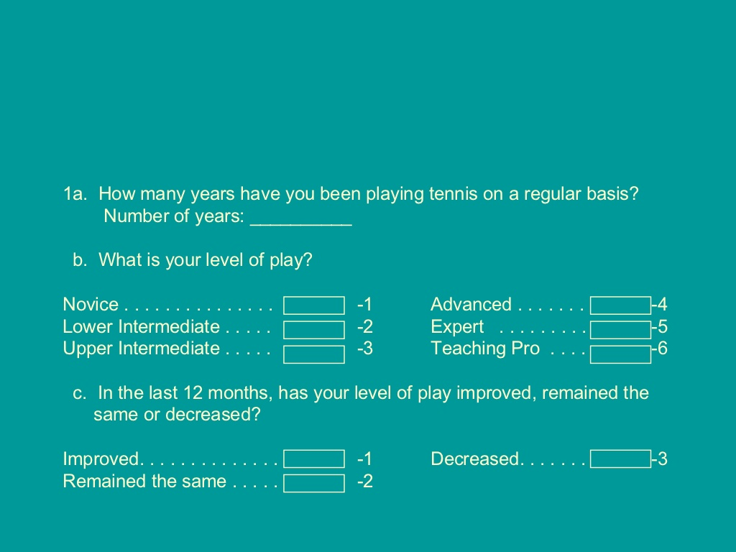

Slide 20
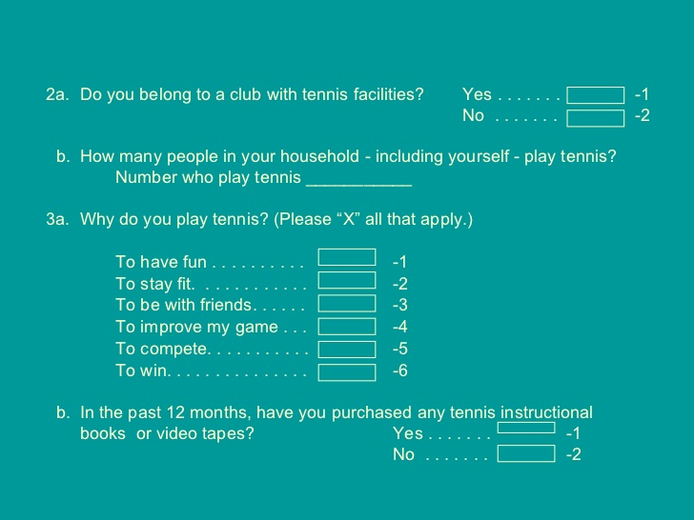

Slide 21
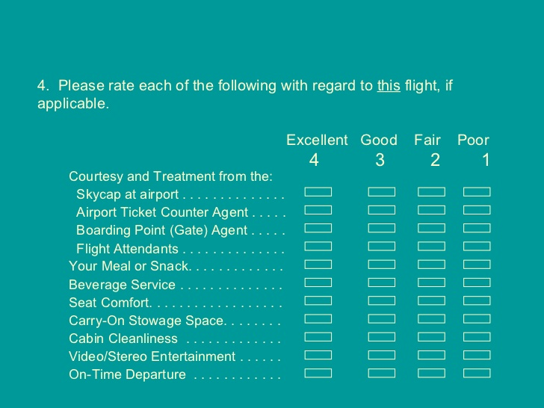

Slide 22
A code is a number or a symbol which Stands for each type of every answer.
Coding means assigning a number a symbol or any mark to the answer


Slide 23
Classification of data
Classification means grouping together the data which are homogeneous in character for the purpose of interpretation
Data is arranged in different groups or classes according to their resemblances for a quick and easy analysis

Slide 24
Significance of classification of data
maintains integrity and confidentiality off data
sorting and categorization of data
facilitates comparison of characteristics
simplifies the bulk of data
Helps in data management
he helps in statistical treatment of data

Slide 25
TABULATION of data

Tabulation is an orderly arrangement of data in rows and columns.

Tabulation summarizes the raw data and displays data in form of some statistical tables.

Slide 26
Types of tables

Vertical Tables

Horizontal Tables

Slide 27
Graphing of data
 Visual representation of data
 Data are
presented as
numbers or
absolute
percentages

The most informative are simple and self-explanatory
https://www.slideshare.net/Sujarvs/presentation-of-data-ppt

Slide 28
Bar chart

In a bar chart, a bar shows each category, the length of which represents the amount, frequency or percentage of values falling into a category.
How Do You Spend the Holidays?
Other
7%
Catching up on w ork
5%
Vacation
5%
Travel to visit family
38%
At home w ith family
45%
0%
5% 10% 15% 20% 25% 30% 35% 40% 45% 50%

Slide 29
Pie chart

The pie chart is a circle broken up into slices that represent categories. The size of each slice of the pie varies according to the percentage in each category.
How Do You Spend the Holiday's
5%
5%
7%
At home with family
Travel to visit family Vacation
Catching up on work Other
45%
38%

Slide 30
Line graph

Displays trends over time
Number of Clinicians Working in Each Clinic During Years 1–4
6
5
4
3
2
1
0 | Year 1 | Year 2 | Year 3 | Year 4
Clinic 1
Clinic 2
Clinic 3
Numberofclinicians

Slide 31
histogram

A graph of the data in a frequency distribution is called a histogram.
Histogram : Daily High Temperature
7
6
5
4
3
2
1
0
5 15 25 35 45 55 More
Frequency

Slide 32
Polygon / ogive

A percentage polygon is formed by having the midpoint of each class represent the data in that class and then connecting the sequence of midpoints at their respective class percentages.
Frequency Polygon: Daily High Temperature
7
6
5
4
3
2
1
0
Frequenc
5
15
25
35
45
55
More

Slide 33
Analysis of Data

Analysis means computation of certain indices or measures along with searching for patterns of relationships that exists among the data groups.

Slide 34
Analysis of Data
Descriptive & Causal Analysis
Inferential or Statistical Analysis
Uni-Variate Analysis
Estimation of Parameter Values
Testing Hypothesis
Bivariate Analysis
Point Estimate
Multi Variate Analysis
Parametric Tests
Interval Estimate
Non
-Parametri c Tests

