Slide 1



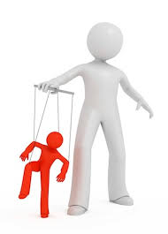

UNIT IV
DIRECTING & CONTROLLING
LEADERSHIP
CONTROLLING
COORDINATION
RECENT TRENDS

Slide 2
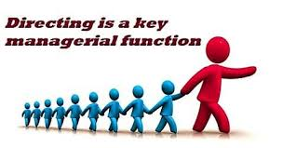

Slide 3
Directing
“Directing is the interpersonal aspect of managing by which the subordinate are led to understand & contribute effectively & efficiently to the attainment of the organisational objectives” – Koontz & O’donnell
Direction is the process of instructing, guiding, counselling, motivating & leading the human resources to achieve organisational objectives.

Slide 4
Directing is influencing people’s behaviour through motivation, communication, group dynamics, leadership & discipline.
The purpose of directing is to channel the behaviour of personnel to accomplish the organisation's mission & objectives while simultaneously helping them to accomplish their own career objectives & prospects.
Directing function gives a manager an active rather that a passive role in the employee's performance , conduct & accomplishments.

Slide 5
Process
Supervision
Motivation
Leadership
Communication

Slide 6


Slide 7
Motivation
“Motivation is a general term applied to various classes of drives, desires, needs, wishes & similar forces that induce an individual or a group to work.”- Koontz & O’donnell
The success & failure of any business enterprise depends on the performance of people working in it.
Determined by : A. Level of ability to do certain work B. Level of motivation
Performance = Ability X Motivation

Slide 8
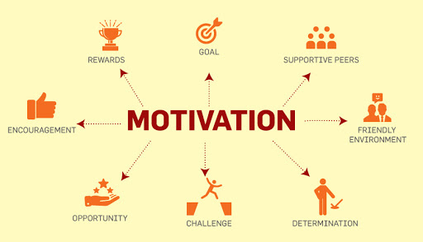

Slide 9
Features
Motivation is an act of managers
Motivation is a continuous process
Motivation can be positive or negative
Motivation is goal oriented
Motivation is complex in nature
Motivation is art
Motivation is system oriented
Motivation is different from job satisfaction

Slide 10
Importance
Basic Significance
Best achievement of common objectives
Best utilisation of resources
Industrial Peace
Facilitates co ordination
Favourable public image
Minimises resistance to change
Stability of workforce

Slide 11
Factors Affecting Motivation
Monetary
Salaries & Wages
Incentives
Non Monetary
Designation
Appreciation & Recognition
Bonus
Delegation of Authority
Working Condition
Job Security & Enrichment

Slide 12
Leadership
“Leadership is an ability of the manager to induce subordinates to work with confidence & zeal.” – Koontz & O’Donnell.
Management is a process of directing the efforts of individuals in order to get specific results.
Organisational & Administrative skills, Administrative tactics, planning & executive talent, personal initiatives & dynamics.

Slide 13
Functions of a Leader
Goal setting & policy maker
Planner
Executive
External group representative
Controller or Internal group relationship
Controller of reward & punishment
Arbitrator & mediator
Link between Management & Workers
A Friend , Philosopher & Guide

Slide 14
Qualities of a Good Leader
General Quality
Physical Fitness
Character
A sense of fair play & justice
Self confidence
Optimistic outlook
Technical Qualities
Expertise in Work Matters
Ability to Convince, Educate & Guide

Slide 15
Managerial Qualities
A balanced state of mind
Organising ability
Sense of responsibility
Motivating skills
Effective Communication
Receptiveness
Human Relations Expert
A man of Foresight
Psychological Qualities
Empathy
Sociability
Knowledge of the self & followers

Slide 16
Leadership Style
Autocratic
Democratic / Participative / Consultative
Laissez faire
Paternalistic
Bureaucratic
Situational
Transformational
Transactional

Slide 17
Trait Theory of Leadership
Tead, Schell & Others.
Advocate : Leadership qualities & traits are not inborn but can be acquired by an individual through education, training & other forms of learning.
Tead : There are 10 qualities that are essential for effective leadership : Physical & nervous energy, a sense of purpose & direction enthusiasm, friendliness & affection, integrity , technical mustery, decisiveness, intelligence, teaching skills & faith.

Slide 18
Successful leader is one who has specific leadership traits which can be acquired.
USA : James Koozes & Barry Z Posner : Surveyed 7500 managers : 1980 to determine traits that make them superior & effective leaders.
Results : Honesty : 87%, Outstanding Competence : 74%, Forward Looking : 67%, Inspiring : 61% & intelligence :46%.
Ralper Stogdil : The leader to be effective should have the qualities like drive for responsibility, task orientation, vigour & persistence in pursuit of goals, venture someness, originality, problem solving skills, drive to exercise initiative in social situation, self confidence & ability t influence other person , etc.

Slide 19
Traits of a successful leaders.
Physical & constitutional factors (Height, Weight, Physique, Energy, Health, Appearance)
Intelligence
Self Confidence
Stability
Sociability
Will (Initiative, Persistence, Ambition)
Dominance
Surgency (Talkative, Cheerfulness, Geniality, Ethusiasm, Expressiveness, Alertness & originality)

Slide 20
Criticism
This theory lacks scientific basis. It does not offer any explanation why leadership occurs.
It does not state which set of qualities are more important for leader & which are least important.
It does not take into account situational variables, needs of followers & environment which determine effectiveness of leadership.
Trait theory has also failed in discovering any trait which clearly & consistently distinguish leader from followers.
Trait theory does not establish relationship among a particulars trait performance & effectiveness.
It has also not been possible for the advocated of trait theory to isolate & identify those traits which are common to all leaders.

Slide 21
Managerial Grid
Developed by Blake & Mouton.
Leadership style consist of factor both the task oriented & relation oriented behaviour in varying degrees.
How managers are concerned for people or production, rather than how much production getting out of group.
Does not represents real production or the extent to which human relationship needs are being satisfied.

Slide 22
Production : The attitudes of superior towards a variety of things. ( Quality of policy decisions, procedures & processes, creativeness of research, quality of staff services, work efficiency & volume of output.)
People : Includes Degree of personal commitment towards goal achievement, maintaining the self esteem of workers, responsibility based on trust & satisfying inter personal relations.
Managerial Grids identifies Five Leadership Styles.

Slide 23
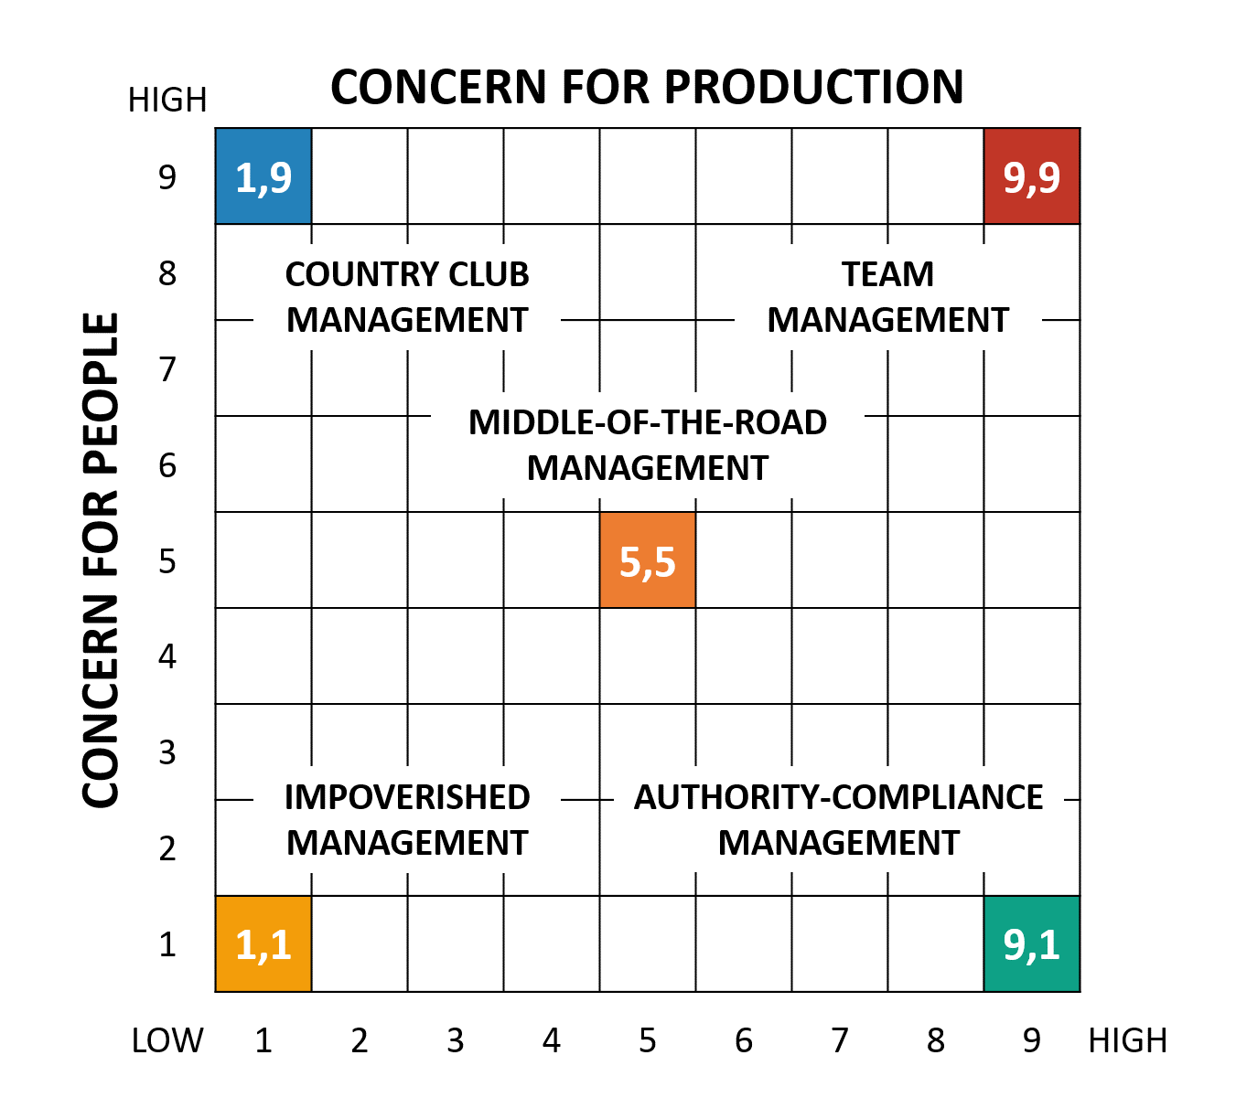

Slide 24
Leadership Styles as per grid
1.1 Exertion of minimum effort is required to get work done & sustain organisational moral.
1.9 Thoughtful attention to needs of people leads to a friendly & comfortable organisational atmosphere & work tempo.
9.1 Efficiency results from arranging work in such a way that human elements have little effect.
5.5 Adequate performance through balance work requirements & maintaining satisfactory morale.
9.9 Work accomplished is from committed people with interdependence through a common stake in organisational purpose & with trust & respect.

Slide 25
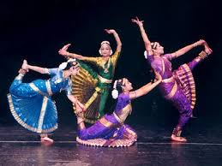

Slide 26
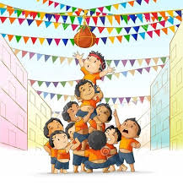

Slide 27


Slide 28
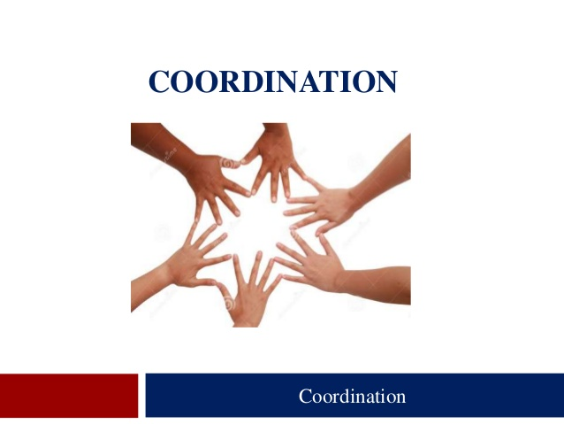
Co-ordination

Slide 29

Co-ordination
“Co ordination is the orderly arrangement of group efforts to provide unity of action in the pursuit of common purpose.”
- James Mooney & Reiley
Co-ordination does not occur automatically, a manager has to achieve it.
Applies to a group & not to an individual.
Individual efforts must be blended into a harmonious stream of actions.

Slide 30
Co-ordination definition……
Co-ordination is the unification, integration, synchronization of the efforts of group members so as to provide unity of action in the pursuit of common goals.
It is a hidden force which binds all the other functions of management.
According to Mooney and Reelay, “Co-ordination is orderly arrangement of group efforts to provide unity of action in the pursuit of common goals”.
According to Charles Worth, “Co-ordination is the integration of several parts into an orderly hole to achieve the purpose of understanding”.

Slide 31
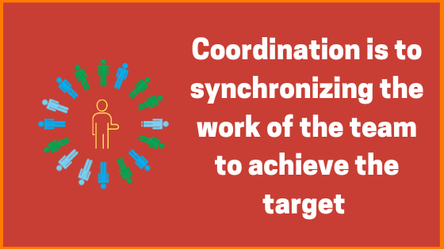

Slide 32
Management seeks to achieve co-ordination through its basic functions of
Planning
Organizing
Staffing Co-ordination
directing
Controlling
Co-ordination is not a separate function of management - because achieving Harmony between individuals efforts towards achievement of group goals is a key to success of management.
Co-ordination is the essence of management

Slide 33
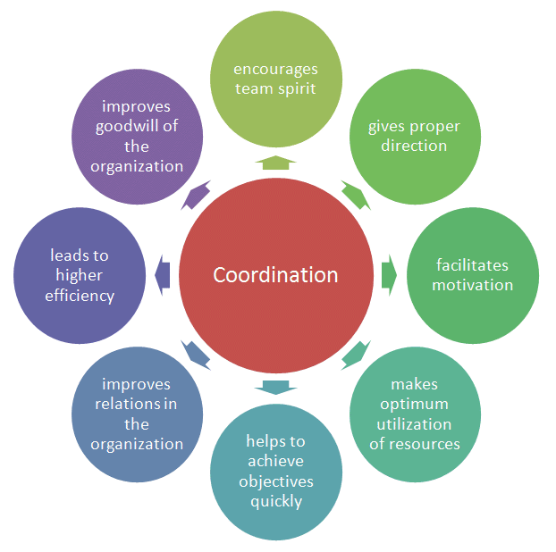
Importance of Co-ordination

Slide 34
Coordination is the Essence of Management

Slide 35
Top Level
Middle level
Lower level
Co-ordinates activities & plans of the middle level
Co-ordinates all tasks and implementations of the Lower level.

Slide 36
Planning
Organising
Staffing
Communication
Motivating
Leading
Controlling
Decision Making
Co-ordination

Slide 37
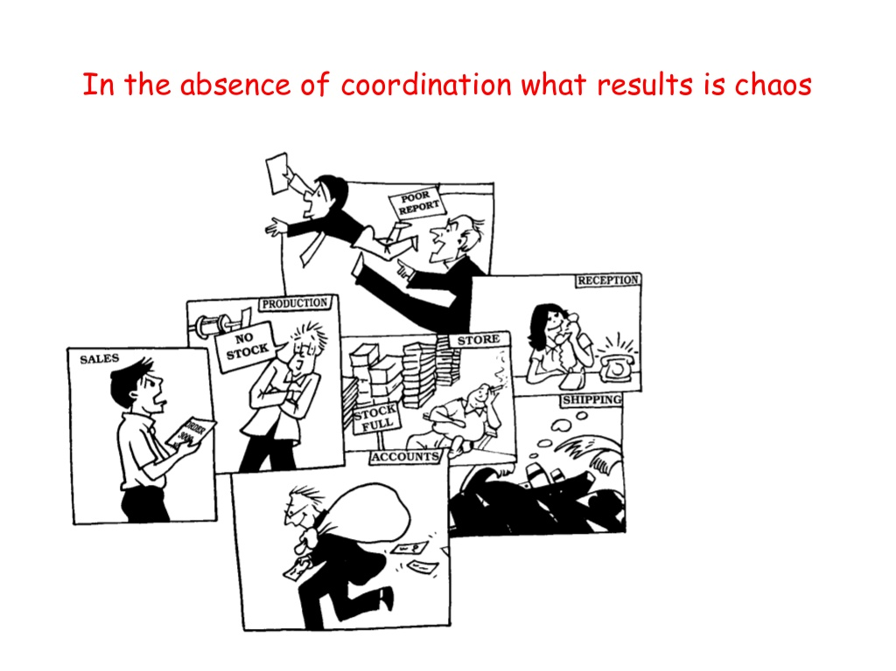

Slide 38

Co-ordination : Essence of Management
Co-ordination
Communicating
Motivating
Leading
Planning
Controlling
Organising
Staffing
Directing

Slide 39
Importance of Co-ordination
Encourages Team Spirit
Leads to Unity of Direction
Brings Motivation
Ensures proper utilisation of resources
Helps quick realisation of goals
Improves organisational relations
Leads to higher efficiency
Improves goodwill of the organisation.

Slide 40
Controlling
“Controlling is determining what is being accomplished, that is evaluating the performance and, if necessary, applying corrected measures so that the performance takes place according to plan.” - Terry
Controlling means examining the past & present activities so as to locate weaknesses, which can be eliminated in the future & also make the achievement of objectives certain.
To control means to monitor, regulate & check to make people conform to the expected norms, to measure progress & to ensure that what has been planned is achieved.

Slide 41
Steps
Establishing Standards ( Tangible & Intangible)
Measuring Actual Performance
Comparing Actual Performance with Standards & Identifying Deviations
Analysing the cause of deviation
Undertaking suitable remedial action.

Slide 42
Essentials
Requirements as to the designing of control system
Suitability
Objectivity
Requirements as to the implementation of control system
Understandable
Prompt
Desirable Requirements
Flexibility
Forward Looking
Measureable
Economical
Connectivity
Simplicity
Comprehensive
Responsibility Specific
Suggestive
Strategic Control points
Participative

Slide 43
Techniques (Operation)
Financial Control : Budgetary Control, Control through Costing, Break Even Analysis, Responsibility Accounting, Internal Audit
Production Control : Inventory & Operating
Marketing Control
Information Control
Project Control

Slide 44
Technique ( Overall)
Direct supervision & Observation
Financial Ratio Analysis
Budgetary Control
Management Audit
Social Audit
Human Resource Accounting
Management Information System
Self Control

