Slide 1
Thakur College of Science & Commerce
Department of Zoology
Academic Year – 2020-21
T.Y.B.Sc. Zoology
Semester – V
Paper –III Unit - I
Mammalian Histology
Dr. Vitthal T. Mohite

Slide 2
Histology
Definition : is the study of the microscopic structure of animal or plant tissues.
1 : a branch of anatomy that deals with the minute structure of animal and plant tissues as discernible with the microscope.
2 : tissue structure or organization.
The main roles of a histologist include staining tissues and preparing or processing tissue specimens, as well as microtomy and accessioning.
All healthy tissues are identifiable microscopically and a knowledge of normal histology is an essential basis for the recognition of the specific microscopic changes occurring in disease.
It is also known as microanatomy or Microscopic anatomy.
To understand cellular architecture of various organs.
Planned organization of cells in the organ system.

Slide 3
Mammalian Histology
The histology is one of the most important disciplines for studying of organic tissues.
The mammalian skeleton is important for protecting vital organs (e.g. heart, liver and brain).
They are providing structural strength so mammals are able to grow into the largest and strongest animals on Earth.
Skin.
Brain.
Heart.
Kidneys.
Liver
Pancreas
Stomach
Small Intestine
Large Intestine
Lungs

Slide 4
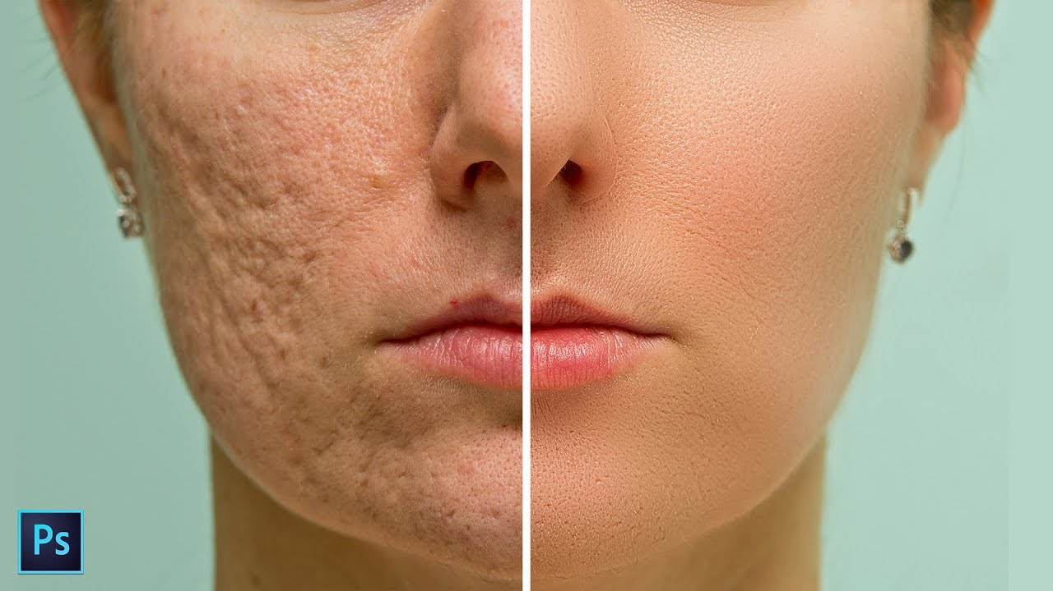
Skin
Largest organ in mammals.
Skin and associated structure makes up integumentary system.
Skin is the layer of usually soft, flexible outer tissue covering the body of a vertebrate animal.
Skin has three main functions: protection, regulation, and sensation.
Regulates the body temperature.
It protects body from physical, chemical and biological attack.
It have different developmental origin, structure and chemical composition.
It is used to communicate other individuals.
Provides nourishments for young.
Composed of two layers i.e. dermis and epidermis.

Slide 5
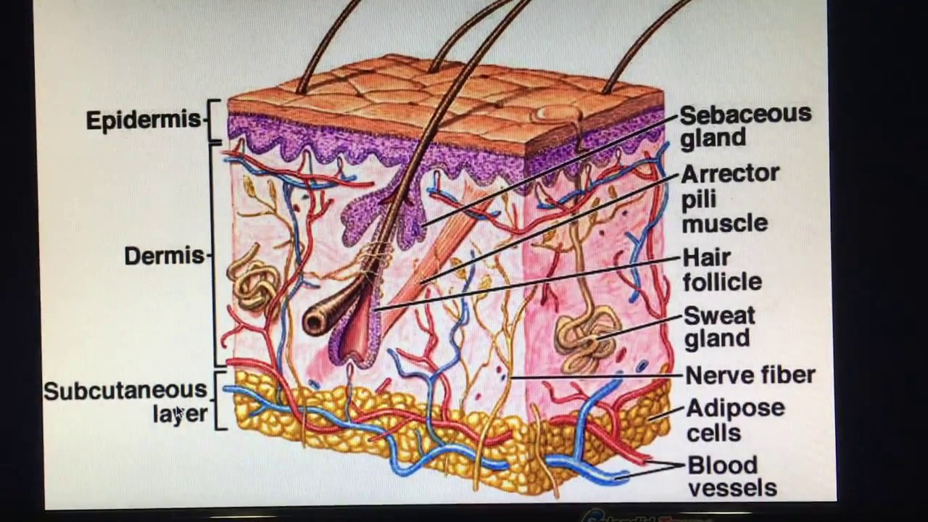
Section of Skin

Slide 6
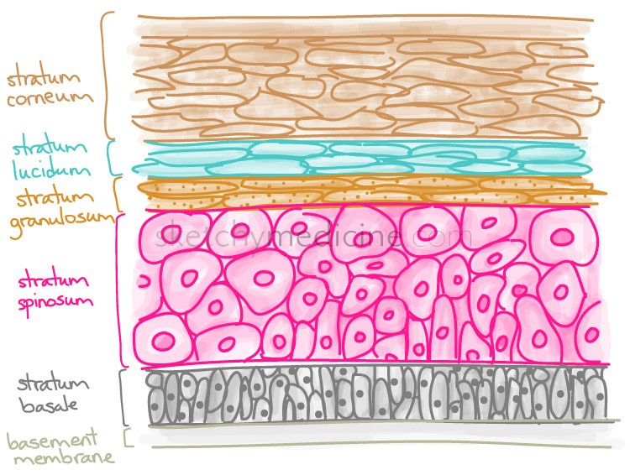
Epidermis layers

Slide 7
Histology of Skin
Histologically, skin consists of two principle tissue layers: the outer epidermis and the deeper dermis.
A hypodermis is situated below the skin, deep to the dermis.
It is composed of subcutaneous adipose tissue, it varies throughout the body and among individuals.
Thick skin found in palms of the hands soles of feet.
In total four layers from deep to superficial
  1. Stratum Basale
  2. Stratum spinosum
  3. Stratum granulosum
  4. Stratum corneum.
  Fifth layer stratum lucidum is present in between stratum corneum & S. granulosum.

Slide 8
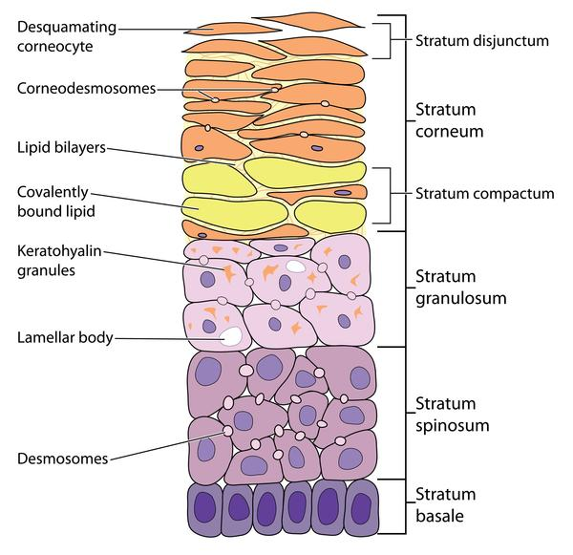
V.S. of Skin

Slide 9
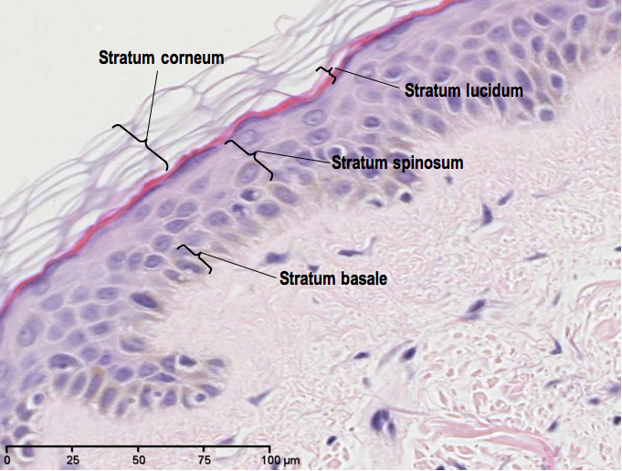
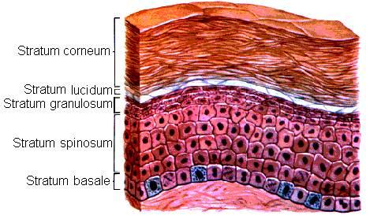
Layers of Skin

Slide 10
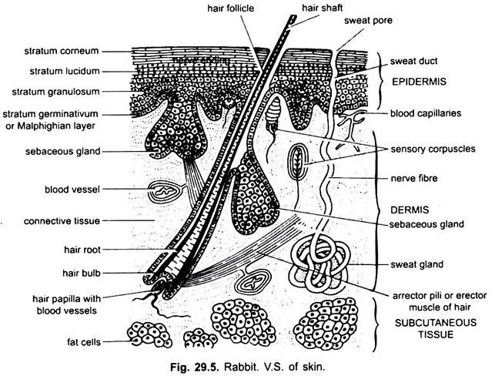
V.S. of Skin

Slide 11
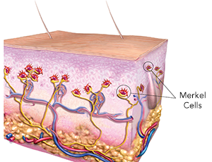
Stratum Basale
Deepest layer of skin, single layered.
Cuboidal shaped.
Attaches epidermis by basal lamina.
Attaches to dermis by collagen fibers called basement membrane.
They are precursor of the keratinocytes
Two types of cells present in Basale layer.
Merkel Cells – Responsible for stimulating nerves.
Melanocytes – produces pigment melanin.
In growing fetus fingerprint forms where Basale cells meet papillae
Result in formation of ridges on your fingers called fingerprint.

Slide 12
Stratum Spinosum
Spiny in appearance due to protruding cells.
Join together via structure called desmosomes.
Desmosomes interlocked with each other strengthen bonds between cells.
This layer is made up of 8-10 layers of cells keratinocytes by the division of stratum Basale.
Keratin fibers and lamellar bodies are also accumumated.
In between there is presence of dendritic cells called Langerhans Cells.
Function is to kill bacteria, foreign particles and damaged cells present in this layer.
Also present tactile cells
Keratinocytes synthesizes keratin release glycolipids helps to prevent water loss.

Slide 13
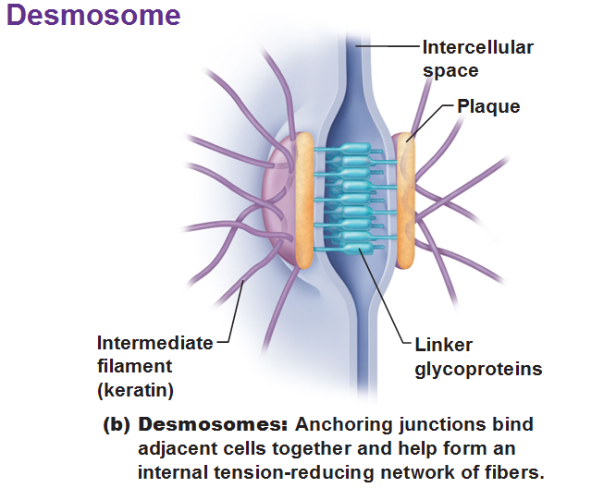

Slide 14
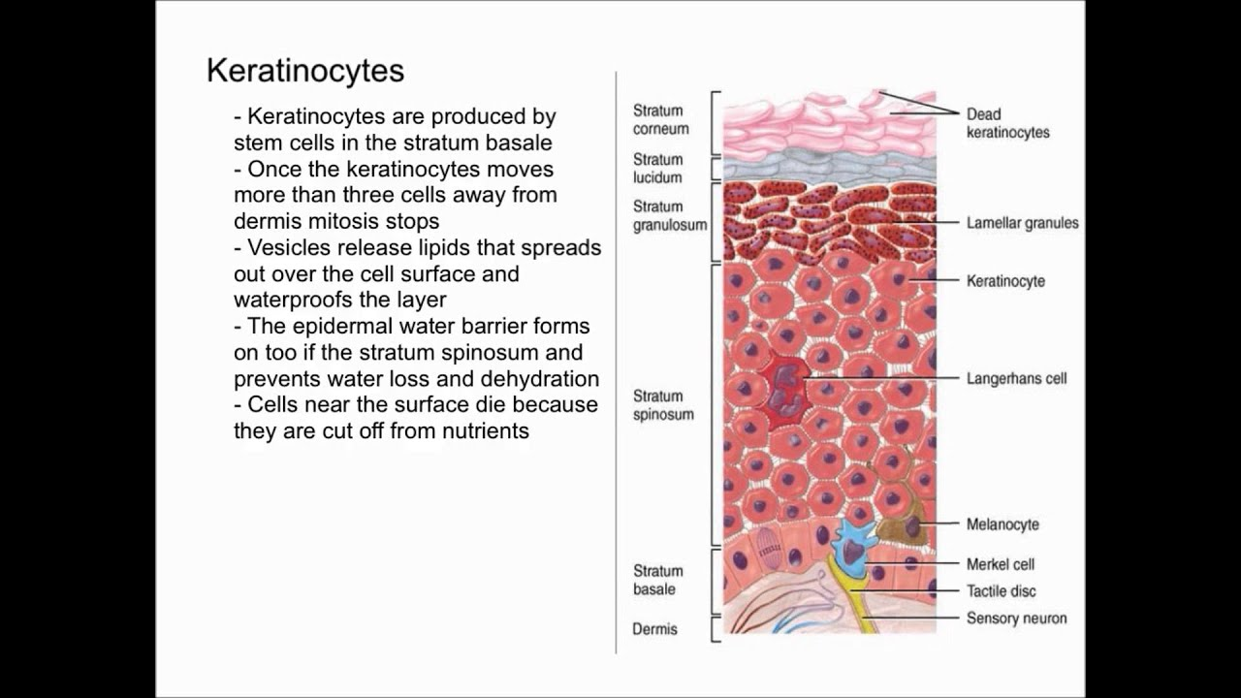

Slide 15
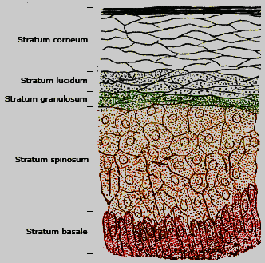
Stratum Granulosum
It has grainy appearance due to keratinocytes.
2-3 cells layer, waterproof mechanism, moisture trapping.
Cells become fatter due to large amount of keratin.
Two proteins makes keratin in bulk histidine- and
cysteine-rich proteins, keratohyalin granules.
Nuclei & other cell organelles disintegrates as cells
Dies
Keratin cell membranes transfer cell to later stage.
Accessory structure of hair & nail.
Make skin flexible.

Slide 16
Stratum Lucidum
Smooth Translucent layer above the s. granulosum.
Thin layer of cells found in only thick region of skin like palms, soles and digits.
It is dead & fattened, densely packed, clear protein rich in lipid.
Keratohyalin gives transparent appearance.
It provides barrier to water.
Acts as cushion.

Slide 17
Stratum corneum
Superficial layer of epidermis exposed to environment.
Name corneum is due to high ketatin.
Made with 15-30 layers of cells, dead & dry.
Prevents penetration of microbes & dehydration.
Cells of this layer periodically sheds.
Entire layer is replaced in period of 4 weeks.

Slide 18
Dermis
Is Core part of Integumentary system.
Different from epidermis & Hypodermis.
It contains b.v., lymph vessels, nerves, hair follicles& sweatglands.
Dermal papilla is finger like projection is superficial layer.
Dermal papillae increase the strength between dermis & epidermis.
Dermis composed of two types of tissues i.e. Collagen, Elastic tissue, Reticular fibers.

Slide 19
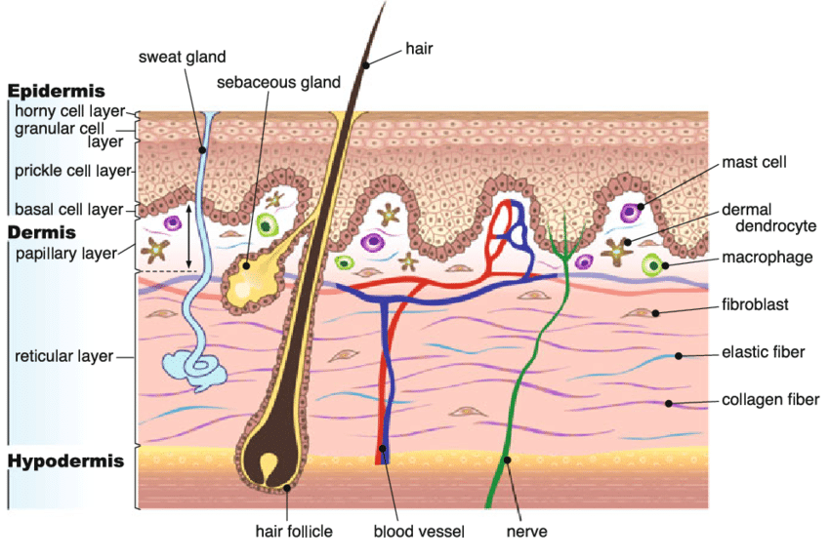

Slide 20
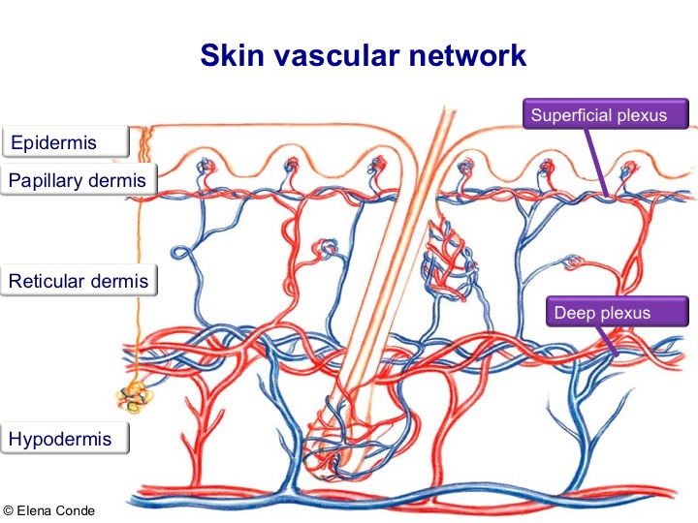
Papillary layer
Made with loose areolar connective tissues.
Collagen & elastin fiber forms loose layers.
Superficial layer is dermal papillae.
Few adipose cells, small blood vessels, phagocytes, defensive cells.
Also contain lymphatic capillaries, nerve fiber, touch receptors.

Slide 21
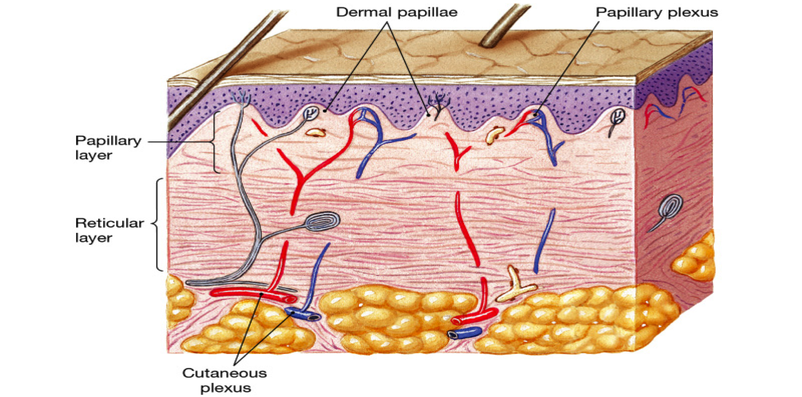
Reticular layer
Underneath the papillary layer, much thicker and of connective tissues.
Well vascularized & rich supply of nerve supply.
It is reticulated due to tight network of fibers.
Elastin fiber provides elasticity to skin.
Collagen fiber provides tensile strength and binds with water to keep skin hydrated.

Slide 22
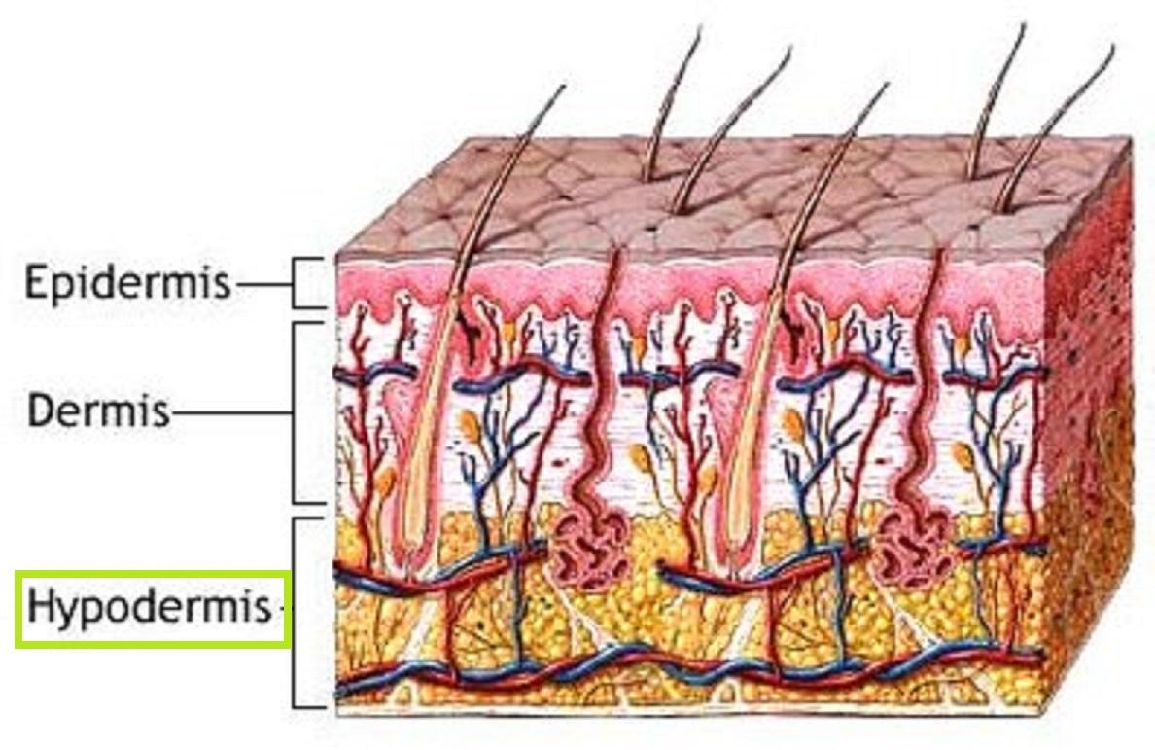
Hypodermis
Layer below the dermis connect the skin fascia of the bones & muscles.
It is not pat of skin & can not clearly distinguished border of dermis & hypodermis.
Made with loose areolar connective, adipose tissues, B.V., Nerves.
Function fat storage (energy), insulation & cushioning (Shock absorber) for integument.

Slide 23
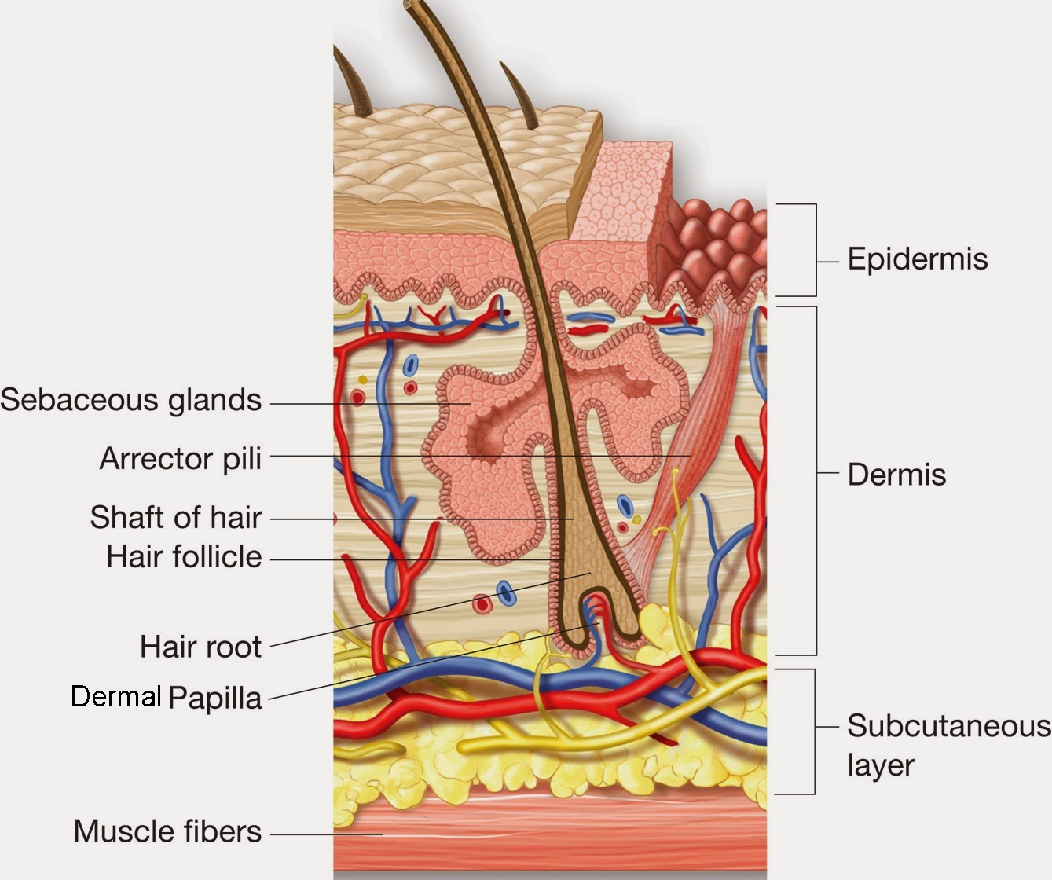
Hair
Is part of the skin that grows hair by packing old cells together.
Attached to the follicle is a sebaceous gland, a tiny sebum-producing gland found everywhere except on the palms, lips and soles of the feet.
The thicker density of hair, the more sebaceous glands are found.
A hair follicle is a tunnel-shaped structure in the epidermis (outer layer) of the skin.
Hair starts growing at the bottom of a hair follicle.
The root of the hair is made up of protein cells and is nourished by blood from nearby blood vessels.
As more cells are created, the hair grows out of the skin.

Slide 24
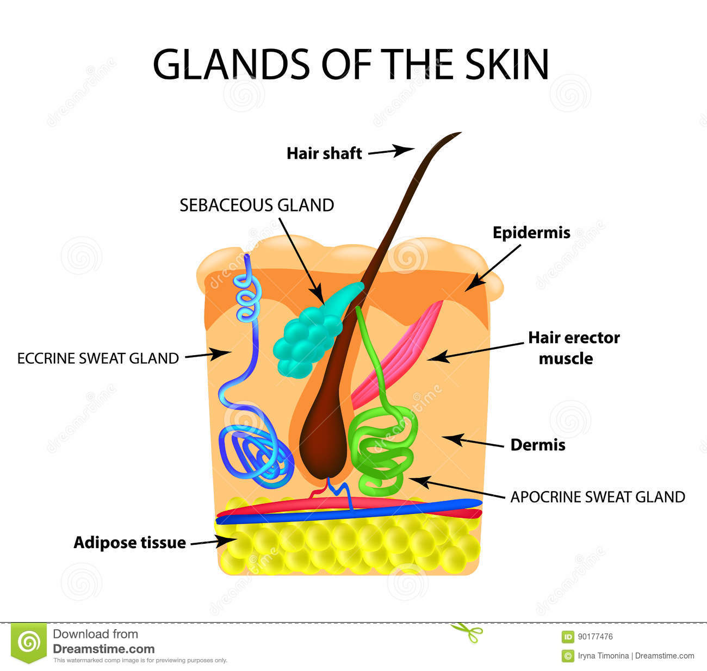
Skin Glands
Sweat gland : Coiled narrow duct opens at skin surface.
3 lac sweat glands present on human body.
Eccrine glands - secrete sweat through pores found in the palms.
Apocrine glands - secrete sweat via canals along hair follicles.
It is milky proteinaceous secretion important for sex attractant in mammals.
Sebaceous glands : Embedded in the dermis region
They continuous secrete oily sebum to lubricate the hair.
They also serve protective & Communicative functions.

Slide 25
Skin Mechanoreceptors
Primary neurons & Nerve endings
Function response to mechanical stimuli by firing action potentials.
Of different types
  1. The Pacinian corpuscles.
  2. Meissner’s Corpuscles
  3. Merkel’s discs
  4. Ruffini endings
  5.Free nerve endings

Slide 26
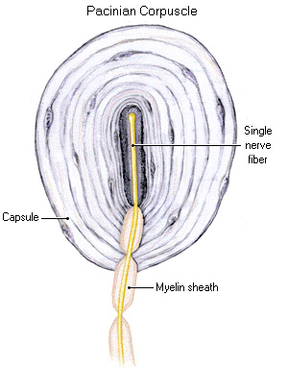
The Pacinian corpuscles
They are lamellar corpuscles , pressure receptors present deeper in skin.
It detects vibratory pressure & touch.
Under microscope it look like onion with several layers.
Size 0.5-1mm long 0.3 -0.7 mm thick.
Centre of capsule called core is unmyelinated terminal part is single nerve fiber.
Lamellae made up of fibrous connective tissues & fibroblast connected by gelatinous material.
The first node of Ranvier is also located in core region.
Several mitochondria exist help high energy production

Slide 27
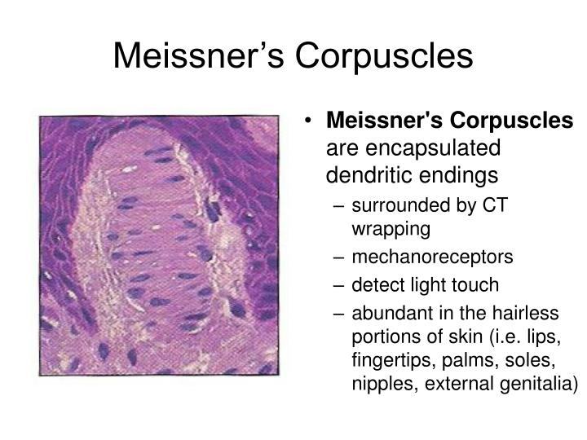
Meissner’s Corpuscles
ss

Slide 28
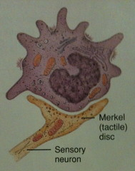
Merkel’s discs
The disk like expansion of the end of a nerve fiber together with a closely associated Merkel cell that has a presumed tactile function.
Merkel cells in the basal epidermis of the skin store serotonin which they release to associated nerve endings in response to pressure.
Nerve ending sensitive to touch.
In humans Markel's cell occur in superficial layers s. Basale.
Each ending consists of a Merkel cell in close apposition with an enlarged nerve terminal.
This is sometimes referred to as a Merkel cell–neurite complex, or a Merkel disc receptor.

Slide 29
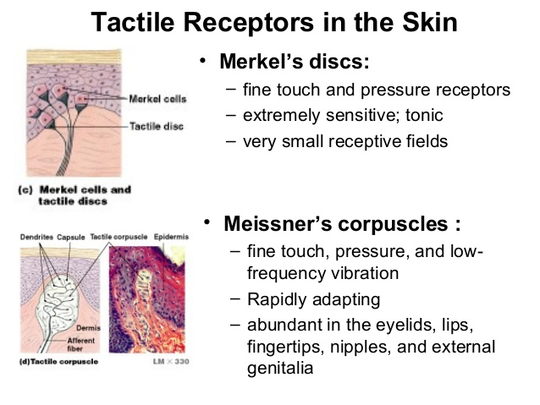

Slide 30
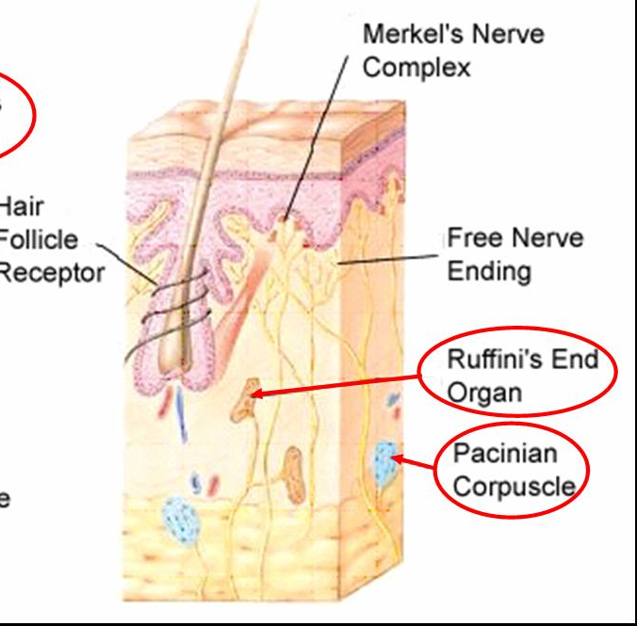
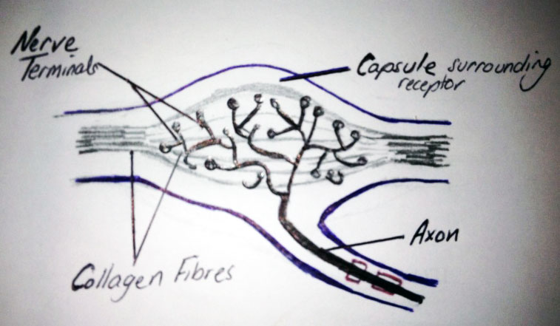
Ruffini Endings
The Bulbous corpuscle or Ruffini ending or Ruffini corpuscle is a slowly adapting mechanoreceptor located in the cutaneous tissue between the dermal papillae and the hypodermis.
Spindle shaped receptor sensitive to skin streach and control finger positions & movement.
Located in deep layer of skin.
Acts as thermoreceptor

Slide 31
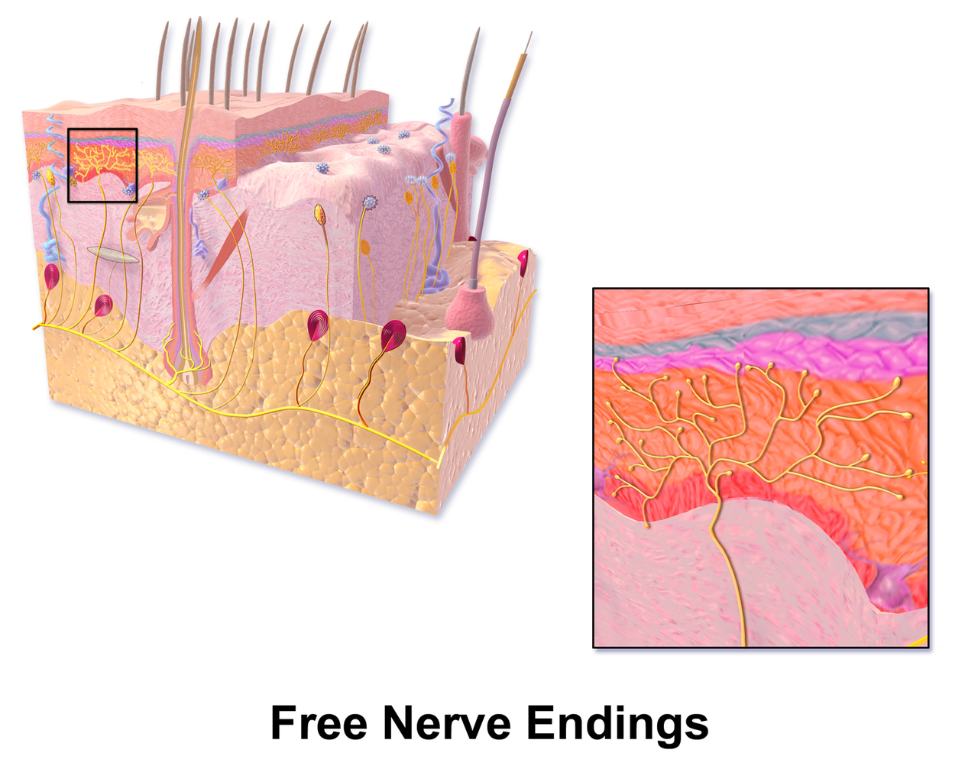
Free nerve Endings
A free nerve ending (FNE) or bare nerve ending, is an unspecialized, afferent nerve fiber sending its signal to a sensory neuron.
Afferent in this case means bringing information from the body's periphery toward the brain.
They function as cutaneous nociceptors and are essentially used by vertebrates to detect noxious stimuli that often result in pain.

Slide 32
Histology of Digestive system
V.S. of Tooth
T.S. of Tongue
T.S. of Stomach
T.S. of Small Intestine
T.S. of large intestine
T.S. of Salivary glands
T.S. of Mammalian Liver

Slide 33
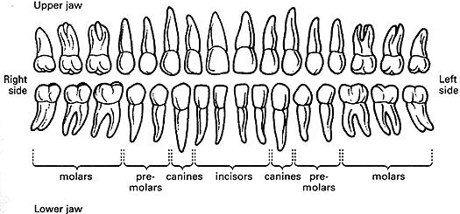
V.S. of Tooth
Mammals are heterodont teeth, incisors, canine, premolars & molars.
Monophyodont ( Small mammals) & Diphyodont (man & Other mammals).
Mammalian tooth made up of two components hard & Soft tissues.
Hard – Enamel, Dentine, cementum.
Soft – tooth pulp.
Others supporting tissues – Peridontium, Gingiva & Alveolar bone.

Slide 34
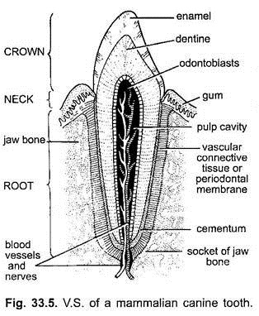
V.S. of Tooth
1. Enamel –
Hardiest tissue formed during developmental stage & does not regenerate.
Color is bluish white to yellow.
Heard less porous more fluorides.
Develops Ameloblast cells during development.
2. Dentine
Hard calcified tissues form crown & root of tooth.
It surrounds the pulp cavity & produced by odontoblast cells.
Yellowish in color harder than bone but softer than enamel.
Sensitive fibers enters in dentine tubules.
3. Cementum :
Thin layer of mineralized tissues covers dentine.
Connect tooth to alveolar bone by ligament.
Produced by cementoblast cells
Two types Acellular and Cellular.

Slide 35
V.S. of Tooth
Soft Tissues
Tooth Pulp :
75 % water 25 % organic matter
Loose CT., pulpal fibroblast, histocytes, plasma cells antigen producing cells, leucocytes.
Pulpal cells & dentine are odontoblast cells.
Extracellular complex contain collagen & amorphous substances.
Function provide nourishment, Support & defense mechanism by immune cells.
Supporting cells:
Peridontal ligament – strong flexible connection of bone & tooth.
Gingiva (Gum) – made of lamina epithelial of stratified squamous epithelium & lamina propria.
Free- bound to inner margins.
Attached - Separated from alveolar mucosa.
Tooth alveolus – Is part of maxilla & support teeth is composed compact lamellar & Spongy bone.

Slide 36
T. S. of Tongue
Muscular structure present in oral cavity.
Important in taste, mastication, swallowing and speech.
It is major bearer of taste buds.
Situated in the floor of the mouth attached to hyoid bone, mandible, styloid processes & pharynx.
Made up of skeletal muscles covered by mucus membrane.
Parts tip, margin, dorsum, inferior surface & root.
Dorsum extends from oral cavity into oropharynx.
V shaped sulcus terminalis runs laterally to foramen cecum.

Slide 37
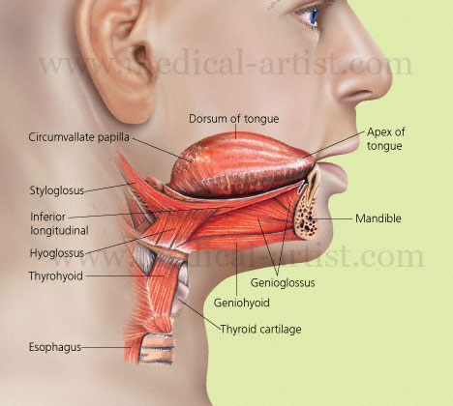
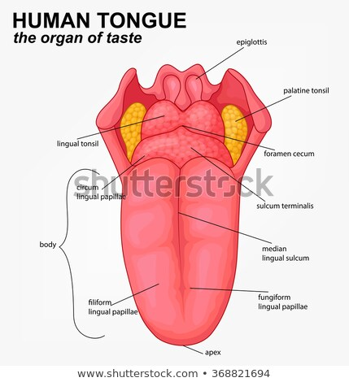

Slide 38
Oral form of dorsum show shallow median groove.
Mucosa has numerous minute papillae.
1. Filiform papillae – narrowest & numerous.
2. Fungiform papillae – rounded heads contains taste buds.
3. Vallate papillae – about 12 large projections arranged in V shaped rows in front of sulcus Terminalis & contains numerous taste buds.
Folia – Present in constant grooves & ridges at the margins posteriorly.

Slide 39
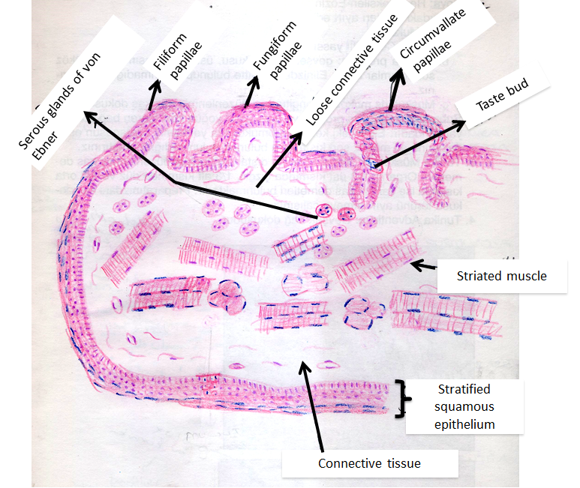
T. S. of Tongue

Slide 40
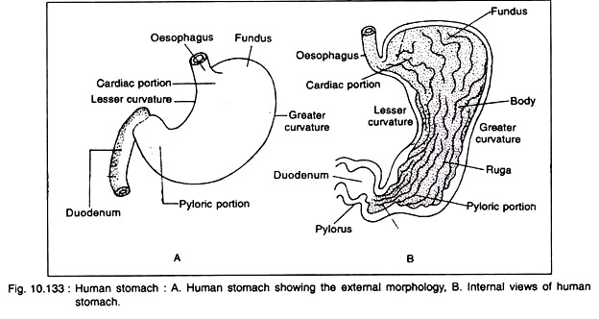
T. S. of Stomach
Four main region of stomach viz. cardiac, fundus, body and pylorus.
Cardiac – esophagus connects stomach located below diaphragm.
Left of cardiac dome shaped fundus.
Below fundus main part of stomach body.
Funnel shaped pyloric connects stomach to duodenum.

Slide 41
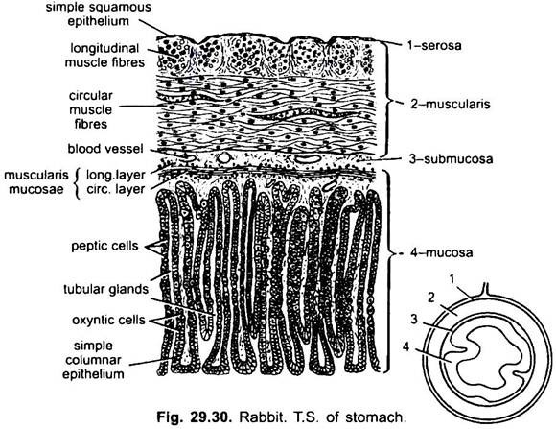
T. S. of Stomach
aa

Slide 42
T. S. of Stomach
Stomach is with four layers Serosa, Muscularis, Submucosa & Mucosa.
Stomach can vigorously churn the food, mechanically broken down in small particles.
In epithelium gastric glands secretes gastric secretion.
Different cells secretes enzymes, HCl, pepsin.
Mucus cells secretes alkaline mucus secretion.
Gastric glands are made up of different types of cells.
Cardiac & Pylorus composed of mucus secreting cells.
Pyloric cells secretes mucus & number of hormones including gastrin.
Fundus & body is site for chemical digestion due to gastric secretion by parietal, chief, mucus, & enteroendocrine cells.

Slide 43
Partial cells are most highly differentiated in body’s epithelial cells.
Larger cells secretes HCl is highly acidic ( 1.5 to 3.5) pH & Intrinsic factor.
Higher acidity kills bacteria injected along with food materials.
Proteins are also denatured & making them available for absorption.
Intrinsic factor is necessary for absorption of Vitamin B 12 in small intestine.
Chief Cells: located in basal region of gastric glands secretes pepsinogen.
HCl converts pepsinogen to pepsin.
Mucous Cells : located in upper part of gastric glands secretes thin acidic mucus.
Mucus is created by goblet cells of the surface epithelium function is unmnown.
Enteroendocrine cells : found in gastic glands secretes various hormones include gastrin.
Stomach is protected from self digestion by mucosal barrier
Stem cells located at point damaged epithelial cells are replaced.

Slide 44
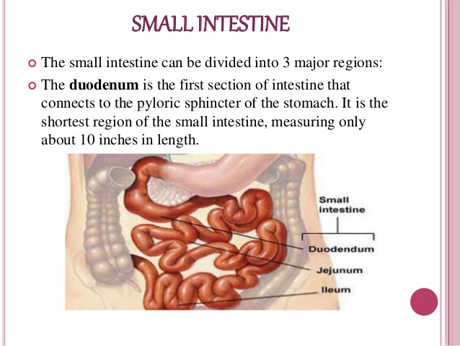
T. S. of Small Intestine

Slide 45
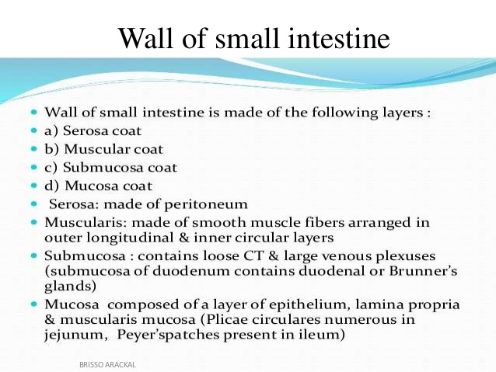

Slide 46
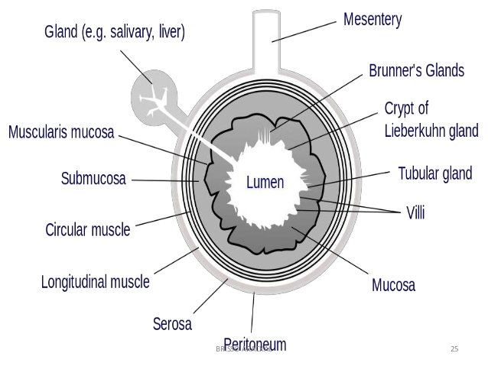
T. S. of Small Intestine

Slide 47
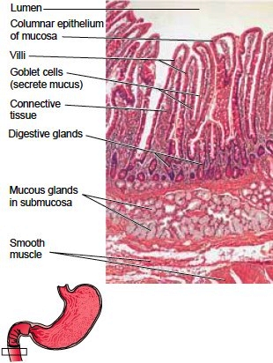
Histology of Small Intestine

Slide 48
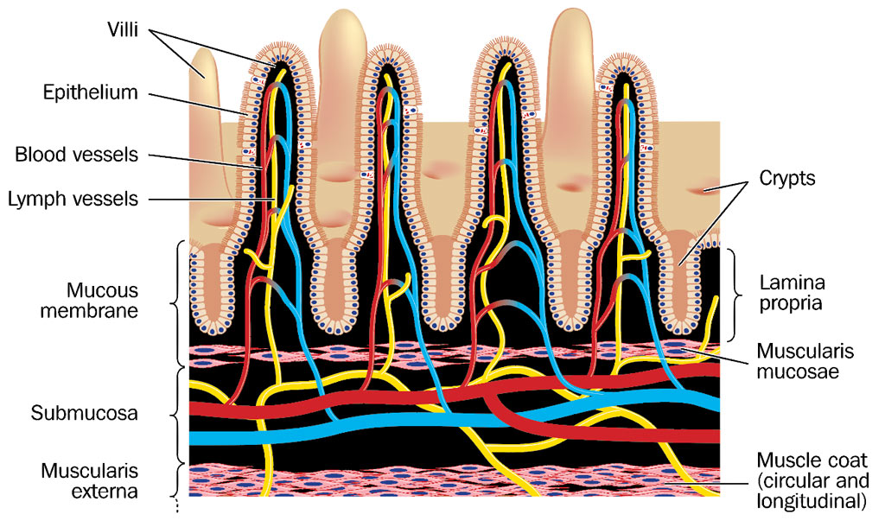

Slide 49
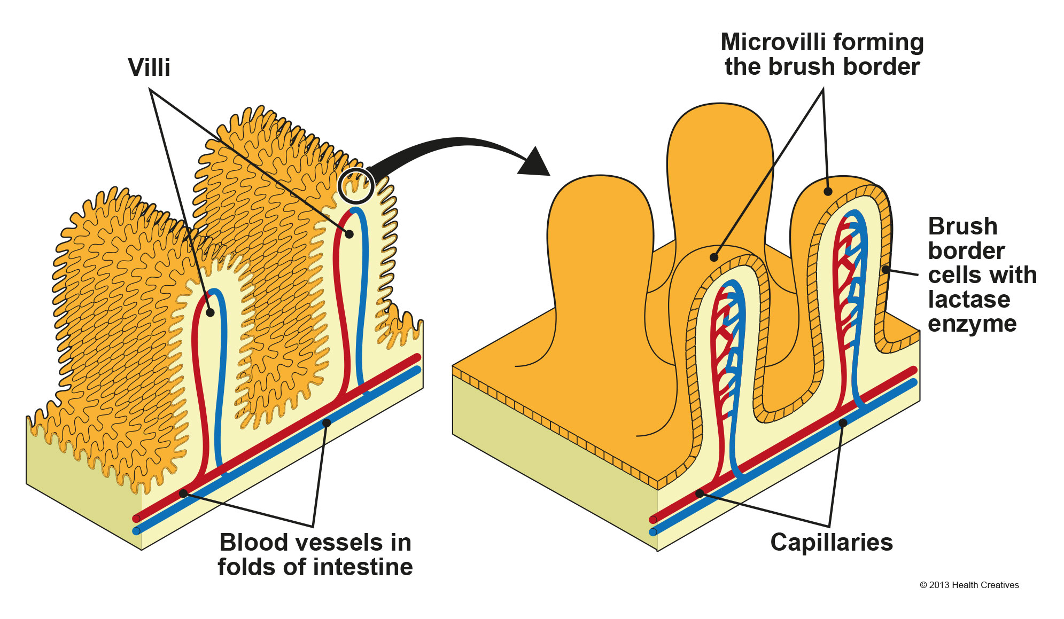

Slide 50
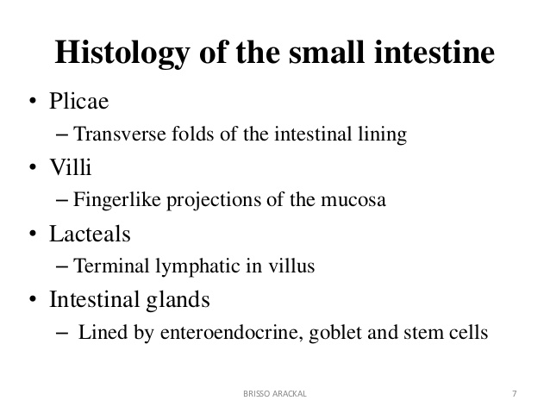

Slide 51
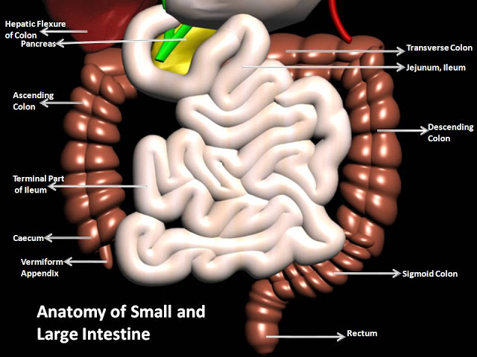
T. S. of Large Intestine

Slide 52
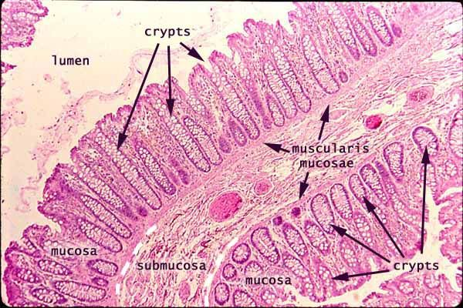
T. S. of Large Intestine
Mucosa does not have folds, except in the rectum
The bands of longitudinal muscle fibers start at the base of the appendix and extend from the cecum to the rectum.
The wall of the large intestine is lined with simple columnar epithelium.
Both the small intestine and the large intestine have goblet cells, but they are abundant in the large intestine.
In histology, an intestinal crypt—called the crypt of Lieberkühn—is a gland found in the epithelial lining of the small intestine and colon.
The crypts and intestinal villi are covered by epithelium that contains two types of cells: goblet cells that secrete mucus and enterocytes that secrete water and electrolytes.

Slide 53
Colon
Mucosa of colon is lined by simple columnar epithelial cells with brush border & numerous goblet cells.
There are no villi.
Crypts of Lieberkühn are straight & unbranched lined with goblet cells.
Leucocyte are abundant with isolate nodules
Submucosa : has the mixture of connective & adipose tissues with numerous B.V.
Muscularis : is different than small intestine forms layer of smooth muscles with thick longitudinal bands called “Taeniae coli”.

Slide 54
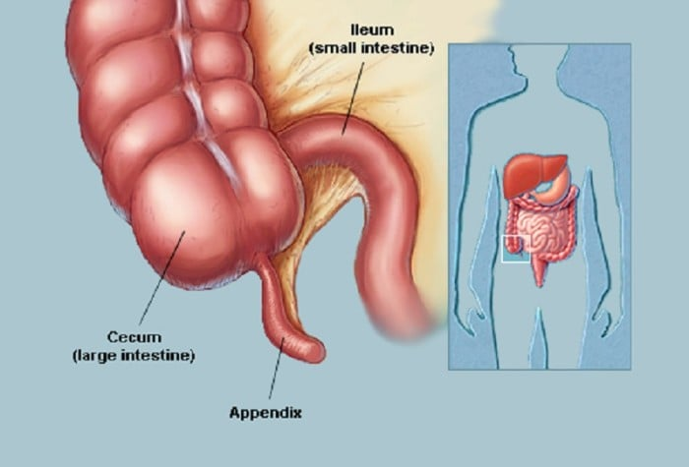
Appendix
The appendix is a finger-like, blind-ended tube connected to the cecum.
The cecum is a pouch-like structure of the colon, located at the junction of the small and the large intestines.
The term "vermiform" comes from Latin and means "worm-shaped."
The appendix used to be considered a vestigial organ, but this view has changed over the past decades.
The human appendix averages 9 cm in length but can range from 5 to 35 cm.
The diameter of the appendix is 6 mm and more than 6 mm is considered a thickened or inflamed appendix.
The longest appendix ever removed was 26 cm long.
The appendix is usually located in the lower right quadrant of the abdomen, near the right hip bone.
The base of the appendix is located 2 cm beneath the ileocecal valve that separates the large intestine from the small intestine.

Slide 55
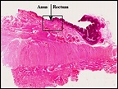
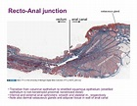
Recto-anal Junction
The epithelium changes abruptly at the junction of the rectum (simple columnar) with the anal canal (stratified squamous moist).
The rectum resembles the rest of the large intestine, having straight intestinal glands with many goblet cells.
A more gradual transition of the epithelium occurs between the anal canal and the anus, the latter being lined by a stratified squamous, keratinized epithelium.

Slide 56
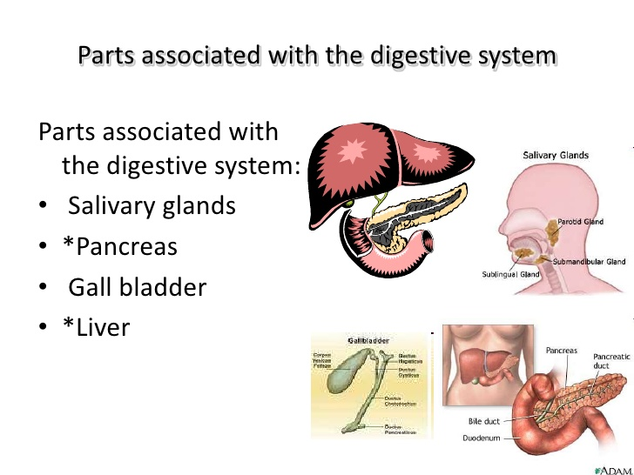
Glands Associated with D.S.
Many glands associated with digestive system.
They secretes enzymes, juices help it for proper digestion of food material.
Liver, pancreas , gall bladder, Salivary glands etc.

Slide 57
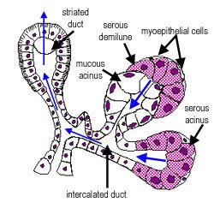
T.S. of Salivary Glands
Three pairs of salivary glands.
Parotid glands
Submandibular glands
Sublingual glands
Numerous lobules contain the secretary units called acini.
Each cells units contains Secretary & Ducts.
Each ducts connects with large interlobular ducts.

Slide 58
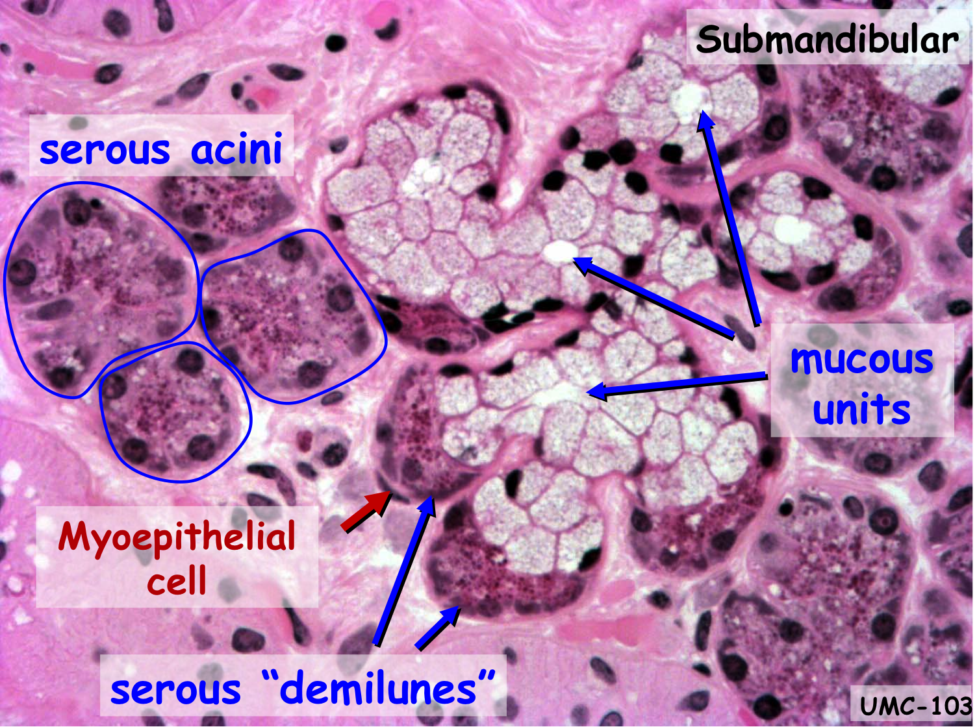
Histology of Salivary Acini
Submandibular glands & sublingual glands possess both mucous & Secretory glands.
Mucus cells are with pale staining & bulgy cytoplasm nuclei pushed towards cell membrane.
Serous Cells : Contains distinctly eosinophilic granules & spherical nuclei.
Classified in three types:
Serous Acini – serous cells & are generally Spherical.
Mucus Acini – only mucus cells & are tubular.
Mixed Acini – Serous & Mucus cells.
There are abundance of fats in parotid glands.
C.T., Stroma, B.V., nerves and large execratory duct.

Slide 59
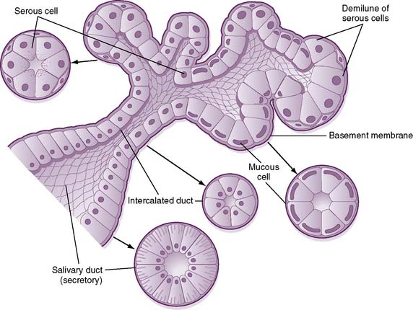

Slide 60
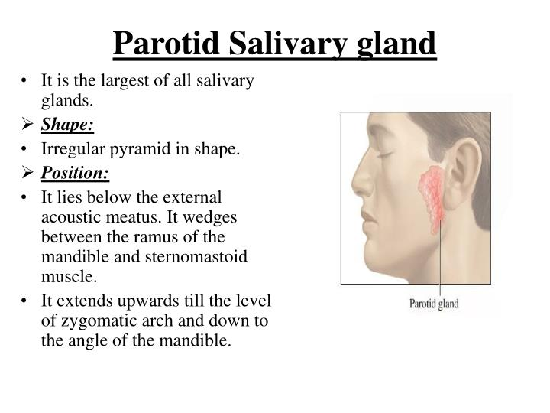

Slide 61
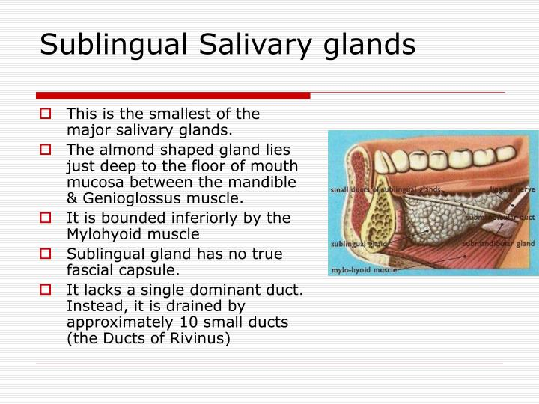

Slide 62
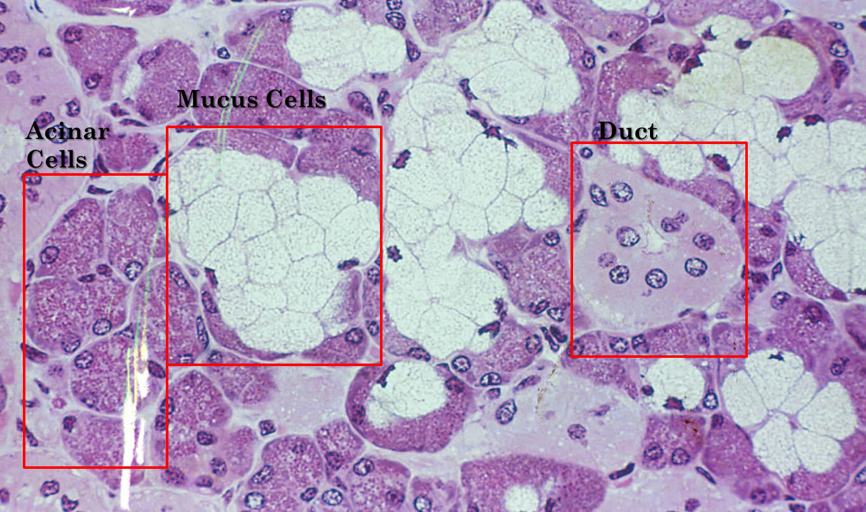

Slide 63

Liver
The liver is the most vital organ in the mammalian body and performs all important functions that impact all body systems.
The liver has lobular structure and lies in the abdominal cavity below diaphragm.
The circulatory system of the liver is different from that of other organs.
Roughly 75% of the blood entering in liver through the portal vein is the venous blood returning back from the small intestine, stomach, pancreas, and spleen.
From this portal venous blood all nutrients along with drugs and other potentially harmful substances are absorbed.
The remaining 25% of the arterial blood received by liver is the oxygenated blood being carried from the pulmonary system to the liver by the hepatic artery.

Slide 64
Functions of Liver
The liver is a metabolically active organ responsible for many vital life functions.
The primary functions of the liver are: Bile production and excretion.
Excretion of bilirubin, cholesterol, hormones, and drugs.
The liver is thought to be responsible for up to 500 separate functions
The liver is responsible for the mainstay of protein metabolism, synthesis as well as degradation.
It is also responsible for a large part of amino acid synthesis.
The liver plays a role in the production of clotting factors, as well as red blood cell production.

Slide 65

T.S. of Liver
Liver is the largest exocrine gland in the body.
It plays very important role in digestion by secretion bile & plays prominent role in detoxification.

Slide 66

Histology of Liver
Sheets of connective tissue divide the liver into thousands of small units called lobules.
A lobule is roughly hexagonal in shape, with portal triads at the vertices and a central vein in the middle.
In contrast, the hepatic acinus is more difficult to visualize, but represents a unit that is of more relevance to hepatic function because it is oriented around the afferent vascular system.
The parenchymal cells of the liver are hepatocytes.
These polygonal cells are joined to one another in anastomosing plates, with borders that face either the sinusoids or adjacent hepatocytes.
The ultrastructure appearance of hepatocytes reflects their function as metabolic superstars, with abundant rough and smooth endoplasmic reticulum, and Golgi membranes.
Hepatocytes make contact with blood in sinusoids, which are distensible vascular channels lined with highly fenestrated endothelial cells and populated with phagocytic Kupffer cells.
The space between endothelium and hepatocytes is called the Space of Disse which collects lymph for delivery to lymphatic capillaries.

Slide 67
Review of Topic
1.1 : Vertical section (V.S.) of skin:
Layers and cells of epidermis; papillary and reticular layers of dermis; sweat glands, sebaceous glands and skin receptors
1.2: Digestive System
V.S. of tooth : Hard, Soft & supporting tissues.
T.S. of Tongue : Types of papillae & Taste buds
T.S. of Stomach
T.S. of Small Intestine
T.S. of Large Intestine
Associated glands
T.S. of Salivary Glands
T.S. of Liver

