Slide 1
SECURITY ANALYSIS & PORTFOLIO MANAGEMENT
MODULE 4

Slide 2
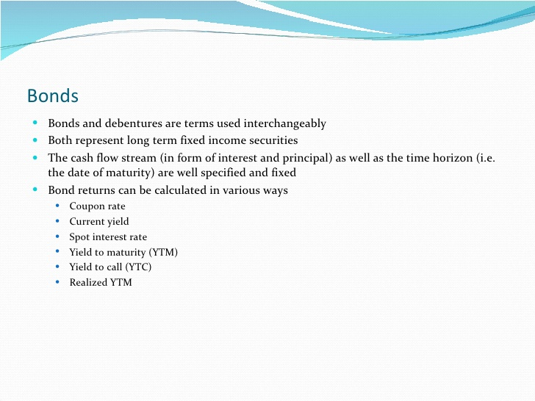
Bond valuation- meaning

Slide 3
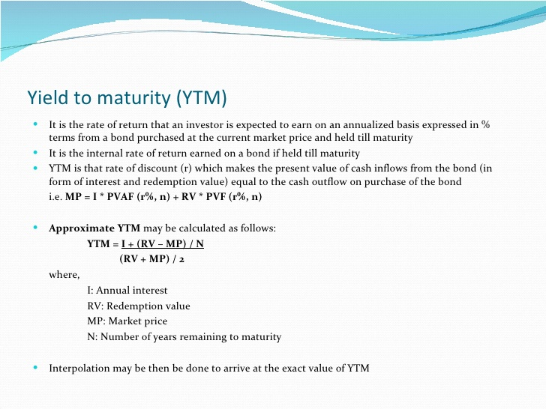
Measuring bond return-yield to maturity

Slide 4
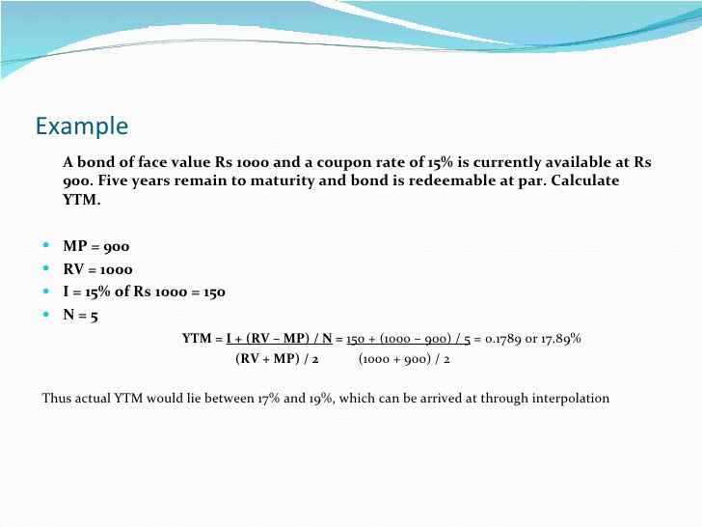
Yield to maturity- example

Slide 5
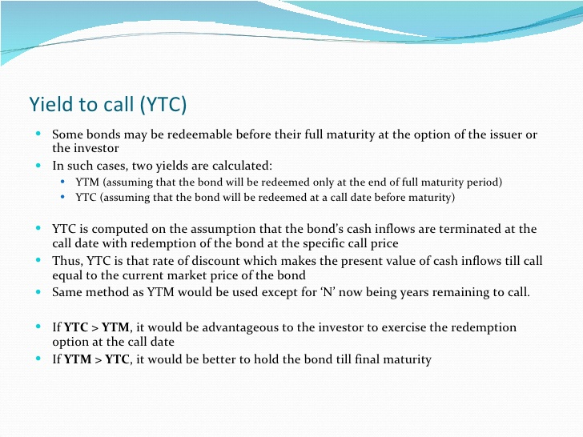
Measuring bond return-yield to call

Slide 6
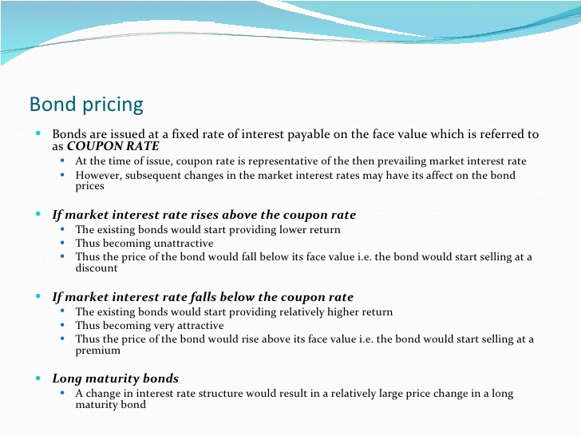
Bond pricing- meaning

Slide 7
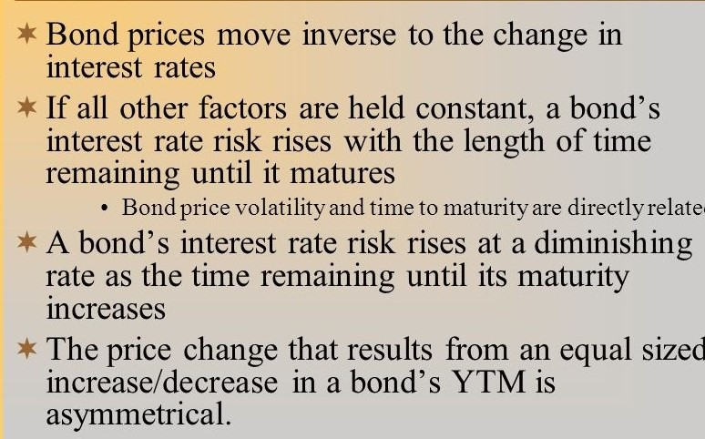
Bond pricing - theorems

Slide 8
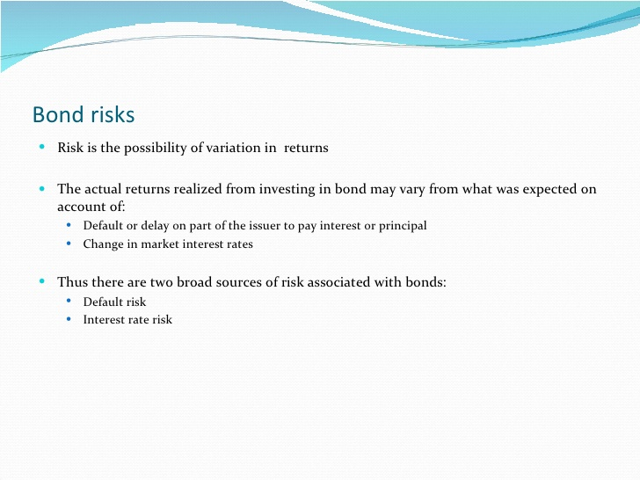
Bond risk

Slide 9
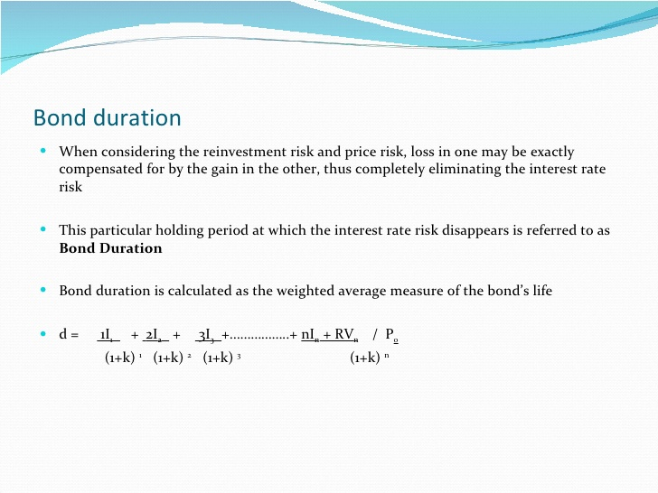
Bond duration

Slide 10


