Slide 1
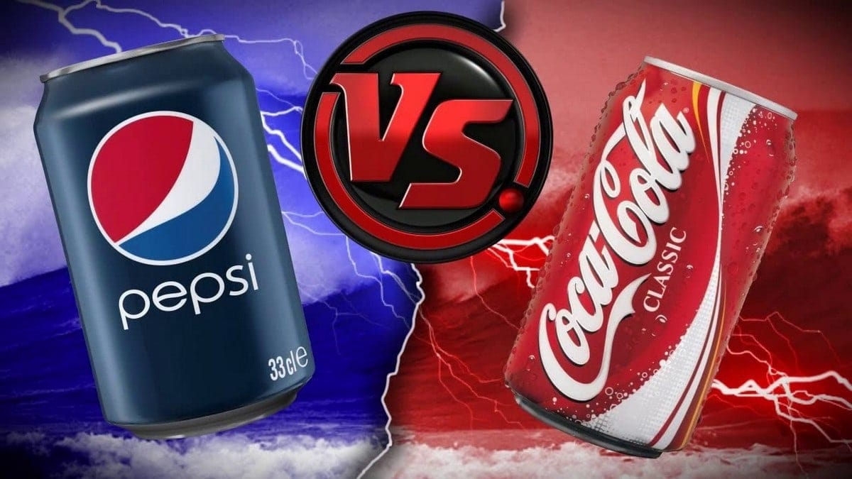

Slide 2
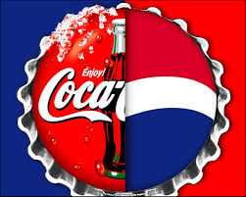
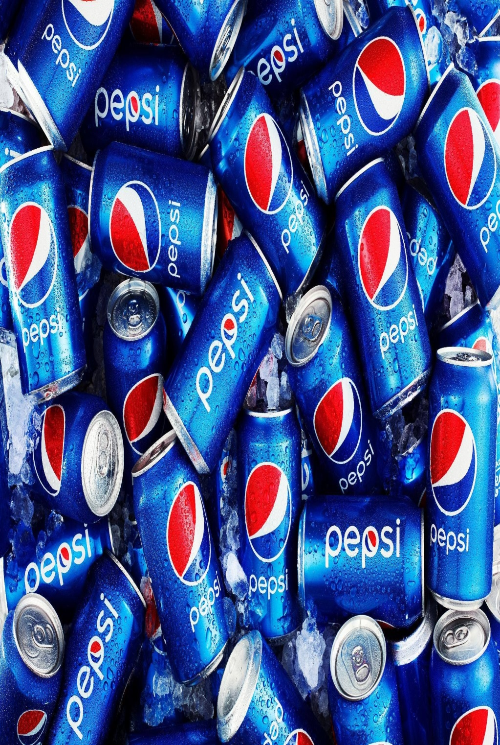
Pepsi
• Pepsi was created and developed in 1898 and introduced as “brads drink "it was later it was re-named as Pepsi cola on June, 16 1903 then to Pepsi in 1961.
• There are around 168,000 employees that work for PepsiCo
• The Pepsi headquarters are in New York

Slide 3
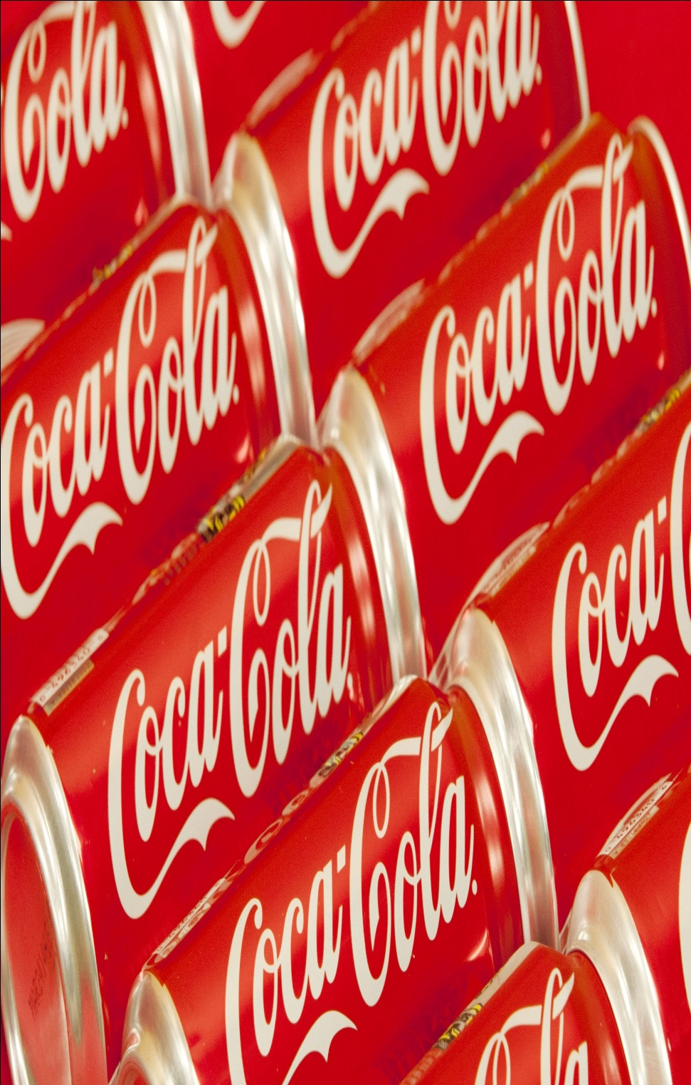
Coca-Cola
Coca Cola was started in May 8, 1886 by Dr. John Pemberton.
• First advertisement published in 1894 in Georgia.
• Coca Cola was bought by Asa Griggs Candler(businessman). In 1903 it was removed.
There are currently 71,000 employees working at Coca-Cola The founder of Coca-Cola is john Pemberton The Coca-Cola headquarters are In Atlanta Georgia

Slide 4
BRAND IMAGE

Slide 5
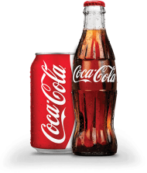
DESIRED BRAND IMAGE
Family
Bubbly
Fun Exciting
Happy
Red
Revolves around emotions and the feeling that people should get when they drink coca cola
If Coca Cola was a person :

Slide 6
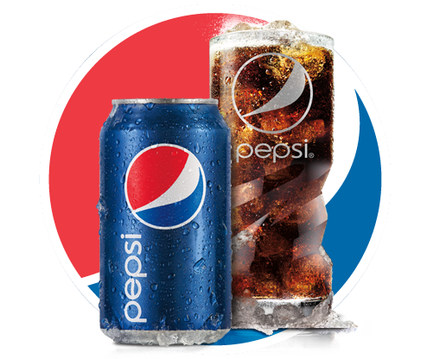
DESIRED BRAND IMAGE
Youthful
Energetic
Teenager
Music
Cool
Trendy
The Next Generation
Revolves around their youthful image and social responsibility
If Pepsi
was a person :

Slide 7
SPONSORSHIP

Slide 8
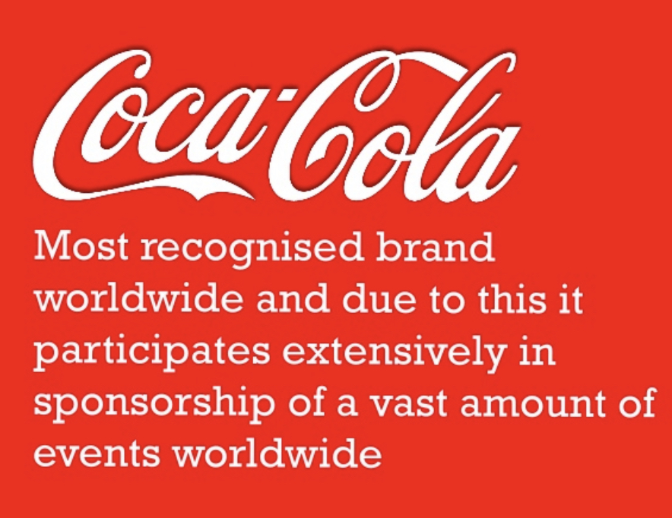
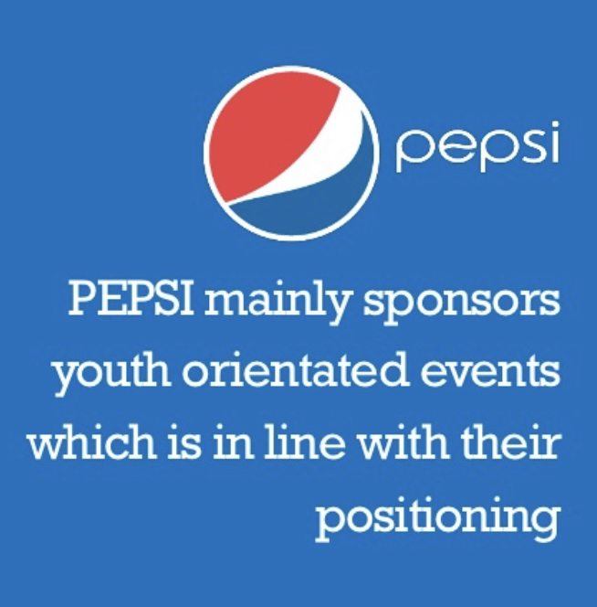

Slide 9
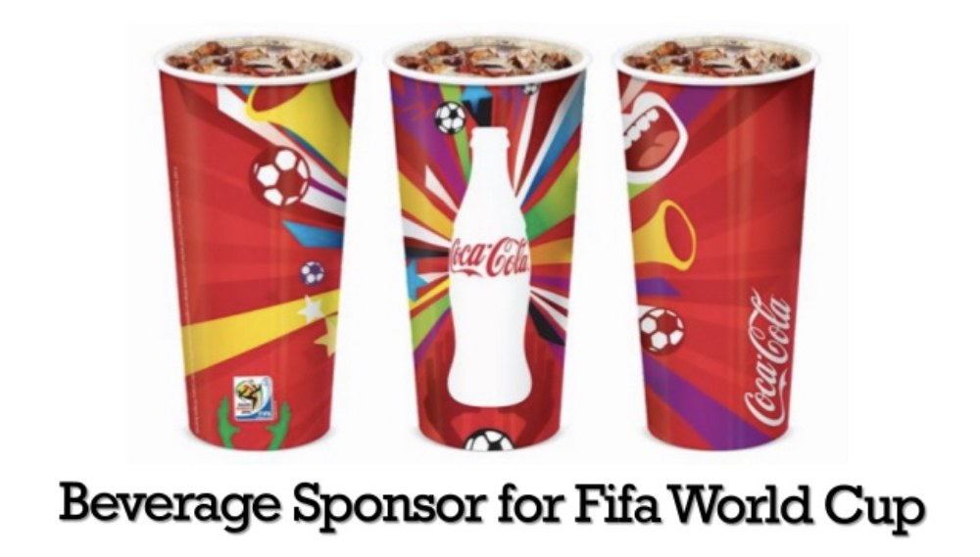
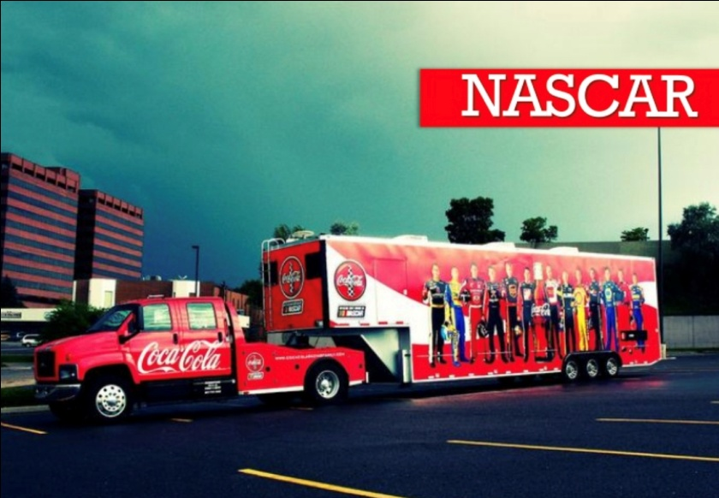
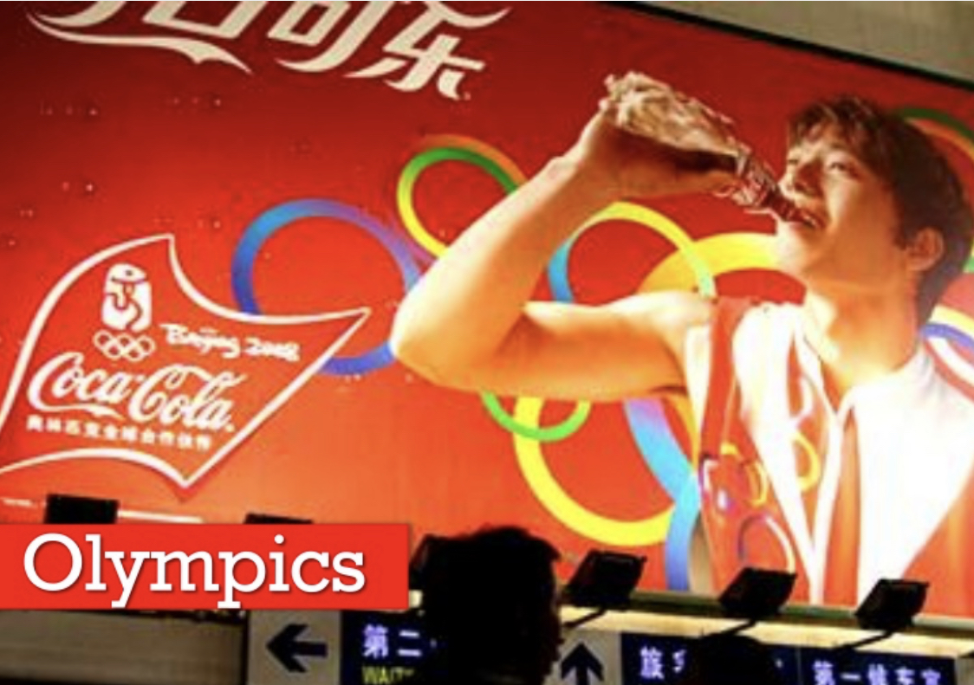

Slide 10
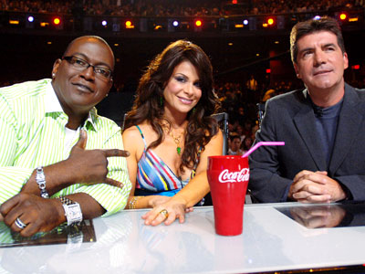
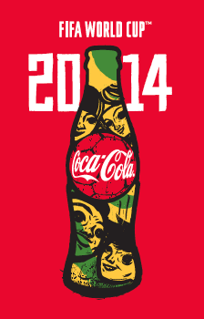
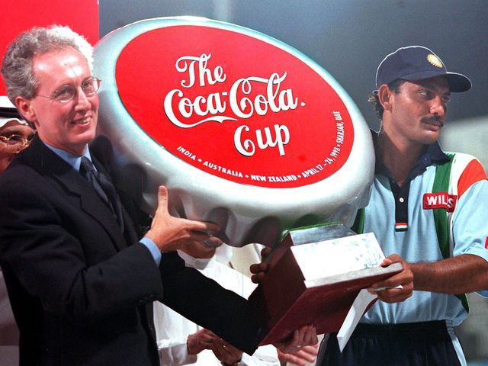

Slide 11
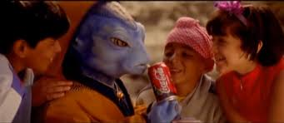

Slide 12


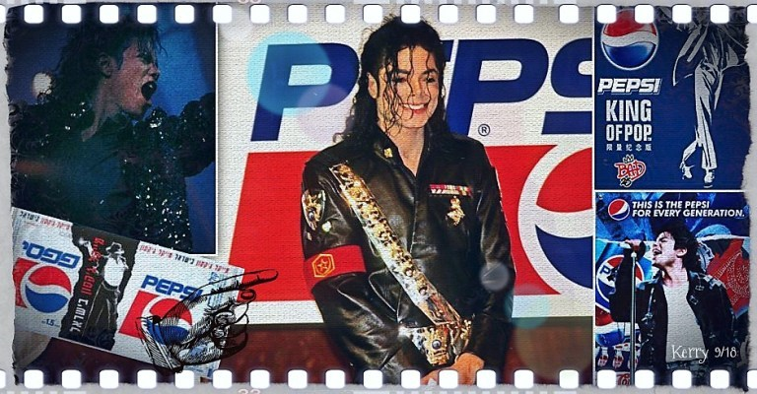

Slide 13

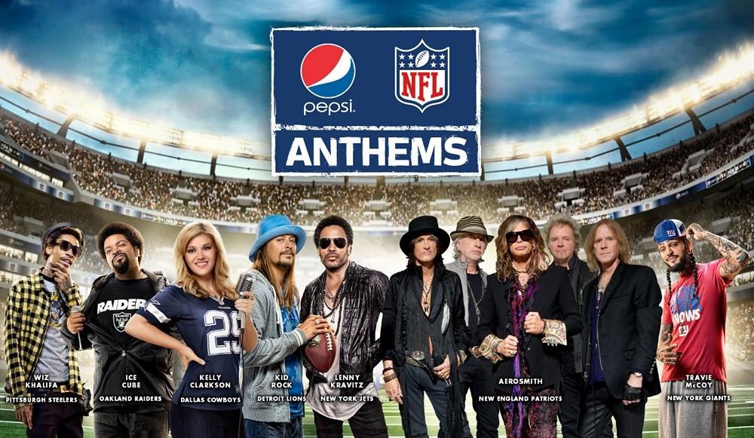

Slide 14
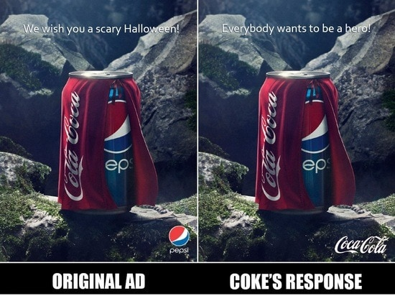
PRINT ADVERTISING

Slide 15
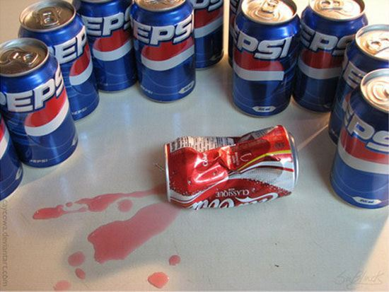
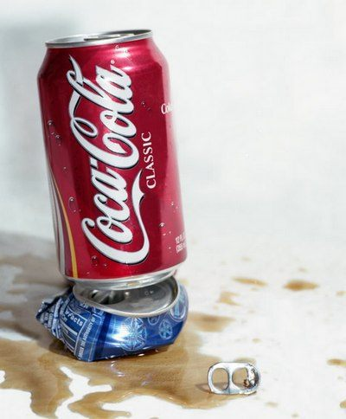

Slide 16
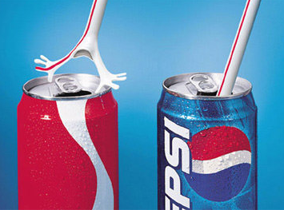
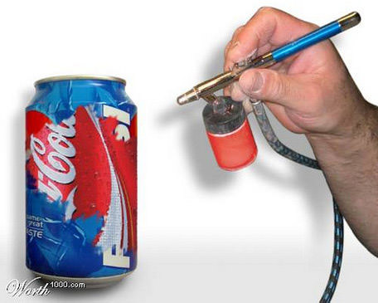

Slide 17
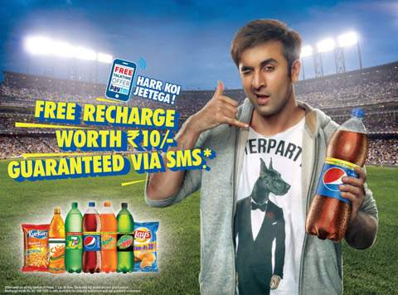
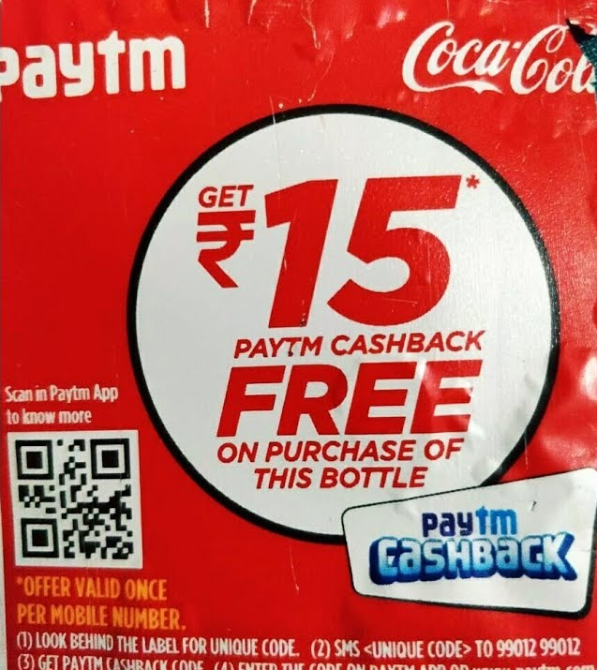
SALES & PROMOTION

Slide 18
MOVIES
AND
ADVERTISEMENTS

Slide 19


Slide 20


Slide 21


Slide 22
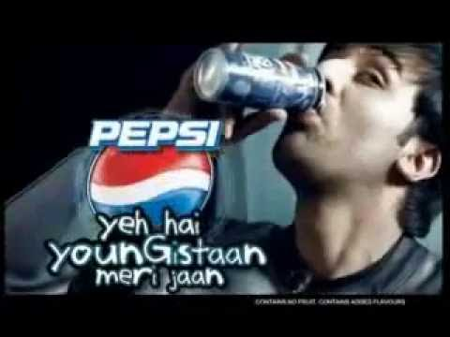


Slide 23
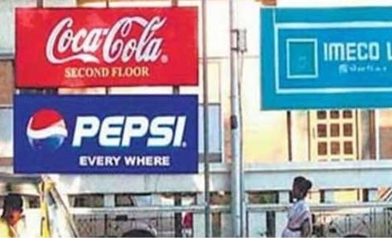
OUTDOOR ADVERTISING

Slide 24
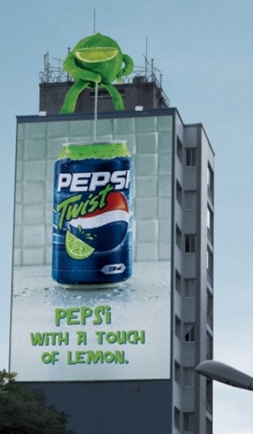
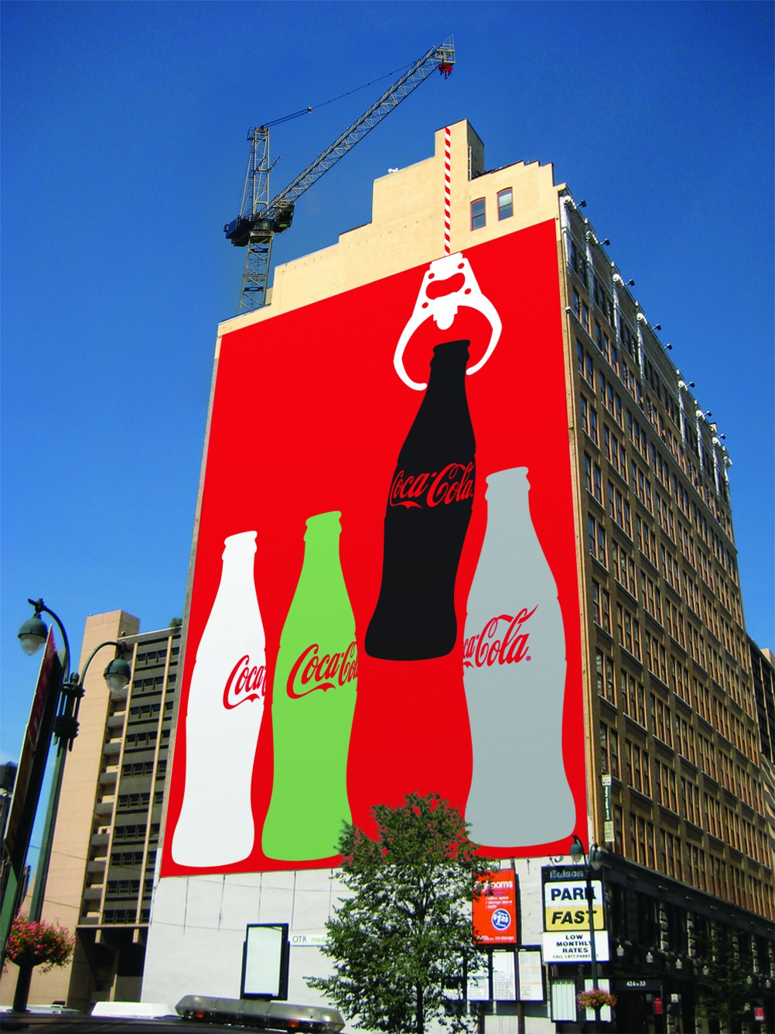

Slide 25
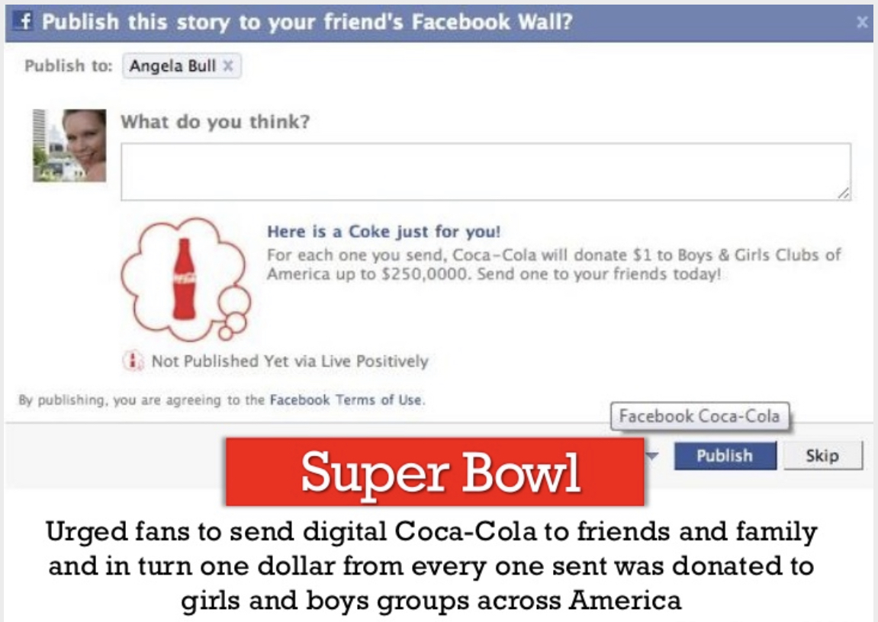
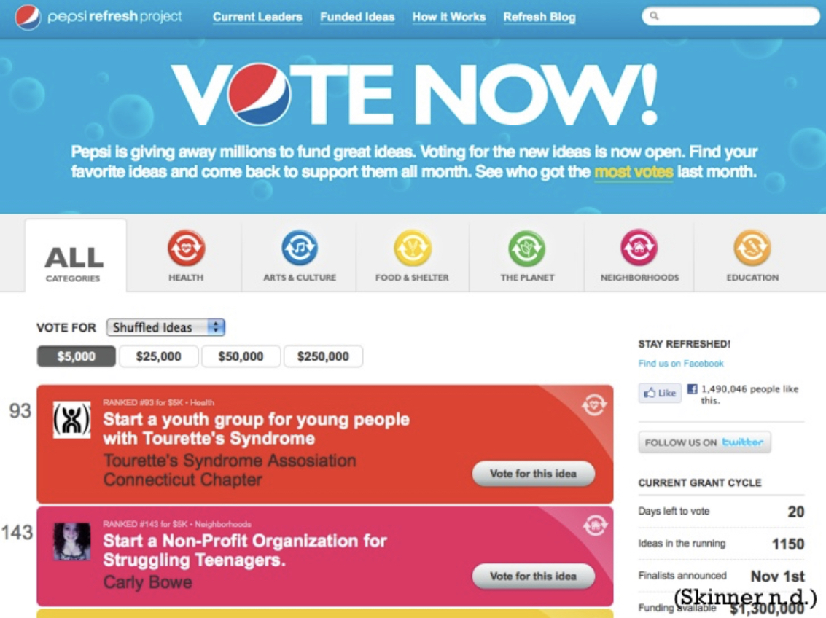
SOCIAL MEDIA ADVERTISING

Slide 26
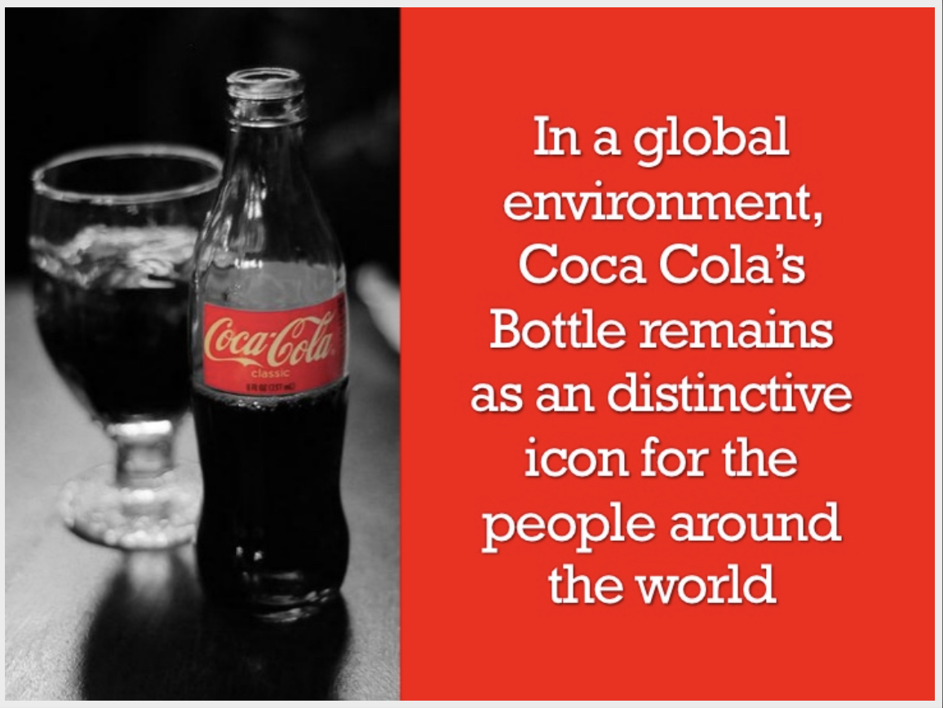
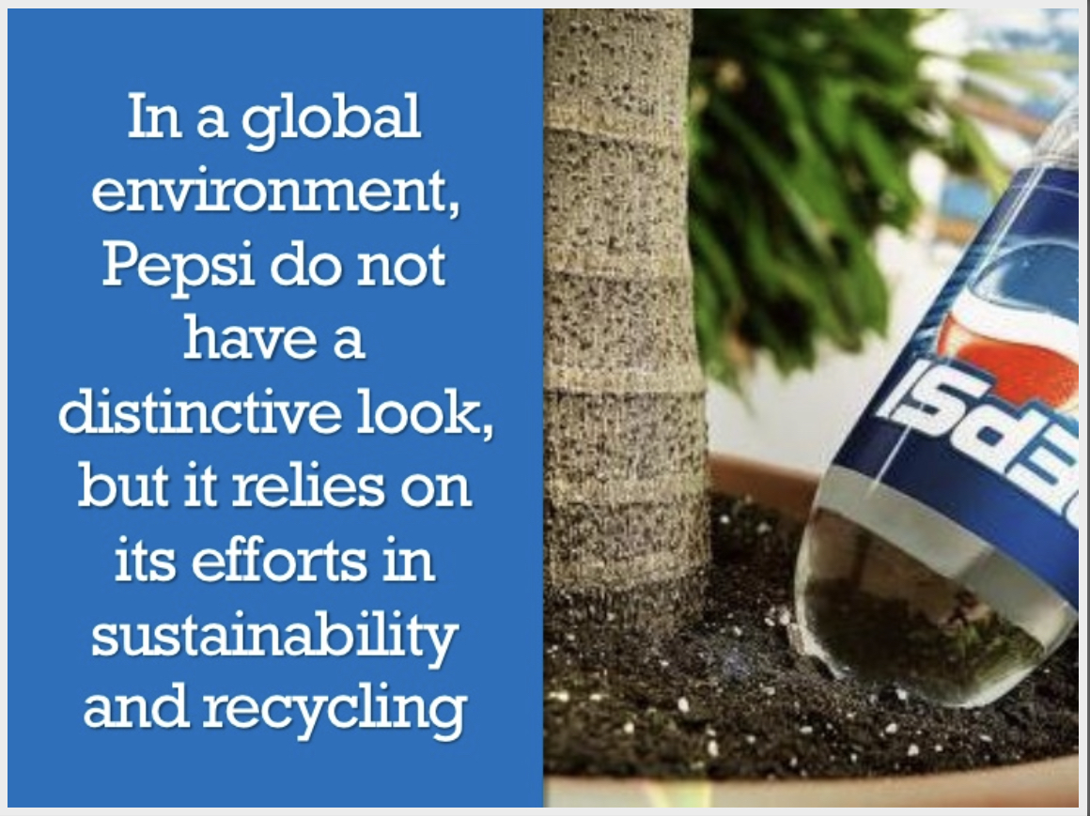
GLOBAL ENVIRONMENT

Slide 27
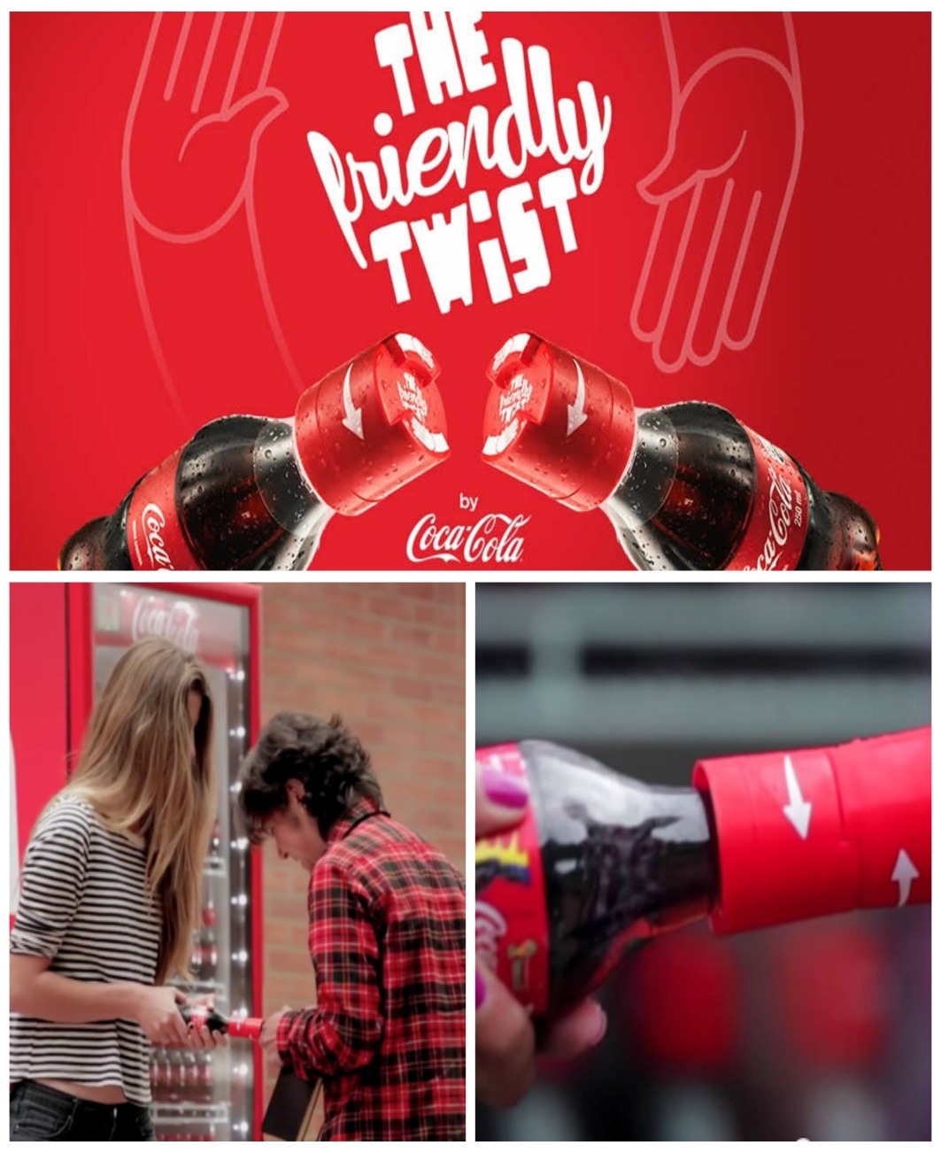
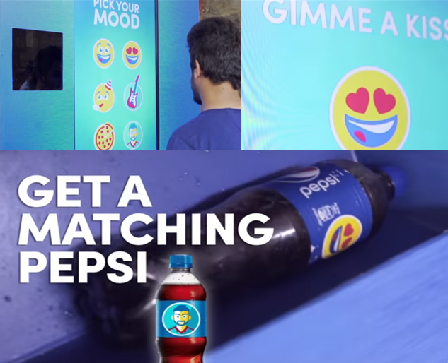
CAMPAIGN

Slide 28
CHALLENGES
• They received alien status upon entry in the Indian market.
• Coca Cola had to agree to sell 49% of its equity as a condition of entering.
• Sales of Pepsi's soft drink concentrate to local bottlers could not exceed 25% of total sales while fruits and vegetables by Pepsi Foods Ltd. had to be processed.
• Inconsistency in legal environment – led to increased lobbying and to corruption which was a great threat.
• According to Indian law it was forbidden to promote products under foreign brand names if sold within India and thus Coca Cola became 'Coca Cola India'& Pepsi became 'Lehar Pepsi'.

Slide 29
• Coca-Cola had to face many issues regarding its quality, resource exploitation and market exploitation along with price-quality trade-offs.
• Coca-Cola was criticized for polluting the nearby fresh water and ground water and soil; because of this issue, farmers are suffering from water scarcity
• They entered the market with products close to those already available in India such as lime beverages, fruit drinks as well as water.
• The segmentation of different areas of India allowed for the differentiation and division of rural and urban Indian youth into categories, 'India A' and 'India B' respectively. Doing so they were able to advertise and promote their products differently so as to target and appeal to these markets individually.

Slide 30
• Because of the attacks by the CSE and NGOs (Non-Governmental Organizations) on Coca-Cola, the brand faced many challenges. First, being the world’s most valuable brand whose value is greatly influenced by the image of the company and its products, their primary problem was trying to rebuilding their image to the Indian public and regaining Indian consumers’ trust.
•PEPSI is getting beaten up in its flagship product category, drinks, in the world’s largest market, North America and got displaced to no.2 position.
•Due to increasing concerns among American regarding use of excessive sugar and increasing concern of obesity rises resulted in decreasing consumption of carbonated drinks

Slide 31
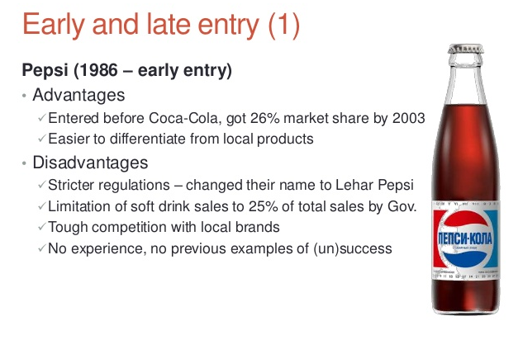

Slide 32
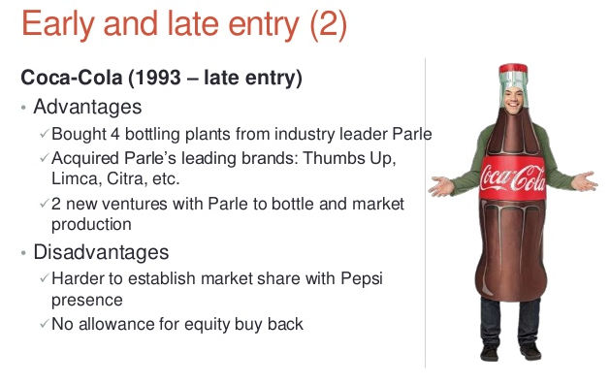

Slide 33
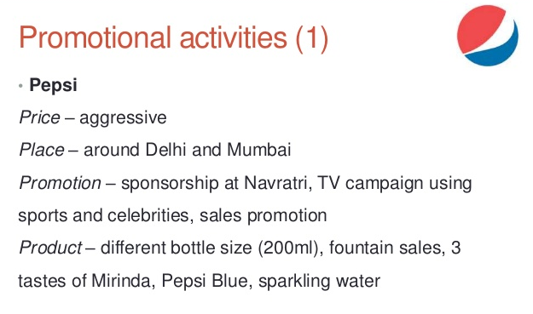

Slide 34
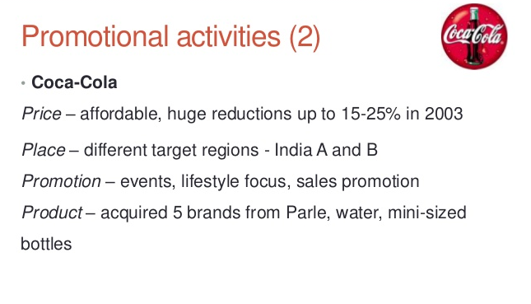

Slide 35
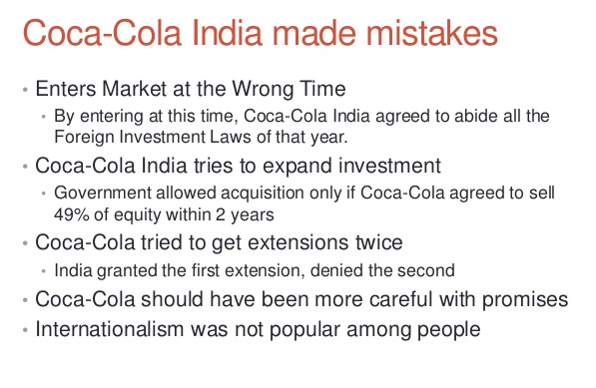

Slide 36
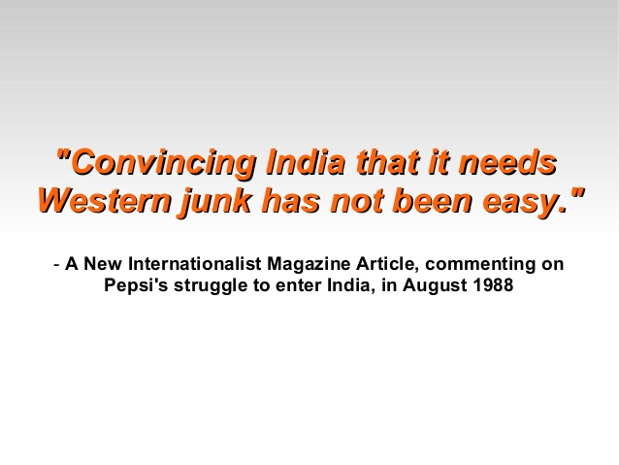

Slide 37
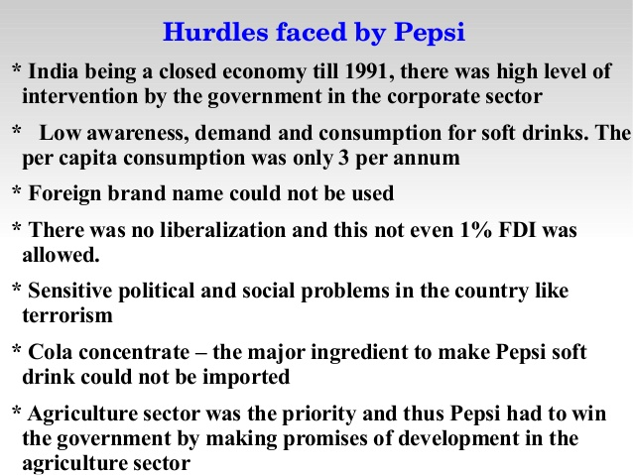

Slide 38
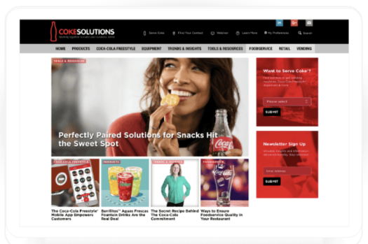

Slide 39
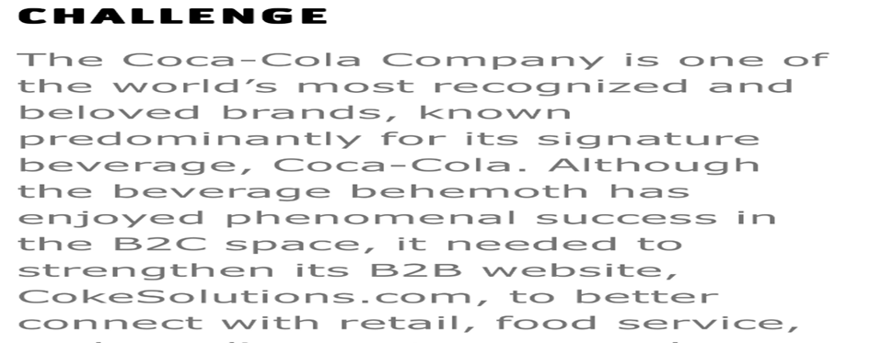

Slide 40


Slide 41
RECOMMENDATIONS
• Concentrate on the brand’s perception - As there is a saying that “marketing is a battle of perceptions, not products”.
• Don’t clone your rivals - In creating New Coke, Coca-Cola was reversing its brand image to overlap with that of Pepsi.
• Don’t be scared to U-turn - By going back on decision to scrap original product, the company ended up creating an even stronger bond between the product and the consumer.
• Do the right market research - Despite the thousands of taste tests carried out on new formula, company failed to conduct adequate research into the public perception of the original brand.

Slide 42
