Slide 1
Unit 4 Project Quality Management
TY BIM
BY PROF AARTI VYAS

Slide 2
Introduction
Project quality management is the process through which quality is managed and maintained throughout a project.
While the context may imply that “quality” means “perfection,” in this case, is usually more about ensuring quality consistency throughout a project.
However, what is exactly meant by “quality” is beholden to what the customer or stakeholder needs from the project, and therefore can be different on a per-project basis.

Slide 3
. According to A Guide to the Project Management Body of Knowledge (PMBOK® Guide), quality is “the degree to which a set of inherent characteristics fulfill requirements.”
The project manager and project management team have a special responsibility to balance quality and grade.

Slide 4
What Is quality
Validation: assurance that the product meets the agreed-upon needs
Verification: compliance with requirements
Precision: repeatable measures in a tight grouping
Accuracy: closeness of a measure to the true value
Tolerance: range of acceptable results

Slide 5
Phrases in quality management
Quality management planning: This involves identifying the quality requirements and standards for the project and product. The goal of the project quality management should be clearly shared with all stakeholders, and appropriate tasks should be delegated to those responsible.
Quality assurance: This involves auditing the quality requirements and quality control results to ensure appropriate quality standards are used. When standards are not met or goals aren’t achieved, necessary steps and corrective actions should be employed to fix these issues.
Quality control: This involves monitoring and recording the results of quality activities to assess performance and recommend necessary changes.

Slide 6
Value Engineering
Value engineering is a systematic and organized approach to providing the necessary functions in a project at the lowest cost.
Value engineering promotes the substitution of materials and methods with less expensive alternatives, without sacrificing functionality.
It is focused solely on the functions of various components and materials, rather than their physical attributes.

Slide 7
Project management information system
A project management information system (PMIS) is how a project’s information is organized. It collects and uses project information through one or more software applications
What these programs do is help project managers to plan, execute and close their project. It’s a way to organize that flood of information, so you don’t drown in data.
There are different types of PMIS software, but most share feature sets that include tools for scheduling, work authorization, information collection and distribution, etc

Slide 8
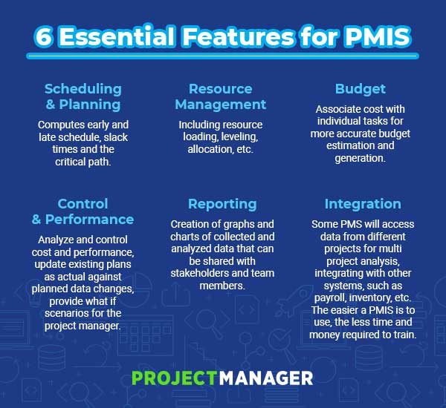

Slide 9
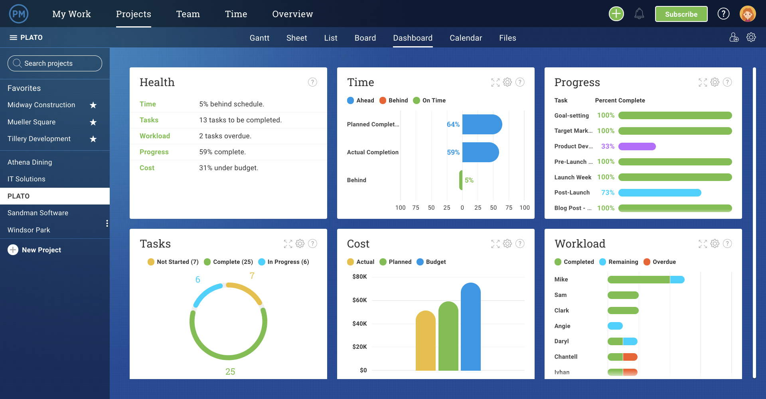
Design

Slide 10
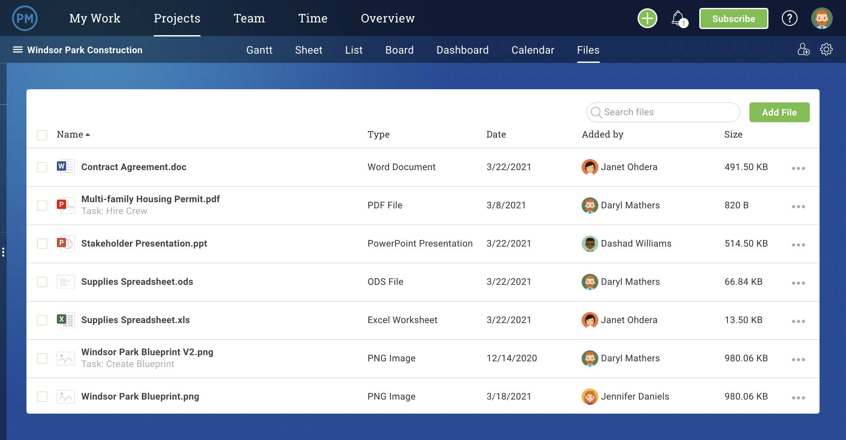
Design

Slide 11
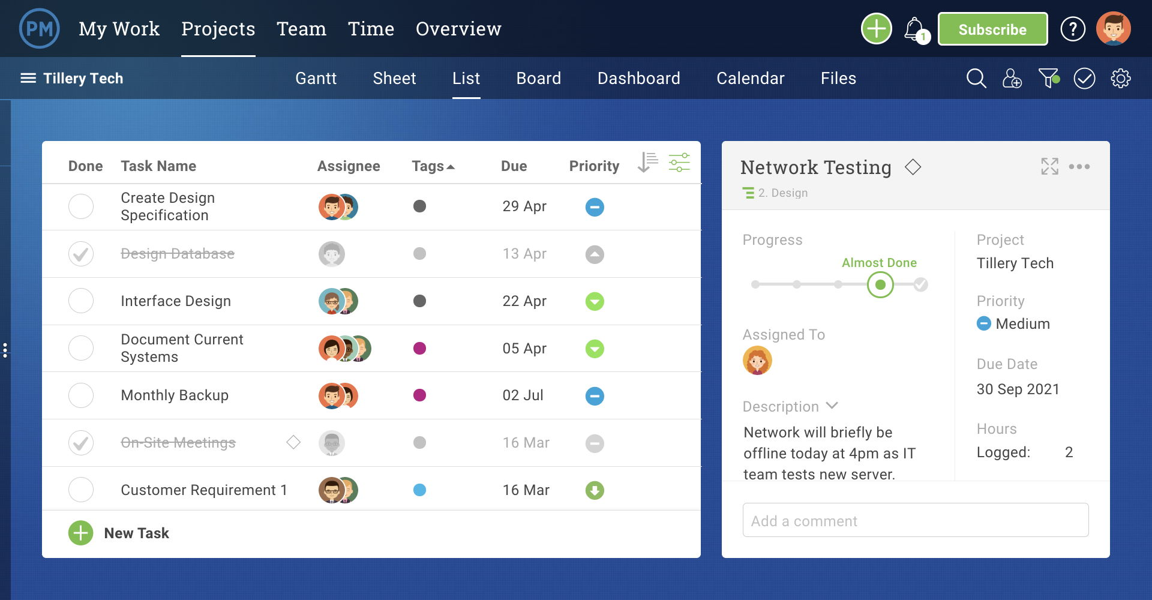
Design

Slide 12
Project management software
It is a software used for project planning,scheduling,resource allocation and change management
Project management software has been around nearly as long as the computer itself .
These systems which often have an easy to use graphical user interface can plan activities ,schedule work to be performed

Slide 13
Advantages of using pms
Accuracy
Affordability
Ease of use
Ability to handle complexity
Maintainability and Modifiability
Record keeping
Speed

Slide 14
Common features of pms
Budgeting and cost control
Calendars
Internet capabilities
Graphics
Importing/Exporting Data
Handling multiple Project and subprojects
Report Generation

Slide 15
Resource Management
Planning
Project Monitoring and Tracking
Scheduling
Security
Sorting and Filtering
What if Analysis

Slide 16
Thank you

