Slide 1
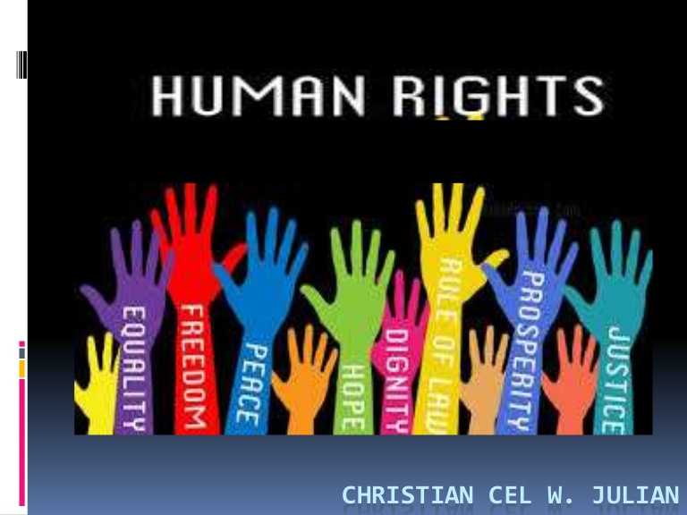
Unit II

Slide 2
Human Rights
Human rights are the rights of people
Rights that an individual can avail and enjoy by virtue of being born as a human being.
The rights relating to life, liberty equality and dignity of an individual guaranteed by the Constitution
Definition
“Rights derived from the inherent dignity of the human person” - UDHR

Slide 3
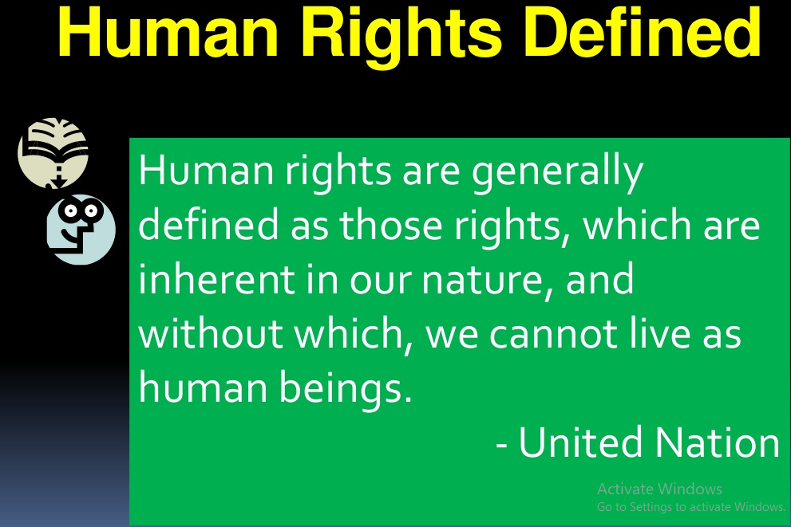

Slide 4
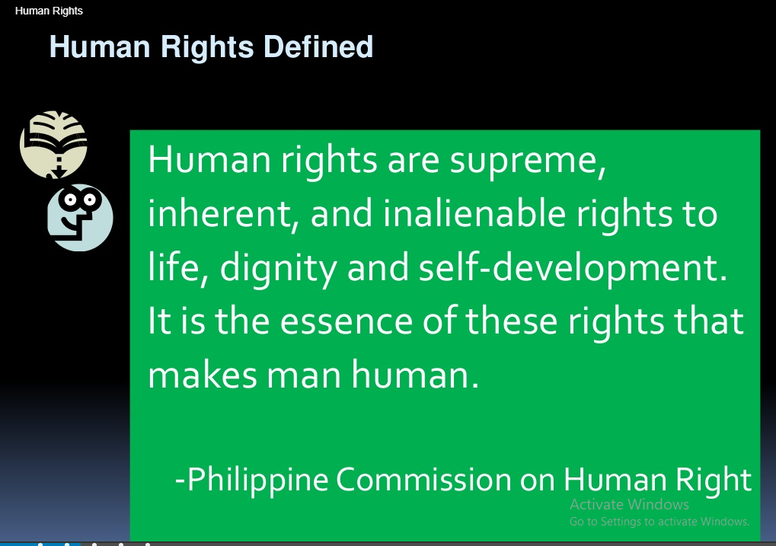

Slide 5
Characteristics of Human
Universal Application
Purpose - - Protection of human rights, Prevention of violations of human dignity
Minimal Rights
Derived from Natural Law
Independent of the state
Support Human Development

Slide 6
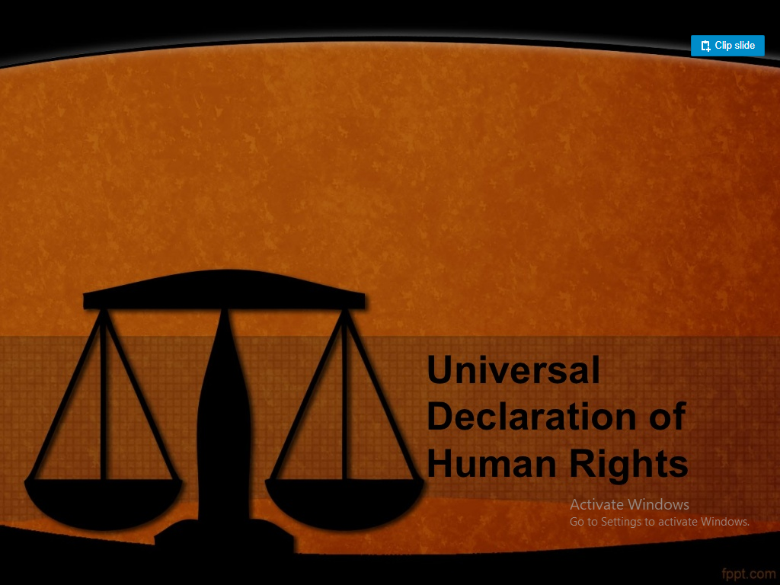

Slide 7
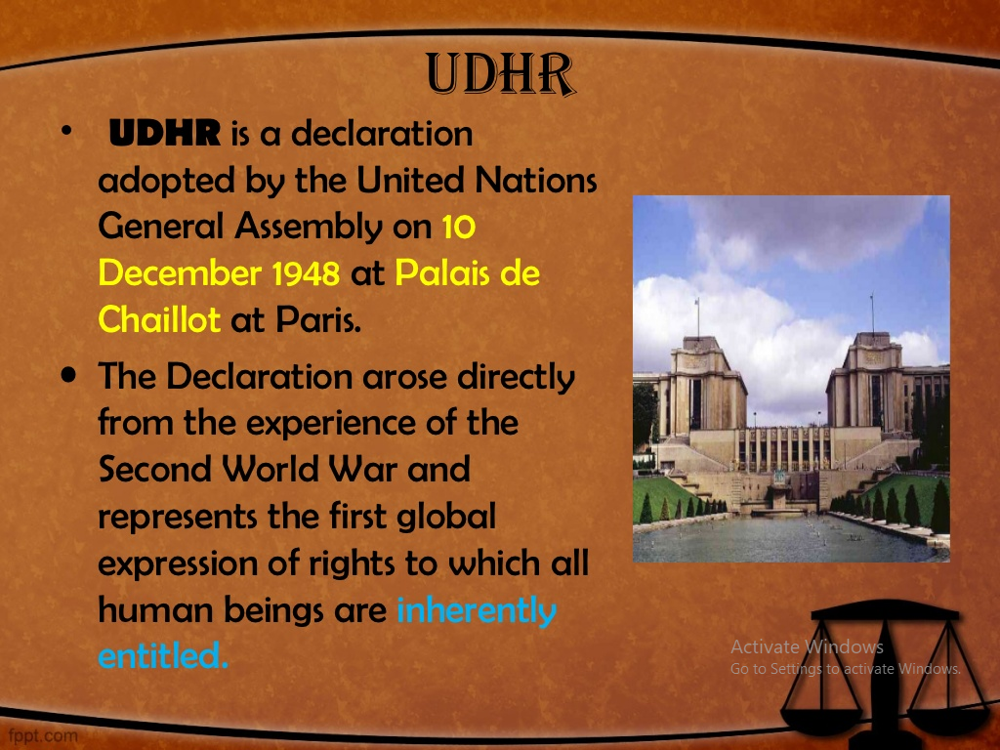

Slide 8
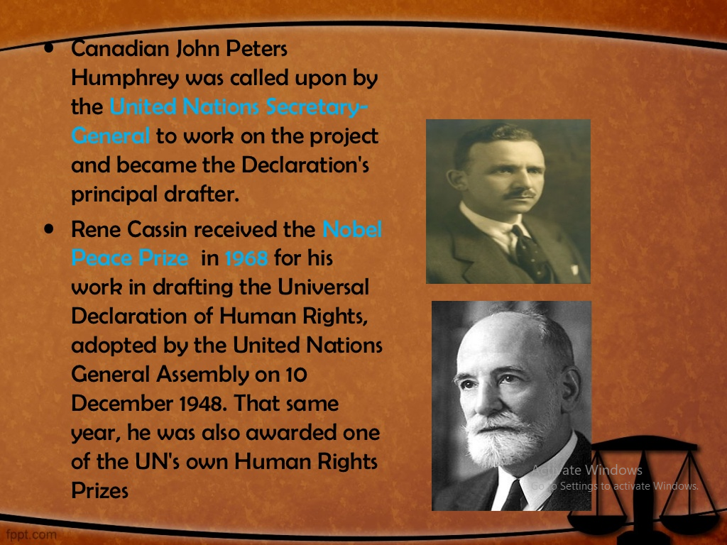

Slide 9
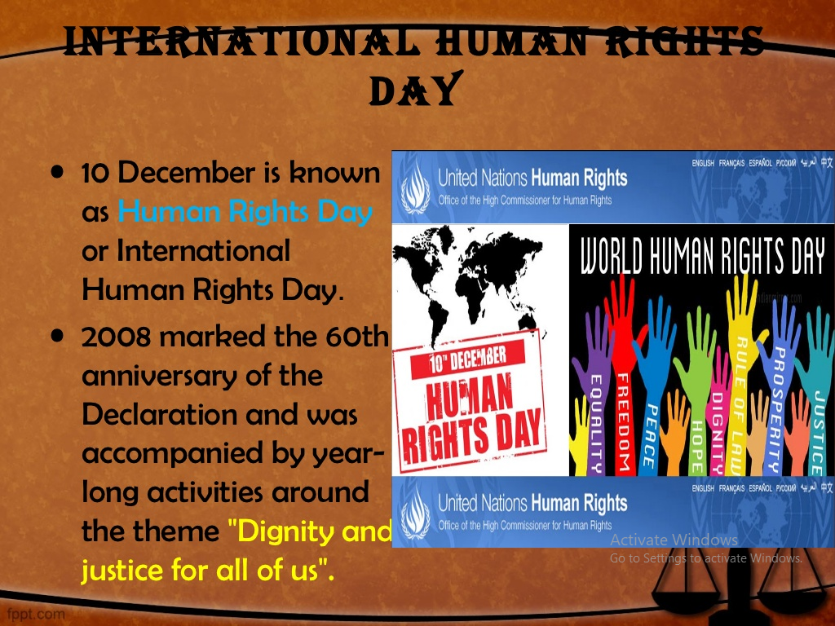

Slide 10
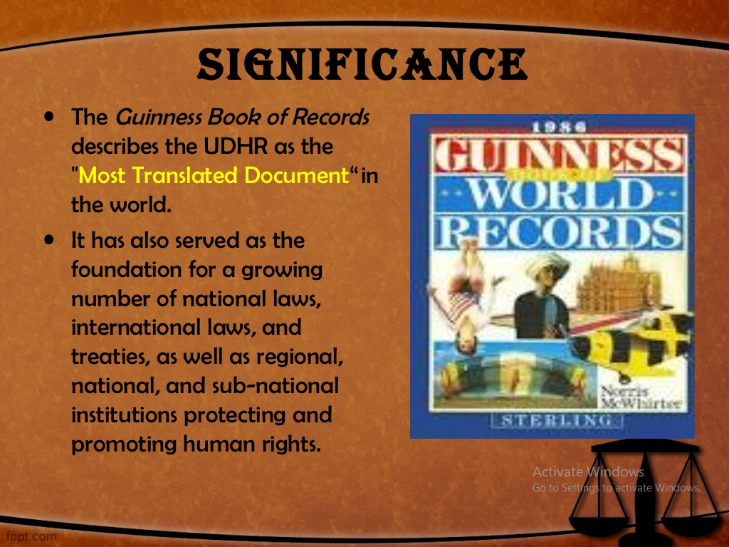

Slide 11
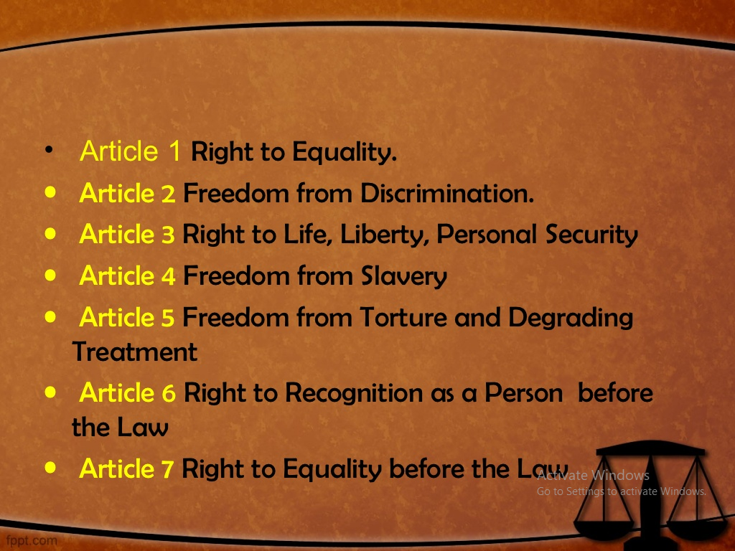

Slide 12
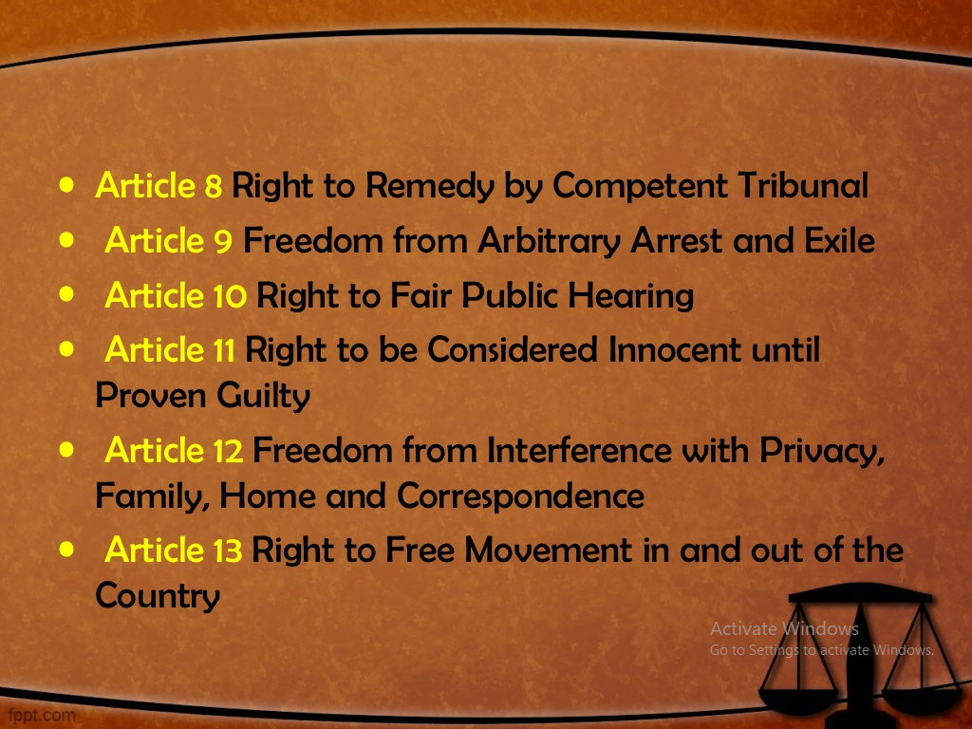

Slide 13
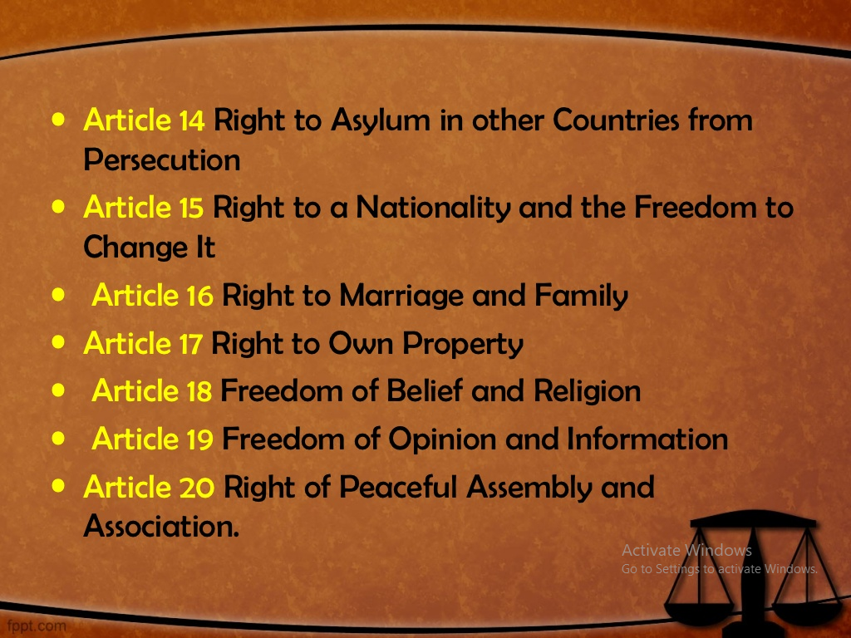

Slide 14
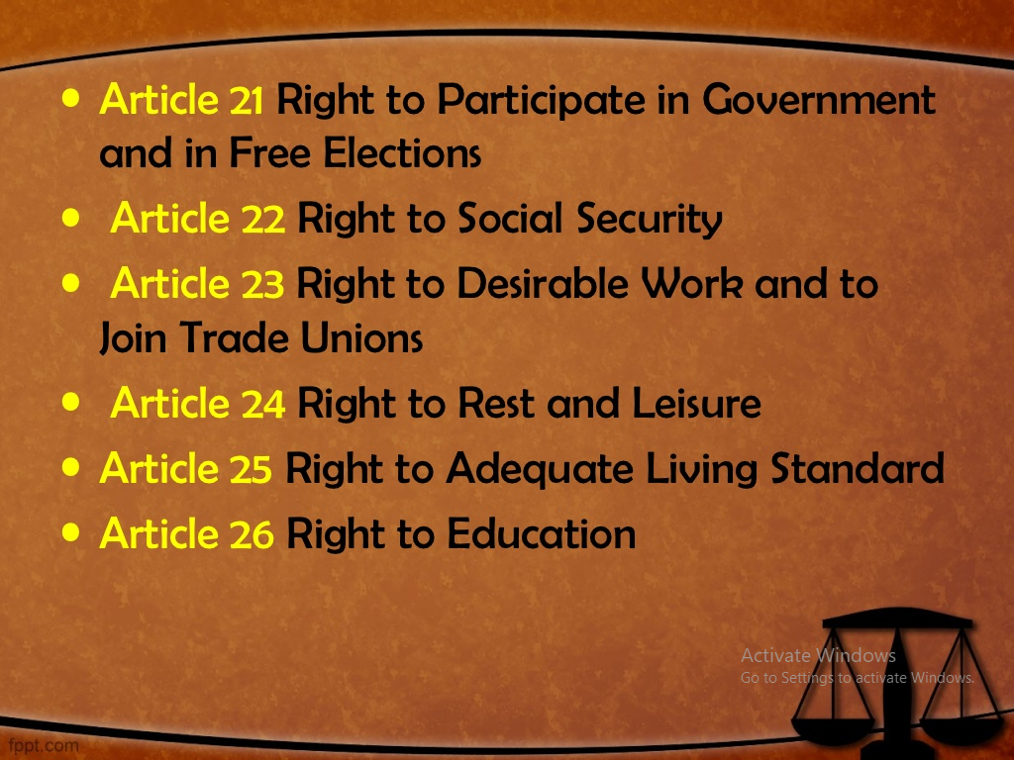

Slide 15
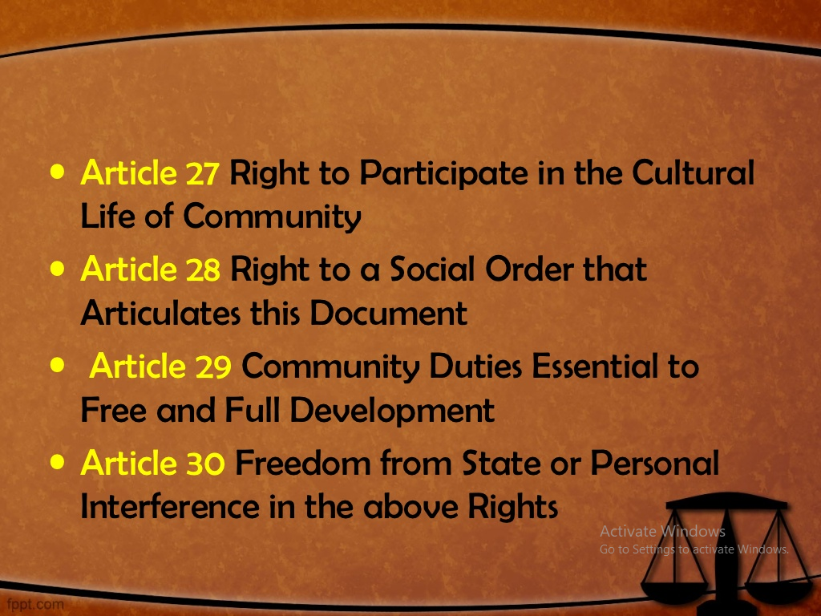

Slide 16
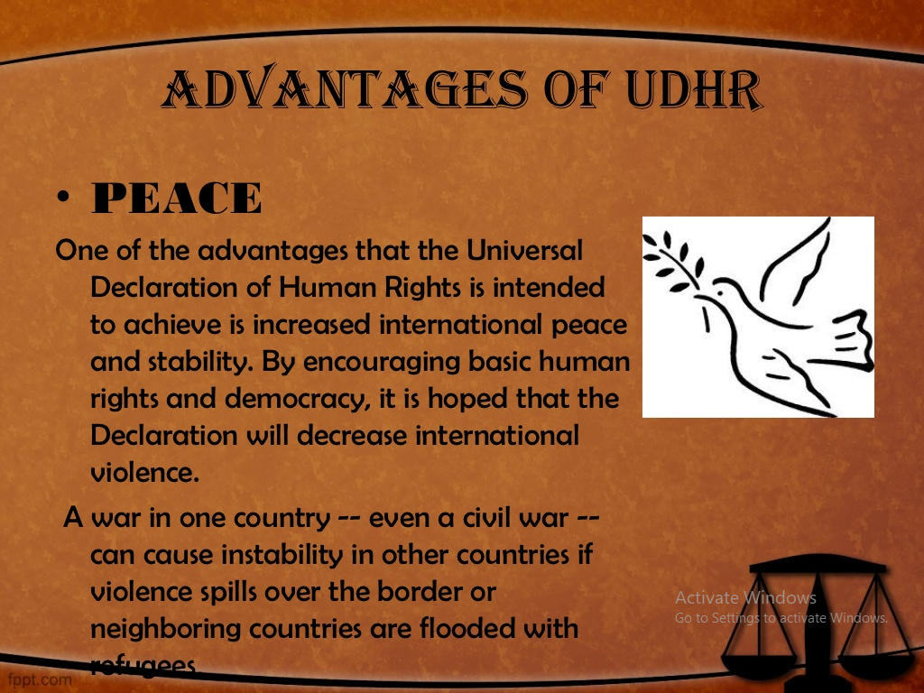

Slide 17
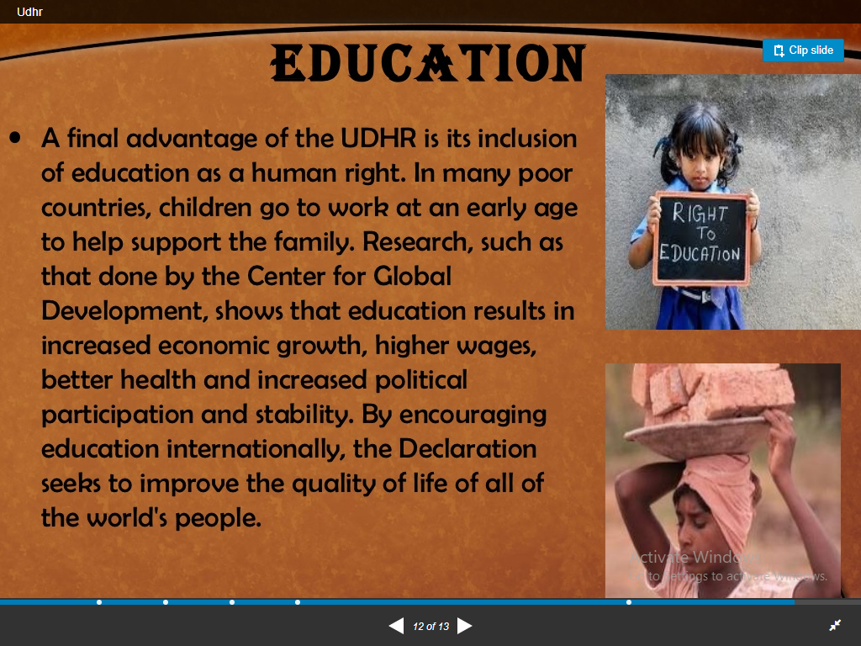

Slide 18
Universal Declaration of Human Rights
UDHR adopted by United Nations General Assembly on 10th Dec. 1948
Mr. John Peters – United Nations Secretariat drafted UDHR
Consists of Preamble and 30 Articles
Preamble
Consists of seven paragraphs
States the reasons for adoption of the declaration

Slide 19
Articles of the UDHR
UDHR adopted by United Nations General Assembly on 10th Dec. 1948
Mr. John Peters – United Nations Secretariat drafted UDHR
Consists of Preamble and 30 Articles
Preamble
Consists of seven paragraphs
States the reasons for adoption of the declaration

