Slide 1
Understanding India

Slide 2
SYLLABUS
Semester I
Unit - 1 : Overview of Indian Society
Understand the multi-cultural diversity of Indian society through its demographic composition: population distribution according to religion, caste, and gender; Appreciate the concept of linguistic diversity in relation to the Indian situation; Understand regional variations according to rural, urban and tribal characteristics; Understanding the concept of diversity as difference.
Explore the disparities arising out of gender with special reference to violence against women, female foeticide (declining sex ratio); Appreciate the inequalities faced by people with disabilities and understand the issues of people with physical and mental disabilities.
Examine inequalities manifested due to the caste system and inter-group conflicts arising thereof;Understand inter-group conflicts arising out of communalism;
Examine the causes and effects of conflicts arising out of regionalism and linguistic differences.

Slide 3
Unit - 2 : The Indian Constitution
The structure of the Constitution - the Preamble, Main Body and Schedules Basic Features of the Constitution.
Fundamental Duties of the Indian Citizen; tolerance, peace and communal harmony as crucial values in strengthening the social fabric of Indian society;
The party system in Indian politics;
Local self-government in urban and rural areas;
The 73rd and 74th Amendments
Role and significance of women in politics.

Slide 4
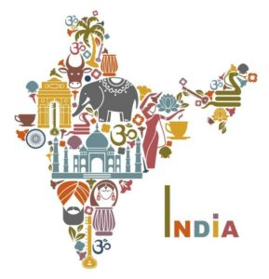
Unit I
Overview of
Indian
Society
https://youtu.be/adZc-lWc9lA

Slide 5
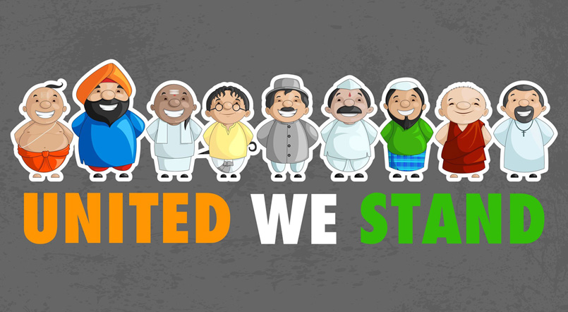
India is a Multicultural society

Slide 6
Main Characteristics of Indian Culture
Multi – Lingual
Multi – Religion
Caste System
Intra-Group Cultural Differences
Influence of the Western Culture
Contribution from Various Races

Slide 7
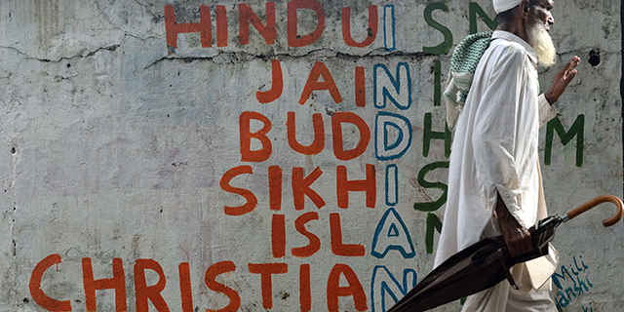
1. Multi Religion
RELIGION
Hinduism
Jainism
Buddhism
Sikhism
Islam
Christianity
Judaism
Zoroastrianism

Slide 8
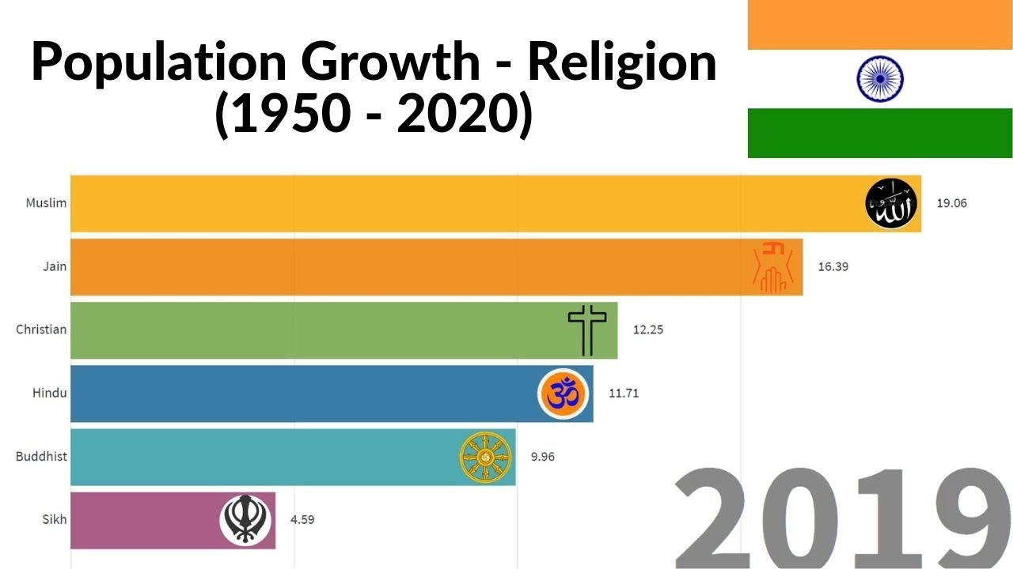

Slide 9
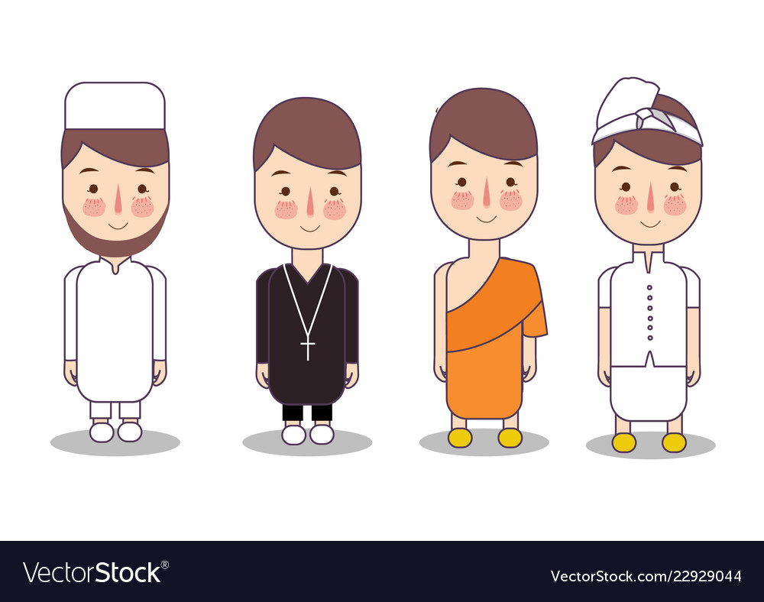
Religion wise composition of Population in India

Slide 10
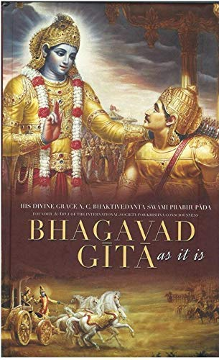
1. Hinduism
Holy book of Hindus – Bhagavad Gita
Four mainValues – Dharma, Artha , Kama and Moksha
Dharma – Virtues , right and wrong , fulfil duties
Artha – desire for power and wealth
Kama – desire for pleasure
Moksha – liberation

Slide 11

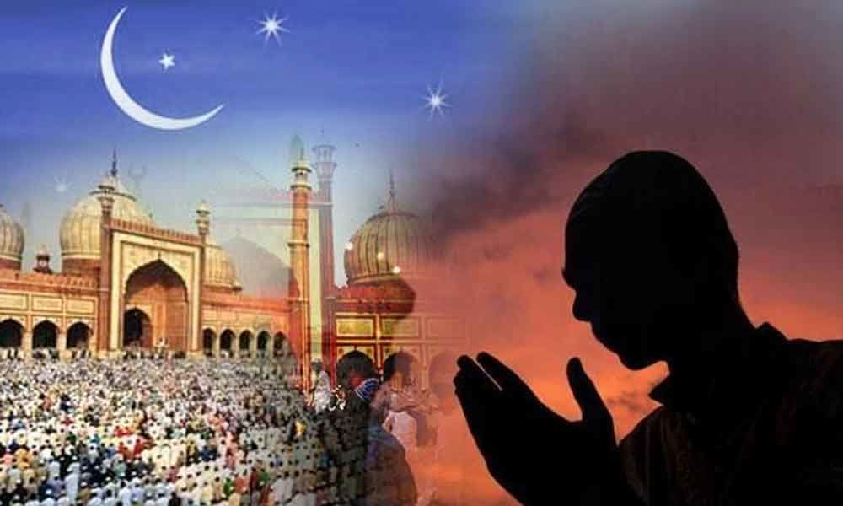
2. Islam
QURAN – holy book
Pilgrimage to Mecca

Slide 12

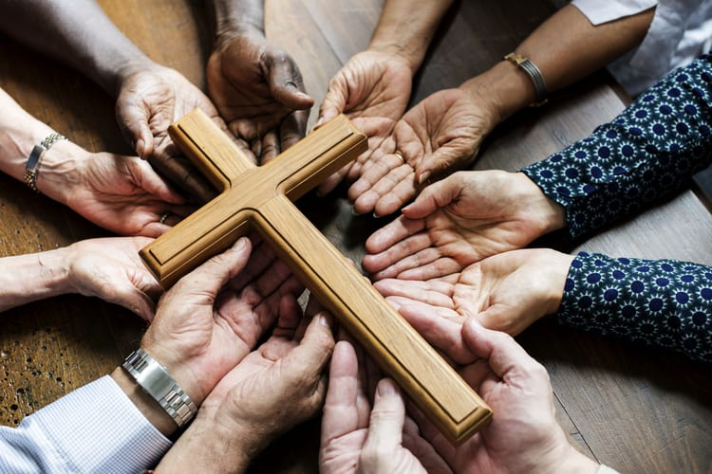
3. Chistianity
Gained roots after Portuguese
Holy book – Bible

Slide 13

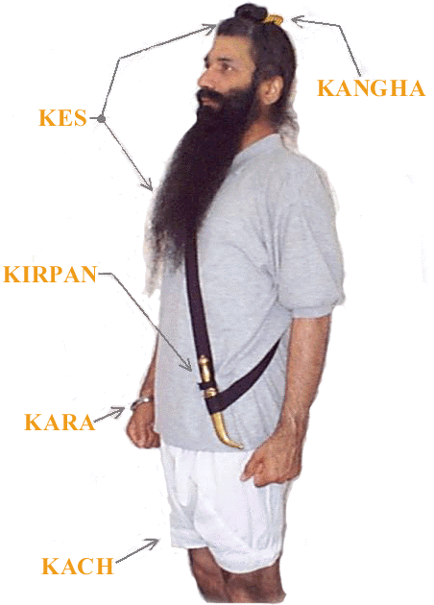
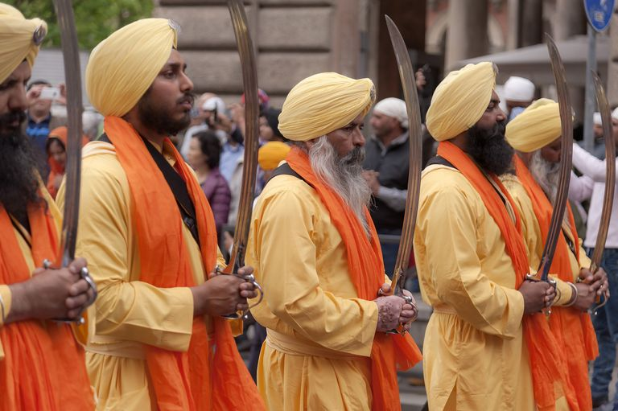
4. Sikhism
Founder - Guru Nanak
Holy book – Guru Granth Sahib
5 religious symbols
Kesh - hair
Kangha – comb
Kara – bracelet
Kirpan – sword
Kaccha – shorts

Slide 14
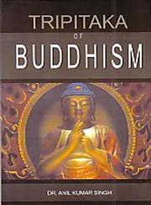
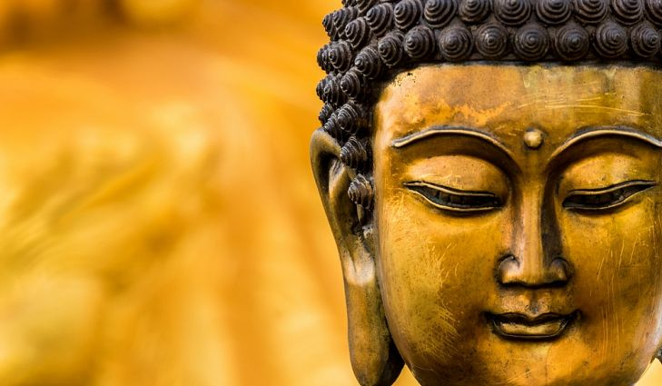
5. Buddihism
Follow Lord Gautam Buddha
Holy book – Tripitaka
Causes of sorrow (dukkha) is desire
Noble Eightfold path
Right view
Right intention
Right speech
Right action
Right livelihood
Right effort
Right Mindfulness
Right concentration

Slide 15
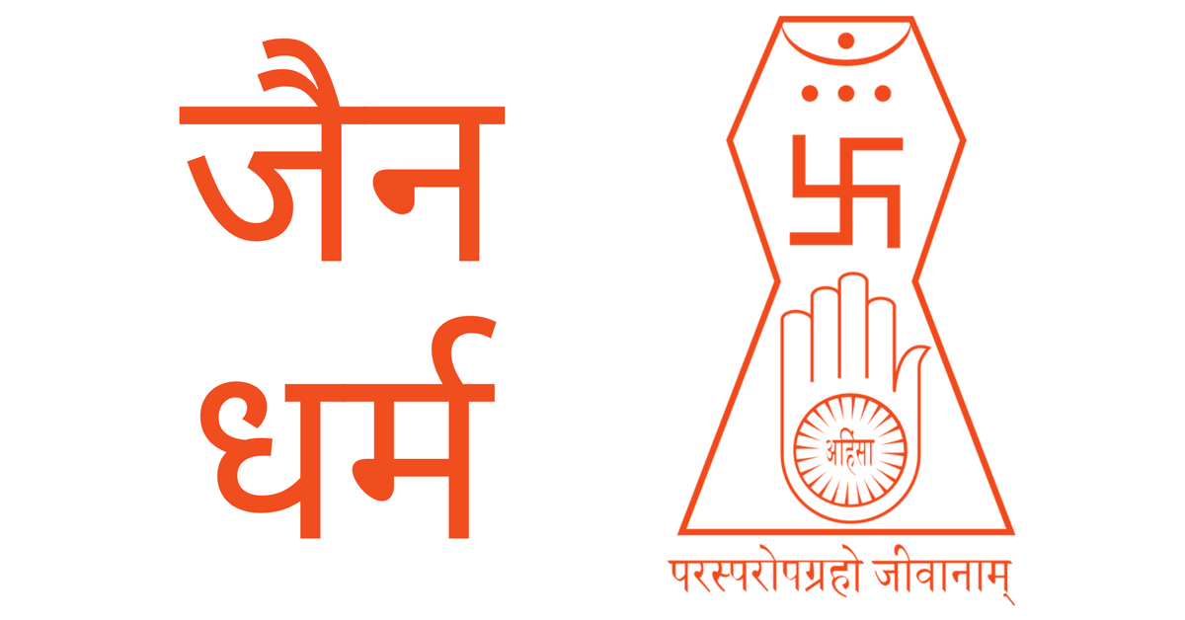
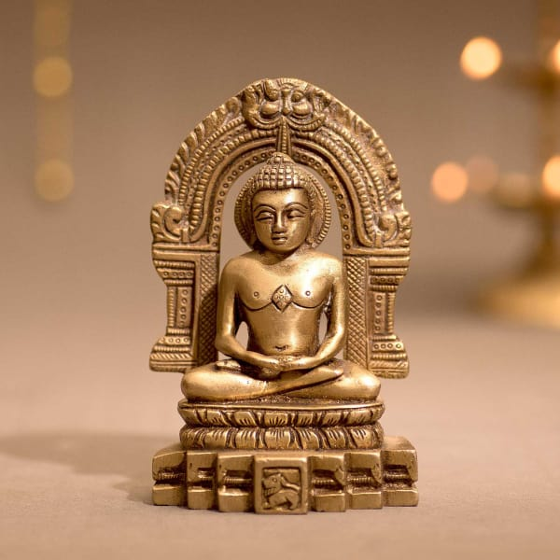
6. Jainism
Follow preaching of Lord Mahavira
Digambar and Shwetamber are two sects of Jainism.
Three Jewels
Samyak Darshan – Right perception
Samyak Jnana- Right knowledge
Samyak Chritra – Right Conduct

Slide 16
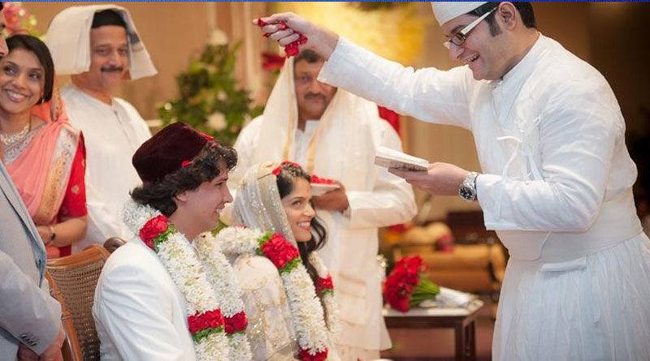

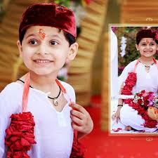
7. Zoroastrianism ( Parsees)
Follow preaching of Zoroaster
Holy book – Zend Avesta
Small Minority

Slide 17
Religious Composition of Population of India (Census, 2011)
Religion | Percent | Persons (Crores)
Hinduism | 79.8 | 96.63
Islam | 14.2 | 17.22
Christanity | 2.3 | 2.78
Sikhism | 1.7 | 2.08
Buddhism | 0.7 | 0.84
Jainism | 0.4 | 0.45
Others | 0.9 | 1.08
Total | 100 | 121.08

Slide 18
2. Multi Lingual
India is a land of multi-lingual people.
The Constitution of India has recognized 22 major official languages.
However, there are as many as 1652 languages and dialects that are spoken in
India.
350 languages of India are considered as major languages.

Slide 19
Language Families in India
 | Indo Aryan Family of languages ( Northern and Western India )
 | Hindi Marathi Bengali Urdu Gujarati Punjabi Sindhi Konkani Rajasthani Bihari Assamese
 | Dravidian Family of Languages ( Southern India)
 | Kannada Malayalam Tamil Telgu Tulu
 | Sino Tibetan Family of languages ( North Bihar, Bengal, Assam)
 | Sikkimese Ladakhi Sherpa Bodo Manipuri Tirupuri
 | Austric languages ( Central and eastern India )
 | Santhali Mundari

Slide 20
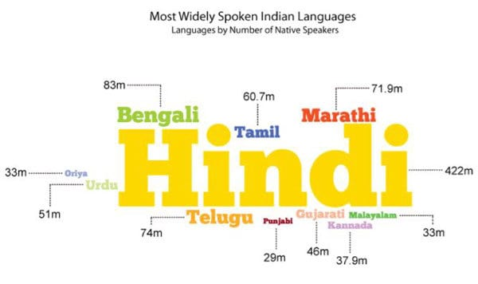

Slide 21
The following are the 22 languages recognized in the 8th Schedule of Indian Constitution
Assamese
Bengali
Bodo
Dogri
Gujarati
Hindi
Kannada
Kashmiri
Konkani
Malayalam
Manipuri
Marathi
Nepali
Oriya
Punjabi
Maithili
Sanskrit
Santhali
Sindhi
Tamil
Telugu
Urdu

Slide 22
Majority of the population speak Hindi (about 41%) followed by Bengali (8.1%), Telugu (7.1%) and
Marathi (7%)
Official Language of India: Hindi is the official language of India, and English is the associate language. The Official Language Bill was introduced in the Lok Sabha in
1963. This Bill provides that the English language may be used in addition to Hindi as an official language.
Official Language of the States: As far as States are concerned, the Indian
Constitution has allowed the respective State Legislatures to recognize some
language(s) for intra-state official transactions. This provision, thus, recognize the
right of substantial section of State's population to have the language spoken by them to be recognized for official purposes within the State.

Slide 23
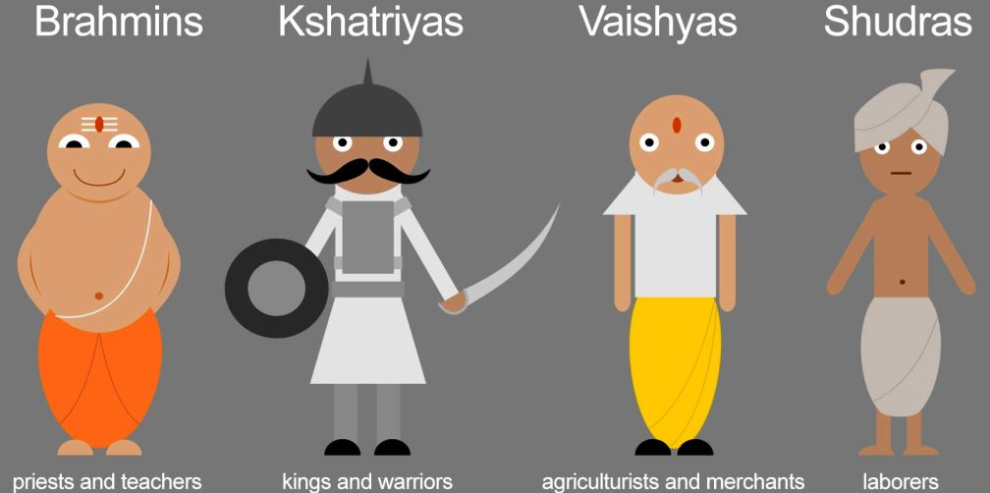
3. Caste System
Brahmins – religious preachers, scholars, teachers
Kshatriya – rulers, administrators and warriors
Vaishya – money leaders, artians, traders
Shudra – workers or labourers

Slide 24
Factors Responsible for Growth of Caste System in India:
The influence of religion is the main factor for growth of caste system in India.
The Hindu Caste System is looked upon as divine ordained institution. Beliefs in
reincarnation and the doctrine of Karma also have fostered the caste system in India. (b) The static rural social structure of India strengthened the growth of caste
system.
(c) Lack of education, especially among the rural masses has contributed to the
growth of caste system in India. Due to illiteracy, people have become orthodox and
they blindly accept the caste rules and restrictions.

Slide 25
(d) The existence of many races in India resulted in the formulation of strict laws
regarding discrimination, as each race made efforts to preserve its purity.
(e) The rulers did not enforce uniform customs, and they recognisedthe various
customs of different groups of people, which inturn encouraged the caste system in
India.
(f) The hereditary occupations of the people, especially in rural areas kept alive the
caste system in India.
(g) The desire to dominate of the upper castes, especially, theBrahmins over the lower castes gave fillip to the growth of castesystem in India.
(h) Other factors that contributed to the growth of caste system in India include the
desire of Brahmins to keep them pure; ancestor worship; idea of exclusive family, etc.

Slide 26
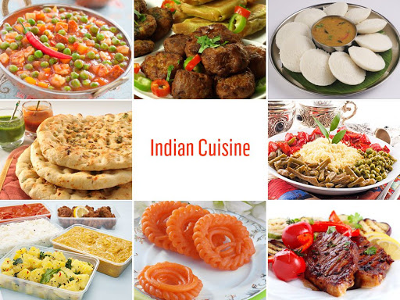
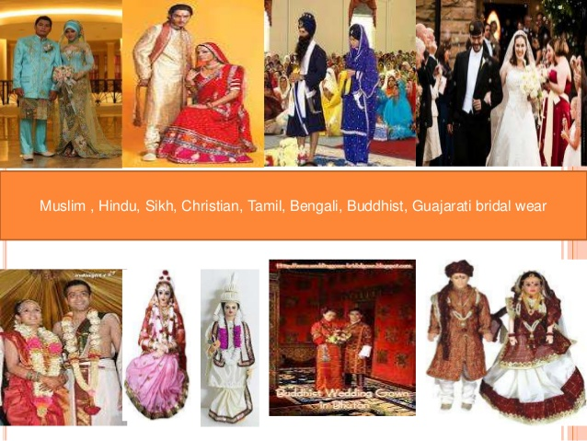
4. Intra group Culture Differences

Slide 27
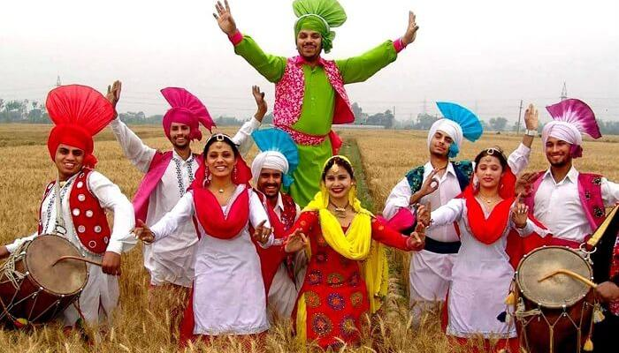
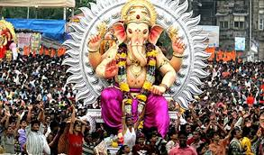
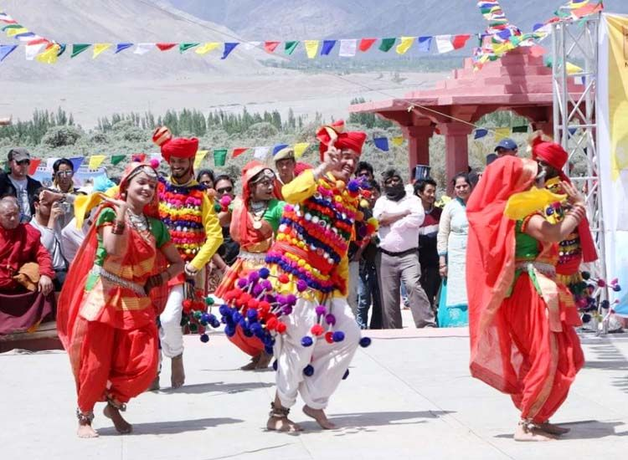
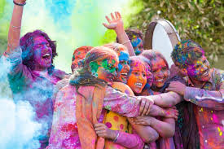

Slide 28


5. Influence of Western Culture

Slide 29
Regional Diversity
In India, there are 28 States and 8 Union Territories. The States differ in terms of quality of people, culture and resources. Therefore, there are regional variations or differences among the States, and also among the sub-regions of each State.
The various regional differences are as follows:
Literacy: For the purpose of census, a person who can both read and write with understanding in any language is treated as literate. In India, the States differ in terms of literacy rates. Some States like Kerala, Mizoram, Tripura and Goa, the literacy rate is high, whereas, in Bihar, Arunachal Pradesh, Rajasthan and Jharkhand the literacy rate is low. For instance, Kerala has highest literacy of about 94% and Bihar has the lowest literacy of 64% as per 2011 census.
Birth Rate and Death Rate:In the highly populated and backward States of North India like Bihar, Madhya Pradesh, Rajasthan, and UP, the birth rate is very high, as compared to more literate Southern States Kerala, Tamil Nadu, Karnataka and Andhra Pradesh. Also, the death rate is high in the backward states

Slide 30
3. Urbanization: In India, there is imbalance in terms of urbanization of population. In
some regions, the urban population has increased over the years; whereas, certain
backward regions are very slow in the growth of urban population.Some States,
especially, the smaller States of Goa and Mizoram,there is higher concentration of
population in urban areas.whereas, in backward States of Madhya Pradesh and Bihar,
there is very low concentration of urban population.
4. Poverty: In India, about 37% of population lives below poverty line. According to
Planning Commission, the poverty in the country has declined to 21.9% (2011-12).As
per World Bank Report (2014), 11.8% population in India lives below poverty line.There is widespread poverty in some states. The highest poverty is in Orissa, followed by
Bihar and Madhya Pradesh. The low poverty States are Goa, Jammu & Kashmir and
Punjab.

Slide 31
5.Infrastructure Development: There is regional imbalance in infrastructure development There is
low level of infrastructure development such astransport, communication,
banking, etc., in most of the States, especially the northern and eastern States.For
instance, it is estimated that nearly 50% of the villages in India, (most of them in
backward states - BIMARU States - Bihar, Madhya Pradesh, Rajasthan and UP) do
not have proper roads and therefore, lack transport facilities.
6. Level of Unemployment: The overall unemployment situation in India is equally
worse. While unemployment exists in all the States of India, its incidence is very high, at over 10% in the most literate States of Kerala, Goa and Tamil Nadu.In the poor States like Orissa, Bihar, Madhya Pradesh, and UP, while the unemployment rates are lower, but the labourers are
exploited with very low wages.
7.Industrialization: There is regional imbalance as far as industries are concerned.
Certain States like Maharashtra, Gujarat, Tamil Nadu and Karnataka have made good progress
in industrialization. But many States lack behind, especially, the north
eastern States. Industrialization is also weak in southern States like Kerala and
Andhra Pradesh.

Slide 32
8. Income Inequalities: In India, there are glaring income inequalities. The income inequalities are glaring mostly in the highly populated States of Bihar, Madhya Pradesh, Rajasthan, and UP. The
reasons for inequalities are:
Unemployment among the poor people.
Low wages for labourers, especially in the unorganized sector.
Lack of financial inclusion.
Poor people in the backward states depend on money lenders for the loan requirements.
The money lenders exploit the poor by charging high interest rates.
9. Gender-Ratio: In India, the gender ratio is in favour of males. However, there are imbalances
in gender ratio across the States. Kerala is the only State where females outnumber males.
Haryana is the worst State as far as gender ratio is concerned. The southern States are better in terms of female-male ratio, whereas, northern States show a deteriorating situation.
10. Life Expectancy: There are regional differences in respect of life expectancy as well.
Biologically, the females are expected to live longer than males. But in certain States of India, the life expectancy of females is less than the males.In particular, States like Bihar, Madhya Pradesh and UP, have low life expectancy for females as compared to males. But in Southern States like Kerala, Andhra Pradesh, Tamil Nadu and Karnataka, the life expectancy of females is higher.

Slide 33
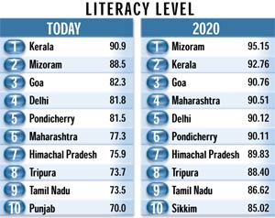
1. Literacy Rate
https://theceo.in/the-ceo-magazine/tcm-special/india-its-literacy-the-sun-is-shining/

Slide 34
2. Birth Rate and Death Rate
High – Bihar. MP, Rajasthan
Low – Kerala , AP, Tamil Nadu
3. Urbanization
High – Goa Mizoram
Low – Mp, Bihar
4. Poverty
Highest – Orissa , Bihar MP
Lower _ Goa, J & K , punjab

Slide 35
5. Infrastructure Development
Low – Bihar, Mp, Rajasthan and UP
6. Level of Unemployment
High – Kerala , Goa , Tamil Nadu
Low – Orissa, Bihar, MP
7. Industrialisation
Highest – Maharashtra, Gujrat, Tamil Nadu
Lower – kerala, AP

Slide 36
8. Income Inequalities
Bihar, Mp , Up
https://youtu.be/_E87V0mWPQA
9. Gender Ratio
High – Kerala
Low – Haryana
https://youtu.be/HWttLz7Dims

Slide 37
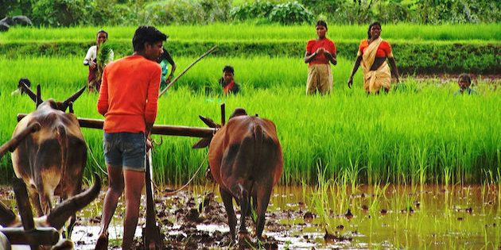
Rural Characteristics

Slide 38
India is a land of villages. As per Census 2011, there are over 6 lakh villages in India. 68.84% of India's population lives in villages, and 31.16% of India's population lives in urban areas (about 7700 towns and cities).The characteristics of rural India are briefly stated as follows:
Caste System: In Indian villages, the caste system is widespread. There is hardly any village without the castes. Each village has several castes, although in some villages a particular
caste dominates. There is inter-dependence of castes in villages due to the specialized
occupations.
2. Intimate Relations: In Indian villages, there are face-to-face relations among the people.
Generally, every person knows each other in the village. This is because; the village population is
of small size, and therefore, personal contact or relations can be maintained through regular
interactions.
3. Status of Women: The rural women are very much dependent on their men folk. The women
require the support of institutions like marriage and family. The rural women mostly engage in
indoor activities and they work in fields as well. They are very much attached to their family
members. Women adjust themselves to the family conditions, and make sacrifices in the interest of the family.

Slide 39
4. Occupation: The rural people are mostly engaged in agriculture. About 80% of
village people are directly or indirectly connected with agriculture and other related areas. Therefore, the prosperity of rural areas is directly connected with agriculture.
5. Size of the Population: Majority of India's population lives in villages. As per 2011
census, 68.84% of India's total population lives in villages. In advanced countries, the
rural population forms a small part of the total population. As per World Development
Indicators (2011), Japan - 9%, Australia-11% and USA-18% of the population are rural based. The main reason for majority of population in rural India is due to developing
nature of Indian economy, and majority of the workers (about 55% in 2011) were
engaged in agriculture. Therefore, due to employment factor, people get concentrated in rural areas.
6. Location Pattern: The rural population lives in about 6,41,000 villages. The
population in rural areas is scattered rather than concentrated. At present, only about 44000 villages has a population of 10,000 plus. In 2.36,000 villages, the population is
less than 500 persons.

Slide 40
7. Literacy: The literacy level of rural people is low as compared to urban population. In 2011, the overall literacy rate in India was about 74%. But the rural literacy rate in many States was less than 50%. The low literacy rate is due to lack of educational facilitie in
villages, and poverty among the rural masses.
8. Conservative Attitude: People in Indian villages are largely conservative in nature They do not easily accept changes in principles, policies, and programmes. They go by
majority opinion and belief. Most of the villages in India are backward mainly because of the 12 conservative attitude of the villagers.
9. Unemployment Rate: The unemployment rate is high in rural areas as compared to
urban areas on Current Daily Status (CDS). The CDS is the most embracive estimate of unemployment as it includes hunemployment as well as underemployment. The two
other estimates are Current Weekly Status (CWS), and Usual Principal and Subsidiary Status (UPSS).

Slide 41
10. Media Exposure: The media exposure of rural masses is comparatively low as
compared to urban areas. The percentage of rural households reached by television
and print media is lower due to poverty and lack of education. Maximum exposure to
media is that of radio.Due to low media exposure, the Government campaigns on
family welfare and other social issues do not reach to the masses in villages.
11. Poverty: 21.92% of India's population lives below poverty line in 2011- 12. In rural
areas, percent of people living below poverty line is 25.70%. The rural poverty is very
high, especially, in the States of Orissa, Bihar and Madhya Pradesh. The main causes of rural poverty are:
High growth of population, especially among the poor.
Social exploitation by the landlords of the farm labourers.
Malpractices by money lenders.Poor implementation of anti-poverty measures.

Slide 42
12. Work Participation Rate:
The work participation rate is the ratio of total workforce
to total population. The work participation rate in rural areas is comparatively similar
for males (53%) as in urban areas (53.8%) As far as female workers are concerned,
the work participation rate is 30% comparatively higher than in urban areas (15.4%).
13. Main Problems:
The main problems faced by rural population include:
Lack of infrastructure facilities such as roads, transport, electricity, etc
Low level of literacy.Higher incidence of poverty as compared to urban areas.
Social exploitation by landlords, and others.Disguised and seasonal
unemployment.

Slide 43
URBAN CHARACTERISTICS
Social Heterogeneity: Urban society is heterogeneous in nature. There are wide differences in the way of life of urban people. The urban masse are mainly diverse in nature. Especially, in the major metros like Mumbai and Delhi, the urban people may speak different languages, follow different customs and traditions, different food habits, and so on.
Secondary Relations: In urban areas, people are mostly indifferent towards one another. In cities, people rarely take personal interest in others. Superficial form of politeness and manners are commonly found. Even the neighbours behave like strangers. In urban areas, people are more individualistic in their attitude.
Social Mobility: Urban people are socially mobile as compared to rural folk Social mobility refers to movement of people from one social status to another, i.e., from lower status to higher status in the society. In urban areas, an individual's position is determined more by his achievements rather than by his birth.

Slide 44
4. Size of the Population: In 2011, about 377.1 million people were living in urban areas in India. India is comparatively lagging in terms of urbanization as compared to developed countries.
5. Location Pattern: The urban population is located in about 5545 towns and cities. The towns and cities are broadly divided into six classes such as Class I, Class II, .... Class VI.
6. Literacy: The urban literacy rate is comparatively higher as compared torural literacy. Most of the major cities/towns have a literacyrate of over 70%. The highest literacy rate in 2011 was recordedin Kerala at over 93%.
7. Occupation: The urban population is mostly engaged in the services sector, followed by the secondary sector. It is obvious that the urban population is not involved in agriculture directly. They may be involved indirectly in the agro-based industries, or in the services sector that support agriculture.

Slide 45
8. Unemployment: Urban areas also face unemployment. However, the unemployment rate has declined in urban areas more sharply than that of rural areas on the basis of CDS. In 2011-12, the unemployment rate in urban areas on CDS basis was 5.5% as compared to 5.7% in rural areas.
9. Media Exposure: The media exposure of urban population is comparatively higher as compared to rural areas. Most of the urban population is exposed to radio, TV and internet. However, the penetration of press is low. Due to good media exposure, the Governmen campaigns on family welfare and on social awareness reach to the urban masses. This has helped to reduce birth rate and also improved literacy rate in urban areas.
10. Poverty: The poverty in urban areas is lower as compared to rural areas In 2011-12, people living below poverty line in urban India are 13.70%. The urban poverty is due to:
Unemployment.
Large sized families, especially among the slum dwellers.
Social evils, such as gambling, alcoholism, etc.

Slide 46
11. Work Participation Rate: The work participation rate for males in rural areas (53%) is comparatively similar as in urban areas (53.8%). As far as female workers are concerned, the work participation rate is 30% in rural areas which is comparatively higher than in urban areas (15.4%).
12. Main problems of Urban Population: The main problems faced by urban population include: Pollution which affects health.Congestion about 40 to 50% of the population live in highly congested slums..Higher level of unemployment, which results in anti-social activities by unemployed.⚫ Low sex ratio, which results in sexual abuse against women.Overcrowding in public transport like trains, and buses. High income inequalities between the rich and the poor.

Slide 47
TRIBAL CHARACTERISTICS
A tribe is a community occupying a common geographic area and having a common
language and culture. The tribes are often called as Girijans' because originally they
used to live in jungles and hilly regions. Some scholars are of the view that the lower
castes who resisted oppression of the upper castes and preferred to live independent
lives, retired to the forests, and are today they are called as tribes of India.
Tribes are referred as Scheduled Tribes in the Indian Constitution. It was Dr. B. R.
Ambedkar (the chairman of the drafting committee of the Constitution) preferred the
term 'Scheduled Tribes" to Adivasis.

Slide 48
Common Territory: A tribe has a definite territory in which its members live.
For example:
Nagas in Nagaland.
Khasis in Assam.
Bhils in Madhya Pradesh.
Todas in Nilgiri Hills of Tamil Nadu.
It is to be noted that certain tribes are found across States. For instance, Gonds
(largest tribe) are found in Madhya Pradesh, Andhra Pradesh, and Maharashtra. The
Bhils (second largest tribe) are found in the Western Region of Maharashtra, Madhya
Pradesh, Gujarat and Rajasthan. The Santhals (third largest) are found in Bihar, Orissa and West Bengal.
2. Common Name:Each tribe is known by its distinctive name. Names of Indian tribes
include Gond, Bhil, Naga, Limbu, Munda, Khasi, Garo Meena, Santhal, Kota, etc.

Slide 49
3. Common Language: Members of a tribe speak a common language or dialect
Common language contributes to the relationship among the tribals. The tribal
languages do not have a script.
4. Common Culture: Each tribe has its own culture. The members of a particular tribe
follow common traditions, morals and values.
5. Endogamous Group:Normally, tribal members are endogamous group. Generally, they marry within their own tribal group. The tribals practice endogamy to maintain the purity of blood and their culture. However, each tribe has many clans within itself and these are exogamous (marrying only outside one's own clan) in nature.
6. Regional Concentration: The tribal population is mostly concentrated in the four regions: North-eastern States such as Arunachal Pradesh, Nagaland, Manipur, Mizoram, Meghalaya and Tripura, where the tribal population is between 70 to 95% of the total population.

Slide 50
7) Religion: Majority of the tribals are Hindus (88%), followed by Christians (6%). A small percentage of tribals follow Buddhism and Islam, and other traditional religions. Although the Census data indicate that majority of the tribals are Hindus, yet
there are several scholars who are of the view that tribals follow Animism,
Fetishism and Totemism.Animism is a belief in the spirit of the dead. Animists
believe that spirits are within the body of every living or non-living beings. They
believe that all activities are caused by spirits. Fetishism is worship of material
things like leaf, feather, horn, stone and so on. Totemism is extension of Fetishism. It is a belief in totem which may be an animal like wolf, hawk, turtle, etc., or plant or a natural object.
8) Occupation: Majority of the tribals are engaged in the agriculture sector. It is
estimated that about 80 to 90% of the tribal working population is engaged in
agriculture and related activities. This is because, the tribal population mostly lives
in rural areas and their literacy level is low to get employment in the secondary and tertiary sector.

Slide 51
9. Caste System: Generally, the tribals do not believe in caste system. However, the tribal community is hierarchically divided into four segments on the basis of ritual
superiority, which resembles Hindu varnas. There is functional distribution of
occupation among the four segments:(i) Hunting and fighting.(ii) Worshipping.
(iii) Cultivation.(iv) Singing and dancing. It is to be noted that unlike varnas, where
worshipping occupies the first place, in the tribal segment, it occupies the second
place.
10. Status of Women: The status of women differs from tribe to tribe. But, by and
large, the status of tribal women is very low, except, in the case of those tribes that
adopt matrilineal system. Most of the women do not have access to education, to
resources and power. They have the lowest degree of personal freedom to take
decision regarding education, marriage, employment, etc.

Slide 52
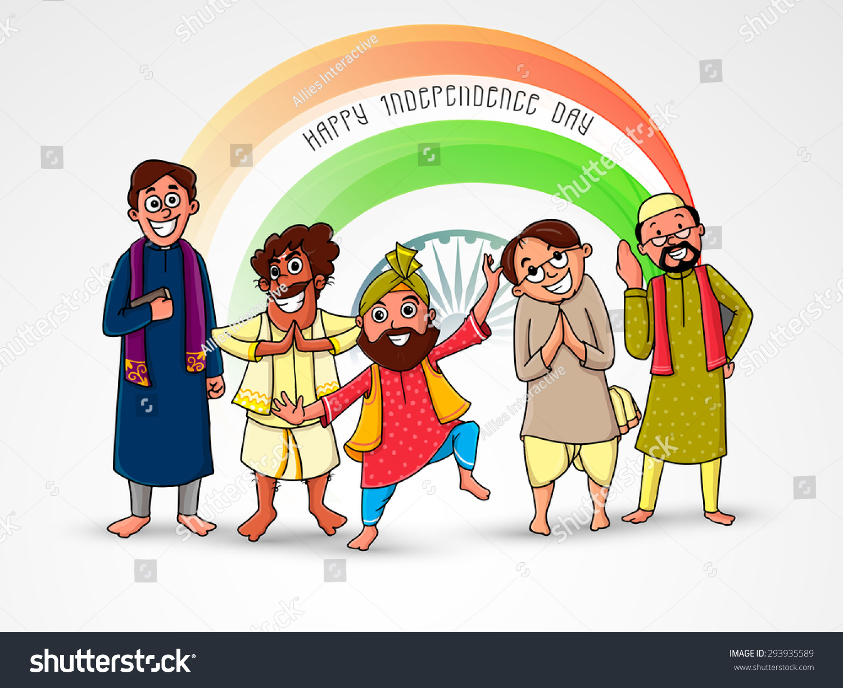
Diversity as Difference

Slide 53
Certain cultural diversities need to be looked upon as positidifferences due to the following reasons:
Pride in Cultural Heritage: The diversity in cultures generates a sense of pride in cultura heritage of one's country. For instance, India has about 1651 languages. Indians living abroad or Indians conversing with foreigners in India may develop a sense of pride while discussing about diverse linguistic heritage of India.
Inter-culture Influence: Various cultural groups influence each other. For instance, the wearing of mangal-sutra by a married Hindu lady has influenced the Christians as well, and now some of the Christian married ladies also wear mangal-sutra.
Communal Harmony: Although, there are language and religion-based conflicts in certain parts of India, yet majority of Indians prefer to live in harmony with each other. Inter-group unity can be seen in inter- faith or inter-religion meets, cultural festivals such as the Carnival in Goa, and Onam in Kerala, where people of different religions, castes, and other diversities take part with equal fervor.

Slide 54
4) Rich Taste of Diverse Cultures: Cultural diversities enable people of the society
to enjoy the rich taste of diverse cultures. For instance, different cultures have
different food habits and cuisine. For instance, Punjabi cuisine is different from that of Gujarati, South Indian and Goan. Therefore, people of India can relish the variety of
cuisines of different States.
5) Promotes Humanistic Values at Workplace: When an organization has a group of employees belonging to diverse cultures, it demonstrates that the organization
recognizes the diversity that exists in people of different backgrounds. It makes the
people of the organization think that their value and worthy contributions are being
realized by the organization and the management.
6) Exchange of Innovative Ideas: When an organization comprises of people with
diverse backgrounds, cultures and experiences, new creative and innovative ideas
crop up in the minds of different people. It is natural that people with varying
experiences and perspectives in life would be able to generate unique ideas and
solutions to problems. This is of immense value to the organization, its employees
and the society as a whole. Such dynamic exchanges that take place between people having different perceptions yield creative results. Such a situation is never created in groups of people who think similarly and belong to similar cultures.

Slide 55
Status of Women in India
The status of women from Vedic period to modern times is stated as follows:
DIGNIFIED STATUS OF WOMEN IN VEDIC PERIOD:During the Vedic period, Indian women enjoyed a dignified and powerful status in the society. The women enjoyed considerable freedom of expression and attained excellence in various activities The ancient Hindu scriptures depict women as:Shakti, Le., the energy or power, the energizing principle d the universe. References are made to Goddess Kali, as energetic and powerful, and destroyer of evil.Prakriti, i.e., nature, the active female counterpart of the cosmic person 'purusa'.
II. DECLINE IN STATUS OF WOMEN IN THE POST VEDICPERIOD:In the post Vedic period, woman was presented in a passive role as a mother, wife, daughter and sister. The Manu Smriti and Dharma Shastras made women totally dependent on men, thereby, depriving them of their right of freedom of movement and expression. The Manu Smriti and Dharma Shastras laid down specific rules for the conduct of women and stressed the need to control women by men. The women were relegated to the secondary position in all walks of life including household.

Slide 56
The secondary status of women was reinforced by certain practices such as:
Practice of sati.
System of devadasi.
Restrictions on education of females.
Practice of dowry system.
Restrictions on widow marriage.
Practice of polygamy, etc.
III. PRESENT DAY STATUS OF WOMEN:
From the 19th century onwards, efforts were made by social reformers like Raja Ram Mohan Roy, Mahatma Jyotiba Phule and others, to uplift the status of women in India. For instance, Raja Ram Mohan Roy organized a movement to oppose the practice of Sati. He succeeded in the passing of 'Sati Abolition Act, 1829. Several other Acts were subsequently passed including Hindu Women's Right to Property Act, 1926. Other than legislations, several other attempts have been made to uplift the women in India including:
Free education for girls upto 12th Standard.
Reservation of seats for women at Panchayat and other elections.
Higher tax exemption for females as compared to males.

Slide 57
The declining gender ratio in India is shown in the following table
Year | Females (per 1000 males)
1901 | 972
1921 | 955
1951 | 946
1961 | 941
1971 | 930
1981 | 934
1991 | 927
2001 | 933
2011 | 940

Slide 58
Causes/Factors of Declining Gender Ratio:
In India, the gender ratio is in favour of males. This means male are more are compared to females. This is especially true in the case of Northern, and Western States of India.
The following are the factors responsible for declining gender ratio in India:
Preference for Male Child: In India across all cultures and religion, preference is given to the male child. The preference for male child results in hatred for girl child. Most of the families
(husband and wife, and in- laws) crave for the birth of a male child. Some even undertake
special prayers and visit various places of worship to get a male child. When a male child is
born, there is lot of rejoicing including special offers to the gods and goddesses. And if a girl
child is born, it brings sadness and gloom, and she is often ill-treated.
Female Foeticide: In India, male child is considered as an asset and female child the liability. 4This is mainly due to certain misconceived religious beliefs and the problem of dowry. In certain States, the girl child is killed immediately after the birth. In certain other cases. Female foeticide is resorted even by educated and rich families. As a result of such practices, the sex ratio has worsened in certain States such as Rajasthan, Punjab, Haryana, Bihar, etc.

Slide 59
3. Female Infant Mortality Rate :The infant mortality rate is higher in the case of girls as
compared to boys. The high female-infant mortality rate is mainly due to poor post-natal (birth)
care of the girl child. Even in the economically better off States like Punjab, there is often neglect of health care of female infants. As per 2016 estimates of Central Intelligence Agency (US), the
overall infant mortality rate in India is 40 deaths of infants out of every 1000 live births; the female infant mortality rate is 42 per 1000 live births, and that of male infant mortality rate is 39 per live
births.
4. Poor Maternal Care: Besides, neglect of the health of the girl child, there is lack of pre-natal
and post-natal maternal care. Due to poor maternal care, there is high incidence of maternal
mortality rate in India.At present, the maternal mortality rate is 200 per 1,00,000 live births, which is quite high as compared to developed countries like Japan (5 per 1,00,000 live births),
Germany (7 per 1,00,000 live births) and France (8 per 1,00,000 live births).
5. Malnutrition of Females: There is often malnutrition of the females including pregnant
women. Preference for providing good food to the male members affects the health of females,
which even results in death of females, which in turn results in declining gender ratio.

Slide 60
6. Poverty:A major cause of declining sex ratio is poverty. Poor families consider males as
insurance against old age, and girls as liability. Therefore, poor treatment is meted out to the girls, including denial of education and malnutrition. The malnutrition in turn results in deaths of female children across several States.
7. The Problem of Dowry System:The poorer In India, there is wide scale practice of dowry
system not only in the rural areas but also in the case of urban areas." families especially in
certain parts of India like Rajasthan and Tamil Nadu commit female infanticide, i.e., killing of
female babies immediately after their birth.Even in the case of middle class and upper class
families, efforts are made for sex determination and subsequent abortion of the girl fetus so as to escape from the dowry net.
8.Small Family Concept:Nowadays, there is a growing trend for a small family concept, especially in the urban areas. A good number of couples do not go for a second child, especially, if the first
child is a male. This tendency also affects the declining sex ratio especially in urban areas.
9. Unemployment:Unemployment is one of the reasons for decline gender ratio in India. Some
people consider girls as a liability and boys as an asset. The unemployed people find it difficult to
raise a girl child and to give dowry at the time of marriage. Therefore, females are neglected and as such some girls die at a very young age.

Slide 61
Violence Against Women
Violence refers to acts that cause physical and mental harm to the victims. In India, ther are several cases of violence against women within the household and also elsewhere.
Types of violence against women :
Criminal Violence
  Rape and Molestation
  Abduction and murder
  Traficking of women
  Bride burning
  Sale or auction of women
  Torturing of women that may even lead to suicide

Slide 62
B) Domestic Violence such as
1) Dowry harressment
2) Sexual abuse by family members
3) Maltreatment of women
4) Malnourishment of females
5) Verbal abuse of women by family members
6) Isolation of females within the households
7) Denial of share in property
C) Social violence which includes:
1) Eve-teasing and lewd comments
2) Forcing a young widow to commit sati.
3) Oppression of widows
4) Sexual harassment at work place
5) Sexual abuse in public transport and other places.
6) False witness in courts against women.

Slide 63
Causes of Violence Against Women:
The causes of violence may be due to the following reasons:
Money Related Causes: Violence may take place on account of money matters. For instance, women may be harassed for dowry by husband or in- laws. The
violence may be also due to non-compliance of unreasonable demand for money
from working wives for gambling, drinking liquor, etc.
Personality Traits: The personality traits may compel a person to indulge
inviolence against women. Some violence-prone personality traitsinclude possessiveness, over suspiciousness, passionate,irrational, immoral, jealous, and unjust.
For instance, overpossessive or over suspicious husbands may doubt their wife's
integrity and may subject her to unwarranted violent behaviour.
Stressful Situations: Violence against women can take place on account of
stressful family situations. For instance, the children may not behave properly, and may even bring disgrace to the family through wrongful acts. In such a situation,
the father may be stressed, and blame and bash his wife for no fault of her.

Slide 64
5) Male Dominance: Violence may be due to male dominance over females. There are number of cases where women are abused and assaulted by the males to show their dominance. They may try to prove that they are always right, and if a female tries to correct them, then that female may be subject to violence.
6) Addiction/Intoxication: Violence against women may be due to intoxication. Intoxication due to alcohol or drugs may lead to a state of inebriation and emotional excitement, and in such a
situation may exhibit violent behaviour towards females, including physical assault and rape.
7. Overexposure to Dark Media: Violence may be due to overexposure of dark media programmes, especially, violence against women related films, and serials. Also, over-exposure to
uncensored may lead to violence against women. Generally, teenagers and youngsters are involved in
this type of violence.
8. Retaliatory Action: Violence may be retaliatory in nature. For instance, a male may be
falsely implicated by a female in certain crime cases, including rape. Such a person may
develop hatred for females and may perpetrate violence against some other females.

Slide 65
Handicapped/Disabled Persons
Types of Disabilities:
The disabled persons belong to the five groups :
Visually Handicapped (blind)
Auditoriily Handicapped (deaf)
Speech handicapped (dumb)
Orthopedically (physical) disability
Mentally Challenged

Slide 66
Visually Handicapped
Causes of Blindness:
Cataract: It is the loss of transparency of the eyes’ lens. This problem normally occurss with the process of aging but may also be caused due to injury.
Glaucoma: The fluid in the eye compresses the lens into the viterous body, which puts pressure on the neurons of the retina, thereby, causing blindness.
Trachoma: It is a serious form of conjunctivities. It generates redness and sensation of foreign body in the eye.
Diseases: Various types of diseases also affect the eyes and cause blindness. Some of the diseases that can cause blindness include diabetes, small px, hyptertension, etc.
Vitamin A Deficiency: Can cause blindness. Drying of Cornea and ulceration. Night blindness
Hypermetropia: Commonly known as far sightedness.
Astigmatism: Visual activity is decreased. Eye strain causes headache.

Slide 67
Auditorilly Handicapped
Types of Deafness:
Conduction Deafness: caused by impairment of the outer and middle mechanism of the ear(s).
Sensory Neural Deafness: Caused by the impairment of the cochlea.
Mixed Deafness: Sometimes, there can be deafness due to impairment of the outer and middle mechanism of the ear, as well as that of the cochlea.
Treatment:
Depending on the root cause for deafness, deafness can be controlled or cured in some cases or in case of total loss of hearing aids are available to enable hearing. Speech therapy in case of stammering or dumbness helps the patient where the communication can take place through the use of sign language.

Slide 68
Orthopedically (Physical) Disabilties
Orthopedically Disabled: Inability to use ones hands or legs for motor functioning or loss of limbs can be included into orthopedically disable. Deformity of hands, legs, spinal cord, muscles can all be included in this type of disability.
Types of Physical Disabilities:
Polio- The virus of polio damages the limbs and cause paralytic condition in the body. It affects the patient in the childhood. India to a great extent has overcome this problem with vaccination. However there are seldom instances of this disease.
Spinal Bifida- Underdeveloped spinal cord or damaged spinal cord lead to spinal bifida. Movement controlled by spinal cord becomes impossible making patient immobile and dependant.
Cerebral palsy- The part of the brain which takes care of motor able activity of a human being if affected adversely or not developed to its optimum level can lead to cerebral palsy.
Muscular dystrophy- Muscle fibres in the body gets weakened then the body gets affected with muscular dystrophy.
Accidents and injury- They can always result in loss of limbs or deformity of limbs.

Slide 69
Other Causes:
Addiction of Alcohol or Drugs
Diseases and Viruses
Child Abuse
Environmental Factors
Poor Socio Economic Conditions
Exposure to Radioactive Rays
Malnutrition of Mother and Child
Treatment:
Regular vaccination should be given for preventing polio. Physiotherapy and occupational therapy can also help patients to be self-reliant in their daily chores. Artificial limb like Jaipur foot helps in movement for those who have lost limbs.

Slide 70
Mental Disabilities
Mental disability- Levels and types of mental disability:
When a person looses the capacity to think independently and rationally, whose intellectual levels are not developed then the person is called mentally disabled. Individuals with an intelligent quotient (IQ) of less than 70 can be considered as a mentally retarded or mentally disabled.
Levels of mental retardation:
On the basis of the IQ levels of an individual the mental retardation is analyzed at four different levels. Mild mental retardation- An individual whose IQ is between 50-70 is called mild mentally retarded. These children can complete their primary level of education comfortably but have problems of concentration and analytical ability is also very low.
Moderate mental retardation- Individual with an IQ between 35-50 is called moderate mentally retarded. They can’t take up formal education and needs support of their family members to do their daily chores. They can be made independent with some basic technical skills and can be made self-reliant in their own health and safety.
Severe mental retardation- Persons with an IQ of 20-35 are severely mentally retarded. Their learning ability is very limited and need close supervision and support of a family member in their daily lives. Profound mental retardation- Individual with an IQ lower than 20 are profound mentally retarded. They can’t be kept at home and need intensive treatment at an asylum or mental hospital.

Slide 71
Types of mental retardation-
There are several types of mental retardation or mental disability.
Down’s syndrome – It is a genetic disability in which there is a problem in the 21st pair of chromosomes.
Autism- The part of the brain dealing with communication is damaged then it can lead to autism. Eye to eye contact, conversation and sometimes even basic motor abilities get affected.
Psychosis and neurosis- Split personality, hallucination, and schizophrenia are all types of this disorder.
Learning disability- Dyslexia, dysgraphia or dyscalculia are all part of learning disability. The learning capacity of an individual in this type of disability is slow and needs special methods for learning.

Slide 72
Treatment:
Psychological counselling, behavioural therapy, occupational therapy can all help
the patient to lead a normal like. Special schools and shelter homes provide them skills in art, handicrafts or other technical skills that enable them to be self
sufficient and confident. Training in social adjustment through skills for safety,
security and hygiene make them more acceptable and adaptable in the family and society.

Slide 73
Casteism
Inequalities Caused by the Caste System
Inequalities and Social Exclusion
Economic Inequalities
Lower Status of Women
Lower Preference for Employment by Private Sector
Lower Status and Unjust Treatment
Lower literacy among Lower Castes
Caste as a Barrier to Social Progress
Larger Size of Families Among Lower Castes

Slide 74
Measures to control casteism:
While the caste system has become an integral part of the Indian society originating in ancient mythology, in
keeping with the modern era a scientific approach should be taken in understanding the relevance of this system today.
1 Casteism just like communalism is an obstacle in achieving national good and hence awareness must be raised among people. One should promote the notions of secularism and nationalism as principle higher than
casteism.
2 Both print and electronic media should conduct programmes and arrange for discussions among scholars widely emphasizing the divisive influence of casteism on society. Scholars from different castes should enable better Understanding among the masses about the concept of reservation as a positive discrimination for creating
equality in opportunities for the downtrodden that have been oppressed for centuries.
3 Policymakers must work towards a more equitable distribution of wealth to overcome economic disparities
among castes.
4 Intercaste-marriages and increased social interactions among people of different caste should be encouraged and accepted.
5 The youth can take the responsibility to raise social awareness about how a well assimilated society is a better off society.
6 Casteist forces adhered to political parties or any other groups fuelling tension should be
identified and banned immediately. The scars left on the hitherto ‘untouchables’ or backward castes can only
be healed with humane and compassionate treatment being meted out.
7 Access to a well-rounded education and equal entitlement to all the fundamental rights so also cultural
development are the only way to give social justice to members of the lower castes.

Slide 75
Communalism
Factors responsible for Communal Violence
Growth of Communal Organisations
Political Parties
Absence of Uniform Civil Code
Inflammatory Speeches
Local Problems
Petty Issues
Failure of Law and Order
Yatras by Political Leaders
Disappointment of Hindu Community
Religious Conversions
Role of Foreign Forces
The Hindu Militancy

Slide 76
Consequences of Communalism
Lawlessness and disorder in the society.
Looting and arosn by anti-social elements
Molestation of women and children
Disruption of economic activities
Development of negative image of State or place in the mids of foreign investors.
Loss of investment by NRI’s or MNCs in certain states due to communal tensions.
Communalism gives a boost to underworld and anti-social elements to further aggravate the situation.
Victimization of the members of a certain community in other countries.

Slide 77
Measures to Resolve Communalism
Law and Order Administration
Identification of Communal Elements
Education
Role of Media
Public Awareness Campaigns
Role of Religious Leaders
Derecognition of Communal Political Parties
Punishment to Government Employees
Setting of Peace Committees.
Special Courts

Slide 78
Causes of Linguism Conflicts in India
1. Geographical Causes:
Geographical isolation and variation promote local identity and distinctiveness among people. The regional differences are also accompanied by linguistic variations and development of different outlook hindering national integration.
2. Historical Causes:
Linguism in India gained momentum during India’s struggle for freedom. Criticizing the British system of division of the country by cutting across linguistic frontiers, our national leaders pleaded for the division of India into different provinces along linguistic lines. After independence, in 1956, the states were reorganized on the basis of homogeneity of languages. “The reconstitution of the states on linguistic lines has created more problems than it has solved. The identity with the nation has been sacrificed to the identity with the linguistic state.”

Slide 79
3. Psychological and Emotional Causes:
Language is the most important social device that a society has evolved. Apart from being the greatest force of socialization, it has certain psychological and emotional characteristics which invoke the feeling of ethnocentrism to a homogeneous group. As a vehicle of communication, it is capable of handling all ideas of communication and interaction. In India, the linguistic groups are tied together by ties of common interest. This creates in the mind of the inhabitant the spirit of regionalism, sectarianism and consequently a separatist feeling contrary to the concept of national integration.
4. Economic Causes:
Linguism may develop due to economic causes too. The Government promotes certain languages and makes provision for the spread of the languages through monetary inducements. This causes concern for other linguistic groups who feel that partiality has been done and they strongly resent it.
5. Political Causes:
Politicians, possessing narrow and parochial outlook and certain regional political parties create linguistic feeling among the people of a locality and exploit their sentiments at the time of election and in matters of various political issues.

Slide 80
Methods to resolve linguistic conflicts:
As of today the Union of India has adopted a Bi-lingual policy, where English and
Hindi are both adopted by the government for official purposes and for use in
Parliament.
The Official Language Amendment Act 1968 has made provisions to control
linguistic riots in the future.
The Act allows optional use of Hindi or the State Official Language in addition to
English.
States, which have not adopted Hindi as their official language, can continue with the use of English for communication between the Union and the State.
States may adopt their regional language as their official language and use it as a medium of instruction in higher education.
Candidates appearing for competitive examinations of the U.P.S.C. are given the freedom to write in their own regional language.
Efforts are taken to promote use of Hindi among non-Hindi speaking people.

Slide 81
Regionalism in India:
There are various aspects that unite the people living in a particular region. A region is characterized by a common language, culture, demographic composition, geographical features, social, historical and political backgrounds. Hence a person tends to be very loyal to a distinct region more than to the country. Regionalism implies excessive loyalty to one’s region or state that tends to pose a danger to national unity.

Slide 82
Causes
Local Politicans boost the regional differences leading to conflicts.
Differences in regional endowments, natural resources and level of development.
River disputes
Boundary disputes
Jharkhand , Chhattisgarh and Uttaranchal were states created because of the inter-state disparities
Inter-state river water disputes – the Cauvery and Krishna river water issue between Karnataka, Tamil Nadu and Kerala have led to bloodshed in the recent past.
Punjab and Haryana have clashed over the issue of Ravi- Beas waters. Border dispute

Slide 83
Measures to resolve regionalism
Efforts should be made by the Central and State governments to promote national unity
and solidarity.
States should be willing to cooperate with each other to resolve their disputes in
the larger interest of the nation.
Cultural, Sports and literary exchanges between states should be encouraged to
foster regional cooperation.
Fiscal and other incentives must be given to industrialists and businesses for
setting up their plants and operations in backward areas to further their development. Ex.
Subsidies and tax exemptions.
Special Area Development programmes should be undertaken in tribal, hilly and
desert regions for their growth.
There should be well coordinated planning between the Centre and states for fair
allocation of funds for regional development.
There should be just and equitable distribution of natural resources.

