Slide 1
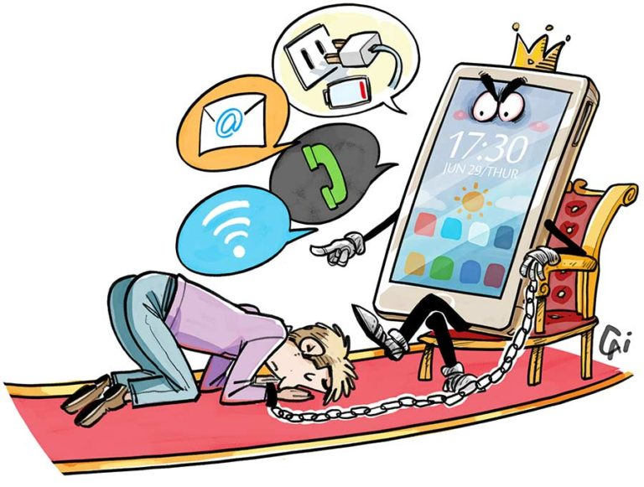
Media-Dependency Theory
Sandra Ball-Rokeach and Melvin DeFleur (1976)

Slide 2
Media dependency theory, a systematic approach to the study of the effects of mass media on audiences and of the interactions between media, audiences, and social systems.
It was introduced in outline by the American communications researchers Sandra Ball-Rokeach and Melvin DeFleur in 1976.

Slide 3
This theory assumes that mass media can have a “moderate” or even “powerful” effect on the formation of opinions, perceptions, and attitudes.
When people have no prior information or attitude disposition regarding a subject, the mass media play a role in telling people what to think.

Slide 4
Mass media effects also are increased when people cannot verify information through personal experience or knowledge. Under the circumstance, they become highly dependent on the media for information.

Slide 5
It proposes an integral relationship among audiences, media and the larger social system. Audiences depend on media information to meet certain needs and achieve certain goals, like uses-and-gratifications theory.

Slide 6
There are potentially three types of effects that result from an audience’s dependency on the media: cognitive, affective, and behavioral.

Slide 7
Cognitive effects are changes in an audience’s attitudes, beliefs, and values
Affective effects include, for example, the development of feelings of fear and anxiety about living in certain neighbourhoods as a result of overexposure to news reports about violent events in such areas.
An example of a behavioral effect is “deactivation,” which occurs when individual members of an audience refrain from taking certain actions, example- non voting

Slide 8
Audience do not depend on all media equally.
Two factors influence the degree of media dependence.
First, you will become more dependent on media that meet a number of your needs than on media that provide just a few.
The second source of dependency is social stability. When social change and conflict are high, established institutions, beliefs, and practices are challenged, forcing you to reevaluate and make new choices. At such times your reliance on the media for information will increase. At other, more stable times your dependency on media may go way down.

Slide 9
