Slide 1
Induction to Techno Management
SYBBI SEM IV-Unit 2
By-Renuka Pal(MSc CS)

Slide 2
Development Life Cycle
SDLC is a series of six main phases to create a hardware system only, a software system only or a combination of both to meet or exceed customer expectations.
The system is a set of interacting or interdependent components forming an integrated whole.
It is a term that can be used in different industries therefore Software Development Life Cycle is a limited term that explains the phases of creating a software component that integrates with other software to create the whole system.

Slide 3
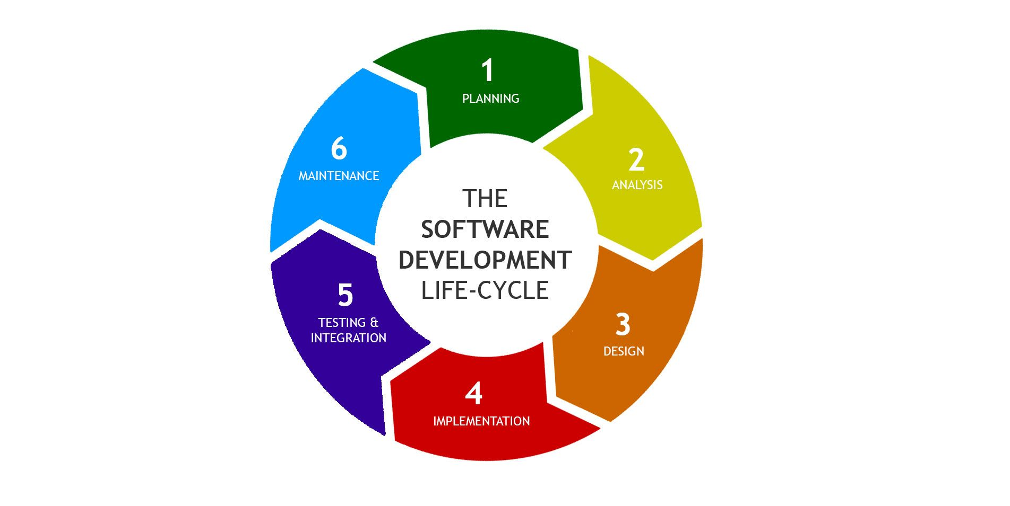
System Development Life Cycle Phases

Slide 4
1. Planning
The planning phase is the most crucial step in creating a successful system.
This planning step includes:
Defining the problems.
Studying the ability of proposing alternative solutions.
Studying how to make your product better that your competitors.
After analyzing this data, you will have three choices i.e to develop a new system, improve the current system or leave the system as it is.

Slide 5
2. System Analysis
The end user requirement should be determined and documented.
A feasible study will be made for the project as well involving determining whether its organizationally, economically, socially, technologically feasible.
This step is involved in everything which should be designed and developed during the project life cycle.

Slide 6
3.Design
In this third phase, the system and software design documents are prepared as per the requirement specification document.
This helps define overall system architecture.
This design phase serves as input for the next phase of the model.
There are two kinds of design documents developed in this phase:
High-Level Design
Low-Level Design

Slide 7
4. Implementation
This phase comes after a complete understanding of system requirements and specifications.
It is the actual construction process after having a complete and illustrated design for the requested system.
The actual coding is done under this phase and the system contains hardware.
After implementing the system is ready to installed in customers premises, ready to become running, live and productive, training may be required for the end users to make sure that they know how to use the system.

Slide 8
5. Testing & Integration
Once the software is complete, and it is deployed in the testing environment.
The testing team starts testing the functionality of the entire system.
This is done to verify that the entire application works according to the customer requirement.
During this phase, QA and testing team may find some bugs/defects which they communicate to developers.

Slide 9
6. Maintenance
Once the system is deployed, and customers start using the developed system, following 3 activities occur:
1. Bug fixing - bugs are reported because of some scenarios which are not tested at all.
2. Upgrade - Upgrading the application to the newer versions of the Software.
3. Enhancement - Adding some new features into the existing software.

Slide 10
Project Management
Project Management is the discipline of using established principles, procedures and policies to manage a project.
A project management oversees the planning, organizing and Implementing of a project.
A project is an undertaking with specific start and end parameters designed to produce to defined outcome, such as a new computer.
The project management plan is expected to effectively and efficiently guide all aspects of a project from start to finish with ideal goal of delivering the outcome on time and on budget.
Business leaders recognize project management as a specific function within the organization and hire individuals.

Slide 11
Responsibilities of a project manager.
Defining project goals.
Outlining the steps needed to achieve those goals.
Identifying the resources required to accomplish those steps.
Determining, the budget and time required for each of the steps, as well as the project as a whole.
Overseeing the actual implementation and execution of the work.
Delivering the finished outcome.

Slide 12
Basic phases of Project Management
Project conception and initialization.
Project definition and planning.
Project launch and execution.
Project performance and control.
Project close.

Slide 13
Data Centers
Data centers are a form of value-added service that offers resources for processing and storing data on a large scale for organizations of any size and even professionals may have at hand a structure of great power and flexibility, high security and qualified in terms of hardware and software to process and store information.

Slide 14
BUILDING DATA CENTERS
1. Location of Data Center: The choice of location for deployment of the data center should be made taking into account of region, consistent with the code of the city zoning, land size, easy access for delivery of equipment, high areas without flooding, existence of infrastructure basic sanitation, water, telephone and electricity.

Slide 15
2. Architecture of Data Center
The main components of On Data Center Areas are:
Social hall.
Meeting rooms to receive visitors.
Data centers usually divided into three areas of physical security in increasing order of restriction of access:
Zone I: Public areas.
Zone II: Areas of Data Center Operation.
Zone III: Equipment room.

Slide 16
3. Construction of Data Center
The construction should provide a solid structure composing secure facilities that compliment and protect equipment and information residing in the Data Center.

Slide 17
4. Air Conditioning in Data Center
The segment of Air Conditioning has the function of maintaining a controlled temperature and humidity in the premises of Data Center.
The segment includes the air conditioning system for cooling units and air handling system.
The distribution of Air Conditioning should be connected to emergency power generators.

Slide 18
5. Fire Protection System in Data Center
The Data Center is a facility for electronics essentials such as servers and the types of computers and telecommunication equipment.
The fire protection system should seek to avoid damage to the equipment in case of fire.

Slide 19
6. Supervision And Control system in Data Center.
The supervision and control system monitors the various segments of Data Center tracking items such as:
Control of loading and parallelism of the generating sets.
Supervision and control of medium voltage panels.
Supervision and control panels for low-voltage.
Integration with system of generators.
Integration with system rectifiers.

Slide 20
7. Data Center building Standards.
It is to implement and maintain methods of standard implementations of structured cabling seeking possible expansions, certification and ensure safety and maximum use of the network.

Slide 21
Role of DBMS in Banking
DBMS helps banks to keep information in order.
They can use it to put all their customers information in one place to access easily.
Information on customers accounts, investments, loans, etc.
Banks make different storage for different accounts and users using those accounts.
They store all the details like opening of an account, closing of an account, withdrawing money, depositing money, etc.

Slide 22
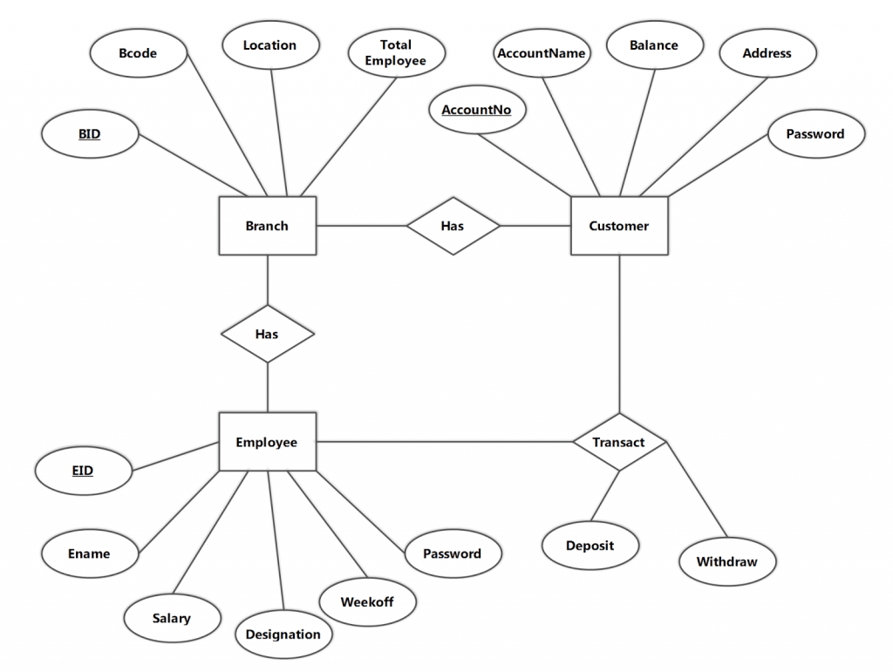
ERD diagram for Bank Management System

Slide 23
Data Warehousing
Data warehousing is the process of constructing and using a data warehouse.
A data warehouse is constructed by integrating data from multiple heterogeneous sources that support analytical reporting, structured and/or ad hoc queries, and decision making.
Data warehousing involves data cleaning, data integration, and data consolidations.
There are decision support technologies that help utilize the data available in a data warehouse.
These technologies help executives to use the warehouse quickly and effectively. They can gather data, analyze it, and take decisions based on the information present in the warehouse.

Slide 24
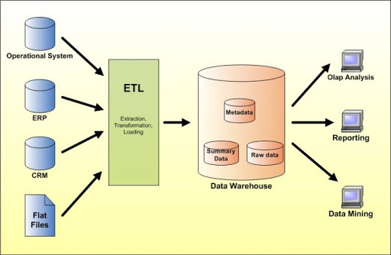

Slide 25
Data Mining
Data mining refers to extracting knowledge from large amounts of data. The data may be spatial data, multimedia data, time series data, text data and web data.
Data mining is the process of extraction of interesting, nontrivial, implicit, previously unknown and potentially useful patterns or knowledge from huge amounts of data.
It is the set of activities used to find new, hidden or unexpected patterns in data or unusual patterns in data.
Using information contained within data warehouse, data mining can often provide answers to questions about an organization that a decision maker has previously not thought to ask.

Slide 26
Data Mining Application Areas
Business Transactions
Electronic Commerce
Marketing.
Risk management
Customer Relationship Management
Customer Acquisition and Retension.

Slide 27
RDBMS and Tools
A database can be a set of flat files stored on computer tape or disk which are managed by Database Management System(DBMS).
There are different types of Database Product such as Relational, network and hierarchical.
The most used DBMS type is the Relational Database Management System(RDBMS).
A database tool is a collective term for tools, utilities and assistants that you can use to perform database administration tasks.

Slide 28
Cont.
Most DBMS software also enforce domain rules such as domain for maritial status, state code or country code could be defined to ensure that only valid values are stored.
DBMS software also enforce cardinality and optionality rules that govern relationships between things of interest.
Eg: 1. each customer may have zero, one or more orders.
2. An order must be initiated by one and only one customer.
3. An order must have one or many order items.

Slide 29
RDBMS Tools
                DB2
DB2 is a relational database management system that was introduced by IBM in 1983. It is widely used on UNIX, Windows, Linux platforms back then.
DB2 edition include the following:
DB2Workgroup.
DB2 Workgroup Unlimited.
DB2 Enterprise Server Edition.
DB2 UDB Data Warehouse Enterprise Edition.

Slide 30
Cont.
The DB2 UDB Data Warehouse Enterprise Edition includes business intelligence capabilities such as ET, data mining and online analytics.
It has API for many languages including:
.NET
CLI
JAVA
PYTHON
PERL
PHP
C++
C
REXX

Slide 31
2. Microsoft Access
Microsoft Access is a low cost relational database management system(RDBMS) used mainly by home users and small businesses.
It can run on personal computers or servers for providing simple databases, reports and data entry forms.
The current version allows to save, read, and interchange data in XML format.
Microsoft provides a wizard to replicate an MS Access database to Microsoft SQL Server.
Microsoft Access can be purchased separately or as a part of the Microsoft Office.

Slide 33
3. MySQL
A popular database management system that is used in some six million installations.
Widely used for web application, specially in PHP.
API exist for following languages:
C
C++
C#
JAVA
PERL
PHP
PYTHON
RUBY

Slide 34
4: Oracle
The Oracle corporation launched its first commercial SQL relational database management system in 1979.
Oracle is world’s largest enterprise software company and sells many application packages that runs on its Oracle DBMS.
In late 2005, the company purchased PeopleSoft and rights to its CRM, purchasing, financial, Human Resource, Supply Chain Management software packages.

Slide 35
5: Microsoft SQL Server
Microsoft SQL Server is a relational database management system that was initially targeted to small and medium sized businesses.
Today, many large corporations are using it for their enterprise information needs.
The first version of SQL Server was introduced in 1989.
In SQL Server, it allows to perform functionality such as ETL(extraction, transform, loading) for data warehousing applications and an OLAP tool(Online analytics).
It provides a secure, reliable, scalable, highly available relational database engine with improved performance to structured and unstructured(XML) data.

Slide 36
Technological changes in Indian Banking Industry

Slide 37
Trends in Banking and Information Technology
India has leapfrogged into the era of innovation in banking by adopting the latest in technology.
Today’s digital age and hyper-connected environment requires banks to re-imagine their business continuously.
And due to this Indian banks are leading the pack when it comes to transforming from digital to truly digital India.
There is growth fuelled by innovative initiatives such as Unified Payments Interface(UPI) and technology.
Some of the major technology trends that are already or will reshape Indian banking.

Slide 38
1. Open banking is the new normal:
Open banking, a connected ecosystem for financial and non-financial services with multiple underlying service providers is the future of banking.
The launch of UPI, by the National Payment Corporation of India has thrown open gates for innovations in the open banking space.
UPI will empower the payment service providers to create state-of-the-art products.
Customers will be given the flexibility that they desire and a unified interoperable interface will allow all service providers to innovate for better customer experience.

Slide 39
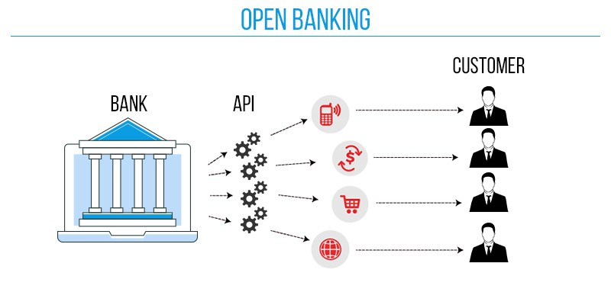
example

Slide 40
2. Banking on cloud
Banks are already making strides in cloud adoption.
Technologies that are changing the face of business such as BIG DATA, BLOCK CHAIN, ARTIFICIAL INTELLIGENCE, IoT will be using cloud computing.
After demonetization, India is heading towards a cashless society and banks prepare to deal with the increased demands by the customers.
Cloud will provide banks with the required elasticity to meet these demands.

Slide 41
3. Block chain
As the banks try to become more efficient and try to meet the increasing demands of customers, block chain will be one of the enablers for re-imagining processes.
Banks will increasingly move some projects and leverage to block chain to automate inter-organizational processes.
The recent emirates NBD and ICICI Bank partnership to launch a block chain pilot network for international remittances and trade finance is a precursor for this technology.

Slide 42
4. Artificial intelligence
AI has the potential to transform from front office and back office operations with self-improving programs.
At ICICI Bank, software robots have been deployed in over 200 business process function, reducing the response time to customers.
AI has already proven itself in providing seamless differentiated customer experience on digital channels and security measures.

Slide 43
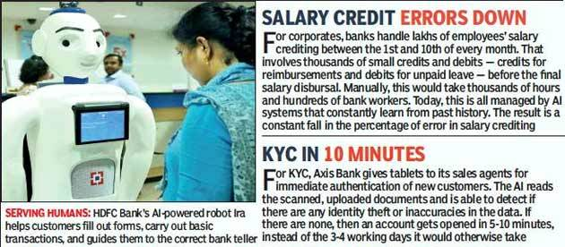
example

Slide 44
Technology in banking
                E-cheques:
E-cheques are a form of electronic tokens designed to make payments through the internet and performs the same functions as a conventional paper cheques does.
As per the electronic form, it can be done in few steps and has more security checks than the standard paper cheque like authentication, public key, cryptography, digital signature, encryption, etc.
With the amendments in Negotiable Instruments act, 1881, an e-cheque has become legalized since 2002 in India.

Slide 45
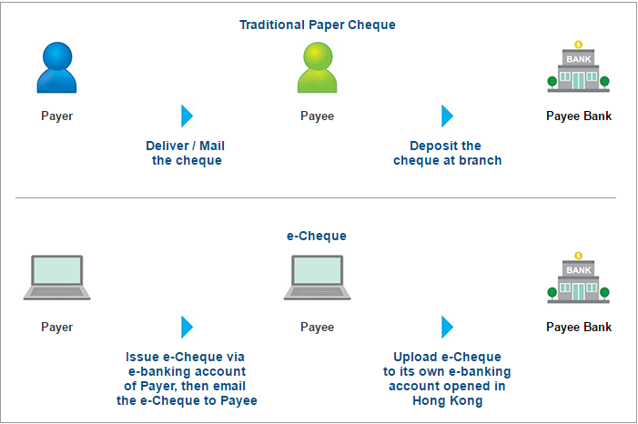
example

Slide 46
2. NEFT & rtgs
National Electronic Funds Transfer (NEFT) is an online system used for transferring small to large amounts of money from one financial entity to another within India.
Real-Time Gross Settlement (RTGS) is a funds transfer system where funds of high quantity are transferred from one bank to another in ‘real-time’ and on a gross basis.
The difference between these both is that the latter is only for an amount exceeding Rs. 2 lakhs.

Slide 47
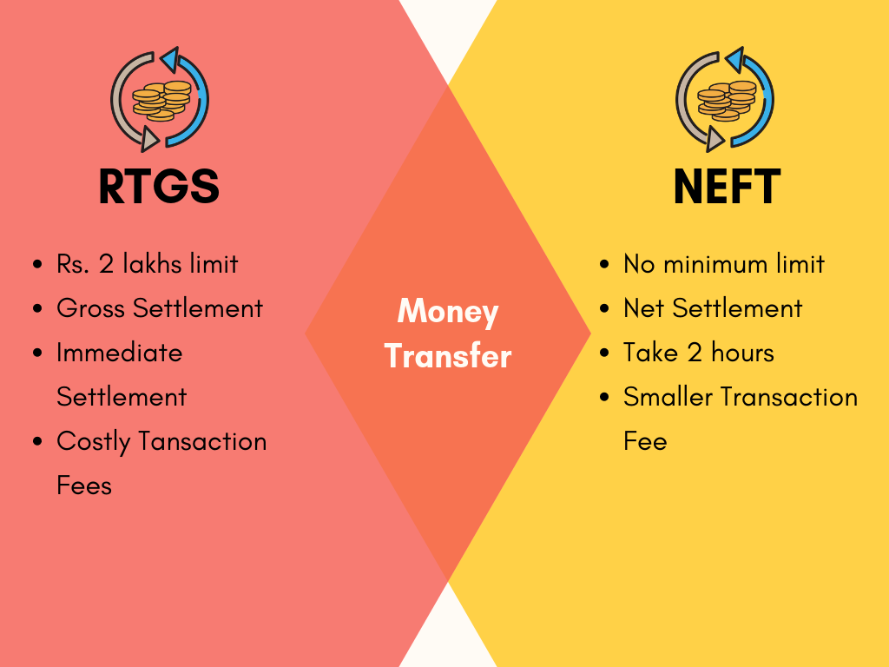
difference

Slide 48
3. Point of sale(pos)
A point of sale terminal (POS terminal) is an electronic device used to process card payments at retail locations. A POS terminal generally does the following:
Reads the information off a customer’s credit or debit card
Checks whether the funds in a customer’s bank account are sufficient
Transfers the funds from the customer’s account to the seller’s account (or at least, accounts for the transfer with the credit card network)
Records the transaction and prints a receipt

Slide 49
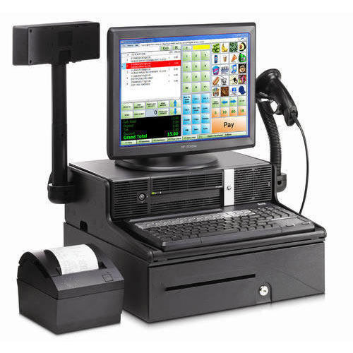
example

Slide 50
4. Mobile banking

Slide 51
5. E-banking

Slide 52
6. Nri banking services
This is the service introduced for people who work abroad and wants to transfer money to their home or families who are at their own country.
This services includes that from anywhere around the world can transfer the money to their loved one easily.

Slide 53
7. Plastic money
Credit cards or smart cards like VISA ELECTRON have made the banking industry more flexible.
Credit cards are a major part role playing in banking and also for the customers convenience.

Slide 54
THANK YOU

