Slide 1
SYBCOM
Semester III
COMMERCE III
(MANAGEMENT: FUNCTIONS AND CHALLENGES)

Slide 2
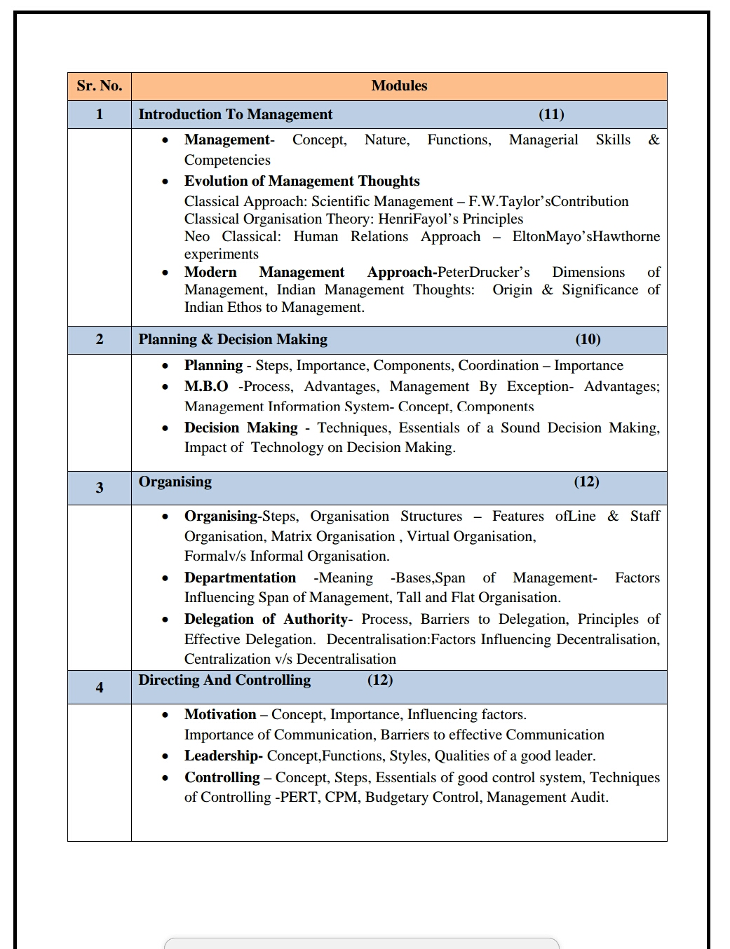

Slide 3
UNIT -I
INTRODUCTION TO MANAGEMENT

Slide 4
Introduction :
To manage means to deal with or to control
Management means the process of dealing with or controlling things for people.
Its control 4 M’s
1. Man - Human Resources ( employees)
2. Money - Financial resources ( capital)
3. Material – Physical resources
4. Machinery – Physical resources
5. Market - ( consumers, dealers, suppliers, distribution, etc.)

Slide 5






Meaning of Management
Management is the art of getting things done by a group of people with effective utilization of available resources
An Individual cannot be treated as a managing body running any organization
A minimum of two persons are essential to form a management

Slide 6
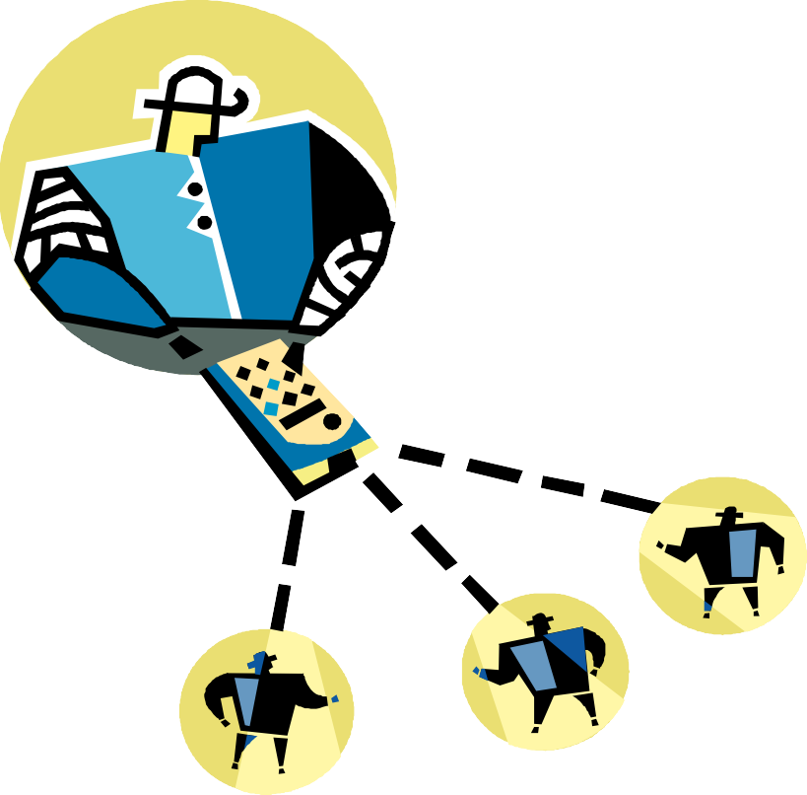
Definition of Management
Management is the art of getting
things done through and with people an informally organized
group.
- Harold Koontz
Management is the art of getting things done through people.
- Mary Parker Follet
is the
art
of
Management
inspiring
directing
and
people.
- James D. Mooney

Slide 7
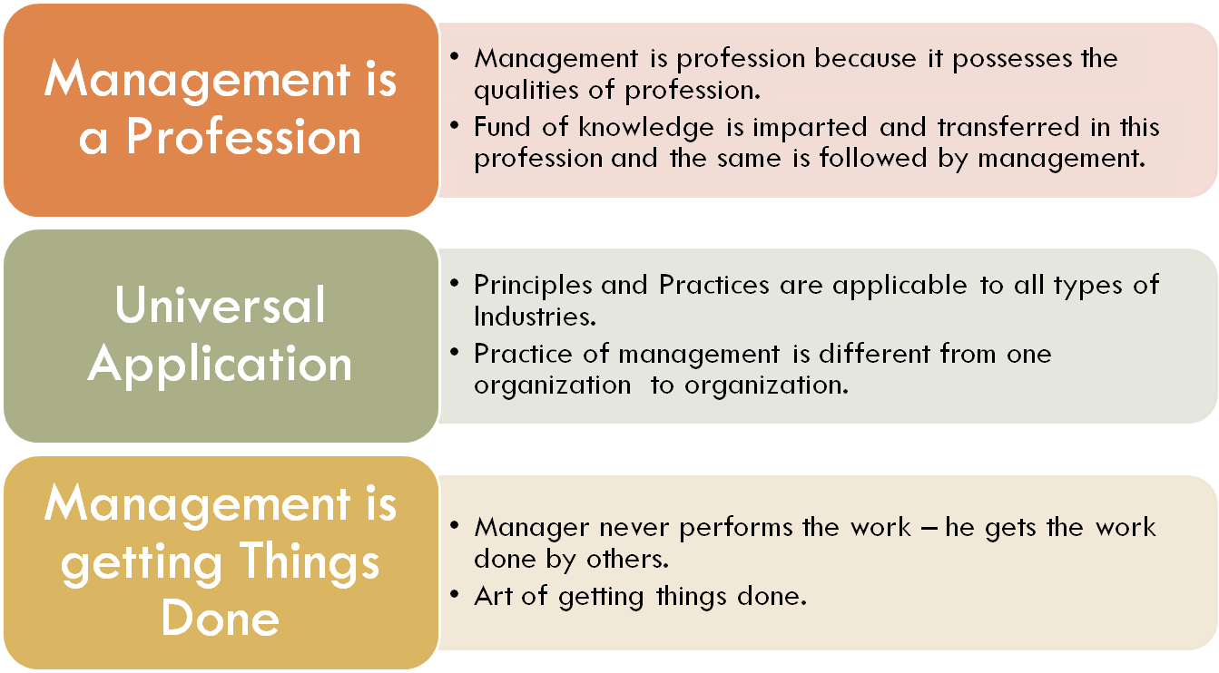
Nature of Management

Slide 8
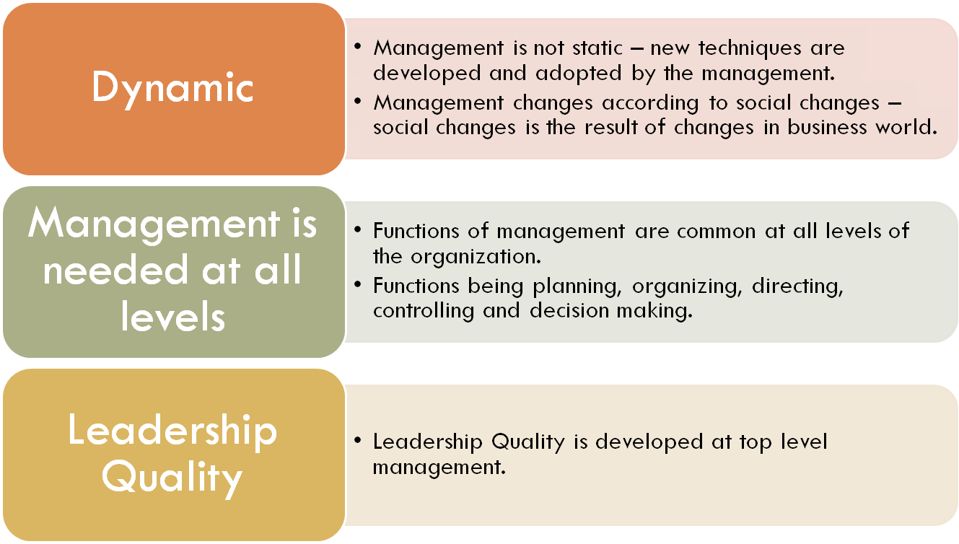
Nature of Management

Slide 9
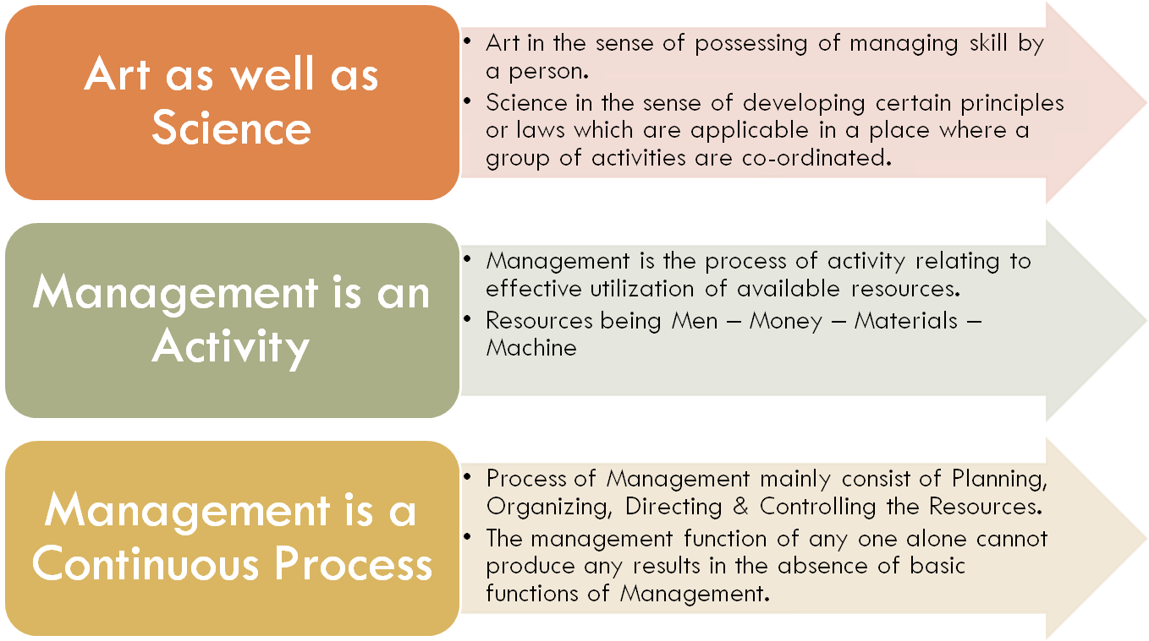
Nature of Management

Slide 10
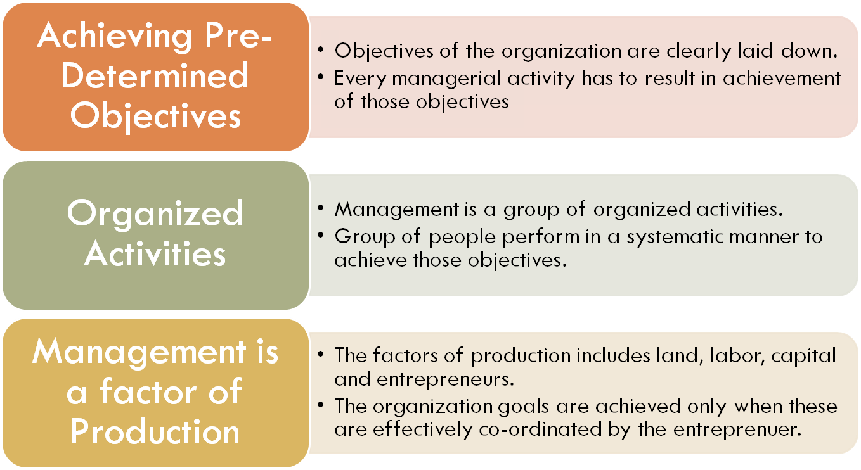
Nature of Management

Slide 11
Nature of Management
All Pervasive
Group Activity
Follow established Principles
Multidisciplinary in Nature

Slide 12
SUMMARY
Management is the art of getting things done through people.
Nature of Management
Group Activity
Management is profession
Management is art as well as science
Management is Dynamic in nature
Management is continuous process
All pervasive
Achieve Result

Slide 13
Video
https://youtu.be/_OBqwhYLEJo

Slide 14

For any query message me on : 9892349293

