Slide 1
Let’s Revise Previous lecture ....
Contribution Called as Scientific management theory of classical Management Theory of F.W. Taylor
Science not thump of rule
Scientific selection and training
Separation of planning and execution
Functional Foremanship
Maximum Output
Differential Piece Wage Rate
Mental Revolution
Time Study
Motion study and Fatigue study

Slide 2
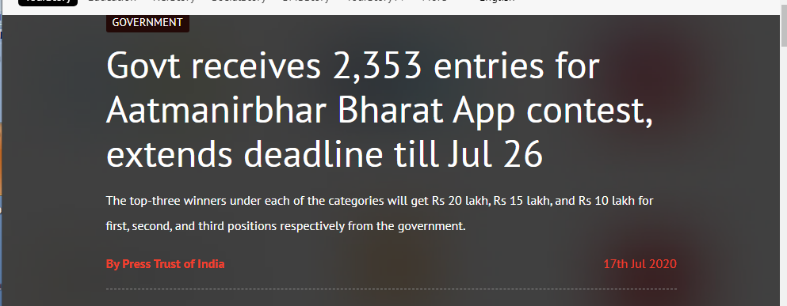
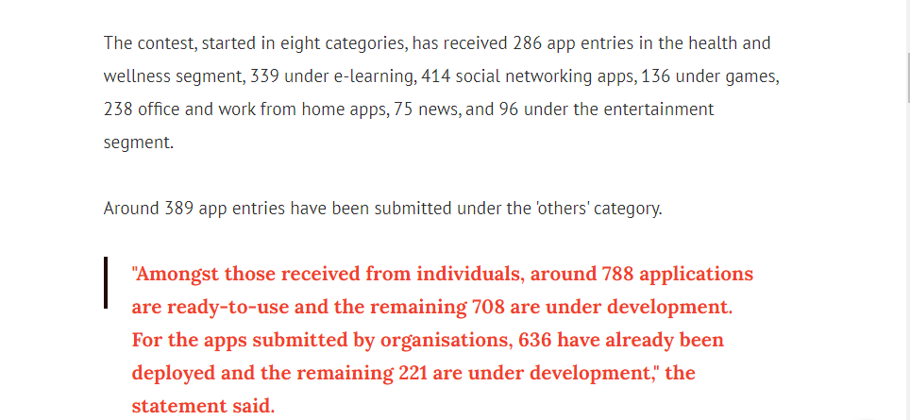

Slide 3
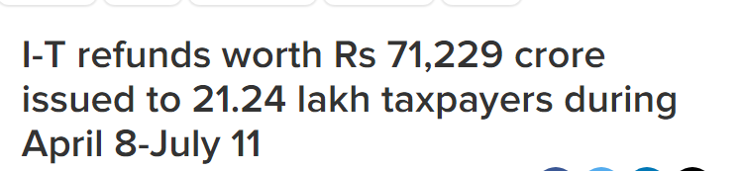


Slide 4
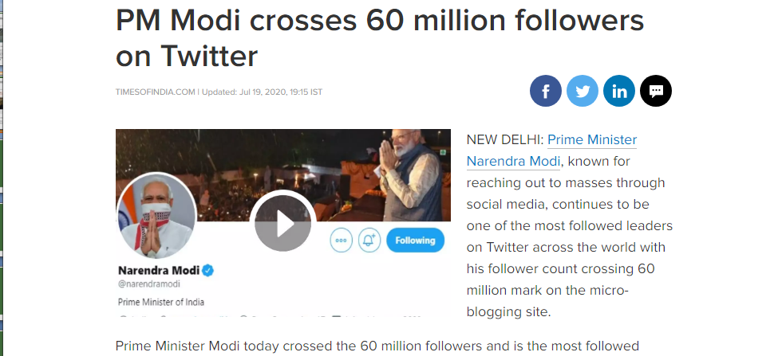
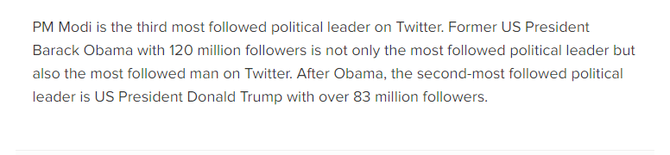

Slide 5
ELTON MAYO:FOCUSING ON HUMAN RELATIONS
1
1

Slide 6
HAWTHORNE EXPERIMENTS
Conducted at the Hawthorne Plant of the Western Electric Company
in Chicago from 1924 – 1932
Experiments conducted by Prof. Elton Mayo and his colleagues of National Academy Of Science
Hawthorne plant was a manufacturing telephone system bell.
30,000 employees were working
Objective of experiment was to find out the behaviour and attitude of employees under better working conditions
many facilities provided to employees productivity was not up to expectations
Investigate reasons for dissatisfaction of employees and decrease in productivity.

Slide 7
ELTON MAYO:FOCUSING ON HUMAN RELATIONS
Father of Human Relations Approach
The experiments were conducted in four phase:
1.
Illumination experiments ( 1924- 1927)
Relay assembly test room experiments ( 1927- 1928)
Mass Interviewing phase (1928- 1930)
Bank wiring observation room experiments (1931- 1932)
2.
3.
4.
2

Slide 8
1.Illumination experiments
Sequence of illumination tests from 1924 to 1927,
to determine the effects Change in lighting on productivity.
Two group were formed- Experimental Group and Control Group
In experimental group- variations in lighting made periodically
No change in control group
3

Slide 9
Observed that productivity increased in both the group
Revealed that no relationship between lighting and productivity
4

Slide 10
2.The Relay Assembly Room
^{To} determine effect of changes in working conditions and productivity.
Group consisted of 6 girls formed.
Girls were chosen on their past performance and Place in separate room
Group Bonus incentive scheme – productivity increased.
Two 5minutes rest time. 5 minutes increased to 10 minutes- Productivity increased

Slide 11
Free snacks and coffee provided in rest period – Productivity increased
Free Snacks and coffee withdrawn and 4 rest period of 5 minutes added – Productivity decreased. Due to frequent rest period.
Rest periods reduced to 2 of 10 minutes and coffee provided – Productivity Increased
Changes in working day and working periods. Saturday holiday and cut half an hour working time – Productivity Increased.
Withdraw all benefits – Productivity Increased

Slide 12
Observation
Absenteeism decreased
Morale increased
Needed less supervision
Develop sense of responsibilities
Productivity increased even benefits withdraw
Socio- psychological factors affects productivity

Slide 13
3. MASS IINTERVIEWING PHASE
21000 people were interviewed between 1928-1930
Initially only direct questions asked after that indirect questions asked.
Observation
Productivity increased if people allowed to talk freely
13

Slide 14
4. Bank Wiring Test Room Experiment:
Conducted during 1931- 1932
A group of 14 male workers in the bank wiring room were placed under observation for six months.
A worker's pay depended on the performance of the group as a whole.
The researchers thought that the efficient workers would put pressure on the less efficient workers to complete the work.
Productivity decreased
14

Slide 15
Observation
Fear of unemployment: if produce more others will loose their job
¬
¬
Fear of raising the standards: if reached the standard rate of production, management would raise the standard of production.
Protection of slower workers: the faster workers protected slower workers by not producing more
Informal relationship influences human behaviour and productivity
15

Slide 16
Findings of Hawthorne Experiments
Social and psychological factors deciding level of output not only working conditions
Informal relations influence worker’s behaviour
Effective communication improve relations
Employees perform better when given freedom to participate in decision making

Slide 17
Summary ....
Hawthorne Experiment Conducted at the Hawthorne Plant of the Western Electric Company in Chicago from 1924 – 1932
conducted by Prof. Elton Mayo
Conducted in 4 phases - Illumination experiments ,Relay assembly test room experiments ,Mass Interviewing phase ,Bank wiring observation
Findings - Social and psychological factors, Informal relations, Effective communication , Employees perform better when given freedom to participate in decision making

Slide 18


