Slide 1

UNIT I
INTRODUCTION TO COMMODITY MARKET

Slide 2
Introduction
Commodity refers too any material ( Bought & Sold) other than actionable claims, money & securities.
Part of our life from Civilization.
Price influences the DD & SS.
Commodities : Raw or Primary Products / Produces. (Not Processed)
https://www.investopedia.com/terms/c/commodity.asp#:~:text=A%20commodity%20is%20a%20basic,is%20essentially%20uniform%20across%20producers.

Slide 3
Farmers Market , Negotiation , Mutual Agreement, Price & Quality with Quantity.
A commodity market is a physical or virtual marketplace for buying, selling, and trading raw or primary products.
Electronic era has replaced our physical market needs.
Robust & Transparent market is desirable & active.
https://www.investopedia.com/terms/c/commodity-market.asp#:~:text=A%20commodity%20market%20is%20a,in%20approximately%20100%20primary%20commodities.

Slide 4
A commodity is a basic good used in commerce that is interchangeable with other commodities of the same type.
Commodities are most often used as inputs in the production of other goods or services.
Investors and traders can buy and sell commodities directly in the spot (cash) market or via derivatives such as futures and options.
Owning commodities in a broader portfolio is encouraged as a diversifier and a hedge against inflation.

Slide 5
Emergence of Commodity Market
Barter System
Clay Tokens => Coins
Animal : First Commodity
DD & SS Patterns
Ancient Fairs & Open Air Markets
Trade Barriers & Trade Agreements
Internationalisation of Commodity

Slide 6
Widespread movements & Migration
Indian Ocean Trade Routes
Golden Silk Route
Transportation & Market Development
Organised Markets
Benefits
Price Stabilisation
Price Structure
DD & SS match
Competition
Expansion of Business / Trade

Slide 7
Commodity Market Eco System
Buyer & Sellers
Market & Exchange
Support Agencies
Lending Agencies
Logistics Companies

Slide 8
Indian Commodity Market
1875 onwards ( 125 Years history)
1980 Khusro Committee
1991 LPG reforms
1994 Kabra Committee
2000 National Agricultural Policy
2003 Future Trading
Positive Change : Larger Market, Participation , Trading System, Transparency , Price Discovery

Slide 9
Markets / Exchanges
Spot Market / Physical Market / Cash Market
Specific Quantity & Price
Terms & Condition
Agricultural Produce Sector
Challenges & opportunities
Farming Community => Contract Farming
Reforms & Infrastructure
Convenient Outlets, Remunerative Prices SS & DD
Production inputs & Services
Marketing : Financing

Slide 10
Structure of Commodity Market in India
Ministry of Consumer Affairs, Foods & Public Distribution
Forward Market Commission
National Electronic Exchange
Regional Exchanges
1. MCX
2. NCDEX
3. NMCE
4. ICEX
1. NBOT
2. Regional Exchanges

Slide 11
Types of Commodities
Agricultural
Hard
Soft
Animals
Precious
Metal
Industrial
Energy
Liquid
Gases

Slide 12
Criteria
No Complicated manufacturing activity
Standardized product
Price => DD & SS
Wide spread trading activity through many competing sellers
Adequate self life

Slide 13
Future Prospects
Global Trading of Agricultural Commodity
India : Domestic Market, Growth potential, Opportunities, Variety of agricultural produce ( Regional Speciality) , Market / Mandi / Bazzar.
Govt. Support : Lifting bans, approval for new exchanges modern infrastructure, online trading, removal of legal hurdles, attracting more participants( training & development)
Agricultural Liberalisation
Potential Sector

Slide 14
Boost to agricultural investments, Food processing industry
Transparent & multiple commodities, Electronic delivery, Efficient mechanism, World class environment
Need : Clearing & Settlement system, Warehousing facility, Efficient price mechanism.
Financial Support
Participation

Slide 15
Focus
Consolidate the market
Strengthen regulation
Generate confidence amongst the participants
Keep the market free from manipulation
Increase awareness among the stakeholders
Empower the farmers with price information
Encourage and facilitate intermediaries

Slide 16


Slide 17

Role of Information in CM
Role : Credible & Timely Information
Perishable Commodities or other.
Farmers : Planning ( Production & Marketing)
Traders , Hedgers, Speculators
Lack of Information
Middle man Interference
Lower price exploitation
Premium Price not available
Accurate & Complete Information
Mobile Technology ( Transparency)

Slide 18
AGMARKNET
Agricultural Marketing Information Network
Advancement in ICT
Ministry of Agriculture, March 2002
Technical Support by NIC ( National Informatics Centre)
Xth Five Year Plan : 2965 Nodes, 2784 Agricultural Commodity Produces
Directorate of Marketing & Inspection

Slide 19
State Agricultural Marketing Board
Computer Software & hardware
1976 nods with internet : March 2007
Software AGMARK developed & implemented
Portal : http://agmarknet.nic.in
1700 market Regularly reports
Single window for various links (Website)
Provides weekly trends analysis
Future Price discovery & International price
Quality , Quantity, Standards, etc

Slide 20
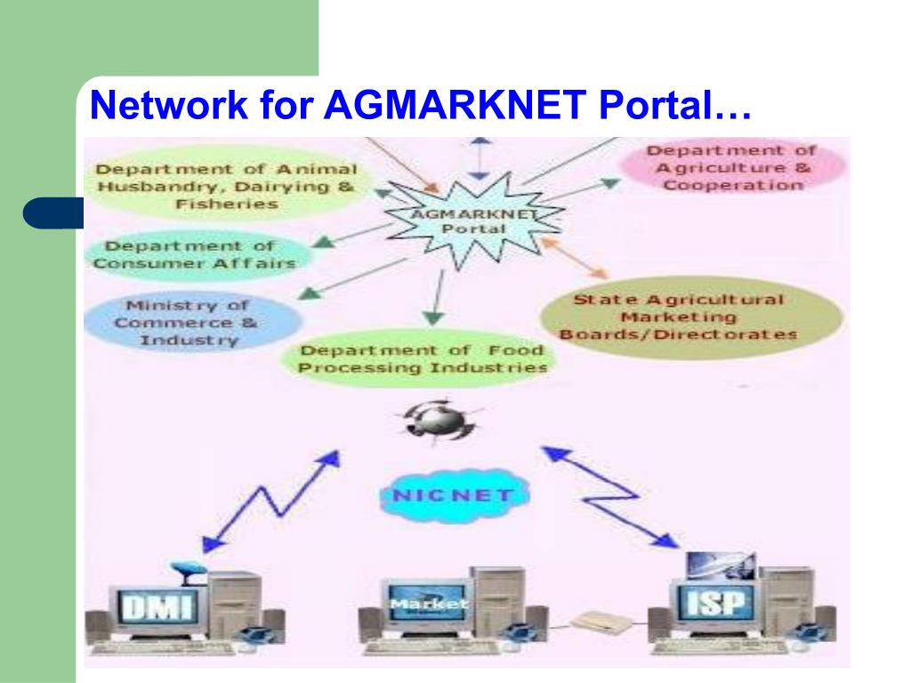

Slide 21
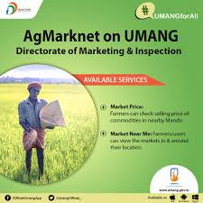


Slide 22
XI th Five Year Plan
Documentation, Transport, Infrastructure, Quality, Grading & Standards.
Contact farming, Opportunities, Interactive Query, Buy back, etc
Warehouse ( Add, facilities, Distance, Pledge)
Success stories ( Knowledge & Planning)
GIS : Geographical Information System
Data Validation software
Electronic display
Public campaigns
Capacity building with different stakeholders

Slide 23
Regional Language
Strategic Alliances
Common service centres
Timely collection & transmission of market information
Role of DMI & NIAM
Price Forecasting
Models : PPP, BBOO : Buy Build Own Operate , ASM : Advertising cum Subscription Model
Information : Price , Market , Links , Users, Technical Support

Slide 24
KCC : Kisan Call Centre
Information & Knowledge intensity transfer to agriculture sector.
Information asymmetry between Farmers , Villages , Region , Country & other Country.
Impressive telecom network ( Pvt. & Govt.)
500,000 villages with public telephone services.
Mass Media & Telecom Network
KCC : 21st April, 2004
Services available throughout country
Common Call Toll Free Number 1551

Slide 25




Slide 26

Specific Call centres, Local Language, Local Agricultural Issue.
13 KCC ( 116 Agri Graduates, 123 Experts)
Level II : 10th June 2004 { 6am to 10pm, Except Sunday & Gazetted Holidays)
IVRS : Interactive Voice Recognition System

Slide 27
Source & Support
Tamilnadu Agri Univ. + C-DAC (Dynamic Market Information)
NHRDF : National Horticultural Research & Development Foundation
CMIE : Centre for Monitoring Indian Economy
MANAGE : National Institute of Agricultural Extension Management
UNCTAD: United Nations Conference on Trade & Development
NAFED : National Agricultural Cooperative Marketing Federation of India Ltd.
Daily NEWS Papers
Specialised Agricultural magazines
Brokers ( Research & Analysis)
Various websites & subscription.

Slide 28


Slide 29
Features | Equity Market | Commodity Market
No. of National Exchange | NSE & BSE | NMCE, NCDEX, MCX, ICEX
Parties | Affluent Investors | Entire Populaton
Avg. Turnover | Rs. 40,000 Crores + | Rs. 11,000 Crores +
Eco System | Exchange, Clearing Banks, Clearing Corporations, Members/ Brokers, Clients | Associations/ Exchanges, Clearing banks, Clearing Corporations, Members / Brokers, Clients
Regulator | SEBI | FMC + SEBI
Products | Spot, Futures, Options & Indices | Spot, Forwards & Futures
Participants | Individuals, Corporate, banks, Institutions, Funds & FIIs. | Individuals, Corporate & ETDs.

Slide 30
Features | Equity Market | Commodity Market
Risk Management Tools | Margins System, Price Circuit Filters, Position Limits, Penalties
Trade Timings | Only Morning Session | Both Morning & Evening Sessions. (24 X 7)
Index Trading | Permitted | Not Permitted
Settlement System | Cash as well as Delivery
Electronic Trading | Yes
Dmat Trading | Fully available | Partially available

Slide 31


Slide 32
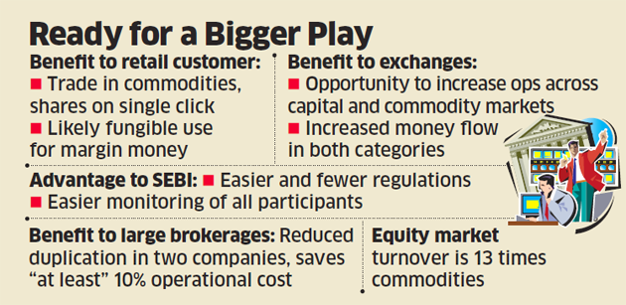

Slide 33
Participation in Commodity Market through Equity Market
Trading in Equity of Commodity based companies
Exchange Traded Funds (ETFs)
Mutual Funds
Hedge Funds

Slide 34
Convergence of Equity Markets & Commodity Markets in India
Lifting Prohibition on Forward Trade in all commodities in 2003. (Liberalized)
Ramamoorthy Committee (by SEBI in 2003)
i) Securities Brokers participation in the Commodities Markets.
ii) Utilisation of infrastructural facilities of stock exchanges by commodity exchanges.
iii) Stock exchanges as well trading in commodities derivatives.

Slide 35
Issue i & ii was endorsed, issue iii opined that it could be taken up for consideration at a future date as the two markets mature further.
Notification & Amendment of Securities Contract ( Regulation) Rule to permit brokers to participate in commodity market after constituting separate legal entity.
Inter Ministerial Task Force on convergence of securities & commodity derivatives market : Chairmanship of Wajahat Habibullah.

Slide 36
Strong commonalities between Commodity & Securities Derivatives.
Commodity Futures : Traceable & Fungible, Squared off & do not go to delivery.
Financial Purpose
Certain differences with regards to delivery & settlement.
Knowledge & procedures for trading in securities.
Building India’s securities infrastructure.
Viability of new multi commodity exchange would be enhanced.

Slide 37
It will reduce capital requirement for creating capacity.
CM : obtain strong liquidity & price discovery in a transparent, anonymous, order matching environment.
Fragmented markets, OTC markets.
Speed up Migration, Screen based trading, indirectly assist the strengthening of agricultural spot markets.
Task Force : Sophisticated, Liquid, Low cost platforms. ( Spontaneously pulls the players from the informal unorganised market)

Slide 38
Harmonization of FCR Act 1952 & SCR Act 1956
A Common regulatory environment.
Constitution of India.
Jurisdiction of Central & State Government, FMC & SEBI.
“Trade & Commerce” , “Agriculture”
Approaches :
Convergence at the level of Brokerage Firms.
Convergence at the level of Policy making.
Convergence at the level of Regulators.

Slide 39
Warehousing
Commodity is fastest growing sector.
Huge untapped potential to grow.
Physical deliveries & deliveries based trading.
Trade & Settlements. ( Cash differences)
Factors
Trust among participants
Efficiency in operations
Location of warehouse
An accredited warehouse service provider.

Slide 40
Warehouses
Independent third party
Providing sufficient storage places.
Assuring quality & Quantity.
Acceptable geographical location.
Preservation & Certification.
WR for Commodity Finance as e-pledge.
Commodity Risk Management : Quality , Quantity, Price, etc

Slide 41
Functional Aspects & Specifications
Procedures & Standards laid down by the Exchange.
Sufficient storage areas, aisles, service areas.
Design & Structure
Protection : Fire, floods, thefts. (Safety Measures)
Material handling Equipments
Remedial Measures

Slide 42
Contamination & Endanger Commodities
Earmarking, Grade, Validity period certificate, Detailed identifications, Expiry of validity period.
Storage conditions
Uniform & Standard description & Unit of measurement (Record)
X Assign / Shift / Transfer or Relocation of commodities.
Physical inspection & Verification compliance for storage norms.
Storage charges (including Insurance, Assaying, Handling, etc)

Slide 43
Warehouse Receipts
An evidence of Quality, Quantity, Ownership.
Security document for bank guarantee.
Financial capacity, integrity , creditworthiness.
Assess the value of goods.
Dematerialised WR’s.
X Negotiable Instrument.
Credit Financing : Farmers, Traders, Processors.

Slide 44
Infrastructure
Short of requirements
FCI : Food Corporation of India.
PDS : Public Distribution System
Capacity : 23 Million Ton, 355 Districts, target of 590 Districts to be covered.
CWC : Central Warehouse Corporation : Capacity : 11 Million Ton.
SWC : State Warehouse Corporation : Capacity : 27 Million Ton.

Slide 45
Agricultural Products, Fertilisers, other Industrial Products.
Third Party Warehouse : Capacity : 8 Million Ton
By 2020 Additional capacity requirement of 50 Lac ton.
Scientific & efficient storage.
Agri trades
Stability of price
Model : BBOO, PPP

Slide 46
Kabra Committee
Chairman : Prof Kamal Nayan Kabra
Appointment : June 1993
Objective:
Inter alia examine the working & trading practices of Commodity exchanges & regulatory functions of FMC.
Recommendation to render it more effective & to bring it in line with Global Exchange.
Forward Trading Constructive
Keep Price in check
Improve marketing & distribution of commodities
Promote growth of exports.

Slide 47
Report
Need for Hedging
Contribution of Forward & Future trading in price discovery
Absence of Hedging, traders & manufactures tend to cover price risk through charging higher price from customers.
Restricted purchase by traders
Weak DD, Post harvest SS
Uncertain future prices
Presence of Arbitrageurs, traders, hedgers, should increase
Export contributions

Slide 48
Requirements
Commodity must be homogeneous
Standardisation into 1 or more grades
DD – SS of commodity should be large ( Free from control)
Price risk management through futures
Speculators role
Storage facility
Future trading

Slide 49
Gold trading under supervision & restrictions
FMC role should be strengthen
Liquidity position
Vigilance & signals
Upgrade facilities
Increase participation
Ready contracts
Amendment in FCR Act 1952
X transferable contracts

Slide 50
Commodity Markets
1875 First organised future market established by Bombay Cotton Trade Association. ( Cotton, Oilseeds & Food grains)
No trading : During WWII
Formally 24 Associations
Recognised by Govt. & FMC
Commodity Market/Exchange : Regional Exchanges , NBOT, Electronic Exchanges
Open Markets, Mandi’s , APMC, TMC, etc

Slide 51
Regional Exchanges
Regional Development
Mgmt : Small Group & Controlled by bulk of business.
Transparency is ?
Liquidity is thin
No Market information
No technical analysis
Few big players
Restricted entry
Trading rights, ownership rights & control
Speculative trading
Limited hedging
Fragmented nature
Personalised contracts

Slide 52
Bikaner Commodity Exchange
BCEL, First in Rajasthan
Incorporated on 31st Jan. 2002 (Under FCRA,1952 & FMC)
Register Office at Bikaner
Future trading for Guarseed, Gram & Mustard Complex
Managed by Elected BOD’s & Standing Committees
Members : Trading Members, Trading cum Clearing Members
Margin System

Slide 53
Chamber of Commerce, Hapur
CoC, Incorporated in Oct. 1923
Wholly independent , transparent, efficient system & professional management.
Premier commodity exchange of India.
Mustard Seeds/ Rapeseeds, Jaggary
Membership : X more than 300 ( Ordinary trading / non trading members)

Slide 54
Trading : Open Outcry method, Trading Ring or Patia.
No trading in public / street allowed.
Mon – Fri : 10am to 4pm, Sat : 10am to 2pm
Authorised representatives
Clearing : Well established system of clearing , settlement & guarantee, impartial & uniform.
Settlement : T+3 basis, Delivery order & Money Settlement
Risk Management : TGF

Slide 55
IPSTA : The Indian Pepper & Spice Trade Association, Kochi
Registered U/s 25 of Companies Act, 1956 at Maltancherry, Kochi
1957 : Prohibited for declaring dividends, direct & indirect benefits to members.
Mutual exchange (Traders => Owners)
Registered under Charitable organisation U/s 12 of I.T.Act 1961
Providing future trading in Pepper since 1957
BOD : 11 Trading Members, 3 Nomination from GOI & 1 Professional
Committee : Ring, Clearing house, Daily rates, Arbitration, Vigilance & Enquiry.

Slide 56
Membership : Ordinary Members, Associate Members, Institutional Clearing Members.
Trading Contracts : Malabar Black Ppper & 500 G/L with 12 contracts(Domestic Division) , MLS ASTA, VB ASTA – 6 contracts (International Division)
Trading System : Online trading from 2003, Bids & offers are matched on basis of price, order expiry date, time, quantity available.
Rate Fixation : Daily rate committee, Manual / Computer Program & Algorithm.
Clearing : Technological support & efficient learning system
Margins : Advance payment for trading, Special margins , TGF ( Traders Guarantee Funds)

Slide 57
VBCL :Vijay Beopar Chamber Ltd
5 Jaggery futures market
UP Haryana Sugar belt
Bhatinda, Delhi, Hapur, Meerut, Muzzafarnagar
Pvt Firm : VBCL, Muzzafarnagar
Profitable exchange & active
Contract : Pansera Jaggery, Chapur, Khura, Khandsari – crude sugar jaggary mixture.
Premium for variety
Maturity : 6 month-> Mid July, 3 month-> mid Jan, 2 month -> mid March, 5 month -> Mid July

Slide 58
Trading System : Open out cry, 10am to 3pm, Price limit +/- 15%, 8 large brokers.
Clearing : Counter party risk management, Mark to market, Clearing house & clearing bank.
Settlement : Physical settlement, Dispute on no delivery , Short squeeze (manipulators)
Participants : Members, Brokers, Entry barriers, 120 members
Governance : BOD’s : 4 Spot market, 6 Future Market, 2 Shareholders, 4 representation from FMC & 2 by BOD nomination
Staff of 18 members
Committee : Clearing house, Daily rate, Survey , Arbitration, vigilance
Regulation : Regulatory body, Daily report, Position (limit , margin rules & charges)

Slide 59
NBOT : National Board of Trade
Not for profit company, U/s 25 of Co’s Act 1956, 30/7/1999.
Offers transparent & efficient trading platform
Converted into for profit company & duly incorporated by ROC, Gwalior on 1/8/2000.
State of the art technology, System for efficient handling of trading.
Commodities : Soybean, Mustard Seeds, Crude Palm oil, etc.

Slide 60
Mgmt : 8 Director : 3 Trading Member, 3 General Public, 1 FMC Nomination & 1 Professional Executive Director.
Role / Committee: Membership, Finance & Business Development; Trading, Clearing & Settlement Committee; Margin, Surveillance & Inspection Committee; Disciplinary & Dispute Redressal Committee.
Membership : 119 Business Members (56 Trading member, 62 Trading cum clearing member & 1 Institutional member.)

Slide 61
Trading
User-friendly & function under fully computerised environment.
Ring hall with outcry system -> Electronic
Online trading platform
Mon – Fri 10am to 5pm, Sat 10am to 2pm
Adequate safety for trades executed.
Daily clearance based on Mark to Market System.
Pre margin requirements
Pro rate basis
Squaring off / Closing out open position

Slide 62
Clearing : Management of Executive Directors, Daily Clearing & Settlement, Weighted Average.
Margin : 40% Principle Amount
Additional Margin : Buying/selling in Bullish / Bearish Trend
Delivery Margin : 25% in cash of settlement value
Trade Guarantee Funds
Limitation:
No independence of ownership & management.
Existence of unofficial market. (Havala)
Non availability of price & non standardisation of contracts.
Fragmented nature of market.

Slide 63
National Demutualized Commodity Derivatives Exchange in India
Price of Agri Commodities : Uncertain & Instability.
Farmers , Processors & Consumers : X Control
Agri. For Survival, Fragmented Land holiday, Weather, Market Problem.
Kabra Committee report 1993, National Agricultural Policy 2000.
Enlarging the coverage of future markets.
Hedging the Price Risk.

Slide 64
Long Hibernation Period
Virtually inoperative Exchanges
Association & Promoted / Managed by Local Traders ( No Nomination & Professionalism)
Threat of Integrity & Transparency
1 April 2003
National Demutualised Commodity Exchange
NMCE : Ahmadabad
NCDEX : Mumbai
MCX : Mumbai
ICEX : Gurgaon

Slide 65
Features
National Level Exchange
I T based System
Professional Mgmt
Governance Structure
No Manipulation
Effective Working
Sound & Modern Technology
Nationalised Trading Platform
Clearing & Settlement Mechanism
Electronic Trading
Physical Delivery
Growth Facilitators
Legal & Regulatory Framework

Slide 66
NMCE : National Multi Commodity Exchange
1st Demutualised Electronic Multi Commodity Exchange of India
National Status : 26th November, 2002
Promoters : CWC , NAFED, GAIC, GSAMB, NIAM, NOL & PNB
Type of Market
Ready Delivery Market
Specific Delivery Market
Future Market
Auction Market

Slide 67
Features
National Status
Reliable, Effective, Impartial & Rule based Management
Electronic Trading
Diverse Participants
Fair Trading Practices
VAR ( Value at Risk) System 99.9%
WR System
TGF
V-SAT Connectivity
Real time price & trade data Dissemination
Market Surveillance Programme

Slide 68
Membership:
PICM : Professional Institution Clearing Members ( No trading)
TCM : Trading cum Clearing Member
TM : Trading Member
Clearing & Settlement:
HDFC Bank
Daily (Payin & Payout)
VAR
Mark to Market

Slide 69
MCX : Multi Commodity Exchange
HO : Mumbai Operation : Nov. 2003
Setup by : FTIL Financial Technologies India Ltd.
Permanent Recognition from GOI
Provides online trading, Clearing & settlement operations for futures market
ISO Certification : 27001:2005 for Information Security Management system, 14001:2004 for Environmental Management System & 9001:2000 for Quality Management

Slide 70
Future Trading : 40+ Commodities
Strategic Alliance : India : 5; International: 11
Key Shareholders/ Promoters : Blue Chip companies & International Financial Sector 17 Companies
Group Ecosystem Venture : Smooth & Hassle free operations.
Investors : NHBC, CMSL, AtomTech, Ticker Plant Ltd., MCX-SX.
Membership : TCM, Institutional TCM, Professional Clearing Members, TM
Jan 2007 : 1600 members with over 10000+ TWS, Eligibility Criteria & Condition, Interest Free Security Deposits(Cash & FD equally)

Slide 71
Trading Platform :
Online Automated Trading Facility
V-SAT (Very Small Aperture Terminal)
MCX-TWS (Traders Work Station)
User friendly
Commodity price tickers, Market watch system, Best Buy/Sell, Last trade price, Volume for day, Open interest, Top gainer/ loser, Net positions, online backup.
Commodities : Precious Metals, Spices, Fibers, Cereals, Oil & oil seeds, Pulses, Energy, Weather, Plantation(Rubber)

Slide 72
NCDEX : National Commodity & Derivatives Exchange of India Ltd.
Professionally managed online multi commodity exchange
Promoters : LIC, NABARD, NSE, Canara bank, CRISIL, Goldman Sachs, Intercontinental Exchange, Indian Farmers Fertilizer Co op ltd, PNB
Only exchange in India promoted by National Level Institutions
Institutional building experience, trusts, nation wide reach, technology & risk management.

Slide 73
Located in Mumbai, Public Ltd company, Incorporated on 23rd April, 2003 under Co’s Act,1956.
Certificate of Commencement May 2003, Operations 15th December 2003
BOD’s & Professional Management : No interest in commodity market
Best global practices, professionalism & transparency.
550+ centres in India.
57 Commodities ( Agro / Non Agro & Others)
Membership : TCM, PCM
Different membership fees & deposits, Eligibility criteria & interest free security deposits.

Slide 74
ICEX : Indian Commodity Exchange Ltd.
9th October, 2009
Screen based online derivative exchange
Public Private partnership
India Bulls Financial Services Ltd + Minerals & Metals Trading Corporation of India Ltd.
Indian Potash Ltd., Infrastructure Development Finance Corporation.
Commodities : Precious Metals, Metals, Energy, Fibers, Minerals, Oil & Oil Seeds, Other Agro products.
Membership : TM, TCM, PCM, ITCM
Risk Management: Margins & Position Limits

