Slide 1
TYBBI: Semester V
International Banking & Finance (IBF)
Akash Deshmukh
• 15.06.2020

Slide 2
Topic:
Balance of Payments (BOPs)

Slide 3
Balance of Payments
Balance of Payments (BOPs) can be defined as systematic record of all economic transactions between the residence of one country and the residence of another country during a given period of time.

Slide 4
Features of BOPs
The accounting procedure of double-entry bookkeeping (debits & credits)
A credit entry records an item or transaction that brings foreign exchange into the country
A debit entry represents a loss of foreign exchange
Systematic record maintained with a period of time into consideration

Slide 5
Balance of Payment
Current Account
Capital Account
Official Reserves Account/ Official Settlements Account
Errors and Omissions/Statistical Discrepancies
Merchandise Account/ Trade of Visible
Invisibles/ Trade of Intangibles
Trade of Tangible Goods
Trade of Services
Transfer Payments
Equity
Debt
FII/FPI
FDI
NRI Accounts
External Commercial Borrowings and Trade Credits

Slide 6
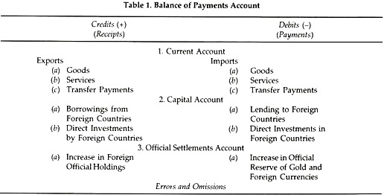

Slide 7
Current Account
Current Account Includes
Merchandise—tangible goods
Services—include travel and tourism, royalties, transport costs, and insurance
Income from investments—interest and dividends
Unilateral transfers—include foreign aid, gifts, and retirement pensions

Slide 8
Capital Account
Capital movements are of two types:
Autonomous capital : refers to those capital flows which take place because of economic considerations
Accommodating capital: It takes place to bring the BOP in equilibrium

Slide 9
Capital Account
FOREIGN INVESTMENT:
(a) Foreign direct investment
(b) Portfolio investment
LOANS:
(a) Commercial borrowing
(b) Borrowing as external assistance
(c) Banking capital transactions

Slide 10
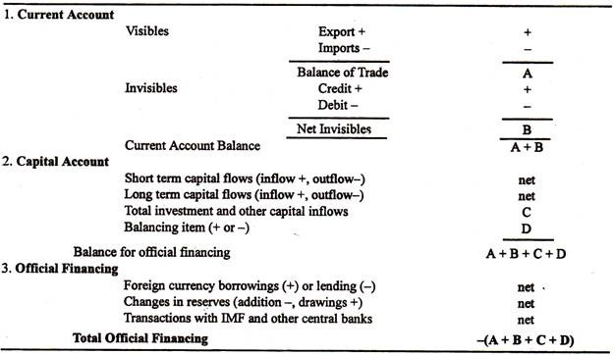

Slide 11
BOP will Balance
BOP will always balance.
Receipts-R (Credit Side), Payments-P (Debit Side)
B=R-P
R>P = Surplus
R<P = Deficit
R=P = Balance

Slide 12
Balances of Balance of Payments
Balance of Payments
Equilibrium
Disequilibrium
Receipts=Payments
Surplus
Deficit
Receipts > Payments
Receipts < Payments
Balance

Slide 13
Different types of Balances in Balance of Payments
Balance of Trade Account
Difference between Export (X) and Import(M)
Surplus (X>M)
Balance of Current Account
Difference between Receipts (R) and Payments (P) of Current Account
Balance of Capital Account
Difference between Receipts (R) and Payments (P) of Current and Capital Account
Deficit (M>X)
Surplus (R>P)
Deficit (P>R)
Basic Balance
Difference between Receipts (R) and Payments (P) of Capital Account
Surplus (R>P)
Deficit (P>R)
Surplus (R>P)
Deficit (P>R)

Slide 14
Special Drawing Rights (SDRs)
The SDRs is neither a currency nor a claim on the IMF. Rather, it is a potential claim on the freely usable currencies of IMF members. SDRs can be exchanged for these currencies.
The SDRs serves as the unit of account of the IMF and some other international organizations.
SDRs are both assets and liability of IMF.
Quota (the amount contributed to the IMF) of a country is denominated (expressed) in SDRs

Slide 15
The currency value of the SDR is determined by summing the values in U.S. dollars, based on market exchange rates, of a SDR basket of currencies.
The SDR basket of currencies includes the U.S. Dollar, Euro, Japanese Yen, Pound Sterling and the Chinese Renminbi (included in 2016).
The SDR currency value is calculated daily (except on IMF holidays or whenever the IMF is closed for business) and the valuation basket is reviewed and adjusted every five years.
The current interest rate on credit 0.0050%

Slide 16
ANY QUESTIONS/QUERIES

Slide 17
CONCLUSION

Slide 18


