Slide 1
Thakur College of Science & Commerce
Department of Zoology
Welcomes
Academic Year – 2020-21
(Paper – III Unit- III)
Apiculture
Dr. Vitthal T. Mohite
Head, Department of Zoology

Slide 2
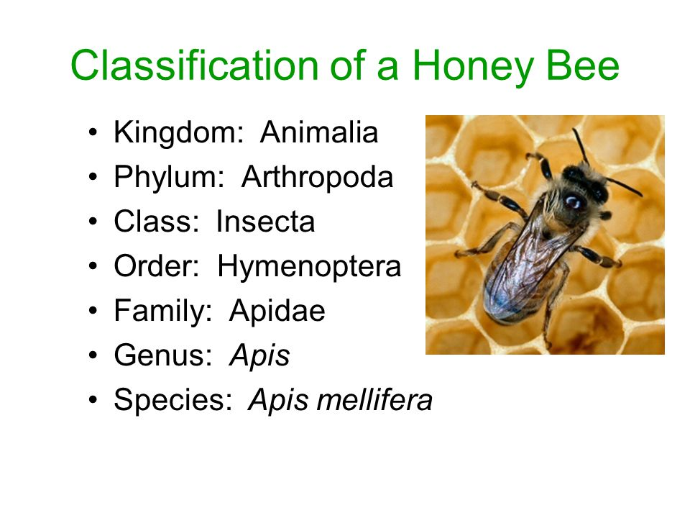
Apiculture

Slide 3
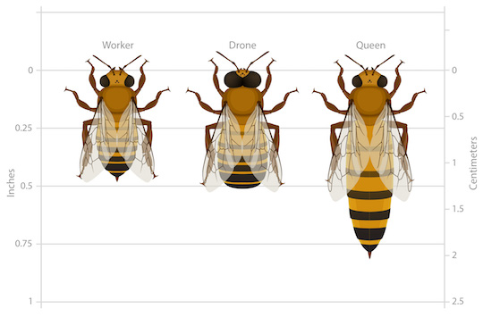
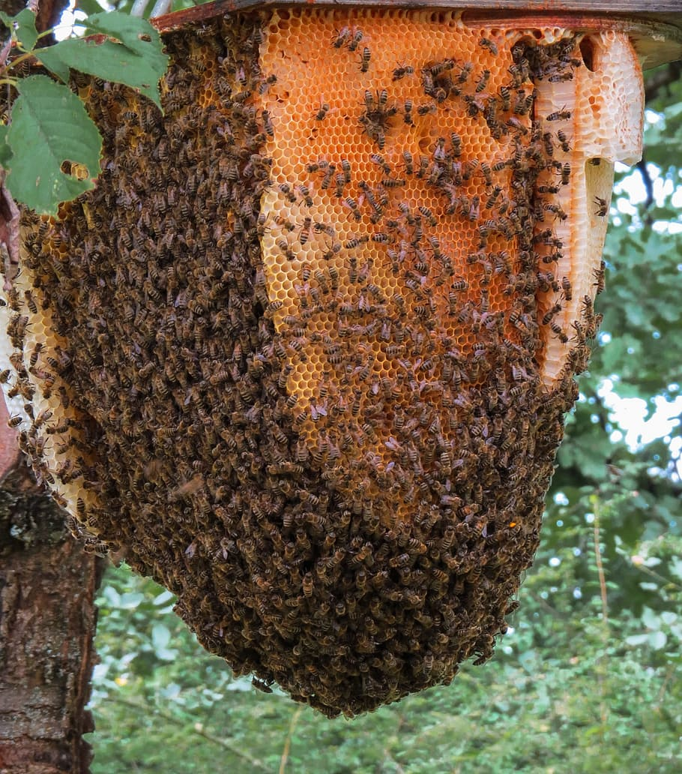
Apiculture- Introduction
Applied branch of Entomology.
Raring of honey bees for honey, wax and to improve crop yield through effective pollination.
L.L. Langstrogth is ‘father of apiculture’.
Bees are social insect, colonial, polymorphic & useful insect.
Human association since 4000 years.
Bee keeping
1. Traditional/ Indigenous method
2. Modern method

Slide 4
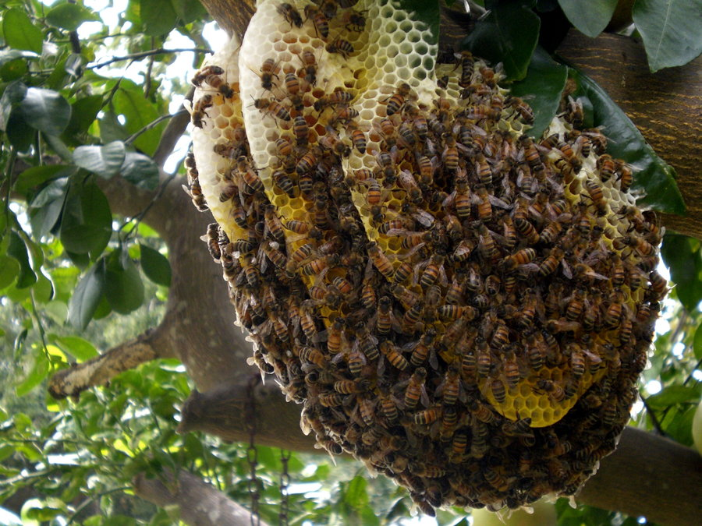
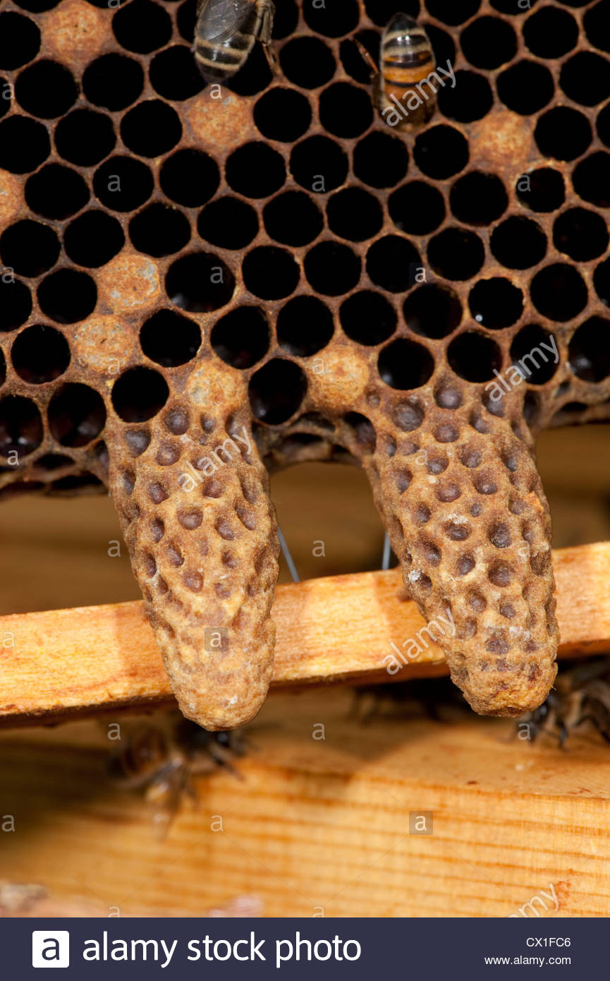
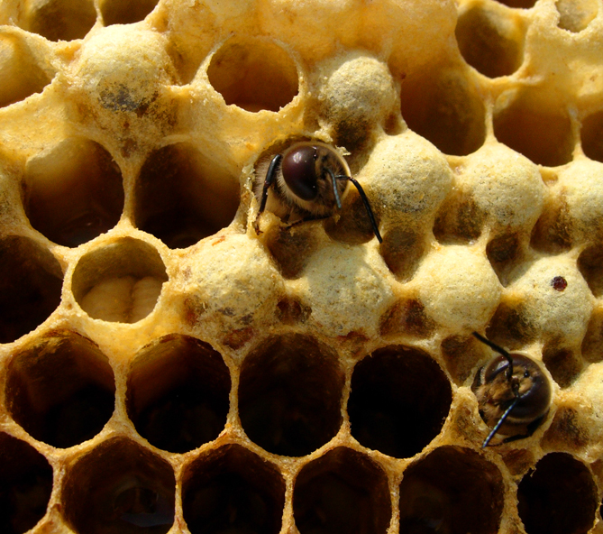
Structure of Natural hive
Honey bees nest is highly organized manner.
Two types of Cells
1. Storage Cells – upper part stores honey and Pollens.
2. Brood cells- Central and lower part : three types.
  a) Worker cell
  b) Drone cells
  c) Queen Cells.
  In one honey hive 1 queen, few hundreds drone and thousands of workers.

Slide 5
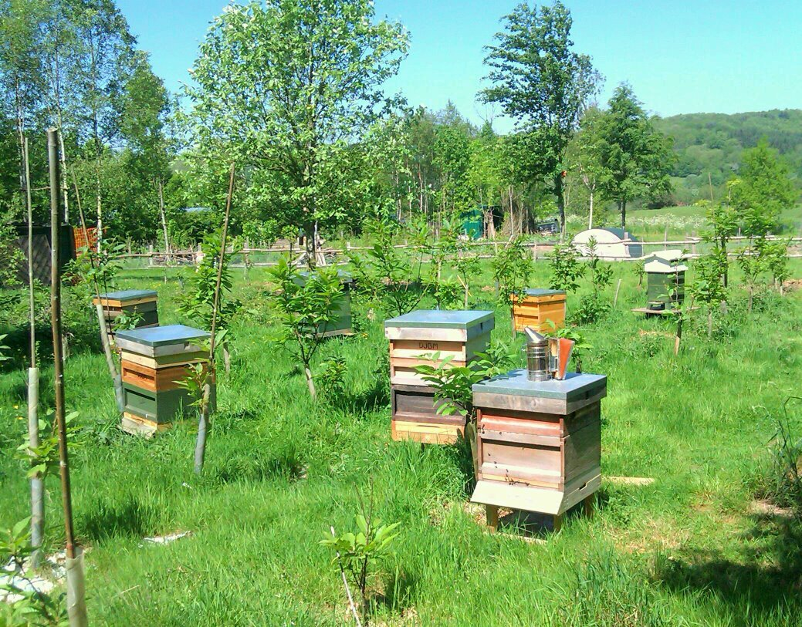
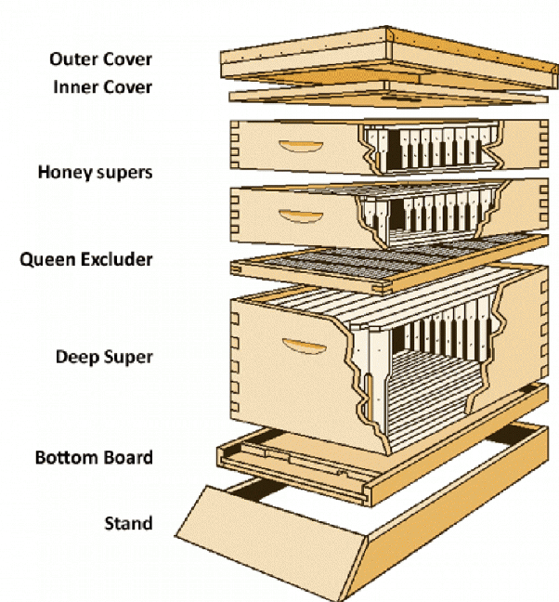
Structure of Artificial hive

Slide 6
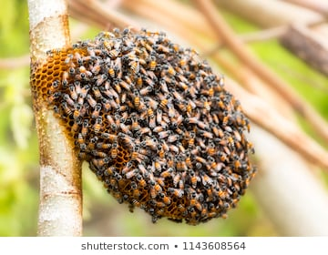
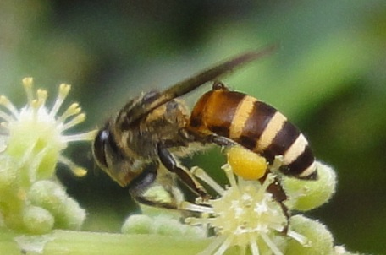
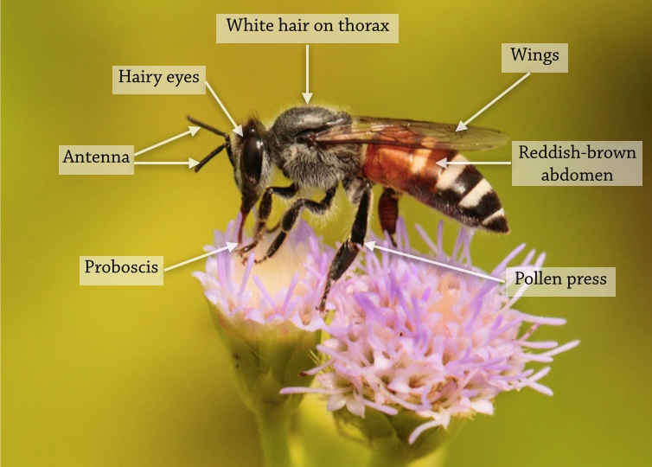
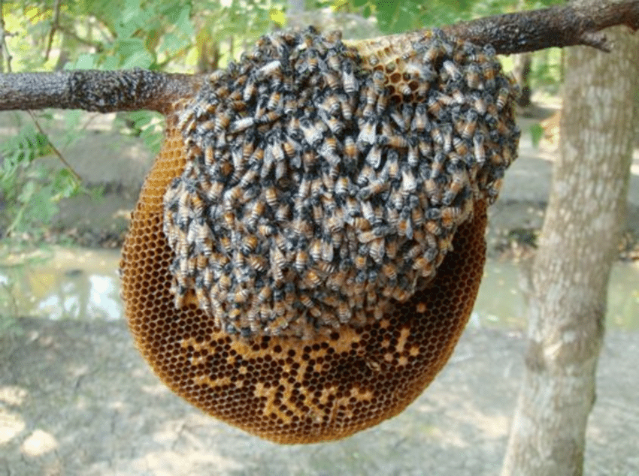
Species of Honey bees used in Apiculture
Apies andreniformes : small sized bees with combs 150-200 cm wide. Found in south Asia, Borneo, Philippines and China.
Apies florae : Called red dwarf honey bee size is 7-10 mm in length. Indigenous to Oman, Indonesia, Philippines, Sudan, southern and southeastern Asia & Iraq.

Slide 7
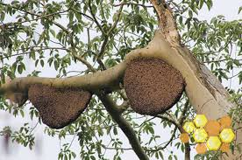
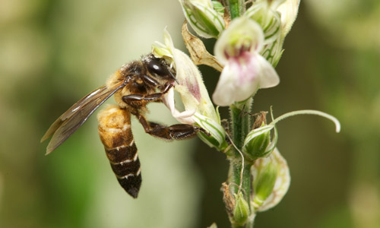
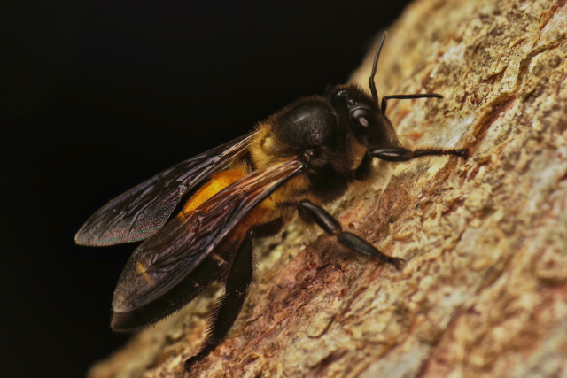
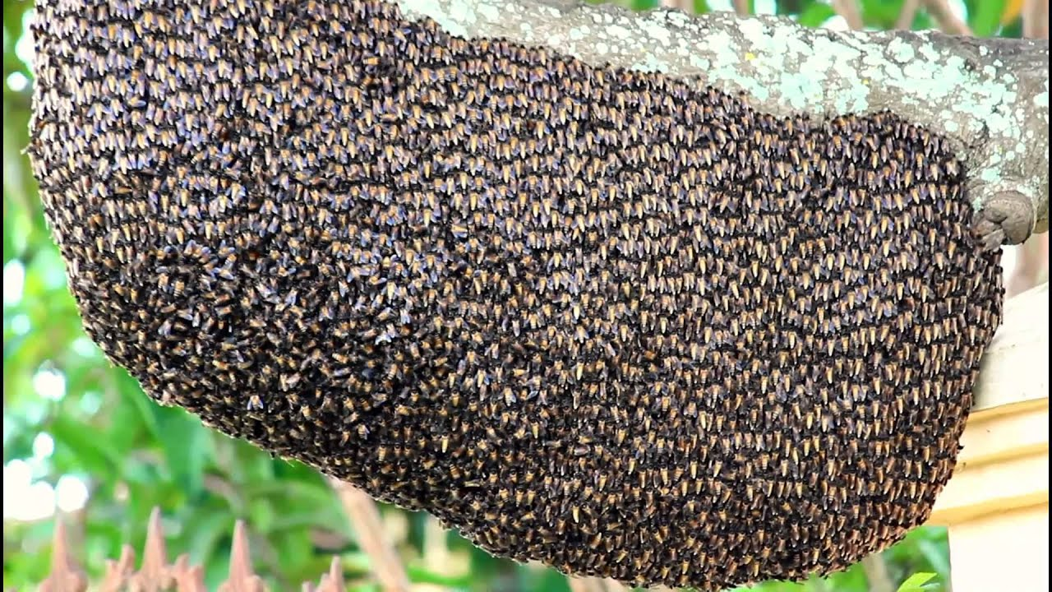
Apies dorsata : The Himalayan giant honey bee or Rock bee larger 17–20 mm single large comb. South and Southeast Asia, found mainly in forested areas such as the Terai of Nepal.
Apies binghami : sub type of A.dorsata. They occur in Indonesia and Philippines

Slide 8
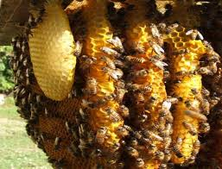
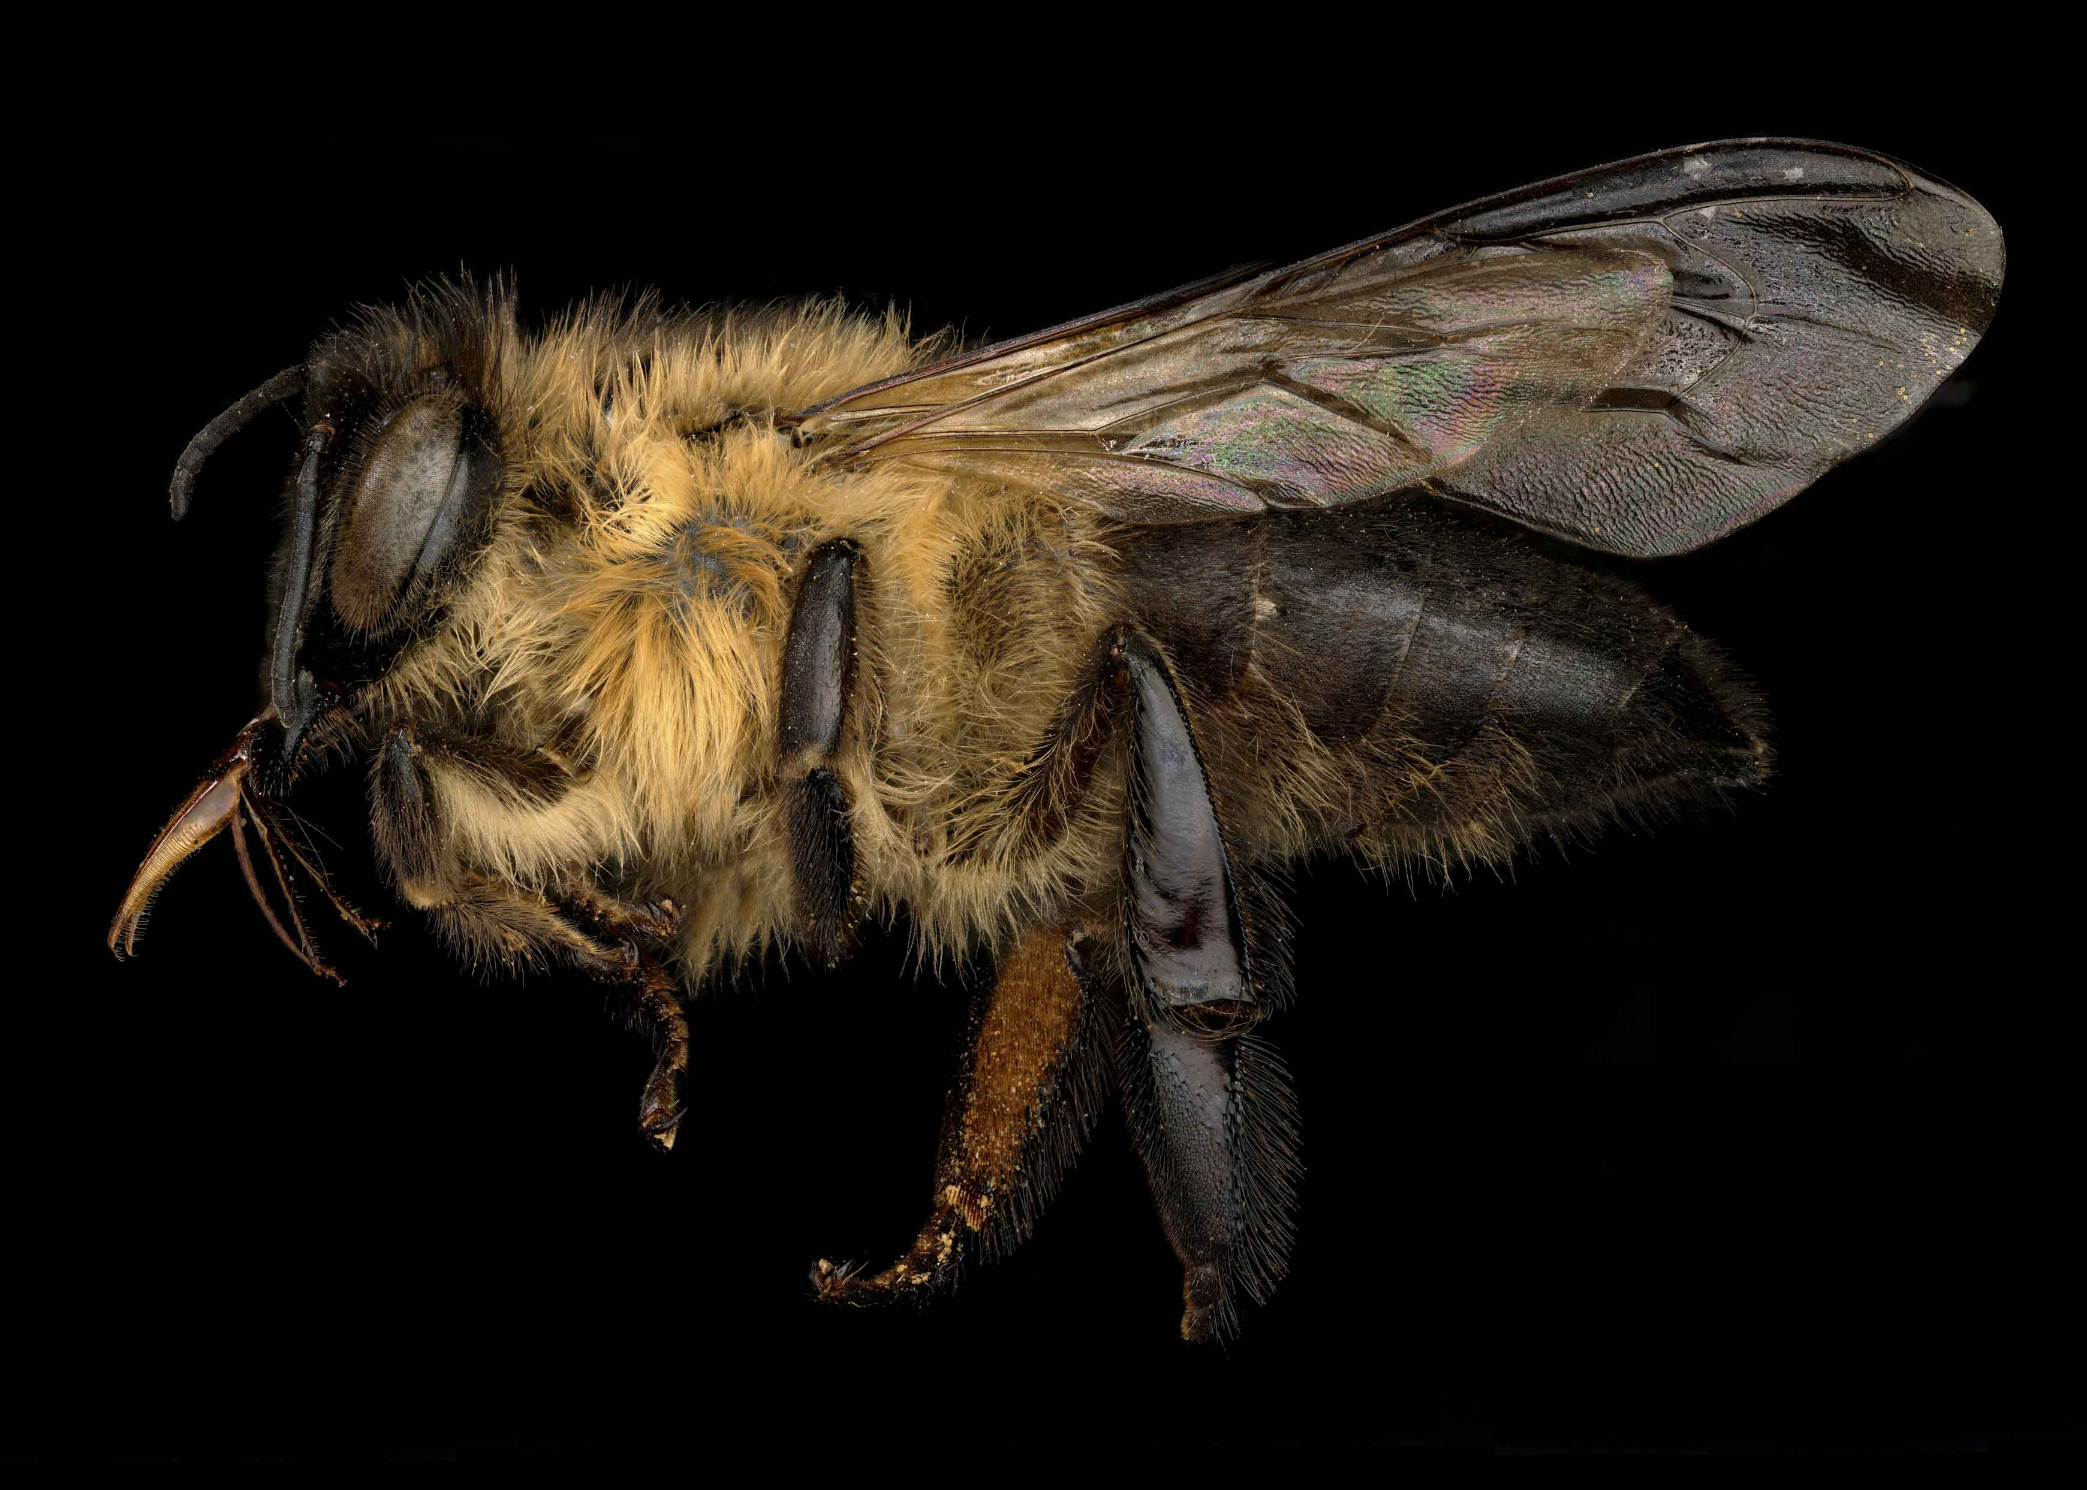
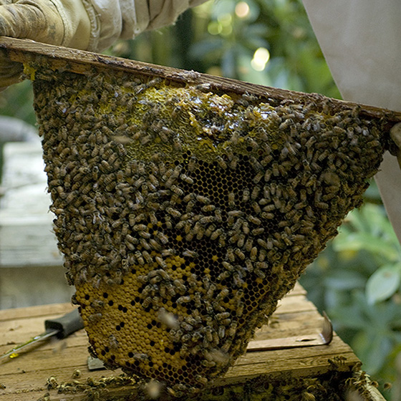
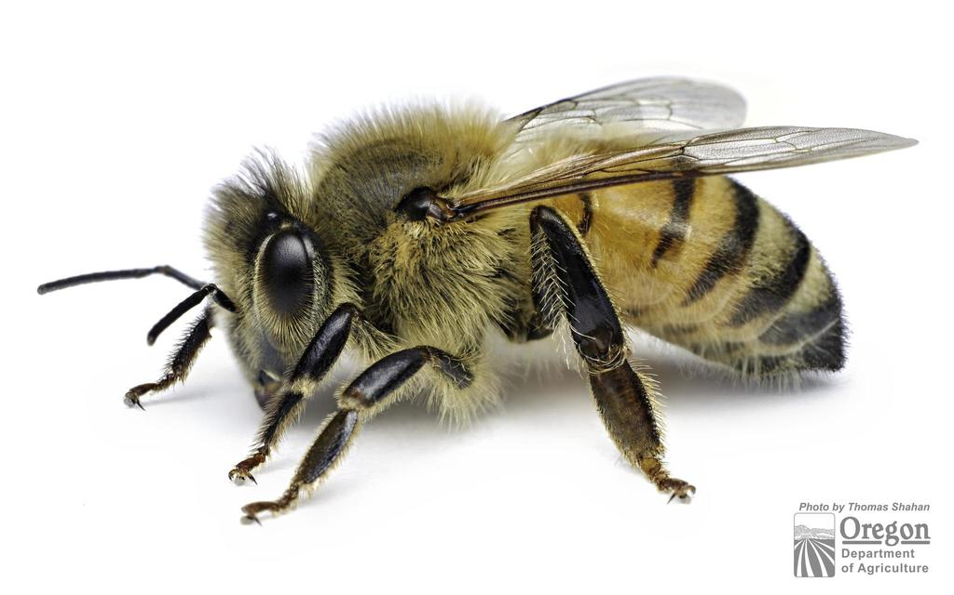
Apies laboriosa : Comparatively large size bees found in Himalayas. It is with medium size hive with multiple comb.
It mostly nests at altitudes between 2,500 and 3,000 m (8,200 and 9,800 ft), building very large nests under overhangs on the southwestern faces of vertical cliffs.
Apies mellifera : The western honey bee or European honey bee the Middle East, and Africa. Also found in America, Australia, Argentina, China,and Mexico.

Slide 9
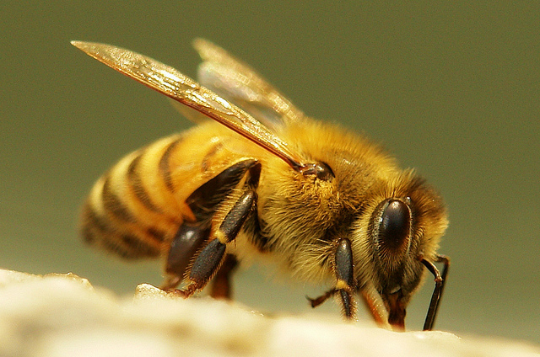
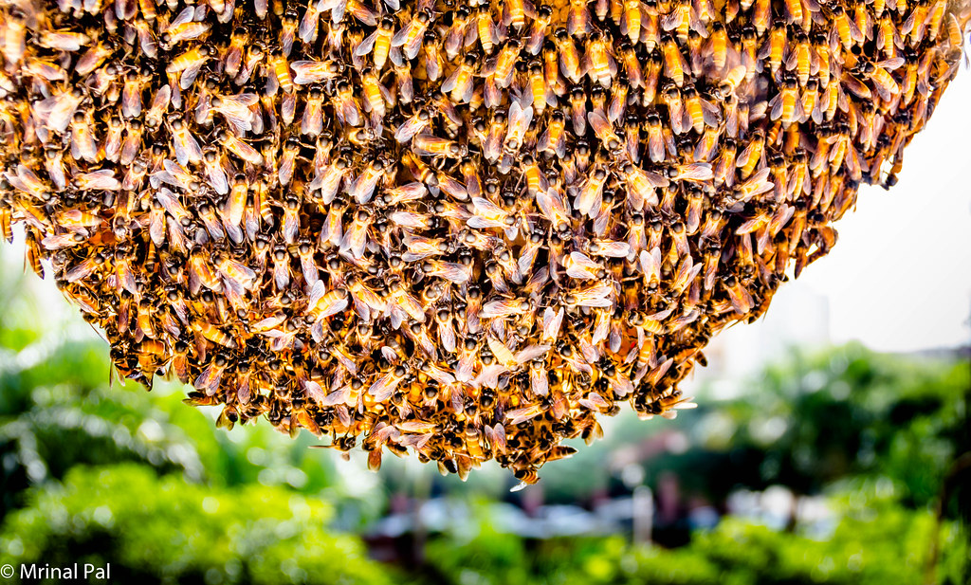
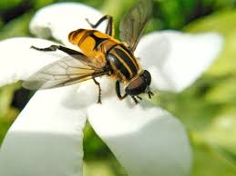
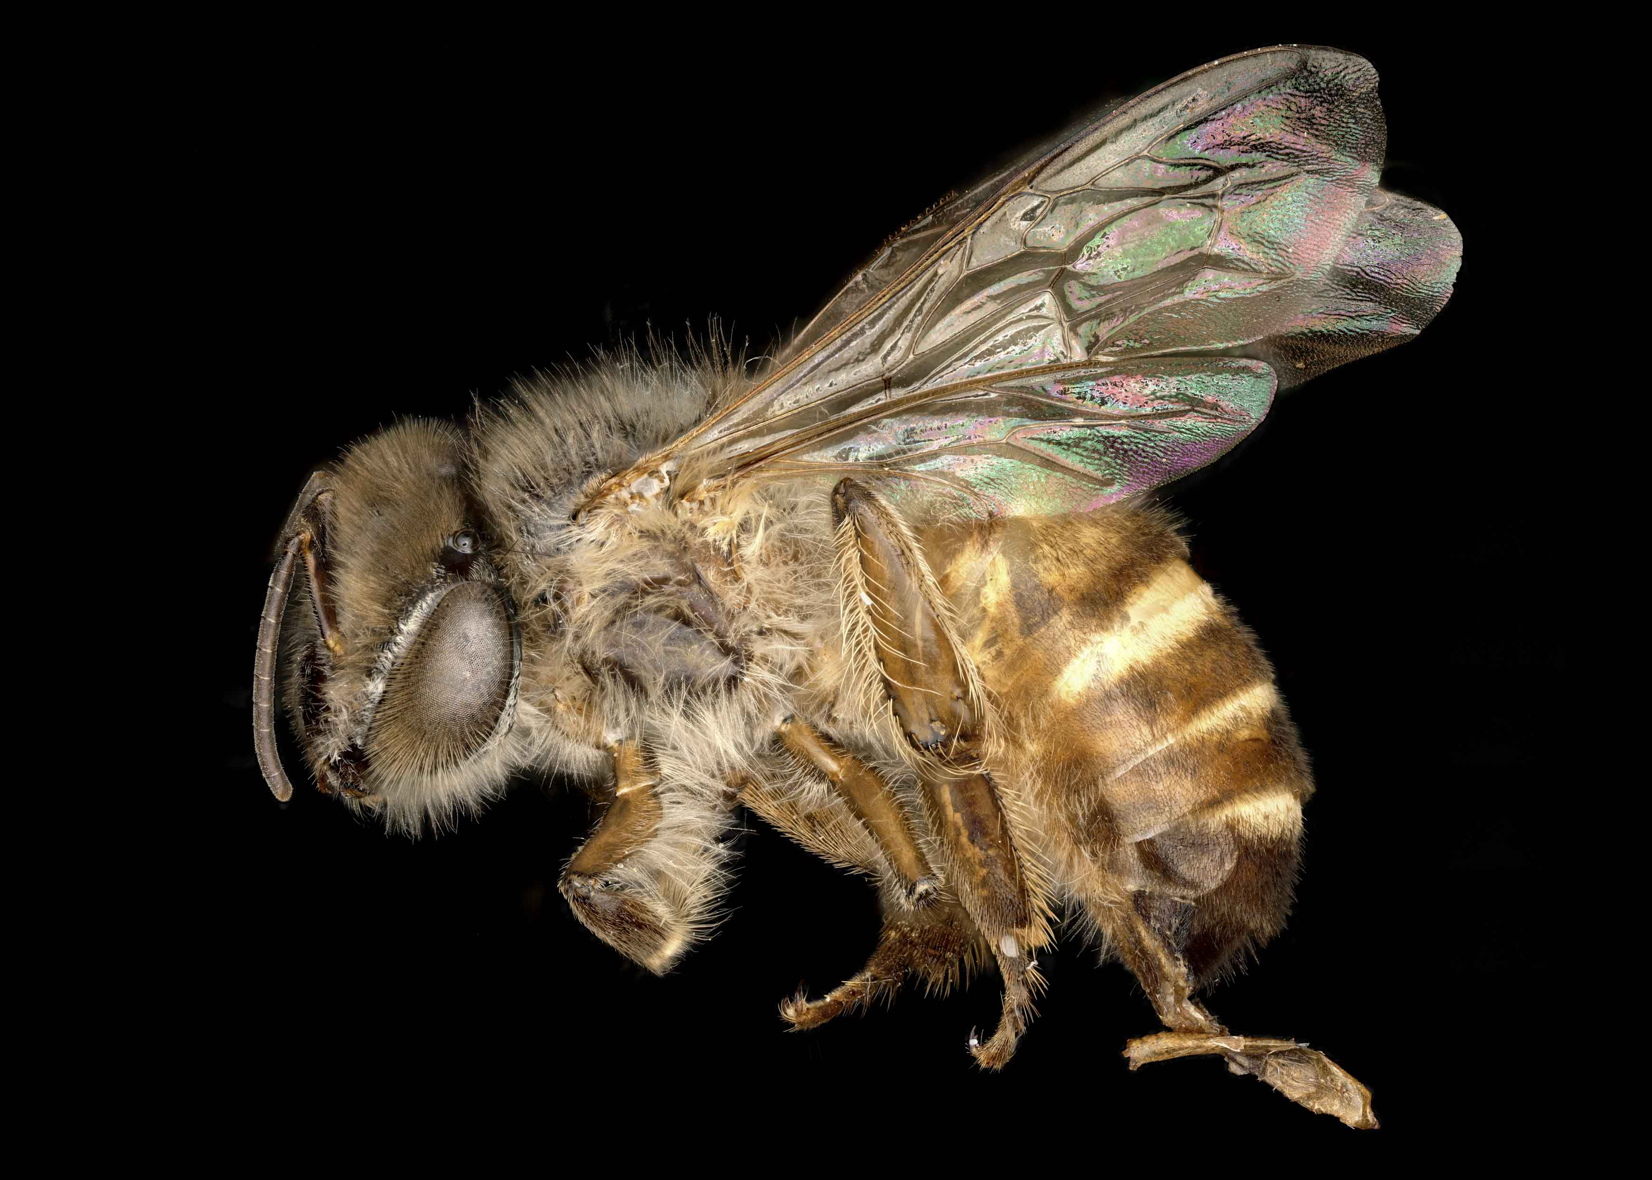
Apies cerana indica : The Indian honey bee It is one of the predominant bees found and domesticated in India, Pakistan, Nepal, Myanmar, Bangladesh, Sri Lanka, Thailand and mainland Asia. Mountain ranges of tropical areas. Also called Asian Honey bee.
Relatively non-aggressive and rarely exhibiting swarming behavior, it is ideal for beekeeping.
Apies koschevnikovi : Known as Red bee is a species of honey bee which inhabits Malaysian and Indonesian Borneo, where it lives sympatrically with other honey bee species such as Apis cerana
Apies nigrocineta : Apis nigrocincta is a species of honey bee that inhabits the Philippine island of Mindanao as well as the Indonesian islands of Sangihe and Sulawesi. The species is known to have queens with the highest mating frequencies of any species of the tribe Apini.

Slide 10
Selection of flora & bees for Apiculture
Flora : nectar producing plant is called Honey Plant
e.g. neem, maize, mango, karvi, jamun, gulmohar, orange, apple, almond, watermelon etc.
Wheat, Sage, berry eucalyptus.
Bee for Apiculture: out of 20000 species of bees 30 are exploited by humans for Apiculture.
Widely used species Apis mellifera.
European bees are also introduced in Asian countries.
Other species are Apis cerana indica and Apis Florae

Slide 11
Advantages & Disadvantages
Traditional Apiculture: Advantages
A. dorsata & A. cerana indica are used.
No special technique is required.
Easy to perform, No investment is required
Wild species is more resistant to pest.
Bees colonies migrates less frequently.
Disadvantages
Extracted honey is impure, not of good quality, less price, contaminated by brood extract.
Increase chance of queen loss during harvesting, is crud method.
Whether, climate can show impact on honey bees.
Race improvement program can not be applied.

Slide 12
Advantages & Disadvantages
Modern Apiculture: Advantages : is a Scientific method discovered by L.L. Langstroth in 1851
Movable frame hive can be used
European bees is used for Apiculture gives more production of honey ( 50 kg/year)
Special technique is required wooden boxes, removable frames, combs.
Easy to perform, No investment is required
Pure honey in large quantity can be produced. Hony hive and bees protected from adverse condition and from enemies.
Bees colonies migrates less frequently. Race improvement program can be applied.
Disadvantages
In flora absent need to provide sugar surup for their survival.
Pesticides may cause heavy loss to the honey colonies bees looses their natural resistance
Seasonal harvesting transportation increase cost.
Growing of flora is difficult and costly.

Slide 13
Pests & Bee enemies
Pests , enemies, diseases in major problems in bee keeping industry.
55 % of bee keeping suffer to attack.
Climatic factor can show impact on bee keeping.
E.g. The wax moth, wasp, ants, bee eaters.
Insects
Birds
Bacterial
Viral

Slide 14
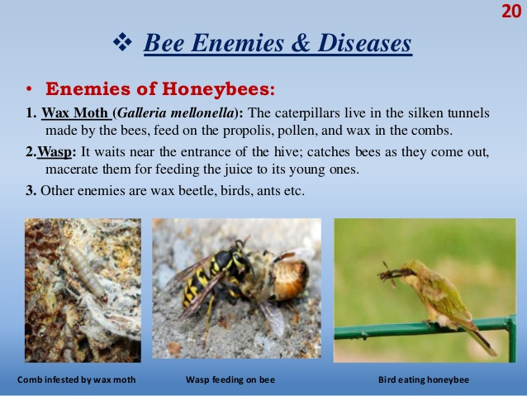

Slide 15
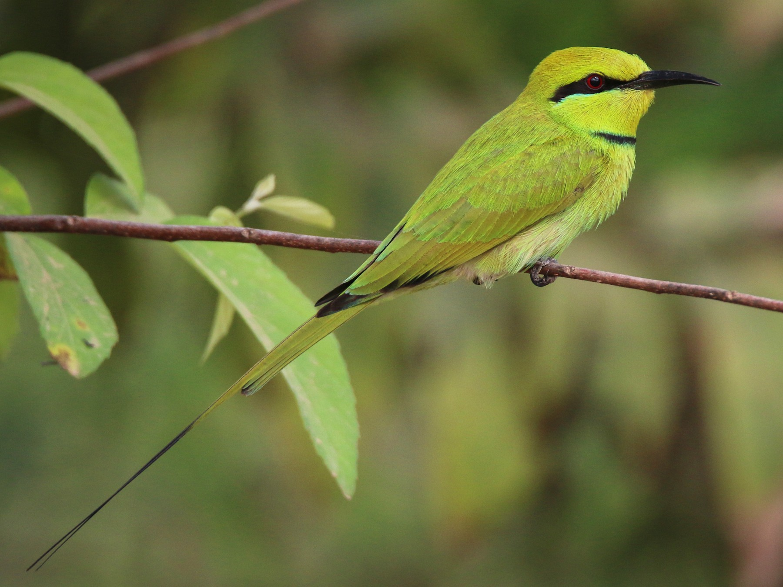
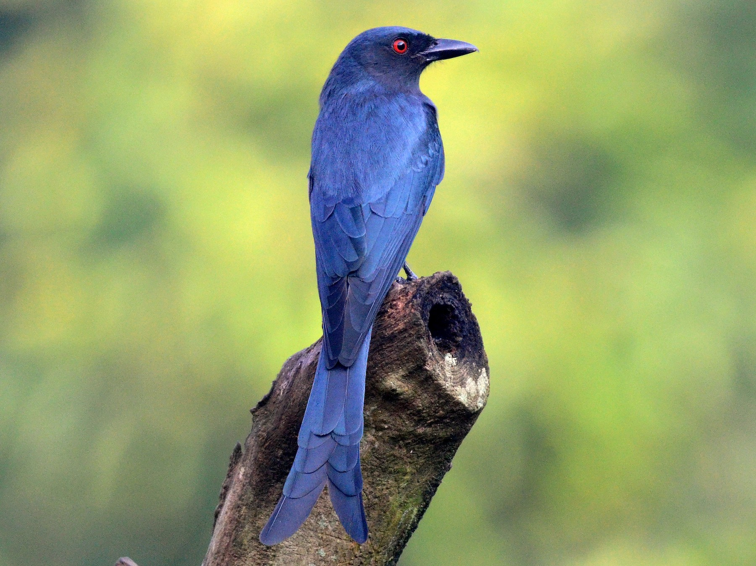
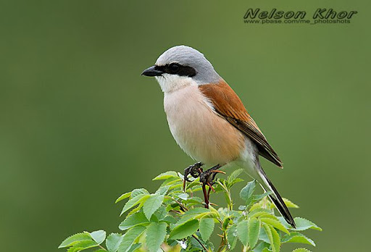



Honey Bee eater birds
Green bee eater,
Drongo
Red backed shrike
Lesser yellow nape
Greater yellow nape
King crow

Slide 16
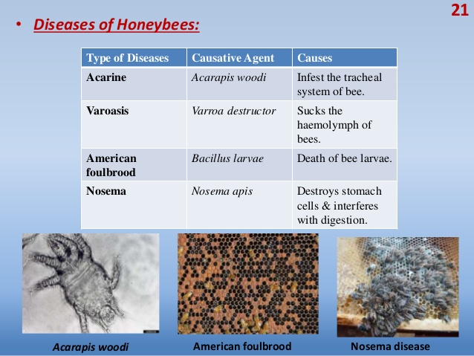

Slide 17
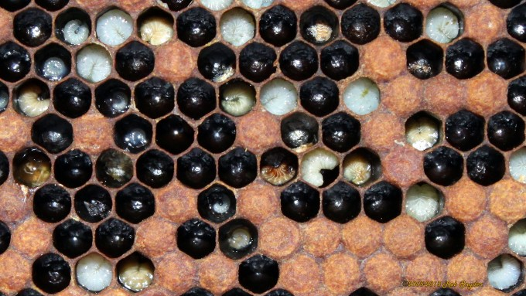
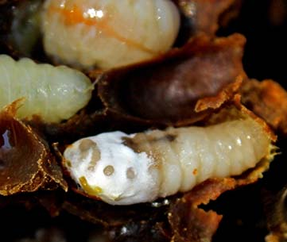
Diseases in honey bees
Bacterial Diseases
American faulbrood disease :
European faulbrood disease (FEB) : Non-spore bacterium Melissococcus plutonus
Affects larvae of all castes
Symptoms – 3-4 days larvae dies. Colour of larvae changes shinney white to pale yellow.
Chalk brood disease (Fungal) (Aschopherosis) : Ascopheria apis affects bee brood chamber, fungal form spores. Infection larvae
Dead larvae swells covers whitish mycelia fungus, harden shrink and look like chalk.
Prevention : Keep hive well ventilated & free from moisture.
Initially white mummies and dead larvae should be removed.

Slide 18
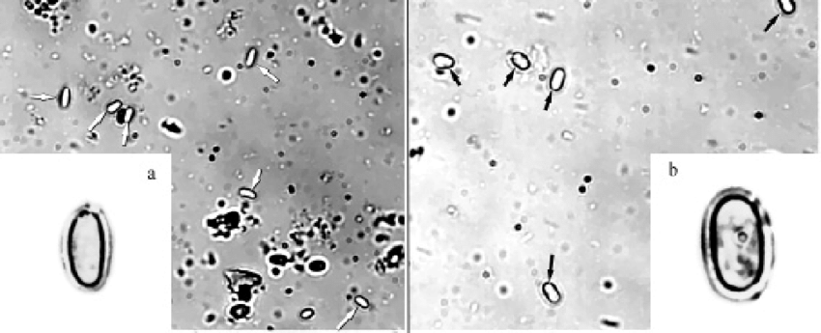
Nosema disease
Microsporadium Nosema apis & Nosema ceranae, spores germinate within one night multiply by forming new spores. Nutrition is impared.
Symptoms : No reliable diagnostic characters. Abdomen is swollen & shiny. Spore presence confirmed after microscopic infections.
Prevention :
Taking care of colonies & apiaries.
Adequate ventilation
Hive should be decontaminated by heat.
Change comb every after two years.
N.apies
N. ceranae

Slide 19
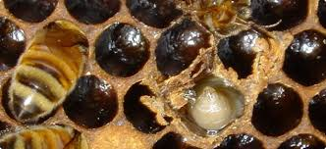
Viral Diseases
Sac brood disease : Attack A. mellifera & A.indica brood.
Larvae appear sac like.
Disease common in Asia including India, Thiland.
Symptoms: larvae fails to pupate & remains streached our their backs
Dead larvae dry out flat scales & adhere to cells floor.
Prevention :
Infected colonies should be removed.
Requeen the colony
Remove infected brood combs
Restore colony strength by providing food & adding new worker populations,

Slide 20
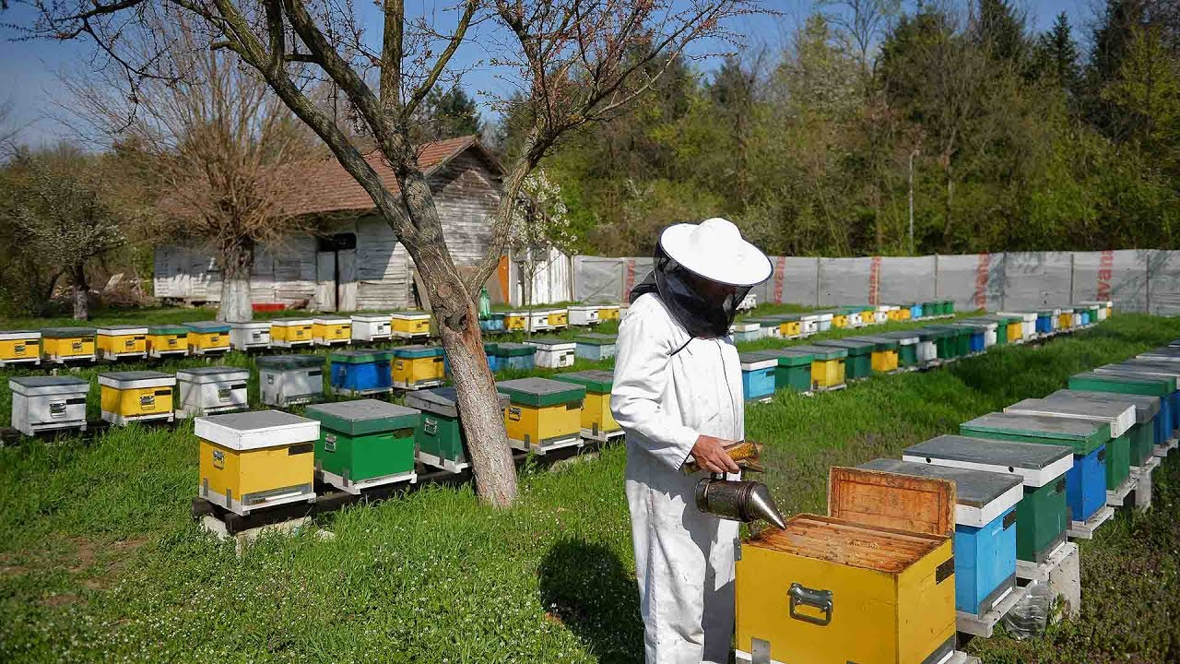
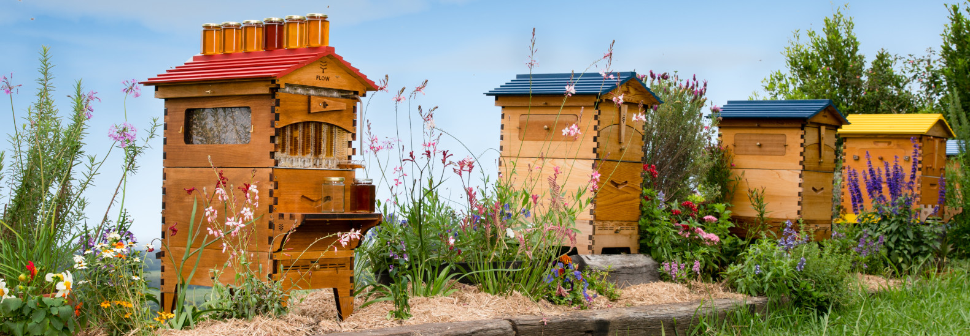
Bee keeping Industry
Present Status:
Provides high returns as honey, Royal jelly, bee wax, bee venom,propolis.
Enables efficient pollination.
Acts as biosensor to maintain quality of environment.
In India bee keeping initiated in 1917 in Travancore and Mysore in 1925.
ICAR established research center in Punjab in 1945.
India produces 4000 metric tons of honey annually
40000 villages involve in honey bees rearing in India.

Slide 21
Recent efforts
Employment Generation in rural India.
Training Program hive manufacturing, Apicultural equipment's, Transport, traders, packers, sellers, dealers, marketing and allied industries.
Institutions started to help bee keepers.
Punjab Agricultural University.
Central food technological Research Institute.
Central Bee research & training Institute
Farming, Research, Education, extension, marketing.
70 % honey and wax marketed in India
Well organized Industry.

Slide 22
Economic Importance
Honey Production : Honey has its origin in certain plant material mainly nector and honey dew.
To produce 100 gm of honey bee visits thousands of flowers.
Worker bees ingest the nectar, pollens and cane sugar get mixed with saliva under goes enzymatic changes called Semi ripened honey.
Fanners perform complex task of turning the semi ripened honey after maintaining proper temperature in the hive.

Slide 23
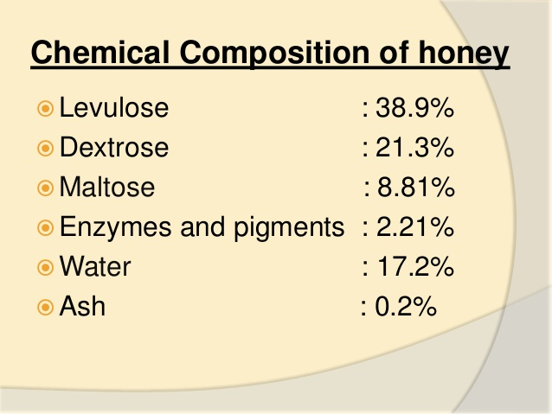

Slide 24
Economic Importance - Honey
Cooking with Honey : Eaten with bread, milk, Cereals, or fruits.
Honey Drinks & beverages : Tej is honey wine made up of gesho (African shrub)
Honey in Cosmetics : hygroscopic properties, face pack, lotions, shampoo, soaps.
Vitamin content of Honey: B1,B2,B3, B5, B6,C,E,K and Carotene. Helpful to curing diseases like beriberi, anemia, pellagra, rickets, & Scurvy.
Honey as Ayurvedic medicine: laxative, anticeptic, coughing illness, respiratory tract infection.
Bactericidal properties of Honey: Inhibit bacterial growth like streptococci, Staphylococci, bacillus, coliform etc.

Slide 25
Economic Importance - Beeswax
40 % of beeswax used in cosmetic industry.
Good quality wax could get price 4-10$ / kg.
Used in shampoo, soaps, skin ointment.
Melting was used in different oils and perfumes.
Used in dyes industry.
30% wax used in pharmaceutical industry.

Slide 26
Other Uses
Making polish furniture, cars,shoes and other lether products.
In lubricants in industrial use.
As Insulation in electronic components.
As sealant for air & water proof sealing of bottle and container.
In making drawing crayons.
For preparation of tissues blocks in Microtomy.
Strengthen threads used in sewing & Kite flying.

Slide 27
Roll of Honey bees in pollinations
Pollination is anthers are transferred to stigma.
Many plants require vector for pollination.
Pollination by bees are called Ëntomophily”.
65 % of pollination takes place by bees.
A.indica & A.Mellifera domesticated for pollination in Punjab.

