Slide 1
Thakur College of Science & Commerce
Department of Zoology
Academic Year – 2020-21
Welcome You all
F.Y. B.Sc. (CBZ)
Zoology
Semester – I
Paper –I Unit - III
Biodiversity & Its Conservation
Dr. Vitthal T. Mohite

Slide 2
Introduction to Syllabus
Class | Semester | Paper | Units
F.Y.B.Sc | I | I | 3 units
 |  | II | 3 Units
 | II | I | 3 Units
 |  | II | 3 Units
S.Y.B.Sc. | III | I | 3 Units
 |  | II | 3 Units
 |  | III | 3 Units
 | IV | I | 3 Units
 |  | II | 3 Units
 |  | III | 3 Units

Slide 3
T.Y.B.Sc.
Class | Semester | Paper | Units
T.Y.B.Sc | V | I | 4 units
 |  | II | 4 units
 |  | III | 4 units
 |  | IV | 4 units
 |  | Applied Component | 4 units ( In Zoology 8 Units)
 | VI | I | 4 units
 |  | II | 4 units
 |  | III | 4 units
 |  | IV | 4 units
 |  | Applied Component | 4 units ( In Zoology 8 Units)

Slide 4
Pattern of Examination
Semester I 60 : 40 pattern
Theory : 60 Marks for each paper
CE : 40 marks
Practical 50 marks each paper.

Slide 5

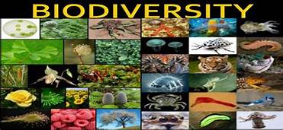
Biodiversity
Definition : Biodiversity is the variety and variability of life on Earth.
Biodiversity is typically a measure of variation at the genetic, species, and ecosystem level.
Terrestrial biodiversity is usually greater near the equator, which is the result of the warm climate and high primary productivity.
Biodiversity is not distributed evenly on Earth, and is richest in the tropics.
These tropical forest ecosystems cover less than 10 percent of earth's surface, and contain about 90 percent of the world's species.
Biodiversity generally tends to cluster in hotspots, and has been increasing through time, but will be likely to slow in the future.
The diversity of all living things (biota) depends on temperature, precipitation, altitude, soils, geography and the presence of other species.

Slide 6
Concept of Biodiversity
Around 50 million species of plants, animals and micro-organisms are existing in the world.
Out of these, about 1.4 million species have been identified so far.
Each species is adapted to live in specific environment, from mountain peaks to the depth of seas, from polar ice caps to tropical rain forests and deserts.
All this diversity of life is confined to only about one kilometer thick layer of lithosphere hydrosphere and atmosphere which form biosphere.

Slide 7
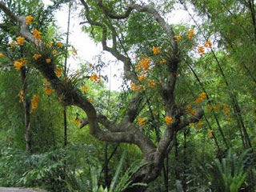
Scope of Biodiversity
Medicinal field: It plays important role as medicines for various diseases are derived from variety of plants and...
Industry :It is the scope of biodiversity as different industries got their raw materials from plants and animals.
Agriculture: It is also the scope of biodiversity which gives different agricultural products that are the products from...
Research and study : It provides unlimited resources.
Job opportunity : It gives opportunity for the people by programs and project that have been launched for biodiversity conservation.
Environment conservation: Different living organism interact with environment factors.
Different living organism like plant and animals are interact with the environmental component.

Slide 8
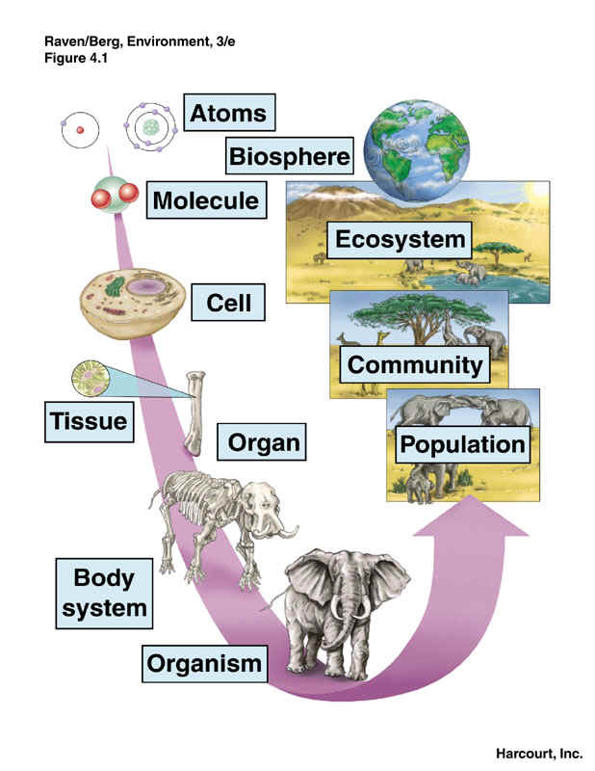
Levels of Organization

Slide 9
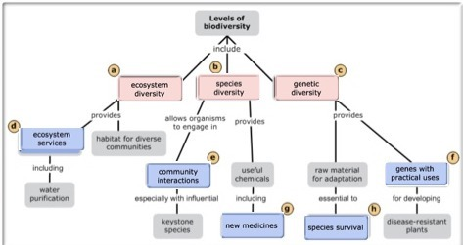

Slide 10
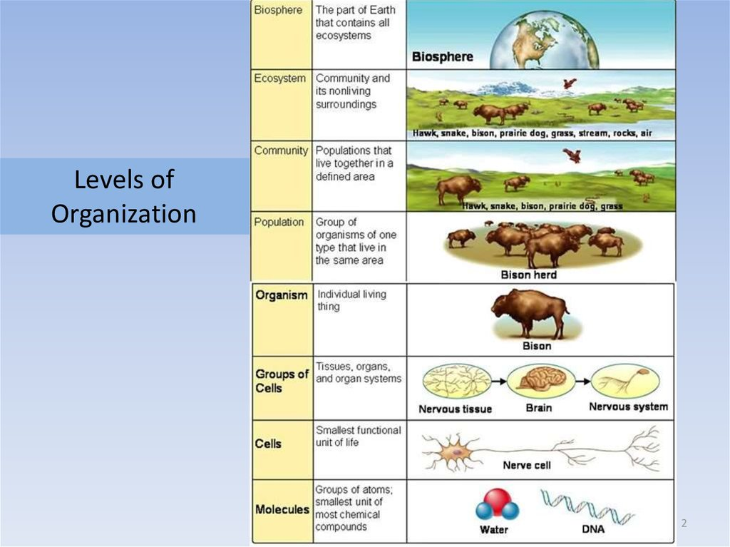

Slide 11
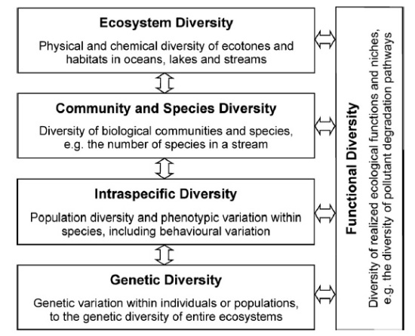

Slide 12
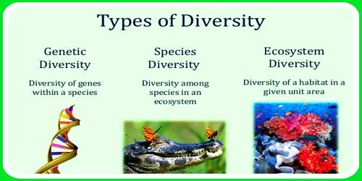
Types of Biodiversity

Slide 13
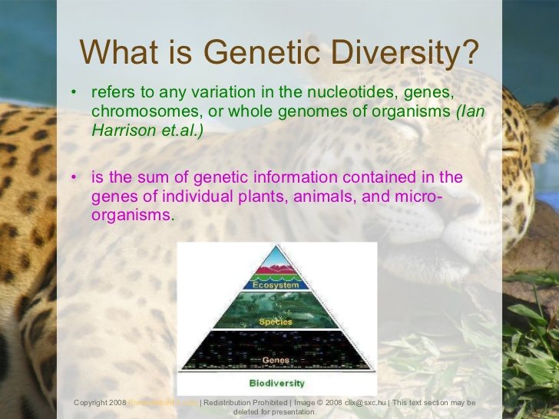

Slide 14
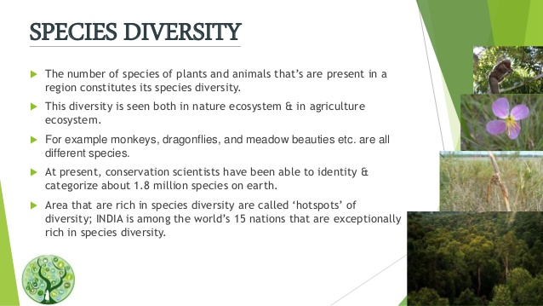

Slide 15
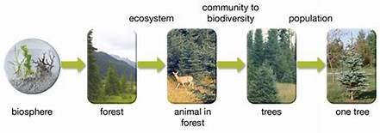
Ecosystem Diversity

Slide 16
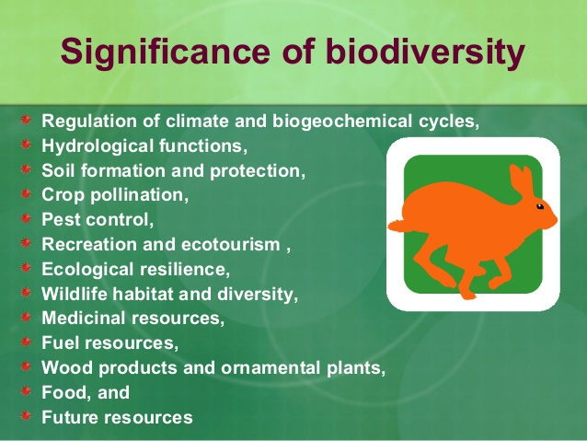

Slide 17
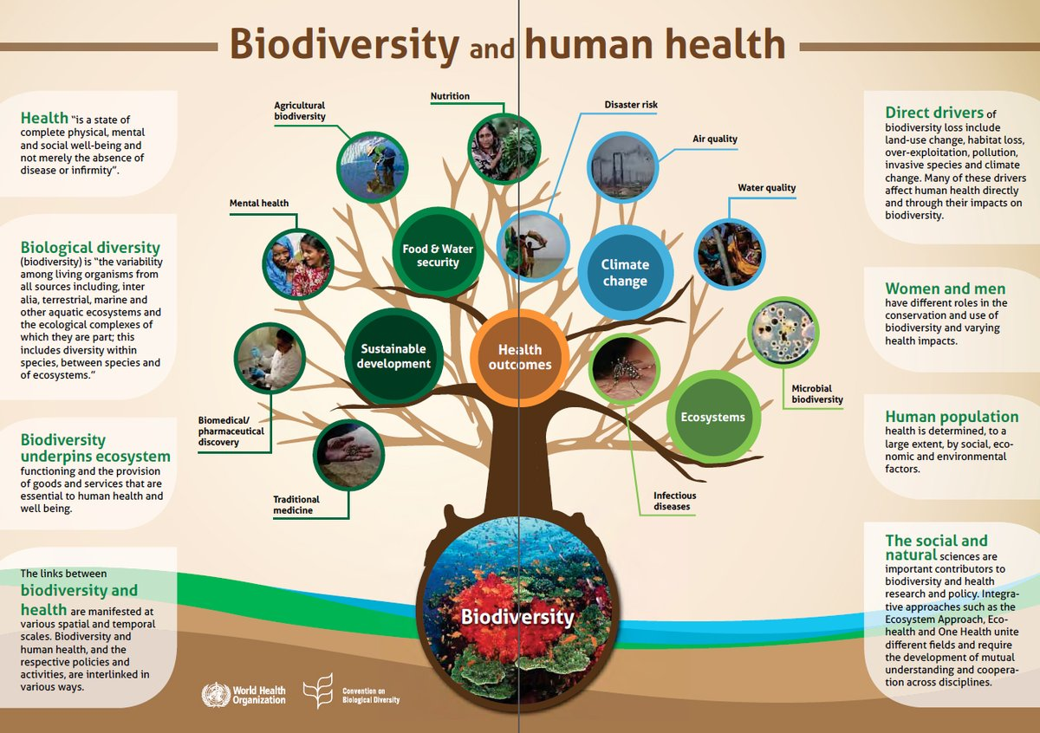

Slide 18
Significance of Biodiversity
Food
Health
Agricultural
Economic
Ecological
Recreational & Aesthetic value
Inspiration

Slide 19
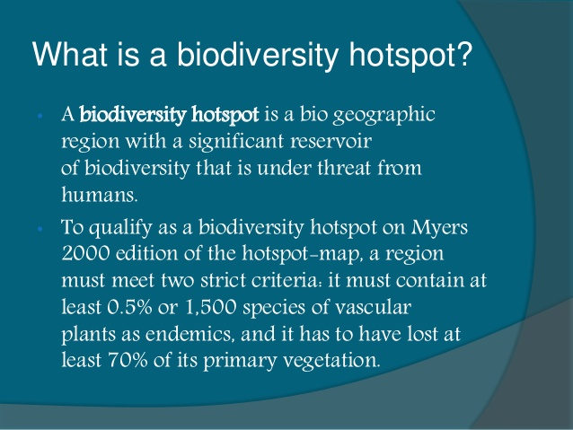

Slide 20
Biodiversity Hot Spots
The Earth’s biodiversity is evenly distributed across its surface.
There are over a thousand major eco-regions in the world.
It is estimated that there are about 200 richest, rarest and most distinctive natural areas in the world. These are referred to as the Global 200.
Hotspots of biodiversity refer to bio-geographic regions where significant levels of biodiversity.
It is with richness and unusual concentration of endemic species are found, however, they are threatened with mindless exploitation and destruction.
A biodiversity is termed as a hotspot if −
It has at least 1,500 vascular plants as endemic.
It must be threatened or under threat of destruction to a considerable extent.
Across the world, about 35 areas are marked as hotspots of biodiversity.
They represent 2.3 percent of the Earth’s land surface but they support more than half of the world’s endemic plant species and almost half of birds, mammals, reptiles, and amphibians as endemic.

Slide 21
Biodiversity Hot Spots
Biodiversity hotspots host their diverse ecosystems on just 2.4% of the planet's surface, however, the area defined as hotspots covers a much larger proportion of the land.
The original 25 hotspots covered 11.8% of the land surface area of the Earth.
Overall, the current hotspots cover more than 15.7% of the land surface area, but have lost around 85% of their habitat.
This loss of habitat explains why approximately 60% of the world's terrestrial life lives on only 2.4% of the land surface area.

Slide 22
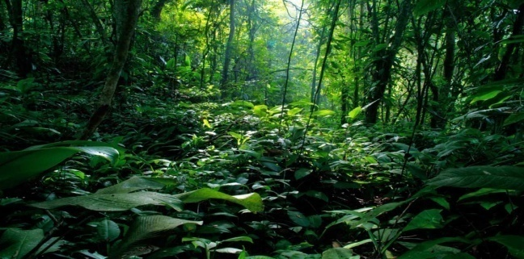
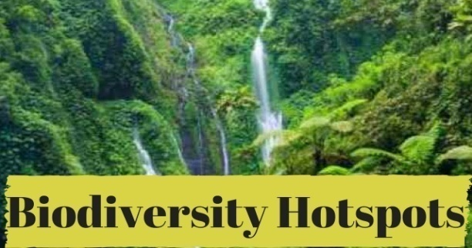
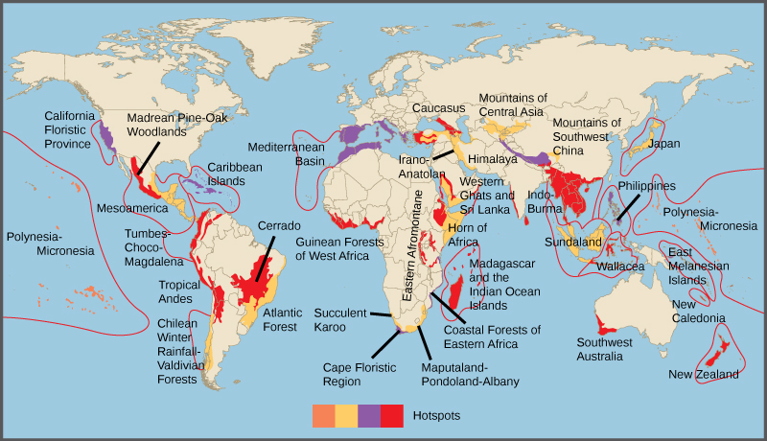
World Biodiversity Hotspots

Slide 23
World Biodiversity Hotspots
North and Central America California Floristic Province •8• Madrean pine-oak woodlands •26• Mesoamerica •2• North American Coastal Plain •36•^{[15][16]} The Caribbean Caribbean Islands •3• South America Atlantic Forest •4• Cerrado •6• Chilean Winter Rainfall-Valdivian Forests •7• Tumbes-Chocó-Magdalena •5• Tropical Andes •1• Europe Mediterranean Basin •14• | Africa Cape Floristic Region •12• Coastal Forests of Eastern Africa •10• Eastern Afromontane •28• Guinean Forests of West Africa •11• Horn of Africa •29• Madagascar and the Indian Ocean Islands •9• Maputaland-Pondoland-Albany •27• Succulent Karoo •13• Central Asia Mountains of Central Asia •31• South Asia Eastern Himalaya •32• Indo-Burma, India and Myanmar •19• Western Ghats and Sri Lanka •21• | Southeast Asia and Asia-Pacific East Melanesian Islands •34• New Caledonia •23• New Zealand •24• Philippines •18• Polynesia-Micronesia •25• Eastern Australian temperate forests •35• Southwest Australia •22• Sundaland and Nicobar islands of India •16• Wallacea •17• East Asia Japan •33• Mountains of Southwest China •20• West Asia Caucasus •15• Irano-Anatolian •30•

Slide 24
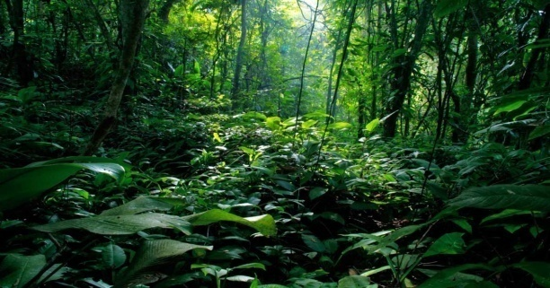
List of Biodiversity Hotspots in the World
North and Central America − California Floristic Province, Madrean pine-oak woodlands, Mesoamerica
The Caribbean − Caribbean Islands
South America − Atlantic Forest, Cerrado, Chilean Winter Rainfall-Valdivian Forests, Tumbes-Chocó-Magdalena, Tropical Andes
Europe − Mediterranean Basin
Africa − Cape Floristic Region, Coastal Forests of Eastern Africa, Eastern Afromontane, Guinean Forests of West Africa; Horn of Africa; Madagascar and the Indian Ocean Islands; Maputaland-Pondoland-Albany; Succulent Karoo
Central Asia − Mountains of Central Asia
South Asia − Eastern Himalaya, Nepal; Indo-Burma, India and Myanmar; Western Ghats, India; Sri Lanka
South East Asia and Asia-Pacific − East Melanesian Islands; New Caledonia; New Zealand; Philippines; Polynesia-Micronesia; Southwest Australia; Sundaland; Wallacea
East Asia − Japan; Mountains of Southwest China
West Asia − Caucasus; Irano-Anatolian
https://youtu.be/FQbcJUGvyOo

Slide 25
Present Status of Biodiversity in Hotspot
Sr. No. | Name of Biodiversity Hotspot | No.of Plants | Endemic plants | No.of Vertebrates | No.of endemic Vertebrates
1 | Tropical Andes | 45000 | 20,000 | 3389 | 1567
2 | Sundaland | 25000 | 15 000 | 1800 | 701
3 | Meditrrranean basin | 19000 | 13 000 | 770 | 235
4 | Islands of Philippines | -- | 5832 | -- | 2185
5 | Caribbean | -- | 7000 | -- | 1518
6 | Inlasnd of Medagascar | -- | 9704 | 987 | 771
7 | Brazil Atlantic Forest | 20000 | 8000 | 1361 | 567
8 | Indo-Burma & | 13500 | 7000 | 2185 | 528
9 | Western Ghats | 218 | 2180 | 1073 | 355
10 | Tanzania – Kenya | 1500 | -- | -- | 121

Slide 26
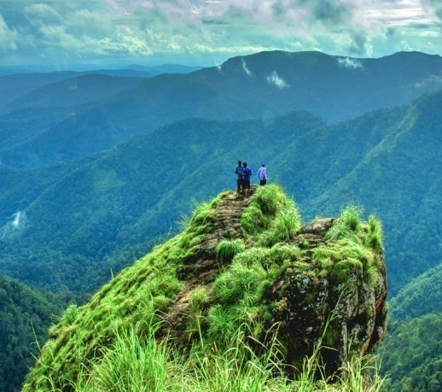
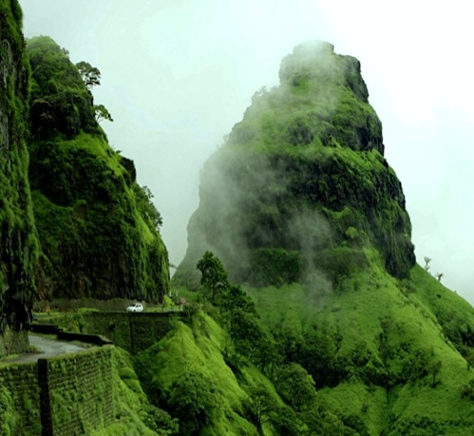
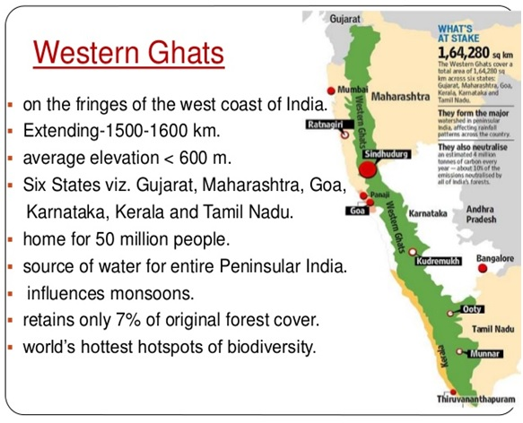
The Western Ghats

Slide 27
The Western Ghats
The Western Ghats is not only a biodiversity hotspot with incredible biological diversity.
The Western Ghats are one of the world’s biodiversity hotspots with over 5,000 flowering plants, 139 mammals, 508 birds...
At least 325 globally threatened species occur here.
The range covers 60,000km 2 and forms the catchment area for a complex of river systems that drain almost 40% of India.
At 2695m, Mt Anamudi in Kerala, India is the highest peak in the Western Ghats.
The Western Ghats are being considered as a UNESCO World Heritage Site.
The region hosts 7,402 species of flowering plants, 1,814 non-flowering plant species.
508 species of birds, 139 species of mammals, 179 amphibian species, 290 freshwater fish species, and as many as 6,000 insect species.
Many species are endemic to the region and at least 325 species that have been globally declared as threatened live in the forests of this ecoregion.

Slide 28
Climate of The Western Ghats
The climate of the Western Ghats ecoregion varies depending on altitude and distance from the equator.
The average annual temperature is around 15 °C.
The climate is tropical humid in the lower reaches of the Western Ghats since it is influenced by the proximity to the Arabian Sea.
The climate becomes more temperature with rising altitude.
In some parts of the Western Ghats, freezing temperatures during winter and frost are common.
The windward side of the Western Ghats receives heavy rainfall during the monsoon season since the mountain range acts as a barrier to the monsoon winds which are forced to rise and deposit most of the rain.
Rainfall in the windward slopes is about 300 to 400 cm while that in the rain shadow region is much lower, about 100 cm.
https://youtu.be/7uPBKxODeh0

Slide 29
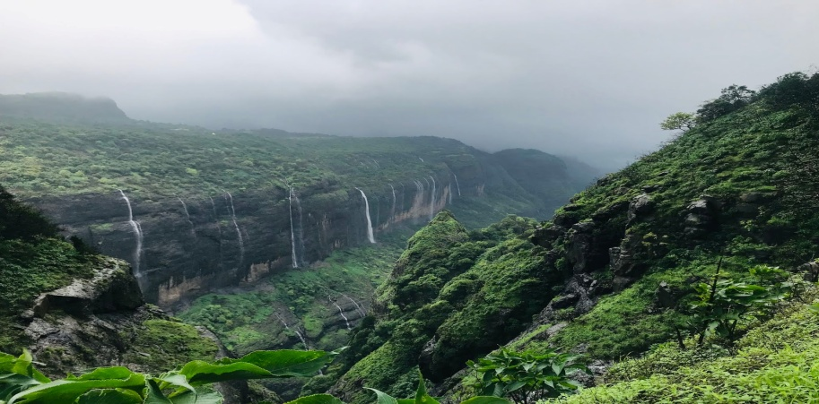
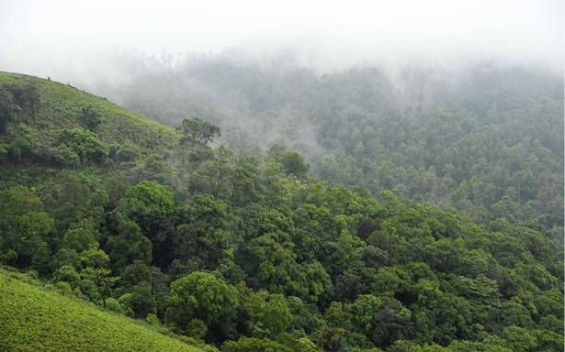
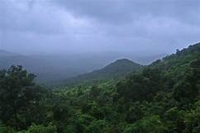
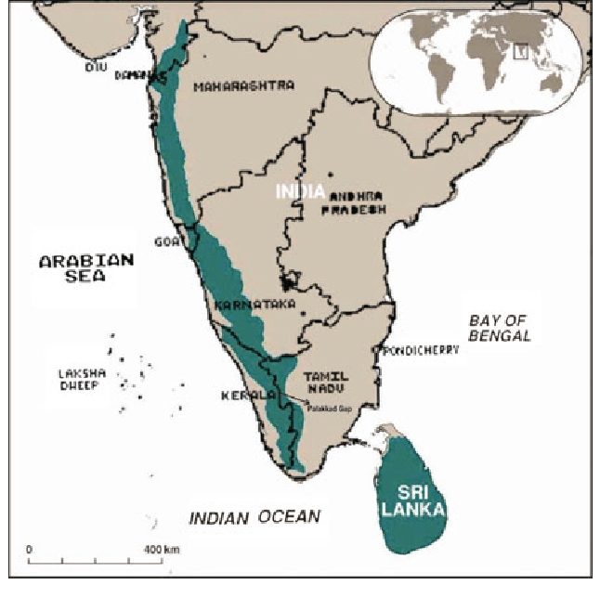
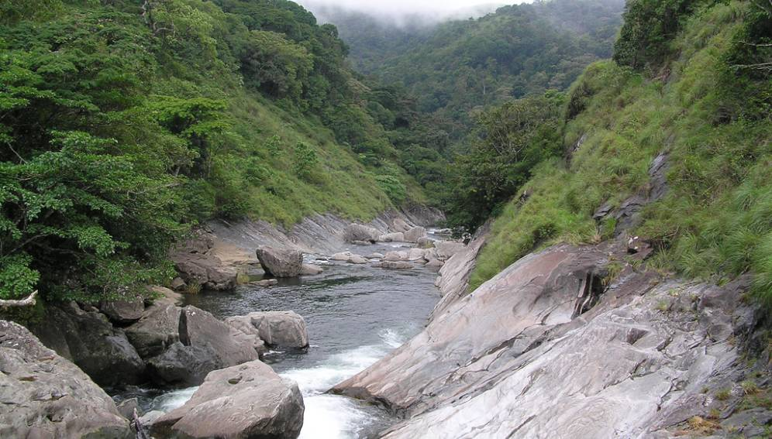
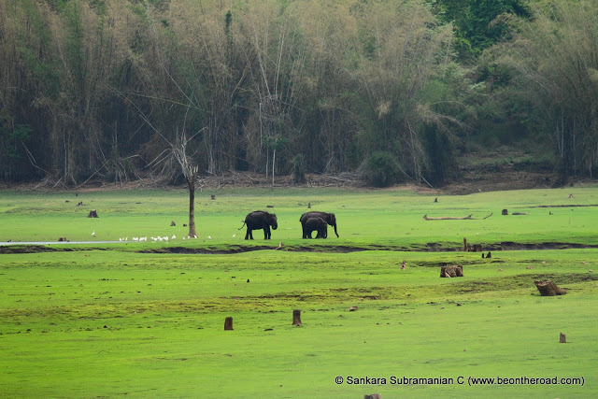
The Western Ghats

Slide 30
Indo –Burma Hotspot
The patterns of biological diversity in the Indo-Burma Biodiversity Hotspot have resulted from the interaction of topography, previous changes in climate, soil characteristics and patterns of seasonal rainfall.
At least a quarter of Indo-Burma's mammal species are considered globally threatened.
the Indo-Burma Biodiversity Hotspot—which comprises all non-marine parts of Cambodia, Lao PDR, Myanmar, Thailand and Vietnam, plus parts of southern China—is one of the most biologically important regions of the planet.
In terms of species diversity and endemism, the Indo-Burma Hotspot is one of the most biologically important regions of the planet.
Due to high human population pressure, rapid economic development, and changing consumption patterns, the natural ecosystems of the hotspot are being placed under increasing pressure.

Slide 31
Indo –Burma Hotspot
Indo-Burma encompasses 2,373,000 square kilometres (916,000 sq mi) of tropical Asia, east of the Ganges-Brahmaputra lowlands.
Formerly including the Himalaya chain and the associated foothills in Nepal, Bhutan and India, Indo-Burma has now been more narrowly redefined as the Indo-Chinese subregion.
The area contains the Lower Mekong catchment. It begins in eastern Bangladesh and then extends across north-eastern India, south of the Brahmaputra River, to encompass nearly all of Myanmar, part of southern and western Yunnan Province in China, all of the Lao People’s Democratic Republic, Cambodia and Vietnam, the vast majority of Thailand and a small part of Peninsular Malaysia.
In addition, the hotspot covers the coastal lowlands of southern China (in southern Guangxi and Guangdong), as well as several offshore islands, such as Hainan Island (of China) in the South China Sea and the Andaman Islands (of India) in the Andaman Sea.
The hotspot contains the Lower Mekong catchment.
The hotspot encompasses 33 terrestrial ecoregions, which include tropical and subtropical moist broadleaf forests, tropical and subtropical dry broadleaf forests, tropical and subtropical coniferous forests, temperate broadleaf and mixed forests, and mangroves.

Slide 32
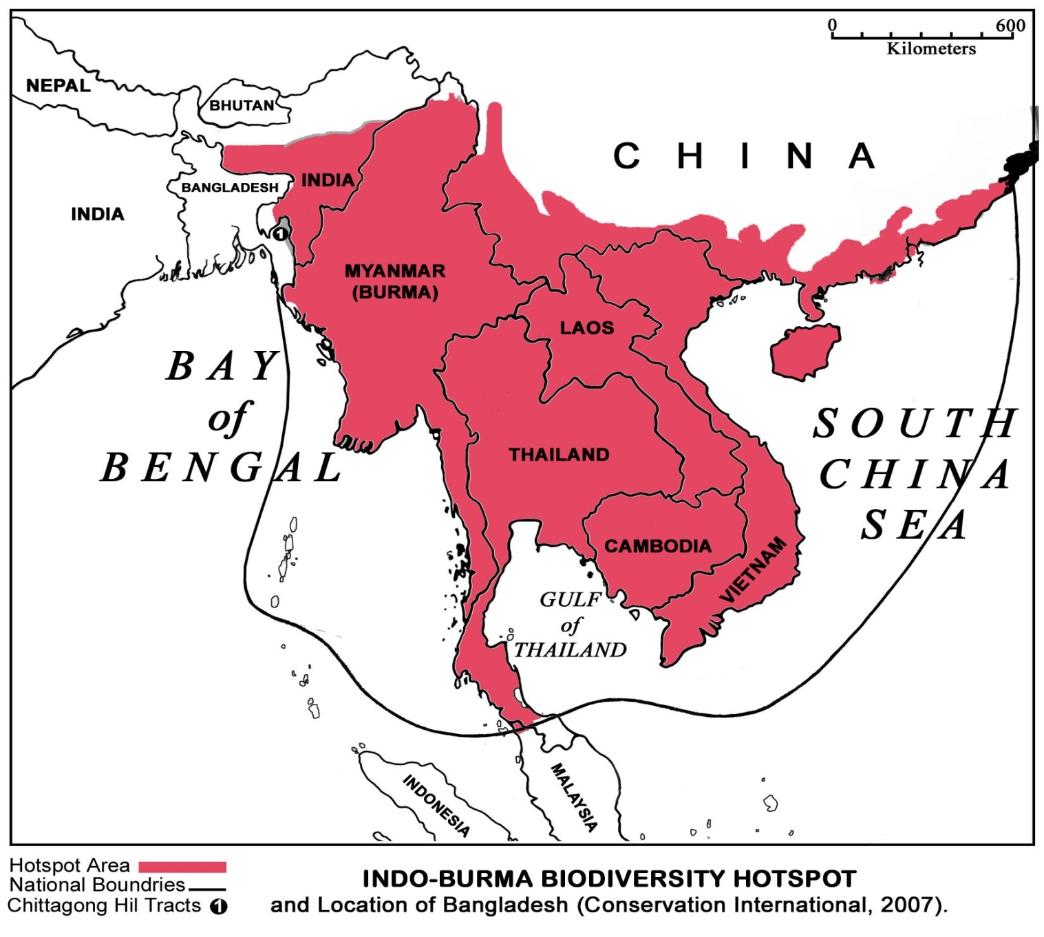
Indo –Burma Hotspot Geographical Location
https://youtu.be/TUKIrCRaN1A

Slide 33
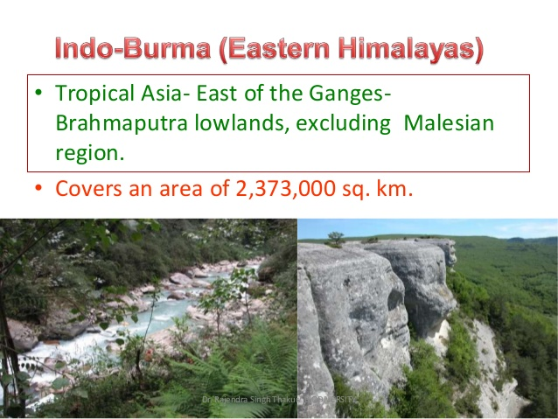
Indo –Burma Hotspot Biodiversity

Slide 34
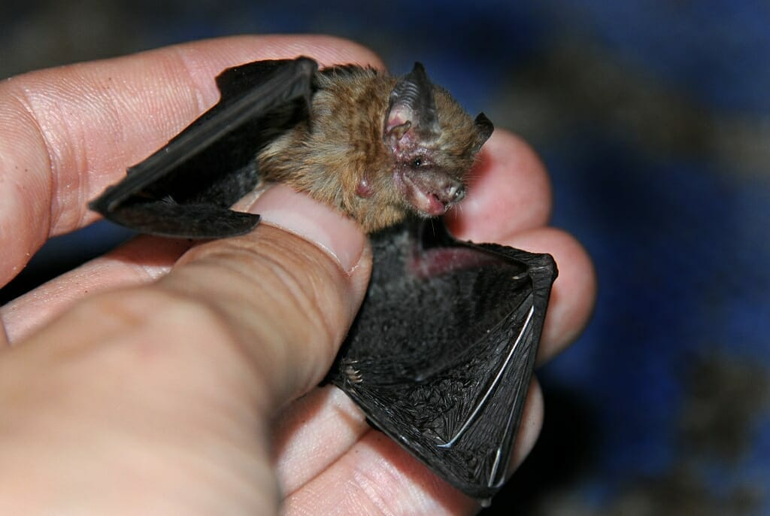
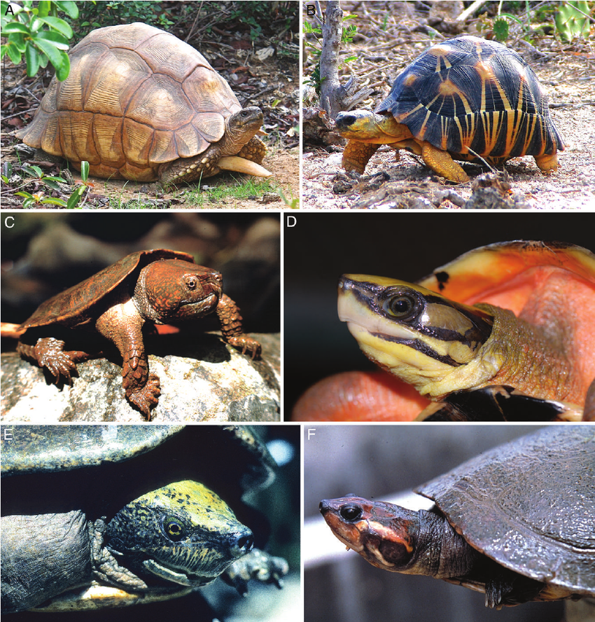
Biodiversity : Flora & Fauna
13500 vascular Plants 7000 endemic.
1262 freshwater fishes 556 are endemic.
323 amphibians 150 are endemic.
Reptilian 520 out of which 200 are endemic.
53 species of turtles. 1/5 of worlds turtles present in this hot spot.
1300 species of birds 60 are endemic.
430 species of mammals 70 are endemic.
315 million human population.
World smallest bat (Kitti’s hog-nosed bat)

Slide 35
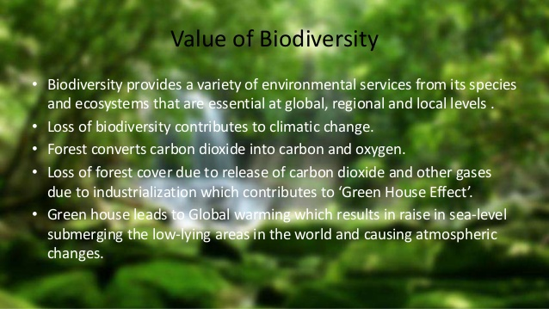

Slide 36
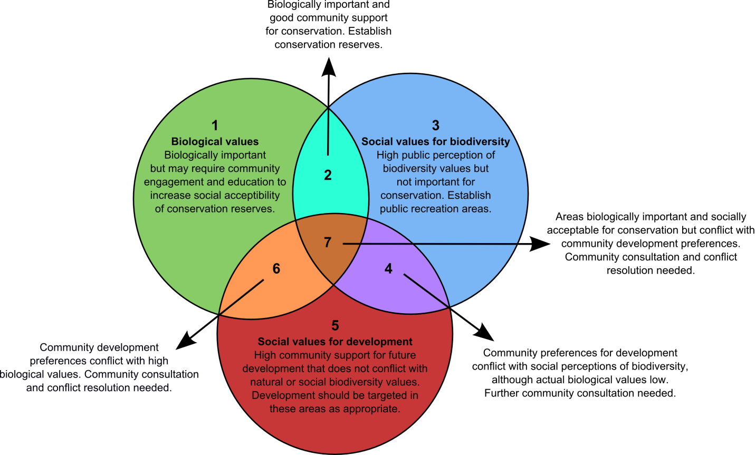
Value of Biodiversity

Slide 37
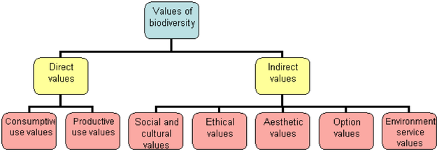
Value of Biodiversity

Slide 38
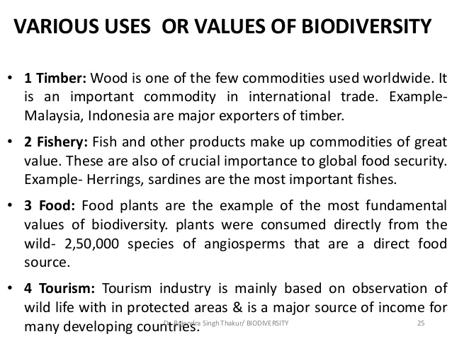

Slide 39
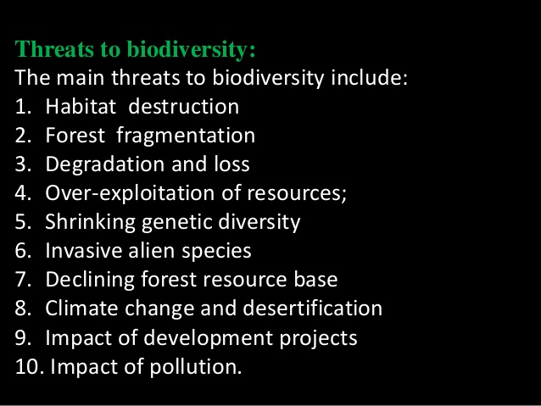
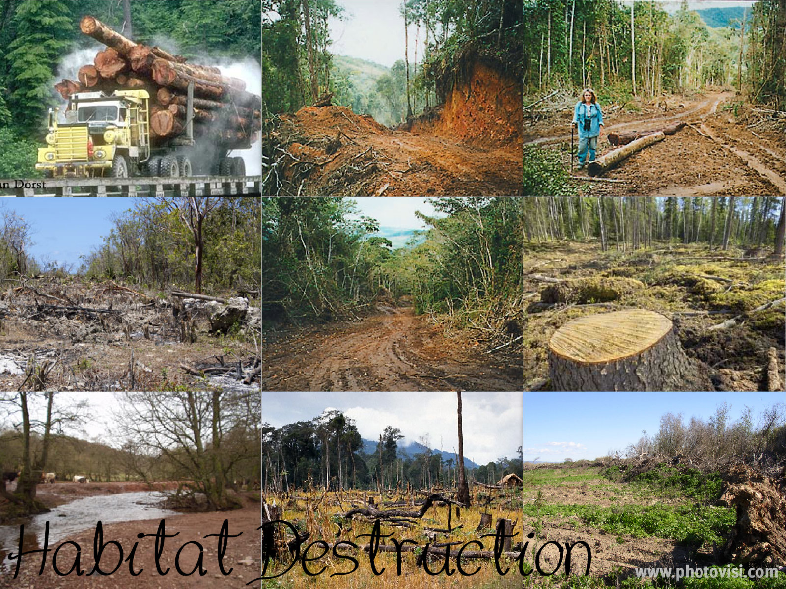

Slide 40
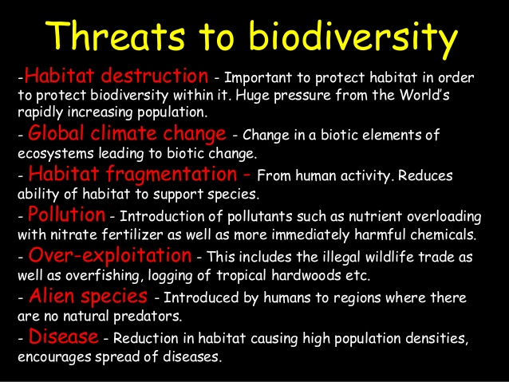

Slide 41
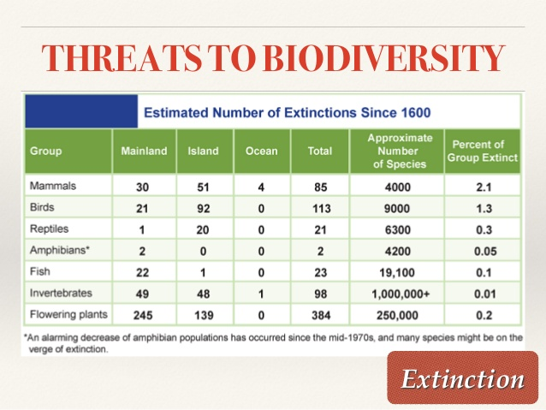

Slide 42
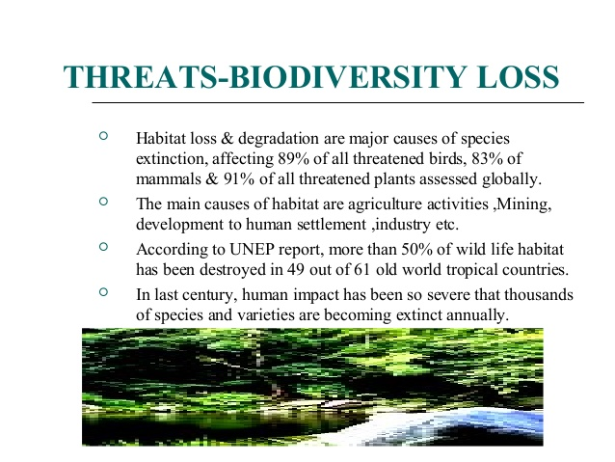

Slide 43
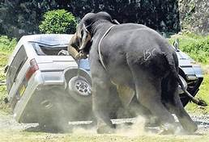
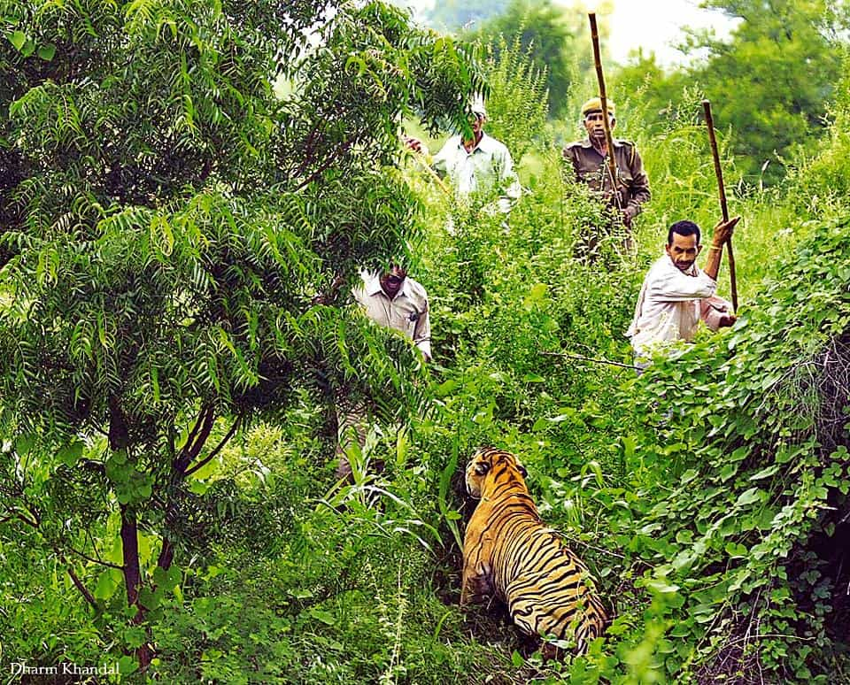
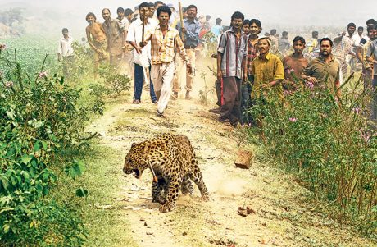
Man Wild life Conflict
Any interaction between humans and wildlife that results in negative impact on humans social, economical or cultural life, on the conservation of wildlife population or on the environment.
Rising human population.
Encroachment in to wildlife territories.
Degradation of habitat.
Pouching
Grazing of livestock.

Slide 44
Biodiversity Conservation and Management
Protecting species, habitat and ecosystem.
Protection of natural resources.
Protection, Preservation and management.
Soil fertility, water cycle, healthy atmosphere.
Maintain natural food chain and food web.
Transfer of energy from one trophic level to another.

Slide 45
Conservation Strategies
In-Situ Conservation : Conservation of habitat, species and ecosystem in their natural habitat.
Declaration of Biosphere, Wild life sanctuaries, National Park and protected areas.
Categorization of species on the basis of status – rare, endemic, endangered.
Legal protection.
Ban on cutting of trees, killing of wild animals.

Slide 46
Ex-Situ Conservation
Seed gene bank : seeds are preserved
Gene Bank : Germplasm is preserved in controlled condition.
Cryopreservation : Conservation is done at very low temperature in liquid nitrogen.
Tissue culture Bank :
Long term Captive Breeding :
Botanical gardens.
Zoological gardens.

Slide 47
National Parks
A national park is a park in use for conservation purposes, created and protected by national governments.
Often it is a reserve of natural, semi-natural, or developed land that a sovereign state declares or owns.
Although individual nations designate their own national parks differently, there is a common idea: the conservation of 'wild nature' for posterity and as a symbol of national pride.^{[1]}
An international organization, the International Union for Conservation of Nature (IUCN), and its World Commission on Protected Areas (WCPA), has defined "National Park" as its Category II type of protected areas.^{[2]} According to the IUCN, 6,555 national parks worldwide met its criteria in 2006.
IUCN is still discussing the parameters of defining a national park.^{[3]}
While this type of national park had been proposed previously, the United States established the first "public park or pleasuring-ground for the benefit and enjoyment of the people", Yellowstone National Park, in 1872.^{[4]}
Although Yellowstone was not officially termed a "national park" in its establishing law, it was always termed such in practice^{[5]} and is widely held to be the first and olde

Slide 48
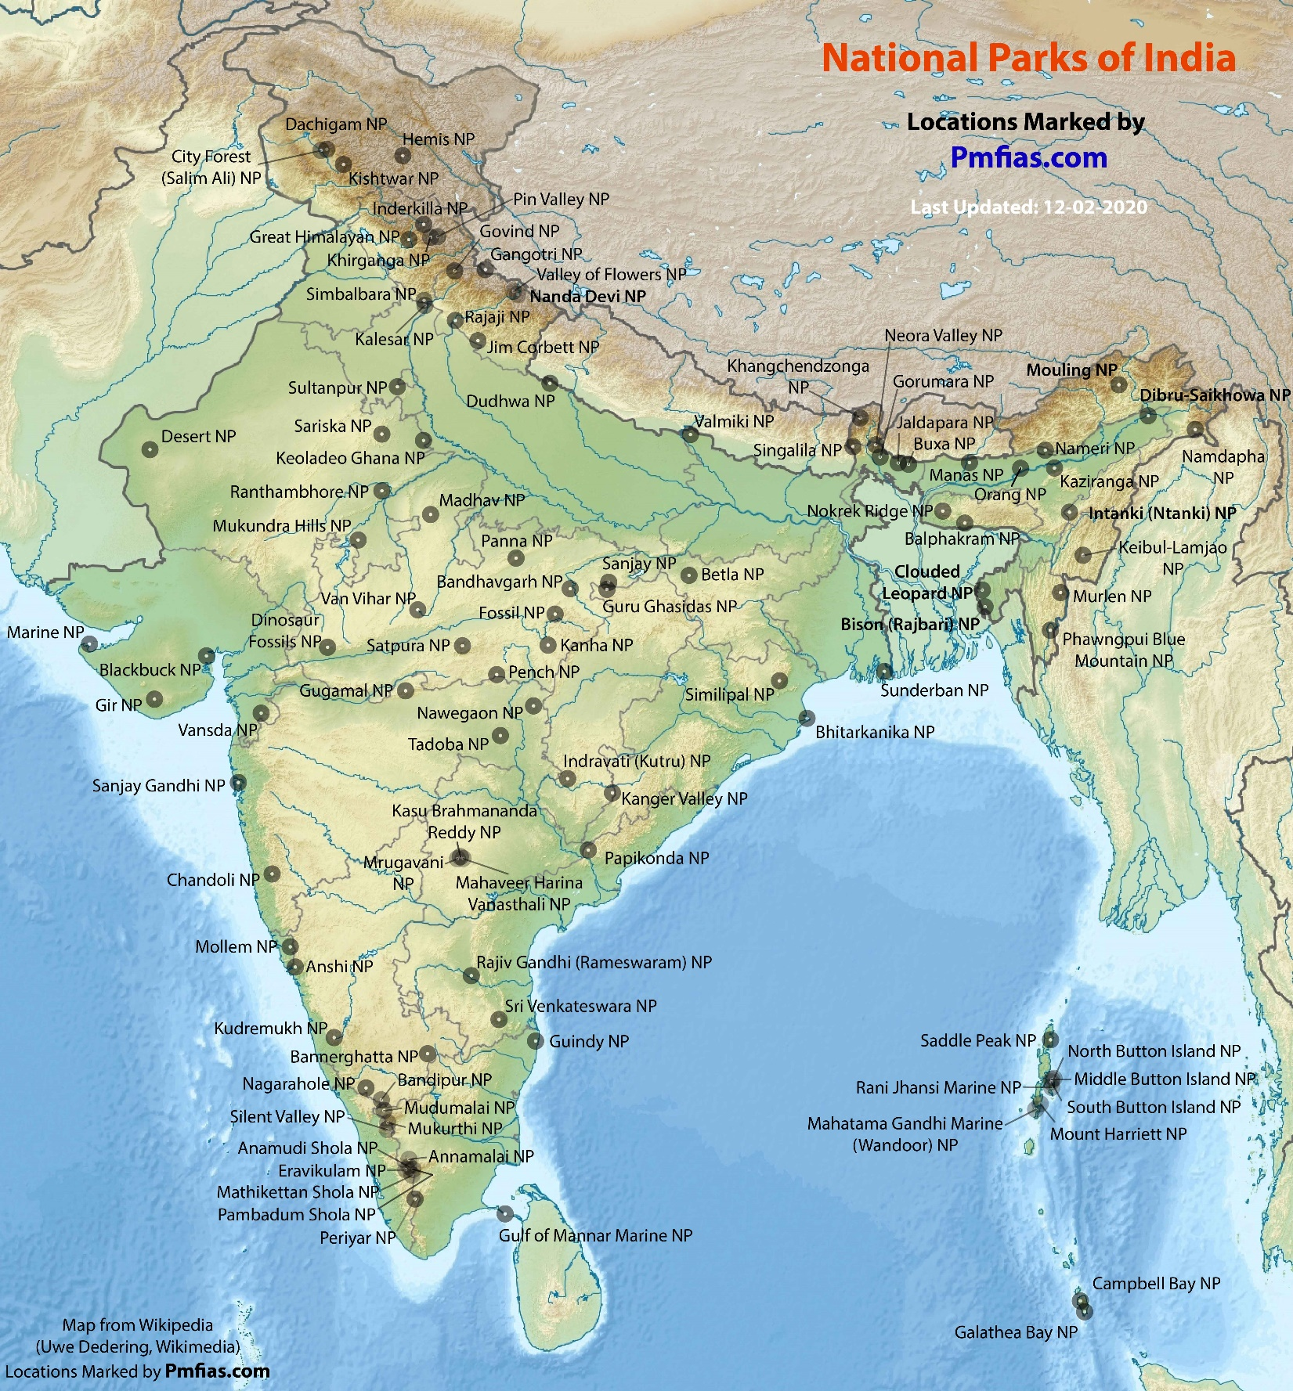

Slide 49
Wild Life Sanctuaries
A nature reserve (also known as a natural reserve, wildlife refuge, wildlife sanctuary, biosphere reserve or bioreserve, natural or nature preserve, or nature conservation area), is a protected area of importance for flora, fauna, or features of geological or other special interest, which is reserved and managed for purposes of conservation and to provide special opportunities for study or research. They may be designated by government institutions in some countries, or by private landowners, such as charities and research institutions. Nature reserves fall into different IUCN categories depending on the level of protection afforded by local laws. Normally it is more strictly protected than a nature park. Various jurisdictions may use other terminology, such as ecological protection area or private protected area in legislation and in official titles of the reserves.

Slide 50
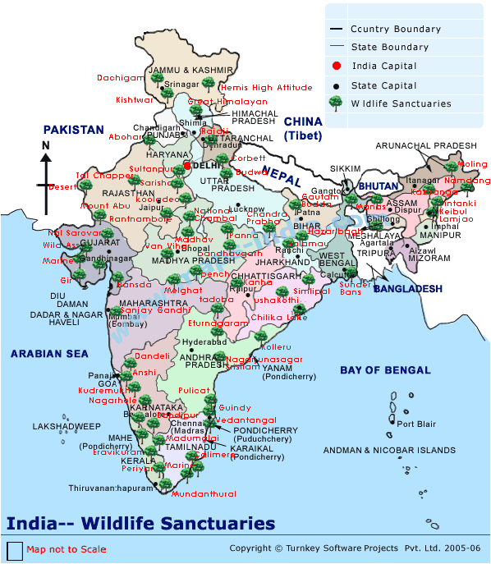

Slide 51
Biosphere Reserves
Biosphere reserves include terrestrial, marine and coastal ecosystems. Each site promotes solutions reconciling the conservation of biodiversity with its sustainable use.
Biosphere reserves are nominated by national governments and remain under the sovereign jurisdiction of the states where they are located.
Protection is granted not only to the flora and fauna of the protected region, but also to the human communities who inhabit these regions, and their ways of life.
Cold Desert, Himachal Pradesh.
Nanda Devi, Uttrakhand.
Khangchendzonga, Sikkim.
Dehang-Debang, Arunachal Pradesh.
Manas, Assam.
Dibru-Saikhowa, Assam.
Nokrek, Meghalaya.
Panna, Madhya Pradesh.

Slide 52
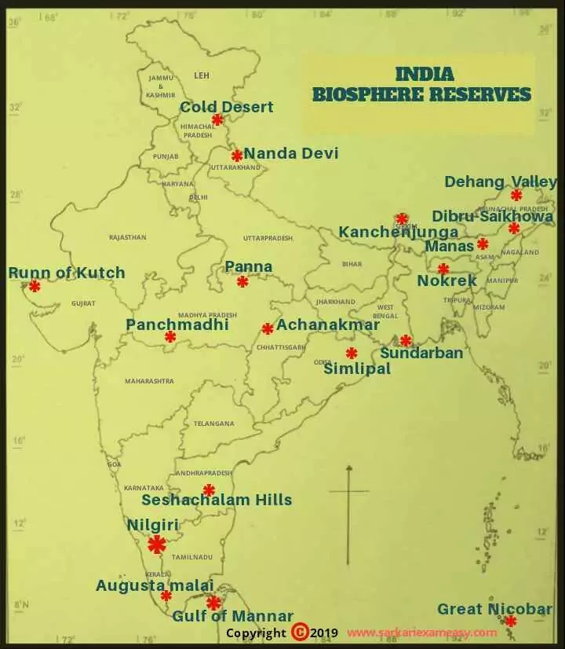

Slide 53
Efforts of the International Organizations
Biodiversity is an inherently international concern.
Species distributions and the ecosystem services that they support are not defined by national boundaries.
As a reflection of societal interests in those ecological benefits, international organisations have grown up to study, develop, regulate and conserve the systems on which much of human-being depends.
The biodiversity related conventions are based on the premise that further loss of biodiversity is unacceptable.
Biodiversity must be conserved to ensure it survives, continuing to provide services, values and benefits for current and future generations.

Slide 54
Efforts of International Organization
The importance of biodiversity has been promoted by the International Convention on Biological Diversity, part of Earth Summit on 3rd to 14 June 1992 held in Rio de Janeiro.
The convention was signed by 152 nations committing that by law to adopt ways and means of conserving biodiversity and to ensure and equity of benefits from biological diversity.
172,108 heads of state Governments, 2400 representatives of NGOs, 10000 on site Journalists has participated.
The convention has spawned many international initiatives and projects while continuing meetings to develop it then.
It has global biodiversity including the collaborative efforts of developed nations, which posses the financial means and scientific expertise required for effective conservation and the developing world water most of biodiversity resides.
Biodiversity conservation is the protection and management of biodiversity to obtain resources for sustainable development. Biodiversity conservation has three main objectives:
To preserve the diversity of species. Sustainable utilization of species and ecosystem.

Slide 55
The Earth Summit
The United Nations Conference on Environment and Development (UNCED), also known as the Rio de Janeiro Earth Summit, the Rio Summit, the Rio Conference, and the Earth Summit (Portuguese: ECO92), was a major United Nations conference held in Rio de Janeiro from 3 to 14 June in 1992.
Earth Summit was created as a response for Member States to cooperate together internationally on development issues after the Cold War.
Due to issues relating to sustainability being too big for individual member states to handle, Earth Summit was held as a platform for other Member States to collaborate.
Since the creation, many others in the field of sustainability show a similar development to the issues discussed in these conferences, including non-governmental organizations (NGOs).
The issues addressed included:
systematic scrutiny of patterns of production — particularly the production of toxic components, such as lead in gasoline, or poisonous waste including radioactive chemicals
alternative sources of energy to replace the use of fossil fuels which delegates linked to global climate change
new reliance on public transportation systems in order to reduce vehicle emissions, congestion in cities and the health problems caused by polluted air and smoke
the growing usage and limited supply of water

Slide 56
Agenda of ‘The Earth Summit’
Identify the components of biological diversity important for Condervation.
To develop National strategies, plans or programs for the conservation and sustainable development.
Right Planning & policy making.
Use of Media and educational programs to increase awareness.
To Establish law to protect Biodiversity.
Rehabilitate and restore degraded ecosystem.
EIA
Establish means to control risk for organisms modifying the Biotechnology.

Slide 57
IUCN
International Union for Conservation of nature (IUCN)
  1. To conserve our vital biodiversity, this is one of the important wheels of life cycle.
  2. It helps the world to find pragmatic solutions to our most pressing environment and development challenges.
IUCN is a membership Union composed of both government and civil society organisations. It harnesses the experience, resources and reach of its more than 1,400 Member organisations and the input of more than 17,000 experts.
This diversity and vast expertise makes IUCN the global authority on the status of the natural world and the measures needed to safeguard it.
It is involved in data gathering and analysis, research, field projects, advocacy, and education.
IUCN's mission is to "influence, encourage and assist societies throughout the world to conserve nature and to ensure that any use of natural resources is equitable and ecologically sustainable".

Slide 58
International Organizations
Convention on Biological Diversity (CBD)
  Aim to bring the conservation of biological diversity, the sustainable use of its components, and the fair and equitable sharing of the benefits arising from commercial and other utilization of genetic resources.
Consultative group for International Agriculture Research (CGIAR)
  1. It is a global partnership that unites organizations engaged in research for a food-secured future.
  2. Prime objective is to reducing rural poverty, increasing food security, improving human health and nutrition, and ensuring sustainable management of natural resources.
Convention on International Trade in Endangered Species of Wild Fauna and Flora (CITES)
  Aims to ensure that international trade in specimens of wild animals and plants does not threaten their survival.
Convention on the Conservation of Migratory Species of Wild Animals (CMS)
  Aims to conserve terrestrial, marine and avian migratory species throughout their range.
International Institute for Environment and Development (MED)
  It acts as the links between biodiversity, conservation and local people's livelihoods.
  The International Treaty on Plant Genetic
The International Treaty on Plant Genetic Resources for Food and Agriculture
  The prime objective is the conservation and sustainable use of plant genetic resources for food and agriculture and the fair and equitable sharing of the benefits arising out of their use, in harmony with the Convention on Biological Diversity, for sustainable agriculture and food security.

Slide 59
WCMC
( World Conservation Monitoring Centre)
Executive agency of UNEP
UNEP-WCMC has been part of UN Environment Programme since 2000, and has responsibility for biodiversity assessment and support to policy development and implementation.
The World Conservation Monitoring Centre was previously an independent organisation jointly managed by IUCN, UN Environment Programme and WWF established in 1988, and prior to that the Centre was a part of the IUCN Secretariat.
The activities of UNEP-WCMC include biodiversity assessment, support to international conventions such as the Convention on Biological Diversity (CBD)
The Convention on International Trade in Endangered Species of Wild Fauna and Flora (CITES), capacity building and management of both aspatial and spatial data on species and habitats of conservation concern.
UNEP-WCMC has a mandate to facilitate the delivery of the global indicators under the CBD's 2010 Biodiversity Target on the rate of loss of biological diversity, and works alongside the CITES Secretariat producing a range of reports and databases.
It also manages the World Database of Protected Areas in collaboration with the IUCN World Commission on Protected Areas.

Slide 60
National Biodiversity Action Plan (NBAP)
Program identified at International Level to solve problem related threatened species.
Ideas lies in The Earth Summit in 1992
194 countries are the members of the NBAP.
Objectives
  To prepare of Biological information on selected species.
  To assess the conservation status of the species within ecosystem.
  To create target for conservation & restoration.
  To setup budget, timeline and institutional partnership.

Slide 61
NBAP in India
Implemented in India during 2000 – 2004.
33 state level, 10 eco-region level, 18 local level 13 thematic plans were proposed for conservation.
✓ Conservation of biodiversity
✓ Sustainable use of its components
✓ Fair and equitable sharing of benefits arising out of the use of genetic resources

Slide 62
Introduction to Wildlife protection Act in India
The Wild Life Protection Act, 1972 is an Act of the Parliament of India enacted for protection of plants and animal species.
Before 1972, India had only five designated national parks.
Among other reforms, the Act established schedules of protected plant and animal species; hunting or harvesting these species was largely outlawed.
The Act provides for the protection of wild animals, birds and plants; and for matters connected there with or ancillary or incidental thereto.
It extends to the whole of India.
It has six schedules which give varying degrees of protection.
Schedule I and part II of Schedule II provide absolute protection - offences under these are prescribed the highest penalties.
Species listed in Schedule III and Schedule IV are also protected, but the penalties are much lower.
Schedule V includes the animals which may be hunted.
The specified endemic plants in Schedule VI are prohibited from cultivation and planting.
The hunting to the Enforcement authorities have the power to compound offences under this Schedule (i.e. they impose fines on the offenders). Up to April 2010 there have been 16 convictions under this act relating to the death of tigers.

Slide 63
Schedule -I :Animals from India
1. Andaman Wild pig (Sus sorofa andamanensis)]
2. Black Buck (Antelope cervicapra) 2 [2-A. •*•]
3. Brow-antlered Deer or Thamin (Cervus eldi)
4. Caracal (Felis caracal) [ 4-A. Catecean specials]
5. Cheetah (Acinonyx jubatus) 4 [5-A. Chinese Pangolin (Mainis pentadactyla)]
6. Clouded Leopard (Neofelis nebulosa)
7. Dugong (Dugong dugon) 2 [7-A Ermine (Mustele erminea)]
8. Fishing Cat (Felis viverrina)
9. Golden Cat (Felis temmincki)
10. Golden Langur (Presbytis geei) 3 [10-A. Giant squirrel (Ratufa macroura)] [10-B. Himalayan Ibex (Capra ibex)] ' [10-C. Himalayan Tahr (Hemitragus jemlahicus)]
11. Hispid Hare (Caprolagus hispidus) 3 [11-A. Hog badgar (Arconyx collaris)]
12. Hoolock (Hyloba tes hoolock)
13. Indian Lion (Panlhera leo persica)
14. Indian Wild Ass (Equus hemionus khur) 3 [15. Indian Wolf (Canis lupas pallipes)]
16. Kashmir Stag (Cervus elaphus hanglu)
17. Leopard Cat (Felis bengalensis)
18. Lesser or Red Panda (Ailurus fulgens)
19. Lion-tailed Macaque (Macaca silenus)
20. Loris (Loris tardigradus)

Slide 64
Schedule -II :Animals from India
Bengal Porcupine.
Bonnet macaque
Common Langur
Giant squirrels
Himalayan black bear
Jackel
Red fox
Sloth bear
Indian Cobra
Rat snake
Sperm whale

Slide 65
Schedule -III :Animals from India
Barking dear
Chital
Gorals
Hog deer
Hyaena

Slide 66
Schedule -IV :Animals from India
Five stripped palm squirrel
Black naped hare
Himalayan mouse hare
Hedge hog
Indian poecupine
Babblers
Barbets
Bulbuls
Ducks
Drongos
Egrets

Slide 67
Schedule -V :Animals from India
Common crow
Fruit bats
Mice
Rats

Slide 68
Schedule -VI :Animals from India
Blue Vanda
Kuth
Ladies Slipper Orchids
Pitcher plant
Red Vanda

Slide 69
Convention on International Trade in Endangered Species
(CITES)
CITES (the Convention on International Trade in Endangered Species of Wild Fauna and Flora, also known as the Washington Convention) is a multilateral treaty to protect endangered plants and animals.
It was drafted as a result of a resolution adopted in 1963 at a meeting of members of the International Union for Conservation of Nature (IUCN).
The convention was opened for signature in 1973 and CITES entered into force on 1 July 1975.
Its aim is to ensure that international trade in specimens of wild animals and plants does not threaten the survival of the species in the wild.
It accords varying degrees of protection to more than 35,000 species of animals and plants.
In order to ensure that the General Agreement on Tariffs and Trade (GATT) was not violated, the Secretariat of GATT was consulted during the drafting process.

Slide 70
CITES works by subjecting international trade in specimens of selected species to certain controls.
All import, export, re-export and introduction from the sea of species covered by the convention has to be authorized through a licensing system.
According to Article IX of the convention, Management and Scientific Authorities, each Party to the Convention must designate one or more Management Authorities in charge of administering that licensing system and one or more Scientific Authorities to advise them on the effects of trade on the status of CITES-listed species.

