Slide 1

Birmingham School
STUART HALL

Slide 2
Learning Objectives
To know about the British Cultural Studies also known as Birmingham School.
To understand the Theories given by Stuart Hall- Reception and Representation
To relate these theories to current scenario with examples

Slide 3
Birmingham School
School of thought that is now known as British Cultural Studies or The Birmingham School of Cultural Studies.
Notable Scholars- Richard Hoggart, Raymond Williams, Stuart Hall

Slide 4
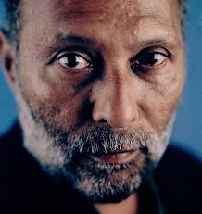
Stuart Hall
Born: 3 February 1932
Kingston, Colony of Jamaica
Died:10 February 2014 (aged 82)
London, England
British Marxist sociologist ,cultural theorist and political activist.

Slide 5
Hall attended Jamaica College and in 1951 was awarded a Rhodes scholarship to study literature at Merton College, Oxford.
He discovered that his dark skin and multiethnic, mixed-race heritage (including his childhood in Jamaica, where skin colour played such a central role in society that even his own parents did not allow him to associate with darker-skinned children) left him feeling out of place in England.

Slide 6
Reception Theory
Reception theory as developed by Stuart Hall asserts that media texts are encoded and decoded.
The producer encodes messages and values into their media which are then decoded by the audience.
However, different audience members will decode the media in different ways and possibly not in the way the producer originally intended.

Slide 7
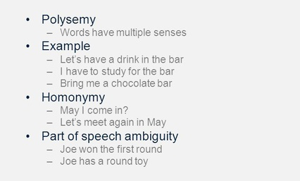
The messages are polysemous (i.e., carrying many potential meanings)

Slide 8
Stuart Hall states that audience members adopt one of the following three positions when they decode the text:
Dominant, or Preferred Reading
Oppositional Reading
Negotiated Reading
Many factors could affect whether the audience take the dominant, oppositional or negotiated reading.
Age
Beliefs
Culture
Gender
Life experience
Mood at the time of viewing

Slide 9
Dominant, or Preferred Reading
Audience will take this position :-
if the messages are clear
if the audience member is the same age and culture
if it has an easy to follow narrative
if it deals with themes that are relevant to the audience.

Slide 10
Oppositional Reading
when the audience rejects the preferred reading, and creates their own meaning for the text.
This can happen if the media contains
controversial themes that the audience member disagrees with.
complex narrative structure
if the audience member has different beliefs or is of a different age or a different culture.

Slide 11
Negotiated Reading
a compromise between the dominant and oppositional readings, where the audience accepts parts of the producer's views, but has their own views on parts as well.

Slide 12
Representation Theory
Representation means- the description or portrayal of someone or something in a particular way.
This is the process whereby media constructs versions of people, places and events in images, words or sounds

Slide 13
Stuart Hall claimed in 1970, that black people were treated as inferior and this was the result of how they have been portrayed in media

Slide 14
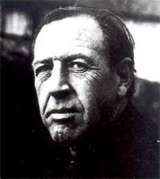
Raymond Williams
Born
The United Kingdom, August 31, 1921
Died
January 26, 1988
Interests
Politics, Culture, Mass Media and Literature

Slide 15
Raymond Williams was a highly influential Marxist critic of the twentieth century Britain.
Born in the working class on the borders of Wales in 1921, he remained all his life deeply committed to his proletarian roots.

Slide 16
He became an academic after serving in the Second World War, and his academic career at Cambridge and Oxford was highly distinguished.

Slide 17
Raymond Williams on Culture

Slide 18
The widely held meaning of culture then….
High Culture- shared and followed by the elites in a society… Examples- Ballet, the one who admire and collect museum types artworks-Paintings,
Example from India- Classical Music- Hindustani and Carnatic, Bharatnatyam, Raja Ravi Verma’s paintings

Slide 19
Low Culture- the one practised by working class
Mass Culture/Popular Culture/Pop Culture-

Slide 20
Raymond Williams on culture
Raymond Williams’ asserted that culture is ‘a whole way of life’ in his 1958 book Culture and Society.
His primary motivation for writing Culture and Society was refuting ‘the increasing contemporary use of the concept of culture against democracy, socialism, the working class or popular education.

Slide 21
The current interpretation then of culture was being used as a means of perpetuating and shoring up social inequality.
The merit of Williams’ conceptualisation of culture is its inclusivity.

Slide 22
The recognition of the cultural worth of all human activity is socially equalising.
His destruction of the distinction between ‘high’ and ‘low’ culture shuns the conservative view that mass participation in culture somehow devalues it and instead opens the way for its democratisation..

Slide 23
Williams’ understands ‘culture’ as being made of two separate components-
a whole way of life,
the arts and learning

Slide 24
Raymond Williams on Technological Determinism
Raymond Williams was a noted critic of technological determinism.
As per him, technological determinism failed to assess the significance of social power relations, interaction, and social circumstances.

Slide 25
Raymond Williams offers four key points that help inform his ideas on shaping:
Technologies are social
Innovation of technologies are not predetermined
The notion that a new technology is inevitable is the result of marketing
Technologies would not necessarily follow the path initially envisioned

Slide 26
Technologies are social
There are social motivations that influence the transformation of an innovation into a technology.
Example- Broadcast Media… Society needed it

Slide 27
Innovation of technologies are not predetermined
The forms and functions of technologies are not predetermined, rather they are based on decisions made by human actors.
For instance, when radio was in its formative stages of development, one potential form was to be something resembling the telephone. The main US telephone company lobbied to keep the ‘common carrier’ network to itself.
This shows how the development of the technology was very much dependent on existing political and economic situations in the society.

Slide 28
The notion that a new technology is inevitable is the result of marketing
Williams believes the idea that technologies are inevitable is the result of marketing from dominant groups, whose aim is to insure that the technologies are accepted into society.

Slide 29
Technologies would not necessarily follow the path initially envisioned

Slide 30
References
https://msu.edu/course/ams/280/represent.html
https://www.youtube.com/watch?v=yJr0gO_-w_Q
https://www.britannica.com/biography/Stuart-McPhail-Hall
https://raymondwilliams.co.uk/about-raymond-williams/
https://www.encyclopedia.com/arts/encyclopedias-almanacs-transcripts-and-maps/williams-raymond
https://www.communicationtheory.org/technological-determinism/

