Slide 1
Technical Analysis
By Sriram Rangarajan

Slide 2
What is Technical Analysis ?
Technical Analysis is the study of market action, primarily through the use of charts, for the purpose of forecasting future price trends. John Murphy
Technical Analysis is the science of recording, usually in graphic form, the actual history of trading (price changes, volume of transactions, etc.) in a certain stock or in “the Averages” and then deducing from that pictured history the probable future trend. Edward & McGee.
Basically Technical Analysis is study of Price and Volume

Slide 3
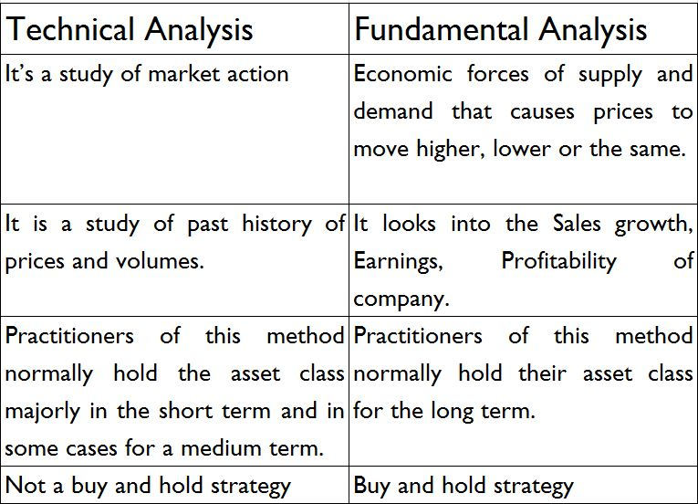
Difference between Technical & Fundamental Analysis

Slide 4
Is Technical Analysis a Holy Grail (Magic formula) to make money?
TA is one of the methods used to study price action. It is Not a Holy Grail, there is no magic formula for making money in markets using TA. Without appropriate risk management, TA is like driving a luxury car without brakes.

Slide 5
Premises /Rationale /Philosophy of Technical Analysis (TA).
The three premises on which the technical approach is based:
1. Market action discounts everything.
2. Price moves in trends.
3. History repeats itself.

Slide 6
Market Action discounts everything
ભાવ ભગવાન છે
TA believes anything that may affect the price either fundamentally, politically, psychologically, or in any other manner is actually reflected in the price itself. Therefore study of price action is all that is required.

Slide 7
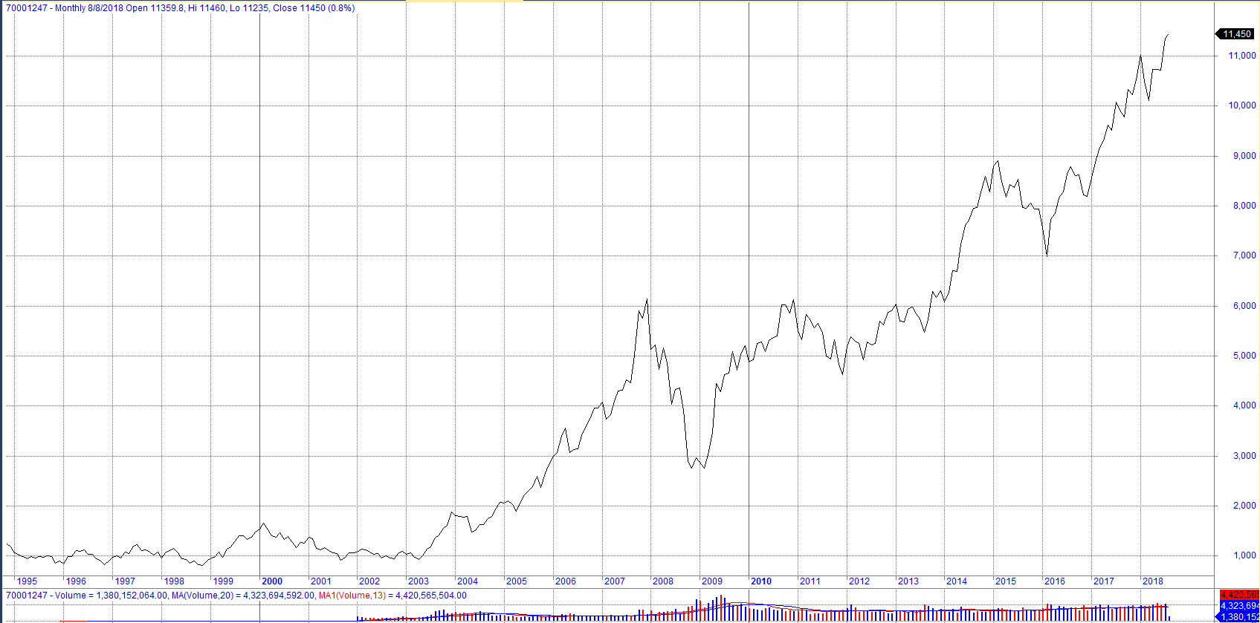
Price move in trends
Technical Analysis is based on the premise of trends. Below is the Monthly line chart of Nifty since 1994.

Slide 8
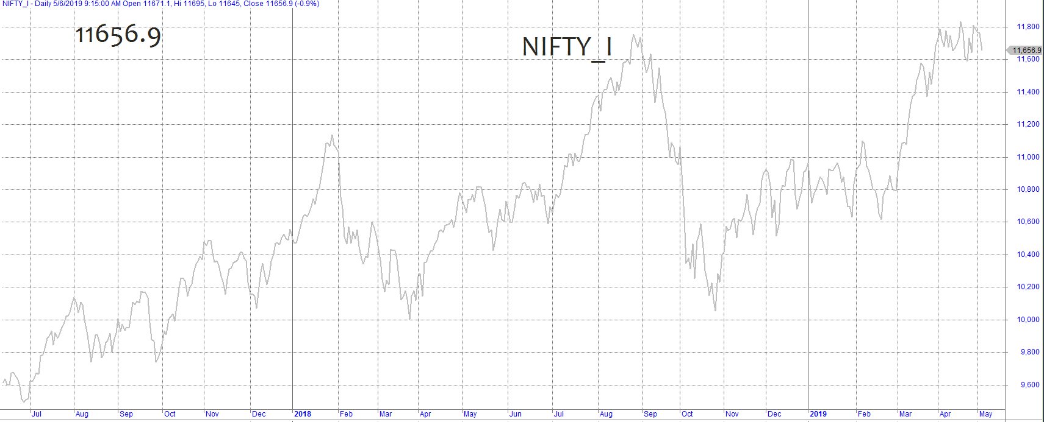
Price move in trends
Below is the Daily line chart of Nifty futures for the period July 2017 to April 2019.

Slide 9
History Repeats itself
Chart patterns based on historical prices have been based on human psychology - greed and fear.
Chartists (Technical Analysts) have identified and categorised patterns over the last 100 years

Slide 10
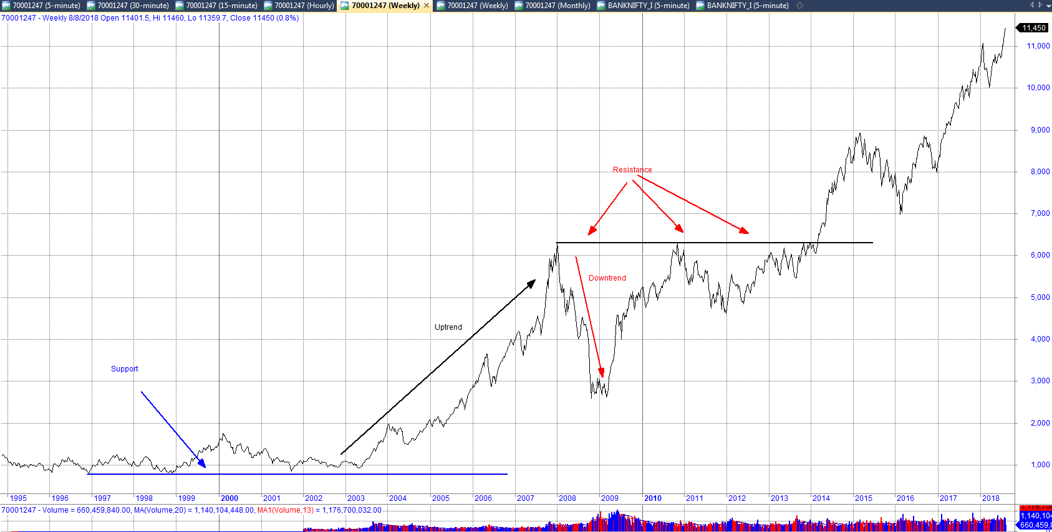
Uptrend, Downtrend, support & resistance

Slide 11
Dow Theory
The Averages Discount Everything
The Market Has Three Movements
  Primary Movement - < 1year to several years.
  Secondary Reactions – from 3 weeks to many months.
  Minor Movement – for one/ two weeks to six weeks.
The Averages must confirm.
  Both the Industrial and Transportation Averages must confirm.

Slide 12
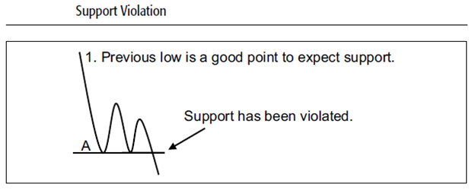
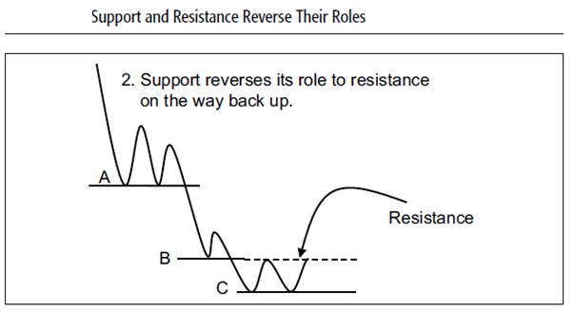
Support & Resistance

Slide 13
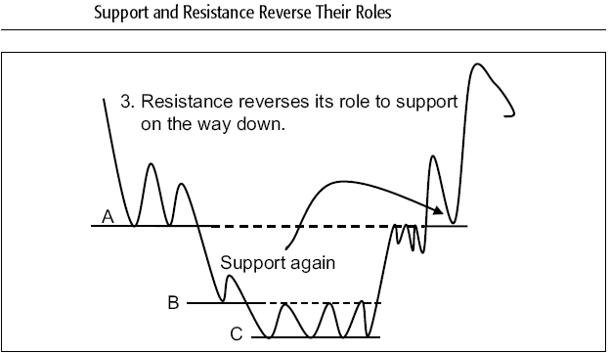
Support & Resistance contd..
Potential Support/Resistance Points
  Previous Highs and Lows
  At Round Numbers
  Trendlines and Moving Averages Represent dynamic levels of Support and Resistance

Slide 14
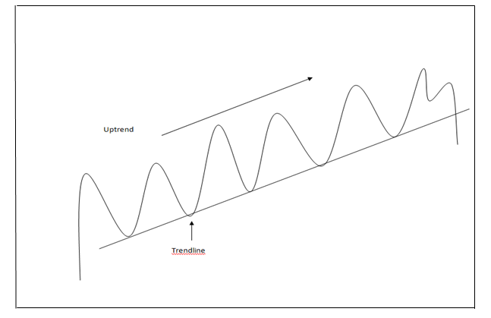
Trendline
The more number of times the price takes support/ resistance on a trend line/ moving average, the more significant is that trend line/ moving average.

Slide 15
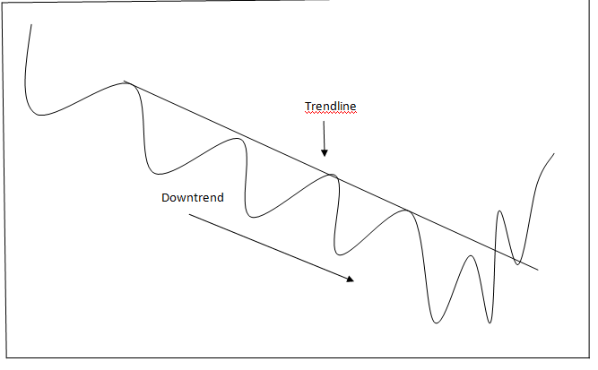
Trendline

Slide 16
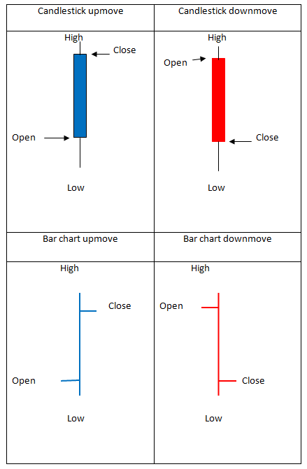
Price Chart Style

Slide 17
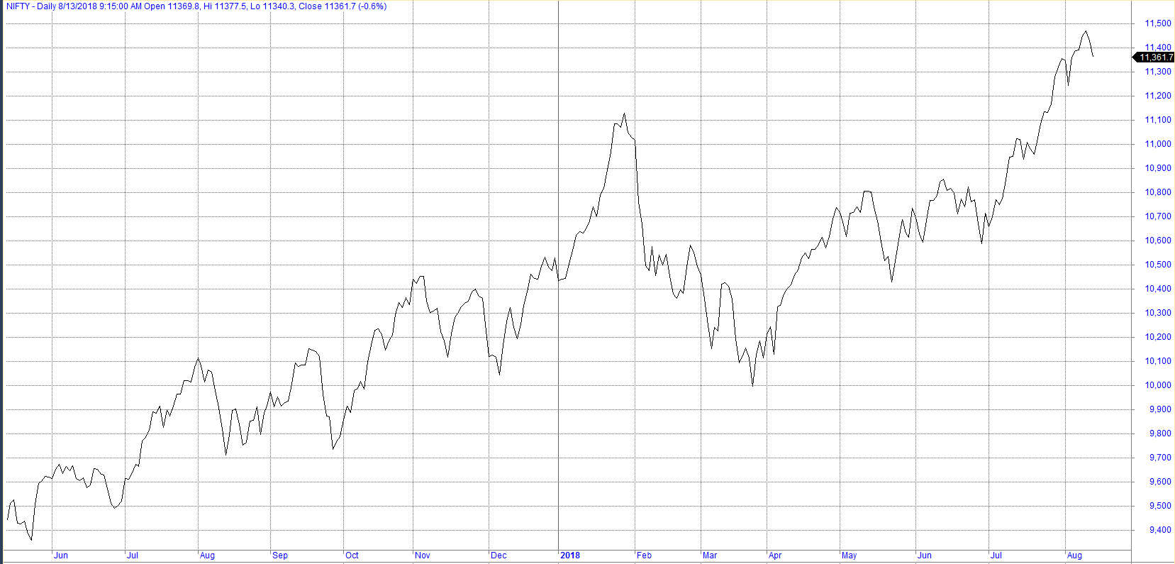
Price Chart Style
Line Chart Nifty

Slide 18
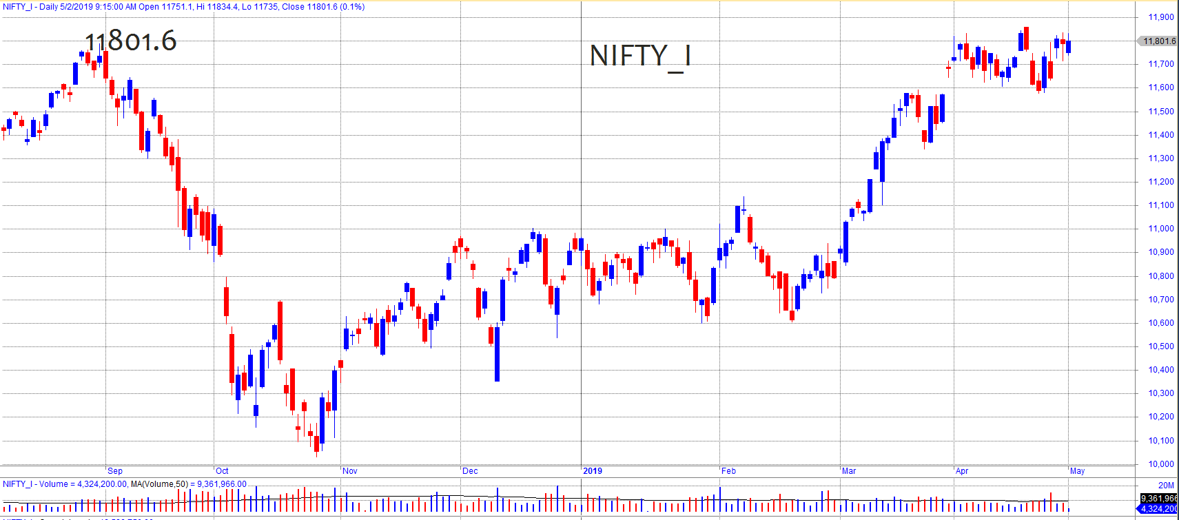
Price Chart Style
Candle stick chart – nifty

Slide 19
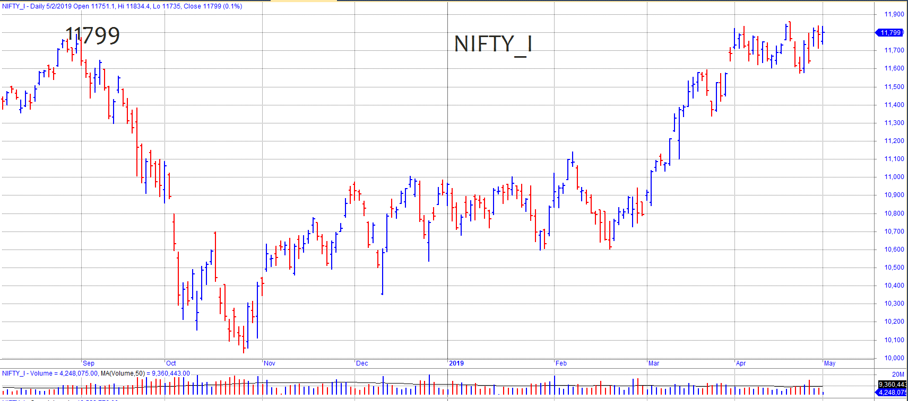
Price Chart Style
Bar Chart - Nifty

Slide 20
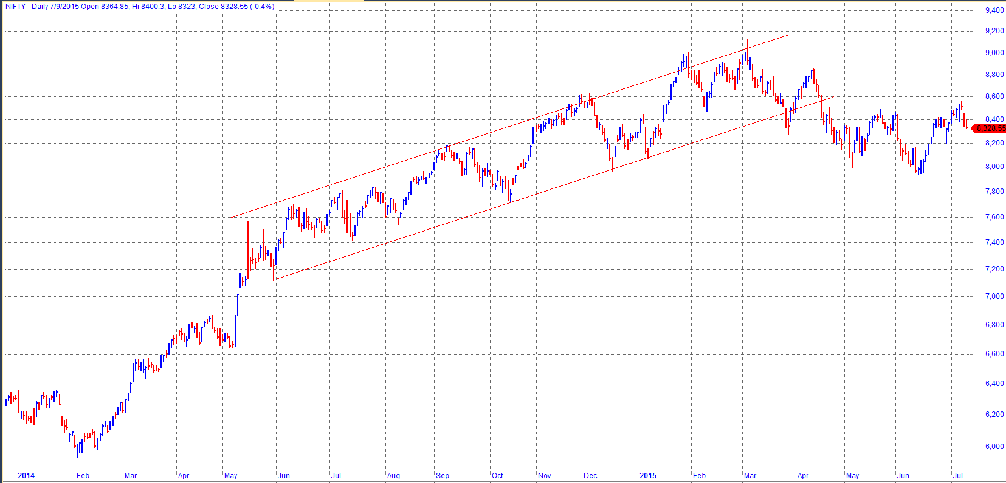
Channel in an Uptrend

Slide 21
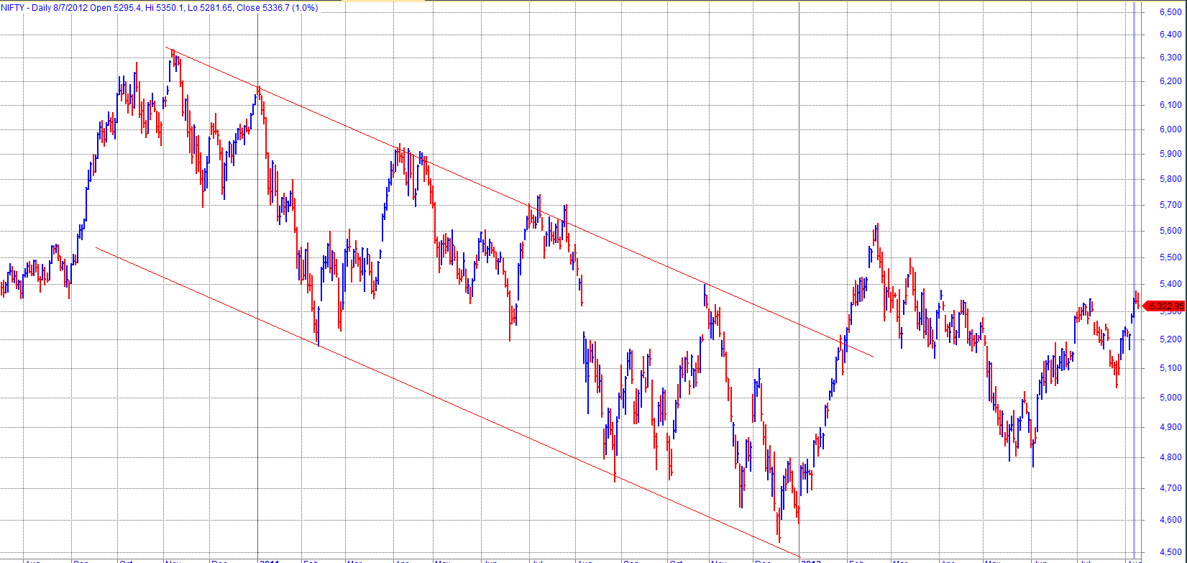
Channel in an Downtrend

Slide 22
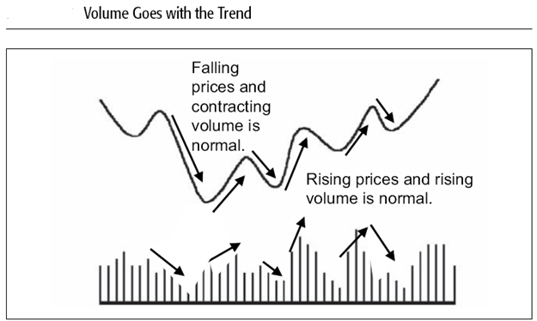
Volume

Slide 23
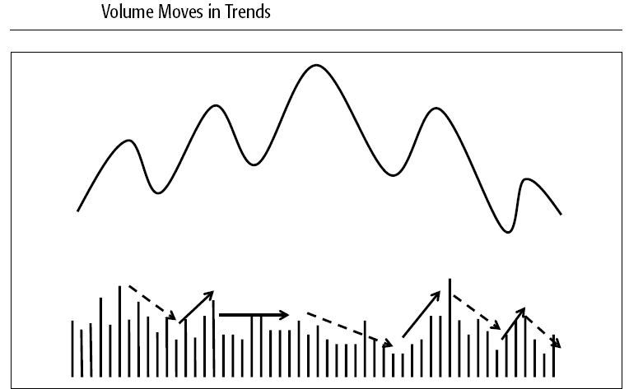
Volume

Slide 24
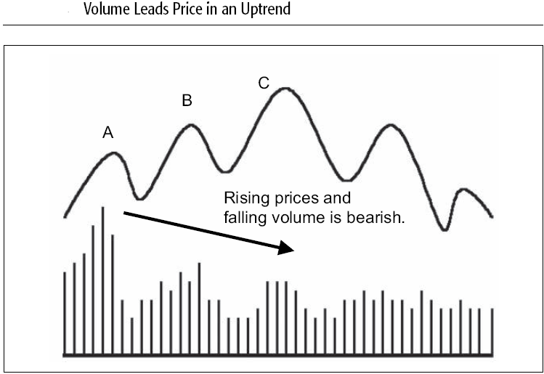
Volume

Slide 25
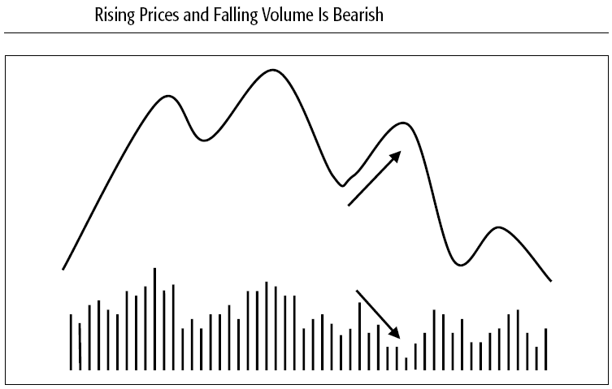
Volume

Slide 26
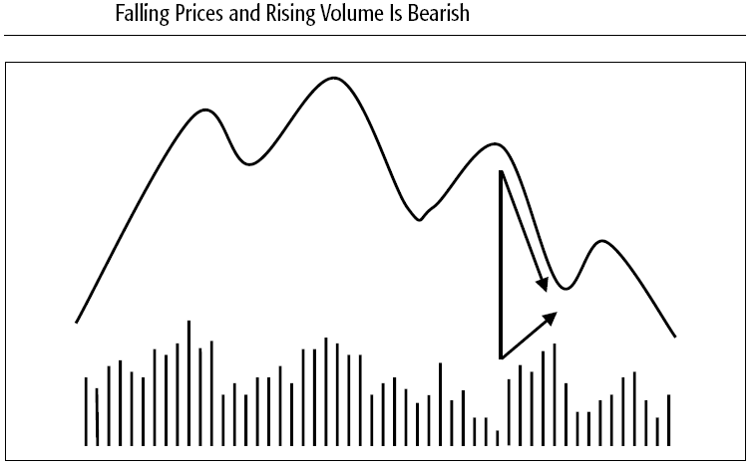
Volume

Slide 27
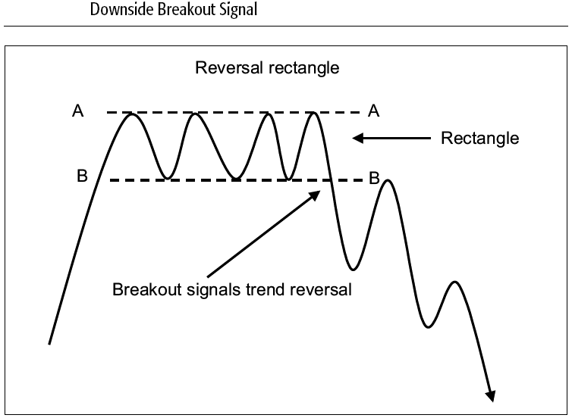
Classic Price Patterns
Rectangle

Slide 28
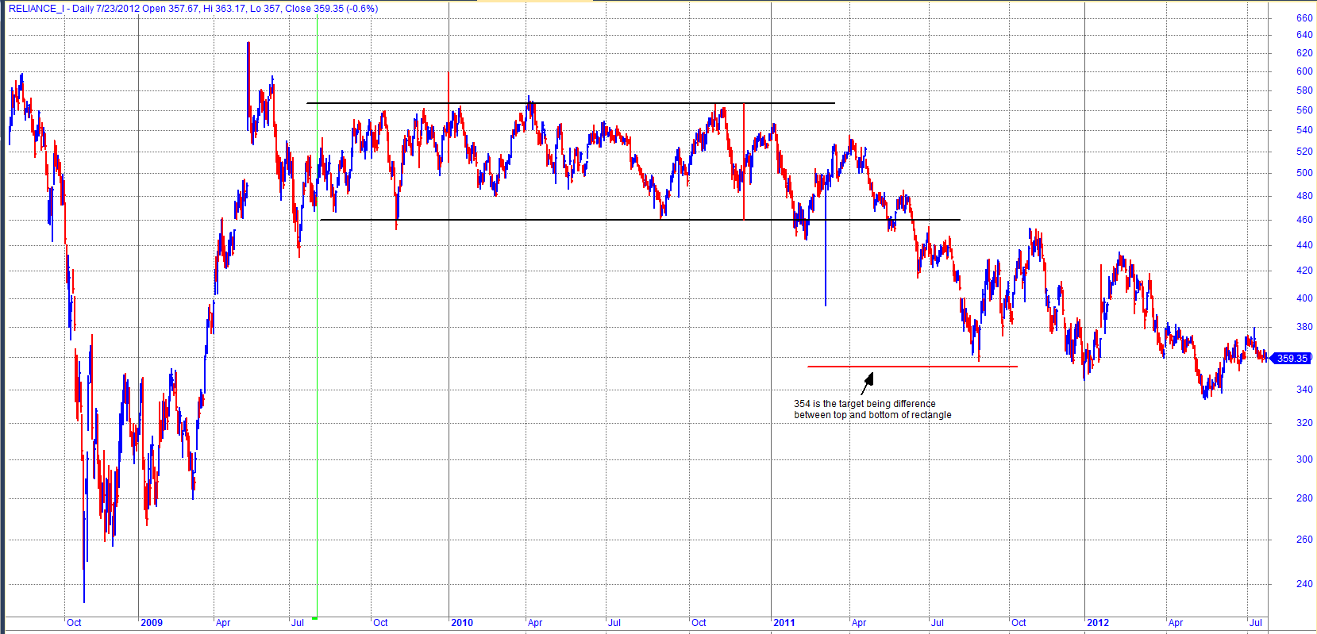
Classic Price Patterns
Rectangle – Reliance Industries - downside breakout

Slide 29
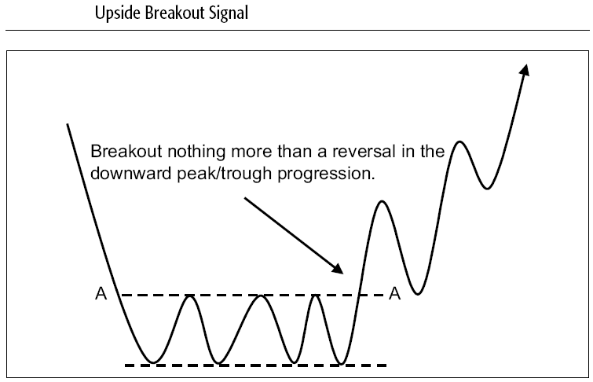
Classic Price Patterns
Rectangle –

Slide 30
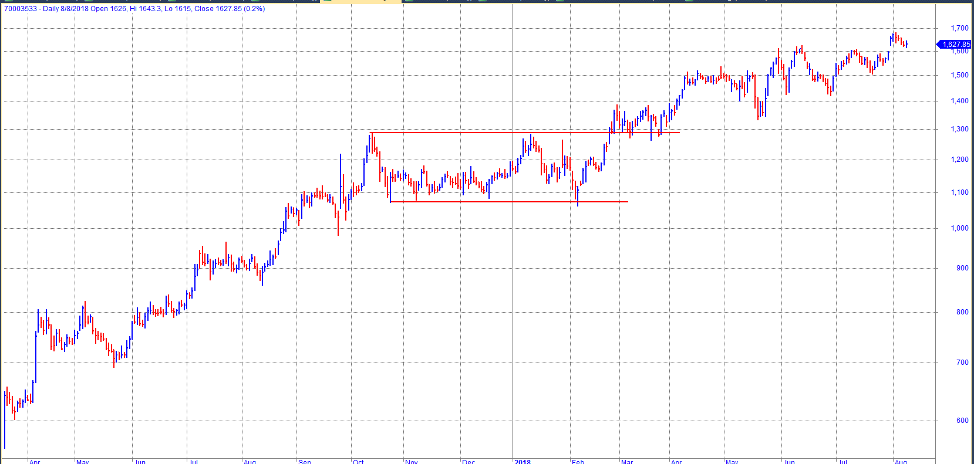
Classic Price Patterns
Rectangle – Avenue Supermarket - Upside breakout

Slide 31
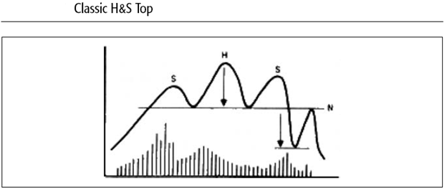
Classic Price Patterns
Head and Shoulders

Slide 32
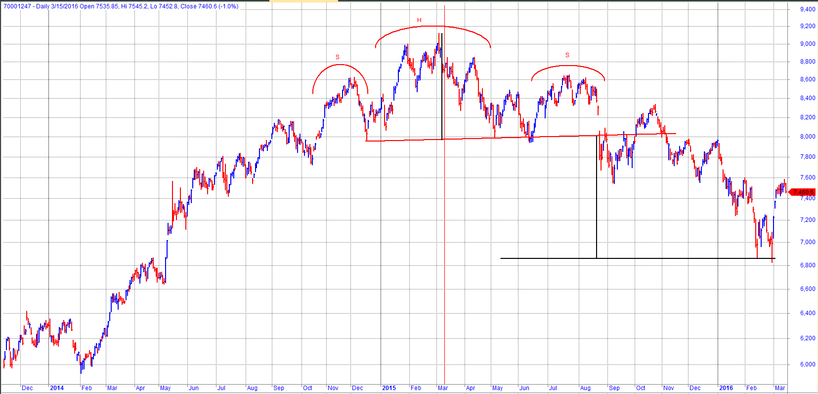
Classic Price Patterns
Head & Shoulder – Nifty

Slide 33
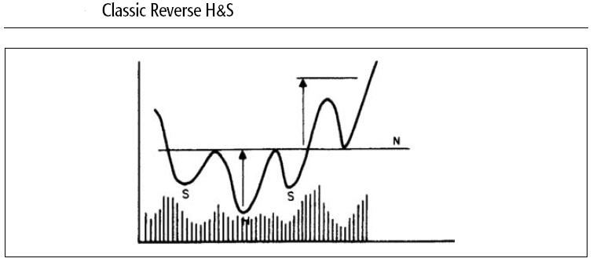
Classic Price Patterns
Reverse / Inverse Head and Shoulder

Slide 34
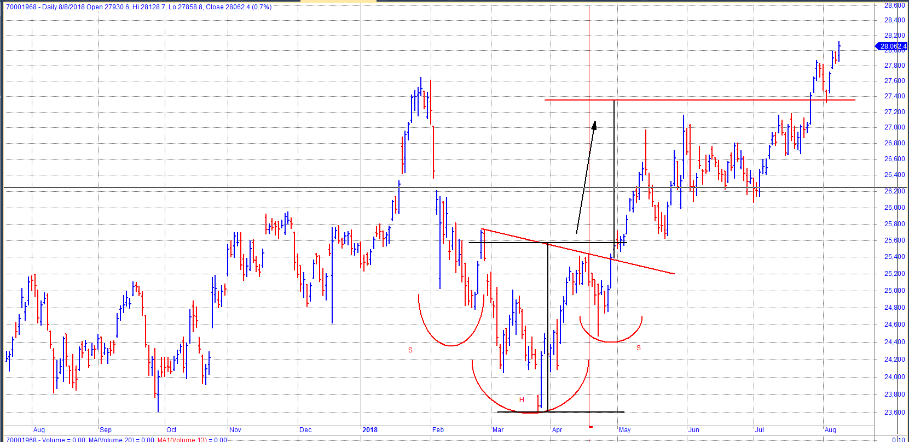
Classic Price Patterns
Classic Inverse H & S - Bank Nifty

Slide 35
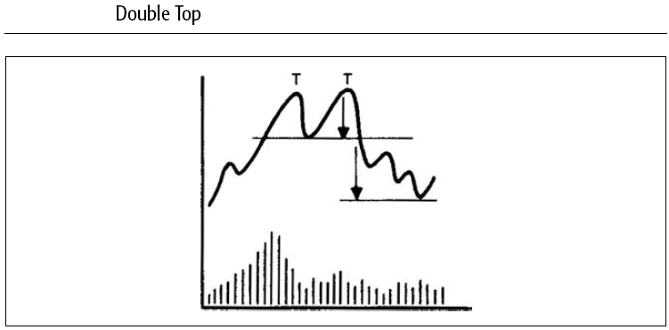
Classic Price Patterns
Double Tops

Slide 36
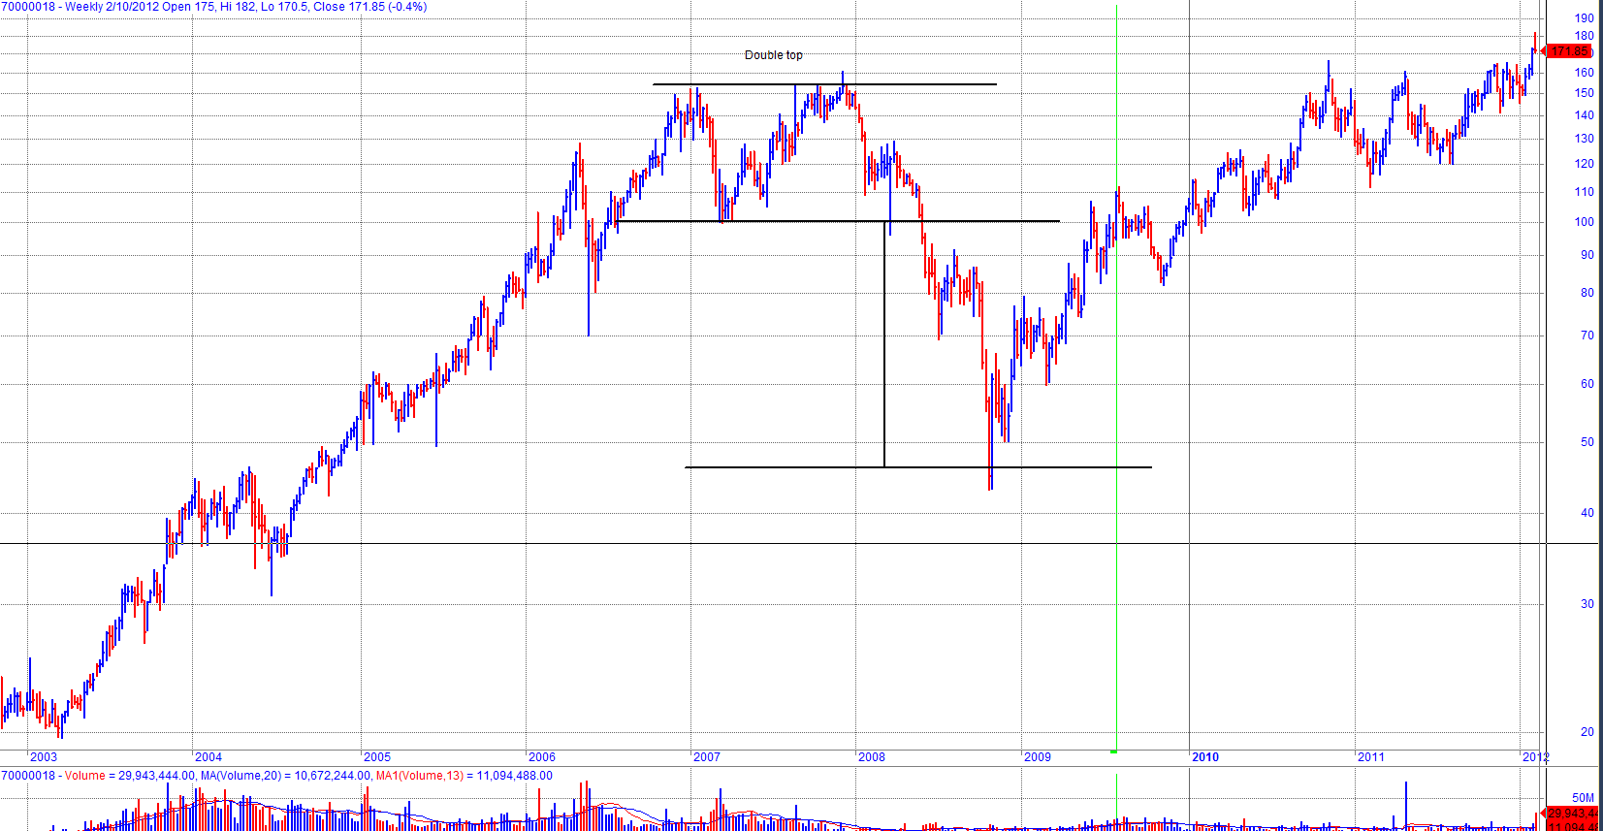
Classic Price Patterns
Double Top in Ambuja Cements

Slide 37
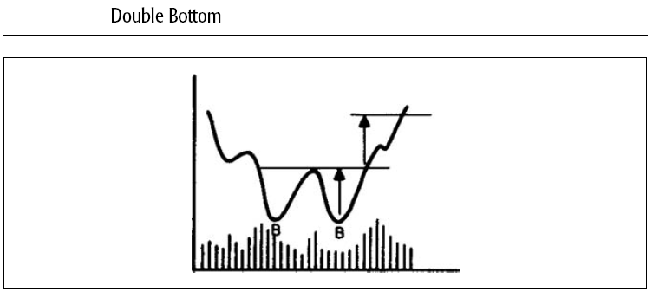
Classic Price Patterns
Double Bottom

Slide 38
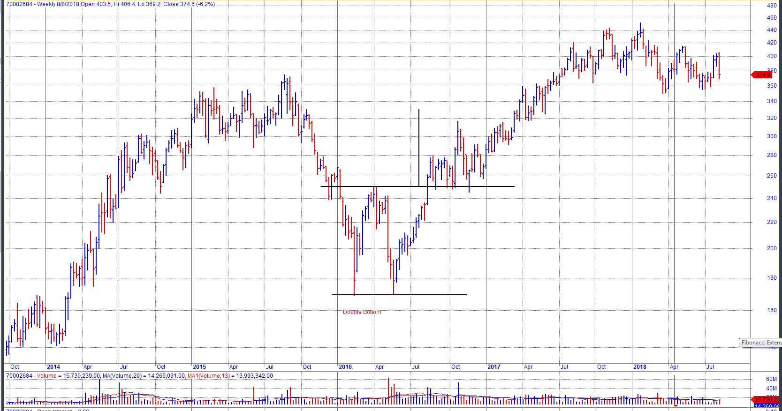
Classic Price Patterns
Double Bottom – Adani Ports.

Slide 39
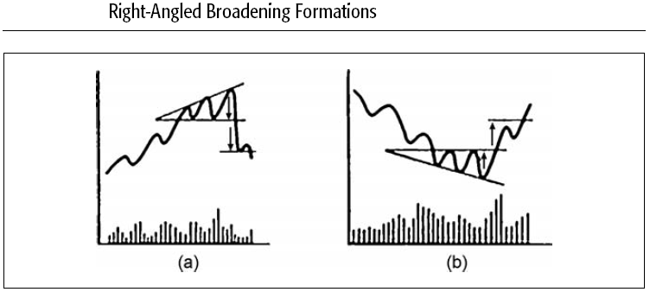
Classic Price Patterns
Broadening Formations

Slide 40
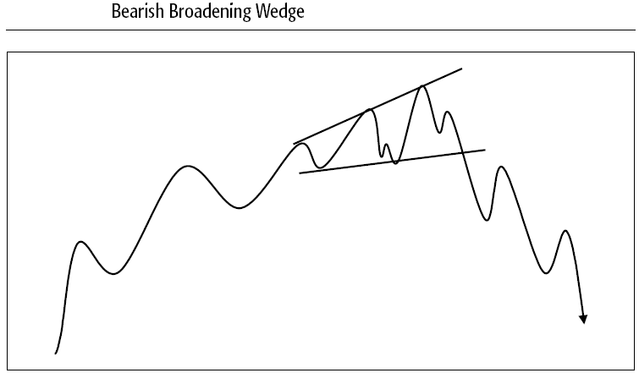
Classic Price Patterns

Slide 41
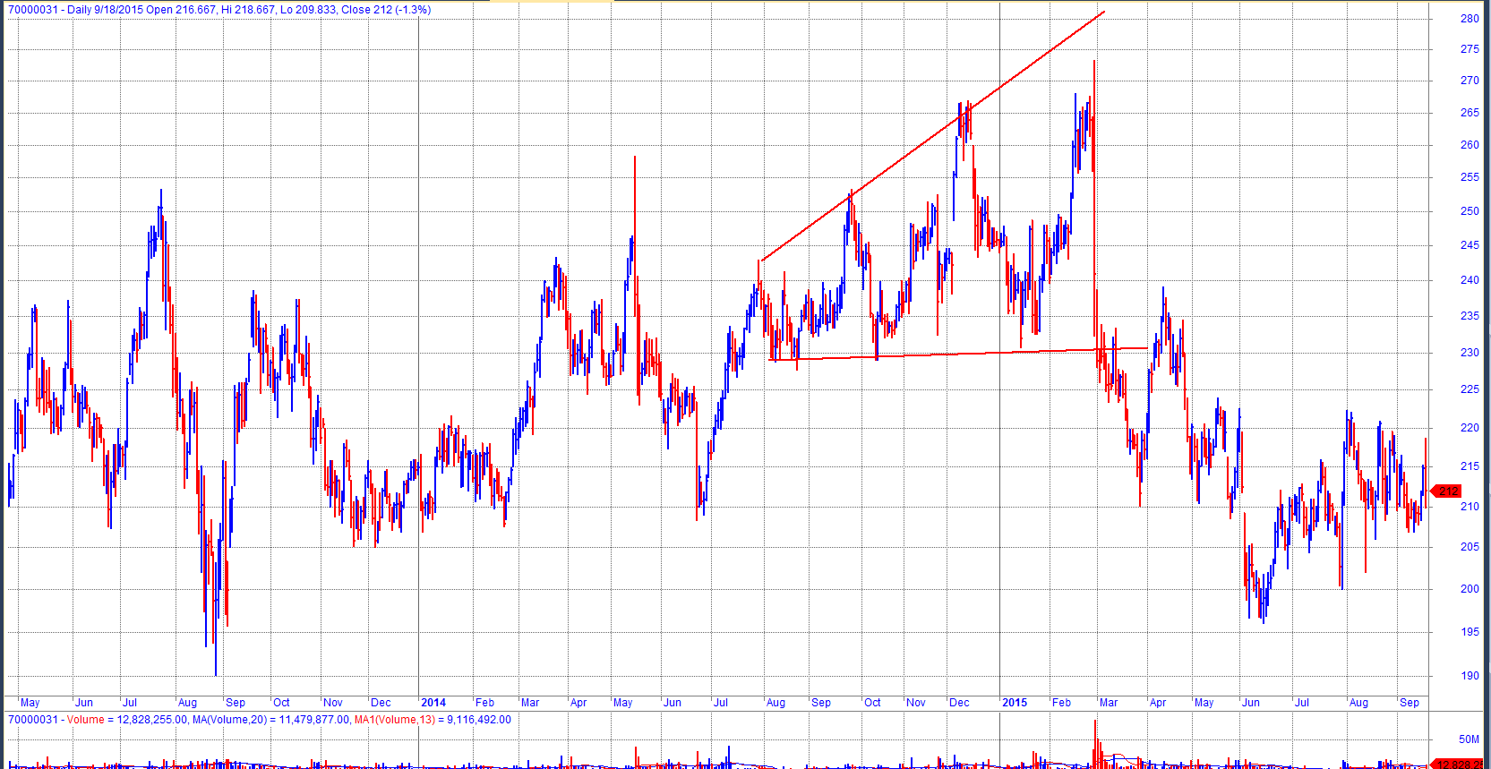
Classic Price Patterns
Bearish Broadening formation – ITC

Slide 42
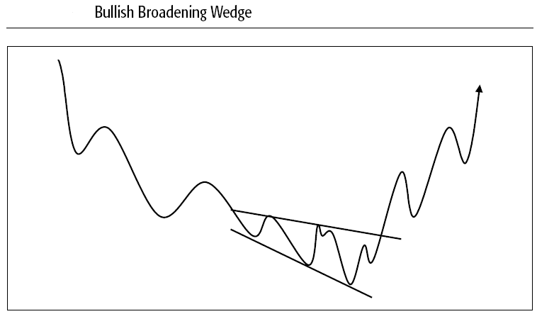
Classic Price Patterns

Slide 43
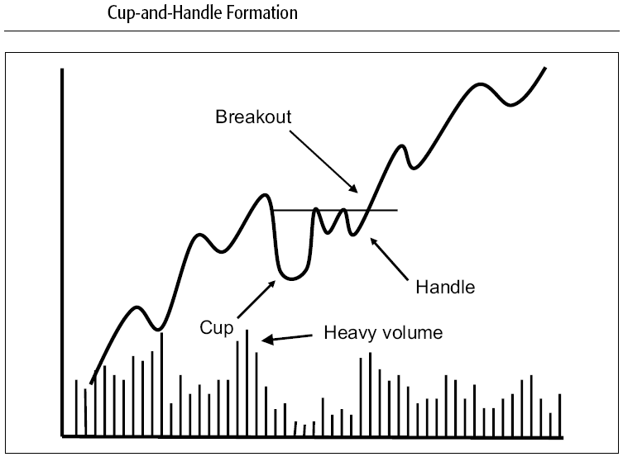
Classic Price Patterns

Slide 44
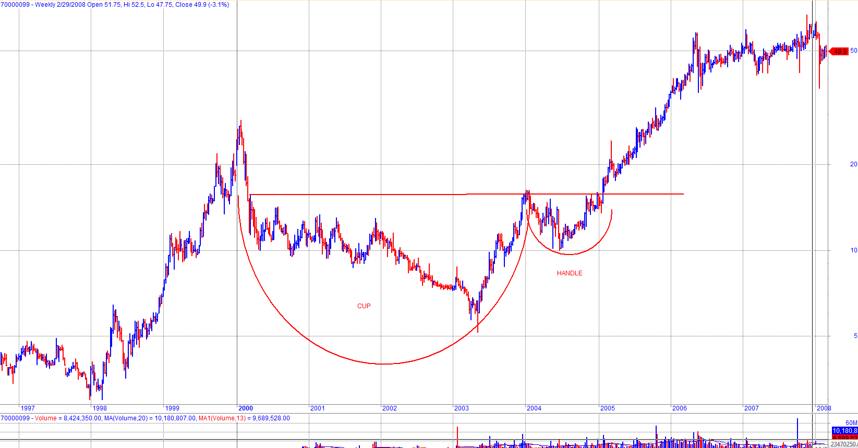
Classic Price Patterns
Cup and Handle - Dabur (India)

Slide 45
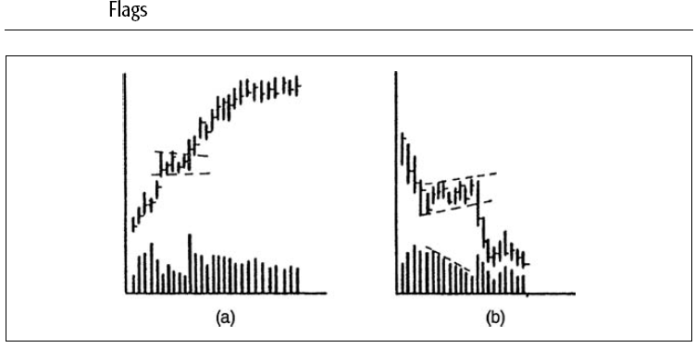
Other Price Patterns and Gaps

Slide 46
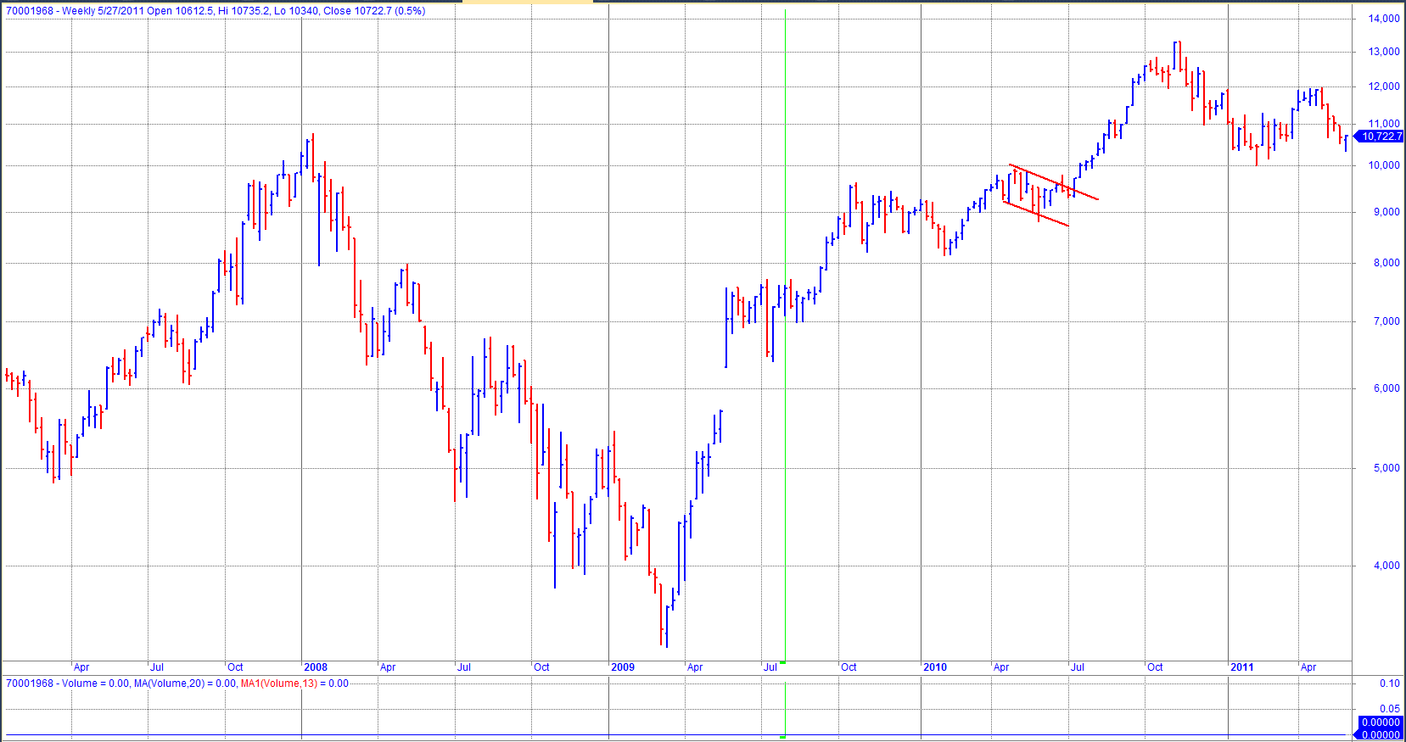
Other Price Patterns and Gaps
Bank Nifty – Flag

Slide 47
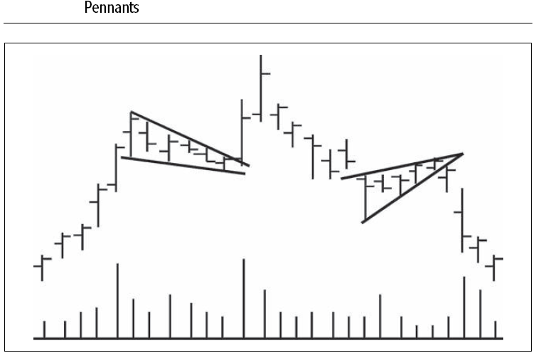
Other Price Patterns and Gaps
Penant

Slide 48
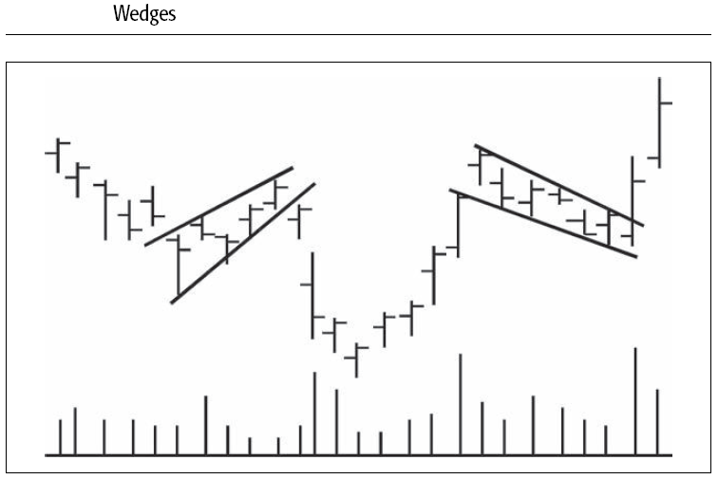
Other Price Patterns and Gaps

Slide 49
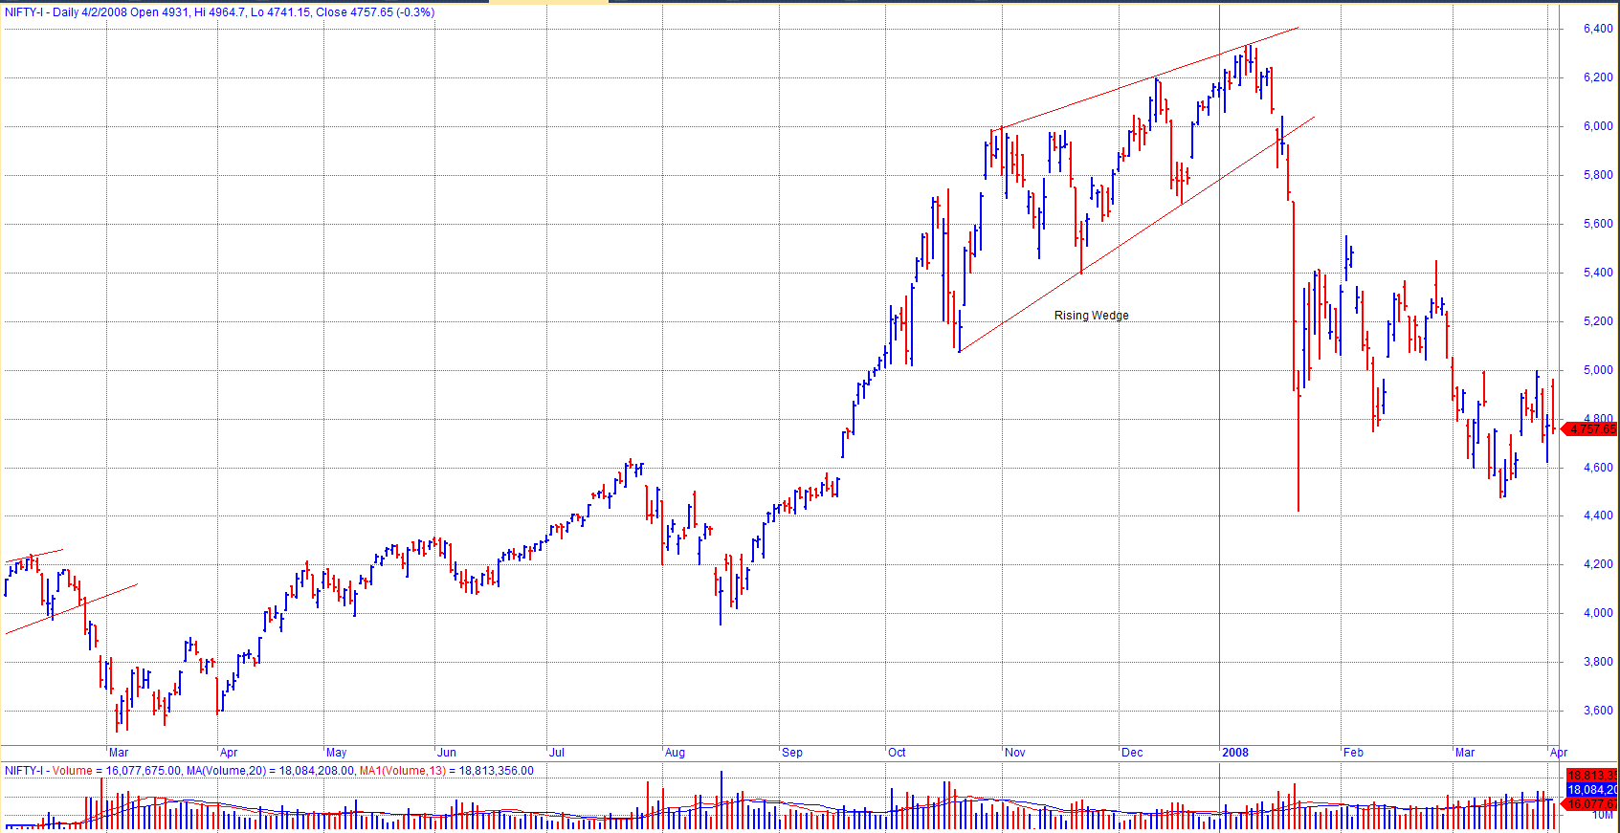
Other Price Patterns and Gaps
Nifty - Rising Wedge

Slide 50
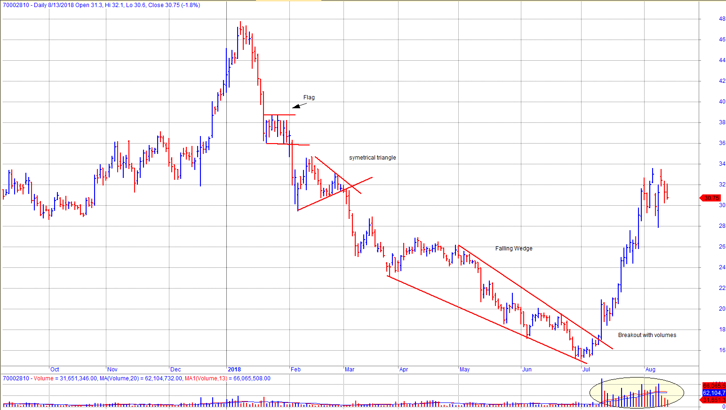
Other Price Patterns and Gaps
Adani Power - Flag, Symmetrical triangle, Falling Wedge, Breakout with volumes.

Slide 51
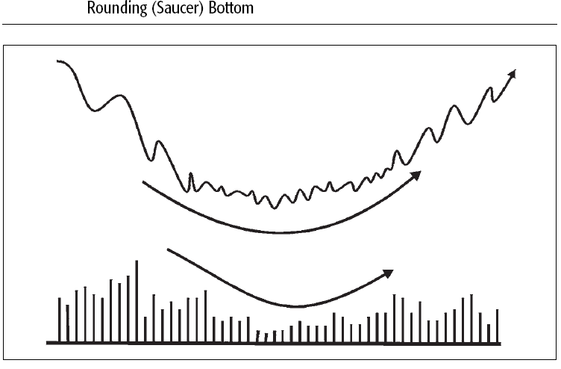
Classic Price Patterns

Slide 52
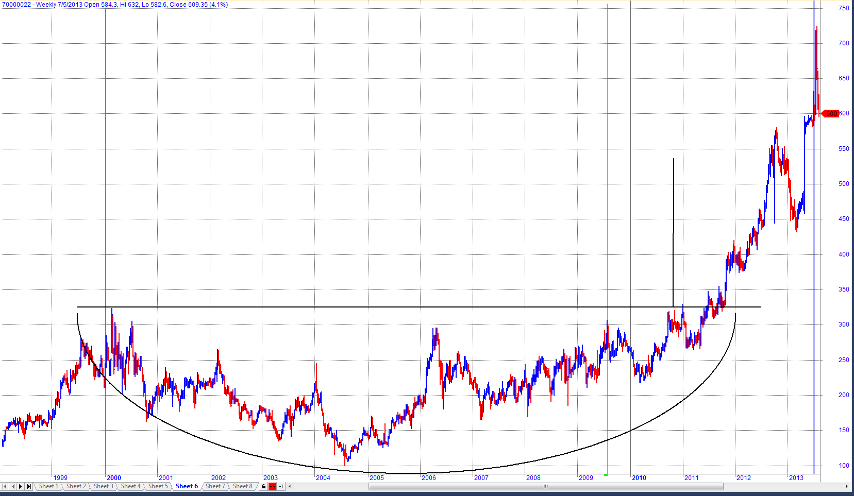
Classic Price Patterns
Saucer pattern – HUL

Slide 53
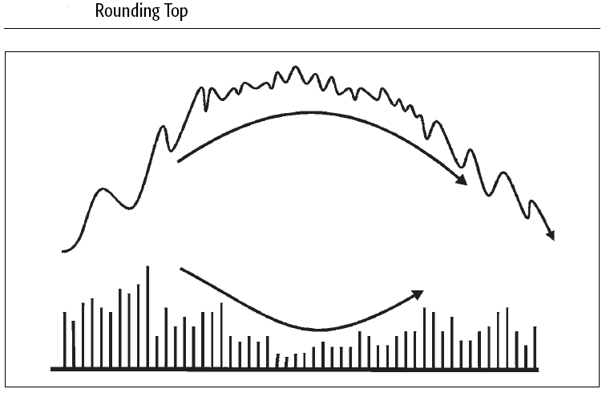
Classic Price Patterns

Slide 54
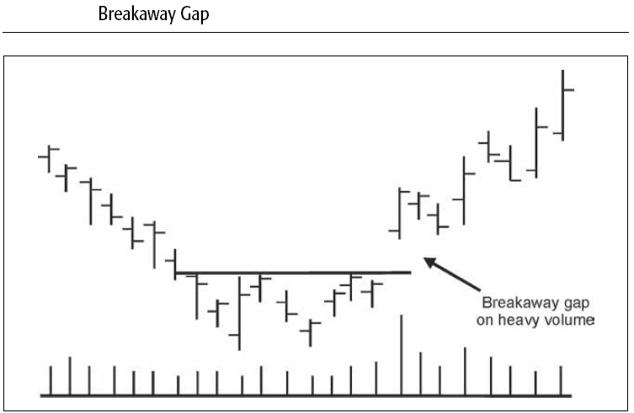
Gaps

Slide 55
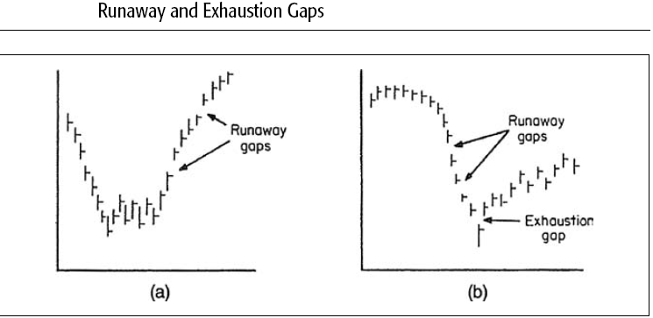
Gaps

Slide 56
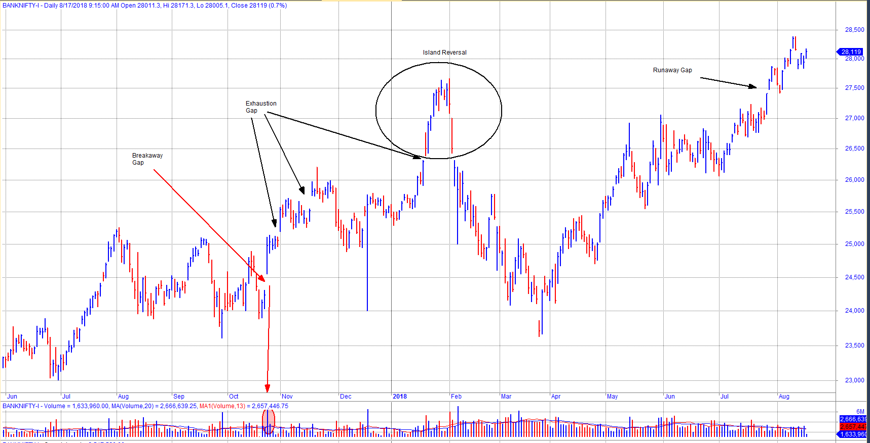
Gaps
Bank Nifty

Slide 57
Moving Averages
An MA is a smoothed version of a trend, and the average itself is an area of dynamic support and resistance.
A carefully chosen MA should reflect the underlying trend; its violation, therefore, warns that a change in trend may already have taken place.
If the violation occurs while the MA is still proceeding in the direction of the prevailing trend, this development should be treated as a preliminary warning that a trend reversal has taken place.
Generally speaking, the longer the time span covered by an MA, the greater is the significance of a crossover signal.
If an MA crossover takes place at the same time a trendline is violated or a price pattern is completed, these signals strongly reinforce each other and, therefore, need less in the form of a filter requirement.
Moving averages should be thought of as a dynamic level of support and resistance.
Few of the Moving Averages are simple moving average (SMA), exponential moving average (EMA), weighted moving average (WMA). The most widely used are SMA and EMA. SMA of 10 days is the average of last 10 days closing price. EMA gives higher weightage to recent readings.

Slide 58

Simple Moving Averages

Slide 59

Exponential Moving Averages
10, 20 and 50 EMA

Slide 60
THANK YOU

