Slide 1
Thakur College of Science & Commerce
Department of Zoology
Applied Component ( Fishery Biology)
Academic Year – 2020-21
Dr. Vitthal T. Mohite

Slide 2
Fishery Biology
Why fishery biology.
What are the application of fishery biology.
Geographical condition of our country.
River network.
Blue revolution in India
Role of Ministry of Agriculture
Job opportunity
Skill development.
Research

Slide 3
Syllabus pattern
In total eight units for each semester.
Will taught only four units by the teachers.
Remaining four units are for self study.
Questions will come from all eight units with internal options.

Slide 4
Semester – V Unit-VI
Quality Control and Packaging
6.1 Post mortem changes and mechanism of spoilage:
i) Hyperaemia ii) Rigor mortis iii) Autolysis iv) Rancidity
6.2 Brief methods for evaluating freshness and quality of fish and prawns / shrimps
i) Organoleptic ii) Microbial iii) Chemical
6.3 Sanitary operations
i) Maintenance of hygiene of food contact surfaces, storage and equipment
ii) Water quality, ice, sewage and waste water disposal and effluent treatment
plant
6.4 Various packaging materials used in freezing and canning industry
i) Polyolefin ii) Wax duplex carton iii) Master carton iv) Can v) Lacquered can
vi) Retort vii) Freezing procedures including hygienic washing, dressing
6.5 Quality Policy and Quality Analysis: ISO 22000/HACCP/ BRC/IFS

Slide 5
Post mortem changes
Sequential Changes takes in the body of organism.
1. Hyperaemia
2. Rigor Mortis
3. Autolysis
4. Rancidity

Slide 6
Hyperaemia
Hyperaemia (also hyperemia) is the increase of blood flow to different tissues in the body.
It can have medical implications but is also a regulatory response, allowing change in blood supply to different tissues through vasodilation.
Clinically, hyperaemia in tissues manifest as erythema (redness of the skin) because of the engorgement of vessels with oxygenated blood.
Hyperaemia can also occur due to a fall in atmospheric pressure outside the body.

Slide 7
Rigor mortis
Rigor mortis is a postmortem change resulting in the stiffening of the body muscles due to chemical changes in their myofibrils.
Rigor mortis helps in estimating the time since death as well to ascertain if the body had been moved after death.
After death, respiration in an organism ceases, depleting the source of oxygen used in the making of adenosine triphosphate (ATP). ATP is required to cause separation of the actin-myosin cross-bridges during relaxation of muscle.
When oxygen is no longer present, the body may continue to produce ATP via anaerobic glycolysis.
When the body's glycogen is depleted, the ATP concentration diminishes, and the body enters rigor mortis because it is unable to break those bridges.

Slide 8
Autolysis
the destruction of cells or tissues by their own enzymes, especially those released by lysosomes.
Autolytic cell destruction is uncommon in living adult organisms and usually occurs in injured cells and dying tissue.
Autolysis is initiated by the cells' lysosomes releasing digestive enzymes into the cytoplasm.
These enzymes are released due to the cessation of active processes in the cell, not as an active process.
In other words, though autolysis resembles the active process of digestion of nutrients by live cells, the dead cells are not actively digesting themselves as is often claimed and as the synonym self-digestion of autolysis seems to imply.
Autolysis of individual cell organelles can be lessened if the organelle is stored in warm isotonic buffer after cell fractionation.

Slide 9
Rancidity
Rancidity, condition produced by aerial oxidation of unsaturated fat present in foods and other products, marked by unpleasant odour or flavour.
Description
Rancidification is the process of complete or incomplete oxidation or hydrolysis of fats and oils when exposed to air, light, or moisture or by bacterial action, resulting in unpleasant taste and odor.

Slide 10
Oorganoleptic tests
characteristics such as general consistency of flesh, odour, color. eye and gill condition etc.
Appearance.
Texture
Color
Odour

Slide 11
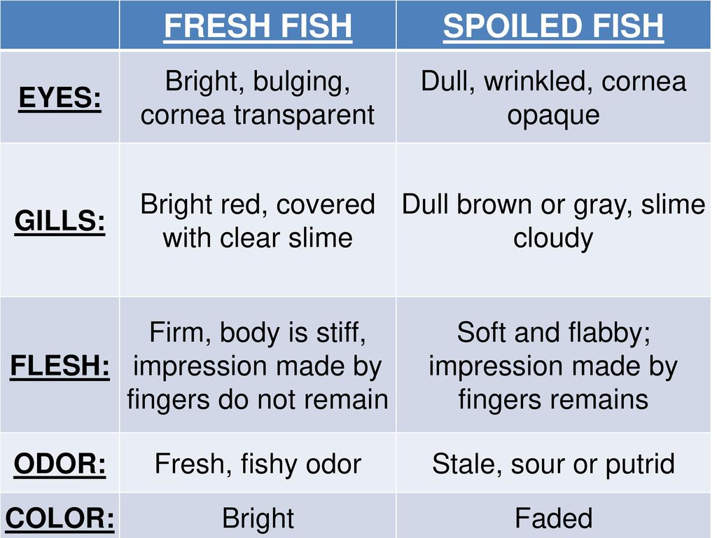

Slide 12
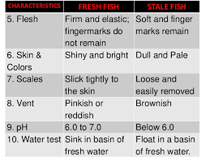

Slide 13
Microbial tests
Traditional bacteriological examinations are laborious, time-consuming, costly
It is recommended that such analyses be limited in number and extent.
Various rapid microbiological methods have been developed during the last decade.
Some of these automated procedures may be of use when large numbers of samples are to be analyzed.
Total Count
Spoilage bacteria e.g. Pseudomonas spp. Photobacterium
Spoilage reaction
Pathogenic bacteria

Slide 14
Biochemical and chemical tests
The establishment of tolerance levels of chemical spoilage indicators would eliminate the need to base decisions regarding product quality on personal opinions.
microbial spoilage or autolysis.
Amines - Total Volatile Basic Amines
Ammonia
Trimethylainine (TMA) Trimethylamine is a pungent volatile amine often associated with the typical "fishy" odour of spoiling seafood.
Nucleotide Catabolites
Ethanol
Measurements of oxidative rancidity

Slide 15
Sanitary operation
i) Maintenance of hygiene of food contact surfaces, storage and equipment
Contact Surfaces : Equipment’s, Utensils, Facilities and Human Resource.
Materials used for contact surfaces : Concrete, glass, iron sheet, plastic rubber sheet, Stainless Steel , Galvanized metals , wood
What to monitor
Condition of the food contact surfaces.
Cleanliness and sanitation of food contact surfaces.
Type and concentration of sanitizer(s) used.
Gloves and outer garments which might contact food are clean and in good condition.
How to Monitor:
Visual Inspection
Surfaces are in good condition
Surfaces cleaned and sanitized
Gloves & outer garments cleaned
Chemical Test
Sanitizer concentration
Verification check
Microbial tests of surfaces

Slide 16
Material used for contact surfaces should be
non toxic,
non absorbent,
Resistant for corrosion.
Food conditions that can influence choice of appropriate food contact surfaces
Pickled fish – Strongly corrosive, highly acidic and salts
Salt cured fish product - Moderately corrosive; Medium acidity and salts
Fresh and refrigerated fish - Weakly corrosive, Low acidity
Fish powders, Dried fish - Non-corrosive
Frozen Fish - Non-corrosive

Slide 17
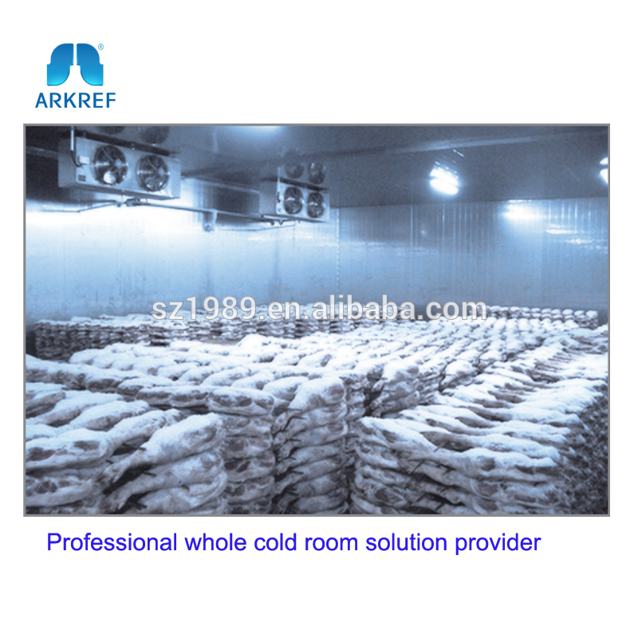
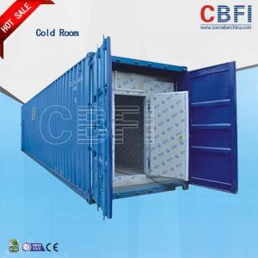
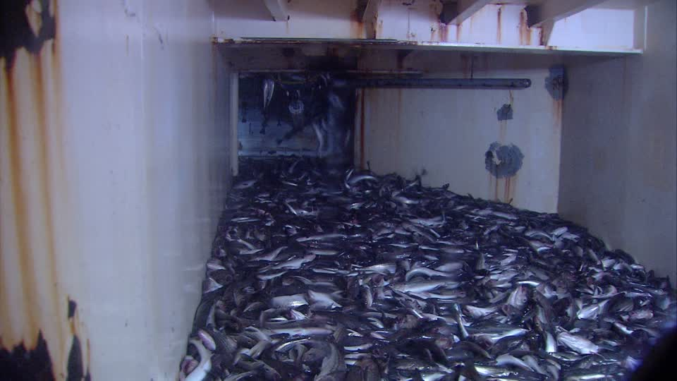
Storage areas
Storage room on fishing vessels & Trawlers.
Transport vehicles
Cold Storages.
Containers during Cargo & shipping

Slide 18
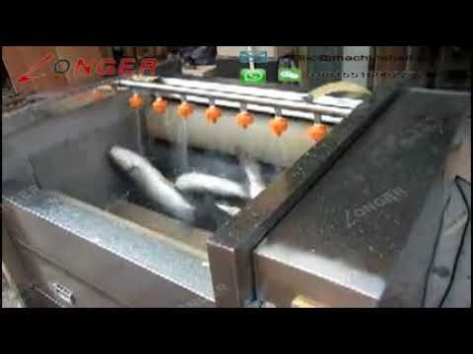
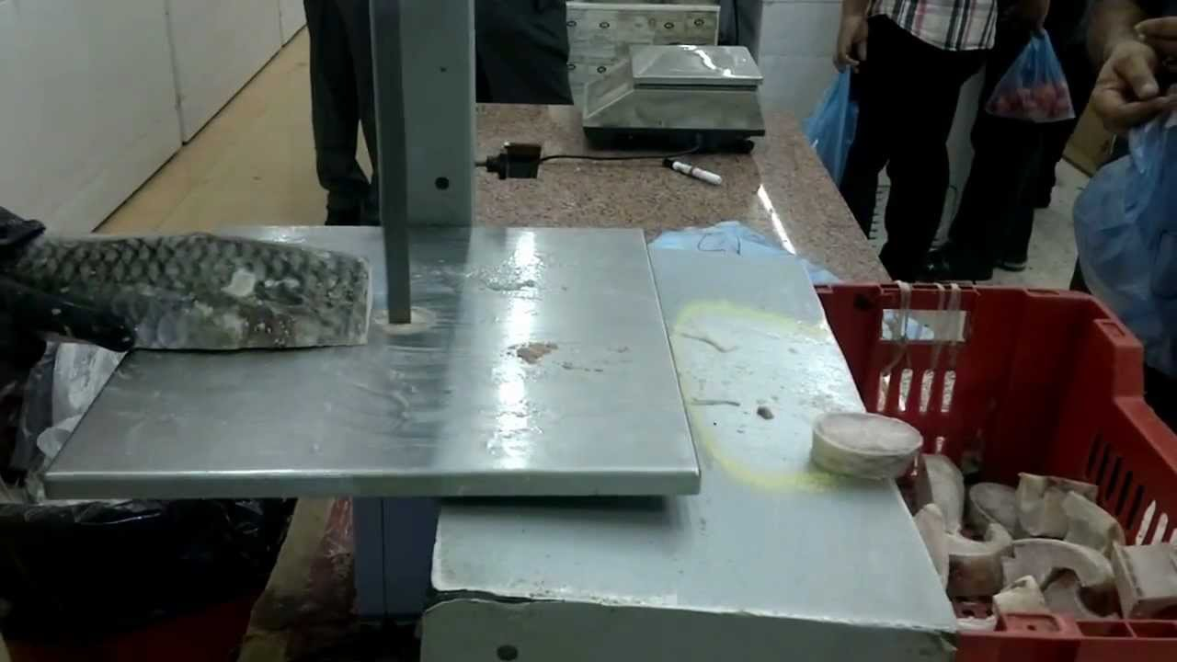
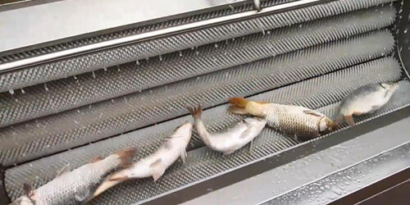
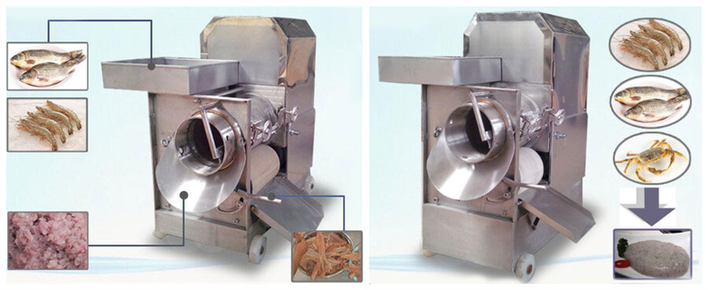
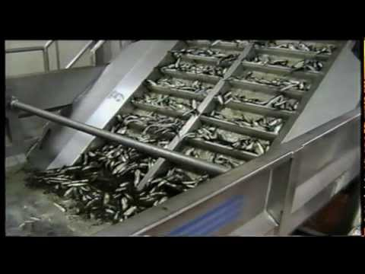
Equipment's used
For Industrial Continuous Type Raw Shrimp & Fish Washing Machine.
Floating Fish feed Processing Machine.
Fish Slicing Machine.
Fish Refiner from Stainless Steel.
Fish De-scaling Machine .
Process Equipment. ...
Fish Bone Separator Machine.
Fish grading machine

Slide 19
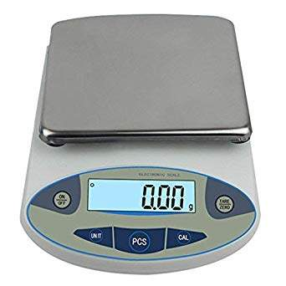


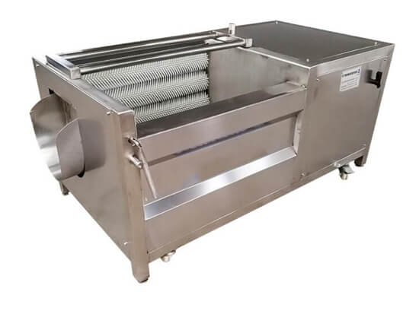

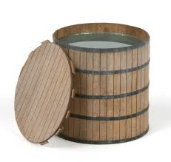
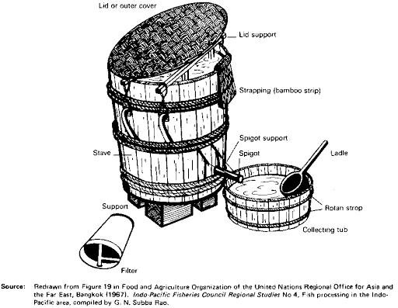
Utensils
Measuring device
Plastic cups
Trays
Salinometer
Thermometer
Knives
Scissors
Fish scaler
Salting drum
Wooden salting vats
Earthen pot
Bamboo bascket
Chopping board

Slide 20
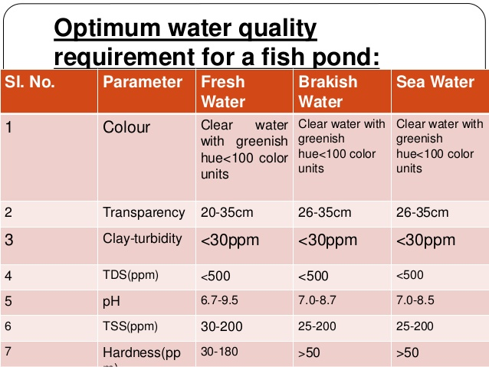

Slide 21
Ice in fish processing
Fresh water ice -
Seawater ice - it is slightly subcooled during manufacture and can be packed well around fish, it may be more efficient in cooling fish than crushed block ice.
Antibiotic ice - tetracycline antibiotics in fish preservation has been carried.

Slide 22
Sewage and waste water disposal and effluent treatment plant
Fishing industry wastewater is highly contaminated.
The degree of pollution of a wastewater depends on several parameters.
The most important are the type of operation being carried out, the fish species being processed and the operating routine in the factory.
The sewage fed fish culture uses the waste recycling process and maintains the good environment around the urban area.
Manuring and supplementary feeding is not required due to high content of nutrients in sewage.
Input cost is very low and production is very high.

Slide 23
Packaging material used in freezing and canning industry
Polyolefin
Cartoon
Wax duplex cartoon
Master cartoon
Simple can
Coated cans

Slide 24
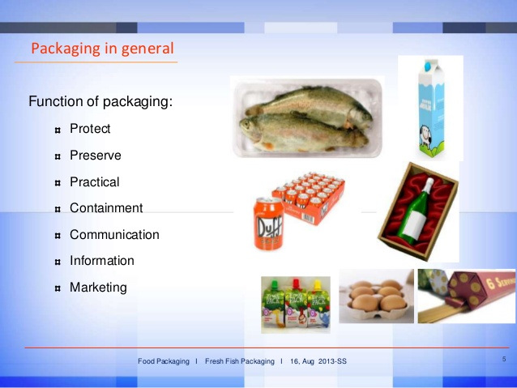

Slide 25
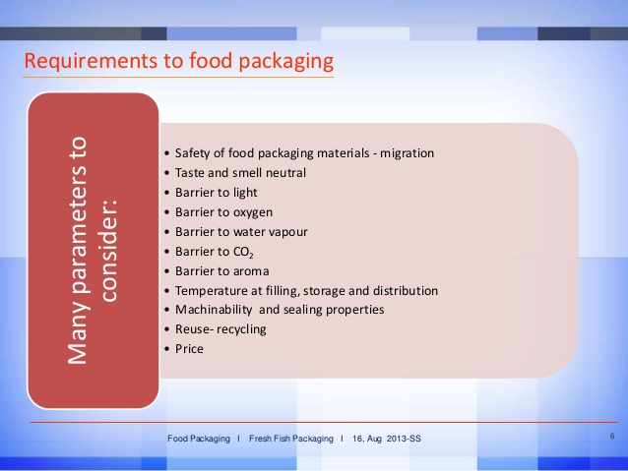

Slide 26
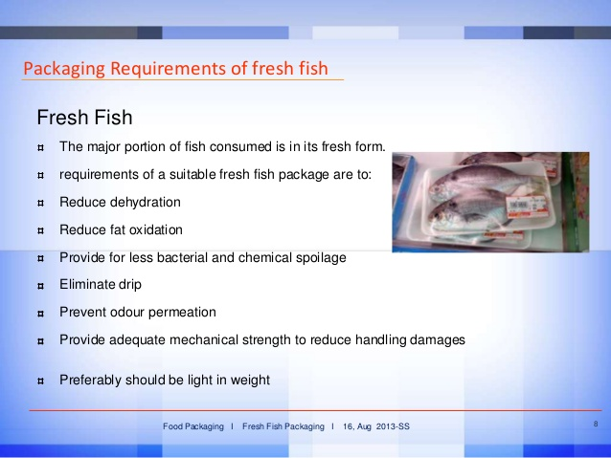

Slide 27
Advantages of Fish packaging
The packaging requirements for each will vary.
Fish packaging produced is highly durable and cost effective.
Protection of product shape and form throughout the transportation process
Consumer product attraction through effective promotional packaging designs
Ensuring product freshness and longevity of shelf life.
Providing nutritional information on labels of packaging that can be beneficial to both consumer and retailer.
Providing better customer convenience through the implementation of effective pouch mechanisms such as re’ sealable

Slide 28
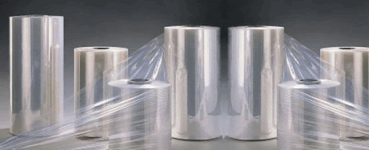
Polyolefin
Plastics. Plastics are organic polymeric materials that can be molded into the desired shape
A polyolefin is a type of polymer produced from a simple olefin as a monomer.
For example, polyethylene is the polyolefin produced by polymerizing the olefin ethylene.
Polypropylene is another common polyolefin which is made from the olefin propylene.
Polyolefins are extremely suitable and safe for packaging.
This is because they are 'chemically inert' materials, which means they do not interact with other materials.
The contents of polyolefin cannot absorb harmful chemicals, additives or by-products from the container.

Slide 29
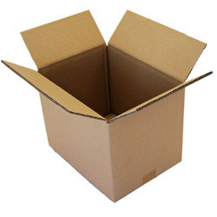
Master cartoon
The master carton is the large outer container that you see first when receiving a package.
It's often marked with the quantity of units inside and shipping
These cartons are specifically designed to be master packs for our popular small carton boxes for freight consolidation and to reduce the number of boxes during transport and delivery.
Choose the one that fits your needs and keep your items and their original packaging protected during the shipment.

Slide 30
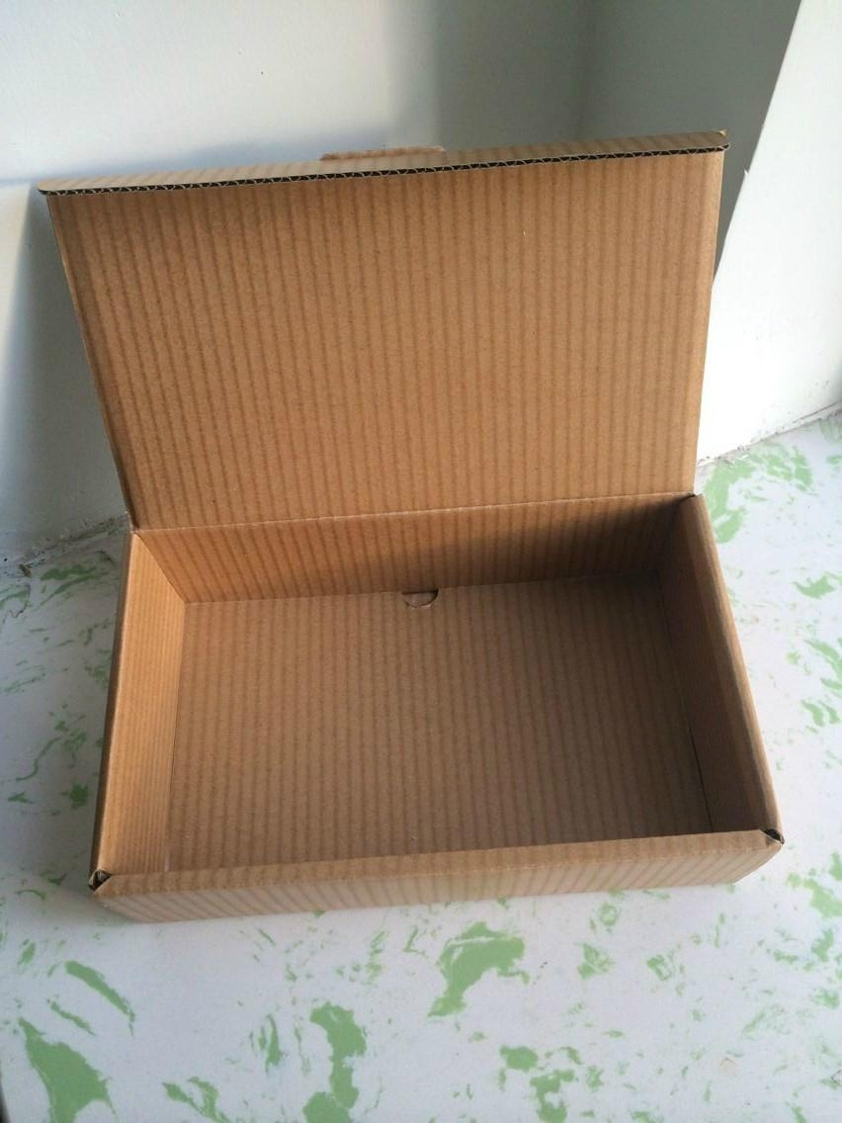
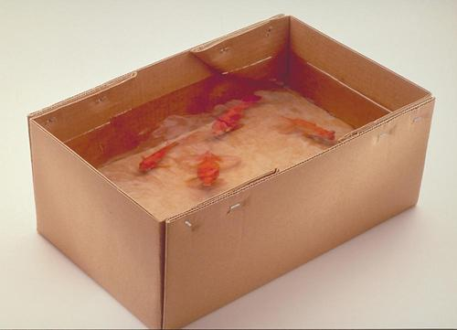
Wax Duplex Cartoon
Proper packaging for frozen :fish is essential for controlling the detrimental effects of oxygen and desiccation by barring the entry of air and escape of moistur.
Protect the contents from flavour contamination, entry of microorganisms, mechanical damage and exposure to light.
Fish packaging cartons are with their special properties such as bursting strength, puncture resistance, water proofness.
tearing, strength, tensile strength, elongation, moisture content, thickness, weight of the carton, dimension, wax content and saponifiable matter.

Slide 31
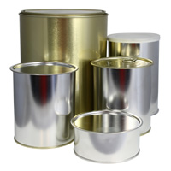
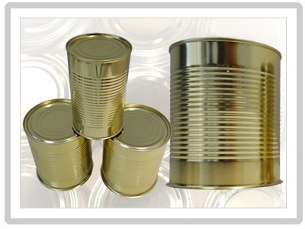
Simple Cans
Other fish that is canned includes tuna cod, mackerel, herring, and anchovy.
Tuna and most canned fish is cooked before it is canned.
Mackerel. Linked to lower blood pressure among males, mackerel is rich in protein and doesn't contain nearly as many calories as chicken or beef. ...
Sardines in Olive Oil. ...
Sardines in Soya Oil. ...
Sardines in Vegetable Oil. ...
Sardines in Water. ...
Light Tuna in Soya Oil. ...
Light Tuna in Water. ...
Tuna Salad With Black Eyed Peas.

Slide 32
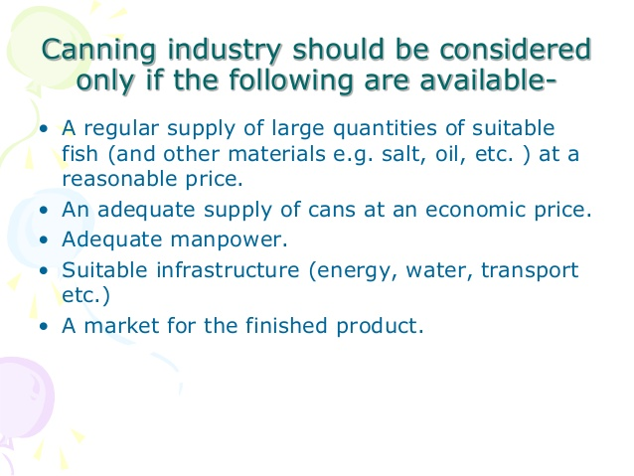

Slide 33
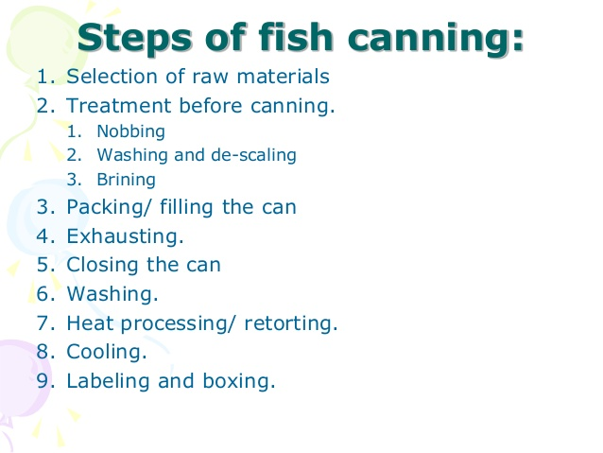

Slide 34
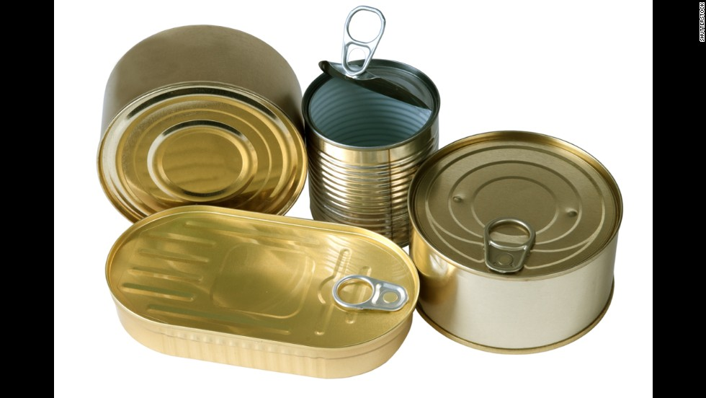
Coated Lacquered Cans
The inside of the can is coated with an epoxy coating, in an attempt to prevent food or beverage from coming into contact with the metal.
To prevent a protective coating is added to the inside of the can.
Preserve the taste and nutritional values of their filling for up to several years.
Coated with an organic layer that prevents chemical reactions between the can’s metal and the food.
Can coatings should withstand the production and sterilization processes.
It is universally applicable for fish and beverage types prevent chemical migration into fishes in quantities that endanger human health.
It preserve the fish and maintain its organoleptic properties over several years

Slide 35
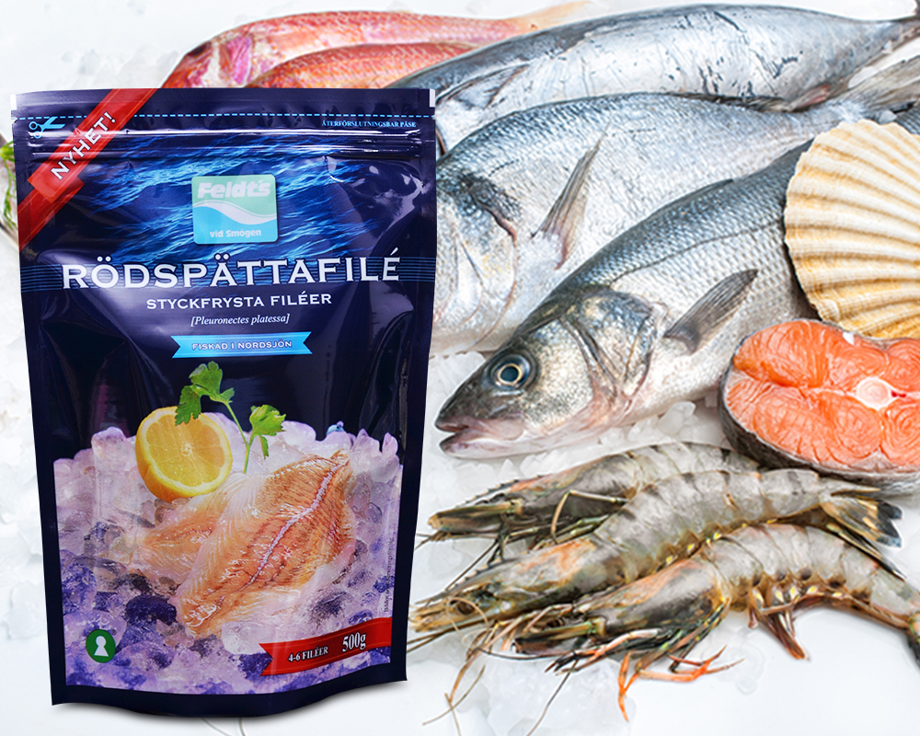
Retort pouches
The term 'retort pouch' is used to describe a flexible or semi-rigid package made from heat-resistant laminated plastic, into which food products are placed, sealed and sterilized at temperatures up to 121°C.
The resulting product is then sterile and shelf-stable.
The pouches are heat processed in an over pressure autoclave.
Work carried out CIFT has shown that oil sardines packed in retort pouches having composition polyester / aluminium foil / cast polypropylene remained in excellent condition even after a period of 3 years

Slide 36
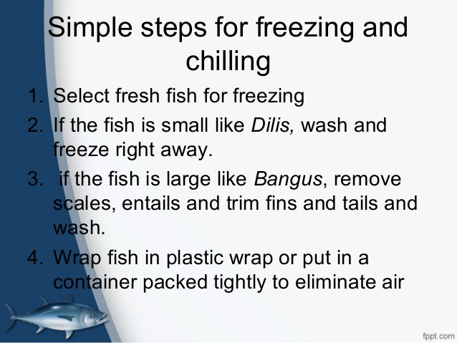
Freezing procedures including hygienic washing, dressing

Slide 37
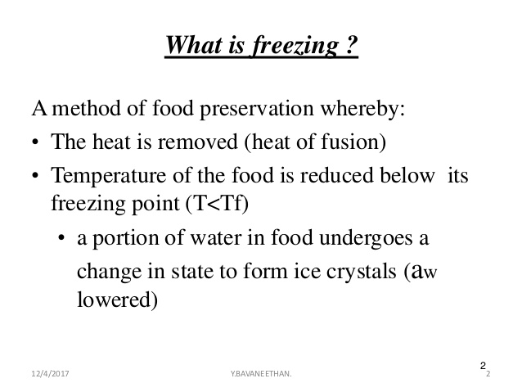

Slide 38
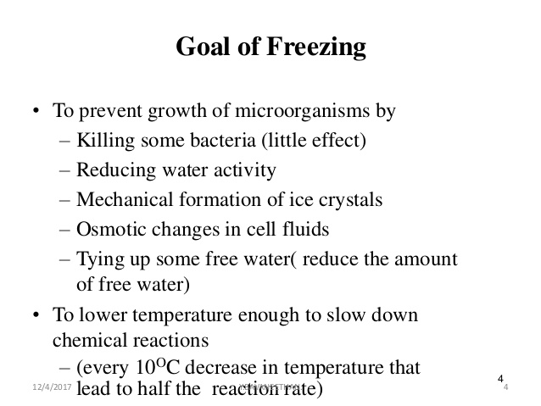

Slide 39
Hygiene washing
Hygiene when handling fish.
Proper hygiene is important in preventing fish contamination by pathogenic bacteria.
Many bacteria are present on the fish in the atmosphere may contaminate fish meat.
Water used for washing should be good quality.
Area of contact surfaces should be sterilized.
Human resources should maintain personal hygiene during working hours.

Slide 40
Quality policy and quality Analysis
Quality control is defined as the continuing assessment of a current operation.
In the case of fish and fishery products, quality control includes the steps taken to protect the quality of the material since catch till it reaches the consumer.
Quality is commonly thought of as degree of excellence.
Proper handling of fish between capture and delivery to the consumer is a crucial element in assuring final product quality.
Is the systematic actions necessary to provide adequate confidence that a product or service will satisfy given requirements for quality.
Proper handling of fish between capture and delivery to the consumer is a crucial element in assuring final product quality.

Slide 41
Quality standards
ISO 22000 ( Food Safety Management) - ISO 22000 provides a layer of reassurance within the global food supply chain, helping products cross borders and bringing people food that they can trust.
HACCP - is a management system in which food safety is addressed through the analysis and control of biological, chemical, and physical hazards from raw material production, procurement and handling, to manufacturing, distribution and consumption of the finished product.
BRC - The British Retail Consortium (BRC) is a trade association for the UK food retail industry created in 1992.
The BRC has published standards for best practices for the food and manufacturing industries for two decades, and also publishes the On-Pack recycling standards for the UK.
IFS - The Institute for Fiscal Studies Uk established quality standards.
ISI - ISI stands for Indian Standards Institute. It was established to create standards for the orderly industrial growth and maintaining quality in industrial production.
It provides an ISI mark which is a certification mark for industrial products in India.

Slide 42
ISO 22000 ( Food Safety Management)
WHAT IS ISO 22000?
ISO 22000, published on 1 September 2005, is
an International Standard designed to ensure
safe food supply chains worldwide
ISO 22000 is a consensus agreement between all the
economic stakeholders concerned, that include
• Suppliers
Users
Government regulators
Other interest groups.
Benefits to the society
Benefits to the consumers.
Assurance on quality safety and Reliability

Slide 43
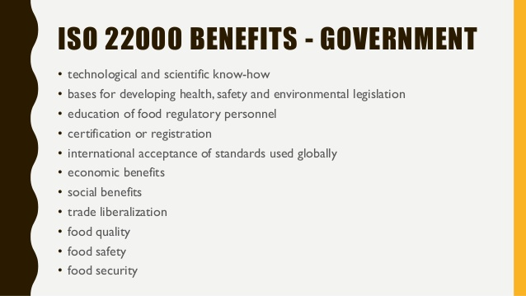

Slide 44
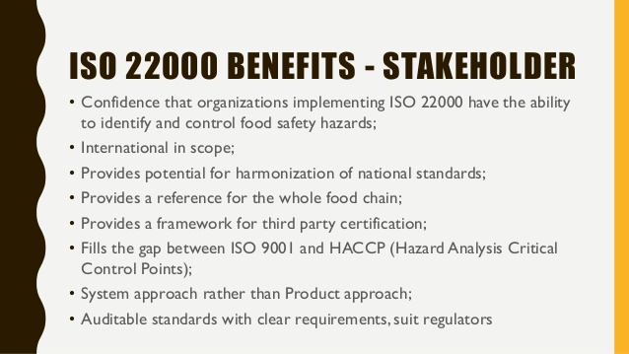

Slide 45
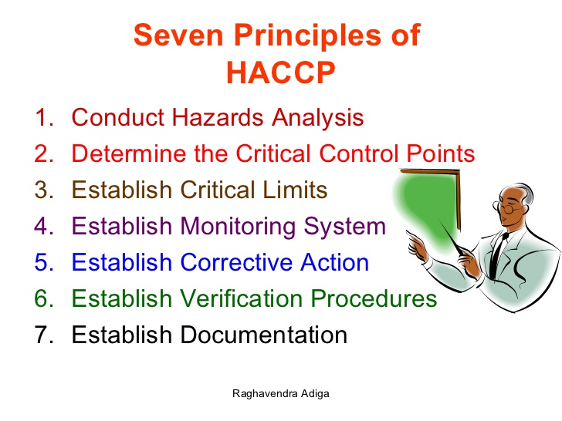
HACCP – Standards

Slide 46
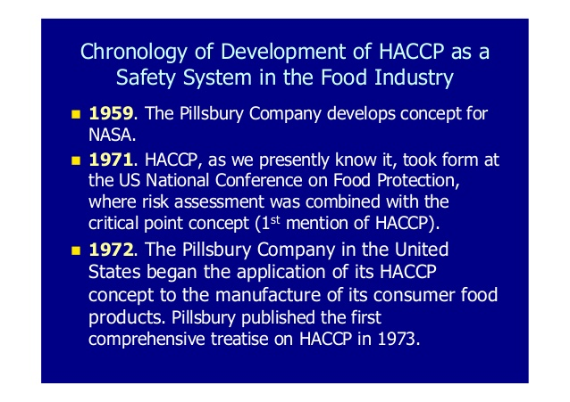

Slide 47
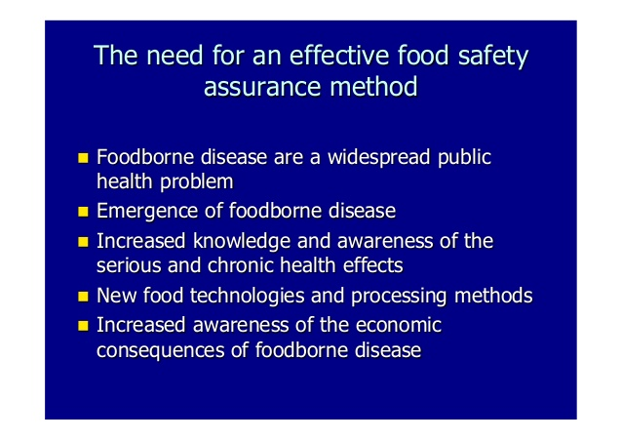

Slide 48
BRC – Standards
The BRC Global Standards provide a scalable option, easily tailored to large or small operations, with suppliers from over 100 countries already certified against it. In keeping with a complete supply chain approach, there are 4 standards under the BRC umbrella, including:
BRC Global Food Standard,
BRC Storage and Distribution,
BRC IOP for Food Packaging, and
BRC Consumer Products.
The major areas covered by the Standards include Senior Management Commitment and Continuous Improvement; Food Safety and Quality Management System; Site Standards; Product Control; Process Control and; Personnel.
Strengths of the BRC standard include highly detailed descriptions of process and hygiene control.
Additionally, BRC certification covers food safety, quality, and also legality, which is of great concern to any stakeholder navigating the complexity of food law.

Slide 49
IFS – Standards
Institute for Fiscal Studies Uk
IFS Certification. NSF Food Safety Certification, LLC is accredited to certify to the International Featured Standard (IFS), a GFSI benchmarked standard for auditing food safety and quality of processes and products of food manufacturers.
It is most relevant for companies that manufacture, process or handle food or food ingredients.
The IFS Standards currently comprise six standards, which have been developed for and by the stakeholders involved in all parts of the supply chain.
All standards are process standards which help users when implementing legal provisions regarding food and/or product safety, and provide uniform guidelines on food, -- product safety and quality issues.
An IFS certification shows that the certified company has established processes which are suitable for ensuring food and/or product safety, and that it has considered and implemented customer specifications.
Certification is open to food manufacturers, brokers, logistics providers, manufacturers of household and hygiene products as well as wholesalers and retailers.

Slide 50
The ISI mark is a standards-compliance mark for industrial products in India since 1955.
The mark certifies that a product conforms to an Indian standard (IS) developed by the Bureau of Indian Standards (BIS), the national standards body of India.
The ISI mark is by far the most recognised certification mark in the Indian subcontinent.

