Slide 1
Enterprise Resource planning

Slide 2
INTRODUCTION TO ERP
ERP stands for enterprise resource planning.
The simplest way to define ERP is to think about all the core processes needed to run a company: finance, HR, manufacturing, supply chain, services, procurement, and others.
At its most basic level, ERP integrates these processes into a single system.

Slide 3
Definition:
Enterprise resource planning (ERP) is a process used by companies to manage and integrate the important parts of their businesses.
Many ERP software applications are important to companies because they help them implement resource planning by integrating all of the processes needed to run their companies with a single system.

Slide 4
Origin of ERP System:
Manufacturing beginnings - ERP's roots start in material requirements planning (MRP), a system for calculating the materials and components needed to manufacture a product that was developed by IBM engineer Joseph Orlicky in 1964.
In 1983, management expert Oliver Wight developed MRP II, which extended MRP to other kinds of operations, including financials, and added support for capacity planning and shop floor control, among others.

Slide 5
Back-office software emerges - Separately, vendors in the 1970s -- including two startups, SAP and Baan began developing mainframe software for managing financial processes on a single database.
By 1990, analysts at research firm Gartner concluded this category of software needed its own name, dubbing it enterprise resource planning to denote its general-purpose role.

Slide 6
Deployment evolves - In the early days of ERP- like systems in the 1970s, the software ran on mainframe computers. By the 1990s, mainframe ERP vendors began migrating the software to the client-server model, where desktop devices communicate with a central server computer. ERP was now accessible to more users more affordably.
Cloud computing's internet connectivity made it feasible for companies to connect their ERP systems to customers, suppliers and partners.

Slide 7
In recent years, ERP vendors have focused most of their R&D on their cloud products to enable AI and machine learning, blockchain, predictive analytics and other emerging technologies that require the superior computing power and internet connectivity of the cloud.

Slide 8
Need for an ERP system
One overall user interface - An ERP system binds the separate work processes into one overall system and presents data through a unified interface.
Better accounting management and financial reporting - An integrated ERP application can eliminate the need of the difficult data entry work, thus freeing resources for other tasks. A centralized ERP platform also increases the visibility of important data and therefore helps to create an overview of your business.

Slide 9
Faster response time - Many small businesses, typically newly started, uses a free online accounting system. ERP systems today have built-in functionality that goes across the business areas of the company, eliminating the need for multiple applications that overlap each other.
An effective cost reduction tool - An ERP system can provide actual and real-time data related to the company's daily operations. This data helps decision makers plan their strategy on a professional and informed basis. An ERP system is an extremely effective tool for managing and monitoring your business

Slide 10
Increased productivity - Most companies will undoubtedly make a greater or lesser effort to reduce the costs and time spent on performing a specific job. An ERP system consolidates all the information that is entered into the system across the many departments and thus serves as a secure warehouse.
Mobility and flexibility - A modern ERP solution can today handle multiple features by utilizing a centralized database that delivers accurate information for use no matter where in the world you are and on which device you use.

Slide 11
Benefits of ERP:
Higher productivity: Streamline and automate your core business processes to help everyone in your organization do more with fewer resources.
Deeper insights: Eliminate information silos, gain a single source of truth, and get fast answers to mission-critical business questions.
Accelerated reporting: Fast-track business and financial reporting and easily share results. Act on insights and improve performance in real time.

Slide 12
Lower risk: Maximize business visibility and control, ensure compliance with regulatory requirements, and predict and prevent risk.
Simpler IT: By using integrated ERP applications that share a database, you can simplify IT and give everyone an easier way to work.
Improved agility: With efficient operations and ready access to real-time data, you can quickly identify and react to new opportunities

Slide 13
Reasons for the Growth of ERP Market:
1.To enable improved business performance
Cycle time reduction: The time required to contact other department is reduced.
Inventory reduction: As the data is integrated there is no need to re enter the data and the paperless transaction is done using EDI
Order fulfillment improvement: There is no conflict between the departments like sales and production so order can be made on time.

Slide 14
2.To support business growth requirements
New Products and New Customers: We can grow our organization by implementing new Products in the market and get the new customers for that product.
Globalize the product: We can globalize the product for International customers
3.To provide flexible, integrated, real time decision support
Managers get the integrated data of different departments at any time to analyze and to take important decisions at the right time.

Slide 15
4.To eliminate limitations in the legacy system:
Integration of the isolated departments
Decision support system
Availability of the right data at right time
Flexibility to change
Supporting latest technologies

Slide 16
5.Take advantage of the untapped mid market:
Increased functionality at reasonable cost
Vertical market solutions
Open system technology

Slide 17
ERP and related technology
The ERP system has 3 significant limitations:
Managers cannot generate custom reports or queries without the help from a programmer and this inhibits them from obtaining information quickly, which is essential for making a competitive advantage.
ERP systems provide current status only, such as open orders. Managers often need to look past status to find trends and patterns that aid better decision-making.
The data in the ERP application is not integrated with other enterprise or division systems and does not include external intelligence.

Slide 18
There are many technologies that help to overcome these limitations.
These technologies when used in conjunction with the ERP package, help in overcoming the limitations of a stand-alone ERP system and thus help the employees to make better decisions.

Slide 19
Some of these technologies are:
1. BUSINESS PROCESS RE-ENGINEERING (BPR)
2. MANAGEMENT INFORMATION SYSTEM (MIS)
3. DECISION SUPPORT SYSTEMS (DSS)
4. EXECUTIVE INFORMATION SYSTEM (EIS)
5. DATA WAREHOUSING
6. DATA MINING
7. ON-LINE ANALYTICAL PROCESSING (OLAP)
8. PRODUCT LIFE CYCLE MANAGEMENT (PLC)
9. SUPPLY CHAIN MANAGEMENT(SCM)

Slide 20
1. BUSINESS PROCESS RE-ENGINEERING
Davenport & Short (1990) define business process as "a set of logically related tasks performed to achieve a defined business outcome”.
A process is "a structured, measured set of activities designed to produce a specified output for a particular customer or market. It implies a strong emphasis on how work is done within an organization" (Davenport 1993).

Slide 21
In their view processes have two important characteristics:
They have customers (internal or external),
They cross organizational boundaries, i.e., they occur across or between organizational subunits.
Processes are generally identified in terms of beginning and end points, interfaces, and organization units involved, particularly the customer unit.
Examples of processes include: developing a new product; ordering goods from a supplier; creating a marketing plan; processing and paying an insurance claim; etc.

Slide 22
Business process reengineering is the main way in which organizations become more efficient and modernize.
BPR transforms an organization in ways that directly affect performance.
BPR is the analysis and redesign of workflow within and between enterprises.

Slide 23
Principles of BPR:
1. Organize around outcomes, not tasks.
2. Identify all the processes in an organization and prioritize them in order of redesign urgency.
3. Integrate information processing work into the real work that produces the information.
4. Treat geographically dispersed resources as though they were centralized.
5. Link parallel activities in the workflow instead of just integrating their results.
6. Put the decision point where the work is performed, and build control into the process.
7. Capture information once and at the source.

Slide 24
Business Process Reengineering Steps
Step #1: Identity and Communicating the Need for Change
Risk of Failure: Not Getting Buy-In From The Company
Step #2: Put Together a Team of Experts
Risk of Failure: Not Putting The Right Team Together
Step #3: Find the Inefficient Processes
Risk of Failure: Inability to Properly Analyze Processes
Step #4: Reengineer the processes and Compare KPIs

Slide 25
ADVANTAGES OF BPR
1. It helps in integrating the various business processes of the organization.
2. With good ERP package, the organization will be able to achieve dramatic improvements in areas such as cost, quality, speed, etc.

Slide 26
Tips for Implementation of BPR project
The best way to map and improve the organization's procedures is to take a top down approach, and not undertake a project in isolation. That means:
• Starting with mission statements that define the purpose of the organization and describe what sets it apart from others in its sector or industry.
• Producing vision statements which define where the organization is going, to provide a clear picture of the desired future position.

Slide 27
• Build these into a clear business strategy thereby deriving the project objectives.
• Defining behaviors that will enable the organization to achieve its' aims.
• Producing key performance measures to track progress.
• Relating efficiency improvements to the culture of the organization
• Identifying initiatives that will improve performance.
Once these building blocks in place, the BPR exercise can begin .

Slide 28
Management Information System(MIS)
To the managers, MIS is an implementation of the organizational systems and procedures.
To a programmer it is nothing but file structures and file processing. However, it involves much more complexity.
The three components of MIS provide a more complete and focused definition, where System suggests integration and holistic view, Information stands for processed data, and Management is the ultimate user, the decision makers.

Slide 29
Management
Management covers the planning, control, and administration of the operations of a concern.
The top management handles planning; the middle management concentrates on controlling; and the lower management is concerned with actual administration.

Slide 30
Information
Information, in MIS, means the processed data that helps the management in planning, controlling and operations.
Data means all the facts arising out of the operations of the concern.
Data is processed i.e. recorded, summarized, compared and finally presented to the management in the form of MIS report.

Slide 31
System
Data is processed into information with the help of a system.
A system is made up of inputs, processing, output and feedback or control.
Thus MIS means a system for processing data in order to give proper information to the management for performing its functions.

Slide 32
Definition
Management Information System or 'MIS' is a planned system of collecting, storing, and disseminating data in the form of information needed to carry out the functions of management.

Slide 33
Objectives of MIS
The goals of an MIS are to implement the organizational structure and dynamics of the enterprise for the purpose of managing the organization in a better way and capturing the potential of the information system for competitive advantage.
Following are the basic objectives of an MIS −
1. Capturing Data − Capturing contextual data, or operational information that will contribute in decision making from various internal and external sources of organization.

Slide 34
2. Processing Data − The captured data is processed into information needed for planning, organizing, coordinating, directing and controlling functionalities at strategic, tactical and operational level.
Processing data means −
making calculations with the data
sorting data
classifying data and
summarizing data

Slide 35
3. Information Storage − Information or processed data need to be stored for future use.
4. Information Retrieval − The system should be able to retrieve this information from the storage as and when required by various users.
5. Information Propagation − Information or the finished product of the MIS should be circulated to its users periodically using the organizational network.

Slide 36
Characteristics of MIS
It should be based on a long-term planning.
It should provide a holistic view of the dynamics and the structure of the organization.
It should work as a complete and comprehensive system covering all interconnecting sub-systems within the organization.
It should be planned in a top-down way, as the decision makers or the management should actively take part and provide clear direction at the development stage of the MIS.

Slide 37
Characteristics of Computerized MIS
It should be able to process data accurately and with high speed, using various techniques like operations research, simulation, heuristics, etc.
It should be able to collect, organize, manipulate, and update large amount of raw data of both related and unrelated nature, coming from various internal and external sources at different periods of time.

Slide 38
It should provide real time information on ongoing events without any delay.
It should support various output formats and follow latest rules and regulations in practice.
It should provide organized and relevant information for all levels of management: strategic, operational, and tactical.
It should aim at extreme flexibility in data storage and retrieval.

Slide 39
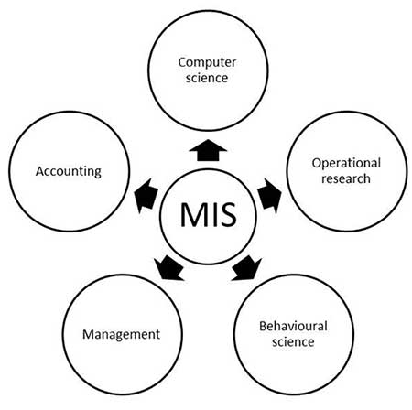
Nature and Scope of MIS
The following diagram shows the nature and scope of MIS −

Slide 40
Decision Support System (DSS)
DSS are interactive software-based systems intended to help managers in decision-making by accessing large volumes of information generated from various related information systems involved in organizational business processes, such as office automation system, transaction processing system, etc.

Slide 41
DSS uses the summary information, exceptions, patterns, and trends using the analytical models.
A decision support system helps in decision-making but does not necessarily give a decision itself.
The decision makers compile useful information from raw data, documents, personal knowledge, and/or business models to identify and solve problems and make decisions.

Slide 42
Programmed and Non-programmed Decisions
There are two types of decisions –
1. Programmed and
2. Non-programmed decisions.
Programmed decisions are basically automated processes, general routine work, where −
      These decisions have been taken several times.
      These decisions follow some guidelines or rules.
For example, selecting a reorder level for inventories, is a programmed decision.

Slide 43
Non-programmed decisions occur in unusual and non-addressed situations, so −
    It would be a new decision.
    There will not be any rules to follow.
    These decisions are made based on the available information.
    These decisions are based on the manger's discretion, instinct, perception and judgment.
For example, investing in a new technology is a non-programmed decision.

Slide 44
Attributes of a DSS
Adaptability and flexibility
High level of Interactivity
Ease of use
Efficiency and effectiveness
Complete control by decision-makers
Ease of development
Extendibility
Support for modeling and analysis
Support for data access
Standalone, integrated, and Web-based

Slide 45
Characteristics of a DSS
Support for decision-makers in semi-structured and unstructured problems.
Support for managers at various managerial levels, ranging from top executive to line managers.
Support for individuals and groups.
Support for interdependent or sequential decisions.
Support for intelligence, design, choice, and implementation.
Support for variety of decision processes and styles.
DSSs are adaptive over time.

Slide 46
Benefits of DSS
Improves efficiency and speed of decision-making activities.
Increases the control, competitiveness and capability of futuristic decision-making of the organization.
Facilitates interpersonal communication.
Encourages learning or training.
Since it is mostly used in non-programmed decisions, it reveals new approaches and sets up new evidences for an unusual decision.
Helps automate managerial processes.

Slide 47
Components of a DSS
Following are the components of the Decision Support System
1. Database Management System (DBMS) −
To solve a problem the necessary data may come from internal or external database.
In an organization, internal data are generated by a system such as TPS and MIS.
External data come from a variety of sources such as newspapers, online data services, databases (financial, marketing, human resources).

Slide 48
2. Model Management System
It stores and accesses models that managers use to make decisions.
Such models are used for designing manufacturing facility, analyzing the financial health of an organization, forecasting demand of a product or service, etc.
3. Support Tools
Support tools like online help; pulls down menus, user interfaces, graphical analysis, error correction mechanism, facilitates the user interactions with the system.

Slide 49
Classification of DSS
There are several ways to classify DSS. Hoi Apple and Whinstone classifies DSS as follows −
1. Text Oriented DSS − It contains textually represented information that could have a bearing on decision. It allows documents to be electronically created, revised and viewed as needed.
2. Database Oriented DSS − Database plays a major role here; it contains organized and highly structured data.
3. Rules Oriented DSS − Procedures are adopted in rules oriented DSS. Export system is the example.

Slide 50
4. Spreadsheet Oriented DSS − It contains information in spread sheets that allows create, view, modify procedural knowledge and also instructs the system to execute self-contained instructions. The most popular tool is Excel
5. Solver Oriented DSS − It is based on a solver, which is an algorithm or procedure written for performing certain calculations and particular program type.
6. Rules Oriented DSS − It follows certain procedures adopted as rules.
7. Compound DSS − It is built by using two or more of the five structures explained above.

Slide 51
Types of DSS
1. Status Inquiry System − It helps in taking operational, management level, or middle level management decisions, for example daily schedules of jobs to machines or machines to operators.
2. Data Analysis System − It needs comparative analysis and makes use of formula or an algorithm, for example cash flow analysis, inventory analysis etc.
3. Information Analysis System − In this system data is analyzed and the information report is generated. For example, sales analysis, accounts receivable systems, market analysis etc.

Slide 52
4. Accounting System − It keeps track of accounting and finance related information, for example, final account, accounts receivables, accounts payables, etc. that keep track of the major aspects of the business.
5. Model Based System − Simulation models or optimization models used for decision-making are used infrequently and creates general guidelines for operation or management.

Slide 53
Executive Information System (EIS)
An EIS is a kind of DSS used in organizations to help executives in decision making.
It does so by providing easy access to important data needed in an organization to achieve strategic goals.
An EIS usually has graphical displays on a user-friendly interface.
Executive information systems can be used for monitoring company performance in many different types of organizations as well as for identifying opportunities and problems.

Slide 54
Current EIS data is available on local area networks (LANs) throughout the company or enterprise, facilitated by personal computers and workstations.
Employees can access company data to help make decisions in their workplaces, departments, divisions, etc.
This enables employees to provide relevant information and ideas above and below the level of their company

Slide 55
Key Characteristics
Detailed data – EIS provides absolute data from its existing database.
Integrate external and internal data – EIS integrates integrate external and internal data. The external data collected from various sources.
Presenting information – EIS represents available data in graphical form which helps to analyze it easily.
Trend analysis – EIS helps executives of the organizations to data prediction based on trend data.
Easy to use – It is a very simplest system to use.

Slide 56
Advantages of EIS
Trend Analysis
Improvement of corporate performance in the marketplace
Development of managerial leadership skills
Improves decision-making
Simple to use by senior executives
Better reporting method
Improved office efficiency

Slide 57
Disadvantage of EIS
Due to technical functions, not to easy to use by everyone
Executives may encounter overload of information
Difficult to manage database due to the large size of data
Excessive costs for small business organizations

Slide 58
Data Warehousing
Data warehousing is the process of constructing and using a data warehouse.
A data warehouse is constructed by integrating data from multiple heterogeneous sources that support analytical reporting, structured and/or ad hoc queries, and decision making.
Data warehousing involves data cleaning, data integration, and data consolidations.

Slide 59
The information gathered in a warehouse can be used in any of the following domains −
Tuning Production Strategies − The product strategies can be well tuned by repositioning the products and managing the product portfolios by comparing the sales quarterly or yearly.
Customer Analysis − Customer analysis is done by analyzing the customer's buying preferences, buying time, budget cycles, etc.
Operations Analysis − Data warehousing also helps in customer relationship management, and making environmental corrections. The information also allows us to analyze business operations.

Slide 60
Understanding a Data Warehouse
A data warehouse is a database, which is kept separate from the organization's operational database.
There is no frequent updating done in a data warehouse.
It possesses consolidated historical data, which helps the organization to analyze its business.
A data warehouse helps executives to organize, understand, and use their data to take strategic decisions.
Data warehouse systems help in the integration of diversity of application systems.
A data warehouse system helps in consolidated historical data analysis.

Slide 61
Data Warehouse Features
1. Subject Oriented − A data warehouse is subject oriented because it provides information around a subject rather than the organization's ongoing operations. These subjects can be product, customers, suppliers, sales, revenue, etc.
2. Integrated − A data warehouse is constructed by integrating data from heterogeneous sources such as relational databases, flat files, etc. This integration enhances the effective analysis of data.

Slide 62
3. Time Variant − The data collected in a data warehouse is identified with a particular time period. The data in a data warehouse provides information from the historical point of view.
4. Non-volatile − Non-volatile means the previous data is not erased when new data is added to it. A data warehouse is kept separate from the operational database and therefore frequent changes in operational database is not reflected in the data warehouse.

Slide 63
Applications
Financial services
Banking services
Consumer goods
Retail sectors
Controlled manufacturing

Slide 64
Types of Data Warehouse
1. Information Processing − A data warehouse allows to process the data stored in it. The data can be processed by means of querying, basic statistical analysis, reporting using crosstabs, tables, charts, or graphs.
2. Analytical Processing − A data warehouse supports analytical processing of the information stored in it. The data can be analyzed by means of basic OLAP operations, including slice-and-dice, drill down, drill up, and pivoting.

Slide 65
3. Data Mining − Data mining supports knowledge discovery by finding hidden patterns and associations, constructing analytical models, performing classification and prediction. These mining results can be presented using the visualization tools.

Slide 66
Functions of Data Warehouse Tools and Utilities
Data Extraction − Involves gathering data from multiple heterogeneous sources.
Data Cleaning − Involves finding and correcting the errors in data.
Data Transformation − Involves converting the data from legacy format to warehouse format.
Data Loading − Involves sorting, summarizing, consolidating, checking integrity, and building indices and partitions.
Refreshing − Involves updating from data sources to warehouse.

Slide 67
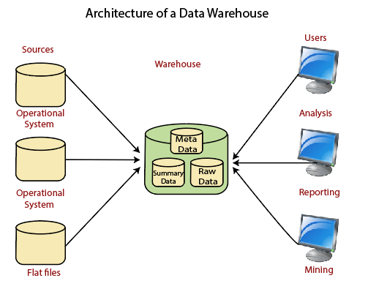
Data Warehouse Architecture

Slide 68
Operational System
An operational system is a method used in data warehousing to refer to a system that is used to process the day-to-day transactions of an organization.
Flat Files
A Flat file system is a system of files in which transactional data is stored, and every file in the system must have a different name.
Meta Data
A set of data that defines and gives information about other data.

Slide 69
Lightly and highly summarized data
The area of the data warehouse saves all the predefined lightly and highly summarized (aggregated) data generated by the warehouse manager.
End-User access Tools
The principal purpose of a data warehouse is to provide information to the business managers for strategic decision-making. These customers interact with the warehouse using end-client access tools.

Slide 70
Data Mining
Data Mining is defined as extracting information from huge sets of data.
In other words, we can say that data mining is the procedure of mining knowledge from data.
The information or knowledge extracted so can be used for any of the following applications −
      Market Analysis
      Fraud Detection
      Customer Retention
      Production Control
      Science Exploration

Slide 71
Data Mining Engine
Data mining engine is very essential to the data mining system.
It consists of a set of functional modules that perform the following functions −
  Characterization
  Association and Correlation Analysis
  Classification
  Prediction
  Cluster analysis
  Outlier analysis
  Evolution analysis

Slide 72
Knowledge Discovery
Some people treat data mining same as knowledge discovery, while others view data mining as an essential step in the process of knowledge discovery. Here is the list of steps involved in the knowledge discovery process −
Data Cleaning − In this step, the noise and inconsistent data is removed.
Data Integration − In this step, multiple data sources are combined.
Data Selection − In this step, data relevant to the analysis task are retrieved from the database.

Slide 73
Data Transformation − In this step, data is transformed or consolidated into forms appropriate for mining by performing summary or aggregation operations.
Data Mining − In this step, intelligent methods are applied in order to extract data patterns.
Pattern Evaluation − In this step, data patterns are evaluated.
Knowledge Presentation − In this step, knowledge is represented.

Slide 74
Advantages of Data Mining
The Data Mining technique enables organizations to obtain knowledge-based data.
Data mining enables organizations to make lucrative modifications in operation and production.
Compared with other statistical data applications, data mining is a cost-efficient.
Data Mining helps the decision-making process of an organization.

Slide 75
Advantages of Data Mining
It Facilitates the automated discovery of hidden patterns as well as the prediction of trends and behaviors.
It can be induced in the new system as well as the existing platforms.
It is a quick process that makes it easy for new users to analyze enormous amounts of data in a short time.

Slide 76
Disadvantages of Data Mining
There is a probability that the organizations may sell useful data of customers to other organizations for money.
Many data mining analytics software is difficult to operate and needs advance training to work on.
Different data mining instruments operate in distinct ways due to the different algorithms used in their design.
Therefore, the selection of the right data mining tools is a very challenging task.
The data mining techniques are not precise, so that it may lead to severe consequences in certain conditions.

Slide 77
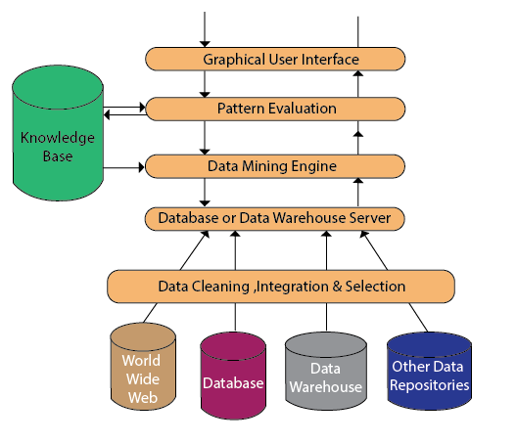
Architecture

Slide 78
1. Data Source:
The actual source of data is the Database, data warehouse, World Wide Web (WWW), text files, and other documents.
Organizations typically store data in databases or data warehouses.
Data warehouses may comprise one or more databases, text files spreadsheets, or other repositories of data.
Sometimes, even plain text files or spreadsheets may contain information.
Another primary source of data is the World Wide Web or the internet.

Slide 79
2. Different processes:
Before passing the data to the database or data warehouse server, the data must be cleaned, integrated, and selected.
As the information comes from various sources and in different formats, it can't be used directly for the data mining procedure because the data may not be complete and accurate.
So, the first data requires to be cleaned and unified.
.

Slide 80
3. Database or Data Warehouse Server:
The database or data warehouse server consists of the original data that is ready to be processed. Hence, the server is cause for retrieving the relevant data that is based on data mining as per user request.
4. Data Mining Engine:
The data mining engine is a major component of any data mining system.
It contains several modules for operating data mining tasks, including association, characterization, classification, clustering, prediction, time-series analysis, etc.

Slide 81
5. Pattern Evaluation Module:
The Pattern evaluation module is primarily responsible for the measure of investigation of the pattern by using a threshold value.
It collaborates with the data mining engine to focus the search on exciting patterns.

Slide 82
6. Graphical User Interface:
The graphical user interface (GUI) module communicates between the data mining system and the user.
This module helps the user to easily and efficiently use the system without knowing the complexity of the process.
This module cooperates with the data mining system when the user specifies a query or a task and displays the results.

Slide 83
7. Knowledge Base:
The knowledge base is helpful in the entire process of data mining.
It might be helpful to guide the search or evaluate the stake of the result patterns.
The knowledge base may even contain user views and data from user experiences that might be helpful in the data mining process.
The data mining engine may receive inputs from the knowledge base to make the result more accurate and reliable.

Slide 84
Online Analytical Processing (OLAP)
OLAP is based on the multidimensional data model.
OLAP is the technology behind many Business Intelligence (BI) applications.
It allows managers, and analysts to get an insight of the information through fast, consistent, and interactive access to information.
OLAP performs multidimensional analysis of business data and provides the capability for complex calculations, trend analysis, and sophisticated data modeling.

Slide 85
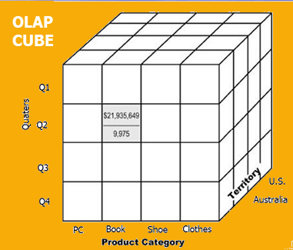
OLAP cube:
At the core of the OLAP concept, is an OLAP Cube. The OLAP cube is a data structure optimized for very quick data analysis.
The OLAP Cube consists of numeric facts called measures which are categorized by dimensions. OLAP Cube is also called the hypercube.

Slide 86
Usually, data operations and analysis are performed using the simple spreadsheet, where data values are arranged in row and column format.
This is ideal for two-dimensional data.
However, OLAP contains multidimensional data, with data usually obtained from a different and unrelated source.
Using a spreadsheet is not an optimal option.
The cube can store and analyze multidimensional data in a logical and orderly manner.

Slide 87
How does it work?
A Data warehouse would extract information from multiple data sources and formats like text files, excel sheet, multimedia files, etc.
The extracted data is cleaned and transformed.
Data is loaded into an OLAP server (or OLAP cube) where information is pre-calculated in advance for further analysis.

Slide 88
Basic analytical operations of OLAP
Four types of analytical operations in OLAP are:
Roll-up
Drill-down
Slice and dice
Pivot (rotate)

Slide 89
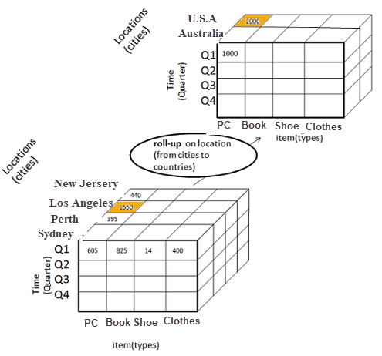
1) Roll-up:
Roll-up is also known as "consolidation" or "aggregation."
The Roll-up operation can be performed in 2 ways
    Reducing dimensions
    Climbing up concept hierarchy. Concept hierarchy is a system of grouping things based on their order or level.
Consider the following diagram

Slide 90
In this example, cities New jersey and Lost Angles and rolled up into country USA
The sales figure of New Jersey and Los Angeles are 440 and 1560 respectively. They become 2000 after roll-up
In this aggregation process, data is location hierarchy moves up from city to the country.
In the roll-up process at least one or more dimensions need to be removed. In this example, Quater dimension is removed

Slide 91
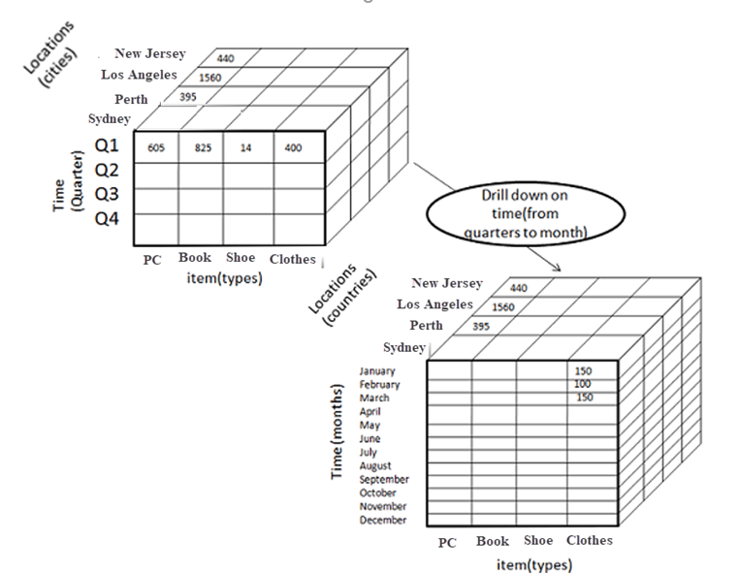
2) Drill-down
In drill-down data is fragmented into smaller parts. It is the opposite of the rollup process. It can be done via
    Moving down the concept hierarchy
    Increasing a dimension
Consider the diagram below
Quater Q1 is drilled down to months January, February, and March. Corresponding sales are also registers.
In this example, dimension months are added.

Slide 92
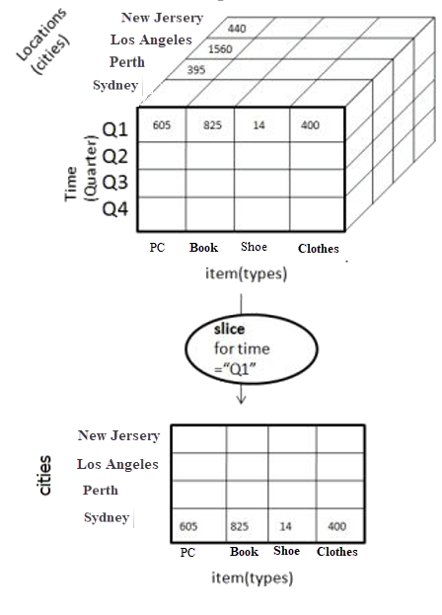
3) Slice:
Here, one dimension is selected, and a new sub-cube is created.
Following diagram explain how slice operation performed:
Dimension Time is Sliced with Q1 as the filter.
A new cube is created altogether.

Slide 93
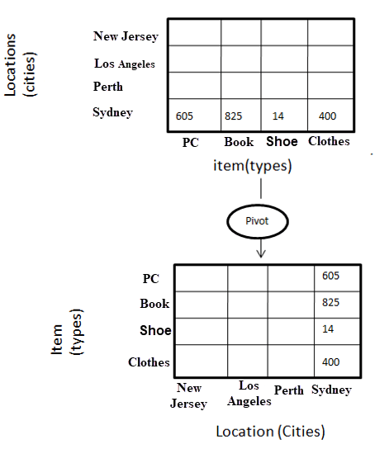
4) Pivot
In Pivot, you rotate the data axes to provide a substitute presentation of data.
In the following example, the pivot is based on item types.

Slide 94
Type of OLAP | Explanation
Relational OLAP(ROLAP): | ROLAP is an extended RDBMS along with multidimensional data mapping to perform the standard relational operation.
Multidimensional OLAP (MOLAP) | MOLAP Implements operation in multidimensional data.
Hybrid Online Analytical Processing (HOLAP) | In HOLAP approach the aggregated totals are stored in a multidimensional database while the detailed data is stored in the relational database. This offers both data efficiency of the ROLAP model and the performance of the MOLAP model.

Slide 95
Desktop OLAP (DOLAP) | In Desktop OLAP, a user downloads a part of the data from the database locally, or on their desktop and analyze it. DOLAP is relatively cheaper to deploy as it offers very few functionalities compares to other OLAP systems.
Web OLAP (WOLAP) | Web OLAP which is OLAP system accessible via the web browser. WOLAP is a three-tiered architecture. It consists of three components: client, middleware, and a database server.
Mobile OLAP: | Mobile OLAP helps users to access and analyze OLAP data using their mobile devices
Spatial OLAP : | SOLAP is created to facilitate management of both spatial and non-spatial data in a Geographic Information system (GIS)
.

Slide 96
ROLAP
ROLAP works with data that exist in a relational database.
Facts and dimension tables are stored as relational tables.
It also allows multidimensional analysis of data and is the fastest growing OLAP.
Advantages of ROLAP model:
High data efficiency.
Scalability.
Drawbacks of ROLAP model:
Demand for higher resources:
Aggregately data limitations.
Slow query performance.

Slide 97
MOLAP
MOLAP uses array-based multidimensional storage engines to display multidimensional views of data.
Basically, they use an OLAP cube.

Slide 98
Hybrid OLAP
Hybrid OLAP is a mixture of both ROLAP and MOLAP.
It offers fast computation of MOLAP and higher scalability of ROLAP.
HOLAP uses two databases.
Aggregated or computed data is stored in a multidimensional OLAP cube
Detailed information is stored in a relational database.

Slide 99
Benefits of Hybrid OLAP:
This kind of OLAP helps to economize the disk space, and it also remains compact which helps to avoid issues related to access speed and convenience.
Hybrid HOLAP's uses cube technology which allows faster performance for all types of data.
Drawbacks of Hybrid OLAP:
Greater complexity level
Potential overlaps

Slide 100
Advantages of OLAP
OLAP is a platform for all type of business includes planning, budgeting, reporting, and analysis.
Information and calculations are consistent in an OLAP cube. This is a crucial benefit.
Quickly create and analyze "What if" scenarios
Easily search OLAP database for broad or specific terms.

Slide 101
Advantages of OLAP
OLAP provides the building blocks for business modeling tools, Data mining tools, performance reporting tools.
Allows users to do slice and dice cube data all by various dimensions, measures, and filters.
It is good for analyzing time series.
Finding some clusters and outliers is easy with OLAP.
It is a powerful visualization online analytical process system which provides faster response times

Slide 102
Disadvantages of OLAP
OLAP requires organizing data into a star or snowflake schema. These schemas are complicated to implement and administer
You cannot have large number of dimensions in a single OLAP cube
Transactional data cannot be accessed with OLAP system.
Any modification in an OLAP cube needs a full update of the cube. This is a time-consuming process

Slide 103
Product Lifecycle Management (PLM)
Product lifecycle management (PLM) is a systematic approach to managing the series of changes a product goes through, from its design and development to its ultimate retirement or disposal.
PLM serves as a product backbone by integrating human skills, data and business processes, e.g., enterprise resource planning (ERP) and manufacturing execution PLM is linked with the manufacturing industry but is also applied to software development and services.

Slide 104
PLM is associated with manufacturing, but the management structure can also be used for software development and service provision.
PLM is typically broken into the following stages:
  Beginning of life (BOL) - includes new product development and design processes.
  Middle of life (MOL) - includes collaboration with suppliers, product information management (PIM) and warranty management.
  End of life (EOL) - includes strategies for how the products will be disposed of, discontinued or recycled.

Slide 105
A PLM software application can help an organization manage their product's lifecycles by providing a data warehouse for all the information that affects the product.
PLM software can be used to automate the management of product-related data and integrate the data with other business processes such as enterprise resource planning (ERP) and manufacturing execution systems (MES).
The goal of PLM is to eliminate waste and improve efficiency.
PLM is considered to be an integral part of the lean production model.

Slide 106
The three main elements of PLM are:
    The Information and Communication Technology (ICT): This is all about the necessary unified platforms and systems, including the architecture, tools, and standards.
    The Processes: This includes all of the people, skills, and organizations involved.
    The Methods: This is the procedures, rules, and practices.

Slide 107
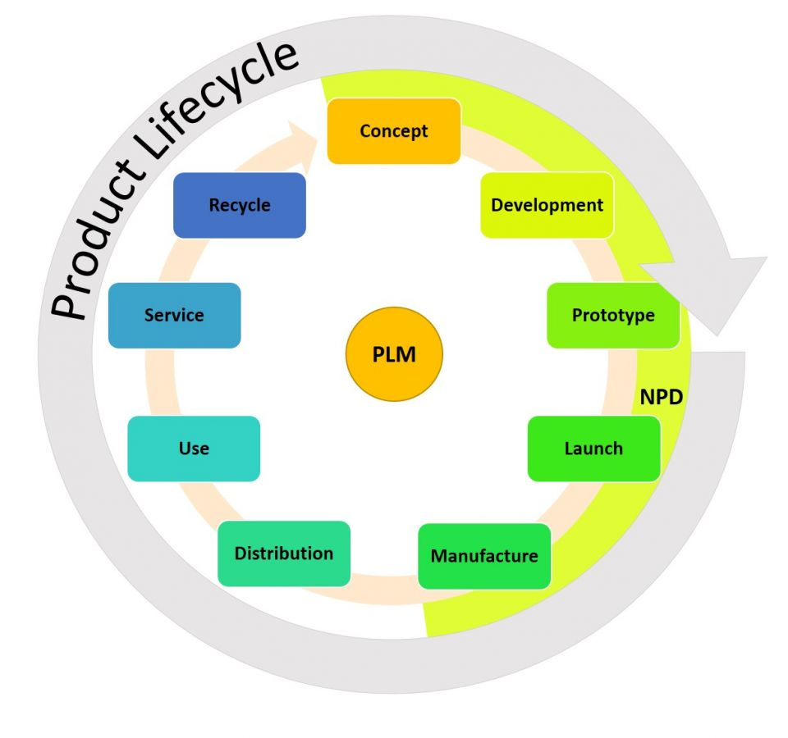
Ultimate PLM

Slide 108
Product Life Cycle
The life cycle of a product is associated with marketing and management decisions within businesses, and all products go through five primary stages:
  Development,
  Introduction,
  Growth,
  Maturity, and
  Decline.
Each stage has its costs, opportunities, and risks, and individual products differ in how long they remain at any of the life cycle stages.

Slide 109
1. Development
The first stage of the product life cycle is the development stage at which the new product generates.
Here, the company needs to pay off various cost involved in product research, manufacturing or acquisition without generating any revenue from it.
The features of this stage are as follows:
Generation of a workable product idea
Making investment
No sales revenue

Slide 110
2. Introduction
At this stage, the new product is launched in the market, and the prospective customers are acquainted with it.
The demand for the product is created at this stage.
The characteristics of the introduction stage are as follows:
Creation of the product’s demand
No or low-profit stage
May encounter brand issues
Low sales volume
Promotion and free samples

Slide 111
3. Growth
The third stage of the product life cycle is the growth stage where the product sales, demand and profits accelerate.
It consists of the following characteristics:
Sales increases rapidly
Constant price
Market segment penetration
High marketing and promotional expenses
Manufacturing cost decreases
High-profit margin

Slide 112
4. Maturity
The sales of the product are at its peak and price is competitive at the maturity stage.
The features of this stage are as follows:
Low cost due to high production volume
Industrial profits decline
High competition
Optimum sales volume
Market saturation
The entry of new competitors
Requires brand differentiation or feature diversification to sustain in the market

Slide 113
5. Decline
This is the last stage of the product where the demand shrinks and its sales start declining.
The features of the decline stage are mentioned below:
Sales volume decreases gradually
Product price falls
Low margin
Implementation of new strategies
Introduction of a new product

Slide 114
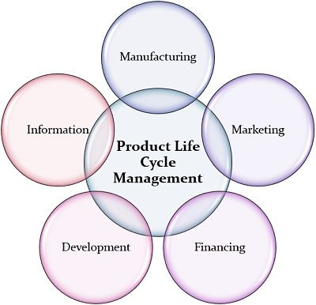
Product Life Cycle Management
The management has to concentrate on various business areas or fields to make the product a success.
Following are the specialized management fields which need to be taken care of right from the launch of the product to its decline in the market:

Slide 115
1. Manufacturing: The cost of production of goods and services matter and vary to a great extent during a product’s life cycle.
This cost very high at the development stage whereas it gradually decreases at the growth and maturity stages.
2. Marketing: The strategy of marketing the product varies at each stage.
When the introduction stage requires excessive marketing and promotion, unlike the growth stage where the product requires less publicity and is popular among customers, this strategy changes entirely at the decline stage.

Slide 116
3. Financing: The initial capital requirement at the introduction stage of a product is quite high.
Whereas, at the growth and maturity stage, the product self finances itself through sales and profit earned by it.
4. Development: At the development stage of a product, the management needs to focus on research and analysis.
It invests maximum time, energy and efforts in the development of a new product.
5. Information: The collection and analysis of potential data, including market trends, effective means of promotion, prospective growth, etc. are necessary for the management

Slide 117
Benefits of Product Lifecycle Management
Getting the product to market faster, putting a higher quality product on the market, increasing sales opportunities, and reducing errors and waste.
Other benefits include:
Improved product quality and reliability
Reduced prototyping costs
More accurate and timely requests for quotes (RFQ)
Quick identification of sales opportunities and revenue contributions

Slide 118
Savings through the re-use of original data
A framework for product optimization
Reduced waste
Improved ability to better manage seasonal fluctuation management
Improved forecasting to reduce material costs
Maximized supply chain collaboration

Slide 119
Limitations:
1. Rigid PLM systems lead to wasted time or costly workarounds
2. A software perspectives hinders problem-solving
3. Required customization wastes company resources
4. Incompatible files require exceptional admin work
5. Legacy systems and data don’t integrate well in enterprise PLM systems
6. Resistant company culture requires education and training

Slide 120
Essential elements of PLM:
Manages design and process documents
Constructs and controls bill of material records
Offers an electronic file repository
Includes built-in and custom part and document metadata ("attributes")
Identifies materials content for environmental compliance
Permits item-focused task assignments
Enables workflow and process management for approving changes
Controls multi-user secured access, including "electronic signature"
Exports data for downstream ERP systems

Slide 121
Challenges of PLM:
Product specification changes are difficult to keep records up to date
Disconnect between manufacturing and operations joining in the PLM process
Supply chain is mismanaged
Difficulty tracking metrics for PLM
Training takes too much time
Different sources for specifications and vendor information
Poor product portfolio management
Obstacles to sustainable packaging

Slide 122
How to Measure and Evaluate Your PLM Program
You can measure and evaluate the effectiveness of your PLM program by looking at the following metrics and the relative changes after implementation:
Innovation: The total sales or revenue coming from new products.
Lead Time: The time from order to delivery.
Cycle Time: The time from production start to completion (including any testing).
Product Life: The length of time the product is usable by the customer.
Product Waste: The amount of waste per product produced.

Slide 123
Product Reliability: The amount of your product found to be flawed or faulty within a period.
Warranty Claims: The number of warranty claims per products sold.
The Accuracy of Provisioning: How accurately you determine the need for parts.
Customer Feedback: The amount of customer input given in the development process.

Slide 124
Supply Chain Management
Supply chain management is the systemic, strategic coordination of the traditional business functions and tactics across these business functions - both within a particular company and across businesses within the supply chain- all coordinated to improve the long-term performance of the individual companies and the supply chain as a whole.

Slide 125
In a traditional manufacturing environment, supply chain management meant managing movement and storage of raw materials, work-in-progress inventory, and finished goods from point of origin to point of consumption.
It involves managing the network of interconnected smaller business units, networks of channels that take part in producing a merchandise of a service package required by the end users or customers.

Slide 126
With businesses crossing the barriers of local markets and reaching out to a global scenario, SCM is now defined as −
Design, planning, execution, control, and monitoring of supply chain activities with the objective of creating net value, building a competitive infrastructure, leveraging worldwide logistics, synchronizing supply with demand and measuring performance globally.

Slide 127
SCM consists of −
operations management
logistics
procurement
information technology
integrated business operations

Slide 128
Objectives of SCM
To decrease inventory cost by more accurately predicting demand and scheduling production to match it.
To reduce overall production cost by streamlining production and by improving information flow.
To improve customer satisfaction.

Slide 129
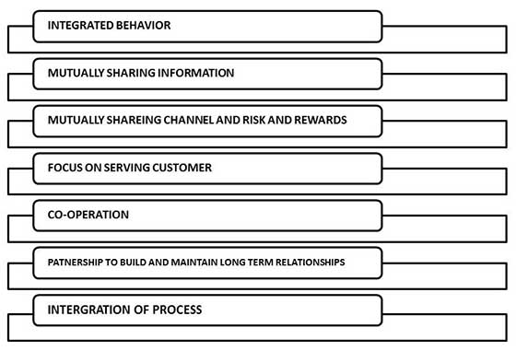
Features of SCM

Slide 130
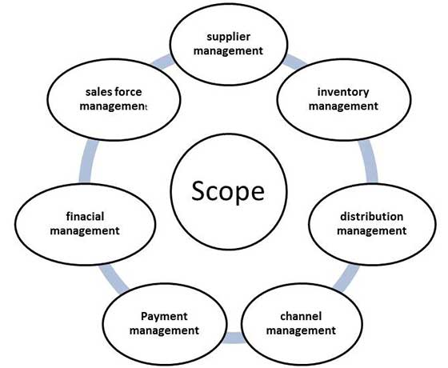
Scope of SCM

Slide 131
SCM Processes
Customer Relationship Management
Customer Service Management
Demand Management
Customer Order Fulfillment
Manufacturing Flow Management
Procurement Management
Product Development and Commercialization
Returns Management

Slide 132
Advantages of SCM
SCM have multi-dimensional advantages −
To the suppliers −
  Help in giving clear-cut instruction
  Online data transfer reduce paper work
Inventory Economy −
  Low cost of handling inventory
  Low cost of stock outage by deciding optimum size of replenishment orders
  Achieve excellent logistical performance such as just in time

Slide 133
Distribution Point −
  Satisfied distributor and whole seller ensure that the right products reach the right place at right time
  Clear business processes subject to fewer errors
  Easy accounting of stock and cost of stock
Channel Management −
  Reduce total number of transactions required to provide product assortment
  Organization is logically capable of performing customization requirements

Slide 134
Operational performance −
  It involves delivery speed and consistency.
External customer −
  Conformance of product and services to their requirements
  Competitive prices
  Quality and reliability
  Delivery
  After sales services

Slide 135
To employees and internal customers −
  Teamwork and cooperation
  Efficient structure and system
  Quality work
  Delivery
Financial management −
  Low cost
  Realistic analysis

Slide 136
Disadvantages:
The biggest disadvantage of supply chain management is the heavy investment of time, money, resources needed to implement and overlook the supply chain.
It is very difficult to decide, 'Outsource Or Not’’
Integrating the supply chain and choosing the correct suppliers is much more difficult

Slide 137
Reasons for failure:
Supply chain management fails if:
Power is retained.
Lack of mutual co-operation.
Killer software applications.
Technology can not synchronize every party.
Work still done by people.
Sales manager and CEO’s do not share.

Slide 138
ERP Security
Data Security is becoming increasingly critical for organizations as the consequences of a security breach are becoming more and more significant.
Hackers are getting more sophisticated, protection laws are getting tighter, and penalties are on the increase.
ERP systems lie at the core of business processes, and they process and maintain most of the business data that is considered to be sensitive.

Slide 139
ERP Security
ERP vendors play their part by investing in platforms and technologies that secure the data so much that the security model is often presented as the cornerstone of the application, but as long the application is extensible, any custom developments pose a risk of breaching security rules

Slide 140
1. Access Control
Access control in ERP applications is concerned with defining and managing authorized users, including granting them the relevant roles they need to access processes and data.
Access control is critical to the goal of protecting data from unauthorized disclosure and modification, at the same time, maintaining appropriate levels of availability to authorized users for operational purposes.

Slide 141
Database Level Security
At the core of an ERP system is a relational database management system (RDBMS) that manages the data input/output and storage on the database server.
The ability to logically customize data objects for a variety of users is key for any enterprise application and is fundamental to the security architecture for managing access to data.
Different database platforms offer tools to create logical data objects that enable different users to view and handle common business objects in different ways.

Slide 142
Data Encryption/Data Masking
In addition to controlling functional and data access, ERP data can be encrypted to reduce exposure risks.
Encryption is an essential tool for securing sensitive information, more commonly used for in-transit data, to ensure the confidentiality and integrity of data are not compromised.
For static data, data encryption is not necessary for all security scenarios, but for sensitive personal data such as credit card numbers or passwords, it is an essential tool.

Slide 143
ERP system security problems
1. Delayed Updates
It’s reported that a whopping 87 percent of business computers feature outdated software, including ERP systems which are not up-to-date.
If your version is currently unsupported, it can make it difficult to rectify any issues, such as crashes.
More importantly, it leaves your business vulnerable to risk.
How to Avoid: If you’re finding you’re often lagging behind when it comes to installing ERP updates, then it might be worth looking into an automatic updater which applies any software updates when available.

Slide 144
2. Full Access Rights
The biggest threat to businesses undoubtedly comes from external sources, but that doesn’t mean we can sit back and ignore potential in-house risks.
Full access rights shouldn’t come as default; instead, it’s important to look at who has access to what data.
How to Avoid: It’s important to maintain audit logs to track any changes.
It’s also worth adding ‘authorizations’ to checklists for new hires, promotions, and any role change documentation.

Slide 145
3. Inadequate Training
It is certainly worth considering the security risk posed by internal sources.
In some cases, the risk may be intended and malicious, but in most cases, it is more likely to be the result of a lack of understanding.
This could be a lack of understanding of the ERP system as a whole, or it could be a lack of understanding of what is expected by the organization in terms of security.
How to Avoid: Ask your ERP provider if system training is including as standard, nominate staff to train new hires, and ensure business protocols are widely available and easily accessible to all employees.

Slide 146
4. Failure to Comply
If your ERP system is being used to store confidential sales information, including personal details and payment details, then it’s essential that the system meets local security standards requirements.
This could include PCI DSS requirements if credit card data is involved.
How to Avoid: Choose an ERP system that’s designed to comply with necessary regulations.
It’s also important to change your vendor-issued password and adhere to good security practices at all times.

Slide 147
5. Use of Unauthorized Systems
The whole point of ERP is integration; to remove the need for what is known as ‘Frankensteining’.
Frankensteining happens when multiple software programs are used simultaneously to achieve a single goal, such as maintaining sales data on an ERP but running reports using Excel.
This practices still takes places across many businesses, even if it is not office protocol.
How to Avoid: Firstly, look into preventing data export unless absolutely required.
Secondly, if your ERP system isn’t doing everything you need it to, then perhaps it’s time to upgrade to a new system.

Slide 148
6. Automatic Trust
Cloud ERP systems are becoming increasingly popular.
This means that any data that you choose to enter into the system isn’t stored locally, but is instead stored by a third party cloud hosting service.
However, there is a slight downside, and that’s the need to place 100 percent of our ERP system security into someone else’s hands.
How to Avoid: Consider your cloud provider very carefully, paying particular attention to their security processes and their data regulations.

Slide 149
Single Authentication
As ERP systems have evolved, they’ve become capable of handling not only a much wider range of information but also more sensitive information as well.
Password cracking is one of the simplest and most common forms of hacking, so it really doesn’t make sense to protect our most important, sensitive, and confidential business data through the use of passwords alone which can be stolen or even guessed relatively easily by experts.
How to Avoid: The obvious solution is 2FA.
The good news is that the 2FA industry has changed in recent years and there is no longer a need for a physical device.
Instead, a code can be sent to an email address.

