Slide 1
Media Evolution
Divya Narang Tinna
Assistant Professor, TCSC

Slide 2
Evolution of Printing Press
Before Printing Press, Oral Communication was used
It had its own shortcomings
Message could not reach in intact form
Earlier man used to write on stones and leaves
The earliest form of Printing was woodblock printing and clay printing
Developed in China more than 5000 years back
Egypt- Pictures were used to represent words (4th Century)
Sumer- Wedge shaped letters were used

Slide 3
Evolution of Printing Press
Sumer- Script was developed (3000-3500 BC)
Cuneiform-System of writing was developed in Sumer
These were wedge shaped characters
All these alphabets were complex and difficult to learn
Sumerians were traders and they were in need of language
Egypt-Hieroglyphs (2900 BC)
Pictures to represent words
China- Ideograms (1900 BC)
Characters which represented ideas

Slide 4
Evolution of Printing Press
Printing Press
Woodblock Printing started in China (600 AD)
Mainly done on textile and paper
1040-Moveable Clay Typeface
1200-First Metal Moveable Type system was made in Korea
Mass Scale Printing was started by Johannes Gutenberg
He was a German Goldsmith, Blacksmith and a Printer

Slide 5
Evolution of Printing Press
He perfected the printing press
He made a start with the help of wooden typeface
Inspired by Koreans, he also developed letters from metal
He knew how to use metals, as metal did not have fibre
It did not absorb ink and were best suited for creating everlasting typefaces
Gutenberg printed his first book, the Bible in 1456 in Europe
By 1500, 2 million books were printed

Slide 6
Printing in India
India had a very rich and old tradition of handwritten manuscripts
These were in Sanskrit, Arabic, Persian, as well as in various vernacular languages
Manuscripts were copied on palm leaves or on handmade paper
Pages were sometimes beautifully illustrated
They would be either pressed between wooden covers or sewn together to ensure preservation
Manuscripts continued to be produced till well after the introduction of print (till late 19th century)

Slide 7
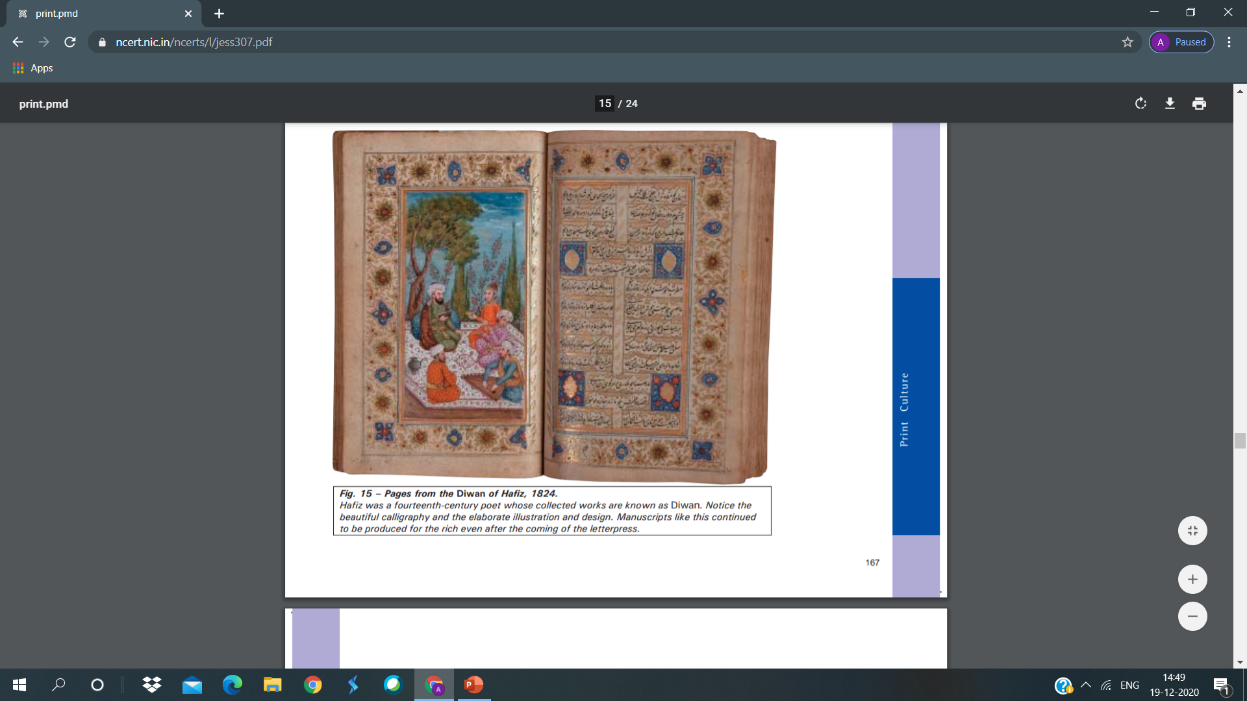

Slide 8
Printing in India
Portuguese established first printing press in Goa in 1557
It was established by Portuguese missionaries
Priests learnt Konkani and printed several tracts
By 1674, about 50 books had been printed in the Konkani and in Kanara languages
Catholic priests printed the first Tamil book in 1579 at Cochin
In1713 the first Malayalam book was printed by them
The English language press did not grow in India till quite late
Although, the English East India Company began to import presses from the late 17th century

Slide 9
History of Internet
Internet is known as network of networks
This enables us to interact and communicate with each other
Internet was not developed within a period of a few days or a few months
It is the result of a long and aggressive research which took many years
In 1969, the American Department of Defense (DOD) started a network of devices
ARPANET-Advanced Research Projects Agency Network
It was started with one computer in California and three in Utah

Slide 10
History of Internet
September 1969, the University of California at Los Angeles (UCLA)
Stanford Research Institute (SRI)
University of California, Santa Barbara (USCB)
University of Utah were connected by a network
This was called the ARPANET
Internet allows easy and quick access to a huge amount of information/resources stored at many different locations around the world
Also referred to as ‘Net’

Slide 11
History of Internet
The actual term “Internet” was finally coined in 1995
Coined by FNC (Federal Networking Council, USA)
Internet is not controlled by any one particular organization
It is managed by a group of voluntary organizations.
These voluntary organizations have formed the Internet Society
Most of the terms on the Internet are prefixed with the term web
Web pages-The electronic pages seen on the Internet
Website-web pages linked with each other combine to form a website

Slide 12
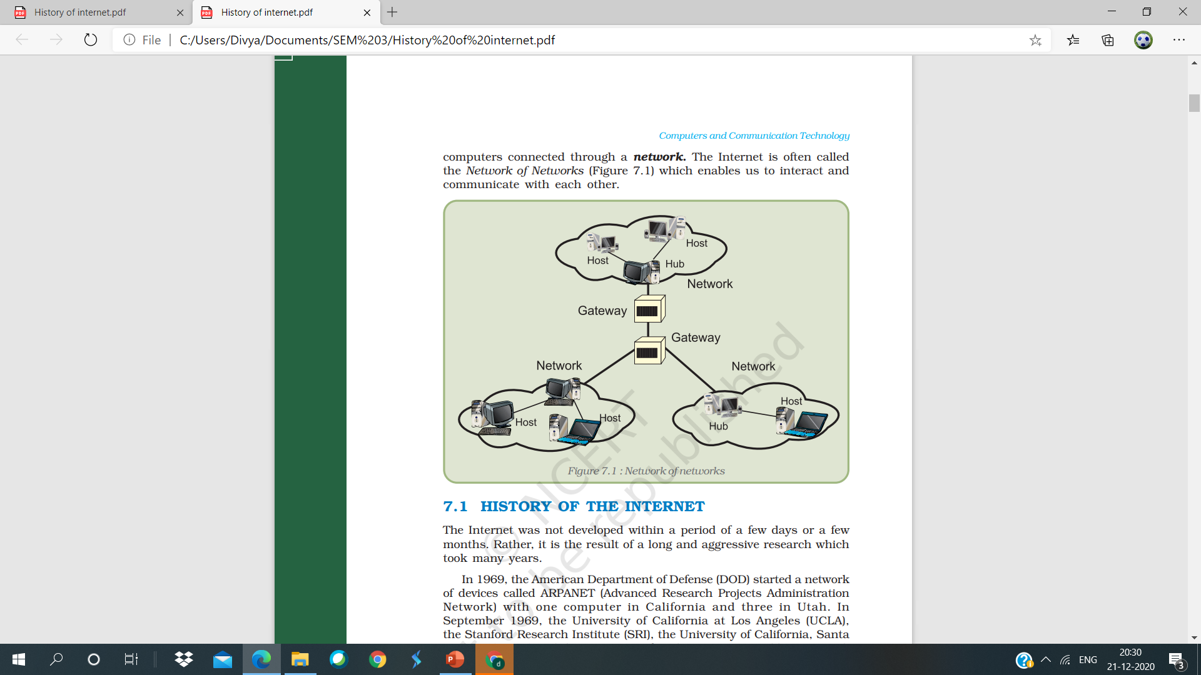
History of Internet

Slide 13
History of Internet
A web page can be written in the language known as HTML
HTML- Hyper Text Markup Language
HTML is a very simple language having a number of options to represent text
WWW-World Wide Web
URL-Uniform Resource Locator
Domain names-All the websites on the Internet have unique names associated with them

Slide 14
History of Internet
1. in – stands for India (country name)
2. gov – indicates government agencies
3. net – network organisations
4. org – non-profit organisations
5. edu – educational organisations
6. com – commercial organisations
7. mil – military or defence

Slide 15
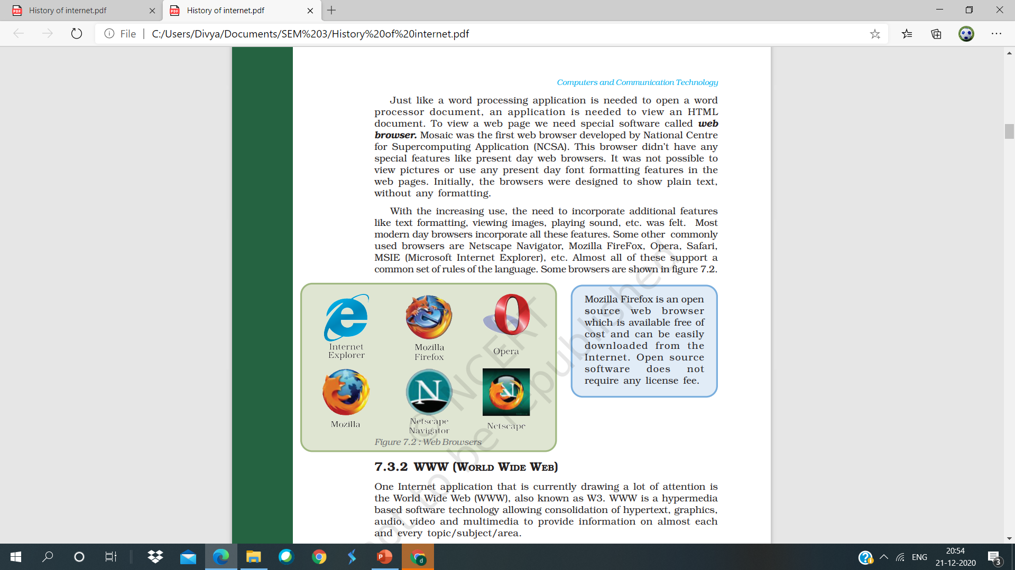
History of Internet

