Slide 1

Presentation on:
FOREIGN TRADE POLICY
MILI SHARMA
ASST.PROFESSOR
THAKUR COLLEGE OF SCIENCE AND COMMERCE

Slide 2
INTRODUCTION
India’s Foreign Trade Policy has, conventionally, been formulated for five years at a time and reviewed annually.
The focus of the FTP has been to provide a framework of rules and procedures for exports and imports and a set of incentives for promoting exports.

Slide 3
INTRODUCTION
Office of Directorate General of Foreign Trade (DGFT) is responsible for the execution of import and export policies of India.
It was earlier Known as chief controller of import and exports till 1991.

Slide 4
Directorate General of Foreign Trade
DGFT plays a very important role in the development of trading relations with various other nations
Directorate General of Foreign Trade is an attached office of the Department of Commerce, Ministry of Commerce and Industry.
DGFT also work as a body to resolve the trade disputes of Exporters and Importers.

Slide 5
Directorate General of Foreign Trade
Headquarter of DGFT is situated in New Delhi.
Under its jurisdiction, there are four Zonal Offices at Delhi, Mumbai , Kolkata and Chennai headed by Zonal Joint Director General of Foreign Trade.
There are 35 Regional Authorities all over the country.

Slide 6
Functions and Responsibility of DGFT
DGFT entrusted with the responsibility of implementing various policies regarding trade for example, Foreign Trade Policy.
DGFT is the licensing authority for exporters, importers, and export and import business.
DGFT can prohibit, restrict and regulate exports and imports

Slide 7
Functions and Responsibility of DGFT (cont.)
DGFT has important role to issue Notifications, Public notices, Circulars, etc in relation to foreign trade policy.
DGFT grant 10 digit IEC (Importer Exporter Code), which is a primary requirement to Import Export
DGFT introduces different schemes from time to time regarding trade benefits throughout the country.
DGFT has introduced ITC (HS CODE) schedule-1 for import items in India and Schedule-2 for Export items from India.

Slide 8
ITC(HS) Code
ITC (HS) Code are well known as Indian Trade Clarification based on Harmonized Systems of coding.
It is an Eight Digit EXIM Code.
DGFT is the Authority to make new codes and addition or deletion in the existing codes.
First 6 digits of the Codes are same as International standards.

Slide 9
Example on ITC(HS) Code
EXIM CODE | ITEM DESCRIPTION | POLICY | TOTAL DUTY
57 | Carpets and other textile floor covering
57 | Carpets and other Textile floor Coverings, knotted whether of not made up
57 01 10 00 | Of wool or fine animal hair | Free | 28.852
5701 | Of other textile material | Free | 28.852
5701 90 10 | Of Cotton | Free | 28.852
5701 90 | Other | Free | 28.852
Chapter
01
Heading
Sub
Heading
90
90
Common Claasification for the Item

Slide 10
FOREIGN TRADE POLICY
2015-2020

Slide 11
VISION, MISSION AND OBJECTIVES
Vision is to make India a Significant participant in world trade by year 2020.
Government aims to raise India’s share in world exports from 2 percent to 3.5 percent.
Building the India Brand – A long term branding strategy has been conceptualized to ensure that ‘Brand India’ becomes synonymous with high quality.

Slide 12
CHAPTER 1
LEGAL FRAMEWORK & TRADE FACILITATION
FOREIGN TRADE POLICY 2015-2020

Slide 13
LEGAL FRAMEWORK
Foreign Trade (Development & Regulation) Act, 1992 regulates the Foreign Trade Policy.
Central Government reserves right in public interest to make any amendment by notification in this policy.

Slide 14
TRADE FACILITATION & EASE OF DOING BUSINESS
Trade Facilitation is a Priority of the government for cutting down the transaction cost and time, thereby rendering Indian exports more compititive.
DGFT has a commitment to function as a facilitator of exports and imports.
Focus is on good governance.

Slide 15
TRADE FACILITATION & EASE OF DOING BUSINESS
An EDI help desk is available to assist the exporters in filling online applications on DGFT Portal and other EDI related issues.
DGFT has introduced the facility of importer exporter code in electronic form (e-IEC).
e-BRC Project has been successfully implemented, which enabled DGFT to capture details of realisation of export proceeds directly from banks through secured electronic mode.

Slide 16
TRADE FACILITATION & EASE OF DOING BUSINESS
ELECTRONIC DATA INTERCHANGE (EDI)
DGFT has put in place a robust EDI system for purpose of export facilitation and good governance.
EDI System reduced the physical interface of exporters and importers with government departments

Slide 17
TRADE FACILITATION & EASE OF DOING BUSINESS
ONLINE FILING OF APPLICATIONS
EDI Initiatives has provided the facility of on line filing of applications.
Applications are received and processed electronically.
All the Regional Authorities and extension counters have been networked with high speed internet.

Slide 18
TRADE FACILITATION & EASE OF DOING BUSINESS
Forthcoming e-Governance Initiatives
Message Exchange for transmission of export reward scrips from DGFT to customs.
Message Exchange for transmission of Bills of Entry from Customs to DGFT
Message Exchange with ministry of corporate affairs for CIN and DIN information.
Message Exchange with CBDT for PAN.

Slide 19
CHAPTER 2
GENERAL PROVISIONS REGARDING EXPORTS AND IMPORTS
FOREIGN TRADE POLICY 2015-2020

Slide 20
GENERAL PROVISIONS REGARIDNG EXPORTS AND IMPORTS
Exports & Imports are free, unless regulated:
Restriction would be as per FTP and/or ITC(HS).
ITC(HS) contains the item wise export and import policy regimes.
The ITC(HS) is aligned with international Harmonized System goods nomenclature maintained by world custom organization.

Slide 21
GENERAL PROVISIONS REGARIDNG EXPORTS AND IMPORTS
IMPORTER EXPORTER CODE / e-IEC
AN IEC is a 10 Digit Number.
It is allotted to a person who intends to import or exports.
No export of import shall made by any person without an IEC number unless specifically exempted.
Only one IEC is permitted against one permanent Account Number (PAN).

Slide 22
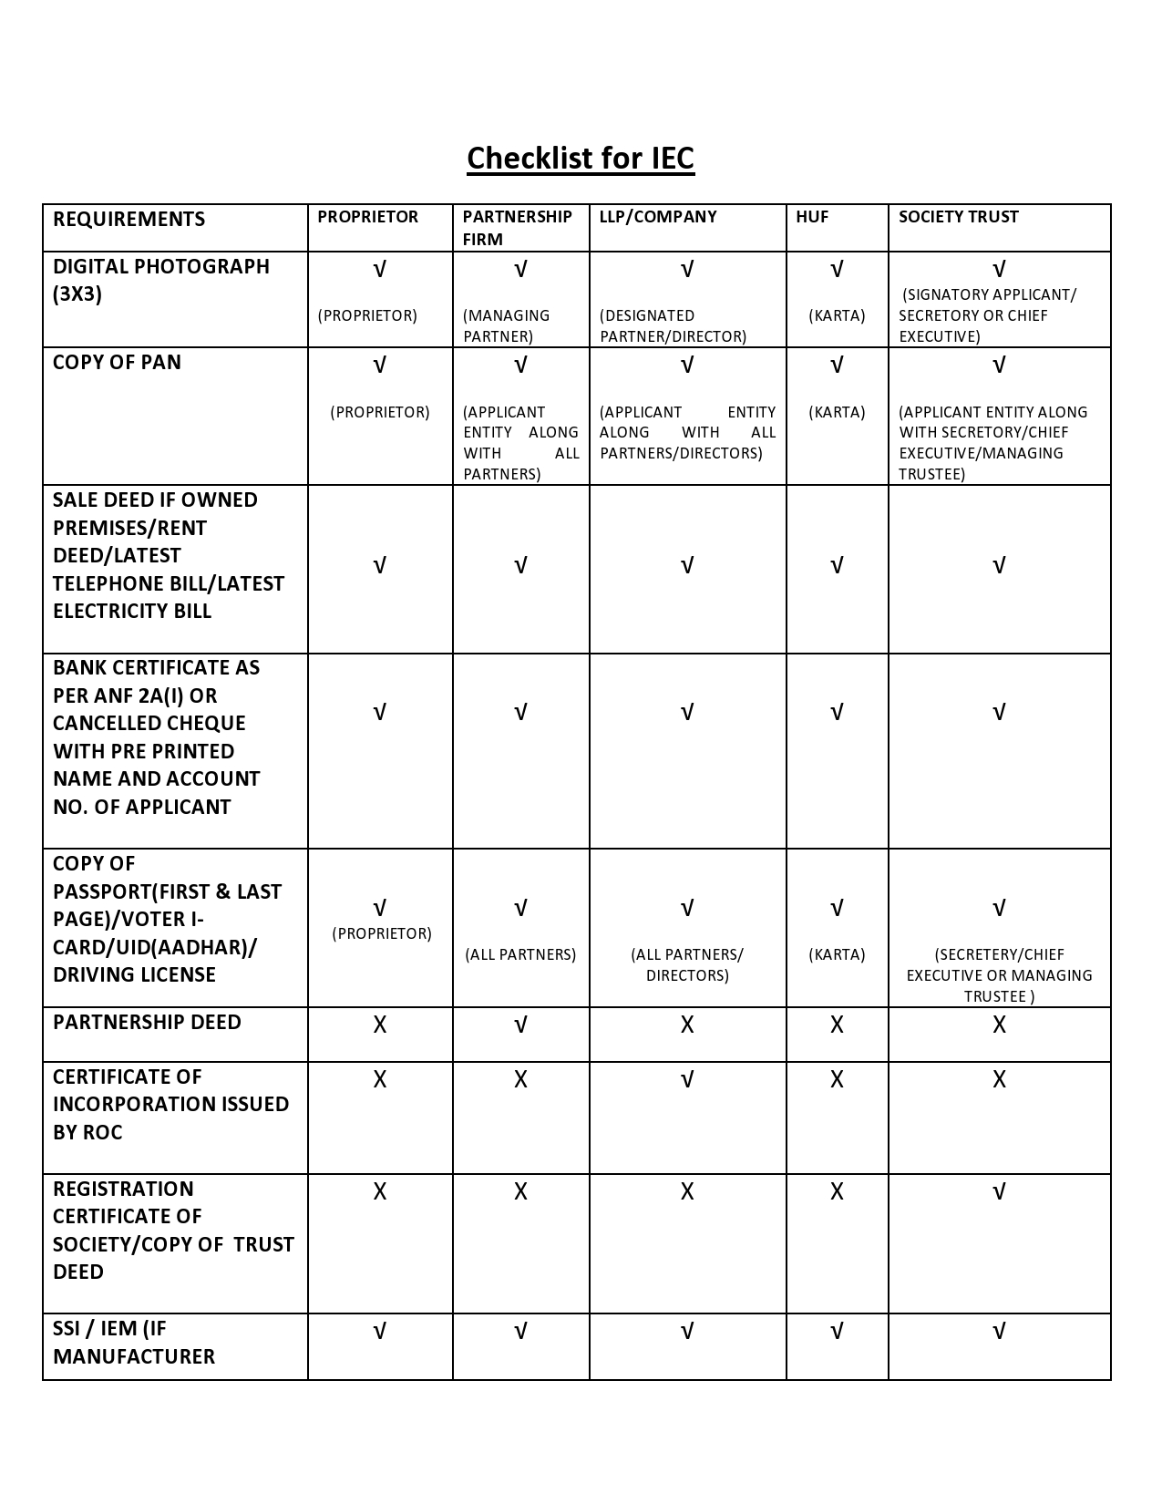

Slide 23
GENERAL PROVISIONS REGARIDNG EXPORTS AND IMPORTS
Documents Required for export of goods from India:
Bill of Lading / Airway Bill
Commercial Invoice cum Packing list*
Shipping Bill / Bill of Export

Slide 24
GENERAL PROVISIONS REGARIDNG EXPORTS AND IMPORTS
Documents Required for import of goods into India:
Bill of Lading / Airway Bill
Commercial Invoice cum Packing list*
Bill of Export

Slide 25
GENERAL PROVISIONS REGARIDNG EXPORTS AND IMPORTS
Restriction on Import and Export:
DGFT may, through a notification, impose restriction on export and import, neccesary for: -
Protection of Public Morals;
Protection of human, animal or plant life or health;
Protection of use of prison labour;
Conservation of exhaustible natural resources;

Slide 26
GENERAL PROVISIONS REGARIDNG EXPORTS AND IMPORTS
Restriction on Import and Export (Cont.)
Protection of patents, trademarks and copyrights and prevention of deceptive practices;
Protection of national treasurers of artistic, Historic or archaeological value;
Prevention of traffic in arms, ammunition and implements of war.

Slide 27
GENERAL PROVISIONS REGARIDNG EXPORTS AND IMPORTS
ACTUAL USER CONDITION:
Goods which are Importable freely without any ‘Restriction’ may be imported by any person. However, if such imports require an Authorisation, actual user alone may import such good(s) unless actual user condition is specifically dispensed with by DGFT.

Slide 28
GENERAL PROVISIONS REGARIDNG EXPORTS AND IMPORTS
CLEARANCE OF GOODS FROM CUSTOMS AGAINST AUTHORIZATION
Goods already imported/ shipped/ arrived, in advance, but not cleared from customs may also be cleared against an authorisation issued subsequently . This facility will however be not available to ‘restricted’ items or items traded through STEs(State Trading Enterprises).

Slide 29
GENERAL PROVISIONS REGARIDNG EXPORTS AND IMPORTS
Export Promotion Council:
Export Promotion councils are organizations of exporters, set up with the objective to promote and develop Indian exports.
Each council is responsible for promotion of a particular group of products/ projects/ services.
EPCs are also eligible to function as registering authorities to issue Registration-cum-membership certificate (RCMC) to its members.

Slide 30
GENERAL PROVISIONS REGARIDNG EXPORTS AND IMPORTS
Registration cum membership certificate (RCMC)
  Any Person applying for:
  An authorisation to import/export,(except items) listed as “Restricted” items in ITC(HS),or
  Any other benefit or concession under FTP
  shall be required to furnish RCMC granted by competent authority in accordance with procedure specified in HBPv1 unless specifically exempted under FTP.

Slide 31
PROFESSIONAL OPPORTUNITIES
ISSUE OF IEC.
ISSUE LICENSE FOR THE RESTRICTED ITEMS.

Slide 32
CHAPTER 3
EXPORTS FROM INDIA SCHEME
FOREIGN TRADE POLICY 2015-2020

Slide 33
EXPORTS FROM INDIA SCHEME
OBJECTIVE:
The objective of Schemes under this chapter is to provide rewards to exporters to offset infrastructural inefficiencies and associated costs involved and to provide exporters a level playing field.

Slide 34
EXPORTS FROM INDIA SCHEME
There shall be following two schemes for exports of Merchandise and Services respectively:
(i) Merchandise Exports from India Schemes (MEIS).
(ii) Service Exports from India Scheme(SEIS).

Slide 35
EXPORTS FROM INDIA SCHEME
NATURE OF REWARDS
Duty Credit Scrips shall be granted as rewards under MEIS and SEIS. The Duty Credit Scrips and goods imported / domestically procured against them shall be freely transferable.

Slide 36
Merchandise Exports from India Scheme (MEIS)
Entitlement :
Exports of Notified Goods/ Products with ITC(HS) code, to notified market listed in appendix 3B, shall be rewarded under MEIS.
Basis of calculation of reward would be on realised FOB value of exports in free foreign exchange, or FOB value of exports as given in the shipping bills in free foreign exchange, whichever is less.

Slide 37
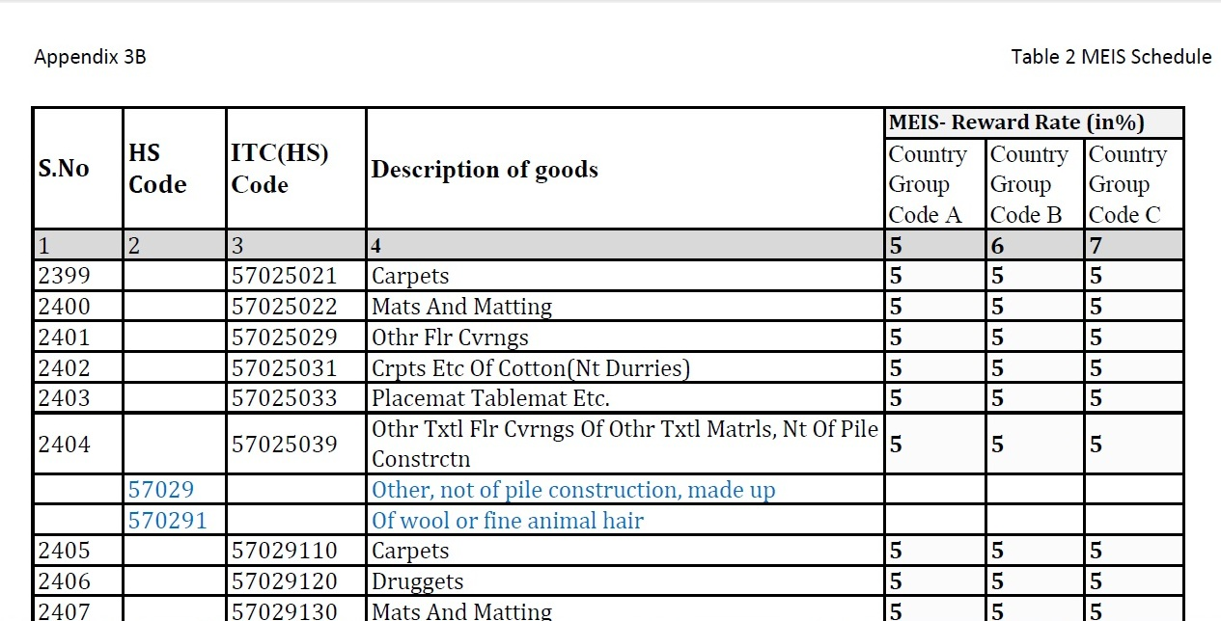
Extracts From Appendix 3B*
*Complete table is provided on the www. dgft.gov.in

Slide 38
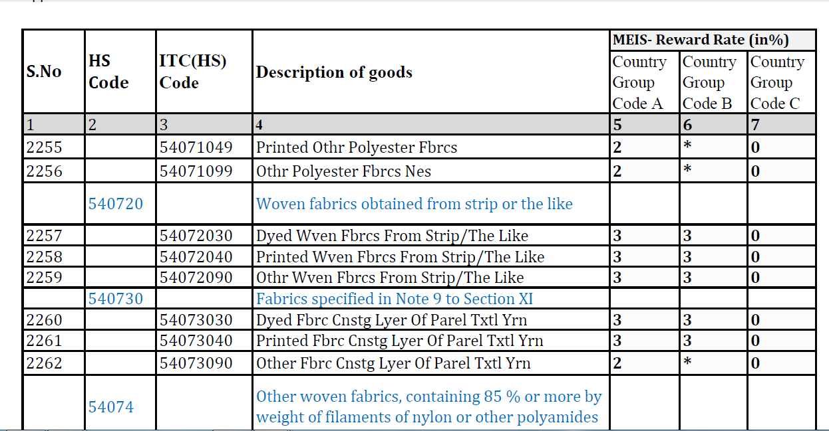
Extracts From Appendix 3B*
*Complete table is provided on the www. dgft.gov.in

Slide 39
Merchandise Exports from India Scheme (MEIS)
Export of goods through courier or foreign post offices using e-Commerce:
Exports of goods through courier or foreign post office using e-commerce, as notified in Appendix 3C, of FOB value upto Rs. 25000 per consignment shall be entitled for rewards under MEIS.
If the value of exports using e-commerce platform is more than Rs. 25000 per consignment then MEIS reward would be limited to FOB value Rs. 25000 Only.

Slide 40
Merchandise Exports from India Scheme (MEIS)
Export of goods through courier or foreign post offices using e-Commerce (cont.):
Such goods can be exported in manual mode through Foreign Post Offices at New Delhi, Mumbai and Chennai.
Export of such goods under Courier Regulations shall be allowed manually on pilot basis through Airports at Delhi, Mumbai and Chennai as per appropriate amendments in regulations to be made by Department of Revenue. Department of Revenue shall fast track the implementation of EDI mode at courier terminals.

Slide 41
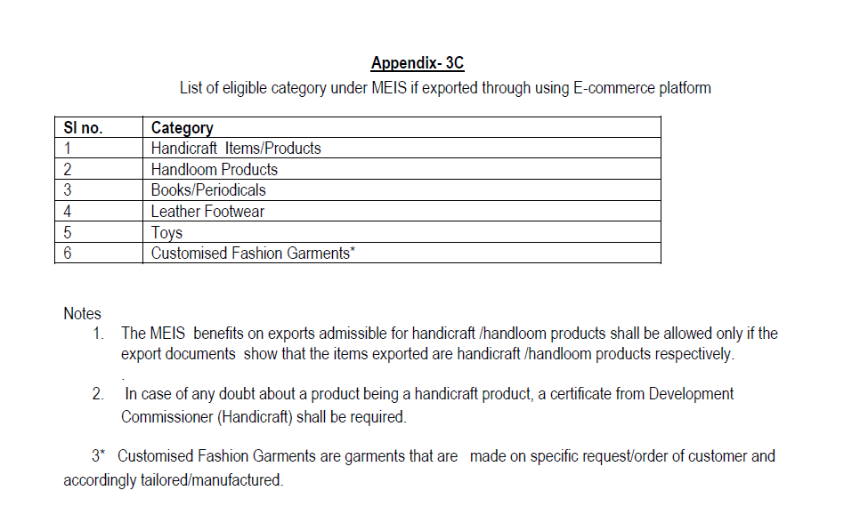

Slide 42
Merchandise Exports from India Scheme (MEIS)
Ineligible Catagories:
Total 19 Catagories are definded as Ineligible catagories under the MEIS, major catagories are provided below:
EOUs/EHTPs/BTPs/STPs who are availing direct tax benefit/ exemption;
Supplies made from DTA units to SEZ Units;
Export through Trans-shipment;
Deemed Export;
Service Exports;
Cereals of all types.
Diamond, Gold, Silver, Platinum, Other precious metal in any form including plain and studed jewellary and other precious semi precious stones.
Exports of Milk & Milk products

Slide 43
Merchandise Exports from India Scheme (MEIS)
Other Points under MEIS
The Documents which are not required to submit in original , shall be retained by the applicant for a period of 3 years from the date of issuance or Scrip.
No Manual feeding allowed for EDI Shipmets.
Rewards would be granted by RA with out verifying the EDI Shipping bills details.
Applicant shall file separate application for each port of export.

Slide 44
Merchandise Exports from India Scheme (MEIS)
Declaration of Intent on Shipping Bills:
Following Declaration of intent is required on the shipping bills to claim the benefit under MEIS Schme:
“We Intend to claim rewards under Merchandise Exports from India Scheme (MEIS)”

Slide 45
Service Export from India Scheme (SEIS)
Objective:
Objective of Service Exports from India Scheme (SEIS) is to encourage the notified Services from India.
Entitlements:
Service Providers of eligible services shall be entitled to Duty Credit Scrips at notified rates (as given in the Appendix 3D) on net foreign exchange earned.

Slide 46
Service Export from India Scheme (SEIS)
Eligiblity:
Service Provider of Notified services, Located in India, shall be rewarded under SEIS, subject to conditions as may be notified.
Minimum net free foreign exchange earning in preceding financial year should be:
  US$10,000 in case of Individual or Proprietorship firm.
  US$ 15000 in Other cases.

Slide 47
Service Export from India Scheme (SEIS)
Eligiblity (Cont.):
Payment in Indian Rupees for service charges earned on specified services shall be treated as receipt in deemed foreign exchange as per guideline of Reserve Bank of India. The list of such services is indicated in Appendix 3E.
Net foreign Exchange = Gross Earning in foreign Exchange – Total Expenses/ payments/ remmitances of foreign exchange relating to service sector in the financial year.

Slide 48
Service Export from India Scheme (SEIS)
Eligiblity (Cont.):
If IEC Holder is mancufacturer and Service provider, Foreign Exchange earning & expenses shall be taken in to account for service sector only.
Service Provider shall have active IEC at the time of rendering such services for which rewards are claimed.

Slide 49
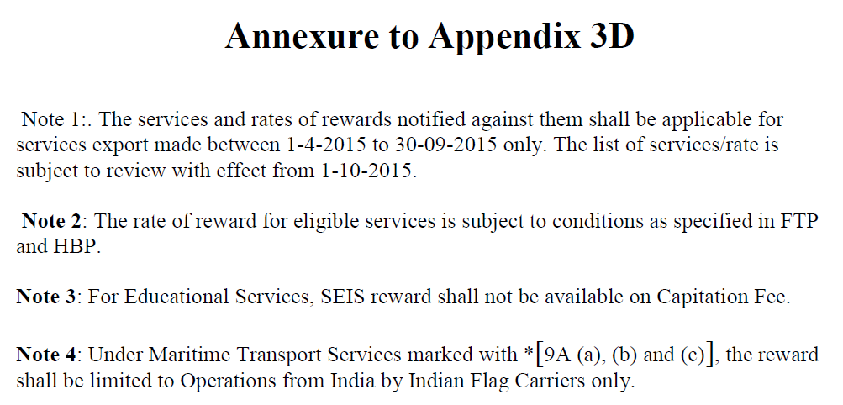

Slide 50
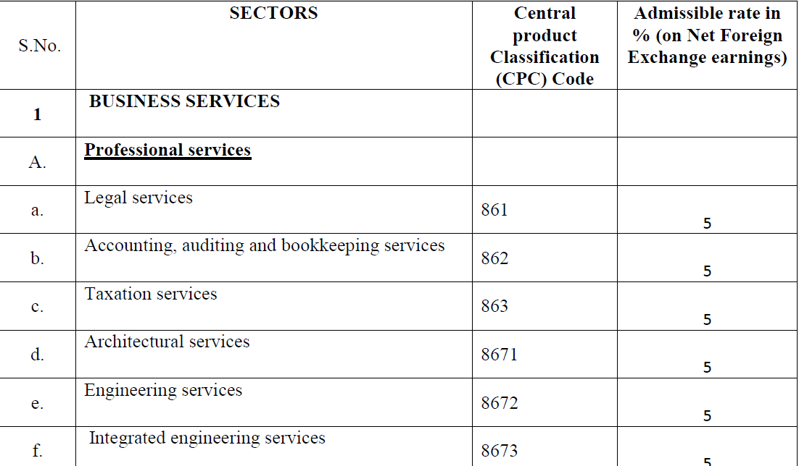
EXTRACTS FROM ANNEXURE TO APPENDIX 3D

Slide 51
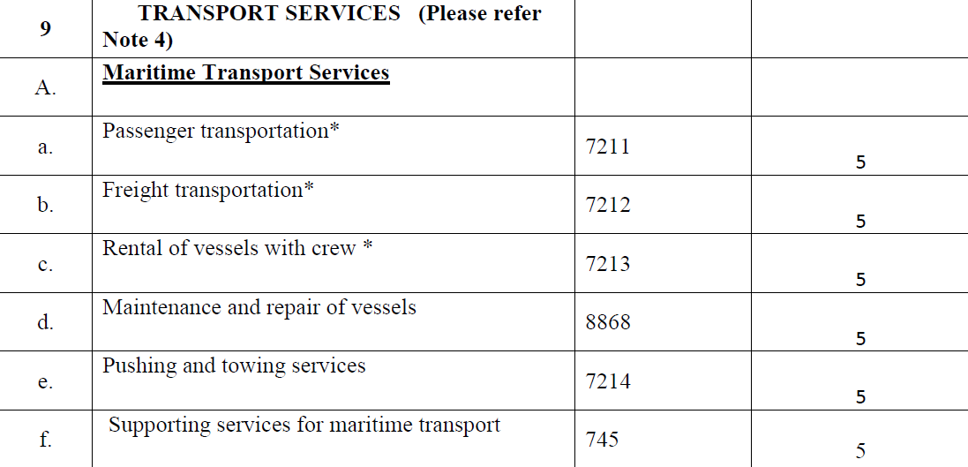
EXTRACTS FROM ANNEXURE TO APPENDIX 3D

Slide 52
Service Export from India Scheme (SEIS)
SPECIAL PROVISIONS:
Government reserves the rights in public interest, to specify export products or services or markets, which shall not be eligible for computation of entitlement of duty credit scrip.
Government reserves right to impose restriction/ change the rate/ ceiling on Duty credit scrip under this chapter.
Government may also notify goods in appendix 3A which shall not be allowed for debiting through duty credit scrips in case of import.

Slide 53
Service Export from India Scheme (SEIS)
SPECIAL PROVISIONS (Cont.):
Government may prescribe value cap of any kind for a product(s) or limit total reward per IEC holder under this chapter at any time.

Slide 54
COMMON PROVISIONS FOR MEIS & SEIS
LAST DATE OF FILING OF APPLICATIONS FOR DUTY CREDIT SCRIPS:
For Application under MEIS:
  Twelve Months from the Let Export (LEO) date OR
  Three months from the date of :
    Uploading EDI shipping Bills on to the DGFT server by customs
    Printing /release of shipping bills for Non EDI shipping Bills
    Whichever is later
    For Application under SEIS:
    12 months from the end of relevant financial year.

Slide 55
COMMON PROVISIONS FOR MEIS & SEIS
RISK MANAGEMENT SYSTEM:
Every month Computer system in DGFT Headquarters on random basis, will select 10% cases for each RA where scrips have already been issued.
RA may turn call for original documents in all such selected cases for further examinations in detail.
In case any discrepancy and/ or over claim is found on such examination, the applicant shall be under obligation to:
  rectify such discrepancy
  refund over claim in cash with interest at the rate prescribed under section 28AA of Customs Act 1962, from the date of issue of scrip in the relevant head of Accounts of Customs with in one month.

Slide 56
COMMON PROVISIONS FOR MEIS & SEIS
RISK MANAGEMENT SYSTEM (Cont.):
  The Original holder of scrip may refund such over claim by surrendering the same scrip whether partially utilized or fully unutilized, without interest.
  Regional Authority may ask for original proof of landing certificates or any other document, which has been uploaded digitally at any time with in three years from the date of issue of scrip.

Slide 57
STATUS HOLDER
Status Holders are business leaders who have excelled in international trade and have successfully contributed to country’s foreign trade.
All exporters having IEC number shall be eligible for recognition as a status holder.
Status recognition depends on export performance.

Slide 58
STATUS HOLDER
An Applicant shall be Catagorised as status holder upon achieving export performance during current and previous 2 (Two) financial years.
The export performance will be counted on the basis of FOB value of export earnings in free foreign exchange.
For Deemed Export , FOR Value of Exports in Indian Rupees shall be Converted in US$ at the exchange rate notified by CBEC, as applicable on 1st April of each financial year.
For granting status, export performance is necessary in at least two out of three year.

Slide 59
STATUS HOLDER
STATUS CATEGORY AND EXPORT PERFORMANCE REQUIRED
Status Category | Export Performance FOB/ FOR (as converted Value) (In US $ million)
One Star Export House | 3
Two Star Export House | 25
Three Star Export House | 100
Four Star Export House | 500
Five Star Export House | 2000

Slide 60
STATUS HOLDER
Double Weightage Benefit:
The export by IEC holders under the following categories shall be entitled for double weightage:
  Micro, small and medium scale (msme) Enterprises.
  Manufacturer Units having ISO/ BIS
  Units Located in North Eastern States including sikkim and Jammu & Kashmir.
  Units Located in Agri Export Zones.

Slide 61
STATUS HOLDER
Double Weightage Benefit (Cont.)
Double Weightage shall be available for grant of One Star Export House Status category only.
A shipment can get double weightage only once

Slide 62
STATUS HOLDER
Conditions for grant of Status
Export performance of one IEC holder shall not be permitted to be transferred to another IEC holder.
Exports made on re-export basis shall not be counted for recognition.

Slide 63
STATUS HOLDER
Privileges to Status Holders:
Authorisation and Customs Clearances for both imports and exports may be granted on self-declaration basis;
Input-Output norms may be fixed on priority within 60 days by the Norms Committee;
Exemption from furnishing of Bank Guarantee for Schemes under FTP, unless specified otherwise anywhere in FTP or HBP;

Slide 64
STATUS HOLDER
Privileges to Status Holders (Cont.):
Exemption from compulsory negotiation of documents through banks. Remmitance/ Receipts, however would be received through banking channels;
Two star and above Export houses shall be permitted to establish Export Warehouses as per Department of Revenue guidelines.
The status holders would be entitled to preferential treatment and priority in handling of their consignments by the concerned agencies.

Slide 65
STATUS HOLDER
Privileges to Status Holders (Cont.):
Manufacturer exporters who are also Status Holders shall be eligible to self-certify their goods (as per their IEM/ IL/ LOI) as originating from India with a view to qualify for preferential treatment under different preferential trading agreements, Free Trade Agreements etc.
Status holder shall be entitled to export freely exportable items on free of cost basis for export promotion subject to an annual limit of Rs. 10 Lakh or 2% of average annual export realization during preceding three licensing years whichever is higher.

Slide 66
PROFESSIONAL OPPORTUNITIES
SHIPMENTS IN ITC(HS) CODE.
ISSUE OF SCRIPS
REGISTRATION OF SCRIPS WITH CUSTOMS
SALE/ PURCHASE OF SCRIPS.

Slide 67
CHAPTER 4
DUTY EXEMPTION / REMISSION SCHEMES
FOREIGN TRADE POLICY 2015-2020

Slide 68
DUTY EXEMPTION /REMISSION SCHEME
OBJECTIVE:
Schemes under this Chapter enable duty free import of inputs for export production, including replenishment of input or duty remission.

Slide 69
DUTY EXEMPTION /REMISSION SCHEME
SCHEMES:
(A) Duty Exemption Schemes
  Advance Authorisation (AA)
  Duty Free Import Authorisation (DFIA)
  (B) Duty Remission Scheme.
  Duty Drawback(DBK) Scheme, administered by department of Revenue

Slide 70
DUTY EXEMPTION SCHEME
ADVANCE AUTHORISATION:
Advance Authorisation is issued to allow duty free import of input, which is physically incorporated in export product.
Advance Authorisation may also be allowed for fuel, oil, catalyst which is consumed / utilised in the process of production of export product.
Advance Authorisation is issued for inputs in relation to resultant product, on the following basis:
  As per Standard Input Output Norms (SION) notified
  OR
  On the basis of self declaration

Slide 71
DUTY EXEMPTION SCHEME
ADVANCE AUTHORISATION
Eligible Applicant/ Export / Supply:
Advance Authorisation can be issued either to a manufacturer exporter or merchant exporter tied to supporting manufacturer.
Advance Authorisation for pharmaceutical products manufactured through Non-Infringing (NI) process shall be issued to manufacturer exporter only.

Slide 72
DUTY EXEMPTION SCHEME
ADVANCE AUTHORISATION
Eligible Applicant/ Export / Supply (Cont.):
Advance Authorisation shall be issued for:
  Physical export (including export to SEZ);
  Intermediate supply; and/or
  Supply of ‘stores’ on board of foreign going vessel / aircraft, subject to condition that there is specific Standard Input Output Norms in respect of item supplied.
  Supply of goods to the categories mentioned in paragraph 7.02 (b), (c), (e), (f), (g) and (h) of this FTP. (i.e. Deemed export as mentioned in that Paragraphs)

Slide 73
DUTY EXEMPTION SCHEME
ADVANCE AUTHORISATION
Advance Authorisation for Annual Requirements:
shall only be issued for items notified in Standard Input Output Norms
shall not be available in respect of SION where any item of input appears in Appendix 4-J.
Notes:
Appendix – 4J Deals with the Export Obligation Period for specified Inputs with Pre - Import Condition.

Slide 74
Appendix 4J
EXPORT OBLIGATION PERIOD FOR SPECIFIED INPUTS WITH PRE IMPORT CONDITION
Sl. No. | Import Item(s) | Export Obligation Period from the date of clearance of each import consignment by Customs Authority
1) | Spice (a) Pepper; cardamom and chilies for Value Addition purpose like crushing / grinding /sterlisation or for manufacture of oils and oleoresins and not for simple cleaning, grading, repacking etc. | 120 days However, for imports completed up to 31.12.2008, Export Obligation Period (EOP) shall be 150 days.
 | (b) Spices other than pepper, cardamom and chilies for manufacture of Spice oils. Oleoresins. | 12 months.
 | (c) Other than (a) & (b) above. | 90 days
2) | Drugs (with a specific export order and pre-import condition) | 12 months
3) | Penicillin and its salts [ITC(HS) Code No. 29411010] | 12 months
4) | Tea | 6 months
5) | Coconut Oil | 90 days
6) | Silk in any form | 9 months
7) | Drugs from unregistered sources | 12 months
8) | Precious Metal/Gold/Silver/Platinum | 120 days

Slide 75
DUTY EXEMPTION SCHEME
ADVANCE AUTHORISATION
SION – EXTRACTS :
Sr. No. | EXPORT ITEM |  | IMPORT ITEM
 | Name | Quanity | Name |  | Quantity
J141 | Articles of Hosiery/ Knitwears made of woollen blended yarn. | 1 kg. | 1 | Synthetic woollen blended yarn containing Synthetic Fibre like Acrylic/ Polyster/ Nylon of Vant Blend | 1.138 Kg./Kg. Content in the export product
 |  |  | 2 | Perchloro ethylene | 0.05 kg/kg content of wool & other animal hair content in the export product
Notes:
Appendix – 4J Deals with the Export Obligation Period for specified Inputs with Pre - Import Condition.

Slide 76
DUTY EXEMPTION SCHEME
ADVANCE AUTHORISATION
SION – EXTRACTS :
Sr. No. | EXPORT ITEM |  | IMPORT ITEM
 | Name | Quanity | Name |  | Quantity
J181 | Gents Readymade Trousers/Jackets/ Overcoat of 100% Raw Wool ( With or Without Lining) | 1 kg. | 1 | Scoured Wool | 1.45 Kg./Kg. content in export
 |  |  | 2 | Lining Fabrics (Only for Jackets and Overcoat with lining) | 1.86 Wq. Mtrs.
Notes:
Appendix – 4J Deals with the Export Obligation Period for specified Inputs with Pre - Import Condition.

Slide 77
DUTY EXEMPTION SCHEME
ADVANCE AUTHORISATION
SION – EXTRACTS :
Sr. No. | EXPORT ITEM |  | IMPORT ITEM
 | Name | Quanity | Name |  | Quantity
J190 | Jeans | 1 No. | 1 | Fabrics to be used in the garment | 1.925 sq. m.
Notes:
Appendix – 4J Deals with the Export Obligation Period for specified Inputs with Pre - Import Condition.

Slide 78
DUTY EXEMPTION SCHEME
ADVANCE AUTHORISATION
Eligibility Criteria for Annual Requirements:
Exporters Shall have past Export Performance in at least preceding two Financial Years.
Entitlement in terms of CIF value of imports shall be upto 300% of the FOB value of physical export and / or FOR value of deemed export in preceding financial year or Rs 1 crore, whichever is higher.

Slide 79
DUTY EXEMPTION SCHEME
ADVANCE AUTHORISATION
Minimum Value Addition:
Minimum value addition required to be achieved under Advance Authorisation is 15%.
Export Products where value addition could be less than 15% are given in Appendix 4D.
For physical exports for which payments are not received in freely convertible currency, value addition shall be as specified in Appendix 4C. (i.e Minimum 33% value Addition).

Slide 80
DUTY EXEMPTION SCHEME
ADVANCE AUTHORISATION
Minimum Value Addition (Cont.):
In case of Tea, minimum value addition shall be 50%.
Minimum value addition for Gems & Jewellery Sector is given in paragraph 4.61 of Handbook of Procedures.

Slide 81
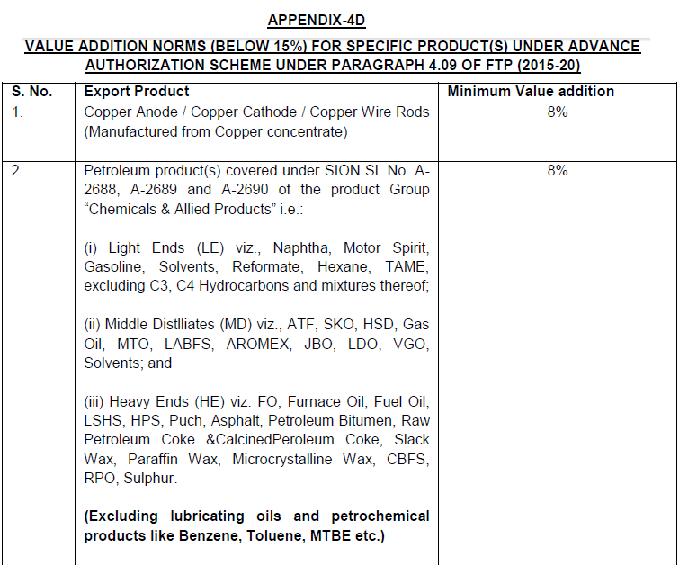

Slide 82
DUTY EXEMPTION SCHEME
ADVANCE AUTHORISATION
Calculation Formula of Value Addition (Except For Gems & Jewellery Sector)
VA = A-B x 100, where
B
A = FOB value of exports realized / FOR value of supply received
B = CIF value of inputs covered by Authorisation, plus value of any other input used on which benefit of DBK is claimed or intended to be claimed.

Slide 83
DUTY EXEMPTION SCHEME
ADVANCE AUTHORISATION
Ineligible categories of import on Self Declaration basis:
Import of following Products shall not be permissible on self – declaration basis:
  All vegetable / edible oils classified under Chapter-15 and all types of oilseeds classified under Chapter-12 of ITC (HS) book;
  All types of cereals classified under Chapter–10 of ITC (HS) book;
  All Spices other than light black pepper (light berries) having a basic customs duty of more than 30%, classified under Chapter-9 and 12 of ITC (HS) book;
  All types of fruits/ vegetables having a duty of more than 30%, classified under Chapter-7 and Chapter-8 of ITC (HS) book;
  Horn, hoof and any other organ of animal;
  Honey;
  Rough Marble Blocks/Slabs; and
  Rough Granite.
  Vitamins except for use in pharmaceutical industry.

Slide 84
DUTY EXEMPTION SCHEME
ADVANCE AUTHORISATION
Validity Period of Import under Advance Authorisation:
12 months from the date of issue of Authorisation.
However, Advance Authorisation for Deemed Export shall be co-terminus with contracted duration of project execution or 12 months from the date of issue of Authorisation, whichever is more.

Slide 85
DUTY EXEMPTION SCHEME
ADVANCE AUTHORISATION
Domestic Sourcing of Inputs:
Holder of an Advance Authorisation / Duty Free Import Authorisation can procure inputs from indigenous supplier/ State Trading Enterprise in lieu of direct import. Such procurement can be against Advance Release Order (ARO), Invalidation Letter, Back-to-Back Inland Letter of Credit.
Regional Authority may issue Advance Release Order or Invalidation Letter at the time of issue of Authorisation simultaneously or subsequently.

Slide 86
DUTY EXEMPTION SCHEME
ADVANCE AUTHORISATION
Free of Cost Supply by Foreign Supplier:
Advance Authorisation shall also be available where some or all inputs are supplied free of cost to exporter by foreign buyer.
In such cases, notional value of free of cost input shall be added in the CIF value of import and FOB value of export for the purpose of computation of value addition.
However, realization of export proceeds will be equivalent to an amount excluding notional value of such input.
Validity of Advance Release Order / Invalidation Letter shall be co-terminous with validity of Authorisation.

Slide 87
DUTY EXEMPTION SCHEME
ADVANCE AUTHORISATION
Export Obligation Fulfillment period:
Period for fulfilment of export obligation under Advance Authorisation shall be 18 months from the date of issue of Authorisation or as notified by DGFT.
In cases of supplies to turnkey projects in India under deemed export category or turnkey projects abroad, the Export Obligation period shall be co-terminus with contracted duration of the project execution or 18 months whichever is more.

Slide 88
DUTY EXEMPTION SCHEME
ADVANCE AUTHORISATION
Export Obligation Fulfillment period (Cont.):
Export Obligation for items falling in categories of defence, military store, aerospace and nuclear energy shall be 24 months from the date of issue of authorization or co-terminus with contracted duration of the export order whichever is more.
Export Obligation Period for specified inputs, from the date of clearance of each consignment, is given in Appendix 4-J.

Slide 89
DUTY EXEMPTION SCHEME
ADVANCE AUTHORISATION
Actual User Condition:
Advance Authorisation and / or material imported under Advance Authorisation shall be subject to ‘Actual User’ condition.
The same shall not be transferable even after completion of export obligation.
Authorisation holder will have option to dispose of product manufactured out of duty free input once export obligation is completed.
Waste / scrap arising out of manufacturing process, as allowed, can be disposed off on payment of applicable duty even before fulfillment of export obligation.

Slide 90
DUTY EXEMPTION SCHEME
ADVANCE AUTHORISATION
Importability/ Exportability of items that are prohibited / Restricted / STE (STATE TRADING ENTERPRISE):
No export or import of an item shall be allowed under Advance Authorisation / DFIA if the item is prohibited for exports or imports respectively.
Export of a prohibited item may be allowed under Advance Authorisation provided it is separately so notified, subject to the conditions given therein.
Items reserved for export by STE can be exported under Advance Authorisation / DFIA only after obtaining a ‘No Objection Certificate’ from the concerned STE.

Slide 91
DUTY EXEMPTION SCHEME
ADVANCE AUTHORISATION
Importability/ Exportability of items that are prohibited / Restricted / STE (STATE TRADING ENTERPRISE) (Cont.):
Import of restricted items shall be allowed under Advance Authorisation/ DFIA.
Export of restricted / SCOMET items however, shall be subject to all conditionalities or requirements of export authorisation or permission, as may be required.

Slide 92
DUTY EXEMPTION SCHEME
DUTY FREE IMPORT AUTHORISATION (DFIA) SCHEME:
Duty Free Import Authorisation is issued to allow duty free import of inputs.
In addition, import of oil and catalyst which is consumed / utilised in the process of production of export product, may also be allowed.

Slide 93
DUTY EXEMPTION SCHEME
DFIA
Eligibility Criteria:
Shall be issued on post export basis for products for which standard input output norms have been notified
Merchant Exporter shall be required to mention name and address of supporting manufacturer of the export product on the export document
Application is to be filed with concerned Regional Authority before effecting export

Slide 94
DUTY EXEMPTION SCHEME
DFIA
Minimum Value Addition:
Minimum value addition of 20% shall be required to be achieved.
For items where higher value addition has been prescribed under Advance Authorisation in Appendix 4C, the same value addition shall be applicable for Duty Free Import Authorisation also.

Slide 95
DUTY EXEMPTION SCHEME
DFIA
Validity & Transferability of DFIA:
Export shall be completed within 12 months from the date of online filing of application and generation of file number.
While doing export/supply, applicant shall indicate file number on the export documents
After completion of exports and realization of proceeds, request for issuance of transferable Duty Free Import Authorisation may be made to concerned Regional Authority within a period of twelve months from the date of export or six months (or additional time allowed by RBI for realization) from the date of realization of export proceeds, whichever is later.

Slide 96
DUTY EXEMPTION SCHEME
DFIA
Validity & Transferability of DFIA (Cont.):
Separate DFIA shall be issued for each SION and each port.
No Duty Free Import Authorisation shall be issued for an export product where SION prescribes ‘Actual User’ condition for any input.
Regional Authority shall issue transferable DFIA with a validity of 12 months from the date of issue. No further revalidation shall be granted by Regional Authority.

Slide 97
DUTY EXEMPTION SCHEME
SCHEMES FOR EXPORTERS OF GEMS & JEWELLERY
Advance Procurement / Replenishment of Precious Metals from Nominated Agencies;
Replenishment Authorisation for Gems;
Replenishment Authorisation for Consumables;
Advance Authorisation for Precious Metals.

Slide 98
DUTY EXEMPTION SCHEME
SCHEMES FOR EXPORTERS OF GEMS & JEWELLERY
Imports of Input:
Exporters of gems and Jewellery can import / procure duty free input for manufacture of export product.

Slide 99
DUTY EXEMPTION SCHEME
SCHEMES FOR EXPORTERS OF GEMS & JEWELLERY
Items of Export:
Following items, if exported, would be eligible:
Gold jewellery, including partly processed jewellery and articles including medallions and coins (excluding legal tender coins), whether plain or studded, containing gold of 8 carats and above;
Silver jewellery including partly processed jewellery, silverware, silver strips and articles including medallions and coins (excluding legal tender coins and any engineering goods) containing more than 50% silver by weight;

Slide 100
DUTY EXEMPTION SCHEME
SCHEMES FOR EXPORTERS OF GEMS & JEWELLERY
Items of Export (Cont.):
Platinum jewellery including partly processed jewellery and articles including medallions and coins (excluding legal tender coins and any engineering goods) containing more than 50% platinum by weight.

Slide 101
DUTY EXEMPTION SCHEME
SCHEMES FOR EXPORTERS OF GEMS & JEWELLERY
Advance Procurement/ Replenishment of Precious Metals from Nominated Agencies :
Exporter of gold / silver / platinum jewellery and articles thereof including mountings and findings may obtain gold / silver / platinum as an input for export product from Nominated Agency, in advance or as replenishment after export in accordance with the procedure specified in this behalf.
The export would be subject to wastage norms and minimum value addition.

Slide 102
DUTY EXEMPTION SCHEME
SCHEMES FOR EXPORTERS OF GEMS & JEWELLERY
Wastage Norms:
Wastage or manufacturing loss for gold / silver / platinum jewellery shall be admissible as per paragraph 4.60 of Handbook of Procedures.

Slide 103
DUTY EXEMPTION SCHEME
SCHEMES FOR EXPORTERS OF GEMS & JEWELLERY
Extracts fro the Para 4.60 of H.B.P.
Sl No | Items of export Percentage of | Percentage of wastage by weight with reference to Gold/ Platinum / Silver content in export item
 |  | Gold / platinum | Silver :
a) | Plain jewellery, articles, and ornaments like Mangalsutra containing gold and black beads /imitation stones, cubic zirconia diamonds, precious, semi-precious stones | 2.5 % | 3.2 %

Slide 104
DUTY EXEMPTION SCHEME
SCHEMES FOR EXPORTERS OF GEMS & JEWELLERY
Extracts fro the Para 4.60 of H.B.P.
Sl No | Items of export Percentage of | Percentage of wastage by weight with reference to Gold/ Platinum / Silver content in export item
 |  | Gold / platinum | Silver :
b) | Studded jewellery and articles thereof | 5.0 % | 5.0 %
c) | Mountings and findings manufactured (by non-mechanised process) indigenously | 2.5 % | 3.2 %

Slide 105
DUTY EXEMPTION SCHEME
SCHEMES FOR EXPORTERS OF GEMS & JEWELLERY
Export against Supply by Foreign Buyer :
Where export orders are placed on nominated agencies / status holder / exporters of three years standing having an annual average turnover of Rupees five crores during preceding three financial years, foreign buyer may supply in advance and free of charge, gold / silver / platinum, alloys, findings and mountings of gold / silver / platinum for manufacture and export.

Slide 106
PROFESSIONAL OPPORTUNITIES
ISSUE OF ADVANCE LICENSES.
ISSUE OF ADVANCE LICENSES FOR ANNUAL REQUIREMENTS.
ISSUE OF EODC AGAINST ADVANCE AUTHORISATION.

Slide 107
CHAPTER 5
EXPORT PROMOTION CAPITAL GOODS (EPCG) SCHEME
FOREIGN TRADE POLICY 2015-2020

Slide 108
EPCG SCHEME
OBJECTIVE:
The objective of the EPCG Scheme is to facilitate import of capital goods for producing quality goods and services to enhance India’s export competitiveness.

Slide 109
EPCG SCHEME
COVERAGE OF EPCG SCHEME:
EPCG Scheme Covers
Manufacturer exporters with or without supporting manufacturer(s);
Merchant exporters tied to supporting manufacturer(s);
Service providers; and
Service Provider who is designated / certified as a Common Service Provider (CSP) by DGFT.

Slide 110
EPCG SCHEME
Import under EPCG Scheme (Eligibility & Validity):
Scheme allows import of capital goods for pre-production and post production at zero custom duty. Capital goods for this purpose include:
  Capital Goods as defined in Chapter 9 including in CKD/SKD condition thereof;
  Computer software systems;
  Spares, moulds, dies, jigs, fixtures, tools & refractories for initial lining and spare refractories; and
  catalysts for initial charge plus one subsequent charge.

Slide 111
EPCG SCHEME
Import under EPCG Scheme (Eligibility & Validity) (Cont.):
Import of capital goods for Project Imports notified by Central Board of Excise and Customs is also permitted under EPCG Scheme.
Import under EPCG Scheme shall be subject to an export obligation equivalent to 6 times of duty saved on capital goods, to be fulfilled in 6 years reckoned from date of issue of Authorisation.

Slide 112
EPCG SCHEME
Import under EPCG Scheme (Eligibility & Validity) (Cont.):
Authorisation shall be valid for import for 18 months from the date of issue of Authorisation. Revalidation of EPCG Authorisation shall not be permitted.
In case countervailing duty (CVD) is paid in cash on imports under EPCG, incidence of CVD would not be taken for computation of net duty saved, provided CENVAT is not availed.

Slide 113
EPCG SCHEME
Import under EPCG Scheme (Eligibility & Validity) (Cont.):
Second hand capital goods shall not be permitted to be imported under EPCG Scheme.
Import of items which are restricted for import shall be permitted under EPCG Scheme only after approval from Exim Facilitation Committee (EFC) at DGFT Headquarters.

Slide 114
EPCG SCHEME
Import under EPCG Scheme (Eligibility & Validity) (Cont.):
Authorisation under EPCG Scheme shall not be issued for import of any Capital Goods (including Captive plants and Power Generator Sets of any kind) for
  Export of electrical energy (power)
  Supply of electrical energy (power) under deemed exports
  Use of power (energy) in their own unit, and
  Supply/export of electricity transmission services

Slide 115
EPCG SCHEME
Import under EPCG Scheme (Eligibility & Validity) (Cont.):
If the goods proposed to be exported under EPCG authorisation are restricted for export, the EPCG authorisation shall be issued only after approval for issuance of export authorisation from Exim Facilitation Committee at DGFT Headquarters.

Slide 116
EPCG SCHEME
Indigenous Sourcing of Capital Goods and Benefits to Domestic Supplier:
A person holding an EPCG authorisation may source capital goods from a domestic manufacturer.
Such domestic manufacturer shall be eligible for deemed export benefit under paragraph 7.03 of FTP.
Such domestic sourcing shall also be permitted from EOUs and these supplies shall be counted for purpose of fulfilment of positive NFE by said EOU

Slide 117
EPCG SCHEME
Calculation of Export Obligation:
In case of direct imports, EO shall be reckoned with reference to actual duty saved amount.
In case of domestic sourcing, EO shall be reckoned with reference to notional Customs duties saved on FOR value.

Slide 118
EPCG SCHEME
Condition to Fulfill Export Obligation:
EO shall be fulfilled by the authorisation holder through export of goods which are manufactured by him or his supporting manufacturer / services rendered by him, for which the EPCG authorisation has been granted.
EO under the scheme shall be, over and above, the average level of exports achieved by the applicant in the preceding three licensing years for the same and similar products within the overall EO period including extended period, if any;

Slide 119
EPCG SCHEME
Condition to Fulfill Export Obligation (Cont.):
In case of indigenous sourcing of Capital Goods, specific EO shall be 25% Less than the Normal EO.
Shipments under Advance Authorisation, DFIA, Drawback scheme or reward schemes under Chapter 3 of FTP; would also count for fulfillment of EO under EPCG Scheme.

Slide 120
EPCG SCHEME
Condition to Fulfill Export Obligation (Cont.):
Export shall be physical export. However, deemed exports as specified in paragraph 7.02 (a), (b), (e), (f) & (h) of FTP shall also be counted towards fulfillment of export obligation.
Payment received in rupee terms for such Services as notified in Appendix 3E shall also be counted towards discharge of export obligation under the EPCG scheme.

Slide 121
EPCG SCHEME
Incentive for early EO Fulfillment:
With a view to accelerating exports, in cases where Authorisation holder has fulfilled 75% or more of specific export obligation and 100% of Average Export Obligation till date, if any, in half or less than half the original export obligation period specified, remaining export obligation shall be condoned and the Authorisation redeemed by RA concerned.

Slide 122
EPCG SCHEME
Reduced EO in various Cases:
For exporters of Green Technology Products, Specific EO shall be 75% of Normal EO.
For units located in North East Region (Arunachal Pradesh, Assam, Manipur, Meghalaya, Mizoram, Nagaland, Sikkim, Tripura) and Jammu & Kashmir, specific EO shall be 25% of the Normal EO.

Slide 123
EPCG SCHEME
Reduced EO in various Cases:
For exporters of Green Technology Products, Specific EO shall be 75% of Normal EO.
For units located in North East Region (Arunachal Pradesh, Assam, Manipur, Meghalaya, Mizoram, Nagaland, Sikkim, Tripura) and Jammu & Kashmir, specific EO shall be 25% of the Normal EO.

Slide 124
EPCG SCHEME
Post Export EPCG Duty Credit Scrip(s) :
Available to exporters who intend to import capital goods on full payment of applicable duties in cash and choose to opt for this scheme.
Basic Customs duty paid on Capital Goods shall be remitted in the form of freely transferable duty credit scrip(s), similar to those issued under Chapter 3 of FTP.
Specific EO shall be 85% of the applicable specific EO under the EPCG Scheme. However, average EO shall remain unchanged.

Slide 125
EPCG SCHEME
Post Export EPCG Duty Credit Scrip(s) (Cont.):
Duty remission shall be in proportion to the EO fulfilled.
All provisions for utilization of scrips issued under Chapter 3 of FTP shall also be applicable to Post Export EPCG Duty Credit Scrip (s).
All provisions of the existing EPCG Scheme shall apply insofar as they are not inconsistent with this scheme.

Slide 126
PROFESSIONAL OPPORTUNITIES
ISSUE OF EPCG LICENSE
ISSUE OF EODC AGAINST EPCG LICENSE.
ISSUE OF POST EXPORT DUTY CREDIT SCRIPS.

Slide 127
CHAPTER 6
EXPORT ORIENTED UNITS (EOUs), ELECTRONICS HARDWARE TECHNOLOGY PARKS (EHTPs), SOFTWARE TECHNOLOGY PARKS (STPs) SCHEME AND BIO-TECHNOLOGY PARKS (BTPs)
FOREIGN TRADE POLICY 2015-2020

Slide 128
EOUs, EHTPs, STPs AND BTPs
INTRODUCTION:
Units undertaking to export their entire production of goods and services (except permissible sales in DTA), may be set up under the EOUs, EHTPs, STPs, or BTPs for manufacture of goods including repair, re-making, reconditioning, re-engineering, rendering of services, development of software, agriculture including agro-processing, aquaculture, animal husbandry, bio-technology, floriculture, horticulture, pisciculture, viticulture, poultry and sericulture. Trading units are not covered under these schemes.

Slide 129
EOUs, EHTPs, STPs AND BTPs
OBJECTIVE:
Objectives of these schemes are to promote exports, enhance foreign exchange earnings, attract investment for export production and employment generation.

Slide 130
EOUs, EHTPs, STPs AND BTPs
INVESTMENT CRITERIA
Only projects having a minimum investment of Rs. 1 Crore in plant & machinery shall be considered for establishment as EOUs. However, this shall not apply to existing units, units in EHTP / STP / BTP, and EOUs in Handicrafts / Agriculture / Floriculture / Aquaculture / Animal Husbandry / Information Technology, Services, Brass Hardware and Handmade jewellery sectors. BOA may allow establishment of EOUs with a lower investment criteria.

Slide 131
EOUs, EHTPs, STPs AND BTPs
ENTITLEMENTS:
ENTITLEMENT FOR SUPPLIES FROM THE DTA
OTHER ENTITLEMENTS

Slide 132
EOUs, EHTPs, STPs AND BTPs
ENTITLEMENT FOR SUPPLIES FROM THE DTA:
Supplies from DTA to EOU / EHTP / STP / BTP units will be regarded as “deemed exports” and DTA supplier shall be eligible for relevant entitlements under chapter 7 of FTP, besides discharge of export obligation, if any, on the supplier.
Suppliers of precious and semi-precious stones, synthetic stones and processed pearls from DTA to EOU shall be eligible for grant of Replenishment Authorisations

Slide 133
EOUs, EHTPs, STPs AND BTPs
ENTITLEMENT FOR SUPPLIES FROM THE DTA (Cont.):
IN ADDITION, EOU/ EHTP/ STP/ BTP UNITS SHALL BE ENTITLED TO FOLLOWING:
(I) Reimbursement of Central Sales Tax (CST) on goods manufactured in India.
(II) Exemption from payment of Central Excise Duty on goods procured from DTA on goods manufactured in India.
(III) Reimbursement of duty paid on fuel procured from Domestic Oil Companies / Depots of Domestic Oil Public Sector Undertakings as per drawback rate notified by DGFT from time to time.
(IV) CENVAT Credit on service tax paid.

Slide 134
EOUs, EHTPs, STPs AND BTPs
OTHER ENTITLEMENTS:
Exemption from industrial licensing for manufacture of items reserved for SSI sector.
Export proceeds will be realized within nine months.
Units will be allowed to retain 100% of its export earnings in the EEFC account.
100% FDI investment permitted through automatic route similar to SEZ units.
Units shall pay duty on the goods produced or manufactured and cleared into DTA on monthly basis in the manner prescribed in the Central Excise Rules.

Slide 135
CHAPTER 7
DEEMED EXPORTS
FOREIGN TRADE POLICY 2015-2020

Slide 136
DEEMED EXPORTS
INTRODUCTION:
“Deemed Exports” refer to those transactions in which goods supplied do not leave country, and payment for such supplies is received either in Indian rupees or in free foreign exchange.

Slide 137
DEEMED EXPORTS
OBJECTIVE:
To provide a level-playing field to domestic manufacturers in certain specified cases, as may be decided by the Government from time to time.

Slide 138
DEEMED EXPORTS
CATAGORIES OF SUPPLY UNDER DEEMED EXPORTS:
A. Supply by Manufactrurer
B. Supply by main/sub-contractor(s):

Slide 139
DEEMED EXPORTS
CATEGORY OF SUPPLY
SUPPLY BY MANUFACTURER:
Supply of goods against Advance Authorisation/Advance Authoriasation for annual requirement/DFIA;
Supply of goods to EOU/STP/EHTP/BTP;
Supply of goods against EPCG Authorisation;
Supply of marine freight containers by 100% EOU (Domestic freight containers-manufacturers) provided said containers are exported out of India within 6 months or such further period as permitted by customs;

Slide 140
DEEMED EXPORTS
CATEGORY OF SUPPLY
SUPPLY BY MAIN/ SUB-CONTRACTOR(S):
Supply of goods to nuclear power projects provided:
    Such goods are required for setting up of any Nuclear Power Project as specified in the list 33 at Sl. No. 511 of Notification No. 12/2012 – Customs dated 17.3.2012, as amended from time to time.
    The project should have a capacity of 440 MW or more.
    A certificate to the effect is required to be issued by an officer not below the rank of Joint Secretary to Government of India, in Department of Atomic Energy.
    Tender is invited through National competitive bidding (NCB) or through ICB.

Slide 141
DEEMED EXPORTS
CATEGORY OF SUPPLY
SUPPLY BY MAIN/ SUB-CONTRACTOR(S) (Cont.):
Supply of goods to United Nations or International Organisations for their official use or supplied to the projects financed by the said United Nations or an International organisation approved by Government of India.
Other Supplies as specified in FTP.

Slide 142
DEEMED EXPORTS
Benefits for Deemed Exports:
Advance Authorisation/ Advance Authorisation for Annual requirements/ DFIA
Deemed Export Drawback.
Refund of Terminal Excise Duty, if exemption is not available.

Slide 143
DEEMED EXPORTS
Conditions for refund of Terminal Excise Duty:
Supply of goods will eligible for refund of TED, provided recipient of goods does not avail CENVAT Credit/ Rebate on such goods.
Supply of goods which are exempted ab-initio from payment of Terminal Excise Duty would be ineligible to get refund of TED.

Slide 144
DEEMED EXPORTS
Supplies on which Exemption from TED is available:
Supplies under ICB;
Supplies of intermediate goods, against invalidation letter, made by an Advance Authorisation holder to another Advance Authorisation holder;
Goods Procured by EOU / EHTP / STP / BTP unit from a unit in DTA; and
Supply of goods to UN/International Organisation or project funded by it.

Slide 145
DEEMED EXPORTS
Conditions for refund of deemed export drawback:
In case CENVAT credit / rebate has not been availed on the inputs / input services, by the supplier of goods, then, benefit as per Column ‘A’ of All Industry Rate of Duty Drawback Schedule shall be admissible.
If CENVAT credit / rebate has been availed by the supplier of goods, on inputs / input services, then, no Drawback shall be admissible as per Column ‘B’ of All Industry Rate of Duty Drawback Schedule. However, in such cases, Basic Customs Duty paid can be claimed as Brand Rate of Duty Drawback based upon submission of documents evidencing actual payment of duties.

Slide 146
CHAPTER 8
QUALITY COMPLAINTS AND TRADE DISPUTES
FOREIGN TRADE POLICY 2015-2020

Slide 147
QUALITY COMPLAINTS AND TRADE DISPUTES
OBJECTIVE:
Exporters need to project a good image of the country abroad to promote exports. Maintaining an enduring relationship with foreign buyers is of utmost importance, and complaints or trade disputes, whenever they arise, need to be settled amicably as soon as possible. Importers too may have grievances as well.
In an endeavour to resolve such complaints or trade disputes and to create confidence in the business environment of the country, a mechanism is being laid down to address such complaints and disputes in an amicable way.

Slide 148
QUALITY COMPLAINTS AND TRADE DISPUTES
Committee on Quality complaints and trade disputes (CQCTD)
To deal effectively with the increasing number of complaints and disputes, a ‘Committee on Quality Complaints and Trade Disputes’ (CQCTD) will be constituted in the 22 offices of the RA’s of DGFT.

Slide 149
QUALITY COMPLAINTS AND TRADE DISPUTES
Functions of the CQCTD
The Committee (CQCTD) will be responsible for enquiring and investigating into all Quality related complaints and other trade related complaints falling under the jurisdiction of the respective RAs.
Wherever required, the Committee (CQCTD) may take the assistance of the Export Promotion Councils/FIEO/Commodity Boards or any other agency as considered appropriate for settlement of these disputes.

Slide 150
QUALITY COMPLAINTS AND TRADE DISPUTES
Mechanism for resolving Quality Complaint and Trade Dispute :
The CQCTD, on receipt of a complaint, from importer abroad, against Indian exporter would call for comments from the firm against whom the complaint has been made. After giving reasonable opportunity of hearing to both sides, CQCTD may arrive at a conclusion to resolve the matter and CQCTD /RA will take action as considered appropriate.
RA would forward a copy of the complaint received from Indian importer, against foreign exporter to the concerned Foreign Trade (FT) Division in the Department of Commerce (DoC). FT Division in DoC will take up the complaint with the concerned Embassy/High Commission/ Consulate General in India and with concerned Indian Embassy/ High Commission abroad for effective resolution of the complaint.

Slide 151
CHAPTER 9
MISCELLANEOUS MATTERS
FOREIGN TRADE POLICY 2015-2020

Slide 152
MISCELLANEOUS MATTERS
Denomination of Import Authorisation/Licence/ Certificate/ Permissions :
CIF value of Authorisation / FOB value of export obligation shall be indicated both in Rupees and in freely convertible currency(s) at the exchange rate(s) prevailing on Authorisation issue date.
Remittance of foreign exchange and discharge of export obligation against Authorisation shall be regulated in freely convertible currency.
No enhancement in Rupee value shall be necessary if remittance of foreign exchange is covered by CIF value of Authorisation shown in freely convertible currency.

Slide 153
MISCELLANEOUS MATTERS
Denomination of Import Authorisation/Licence/ Certificate/ Permissions (Cont.) :
However, on Advance Authorisation(s), issued for exports to ACU countries, export obligation shall be denominated and discharged in ACU dollars.
Export obligation in Advance Authorisation for intermediate supply and for deemed export, where supplies are to be made within the country, shall be denominated and discharged in Indian rupees.

Slide 154
MISCELLANEOUS MATTERS
LATE CUT :
Wherever any application for any fiscal/financial benefits under FTP complete in all respects is received after expiry of last date for submission of such application, the application may be considered after imposing a late cut in the following manner:

Slide 155
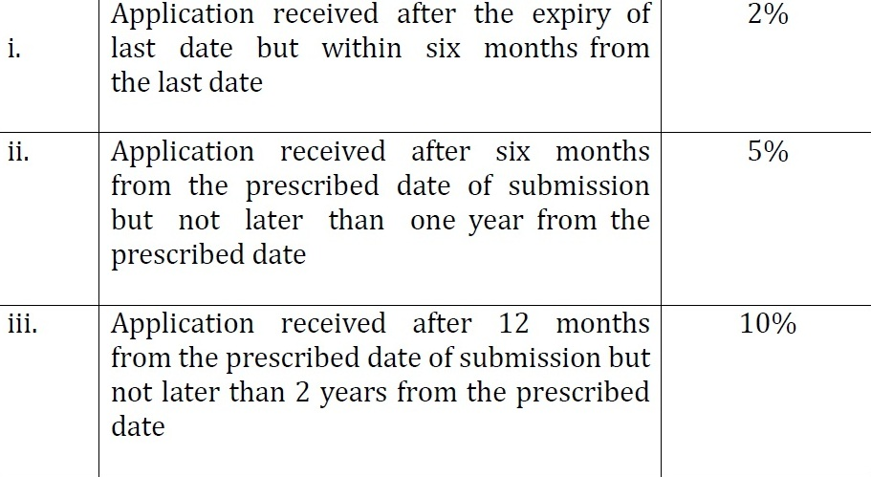
MISCELLANEOUS MATTERS
LATE CUT (Cont.) :

Slide 156
MISCELLANEOUS MATTERS
Clarifications on Policy/Procedure :
A request seeking clarifications on any provision of FTP or HBP, importability or exportability of items under ITC(HS), made to DGFT in the form in ANF2F. Clarification may also be sought on E-mail.

Slide 157
MISCELLANEOUS MATTERS
Export Facilitation :
In order to resolve exporters' problems in a co-ordinated manner, field offices of DGFT shall act as Export Facilitation Centres and nodal agencies.

Slide 158
MISCELLANEOUS MATTERS
General Power of Review :
DGFT may, on his own or otherwise, call for records of any case pending with or decided by an officer subordinate to him or an officer of any EPC/FIEO including a Group/ Committee of officers nominated, appointed or authorised by him and pass such orders as he may deem fit.

