Slide 1
Consumer Behaviour

Slide 2
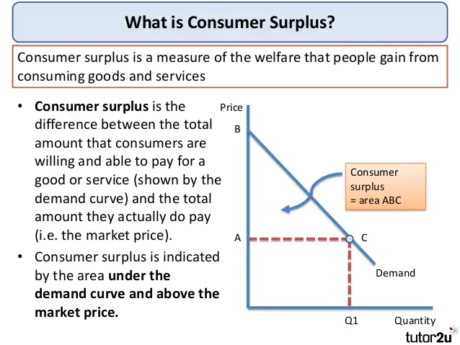
https://youtu.be/oL20S7c0ZJE

Slide 3
Indifference curve analysis
Developed By - Edge worth
It was later preferred by J.R Hicks & R.J.D. Allen
Indifference curve approach is also known as ordinal utility approach..
consumer express their utility in terms of preference not in term of quantity.

Slide 4
What is indifference Curve?
Definition: An indifference curve is a graph showing combination of two goods that give the consumer equal satisfaction and utility. Each point on an indifference curve give the consumer same utility.
Description: Graphically , the indifference curve is drawn as a downward sloping convex to the origin. The graph shows a combination of two goods that the consumer consumes.

Slide 5
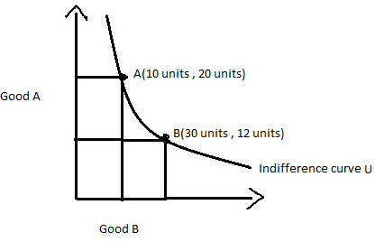
Indifference Curve
The diagram shows the U indifference curve showing bundles of goods A and B. to the same utility as both of them give him the equal satisfaction.
In other words, point A gives as much utility as point B to individual .
The consumer will be satisfied at any point along the curve assuming that other things are constant.

Slide 6
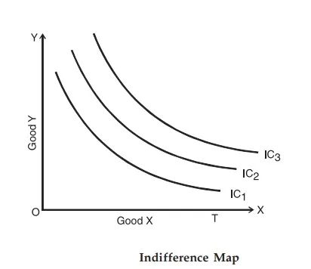
Indifference map
Collection of indifference curve is called indifference map.
Each indifference curve represents a certain level of satisfaction

Slide 7
Assumptions of Indifference Curve Analysis
https://youtu.be/7dwCBn1OTn8
a) Consumer is rational.
b) Utility can be measured in Ordinal numbers.
c) Marginal rate of substitution (MRS) diminishes
MRS=marginal rate of substitution is the rate at which a consumer is ready to give up one good in exchange for another good while maintaining the same level of utility)

Slide 8
Assumptions of Indifference Curve Analysis (contn..)
d) Consumer’s behavior is Consistent.
E.g. if consumer prefers A combination > B combination at one time, then at another time he will not prefer more of B combination than A combination.
e) Transitivity.
E.g. if consumer prefers A combination to B combination and B combination to C combination, then he will definitely prefer A combination to C combination.
f) Consumer’s scale of Preference is Independent of his income and prices of goods in the market.

Slide 9
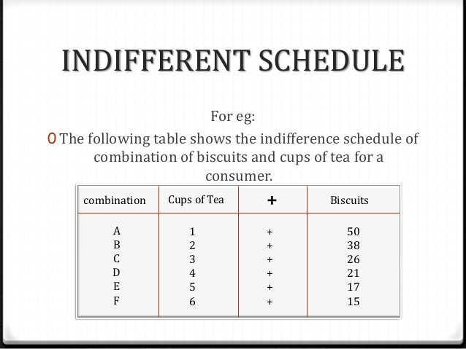
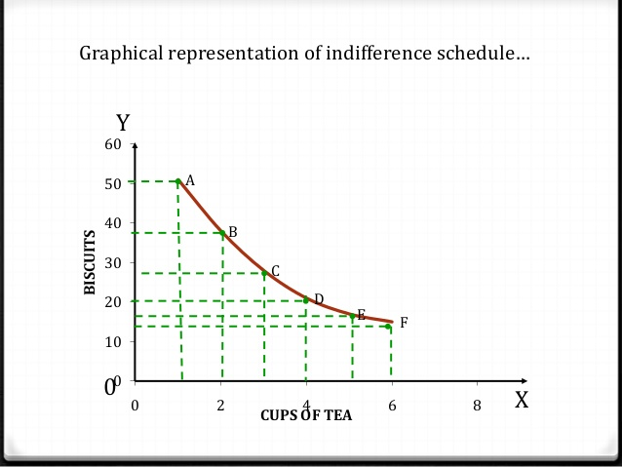

Slide 10
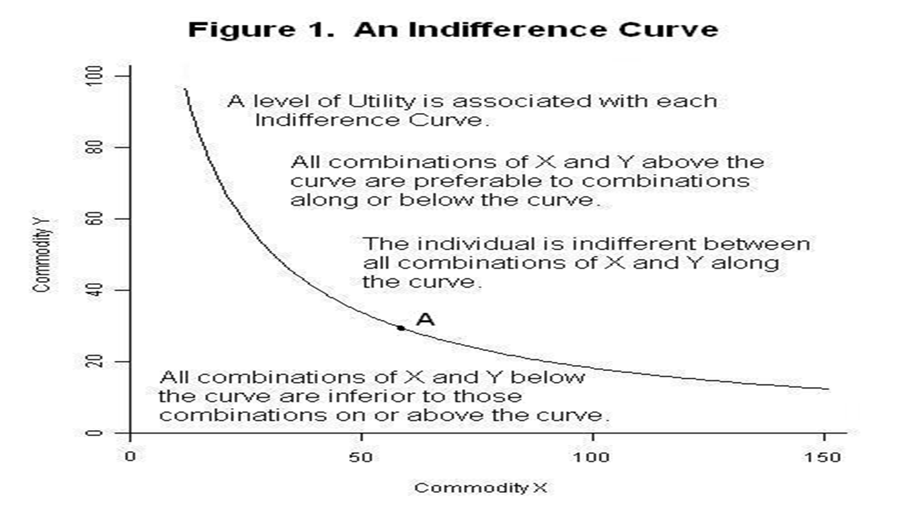
https://youtu.be/wrdib31J7wg

Slide 11
Properties of indifference curves
An indifference curve slope down. which means, that with the more consumption of one good the consumption of the other is to be reduced to maintain the utility.
Indifference curves are convex to the origin. indifference curves are convex to the origin because of the diminishing marginal rate of substitution.
Higher indifference curve represents higher level of satisfaction. The consumer derives more satisfaction from the combination of two goods on a higher indifference curve because more units of both the commodities are used that will surely be more satisfying than the lower quantity combinations.

Slide 12
Properties of indifference curves
Indifference curves cannot intersect each other.
It is because at the point of tangency, the higher curve will give as much as of the two commodities as is given by the lower indifference curve.
indifference curves cannot be thick .
The indifference curves cannot be thick because if they are thick, they would be violating "non-satiation" assumption.
indifference curve never touches horizontal axis or vertical axis. it implies that the customer never prefers only one commodity because when it touches axes, one of the commodities becomes zero quantity. ... Hence, an indifference curve does not touch either horizontal axis or vertical axis

Slide 13
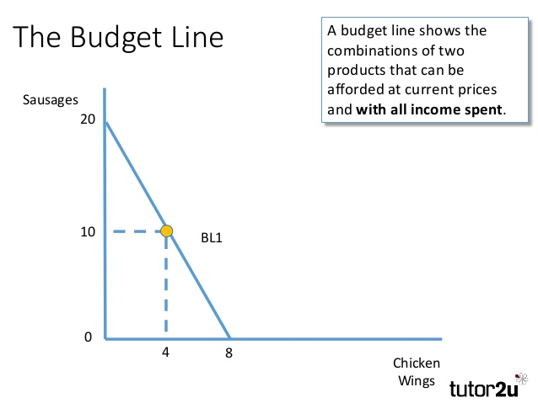

Slide 14
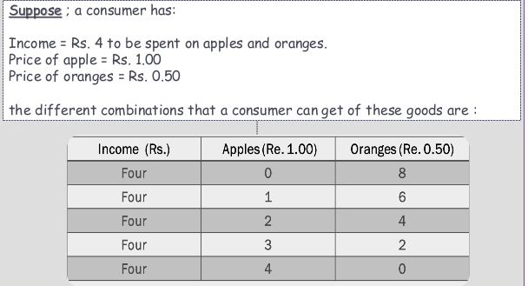
Illustration

Slide 15
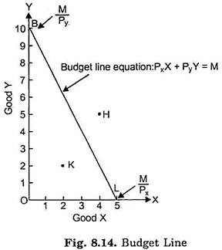
Budget line
https://youtu.be/kfqsakiQUb8
Definition:
The budget constraint presents the combinations of goods that the consumer can afford given her income and the price of goods.
Equation: Px * X + Py * Y=I
Rearrange: Y = I/ Py + (-Px / Py) *X
intercept slope

Slide 16
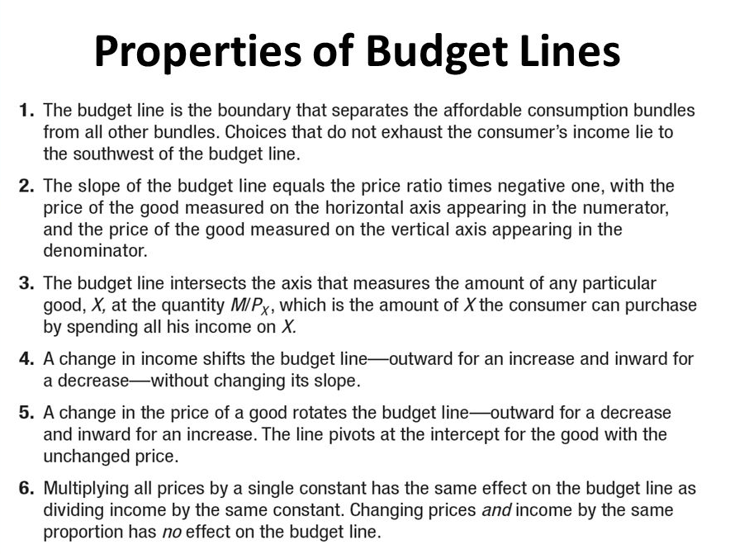

Slide 17
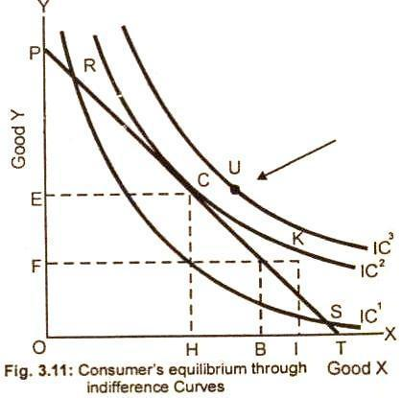
Consumer equilibrium under indifference curve analysis
https://youtu.be/JiJlZGqZXZk
First order condition: a given price line should be tangent to an indifference curve or marginal rate of satisfaction of good x for good y (MRSxy) must be equal to the price ratio of two goods.
MRSxy = Px/Py
Slop of IC= slop of budget line

Slide 18
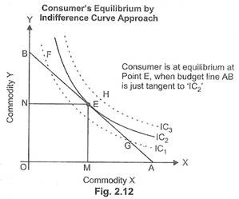
Contn…
Second order condition: the second order condition is that indifference curve must be convex to the origin at the point of tangency.

Slide 19
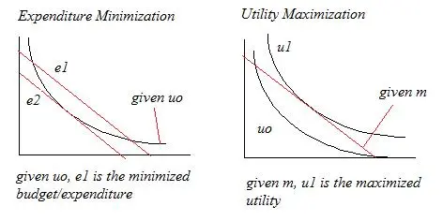
Consumer Equilibrium

