Slide 1
Unit 3
Strategies of Private Equity

Slide 2
Contents to be learnt
Leverage Buyout, Growth Capital, Mezzanine Capital
Distressed Debt, other Strategies
Due Diligence- Procedure and Challenges
Due Diligence in Emerging PE Market
Investing in Developing Market
Past Performance and Strategy

Slide 3
Leveraged Buyout
A leveraged buyout (LBO) is the acquisition of another company using a significant amount of borrowed money to meet the cost of acquisition. The assets of the company being acquired are often used as collateral for the loans, along with the assets of the acquiring company
In a leveraged buyout (LBO), there is usually a ratio of 90% debt to 10% equity. Because of this high debt/equity ratio, the bonds issued in the buyout are usually not investment grade and are referred to as junk bonds. LBOs have garnered a reputation for being an especially ruthless and predatory tactic as the target company doesn't usually sanction the acquisition. Aside from being a hostile move, there is a bit of irony to the process in that the target company's success, in terms of assets on the balance sheet, can be used against it as collateral by the acquiring company.

Slide 4
Leveraged Buyout
LBOs are conducted for three main reasons:
to take a public company private.
to spin-off a portion of an existing business by selling it.
to transfer private property, as is the case with a change in small business ownership.
However, it is usually a requirement that the acquired company or entity, in each scenario, is profitable and growing

Slide 5
Advantages of a Leveraged Buyout
Leveraged buyouts have become increasingly popular because they require very little upfront capital and can insulate a purchasing company from a financial setback. If a deal doesn't work out, the acquired company is saddled with bad debt, not the purchaser.
This doesn't mean that a purchasing company is completely insulated from loss. In addition to the up-front capital, purchasers can face potentially significant liability in the form of shareholder lawsuits if they use an LBO to saddle an otherwise-healthy company with untenable payments. However, the purchasing company is protected against direct loss on the underlying debt.
It is not uncommon for otherwise profitable firms to face financial difficulties and even bankruptcy following a leveraged buyout, as they must subsequently pay a debt worth almost the entire value of the company.

Slide 6
Four Uses For a Leveraged Buyout
1. To Privatize a Public Company
Taking a publicly traded company private means consolidating its public shares in the hands of private investors who take those shares off the market. Those investors will now own either all or a majority of the target company. This requires enough capital to purchase all or most of the company's net value.
Since these investors will now own the company, they can have the company assume the debt liability for this transaction.

Slide 7
Four Uses For a Leveraged Buyout
To Break Up a Large Company
Sometimes a company may grow large and inefficient, such that the whole is worth less than the sum of its parts. In this case an investor may purchase the company and split it off, selling it as a series of smaller companies. For example, a company that manufactures cars, airplanes and tanks might get split up into an automotive, an aerospace and a defense firm, each of which would get sold to larger companies in the relevant industries.
In this case the investor would buy the company through a leveraged buyout in the belief that these individual sales will more than pay off that loan.

Slide 8
Four Uses For a Leveraged Buyout
To Improve an Underperforming Company
Finally, an investor might believe that a firm is significantly underperforming its potential. In this case the purchase price of the company would be worth much less than what the company could eventually be worth, making a leveraged buyout a good option.

Slide 9
Four Uses For a Leveraged Buyout
To Enrich Shareholders and Owners
When a company is purchased, the purchase price flows to all owners and the stock price generally surges. For a privately held firm the individual owner(s) collect that money directly minus any partnerships or other liabilities.
For a publicly held firm the purchase capital accrues to shareholders. This typically enriches executives and members of the board of directors. The former group will often have their compensation tied to stock performance, while the latter group typically comprises some of the company's largest shareholders.

Slide 10
Capital Structure in an LBO Model
Capital structure in a Leveraged Buyout (LBO) refers to the components of financing that are used in purchasing a target company. Although each LBO is structured differently, the capital structure is usually similar in most newly-purchased companies, with the largest percentage of LBO financing being debt. The typical capital structure is financing with the cheapest and less risky first, followed by other available options.
An LBO capital structure may include the following:

Slide 11
Capital Structure in an LBO Model
Bank Debt
Bank debt is also referred to as senior debt, and it is the cheapest financing instrument used to acquire a target company in a leveraged buyout, accounting for 50%-80% of an LBO’s capital structure. It has a lower interest rate than other financing instruments, making it the most preferred by investors.
However, bank debts come with covenants and limitations that restrict a company from paying dividends to shareholders, raising additional bank debts, and acquiring other companies while the debt is active. Bank debts typically come with a payback time of 5 to 10 years. If the company liquidates before the debt is fully paid, bank debts get paid off first.

Slide 12
Capital Structure in an LBO Model
High Yield Debt/Subordinated Debt
High yield debt/Junk Bonds is typically unsecured debt and carries a high interest rate that compensates the investors for risking their money. They have less restrictive limitations or covenants than there are in bank debts. In the event of a liquidation, high yield debt is paid before equity holders, but after the bank debt. The debt can be raised in the public debt market or private institutional market. Its payback period is typically 8 to 10 years, with a bullet repayment and early repayment options.

Slide 13
Capital Structure in an LBO Model
Mezzanine Debt
Mezzanine debt is a small middle layer in the LBO capital structure that is a hybrid of debt and equity and is junior or subordinate to other debt financing options. It is often financed by hedge funds and private equity investors and comes with a higher interest rate than bank debt and high-yield debt.
Mezzanine debt takes the form of a high yield debt with an option to purchase a stock at a specific price in the future as a way of boosting investor returns commensurate with the risk involved. It allows early repayment options and bullet payments just like high yield debt. During a liquidation, mezzanine debt is paid after other debts have been settled, but before equity shareholders are paid.

Slide 14
Capital Structure in an LBO Model
Equity
Equity comprises 20-30% of LBO financing, depending on the deal. It represents the private equity fund’s capital and attracts a high interest rate due to the risk involved. In the case of a liquidation, the equity shareholders are paid last, after all the debt has been settled. If the company defaults on payments, the equity shareholders may not receive any returns on their investments.

Slide 15
Capital Structure in an LBO Model
Credit Metrics
One of the keys to building an LBO model is making sure the credit metrics and debt covenants work for the deal. In the screenshot below, you will see how an analyst would model the credit metrics for this leveraged buyout.
Key credit metrics in an LBO model include:
Debt/EBITDA
Interest Coverage Ratio (EBIT/Interest)
Debt Service Coverage Ratio (EBITDA – Capex) / (Interest + Principle)
Fixed Charge Coverage Ratio (EBITDA – Capex – Taxes) / (Interest + Principle)

Slide 16
Capital Structure in an LBO Model
What is the Net Debt to EBITDA Ratio?
The net debt to earnings before interest, taxes, depreciation, and amortization (EBITDA) ratio measures financial leverage and a company’s ability to pay off its debt. Essentially, the net debt to EBITDA ratio (debt/EBITDA) gives an indication as to how long a company would need to operate at its current level to pay off all its debt. The ratio is commonly used by credit rating agencies to determine the probability of a company defaulting on its debt.

Slide 17
Capital Structure in an LBO Model
What is Interest Coverage Ratio (ICR)?
The Interest Coverage Ratio (ICR) is a financial ratio that is used to determine how well a company can pay the interest on its outstanding debts. The ICR is commonly used by lenders, creditors, and investors to determine the riskiness of lending capital to a company. The interest coverage ratio is also called the “times interest earned” ratio.

Slide 18
Capital Structure in an LBO Model
What is a Coverage Ratio?
A Coverage Ratio is any one of a group of financial ratios used to measure a company’s ability to pay its financial obligations. A higher ratio indicates a greater ability of the company to meet its financial obligations while a lower ratio indicates a lesser ability. Coverage ratios are commonly used by creditors and lenders to determine the financial standing of a prospective borrower.
The most common coverage ratios are:
Interest coverage ratio: The ability of a company to pay the interest expense (only) on its debt
Debt service coverage ratio: The ability of a company to pay all debt obligations, including repayment of principal and interest
Cash coverage ratio: The ability of a company to pay interest expense with its cash balance
Asset coverage ratio: The ability of a company to repay its debt obligations with its assets

Slide 19
Why do PE firms use so much leverage?
Simply put, the use of leverage (debt) enhances expected returns to the private equity firm. By putting in as little of their own money as possible, PE firms can achieve a large return on equity (ROE) and internal rate of return (IRR), assuming all goes according to plan. Since PE firms are compensated based on their financial returns, the use of leverage in an LBO is critical in achieving their targeted IRRs (typically 20-30% or higher).
(The Internal Rate of Return (IRR) is the discount rate that makes the net present value (NPV) of a project zero. In other words, it is the expected compound annual rate of return that will be earned on a project or investment.)

Slide 20
Why do PE firms use so much leverage?
While leverage increases equity returns, the drawback is that it also increases risk. By strapping multiple tranches of debt onto an operating company the PE firm is significantly increasing the risk of the transaction (which is why LBOs typically pick stable companies). If cash flow is tight and the economy of the company experiences a downturn they may not be able to service the debt and will have to restructure, most likely wiping out all returns to the equity sponsor.

Slide 21
What type of company is a good candidate for an LBO?
Generally speaking, companies that are mature, stable, non-cyclical, predictable, etc. are good candidates for a leveraged buyout.
Given the amount of debt that will be strapped onto the business, it’s important that cash flows are predictable, with high margins and relatively low capital expenditures required. This steady cash flow is what enables the company to easily service its debt. In the example below you can see in the charts how all available cash flow goes towards repaying debt and the total debt balance (far right chart) steadily decreases over time.

Slide 22
Disadvantages of LBO
Risky form of finance. Debt is a source of funding that can help a business grow more quickly. Leveraged finance is even more powerful, but the higher-than-normal debt level can put a business into a state of leverage that is too high which magnifies exposure to risk.
More costly. Leveraged finance products, such as leveraged loans and high yield bonds, pay higher interest rates to compensate investors for taking on more risk.
Complex. The financial instruments involved, such as subordinated mezzanine debt, are more complex. This complexity calls for additional management time and involves various risks.

Slide 23
Example
Example
In 2007, Blackstone Group acquired Hilton Hotels through a leveraged buyout for $26 billion, representing a 40% premium to the company’s stock price. The transaction was completed with approximately 20% cash and 80% leverage. In the 2008–2009 financial crisis, Hilton came very close to seizure, though was able to refinance their debt at a lower rate. By the time 2013 rolled around, Hilton raised billions in an IPO and Blackstone eventually exited the investment with a $10 billion profit.

Slide 24
LBO- Indian Example
Target Company | Country | Indian Company | Value | Type
Tetley | United Kingdom | Tata Tea | ?271 million | LBO
Whyte & Mackay | United Kingdom | UB Group | ?550 million | LBO
Corus | United Kingdom | Tata Steel | $11.3 billion | LBO
Hansen Transmissions | Netherlands | Suzlon Energy | 465 million | LBO
American Axle | USA | Tata Motors | $2 billion | LBO
Lombardini | Italy | Zoom Auto Ancillaries | $225 million | LBO

Slide 25
Growth Capital
Growth capital (also called expansion capital and growth equity) is a type of private equity investment, usually a minority investment, in relatively mature companies that are looking for capital to expand or restructure operations, enter new markets or finance a significant acquisition without a change of control of the business.
Companies that seek growth capital will often do so to finance a transformational event in their lifecycle. These companies are likely to be more mature than venture capital funded companies, able to generate revenue and profit but unable to generate sufficient cash to fund major expansions, acquisitions or other investments.

Slide 26
Growth Capital
Because of this lack of scale, these companies generally can find few alternative conduits to secure capital for growth, so access to growth equity can be critical to pursue necessary facility expansion, sales and marketing initiatives, equipment purchases, and new product development.
Growth capital can also be used to effect a restructuring of a company's balance sheet, particularly to reduce the amount of leverage (or debt) the company has on its balance sheet.

Slide 27
Features of Growth Capital
Growth equity investments, as defined by the National Venture Capital Association, feature the following:
Company’s revenues are growing rapidly.
Company is cash flow positive, profitable or approaching profitability.
Company may be founder-owned and often has no prior institutional investment.
Investor is agnostic about control and purchases minority ownership positions more often than not.

Slide 28
Features of Growth Capital
Industry investment mix is similar to that of venture capital investors.
Capital is used for company needs or shareholder liquidity and additional financing rounds are not usually expected until exit.
Investments are unlevered or use light leverage at purchase.
Investment returns are primarily a function of growth, not leverage.

Slide 29
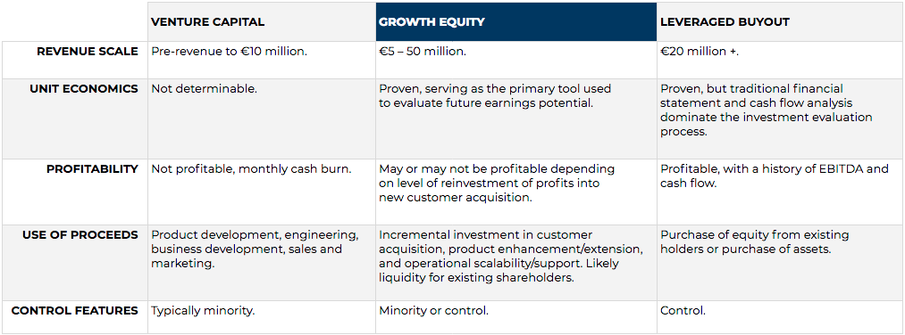

Slide 30
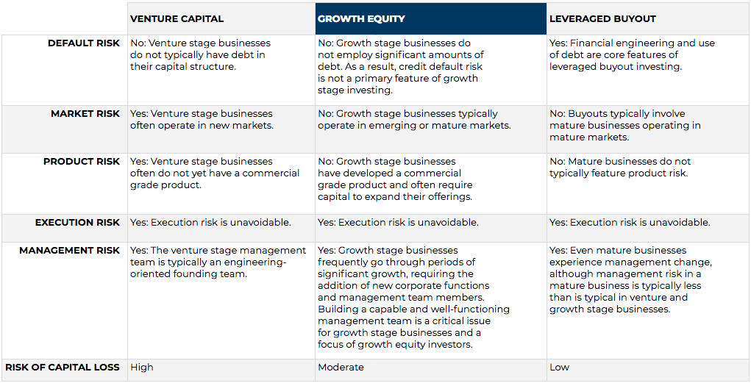

Slide 31
Mezzanine capital
Mezzanine finance is fundamentally the bridge between equity and debt. While its structure and form are more inclined towards debt, it replicates equity in terms of performance and growth.
Mezzanine finance sits between ownership funds and senior debt on the balance sheet. It is available on rates as high as 19% to 20% per annum while a conventional bank may only charge around 4%.
However, borrowers find relief in the fact the stipulations governing the lending terms of a mezzanine finance are not very stringent. Moreover, it also does not lead to charge creation on the assets of the borrower.

Slide 32
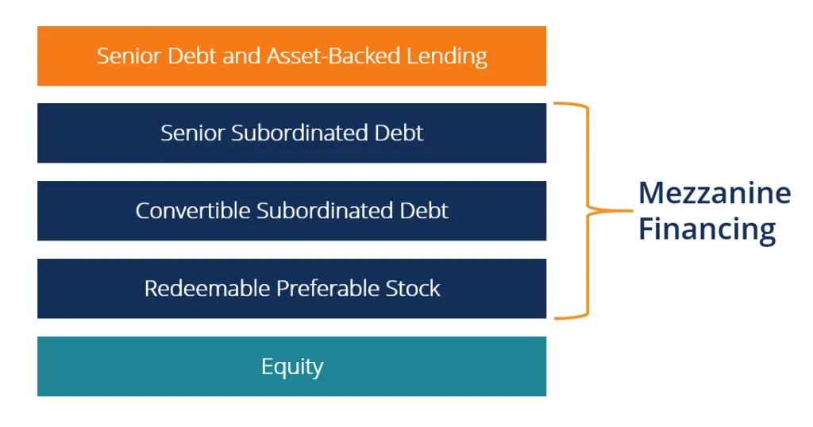

Slide 33
Mezzanine capital
When companies have maximized their senior debt borrowing capacity or seek to preserve future senior debt capacity and need additional capital to pursue growth opportunities (acquisitions, large capital programs, etc.), or for shareholder activity (distributions, shareholder buyout, etc.) they are typically left with two options: raise outside equity or utilize mezzanine financing.
Mezzanine financing can be viewed as either expensive (higher coupon) debt or cheap (less dilutive) equity, as mezzanine carries a higher interest rate than the senior debt that companies would obtain through their banks (reflecting greater risk than senior debt), but is substantially less expensive than equity in terms of overall cost of capital. More specifically, mezzanine financing is less dilutive than raising additional equity to satisfy a capital need, and ultimately allows existing owners to maintain control. Mezzanine is patient capital that enables companies to pursue opportunities from a long-term strategic approach, which may not have seemed feasible otherwise.

Slide 34
Mezzanine capital
Mezzanine financing is usually unsecured and subordinated to a company’s senior debt (both structurally in terms of its right of repayment, and time subordinated with a longer dated maturity and no scheduled principal amortization prior to maturity, which leads most senior lenders to consider mezzanine financing as “equity-like,” patient capital sitting behind their facilities.
In the event a company is facing liquidity constraints, the senior lender can pause (or “block”) current interest payments on mezzanine debt. These features typically provide a company’s banks or senior lenders with comfort in their senior position, and, as a result, mezzanine financing is often preferred by first lien senior lenders relative to second lien loans or other debt alternatives.

Slide 35
Mezzanine capital
It is common for a private equity firm to provide capital in exchange for majority or complete ownership of a company in situations where mezzanine can be used instead, such as an acquisition or ownership transition. Rather than giving up control of the business, companies can turn to a mezzanine-supported recapitalization, or “minority recapitalization,” as an attractive alternative.
Mezzanine financing is ultimately a way for companies to grow faster than they could otherwise on a senior basis alone and also execute an ownership or management transition in a way that allows existing stakeholders to increase their ownership interest

Slide 36
Advantages of Mezzanine Finance
To Borrower
Ease of Obtaining & Flexibility
Mezzanine finance is much easier to borrow than conventional loans. The mezzanine investors are often Venture Capitalists or Equity investors who share the entrepreneurial spirit of the borrower and are thus willing to take on some risk. Though very expensive, mezzanine finance can be sanctioned for 3x to 4x times to what a bank would do.
Another and most important benefit of a mezzanine investor on board is retention of ownership. Since the lender is charging hefty amounts of interest, he settles for little to no share in equity. This enables the management to function independently without any interference in strategic decision making.

Slide 37
Advantages of Mezzanine Finance
Value Creation
Having a mezzanine investor on board is perceived as a positive signal by the shareholders. It validates and reinforces their conviction for the prospects of the company. Having a mezzanine investor is ideal for companies who are past their startup or inception phase and are now operating with steady cash flows. Companies in growth phase are more comfortable paying more (in terms of interest) for a new and potential project rather than diluting equity. Thus, the investor sense forthcoming projects or expansion plans in the pipeline with the onset of mezzanine finance. This consequently increases the share value.
Value is also created in terms of savings on operations. The interest rates, however high, are tax deductible and therefore save the company a considerable outflow of valuable cash

Slide 38
Advantages of Mezzanine Finance
To Lender
Warrants
Mezzanine Finance is often structured to incorporate “kicks” for the lenders. Such kicks are nothing but warrants or convertible equity options the lenders can exercise and acquire a stake in the company. The options are exercisable at a specified date or in the event of a specific event occurring, subject to the agreement between the two parties. Such options compensate for the high risk taken on by the lenders. They can obtain a piece of the pie by converting their debt component into equity in case the company walks into windfall success

Slide 39
Advantages of Mezzanine Finance
Lucrative & Safe Investment
Mezzanine finance makes available the best of both worlds to the lender. He enjoys the benefits of an equity investment in form of high returns and a dynamic portfolio. In the case of a successful launch by the borrowing company, the lender can exercise equity option and partake in the enormous profits.
On the other hand, the lender’s uncertainty component is also capped in the form of fixed interest rate payments. Even in the worst scenario, the lender receives at least, the interest. The interest earned by a mezzanine lender outperforms that earned by a conventional lender by a substantial amount. It is, therefore, a win-win situation for the lender.

Slide 40
Disadvantages of Mezzanine Finance
For Borrower
Backfire
As discussed, mezzanine finance is available rather easily but at very high rates of interest. This pro can quickly turn to a con in case the project does not take off. In such a scenario, not only will the borrower have to deal with the mess of a failed project but also be ready to pay off the incredibly expensive loan it had taken up in anticipation of success. Therefore, it will be a double whammy for the borrower leaving the borrower to fight an uphill battle.

Slide 41
Disadvantages of Mezzanine Finance
Covenants
The loans are unsecured and subject to high risk. The lenders therefore often impose restrictive covenants to protect themselves. Some of them include equity warrants, restriction from borrowing additional debt and in some cases interference in management. The borrower jeopardizes ownership and independence by taking on mezzanine finance. Since there is always a chance of conversion to equity. Also, the value of the company may suffer greatly upon exercise of options. It leads to a dilution of EPS and generates negative sentiment among the shareholders.

Slide 42
Disadvantages of Mezzanine Finance
For Lender
Long Gestation
Mezzanine finance is typically sought by companies in their growth or expansionary phase. The nature of investment is such that it cannot expect to generate returns immediately. Such projects have an incubation period and take a considerable time to finally start generating returns. Because of this, the mezzanine finance is not for investors wanting to make a quick kill or reap speedy profits. The lenders must have an appetite to stash away a sum and not expect anything a for a while. This is also the reason why several mezzanine finance agreements stipulate the commencement of interests after a period and not immediately.

Slide 43
Disadvantages of Mezzanine Finance
High Risk
As if often the case, higher the upside equally deeper is the downside. So is the case of Mezzanine loans. Mezzanine finance is granted without any collateral and often the investment is made in high yielding but risky projects. The lender is always exposed to the odds of the venture tanking and losing his money. No extent of high interest may protect him from such an event. In case of a disastrous launch by the borrower, the company may go bankrupt. The lender shall then have to lose both the principal and debt.

Slide 44
Distressed Buyout
In a typical distressed buyout, a private equity firm purchases a financially distressed company below market value with the intention of divesting the company in the future for a higher value.
The two main causes of distress for a company include
excessive financial leverage and
operational volatility, such as a cyclical business.

Slide 45
Distressed Buyout
Prior to executing a distressed buyout opportunity, a distressed buyout firm has to make judgments about the target company’s value, the survivability, the legal and restructuring issues that may arise (should the company’s distressed assets need to be restructured), and whether or not the creditors of the target company will become equity holders.
If the creditors are likely to become equity holders, they will acquire many rights as full or partial owners of the business, and this can lead to very important issues regarding control of the business

Slide 46
Distressed Buyout
In distressed private equity, firms invest in troubled companies’ Debt or Equity to take control of the companies during bankruptcy or restructuring processes, turn the companies around, and eventually sell them or take them public.
Distressed PE firms raise capital from Limited Partners, keep it locked up for long periods, and use it to buy assets or companies

Slide 47
Distressed Buyout Strategies
Distressed firms and groups might use any of the following five strategies to invest
Distressed Debt Trading – This one is similar to what many distressed hedge funds and credit funds do: buy Debt that trades at a considerable discount to par value, such as 30%+, and sell it once the price rises (or, do the opposite and bet against the Debt with a credit default swap).
Distressed Debt Non-Control – In this one, firms still look for Debt trading at huge discounts, but they buy the Debt to gain influence in the restructuring or bankruptcy process. They’re betting that they can negotiate the terms in their favor such that the market value of the Debt rises significantly.

Slide 48
Distressed Buyout Strategies
Distressed Debt Control – Here, the PE firm buys the “fulcrum security” that will end up being converted into Equity and having a controlling stake in the company post-restructuring. The firm then operates the company, makes improvements, and sells it or takes it public.
Turnaround – With this one, the PE firm acquires Equity in the company rather than Debt, usually before a bankruptcy process begins, and then attempts to restructure the company and get it out of distress.
Special Situations – This is a broad strategy that could include any of the ones above (bankruptcy itself is a “special situation”), but which could also refer to investments in spin-offs, asset sales, recapitalizations, acquisitions, or capital raises.

Slide 49
Distressed Buyout Strategies
In practice, most distressed PE firms and groups look for “good companies with poor Balance Sheets.”
If the company’s entire industry is declining, it will be exceptionally difficult to make that company viable in only a few years.
And if the company is fundamentally flawed because it sells products/services no one wants, it’s also hard to fix in a short time frame.
But if the company is in a decent industry and sells products/services that people are buying, but has made a mistake with a lawsuit, a Debt issuance, or an acquisition integration, those problems are more “fixable.”

Slide 50
Other strategies
Special situations
"Special Situations" or "Turnaround" strategies where an investor will provide debt and equity investments, often "rescue financing" to companies undergoing operational or financial challenges
Secondaries
Secondary investments refer to investments made in existing private-equity assets. These transactions can involve the sale of private-equity fund interests or portfolios of direct investments in privately held companies through the purchase of these investments from existing institutional investors.

Slide 51
Other strategies
Secondary investments provide institutional investors with the ability to improve diversification particularly for investors that are new to the asset class. Secondaries also typically experience a different cash flow profile, diminishing the j-curve effect of investing in new private-equity funds
Often investments in secondaries are made through third-party fund vehicle, structured similar to a fund of funds although many large institutional investors have purchased private-equity fund interests through secondary transactions

Slide 52
Due Diligence (DD)
Due diligence is an investigation, audit, or review performed to confirm facts or details of a matter under consideration.
In the financial world, due diligence requires an examination of financial records before entering into a proposed transaction with another party
Due diligence is a systematic way to analyze and mitigate risk from a business or investment decision.
An individual investor can conduct due diligence on any stock using readily available public information.
The same due diligence strategy will work on many other types of investments.

Slide 53
Due Diligence
Due diligence involves examining a company's numbers, comparing the numbers over time, and benchmarking them against competitors.
Due diligence is applied in many other contexts, for example, conducting a background check on a potential employee or reading product reviews.
Types of Due Diligence
Due diligence is performed by equity research analysts, fund managers, broker-dealers, individual investors, and companies that are considering acquiring other companies. Due diligence by individual investors is voluntary. However, broker-dealers are legally obligated to conduct due diligence on a security before selling it.

Slide 54
Importance of Due diligence
Due diligence is a part of the care expected of fund managers to ensure that they base their investment decision on accurate information.
It helps address the concern that the quality of disclosure in a privately owned enterprise might be of relatively poorer quality, influenced as it is by tax and other extraneous considerations.
By contrast, publicly listed enterprises are expected to deliver better information, thanks to the disclosure standards mandated by the Securities and Exchange Board of India, the capital market regulator.

Slide 55
Challenges of Due diligence
The reasons many due diligence reports do not uncover the inaccuracies in the accounting disclosures are numerous and complex.
First and foremost, the staff in many accounting and audit firm is highly overworked, thanks to the profitability compulsions of their employers. This can often lead to an inadequate scrutiny of the books during due diligence, although the accountants charge fees that will make a Supreme Court lawyer feel jealous.
Second, the high level of concentration in the accounting and audit industry makes conflicts of interest almost inevitable.

Slide 56
Challenges of Due diligence
Thirdly, often the distinction between creative accounting and fraud is blurred in India. For example, real expenses are concealed or imaginary revenue is accounted for on the basis of fictitious sales documents. No amount of auditing skills can unearth such wrong accounting.
Lastly, and perhaps most importantly, the investment industry is also to blame. Fund managers court an entrepreneur even after the latter is found to have a dodgy reputation. In their anxiety to put money to work, fund managers imagine that due diligence by an international audit firm, followed by a bulky contract choking with representations and warranties, will make a mendacious owner-manager change his spots.

Slide 57
Sample due diligence questions
Commercial due diligence includes understanding the company’s value proposition, market position, historical performance, and industry trends in order to assess the target’s ability to achieve its forecasted projections.
Sample due diligence questions include:
Competitive Landscape and Market Position: It is important to understand how sustainable the target’s business model is and where it is positioned relative to its competitors.
What is your competitive advantage (e.g. product offering, technology, price, premium brand, distribution capabilities, geographic presence, fully-integrated solution, etc.)? Is this a disruptive business model (i.e., one that changes the landscape of how business is done in this space in some way)?

Slide 58
Sample due diligence questions
What are the barriers to entry into the business? What are the costs of switching to a competitor’s product?
Where does the company fit in the industry value chain? How has the industry changed over the last 5 years? How do you expect that to change over the next 5 years?
Who are your main competitors? From whom have you been gaining/losing market share? What firm is the biggest threat to your company? What is the biggest share gain opportunity?
What is the market landscape (e.g. oligopoly, fragmented market, first-mover, etc.)? How saturated is the market

Slide 59
Sample due diligence questions
Industry Growth/Addressable Market: When evaluating the industry, it is crucial to understand the market environment and the external factors affecting the business.
What is the historical growth of the market? What is the projected growth of the market over the next 5 years? How mature is the industry?
What is the total addressable market? What segments of the industry are growing faster than others?
Describe the key macroeconomic drivers of the business. What are the trends?
Have there been any significant changes to the industry landscape (e.g. disruptive new entrants, consolidation, vertical/horizontal integration, demand/supply imbalance, etc.)?
What are the regulatory concerns and how can it adversely affect the business?

Slide 60
Sample due diligence questions
Customer Base/Suppliers: This entails understanding the “stickiness” of customers and the company’s reliance on suppliers.
How many customers do you have? What is the concentration of your top 50 customers?
What is the typical contract length of a customer relationship? What is a typical renewal rate? What percentage of customers have multiple products?
Who are the key decision makers for the customers? What are the buying dynamics? How long is the entire sales process?

Slide 61
Sample due diligence questions
Please describe your most recent customer wins and losses. What were the main reasons?
How many suppliers do you have? What is the concentration of your top suppliers? How large of a customer are you to them? What is the average length of the relationship? How often are your supply contracts renegotiated?
If you receive price increases from your suppliers, are you able to pass it through to your customers?

Slide 62
Sample due diligence questions
Capital Requirements of the Business: A good understanding of the total capital needed to run the operations of a business is needed, especially during difficult times.
How capital intensive is the business? What percentage of capital expenditures is growth capital vs. replacement/maintenance capital? How has that trended over the last 5 years? What kind of lead-time is needed (i.e. time from purchase order to delivery) when making a purchase order? How large of a deposit is customary for new purchases?
How cyclical is the business? Are there any severe seasonal changes in demand? What are the factors? How much visibility do you have in expected sales?

Slide 63
Sample due diligence questions
What percentage of the cost structure is fixed vs. variable? What is the breakdown of operating expenses?
What is the normal working level of cash to run the business for a year?
At what manufacturing capacity is the company running right now? How quickly and to what extent can it be reduced if demand falls?
What would be your biggest concern in a downside scenario?

Slide 64
Sample due diligence questions
Financial Performance (Historical & Projected): This analysis provides a deeper look into the company’s historical performance in order to understand how realistic the company’s forecasted projections are.
Provide a comparison of the historical performance to the management budgets for the last 5 years. Describe the methodology behind the budget and the reasons for beating/missing the budget.
What are the key performance indicators (KPIs) the management uses to monitor the business? Describe the trends in these indicators.
Break out your organic growth over the last 5 years (not including the impact from acquisitions).

Slide 65
Sample due diligence questions
Provide your 5-year financial model and describe the key drivers in your projections.
Growth: Please describe key assumptions. How does it compare to expected market growth? Where will it come from (increase in price, increase in volume, increase in market share, new products, acquisitions, etc.)?
Margins: Please describe key assumptions. Why (for example) do you expect margins to increase so significantly compared to historical performance? Where will it come from (operating leverage, cost efficiencies, higher margins on products, revenue/cost mix, etc.)?

Slide 66
Sample due diligence questions
KPIs: Describe key assumptions. How do they compare to the industry average and/or your main competitors?
What are the primary risks to this forecast (new product introduction, successful expansion into new geography, customer concentration, sufficient hiring of employees, R&D resources, etc.)?

Slide 67
Financial due diligence
Financial due diligence confirms that all the financial information provided is accurate and helps PE firms understand some of the unique dynamics of the company from a financial reporting perspective. The firms typically hire accountants and/or auditors to review the financials, operations, customers, markets, and tax issues in detail. This is usually referred to as “transaction advisory services.”
The main areas of financial due diligence include:
Quality of earnings:
Debt and debt-like items:.
Normal working level of capital:
Tax structure:

Slide 68
Legal due diligence
Legal due diligence is mainly confirmatory. It is focused on confirming that the target company is not subject to any future liabilities including regulatory issues, threatened or ongoing lawsuits, and unusual or onerous contract provisions.
Corporate filings:
Material contracts: .
Property, plant and equipment: .
Human resources: .
Health and welfare plans: Information technology: .
Lawsuits/litigation/patents: Environmental:

Slide 69
Other areas for due diligence
Information technology: IT issues can cause a significant block in a smooth transition if the systems are not reviewed correctly and comprehensively. The smooth process of IT systems is crucial to conducting accurate reviews of tax liabilities and accounting as well as maintaining historical financial records.
Human resources: HR plays an important role in due diligence because it affects payroll and that in turn affects the taxes for which the company is responsible. State filing requirements and income regulations are based partly on the location of the payroll.

Slide 70
Due diligence checklist
A. Companies goodwill
B. Financial Information
C.Customer Information

Slide 71
Emerging Market Due Diligence
Top-Down or Bottom-Up? •
Most PE’s build portfolio bottom-up, not top-down •
For each country questions asked like:
• Is there enough deal flow for a country-dedicated fund?
• What is the most relevant skill set for PE in this market?
• Can we find a GP with the right skill set to capitalize on the opportunity? If we get positive answers to these questions, we invest.

Slide 72
Emerging Market Due Diligence
Comparison with Developed Market Diligence
• Points of Difference in EM Diligence –
Deal Flow –
What are the drivers of returns? –
Matching the GP skill set to the drivers of returns –
How local is the GP?
- Reputation – Politically Connected Persons - Environmental & Social Sustainability - Legal Environment - Exits

Slide 73
Due Diligence in Emerging Market
It is Important to Understand How the Returns will be Made:
There are four basic drivers of return in PE:
• Leverage
• Valuation Multiple Expansion
• Revenue Growth
• Improved Efficiency
Implementing each of these strategies requires a different skill set in the GP. To invest in EM PE successfully you need to understand the strategies which are possible in the Market and ensure the GPs you back have the skills to implement those strategies.

Slide 74
Investing in developing Market
As the opportunity in emerging market private equity has expanded since 2000 the risks and the differences with private equity in developed markets have declined somewhat.
However, differences are still present and it is worth investors while to understand what the differences are and how they might shape an approach to investment in emerging market private equity.
The differences affect both the scale of the opportunity and the risk

Slide 75
Investing in developing Market
Of those differences affecting risk, some can be mitigated considerably. Overall, it can be stated that
(i) the risks in emerging market private equity have, in the last decade, typically been over-stated by investors;
(ii) the emphasis on growth and efficiency improvement as the source of return on equity in most emerging markets results in a private equity model that is less exposed to cyclical or macro shocks than the developed market private equity model that is more dependent on leverage and also possibly on multiple expansion; and
(iii) for investors not restricted by a large minimum commitment size, there is a broad diversification opportunity of which few investors are taking advantage.

Slide 76
Past Performance & Strategy
Private Equity (PE) and Venture Capital (VC) investments in India have usually followed global trends, both in terms of volume and the general spread of such investments across broad industry sectors. 2018-19 and 2019-20 saw some record PE/VC activity around the world, and India was amongst the most preferred destinations for the investors. Similarly, the projected fall in the deal activity for 2020-21 in India from the highs of the past two years also mirrors global cues such as the first general slowdown in the global economy since 2012; the changing dynamics in Europe as the completion of the UK's withdrawal from the EU (Brexit) begins to unravel its implications; and lastly and most importantly – the global economic disruptions due to the COVID-19 outbreak

Slide 77
Past Performance & Strategy
However, ever since the general elections in 2019 resulted in one of the most decisive mandates given to a government in the past 30 years, India may be well poised to handle these challenges in the coming years better than some other countries like USA which are at a crossroads of political and social change.
A combination of all the above factors is bound to bring down the overall PE/VC activity in India. However, there is a growing sentiment that as the world economy slowly bounces back in the coming months, there will be a radically different business landscape that would survive these economic disruptions. This would throw up new and unique challenges for corporates and can lead to immense value to be made from such opportunities.

Slide 78
Past Performance & Strategy
Trends in 2020 and beyond
The trends from the first six months of 2020 have shown that PE/VC funds are not shy of investing money even in these uncertain times. However, instead of betting more on new companies or large-scale buyout deals, their focus has been on portfolio management and structured deals – even doubling down in many instances and assisting their investee companies in navigating through these challenges through debt financings.
This trend is expected to continue throughout this year and into the first half of 2021 as well, where funds favour multi-series rounds to established companies over single large fundings to early stage companies. All the companies based on defiance of unit economics and respect for GMV multiples may also see major consolidation, especially new tech and online businesses still facing cashburns.

Slide 79
Past Performance & Strategy
However, fundraising has been quite interesting. While it has slowed down from the highs of 2018-19, PE and VC fundraising in India can be expected to be buoyant and market players remain bullish on the Indian market and its potential. Established players in the Indian market have built up their war chests in anticipation of the economy rebounding soon once the COVID-19 pandemic subsides and more importantly, in view of valuations coming down.
There are several examples - Lightspeed Venture Partners has renewed its fund-raising for its India focussed verticals, Sequoia Capital recently closed its largest ever corpus of USD1.35 billion for Indian spread across multiple funds, Edelweiss has been raising capital and Tiger Capital has made grand re-entry plans.

Slide 80
Past Performance & Strategy
COVID-19: Challenges to PE/VC
Sweeping structural changes introduced by the government over the last few years, such as introduction of Goods and Services Tax, etc, radically impacted the way businesses functioned, and comparatively slowdown the economy in 2019. The final blow to this slowing economy was COVID-19 reaching Indian shores in the first quarter of 2020. The nationwide lockdown that intended to break the chain of virus spread resulted in supply chain disruptions, a credit crunch, labour shortages and lack of industrial output, which combined to result in the worst quarter for Indian economy in over a decade.

Slide 81
Past Performance & Strategy
Several sectors, including tourism, hospitality, aviation and entertainment, have been severely hit with little hope of ever going back to normal. Other sectors, such as manufacturing, oil and natural gas, telecom and power, were also badly hit, but are slowly regaining their footing as the lockdown restrictions are gradually lifted across the country in a phased manner. Then there are sectors such as financial services, consultancy, banking and IT which have fared better comparatively and have quickly regained momentum due to government support. Courts and tribunals have also been remotely functioning at minimum capacity and until recently were only hearing urgent matters.

Slide 82
PE/VC activities in light of COVID-19 disruptions
In view of these disruptions, PE/VC activity is expected to slow down, though new and attractive opportunities await market players. Distressed deals, special situations financing, stake sales, short term debt, equity infusions through rights issue are some of the funding opportunities that we expect to gain momentum. Traditional PE/VC deals can be expected to be mixed with structured debt, use of leverage and convertible instruments, etc. There will also be attractive valuation opportunities as companies take a hit on productivity and output due to the pandemic.

Slide 83
PE/VC activities in light of COVID-19 disruptions
However, this also means that the existing investments need to be reassessed from a short-term and long-term profitability perspective. Further, price corrections in stock markets make private investment in public equity (PIPE) an attractive opportunity for market players. PIPE deals are expected to pick up in the coming year and form a greater chunk of the overall PE activity compared to 2018 and 2019, respectively.
A major challenge in the near term for PE/VC funds would be planning their exits and cashing in on their returns, especially for exits through initial public offerings (IPOs) on stock exchanges. Several established companies have pushed their IPOs in 2020-21 by at least 12 to 18 months as they wait for stock market volatility to ease out. Given these factors, exit options for both existing and prospective investments need to be re-assessed by PE/VC funds

Slide 84
Future of Private Equity and Venture Capital in India
As the world tries to overcome these extraordinary times, all signs point towards a radically different environment in the near future. The COVID-19 pandemic has forced humans and businesses to rethink their previous habits and evolve their processes in order to survive in the coming times. Private equity and venture capital have traditionally been oriented towards disruption – finding the next big thing, the next unicorn, the next idea that can change the world.
While, in these times, it is becoming increasingly more difficult to understand or predict the future, PE/VC funds will also have to realign themselves to their changing times. New business models will emerge out of this crisis while existing businesses will have to either adapt or perish. Fund managers are not expected to be sitting idle, in fact their tasks may end up becoming more challenging with deals going through a faster pace than before (especially as quality assets at right valuations are still far and few).

Slide 85
Future of Private Equity and Venture Capital in India
There is enough room for growth in India – which has long been positioned as a place where the next billion customers will come from.
The regulatory environment is geared towards supporting foreign capital, and with a stable government that is more than eager to nurture investments, India is poised to emerge out of this crisis as a preferred destination for private equity and venture capital in the coming times.

