Slide 1
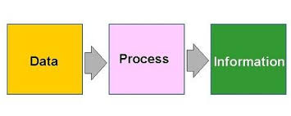
Research Methodology
Unit 3: Data analysis & Interpretation

Slide 2
Unit-3.Data Analysis and Interpretation
Contents to be covered
Processing of Data– Meaning & Essentials of i) Editing ii) Coding iii) Tabulation
Analysis of Data-Meaning, Purpose, Types.
Interpretation of Data-Essentials, Importance, Significance and Descriptive Analysis
Testing of hypothesis– One Sample T- Test, ANOVA, F- test, Chi Square and Paired Sample Test

Slide 3
Data processing
Data processing is, generally, “the collection and manipulation of items of data to produce meaningful information”
Data processing occurs when data is collected and translated into usable information. Usually performed by a data scientist or team of data scientists, it is important for data processing to be done correctly as not to negatively affect the end product, or data output.
Data processing starts with data in its raw form and converts it into a more readable format (graphs, documents, etc.), giving it the form and context necessary to be interpreted by computers and utilized by employees throughout an organization

Slide 4
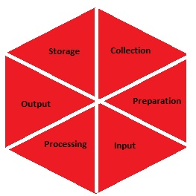

Slide 5
Data processing cycle-Features/Stages
Six stages of data processing
1. Data collection
Collecting data is the first step in data processing. Data is pulled from available sources, including data lakes and data warehouses. It is important that the data sources available are trustworthy and well-built so the data collected (and later used as information) is of the highest possible quality.

Slide 6
Data processing cycle
2. Data preparation
Once the data is collected, it then enters the data preparation stage. Data preparation, often referred to as “pre-processing” is the stage at which raw data is cleaned up and organized for the following stage of data processing. During preparation, raw data is diligently checked for any errors. The purpose of this step is to eliminate bad data (redundant, incomplete, or incorrect data) and begin to create high-quality data for the best business intelligence.

Slide 7
Data processing cycle
3. Data input
The clean data is then entered into its destination (perhaps a CRM like Salesforce or a data warehouse like Redshift), and translated into a language that it can understand. Data input is the first stage in which raw data begins to take the form of usable information.

Slide 8
Data processing cycle
4. Processing
During this stage, the data inputted to the computer in the previous stage is actually processed for interpretation. Processing is done using machine learning algorithms, though the process itself may vary slightly depending on the source of data being processed (data lakes, social networks, connected devices etc.) and its intended use (examining advertising patterns, medical diagnosis from connected devices, determining customer needs, etc.).

Slide 9
Data processing cycle
5. Data output/interpretation
The output/interpretation stage is the stage at which data is finally usable to non-data scientists. It is translated, readable, and often in the form of graphs, videos, images, plain text, etc.). Members of the company or institution can now begin to self-serve the data for their own data analytics projects

Slide 10
Data processing cycle
6. Data storage
The final stage of data processing is storage. After all of the data is processed, it is then stored for future use. While some information may be put to use immediately, much of it will serve a purpose later on. Plus, properly stored data is a necessity for compliance with data protection legislation. When data is properly stored, it can be quickly and easily accessed by members of the organization when needed.

Slide 11
Essentials of processing data
Reliability & Validity
Stability
Completeness
Accuracy
Uniformity

Slide 12
Essentials of processing data
Flexibility
Realistic
Acceptance
Use of resources
Consistency

Slide 13
Processing of data--editing, coding, classification and tabulation
After collecting data, the method of converting raw data into meaningful statement; includes data processing, data analysis, and data interpretation and presentation.
Data reduction or processing mainly involves various manipulations necessary for preparing the data for analysis.
The process (of manipulation) could be manual or electronic.
It involves editing, categorizing the open-ended questions, coding, computerization and preparation of tables and diagrams.

Slide 14
Editing Of Data
Editing is the process of eliminating errors in the raw data collected so that the data may subsequently undergo tabulation and classification.
Data editing is possible at two levels
Micro-editing i.e. editing of data at record level
Macro-editing i.e. editing of data for removing errors in data collected.

Slide 15
Need or significance of data editing
To Check accuracy of data
To bring consistency in the information collected through interviews of respondents
To remove errors
To improve quality of data
To evaluate the performance of field staff
To take uniform decisions on incorrect answers.

Slide 16
Procedure/Process of editing data
Five type of answers are usually dealt with.
1.The incorrect answer
2.The incomplete answer
3.The inconsistent answer
4. The ‘Don’t know’ answer or ‘No reply’ answer
5.The answer not available in the standard format.

Slide 17
Editing Methods
Interactive editing
The term interactive editing is commonly used for modern computer-assisted manual editing. Most interactive data editing tools applied at National Statistical Institutes (NSIs) allow one to check the specified edits during or after data entry, and if necessary to correct erroneous data immediately. Several approaches can be followed to correct erroneous data:
Re contact the respondent
Compare the respondent's data to his data from previous year
Compare the respondent's data to data from similar respondents
Use the subject matter knowledge of the human editor
Interactive editing is a standard way to edit data.

Slide 18
Editing Methods
Selective editing
Selective editing is an umbrella term for several methods to identify the influential errors, and outliers. Selective editing techniques aim to apply interactive editing to a well-chosen subset of the records, such that the limited time and resources available for interactive editing are allocated to those records where it has the most effect on the quality of the final estimates of publication figures. In selective editing, data is split into two streams:
The critical stream
The non-critical stream
The critical stream consists of records that are more likely to contain influential errors. These critical records are edited in a traditional interactive manner. The records in the non-critical stream which are unlikely to contain influential errors are not edited in a computer assisted manner.

Slide 19
Editing Methods
Macro editing There are two methods of macro editing:
Aggregation method
This method is followed in almost every statistical agency before publication: verifying whether figures to be published seem plausible. This is accomplished by comparing quantities in publication tables with same quantities in previous publications.
Distribution method
Data available is used to characterize the distribution of the variables.Then all individual values are compared with the distribution. Records containing values that could be considered uncommon (given the distribution) are candidates for further inspection and possibly for editing.
Automatic editing
In automatic editing records are edited by a computer without human intervention^{[7]}. Prior knowledge on the values of a single variable or a combination of variables can be formulated as a set of edit rules which specify or constrain the admissible values

Slide 20
Essentials of good data editing
Quick & Accurate
Economical
Flexible
Avoid bias
Uniformity
Consistency
Completeness
Reliability

Slide 21
Coding of Data
Coding is the procedure of classifying the answers to a question into meaningful categories.
It helps in arranging or grouping of varies responses into manageable categories for the purpose of classification, tabulation and analysis of data.
Numeric coding simplifies the researcher’s task in converting a nominal variable like gender to a 1 or 2.

Slide 22
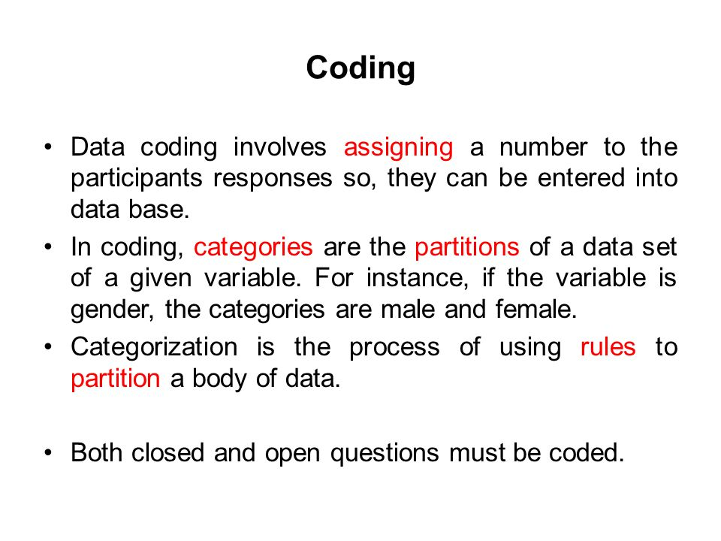

Slide 23
Types of Code
Numerical Codes
Alphabetical Codes
Alpha- Numerical Code
A Code is a number/symbol which stands for each type of reply.Coding means assigning a number, symbol or other mark to every answer.
Coding can be done along with editing or it may be done after editing.

Slide 24
Essentials of Good Coding
Should cover all type of answers given by the respondents
Coding categories should not overlap
A code sheet containing the code numbers should be prepared for a quick reference
Work should be done by a responsible person to avoid mistakes
Appropriate use of numbers, alphabets, symbols must be used.

Slide 25
Tabulation Of Data
Tabulation is a technique or process of summarising and arranging the data in a compact form for further analysis
It is sorting and counting of data and allocating the same to relevant classification of categories.
Arrangement of data is done in rows & columns

Slide 26
Need & Importance of Tabulation of Data
Brings orderly arrangement of data
Brings accuracy and speed in arranging the data
Facilitates correct analysis and interpretation of data
Saves time during analysis of data
Needed for drawing diagrams and charts

Slide 27
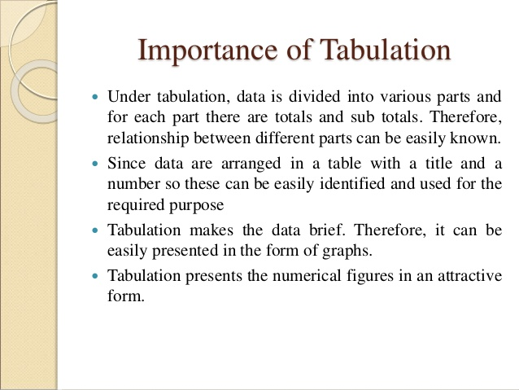

Slide 28
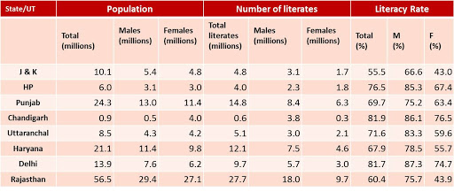

Slide 29
Methods of Tabulation of data
There are two methods
1.Manual/Hand Tabulation:
Counting is done by hand. Very old method. Done with the help of tallybars.
2. Machine/Mechanical/Electronic Tabulation
Now a days computer processing is done as computers handle large number of complex data speedily & accurately

Slide 30
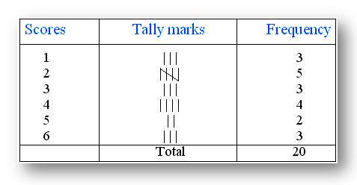

Slide 31
Graphical Presentation Of Data
A picture is said to be more effective than words for describing a particular thing
A graphic representation is the geometrical image of a set of data
It is a mathematical picture
It enables us to think about a statistical problem in visual terms
It is an effective and economic device for the presentation , understanding and interpretation of the collected data

Slide 32
IMPOTANCE OF GRAPHICAL REPRESENTATION
It is used to make the data understandable to common man
It helps in easy and quick understanding of data
Data displayed by graphical representation can be memorised for a long time
Can be compared at a glance.

Slide 33
TYPES OF GRAPHICAL REPRESENTATION
Line graph
line graphs are simple Mathematical graphs that are drawn on the graph paper by plotting the data connecting one variable on the horizontal X- axis and other variable of data on the vertical Y-axis.
Bar graph
In bar graphs data is represented by bars. The bars can be made in any direction i.e. vertical or horizontal

Slide 34
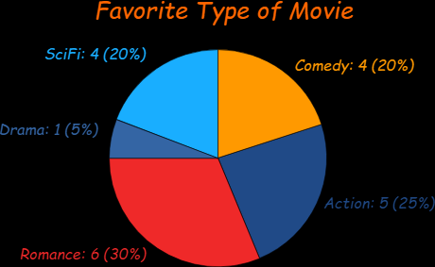
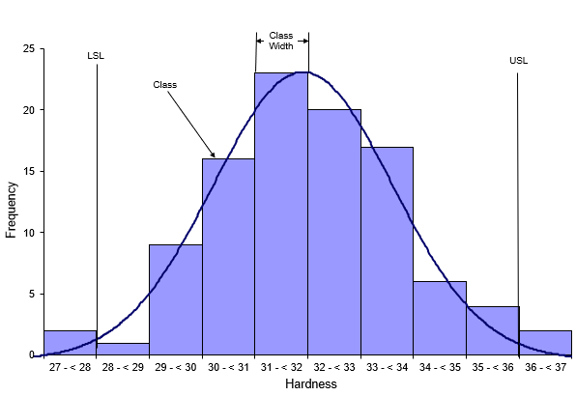
TYPES OF GRAPHICAL REPRESENTATION

Slide 35
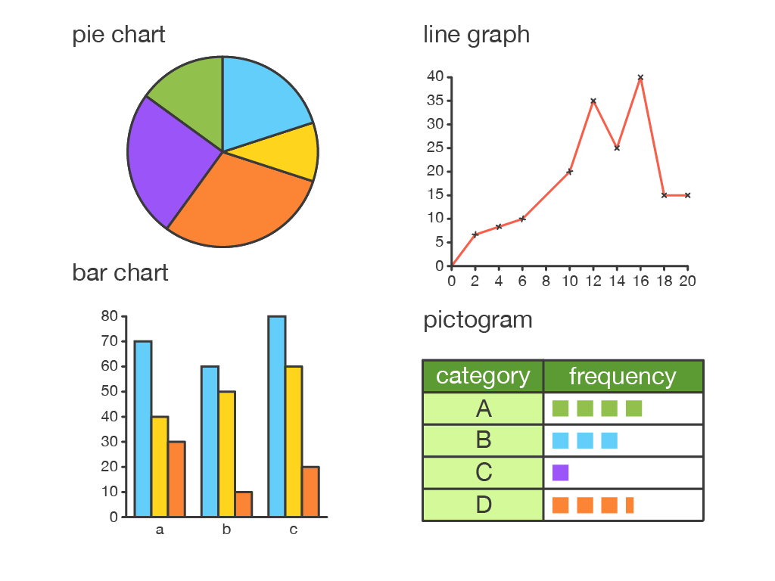

Slide 36
Histogram
A histogram is essentially a bar graph of a frequency distribution.  It can be constructed for equal as well as unequal class intervals
Area of any rectangle of a histogram is proportional to the frequency of that class.
When do we use histogram?
When data are given in the form of frequencies.
When class interval has to be displayed by a diagram.
When we need to calculate the Mode of a distribution graphically.

Slide 37
PIE DIAGRAM
It is a circle in which different components are represented through the sections or portions of a circle.
To draw a pie diagram, first the value of each category is expressed as a percentage of the total and then the angle 360⁰ is divided in the same percentages
When do we use pie diagram?
When the data are given in percentage.
When different aspect of a variable are to be displayed.
When the data are to be compared normally.

Slide 38
Analysis of Data
David J. Luck and Ronald S Rubin
“ the refinement and manipulation of data that prepares them for application of logical inference”
Data analysis is a process of inspecting, cleansing, transforming and modelling data with the goal of discovering useful information, informing conclusions and supporting decision-making

Slide 39
Purpose of Data Analysis
To ensure that necessary information is available to solve a problem
To convert huge data into meaningful form for interpretation
To confirm that date is legitimate
To verify the reliability of measuring instruments
To understand the result from surveys

Slide 40
Purpose of Data Analysis
To provide information on data gaps for designing and redesigning surveys to formulate quality objectives
To perform data quality assessment
To publish or summarise results of data analysis in official releases
To see that the data falls within parameters.

Slide 41
Types of Data Analysis
Text Analysis
Statistical Analysis
Diagnostic Analysis
Predictive Analysis
Prescriptive Analysis

Slide 42
Types of Data Analysis
Text Analysis
Text Analysis is also referred to as Data Mining. It is a method to discover a pattern in large data sets using databases or data mining tools. It used to transform raw data into business information. Business Intelligence tools are present in the market which is used to take strategic business decisions. Overall it offers a way to extract and examine data and deriving patterns and finally interpretation of the data

Slide 43
Types of Data Analysis
Statistical Analysis
Statistical Analysis shows "What happen?" by using past data in the form of dashboards. Statistical Analysis includes collection, Analysis, interpretation, presentation, and modeling of data. It analyses a set of data or a sample of data. There are two categories of this type of Analysis - Descriptive Analysis and Inferential Analysis.

Slide 44
Types of Data Analysis
Descriptive Analysis
analyses complete data or a sample of summarized numerical data. It shows mean and deviation for continuous data whereas percentage and frequency for categorical data.
Inferential Analysis
analyses sample from complete data. In this type of Analysis, you can find different conclusions from the same data by selecting different samples.

Slide 45
Types of Data Analysis
Diagnostic Analysis/Causal Analysis
Diagnostic Analysis shows "Why did it happen?" by finding the cause from the insight found in Statistical Analysis. This Analysis is useful to identify behavior patterns of data. If a new problem arrives in your business process, then you can look into this Analysis to find similar patterns of that problem. And it may have chances to use similar prescriptions for the new problems.

Slide 46
Types of Data Analysis
Predictive Analysis
Predictive Analysis shows "what is likely to happen" by using previous data. The simplest example is like if last year I bought two dresses based on my savings and if this year my salary is increasing double then I can buy four dresses. But of course it's not easy like this because you have to think about other circumstances like chances of prices of clothes is increased this year or maybe instead of dresses you want to buy a new bike, or you need to buy a house!
So here, this Analysis makes predictions about future outcomes based on current or past data. Forecasting is just an estimate. Its accuracy is based on how much detailed information you have and how much you dig in it.

Slide 47
Types of Data Analysis
Prescriptive Analysis
Prescriptive Analysis combines the insight from all previous Analysis to determine which action to take in a current problem or decision. Most data-driven companies are utilizing Prescriptive Analysis because predictive and descriptive Analysis are not enough to improve data performance. Based on current situations and problems, they analyze the data and make decisions

Slide 48
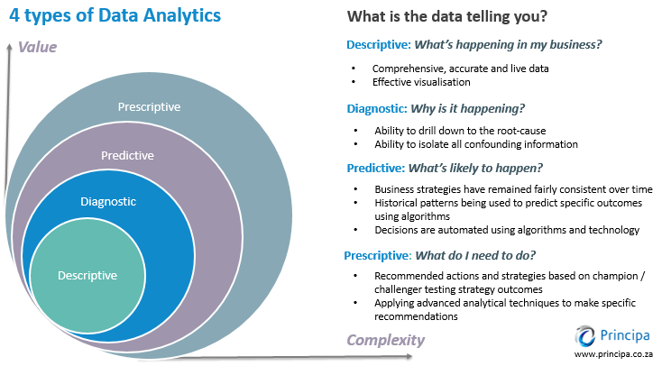

Slide 49
Interpretation of Data
Data interpretation is the process of reviewing data through some predefined processes which will help assign some meaning to the data and arrive at a relevant conclusion.
It involves taking the result of data analysis, making inferences on the relations studied, and using them to conclude.

Slide 50
Essentials of Interpretation of data
Simplicity
Continuous
Complete in all respects
Balance
Flexibility

Slide 51
Essentials of Interpretation of data
Selectivity
Acceptance
Use of resources
Utility of Action
Effective control

Slide 52
Importance/Significance of Interpretation of Data
Condensed data
Part of research process
Logical reasoning
Creative process
Accuracy & Simplicity

Slide 53
Importance/Significance of Interpretation of Data
Decision making
Validate the findings
Predict the future
Use of hypotheses
Findings & recommendations

Slide 54
Descriptive analysis
A descriptive analysis is an important first step for conducting statistical analyses.
It gives an idea of the distribution of the data, helps to detect outliers and typos, and enable you identify associations among variables, thus making you ready to conduct further statistical analyses
Descriptive research has three main purposes:
To Describe, To Explain and To Validate findings.

Slide 55
Descriptive analysis
Descriptive statistics is useful because it allows to take a large amount of data and summarize it.
For example, let’s say you had data on the incomes of one million people. No one is going to want to read a million pieces of data; if they did, they wouldn’t be able to get any useful information from it. On the other hand, if you summarize it, it becomes useful: an average wage, or a median income, is much easier to understand than reams of data

Slide 56
Descriptive analysis
Descriptive statistics are one of the fundamental “must knows” with any set of data. It gives a general idea of trends in the data including:
The mean, mode, median and range.
Variance and standard deviation.
Skewness.
Count, maximum and minimum

Slide 57
Descriptive analysis
Descriptive statistics can be further broken down into several sub-areas, like:
Measures of central tendency.
Measures of Variability or Dispersion
Measures of Diversion from Normality/ Shapes of Distributions
Measures of Probability.

Slide 58
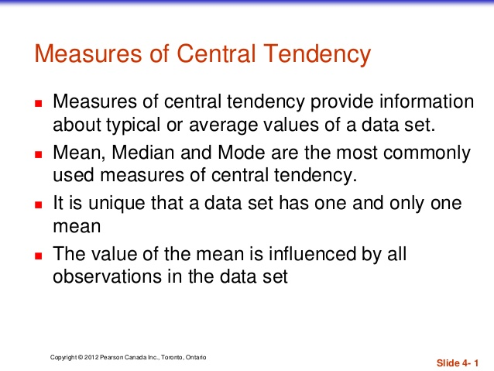

Slide 59
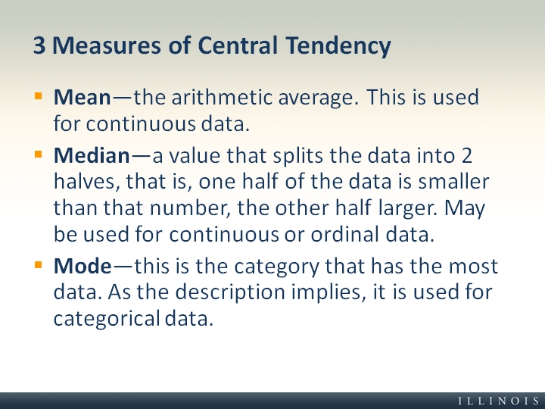

Slide 60
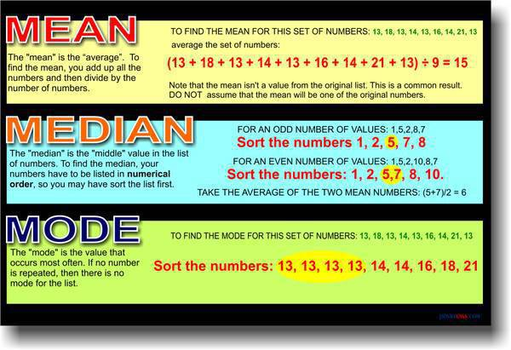

Slide 61
Measures of Central Tendency
Mean: The mean is the sum of the values in the set divided by the number of items in the set. There is basically no difference between the mean, the arithmetic mean, and the average. In statistics, the term 'mean' is used instead of 'average'
For example, what is the mean for 2, 4, and 6?
(2 + 4 + 6)/3 = 12/3
(2 + 4 + 6)/3 = 4

Slide 62
Measures of Central Tendency
Mode: The mode of a set of data is the value or values that occur more often.
For example, the mode of 6, 5, 2, 3, 5, 1, 8 is 5 because 5 appears more often than the other values.
Median: The median of an ordered set of data is the value in the middle.
For example, the median of 4, 6, 8, 10, 12 is 8 since 8 is the value in the middle

Slide 63
Measures of Variability or Dispersion
Variability is the measure of Spread of a data set.
The commonly used measures are range variance and standard variance.
Range is the difference between the largest and smallest measures.
Variability relates to how spread out a group data is i.e. variability measures how much the score differs from each other.
Variability is also called as Dispersion or Spread

Slide 64
Measures of Measures of Diversion from Normality/ Shapes of Distributions
In statistics, normality tests are used to determine whether a data set is modeled for normal distribution. Many statistical functions require that a distribution be normal or nearly normal. There are both graphical and statistical methods for evaluating normality:
Graphical methods include the histogram and normality plot
Statistically, two numerical measures of shape – skewness and excess kurtosis – can be used to test for normality. If skewness is not close to zero, then data set is not normally distributed

Slide 65
Skewness
In statistics, skewness is a measure of the asymmetry of the probability distribution of a random variable about its mean. In other words, skewness tells you the amount and direction of skew (departure from horizontal symmetry). The skewness value can be positive or negative, or even undefined. If skewness is 0, the data are perfectly symmetrical, although it is quite unlikely for real-world data.
Skewness lets you test by how much the overall shape of a distribution deviates from the shape of the normal distribution

Slide 66
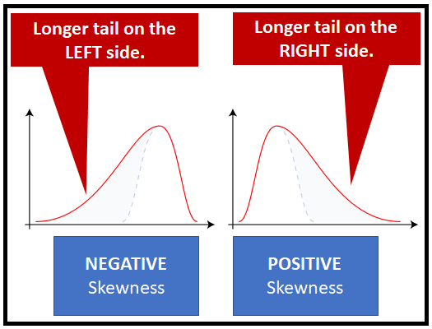

Slide 67
Kurtosis
The term ‘Kurtosis’ refers to ‘peakedness’ or the flatness of a frequency distribution as compared with the normal.The measure of Kurtosis describes the degree of concentration of frequencies in a given distribution.
Kurtosis is a measure of how differently shaped are the tails of a distribution as compared to the tails of the normal distribution. While skewness focuses on the overall shape, Kurtosis focuses on the tail shape

Slide 68
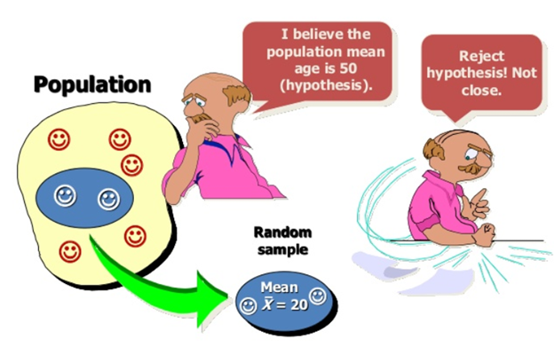

Slide 69
Testing of Hypothesis
A Hypothesis test is a statistical test that is used to determine whether there is enough evidence in a sample of data to infer that a certain condition is true for the entire population.
An assumption about a population parameter or about probability distribution of a random variable regarding population is known as Statistical hypothesis. Simply, the hypothesis is an assumption which is tested to determine the relationship between two data sets.
For example, waiting time for getting into a bus in 15 minutes

Slide 70
Testing of Hypothesis
A hypothesis test examines two opposing hypotheses about a population: the null hypothesis and the alternative hypothesis
Null hypothesis (H0):
The null hypothesis states that a population parameter is equal to a value. The null hypothesis is often an initial claim that researchers specify using previous research or knowledge

Slide 71
Testing of Hypothesis
Alternative Hypothesis (H1):
The alternative hypothesis states that the population parameter is different than the value of the population parameter in the null hypothesis. The alternative hypothesis is what you might believe to be true or hope to prove true.

Slide 72
Testing of Hypothesis
In hypothesis testing, two opposing hypotheses about a population are formed Viz. Null Hypothesis (H₀) and Alternative Hypothesis (H₁). The Null hypothesis is the statement which asserts that there is no difference between the sample statistic and population parameter and is the one which is tested, while the alternative hypothesis is the statement which stands true if the null hypothesis is rejected.

Slide 73
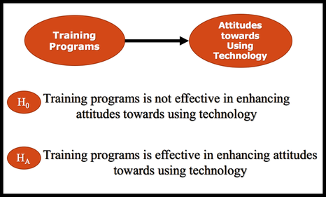
Testing of Hypothesis
The null hypothesis is opposite of alternative hypothesis. If we can prove that the null hypothesis is false , then we can conclude that the research or alternative hypothesis is true.For Example:

Slide 74
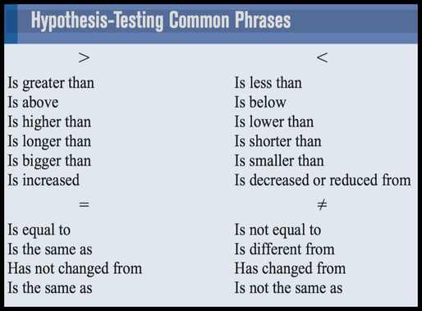

Slide 75
One-Tailed Test & Two-Tailed Test
There are two forms of research hypothesis.
The critical or rejection region can be one side of the distribution or both sides of the distribution depending on the nature of the research hypothesis.
Directional research hypothesis or one tail test has one critical region. On the contrary, the Non-directional research hypothesis or two tail test has two rejection regions on both sides of the distribution.

Slide 76
One-Tailed Hypothesis Tests
One-tailed hypothesis tests are also known as directional and one-sided tests because you can test for effects in only one direction. When you perform a one-tailed test, the entire significance level percentage goes into the extreme end of one tail of the distribution.
A one-tailed test is a statistical test in which the critical area of a distribution is one-sided so that it is either greater than or less than a certain value, but not both
An example can be whether a machine produces more than one-percent defective products. In this situation, if the estimated value exists in one of the one-sided critical areas, depending on the direction of interest (greater than or less than), the alternative hypothesis is accepted over the null hypothesis

Slide 77
Two-tailed test
A test that is conducted to show whether the mean of the sample is significantly greater than and significantly less than the mean of a population is considered a two-tailed test
A two-tailed test is appropriate if the estimated value is greater or less than a certain range of values, for example, whether a test taker may score above or below a specific range of scores

Slide 78
Two-tailed test
Example:
A medical researcher is interested in finding out whether a new medication will have any undesirable side effects. He knows that the mean pulse rate for the population under study is 82 beats per minute. Hence, he tries to find whether the pulse rate will increase, decrease, or remain unchanged after a patient takes the medication?

Slide 79

Two-tailed test
The null hypothesis specifies that the mean will remain unchanged, and the alternative hypothesis states that it will be different. This test is called a two-tailed test , since the possible side effects of the medicine could be to raise or lower the pulse rate

Slide 80
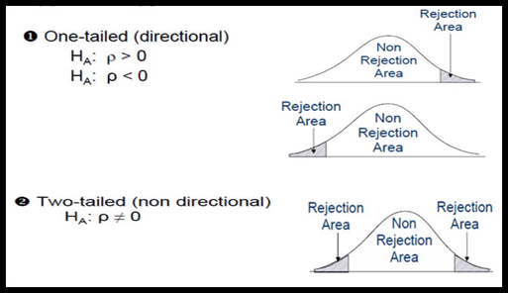

Slide 81
Type 1 Error, Type 2 Error
In every study, there is a chance for error. In other words, there is always the possibility of reaching the wrong conclusion. There are two different errors that we can make, Type 1 error and Type 2 error.
Type 1 Error: We may reject the null hypothesis when it is, in fact, true. This occurs when we think there is a difference between our groups, but there really isn’t. We can minimise this possibility by selecting an appropriate alpha level .

Slide 82
Type 1 Error, Type 2 Error
Type 2 Error: Type 2 error occurs when we fail to reject a null hypothesis when it is, in fact, false (i.e. believing that the groups do not differ, when in fact they do).
Unfortunately, these two errors are inversely related. As we try to control for a Type 1 error, we actually increase the likelihood that we will commit a Type 2 error.

Slide 83
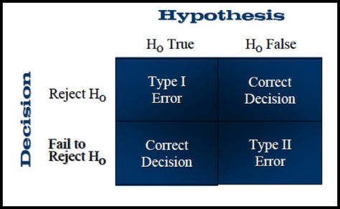

Slide 84
Hypothesis Testing Procedure
Set up a Hypothesis
Set up a suitable Significance Level
Determining a suitable Test Statistic
Determining the Critical Region
Performing computations
Decision-making

Slide 85
Understanding t-Tests: 1-sample, 2-sample, and Paired t-Test
In statistics, t-tests are a type of hypothesis test that allows you to compare means. They are called t-tests because each t-test boils your sample data down to one number, the t-value. If you understand how t-tests calculate t-values, you’re well on your way to understanding how these tests work
Note: The One Sample t Test can only compare a single sample mean to a specified constant. It can not compare sample means between two or more groups. If you wish to compare the means of multiple groups to each other, you will likely want to run an Independent Samples t Test (to compare the means of two groups) or a One-Way ANOVA (to compare the means of two or more groups).

Slide 86
The One Sample t Test
The One Sample t Test determines whether the sample mean is statistically different from a known or hypothesized population mean. The One Sample t Test is a parametric test.
This test is also known as:
Single Sample t Test
The variable used in this test is known as:
Test variable
In a One Sample t Test, the test variable is compared against a "test value", which is a known or hypothesized value of the mean in the population.

Slide 87
Analysis of variance
ANOVA
Analysis of variance (ANOVA) is a collection of statistical models and their associated estimation procedures (such as the "variation" among and between groups) used to analyze the differences among group means in a sample. ANOVA was developed by the statistician Ronald Fisher. The ANOVA is based on the law of total variance, where the observed variance in a particular variable is partitioned into components attributable to different sources of variation. In its simplest form, ANOVA provides a statistical test of whether two or more population means are equal, and therefore generalizes the t-test beyond two means.

Slide 88
Analysis of variance
ANOVA
ANOVA is a form of statistical hypothesis testing heavily used in the analysis of experimental data. A test result (calculated from the null hypothesis and the sample) is called statistically significant if it is deemed unlikely to have occurred by chance, assuming the truth of the null hypothesis. A statistically significant result, when a probability (p-value) is less than a pre-specified threshold (significance level), justifies the rejection of the null hypothesis, but only if the a probability of the null hypothesis is not high.

Slide 89
F-Test
An F-test is any statistical test in which the test statistic has an F-distribution under the null hypothesis.
It is most often used when comparing statistical models that have been fitted to a data set, in order to identify the model that best fits the population from which the data were sampled.
Exact "F-tests" mainly arise when the models have been fitted to the data using least squares. The name was coined by George W. Snedecor, in honour of Sir Ronald A. Fisher. Fisher initially developed the statistic as the variance ratio in the 1920s.

Slide 90
F-Test
Common examples of the use of F-tests include the study of the following cases:
The hypothesis that the means of a given set of normally distributed populations, all having the same standard deviation are equal. This is perhaps the best-known F-test, and plays an important role in the analysis of variance (ANOVA).
The hypothesis that a proposed regression model fits the data well.
The hypothesis that a data set in a regression analysis follows the simpler of two proposed linear models that are nested within each other.
In addition, some statistical procedures, such as Scheffé's method for multiple comparisons adjustment in linear models, also use F-tests.

Slide 91
Chi-Square Test
A chi-squared test, also written as χ² test, is a statistical hypothesis test that is valid to perform when the test statistic is chi-squared distributed under the null hypothesis, specifically Pearson's chi-squared test and variants thereof. Pearson's chi-squared test is used to determine whether there is a statistically significant difference between the expected frequencies and the observed frequencies in one or more categories of a contingency table.
In the standard applications of this test, the observations are classified into mutually exclusive classes. If the null hypothesis that there are no differences between the classes in the population is true, the test statistic computed from the observations follows a χ² frequency distribution. The purpose of the test is to evaluate how likely the observed frequencies would be assuming the null hypothesis is true.

Slide 92
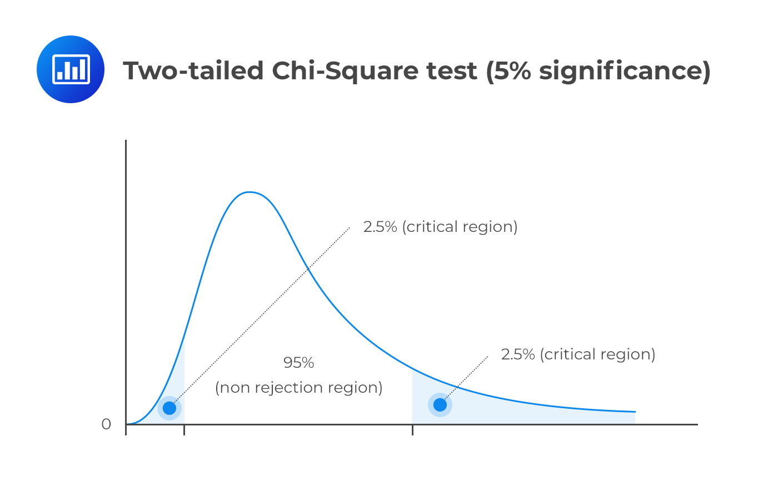

Slide 93
Chi-Square Test
Test statistics that follow a χ² distribution occur when the observations are independent and normally distributed, which assumptions are often justified under the central limit theorem. There are also χ² tests for testing the null hypothesis of independence of a pair of random variables based on observations of the pairs.
Chi-squared tests often refers to tests for which the distribution of the test statistic approaches the χ² distribution asymptotically, meaning that the sampling distribution (if the null hypothesis is true) of the test statistic approximates a chi-squared distribution more and more closely as sample sizes increase.

