Slide 1
Sm&crm unit 1
Dr Rakhi BHATTACHARYA

Slide 2
Unit 1 syllabus
Introduction - Meaning, Nature of services, Need and Significance of services, Difference between marketing of goods and services, Marketing Mix in services, Service Quality, Gap Model; Market Research of service marketing, Marketing of financial-Tourism-Educational services, Affiliate Marketing.

Slide 3
SERVICE
A Service is an act of performance that one party can offer to another that is essentially intangible and does not result in the ownership of anything. Its production may or may not be tied to a physical product.”
- Philip Kotler
V

Slide 4

DIFFERENCE BETWEEN GOODS AND SERVICES

Slide 5
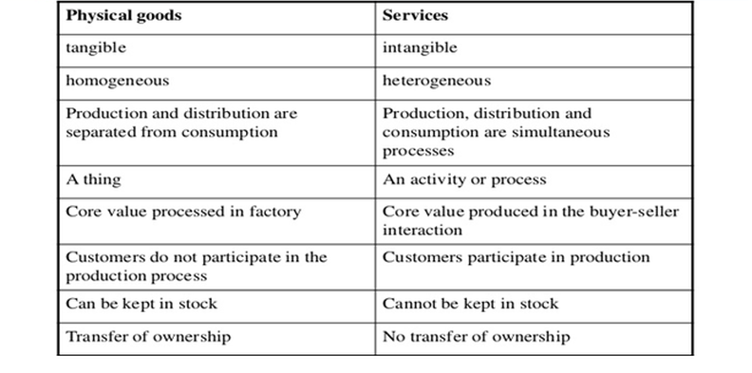
DIFFERENCE BETWEEN GOODS AND SERVICE

Slide 6
CHARACTERISTICS OF SERVICE MARKETING
1. INTANGIBILITY
2. PERISHABILITY
3. INSEPARABILITY
4. HETEROGENEITY
5. OWNERSHIP
6. SIMULTANEITY
7. QUALITY MEASUREMENT
8. NATURE OF DEMAND

Slide 7
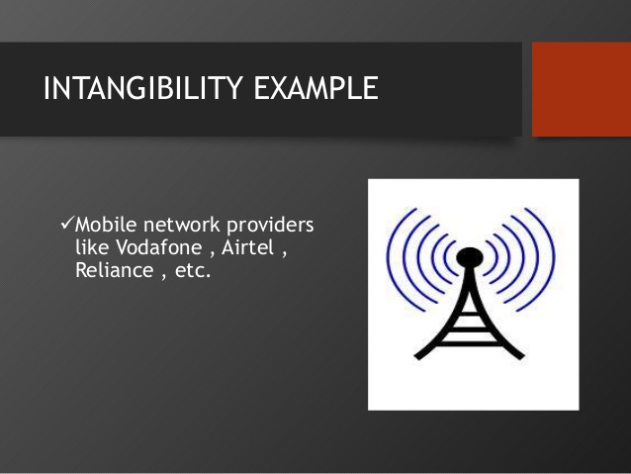

Slide 8
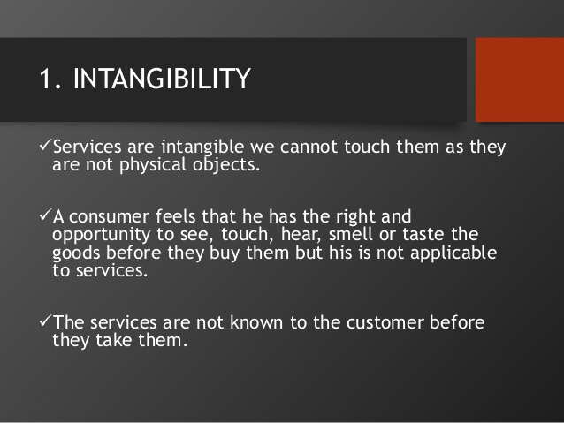

Slide 9


PERISHABILITY

Slide 10
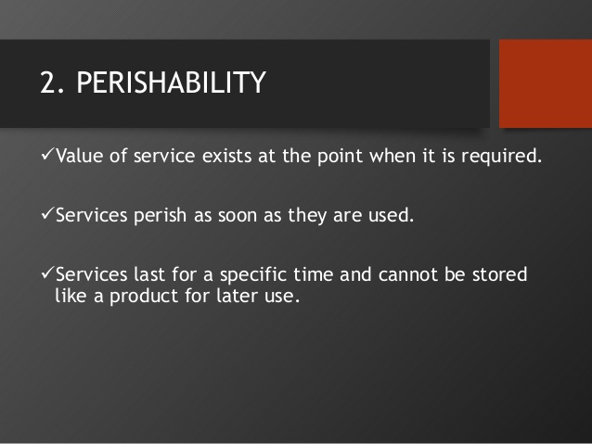

Slide 11

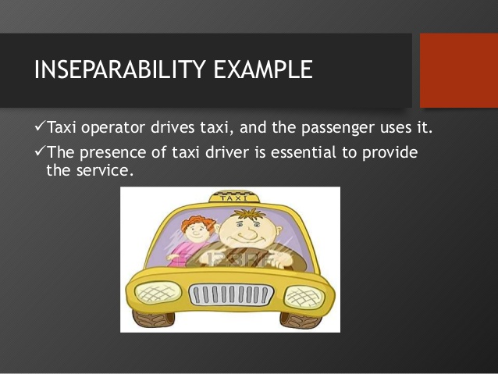
INSEPARABILITY

Slide 12
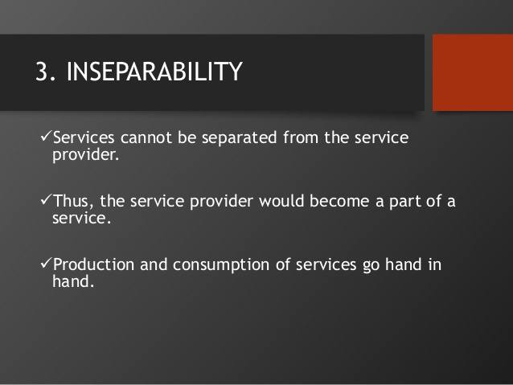

Slide 13
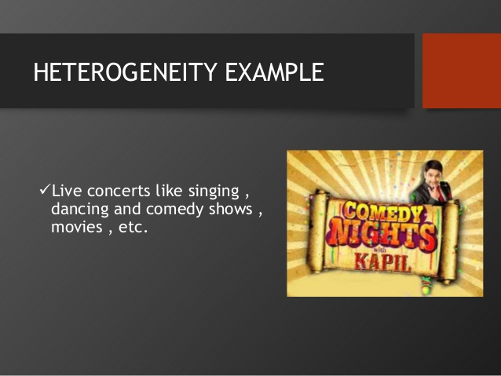
HETEROGINITY

Slide 14
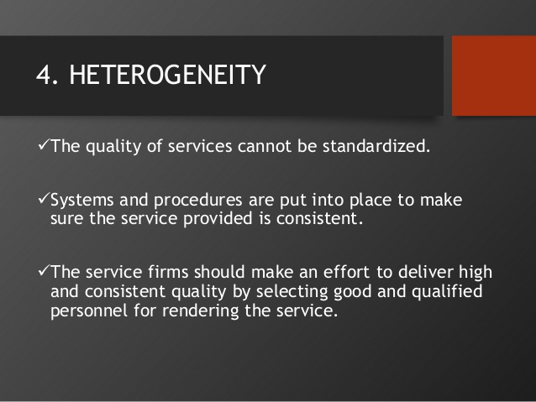

Slide 15
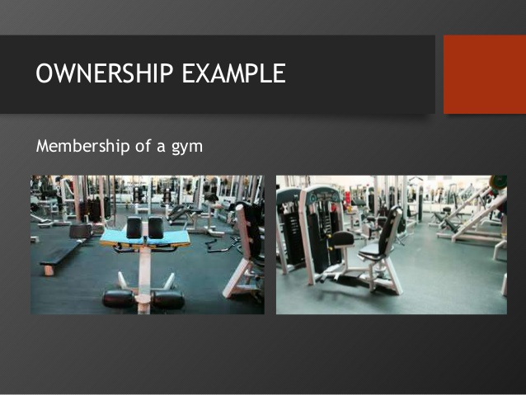

Slide 16
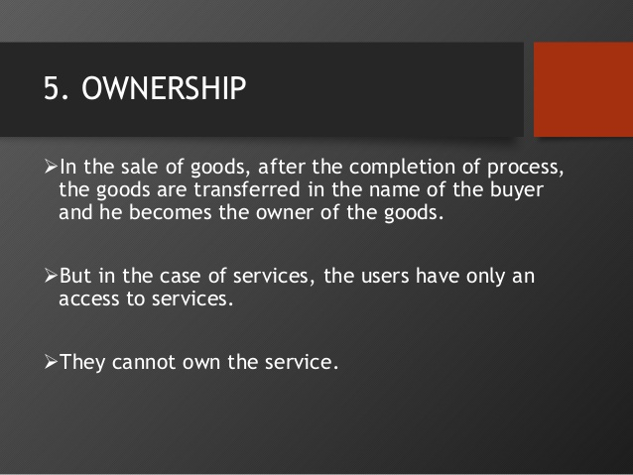

Slide 17
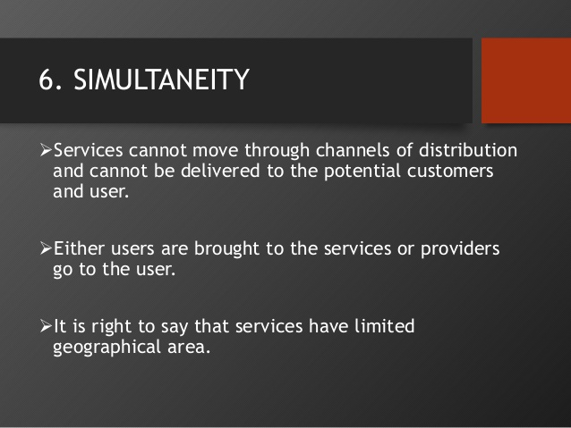

Slide 18
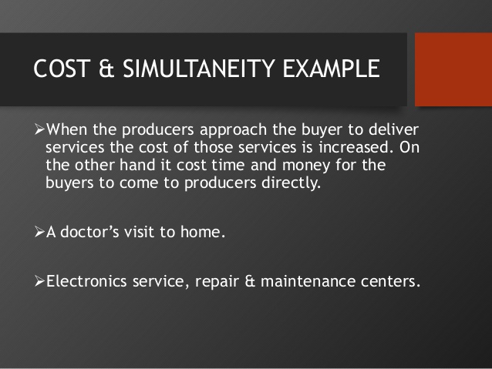

Slide 19
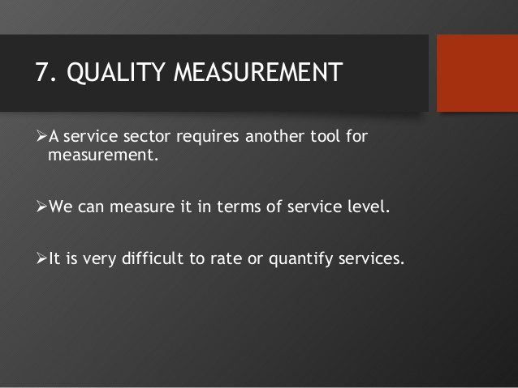

Slide 20
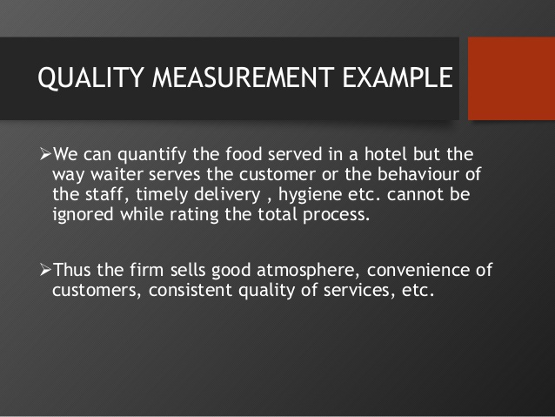

Slide 21
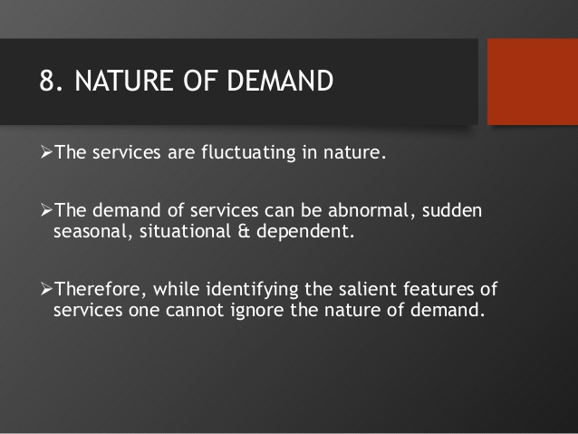
NATURE OF DEMAND

Slide 22
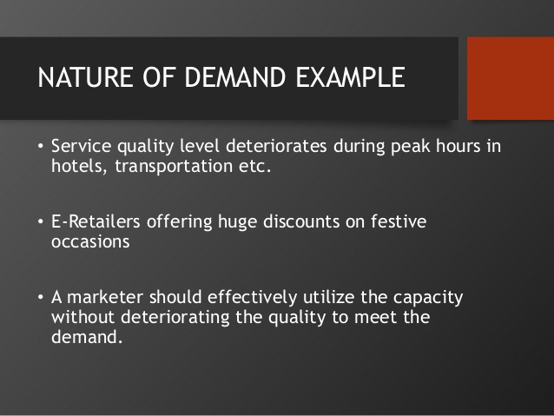

Slide 23
SCOPE OF SERVICES
The following are the various areas of the service sector:
1. Education: Educational services are rapidly increasing in India because many foreign universities have entered India. We have a great exposure to higher education involving IITs, IIMs and Research organizations.
2. Health Care: It is required by all sections of the society. We have government as well as Private Hospitals which provide medical and healthcare services to people.
3. Information Technology: India is one of the leading IT exporting countries in the world. This sector opens the door for many jobs in the country and earns valuable foreign exchange. WIPRO, INFOSYS are the world known Indian IT companies.
4. Financial Services: Financial services are required by the business organizations and individuals. Such services are needed for raising capital and reconstruction of business.
5. Banking: Banks provide different services to the individuals and corporate sector. It primarily facilitates the deposits and lendings. Now a days bank provide ATM, E-Banking and so on services to the customers.

Slide 24
6. Insurance: Insurance is basically covering risk which can be life or general insurance. Human life is full with risk and uncertainties. To cover this risk and uncertainties life insurance provides many policies. In case of general insurance we may observe fire insurance and marine insurance services.
7. Tourism: Tourism sector also comes under the scope of services as it provides services to tourists like food, accommodation, hotels etc. In recent times many forms of tourism are popular like Historical Tourism, Medical Tourism, Spiritual Tourism, Adventure Tourism etc.
8. Transport: A Transport service creates place utility. It covers Road, Rail, Air and Water Transport which makes the movement of goods and people possible from one place to another.
9. Consultancy: Professional experts for different consultancy are available in India. There is high demand for legal, managerial, technical, engineering, financial consultancy. 10. Courier: Courier service is for transportation of letters, parcels, medicine, currency notes within and outside India. It is extensively used by individuals, Corporates, Institutions etc.

Slide 25
OTHER SERVICES
EVENT MANAGEMENT
TELECOMMUNICATION
REAL ESTATE
ENTERTAINMENT
PUBLIC RELATION
MEDIA
DEFENCE

Slide 26
Classification of Services
1. On the basis of the End User:
● Consumer: Leisure, Hairdressing, personal finance, haircut, Holiday Packages, etc.
● Business to Business: Advertising Agencies, Printing, Accountancy, Consultancy
● Industrial: Plant Maintenance, Repair and Services, Installation and Project Management.
2. On the basis of Tangibility:
● Highly tangible: Telecommunications, Mobile Services, car Rental, Vending Machines, ATM Machines etc.
● Service linked to tangible goods: Repairs of domestic appliances, Air-Conditioning Services, Computer Maintenance, car Service, etc.
● Highly intangible: Psychotherapy, Consultancy, Legal Services etc.

Slide 27
CLASSIFICATION OF SERVICE
INDIVIDUAL END USER
(ENTERTAINMENT;TRAVEL ETC.)
ON THE BASIS OF END USER
B to B End User
(PWC to Infosys; advertising, accountancy; software
Industrial End User
( factories using pest control services)

Slide 28
HIGHLY TANGIBLE
ON THE BASIS OF TANGIBILITY
SERVICES LINKED TO TANGIBLE GOODS
HIGHLY INTANGIBLE GOODS

Slide 29
Classification of Services
3. On the basis of People and Equipment:
● People-based services: Restaurants and Medical Services, High contact : Education, Dental Care, etc.
● Equipment-based: Launderette, Vending Machine, Cinema, Low contact: Automatic Car Wash, etc.
4. On the basis of The Expertise and Skills: ● Professional: Medical Services, Legal Services, Accountancy, Tutoring, Lawyers etc. ● Non-professional: Babysitting, Day care taking, Casual Labour, etc.
5. On the basis of Profit: ● Not for profit: The Scouts Association, charitable trusts, and public sector units etc. ● For profit: Commercial Banks, Airlines, Tour operators, Hotel Industries, Sole Trading firms, Joint Stock Companies, etc.

Slide 30
SERVICE ON BASIS OF CONTACT
HIGH CONTACT
PEOPLE AND EQUIPMENT BASED SERVICE
LOW CONTACT

Slide 31
PROFESSIONAL
ON THE BASIS OF EXPERTISE AND SKILL
NON PROFESSIONAL

Slide 32
PROFIT MAKING
ON THE BASIS OF PROFIT ORIENTATION
NON PROFIT MAKING

Slide 33
BOTH LOCATION ( EDUCATION; FOOD DELIVERY)
ON THE BASIS OF LOCATION OF DELIVERY
PROVIDER LOCATION
(HOSPITALS; MALLS)
CUSTOMER LOCATION ( REPAIR ; PAINTING)

Slide 34
Importance of Service Sector in India
1. Higher Sectoral growth: In India service sector is the highest growing sector as compared to agriculture and secondary sectors. There is rapid diversification in the growth of services like real estate, banking, hotel, insurance, telecommunication etc. In short, growing growth rate in service sector indicates the development of Indian Economy.
2. Contribution to GDP: Service sector is the largest contributor to India’s GDP i.e. 58%. Since 1951, the contribution of service sector to the GDP has doubled due to liberalization, professionalism and growing urbanization in India.
3. Capital Formation: Sub-sectors of the service sector like banking and insurance encourage savings on the part of people. The savings get converted into investments. The investment in turn leads to capital formation in the country.

Slide 35
4. Supports to Primary and secondary Sector: Without the support of service sector it would be difficult for other sectors to function in the economy. Many services help primary and secondary sectors like banking sector provides credit for working capital, insurance sector provides risk cover to industrialists, transport services provide proper movement of men, material and machine etc.
5. Employment Opportunities: since 1951, there has been an increase in the share of employment of the service sector. As per the study for every 1000 working forces, 147 people in rural areas and 582 people in urban areas are engaged in service sector.
6. Revenue to the Government: The service sector provides revenue to the government by way of service tax. The service tax was introduced in 1994-95. Service tax contributes approximately 18% contribution in total gross revenue of the central government.

Slide 36
7. Regional Development: The service sector helps the country to achieve regional development by providing services like transport, banking, communication etc. in various regions. After 1991, many states are economically developed due to the progressive growth of service sector.
8. Improves Efficiency: Efficiency is the ratio of returns to costs. An efficient organization can get higher returns at a lower cost. For improving efficiency, research and development, consultancy, education, training etc. are helpful.
9. Reduces Inequalities: By providing employment to millions of people across the country, the services sector generates income for the employed, which helps to reduce income and wealth inequalities..
10. Social Development: Due to the service sector contribution in India people are socially developed in terms of literacy, life expectancy and family welfare

Slide 37
APART FROM ABOVE THE IMPORTANCE OF SERVICE SECTOR ARE AS FOLLOWS:
Service sector earns huge foreign exchange
Service sector brings reputation for the country.
Service sector finance India’s trade deficit.
India is one of the leading Asian Service exporter along with China, Singapore.
India has registered huge growth in service sector compared to any other sector..

Slide 38
IMPORTANCE OF THE SERVICES SECTOR IN THE INDIAN CONTEXT
India is currently the second fastest growing service economy in the world. Services in India are emerging as a prominent sector in terms of contribution to national and state incomes, trade flows, FDI inflows and employment.
The services sector, with a share of 55.2% in India’s Gross Value Added (GVA), continued to be the key driver of India’s economic growth contributing almost 72.5% of GVA growth in 2017–18, as stated in the Economic survey 2017–18. The importance of the service sector in the Indian economy is explained as under :

Slide 39
1. Contribution to GDP Gross Domestic Product (GDP) is the indicator of the performance of the economy. The share of services in the GDP has grown rapidly in the recent years. The share of services in India’s GDP at factor cost (current price) increased from 33.3% in 1950-51 to 51% in 2000 and to about 60% in 2016-17, growing approximately at 8% per annum.
2. Contribution of services sector in employment generation The services sector provides employment to a large segment of the workforce. The share of service sector in employment has gone up from 19.7% to 30% over the last two decades. The share of employment in the service sector is much lower in rural areas as compared to urban areas. According to The Economic Survey, for every 1000 people employed in rural areas, 241 are engaged in service sector (including construction), where as for every 1000 people employed in urban areas, 683 are engaged in service sector (including construction). Some of the North Eastern states like Sikkim, Tripura and Manipur have a high share of employment in service sector. Chandigarh, Delhi and Kerala also have high share of employed people in service sector. Construction, trade, hotels & restaurants.

Slide 40
Marketing of product and service
Product
Goods can be easily inventoried, patented demand can be managed.
Consistent quality, quality standardised.
Goods are produced first and then sold.
Goods require 4Ps of marketing.
Advertisement does not require much of proof or testimonial as goods are there for everybody to see.
Pricing includes cost of material, manufacturing cost, marketing etc.
Stable location for selling goods and services are required.
intangibility. Cannot be inventoried or patented.
Lacks standardisation
services are first sold and then produced
No consistency. Can be customised.
Service require additional P
Demonstration of process and proof and testimonial important for building service expectation.
Service pricing is mostly profit.
O stable location is required.

Slide 41
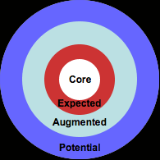
TOTAL PRODUCT CONCEPT BY THEODRE LEWITT

Slide 42
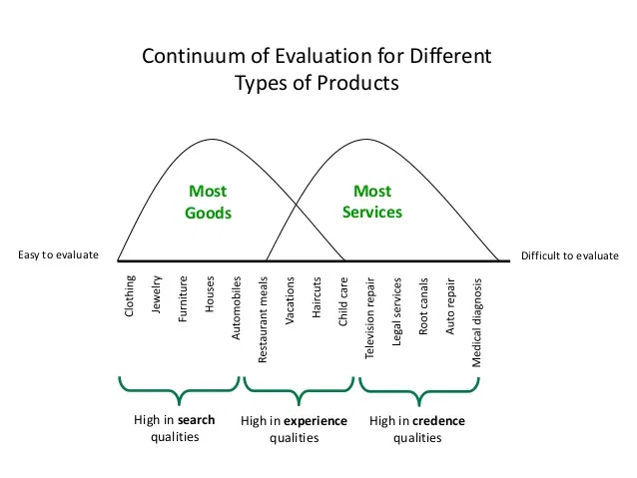

Slide 43
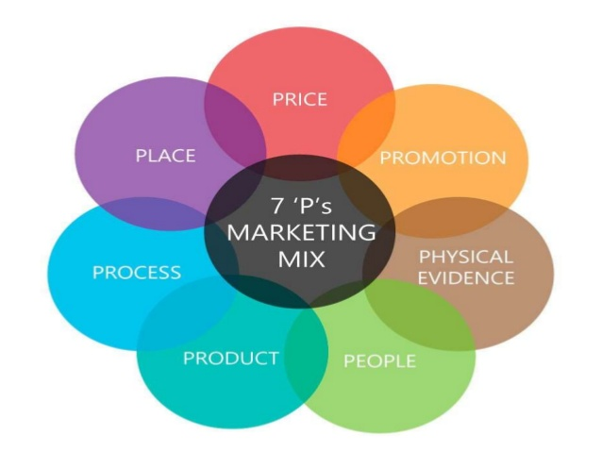

Slide 44
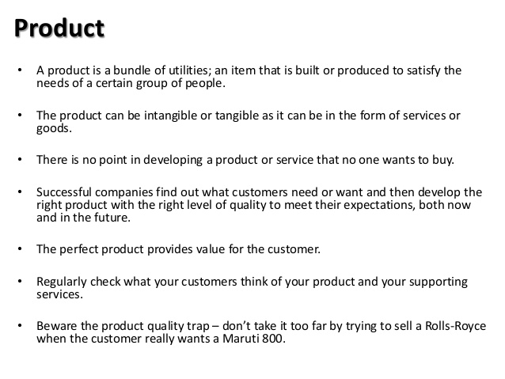

Slide 45
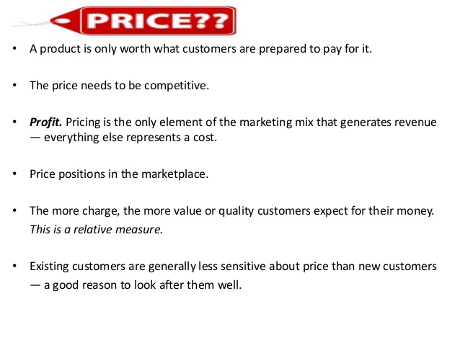

Slide 46
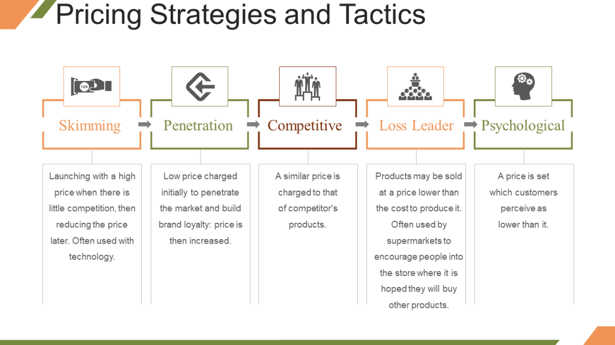

Slide 47
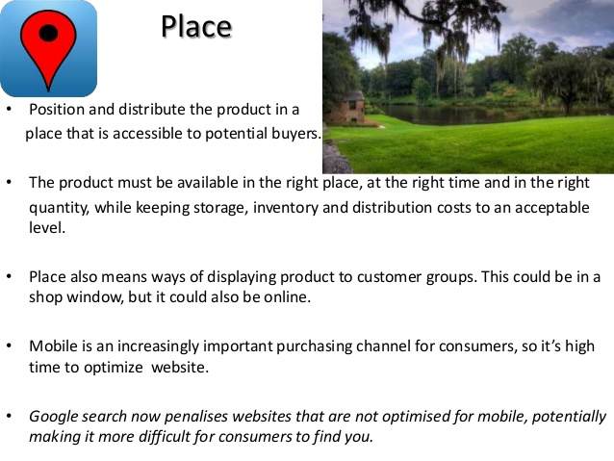

Slide 48
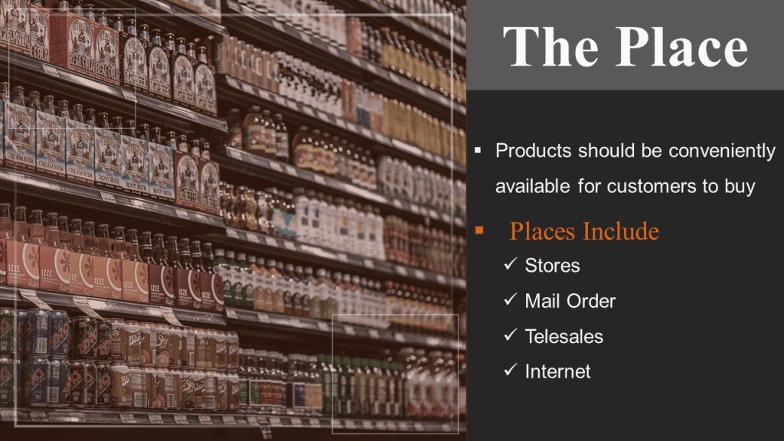

Slide 49
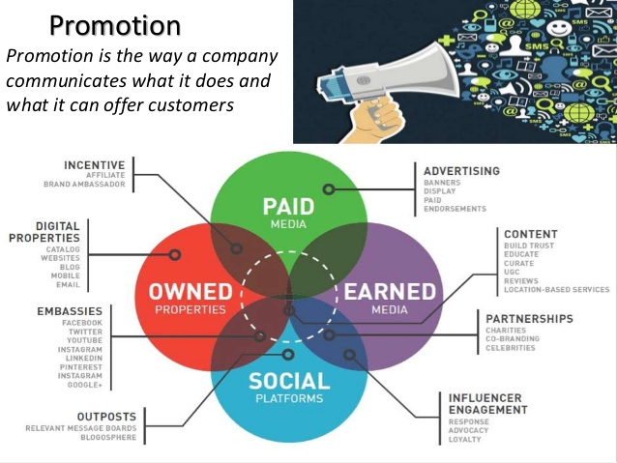

Slide 50


Slide 51
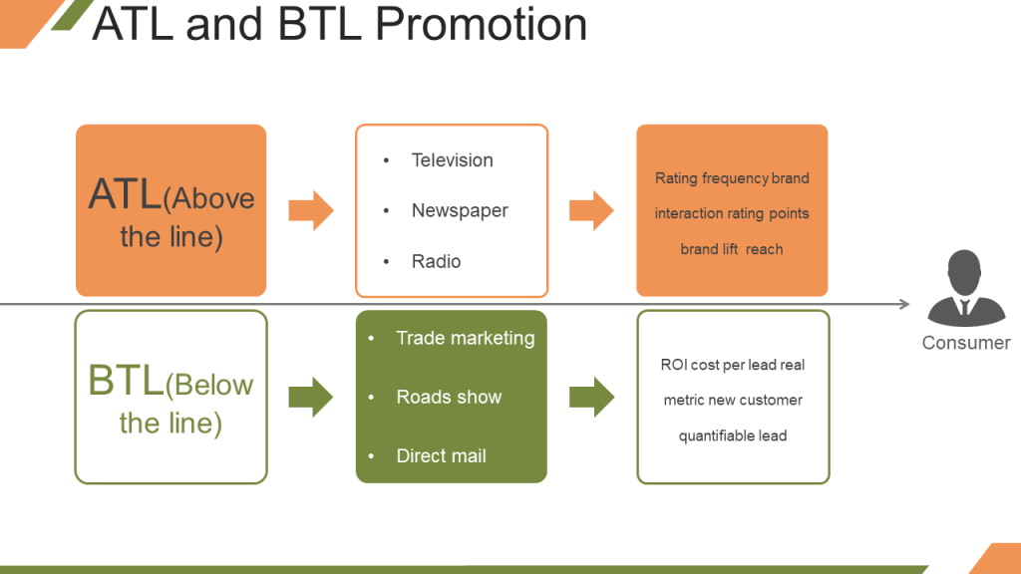

Slide 52
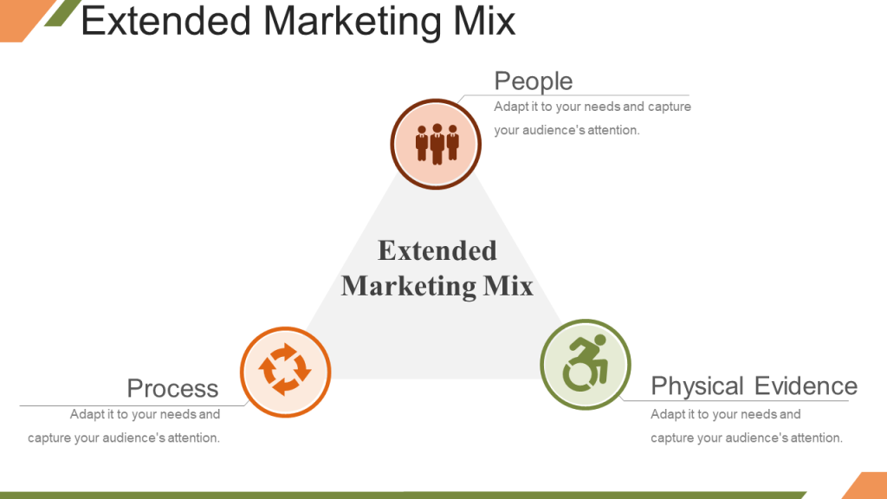

Slide 53


Slide 54
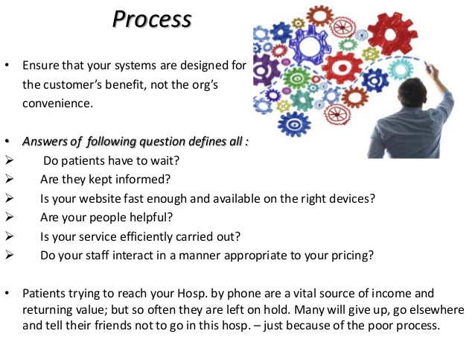

Slide 55
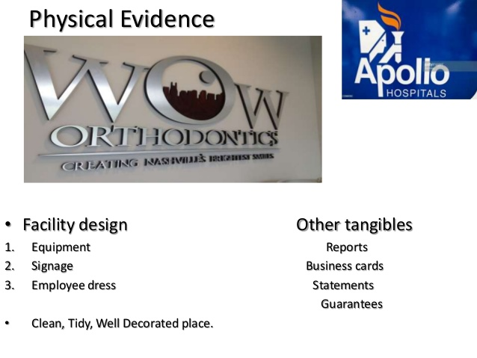

Slide 56
https://www.youtube.com/watch?v=6EJYxM2lEJs

Slide 57
https://www.youtube.com/watch?v=GhFpvXsmBXY

Slide 58
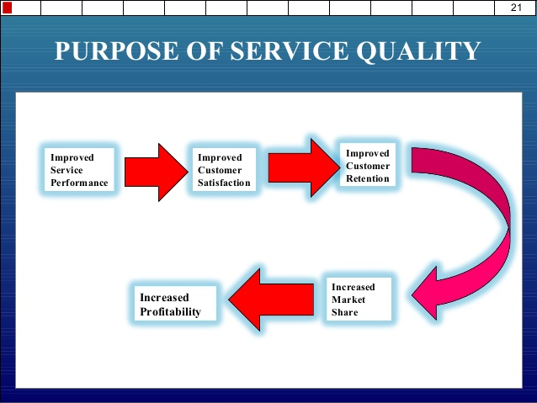

Slide 59
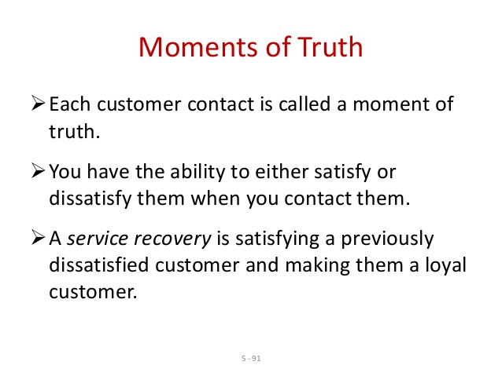

Slide 60
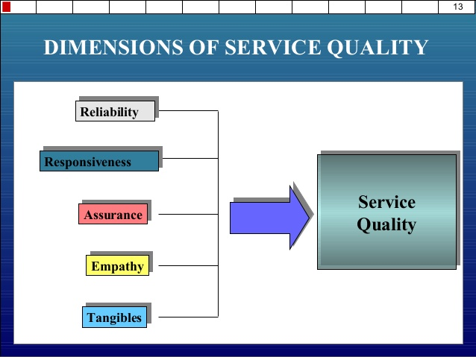

Slide 61
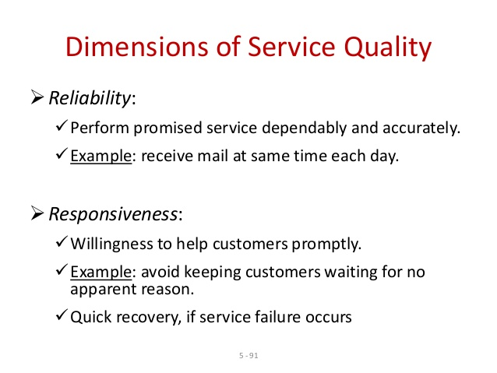

Slide 62
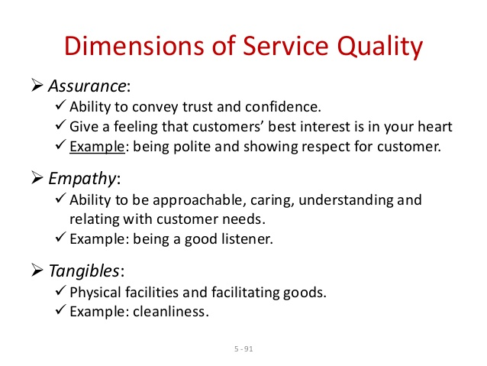

Slide 63
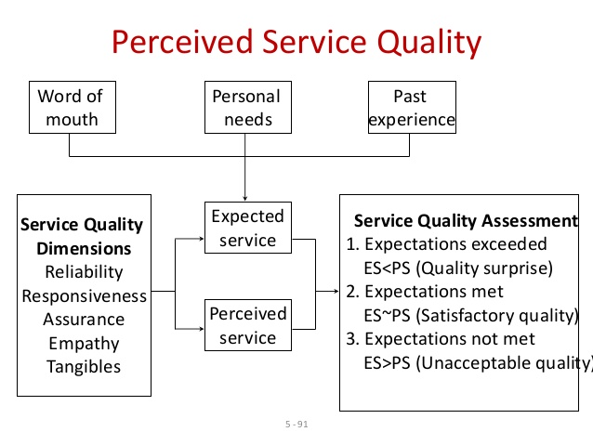

Slide 64
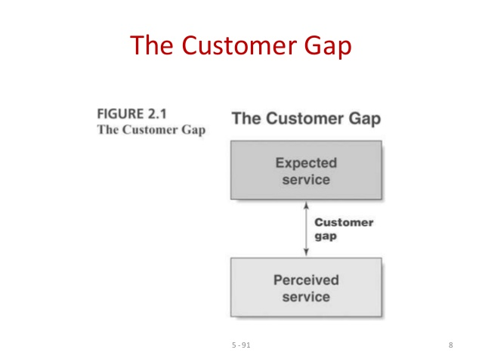

Slide 65
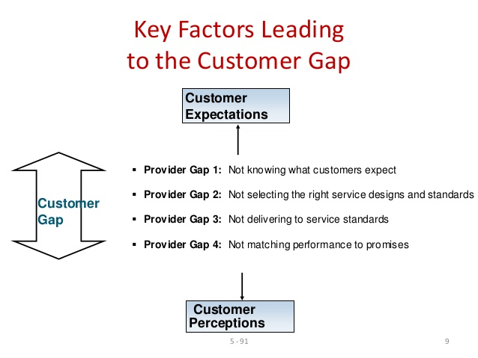

Slide 66
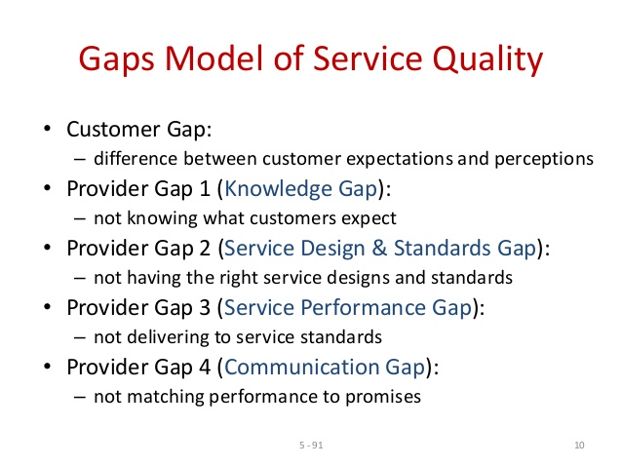

Slide 67
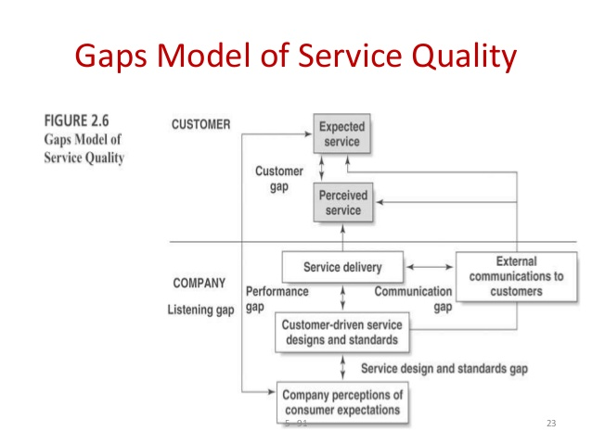

Slide 68
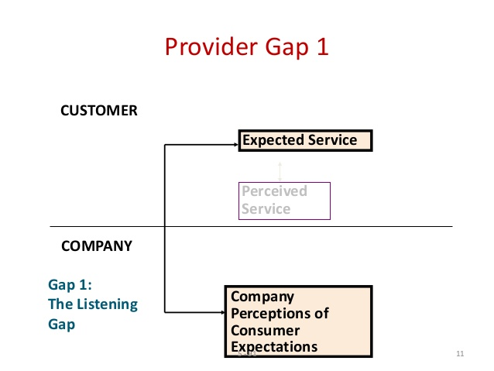

Slide 69
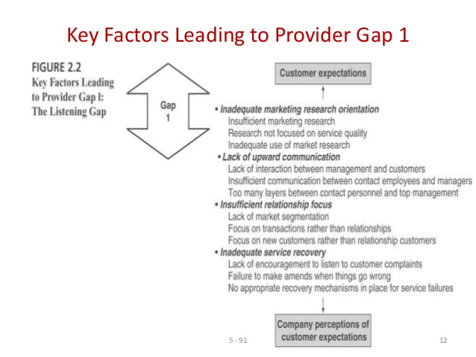

Slide 70
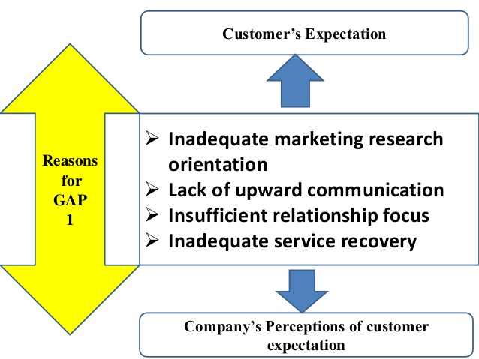

Slide 71
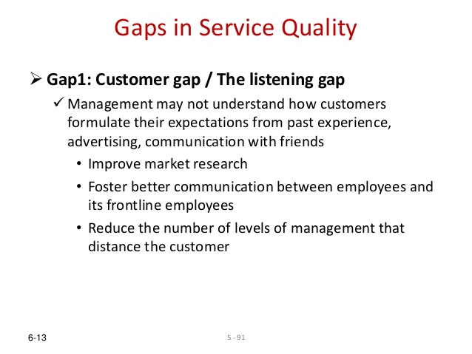
REDUCING LISTENING GAP

Slide 72
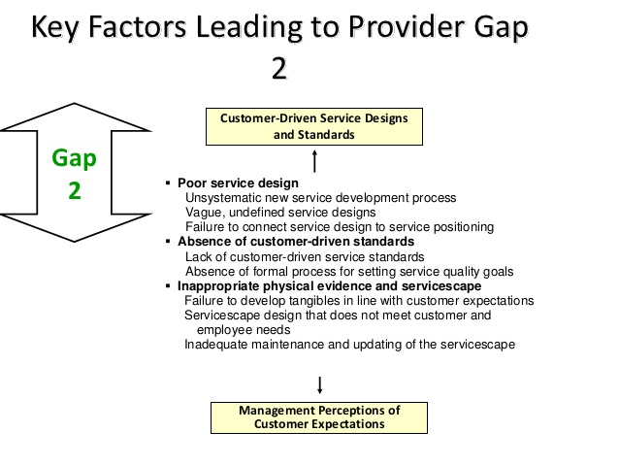

Slide 73
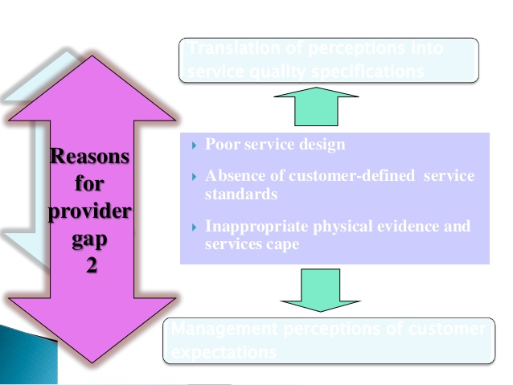

Slide 74
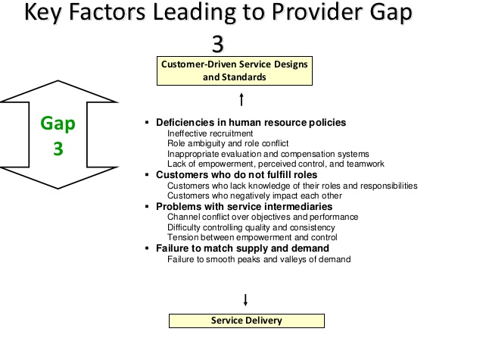

Slide 75
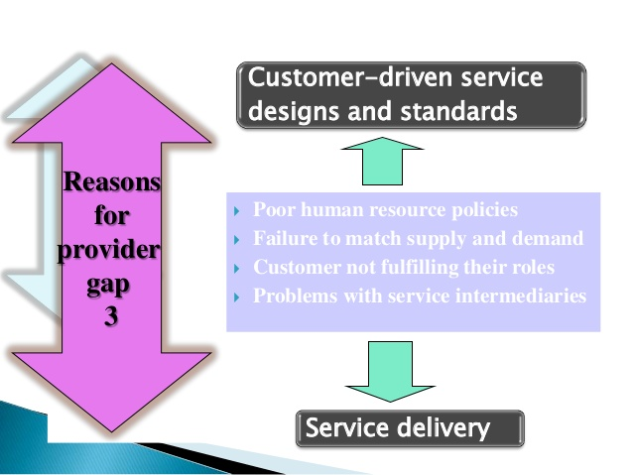

Slide 76
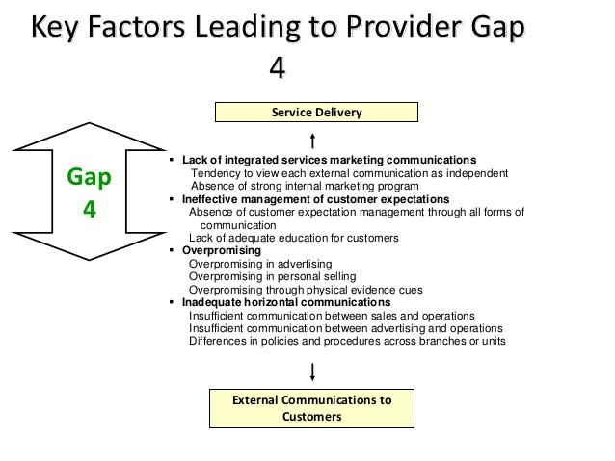

Slide 77
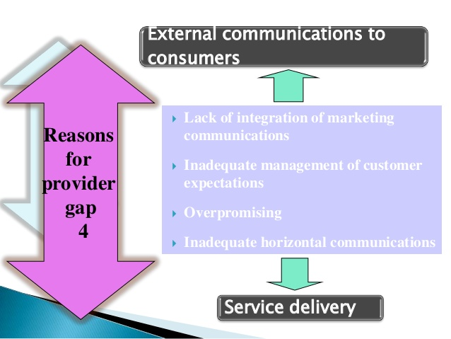

Slide 78
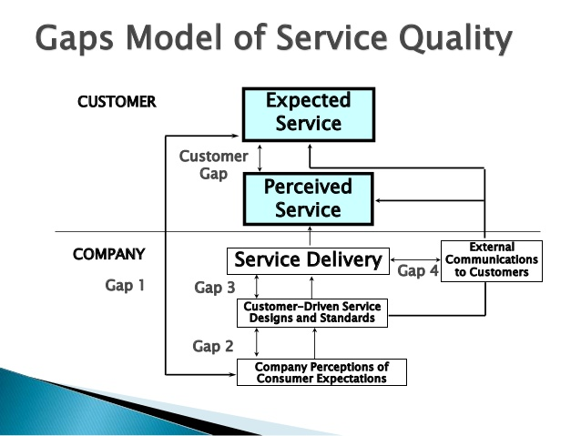

Slide 79


Slide 80


Slide 81


Slide 82


Slide 83


Slide 84


Slide 85


Slide 86


Slide 87


Slide 88


Slide 89


Slide 90


Slide 91


Slide 92


Slide 93
MARKETING RESEARCH IN SERVICES
To understand customer requirement or expectation of service.
To monitor track performance
To evaluate overall track performance of the organisation compared with that of the competitors
To evaluate gaps between customer expectation and perception.
To identify dissatisfied customer so that service recovery can be attempted.
To gauge the effectiveness of change in service delivery.
To appraise the service performance of individual employees and teams for evaluation, recognition and reward.
To determine customer expectation from new service
To monitor changing customer expectation in the industry.
To forecast future expectation of the customer.

Slide 94
CRITERIA FOR AN EFFECTIVE RESEARCH IN SERVICE
Research has to include qualitative and quantitative method of study.
Research must include expectation and perception of the customer.
Research should balance cost and benefit.
Statistical validity to be ensured in Research.
Research should be continuous.
Research should include measurement of customer loyalty, behavioural intentions and behaviour,

Slide 96
Type of service marketing research
Complaint solicitation
CRitical incident studies
Requirement research
Relationship survey to understand company’s relationship and strength and weakness
Mystery shoppers
Process checkpoint evaluation
Market oriented ethnography
Future expectation research
Lost customer research

