Slide 1
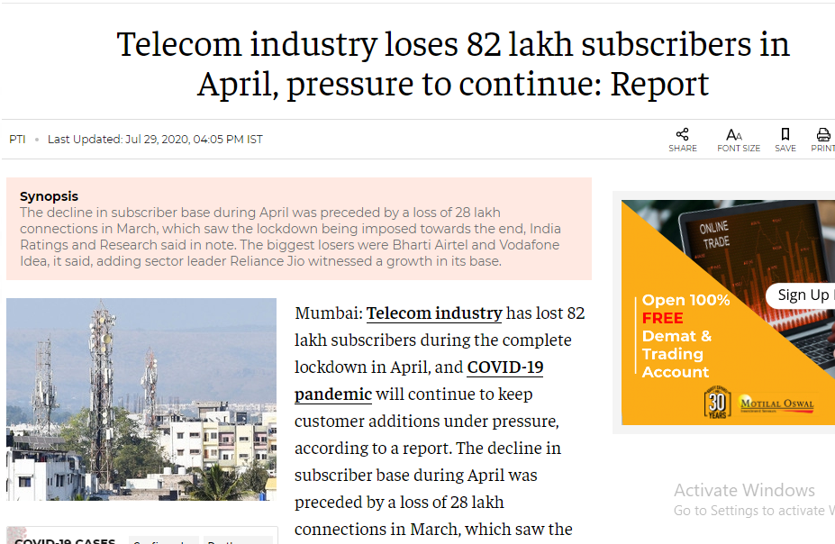
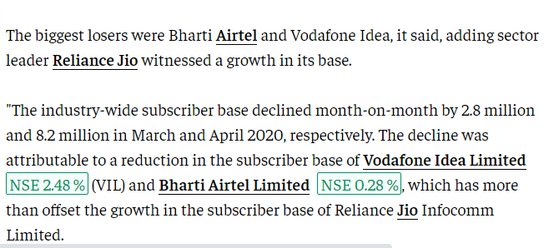

Slide 2
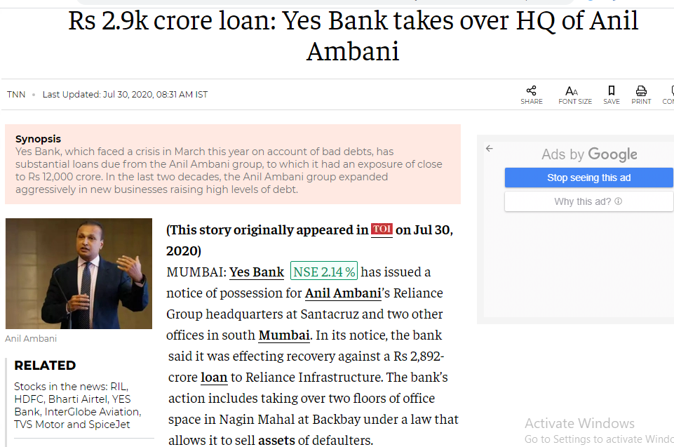

Slide 3
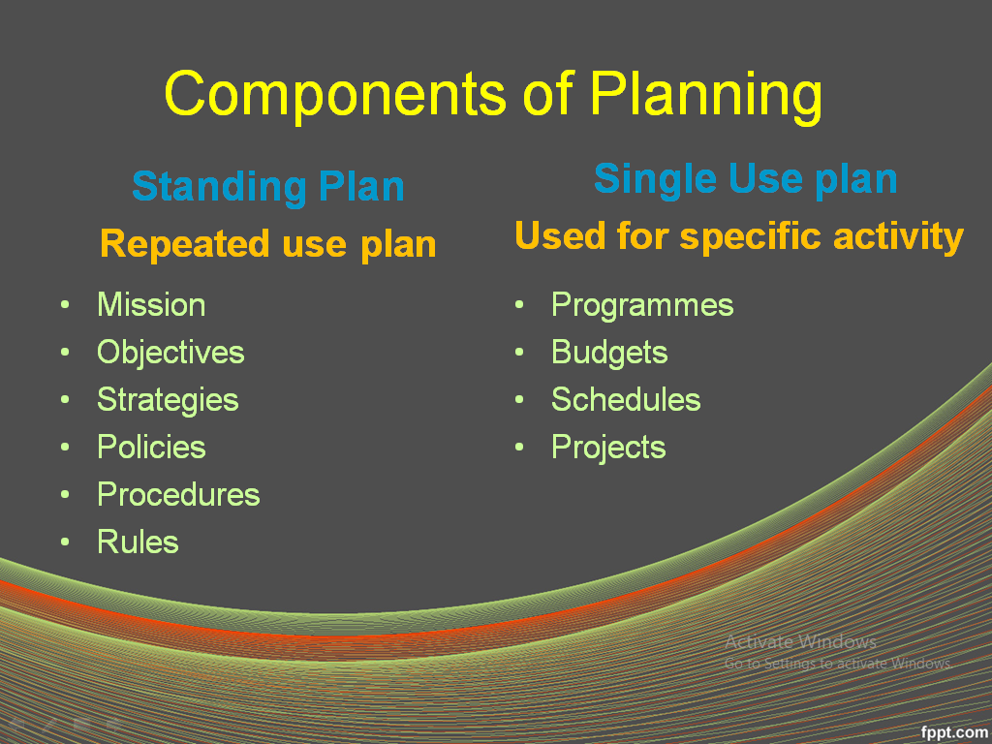
Let’s Revise Previous lecture ....

Slide 4

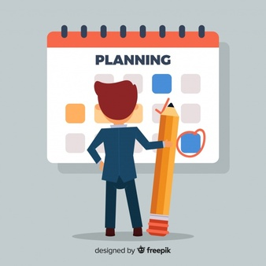
Importance of Planning

Slide 5


Slide 6
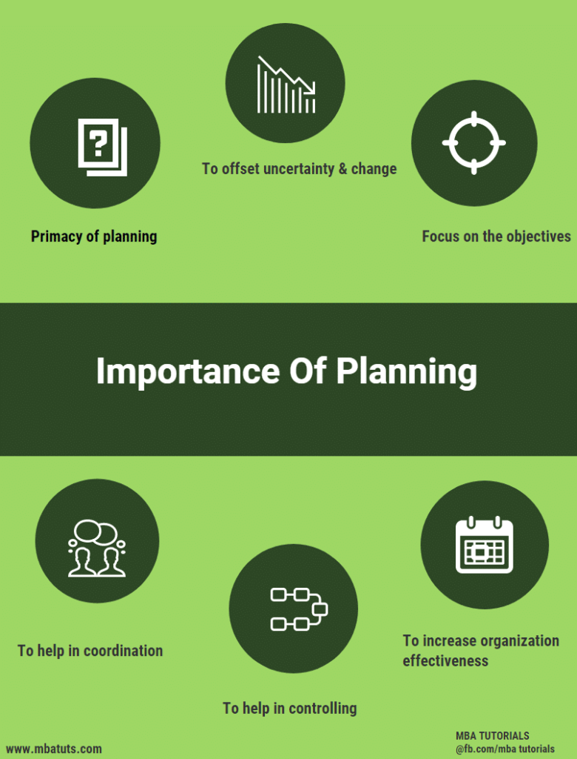

Slide 7
1. Minimizes Risks
Helps to minimize risk
Potential risks forecasted
Proactive decision are decided

Slide 8
2. Facilitates Direction
Provide schedules or time table
makes clear what employees have to do, how to do
no planning, employees would be working in different directions
organisation would not be able to achieve its desired goal.

Slide 9
3. Facilitates Organising
Depend on target, resources are arranged
If higher target, higher resources arranged
If lower target, lower resources arranged

Slide 10
4. Facilitates Control
Plan provides target
Compared with actual performance
Help to find out deviations
Take step to correct deviations

Slide 11
5. Encourages Innovation
Proper time to plan in advance
Come out with innovative ideas and thoughts
Bring best result

Slide 12
6. Facilitates Decision making
Frames alternative plans
After analysis, best plan selected
Help to choice best plan

Slide 13
7. Generate efficiency
Efficiency means more benefits at less cost
Planning enables optimum utilisation of resources
Highest return at lower cost

Slide 14
8. Motivate Personnel
Consult subordinate before planning
Active involvement of subordinates
Functional clarity
Motivated and dedicated work force

Slide 15
SUMMARY ....
Importance of Planning
Minimizes Risks
Facilitates Direction
Facilitates Organising
Facilitates Control
Encourages Innovation
Facilitates Decision making
Generate efficiency
Motivate Personnel

Slide 16


