Slide 1

MANAGEMENT-II
(MANAGEMENT APPLICATION)
TYBAF: SEM-V
-By Mr. Hasim Khan

Slide 2
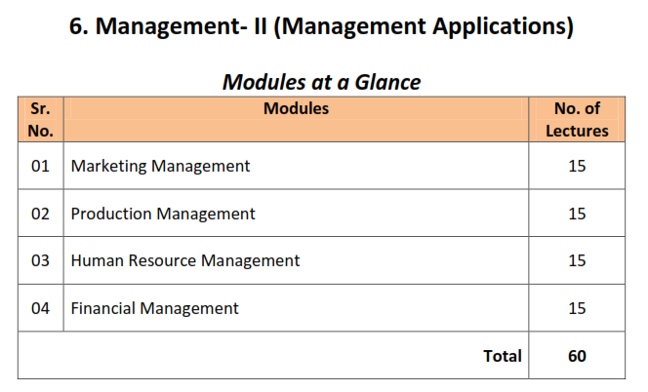
SYLLABUS

Slide 3
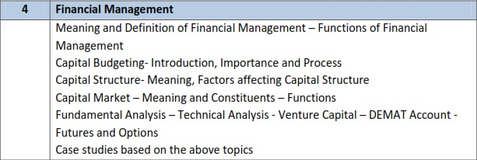
UNIT-IV: FINANCIAL MANAGEMENT

Slide 4

Financial Management: Meaning & Definitions
Financial Management means planning, organizing, directing and controlling the financial activities such as procurement and utilization of funds of the enterprise. It means applying general management principles to financial resources of the enterprise.
According to Dr. S.N. Maheshwari, “ Financial Management is concerned with raising financial resources and their effective utilization towards achieving the organizational goals.”

Slide 5
The most popular and acceptable definition of financial management given by S.C.Kushal is that “Financial management deals with procurement of funds and their effective utilization in the business”.
Weston and Brigham: Financial management is an area of financial decision-making, harmonizing individual motives and enterprise goals”.
Joshep and Massie: Financial management is the operational activity of a business
that is responsible for obtaining and effectively utilizing the funds necessary for efficient operations”

Slide 6
The Objectives of Financial Management
1. Profit Maximization
One of the reasons a company employs a financial manager is to maximize profit while managing the finance of the company.
The gain can be in the short or long-term. But the main focus is that the individual or department handling the financial issues of the company must ensure that the company in question is making sufficient profit.
2. Proper Mobilization of Finance
The collection of funds to run the business is also an integral part of Financial Management
that the manager needs to handle appropriately.
Once the manager concludes the estimation of the amount needed for a business process, the required amount can then be requested from any legal sources such as debenture, shares, or even request for a bank loan. But the point is that there should be a proper balance between the money the firm has and the amount borrowed.

Slide 7
3.The Company’s Survival
The survival of the company is essential. That is one of the reasons of management considers hiring financial managers in the first place. The manager has to make adequate financial decisions to ensure the company is successful.
4. Proper Coordination
There must be a proper understanding and corporation among the various departments. The finance department must understand and agree with other departments within the company for the business to function smoothly.
5. Lowers Cost of Capital
Financial managers also try their very best to reduce the cost of capital, which is something that is vital to the business. They ensure money borrowed attracts little interest rates so the company can maximize profit.

Slide 8
Capital requirement is estimated properly
Proper utilization of collected capital
Fair rate of return to the investors
Proper financial coordination with other departments
Create good image of the company
Maintain adequate cash flow
Ensure survival, growth and stability of the company
Proper financial discipline
Retain a part of yearly profits
Raise additional funds required for the business at reasonable cost

Slide 9
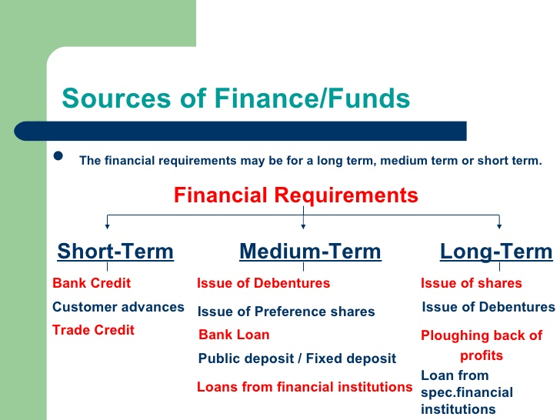

Slide 10
Financial Management: Functions
Executive Functions
Routine Functions
Estimating capital requirement.
Determining capital structure.
Investment decisions.
Allocation of surplus
Replanning
Managing cash flow
Deciding new sources of finance
Advising the top management
Record keeping and financial reporting
Credit management
Cash planning and cash management
Maintaining custody of securities, financial documents and other valuables papers.
Supplying financial information to top management regularly for review, evaluation and policy decision.

Slide 11
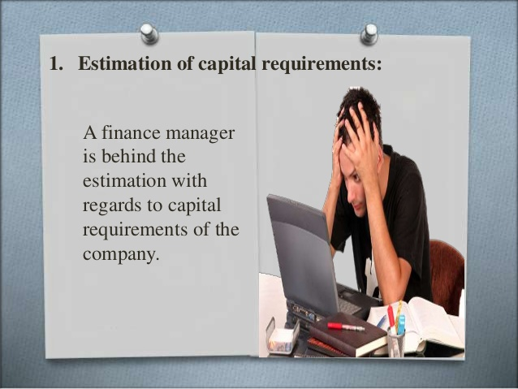

Slide 12


Slide 13


Slide 14


Slide 15


Slide 16
Financial Controls
Financial control may be construed as the analysis of a company’s actual results, approached from different perspectives at different times, compared to its short, medium, and long-term objectives and business plans

Slide 17
Replanning
Finance manager has to introduce suitable replanning on the basis of the feedback obtained from the financial control system introduced.
If the performance is not as per the standards set, then suitable action is required.

Slide 18
Managing cash flow
Adequate cash supply is necessary for meeting the essential business needs including payment of wages etc.
Shortage of cash at any stage should be avoided.
Similarly excess cash is unremunerative and should be invested.

Slide 19
Deciding new sources of funds
Business units always requires funds for meeting growing expenses and also for expansion and diversification of business activities.
Should select short term or long term sources of funds.
Reliable end economical sources should be preferred.

Slide 20
Advising to the top level management
Financial manager is an expert in his field so he should be consulting the top level manager regarding financial decisions of the company.

Slide 21
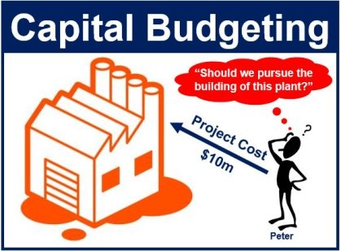
CAPITAL BUDGETING: Meaning
Financial Management deals with preparation of budgets.
A budget is a plan which express the anticipated results in numerical terms.
When a budget is prepared with respect to capital expenditure, it is called as capital budgeting.
Hence, it can be said that capital budgeting involves firm’s decision to invest current funds in long term assets to get the benefits over the years.

Slide 22
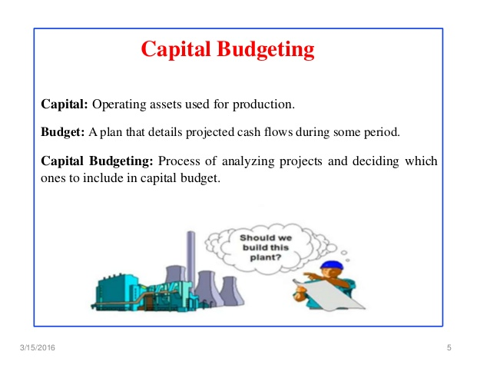

Slide 23
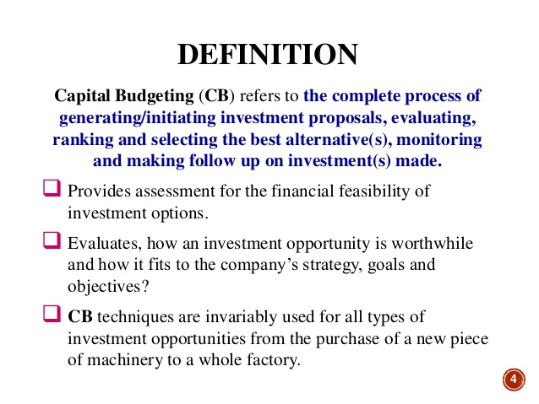

Slide 24
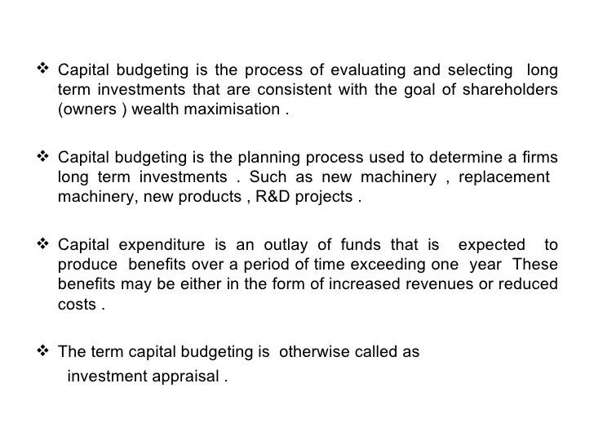

Slide 25
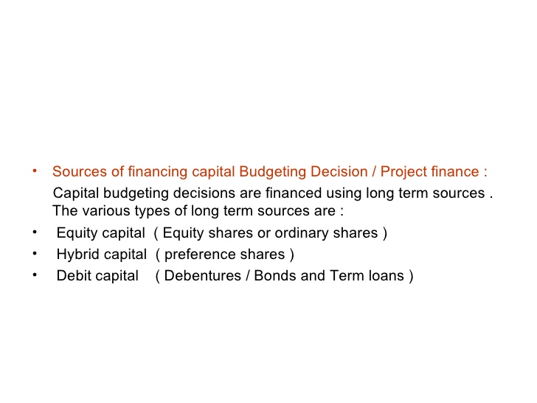

Slide 26
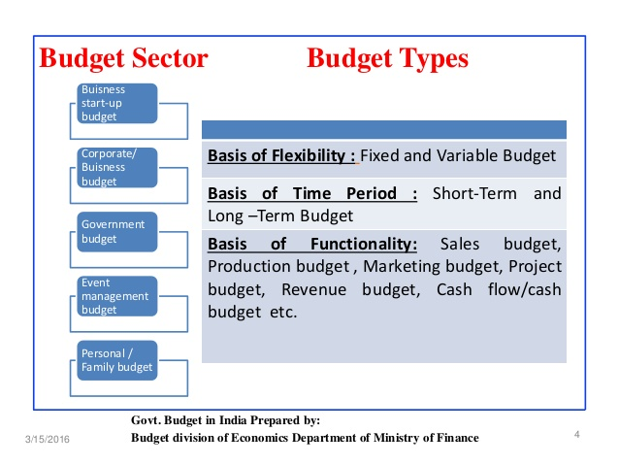

Slide 27
What Is Capital Budgeting?
Capital budgeting involves choosing projects that add value to a company. The capital budgeting process can involve almost anything including acquiring land or purchasing fixed assets like a new truck or machinery.
Corporations are typically required, or at least recommended, to undertake those projects that will increase profitability and thus enhance shareholders' wealth.
However, the rate of return deemed acceptable or unacceptable is influenced by other factors specific to the company as well as the project.
For example, a social or charitable project is often not approved based on the rate of return, but more on the desire of a business to foster goodwill and contribute back to its community.

Slide 28
Why is capital budgeting important?
Capital budgeting is an important financial management tool because it provides a means for evaluating and measuring a project's value throughout the life of the project.
Using capital budgeting is important when you need to assess and rank the value of projects or investments that require a large capital investment to determine whether they are worth pursuing.

Slide 29
Why is capital budgeting important?
For example, investors can use capital budgeting to analyze investment options and decide which ones are worth investing in.
Capital budgeting is also important to a company's financial decision makers because it helps them make informed financial decisions for projects they expect to last a year or more that require a large capital investment. Such projects can include

Slide 30
CAPITAL BUDGETING: Importance
Investing in new equipment, technology and buildings
Upgrading and maintaining existing equipment and technology
Completing renovation projects on existing buildings
Expanding their workforce
Developing new products
Expanding into new markets

Slide 31
CAPITAL BUDGETING: Importance
LONG TERM GAINS
ACCOUNTABILITY
AVOIDING OF LOSSES
ESTIMATING COST
BETTER COMPETITIVE POSITION
New machinery, new plant , R & D
Due to modernization
Management must carefully invest
Cost and benefits involved in project
Investment in FA help to make more profit.

Slide 32
PROCESS OF CAPITAL BUDGETING
Strategic Planning
Identification of Investment Opportunities
Screening of Projects
Financial Appraisal of Projects
Qualitative Factors in Project Evaluation
Accept or Reject Decision
Project Implementation
Follow Up

Slide 33
CAPITAL STRUCTURE: MEANING
The capital structure is the particular combination of debt and equity used by a company to finance its overall operations and growth.
Debt comes in the form of bond issues or loans, while equity may come in the form of common stock, preferred stock, or retained earnings. Short-term debt is also considered to be part of the capital structure.
Capital structure is how a company funds its overall operations and growth.
Debt consists of borrowed money that is due back to the lender, commonly with interest expense. Equity consists of ownership rights in the company, without the need to pay back any investment.
The Debt-to-Equity (D/E) ratio is useful in determining the riskiness of a company's borrowing practices

Slide 34
Factors Affecting Capital Structure
1) Desire to Retain Control
2) Timing
3) Flexibility
4) Nature
5) Amount of Capital Required
6) Period of Finance
7) Cost of Financing
8) Taxes
9) Attitude of Lender
10) Profitability
11) Growth Rate
12) Trading on Equity
13) Size of Company
14) Purpose of Financing

Slide 35
CAPITAL MARKET: MEANING AND CONSTITUTENTS
Capital markets are venues where savings and investments are channeled between the suppliers who have capital and those who are in need of capital. The entities that have capital include retail and institutional investors while those who seek capital are businesses, governments, and people.
Capital markets refer to the places where savings and investments are moved between suppliers of capital and those who are in need of capital.
Capital markets consist of the primary market, where new securities are issued and sold, and the secondary market, where already-issued securities are traded between investors.
The most common capital markets are the stock market and the bond market.

Slide 36
Functions of Capital Markets
Capital Formation
Economic Growth
Development of Backward Areas
Generates Employment
Development of Stock Markets
Foreign Capital
Development Role of Financial Institutions
Investment Opportunity
Revival of Sick Units
Easy Liquidity

Slide 37
Fundamental Analysis
Fundamental Analysis (FA) is a holistic approach to study a business. When an investor wishes to invest in a business for the long term (say 3 – 5 years) it becomes extremely essential to understand the business from various perspectives.
It is critical for an investor to separate the daily short term noise in the stock prices and concentrate on the underlying business performance.
Over the long term, the stock prices of a fundamentally strong company tend to appreciate, thereby creating wealth for its investors.

Slide 38
Approaches to Fundamental Analysis
Top-down Approach
Bottom-Up Approach
Economic Analysis
Industry Analysis
Company Analysis
Company Analysis
Industry Analysis
Economic Analysis

Slide 39

Technical Analysis
Technical analysis involves forecasting fluctuations in prices in securities market. It assumes that changes in share prices can be determined by analyzing market activity i.e.:
Studying the patterns of price fluctuations in the past
Studying the movement in certain technical indicators.
The objective of technical analysis is to forecast the direction of the future price. Technical analysts have developed tools and techniques, such as charts, etc. to identify patterns that can suggest future activity.

Slide 40

Venture Capital
Venture capital is a form of private equity and a type of financing that investors provide to startup companies and small businesses that are believed to have long-term growth potential.
Venture capital generally comes from well-off investors, investment banks and any other financial institutions. However, it does not always take a monetary form; it can also be provided in the form of technical or managerial expertise.
Venture capital is typically allocated to small companies with exceptional growth potential, or to companies that have grown quickly and appear poised to continue to expand

Slide 41
Procedure for Dematerialization
Opening a Demat Account
Submission of DRF and Share Certificates
Forwarding of DRF and Share Certificates
Confirmation from Depository
Recording by Depository
Updating of Records by DP
Confirmation to Demat Account Holder
Operation of Demat Account
Verification and Updating the Records

Slide 42
Futures
Futures contract is a legal agreement to buy or sell a particular commodity asset, or security at a predetermined price at a specified time in the future.
Futures contracts are standardized for quality and quantity to facilitate trading on a futures exchange.
The buyer of a futures contract is taking on the obligation to buy and receive the underlying asset when the futures contract expires.
The seller of the futures contract is taking on the obligation to provide and deliver the underlying asset at the expiration date.

Slide 43
OPTIONS
Options are financial instruments that are derivatives based on the value of underlying securities such as stocks.
An options contract offers the buyer the opportunity to buy or sell—depending on the type of contract they hold—the underlying asset. Unlike futures, the holder is not required to buy or sell the asset if they choose not to.
Call options allow the holder to buy the asset at a stated price within a specific timeframe.
Put options allow the holder to sell the asset at a stated price within a specific timeframe.
Each option contract will have a specific expiration date by which the holder must exercise their option. The stated price on an option is known as the strike price.

Slide 44
THANK YOU
KINDLY GIVE YOUR ATTENDANCE

