Slide 1
Agents of socialization

Slide 2
Agents of Socialization
Sociologists use the term agents of socialization to describe the specific individuals, groups, and institutions that enable socialization to take place.

Slide 3

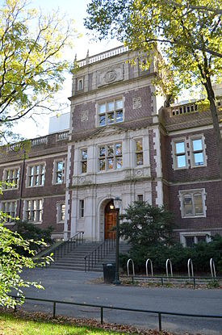

Primary Agents of Socialization
The primary agents of socialization include the family, the peer group, the school, and the mass media.

Slide 4
The Family
The most important agent of socialization in almost every society.
Primary importance rests in its role as the principal socializer of young children.
Children first interact with others and learn the values, norms, and beliefs of society through their families.

Slide 5
The Family
Socialization in a family setting can be both deliberate and unintended.
Deliberate: Intended socialization activities. Ex., father teaching children about the importance of telling the truth.
Unintended: Can have an even greater effect on children than deliberate attempts at socialization. Ex., a father explains the importance of being polite. However, the child witnesses the father being impolite. Is the child likely to follow what the father says or what the father actually does?

Slide 6
The Family
The socialization process differs from family to family.
Families come in all shapes and sizes (family size, family make-up [single parent], race, ethnicity, religion, geographic region).
All these differences affect the way a family socializes its children.

Slide 7
The Peer Group
As children grow older, forces outside of the family increasingly influence them.
Children begin to relate more and more to their peer groups.
Peer Group: A primary group composed of individuals of roughly equal age and similar social characteristics.

Slide 8
The Peer Group
Peer groups are particularly influential during the pre-teenage and early teenage years.
Winning peer acceptance is a powerful force in the lives of young people.
To win this acceptance, young people willingly adopt the values and standards of the peer group.
Young people often shape themselves into the kind of person they think the group wants them to be.

Slide 9
Peer-Group Socialization vs. Socialization Within the Family
Socialization Within the Family
Peer-Group Socialization
The norms and values imparted by the family usually focus on the larger culture.
Parents often become alarmed if they come to believe that the norms and values of the peer group are more important to their children than those of society as a whole.
In peer groups, the focus is the subculture of the group.
Peer-group goals are sometimes at odds with the goals of the larger society.

Slide 10
The School
School occupies large amounts of time and attention.
Between the ages of 5 and 18, young people spend some 30 weeks a year in school.
The school plays a major role in socializing individuals.
Much of this socialization is deliberate.

Slide 11
The School
Class activities are planned for the deliberate purpose of teaching reading, writing, arithmetic, and other skills.
Extracurricular activities such as school dances, clubs, and athletic events, are intended to prepare the student for life in the larger society.
Schools also attempt to transmit cultural values, such as patriotism, responsibility, and good citizenship.

Slide 12
The School
A large amount of unintentional socialization also occurs within the school.
What are some examples of unintentional socialization that occurs within the school?

Slide 13
The Mass Media
Influential agent of socialization that involves no face-to-face interaction.
Mass Media: Instruments of communication that reach large audiences with no personal contact between those sending the information and those receiving it.
Major forms of mass media are books, films, the Internet, magazines, newspapers, radio, and television.

Slide 14
The Mass Media
Television probably has the most influence on the socialization of children.
98 percent of homes in the United States have television sets, with an average of more than two sets per home.
Most children watch an average of about 28 hours each week.

Slide 15
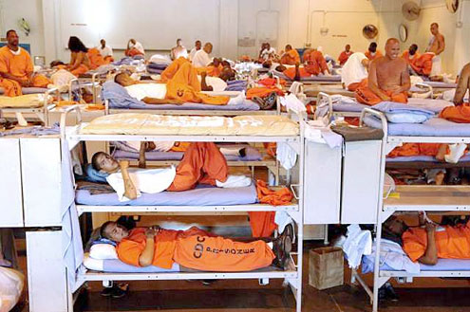
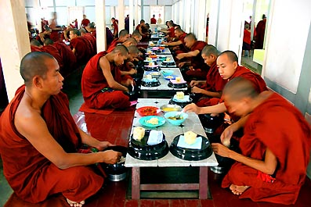
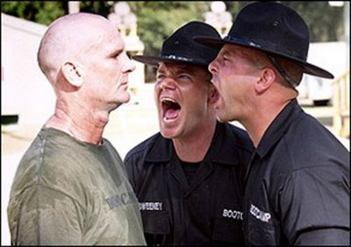
Resocialization
Total Institution: A setting in which people are isolated from the rest of society for a set period of time and are subject to tight control.

Slide 16
Resocialization
Socialization in a total institution differs from the process found in most other settings.
Total institutions are primarily concerned with resocializing their members.
Resocialization: Involves a break with past experiences and the learning of new values and norms.

Slide 17
Resocialization
In the cast of most total institutions, resocialization is directed toward changing an individual’s personality and social behavior.
This is accomplished by stripping away all semblance of individual identity and replacing it with an institutional identity – uniforms, standard haircuts, and so on.
The individual is also denied the freedoms of the outside world.
Once the person’s sense of self has been weakened, it is easier for those in power to convince the person to conform to new patterns of behavior.

