Slide 1
Maslow’s Hierarchy of Need

Slide 2
Introduction
Maslow's hierarchy of needs is a theory in psychology proposed by Abraham Maslow in his 1943 paper “A Theory of Human Motivation” in psychological review.
Maslow's hierarchy of needs is a motivational theory in psychology.

Slide 3
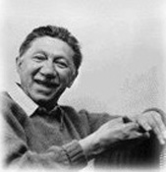
Abraham Maslow
Theory is commonly depicted as a five-tier pyramid
Abraham Harold Maslow (April 1, 1908 – June 8, 1970) was an American psychologist who was best known for creating Maslow's hierarchy of needs

Slide 4
The basic premise of this theory is that humans are born with certain needs, which can be categorized into levels depending on their degree of importance.
The 3 lowest needs are also known as deficiency needs. Unless these needs are satisfied, an individual will fail to develop into a healthy person, both physically and psychologically.
Last two needs are called growth needs as satisfaction of these needs help a person grow and develop as a human being.

Slide 5
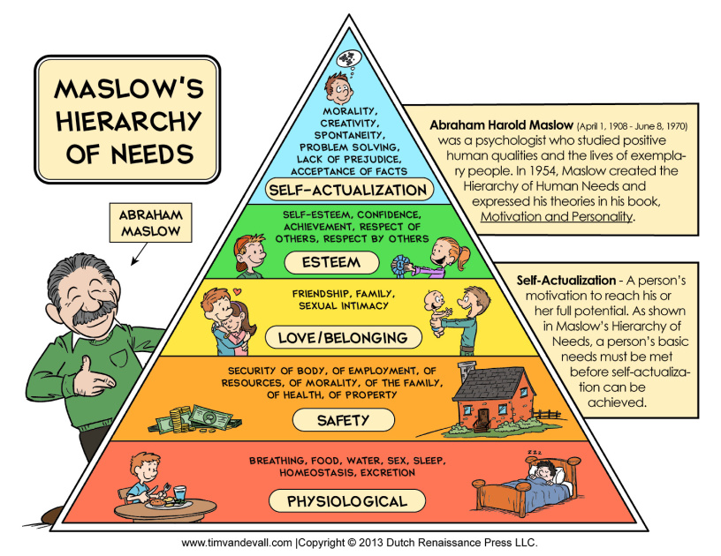

Slide 6
Hierarchy Of Needs
Physiological Needs

Slide 7
                Physiological Needs Include:
Breathing
Sleep
Clothing
Shelter
Water
Sex
Food
These are the physical requirements for human survival.

Slide 8
If these requirements are not met, the human body cannot function properly and will ultimately fail.
Physiological needs are thought to be the most important; they should be met first. This is the first and basic need on the hierarchy of needs. Without them, the other needs cannot follow up.
Most of these bodily needs can be satisfied through money. So, providing the employees with money in form of salary and wages to help them fulfill their physiological needs is the most basic thing that companies do.
Examples: Acceptable pay and working condition

Slide 9
Hierarchy Of Needs
Safety Needs
Physiological Needs

Slide 10
Safety and security needs
Safety and security needs are about keeping us safe from harm.
These needs include:
Shelter,
Job security,
Health, and
Safe environments.
If a person does not feel safe in an environment, they will seek to find safety before they attempt to meet any higher level needs. These security needs are important for survival, but they are not as important as the basic physiological needs.

Slide 11
At this level, the needs for security and safety become primary. People want control and order in their lives, so this need for safety and security contributes largely to behaviour's at this level.
Some of the basic security and safety needs include:
Financial security
Heath and wellness
Safety against accidents and injury
Finding a job, obtaining health insurance and health care, contributing money to a savings account, and moving into a safer neighbourhood are all examples of actions motivated by the security and safety needs. Together, the safety and physiological levels of the hierarchy make up what is often referred to as the basic needs.

Slide 12
7 ways to ensure safety and security in the workplace
1: Make sure you are following provincial and federal regulations.
2: Have a health and safety plan is place including an emergency procedures.
3: Involve employees in safety planning.
4: Maintain premises and machinery
5: Educate your employees about safety and security
6: Foster a culture of safety and security
7: Install verified security system such as controlled access, panic button, fire detection and verified CCTV and audio

Slide 13
Hierarchy Of Needs
Love & Belonging
Needs
Safety Needs
Physiological Needs

Slide 14


Slide 15
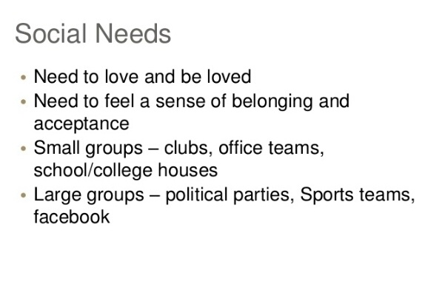

Slide 16
Love and Belongings
Man is a social animal.
According to Maslow, humans need to feel a sense of belonging and acceptance among social groups. Many people become susceptible to loneliness, social anxiety, and clinical depression in the absence of this love or belonging element.
Deficiencies within this level of Maslow's hierarchy – due to neglect, shunning, ostracism, etc. – can adversely affect the individual's ability to form and maintain emotionally significant relationships in general.

Slide 17
Organizations can help fulfill this kind of need by organizing different team events aimed at developing a fondness and friendliness among different employees.
One can overcome this need by working in a team , social facilities, mentoring and coaching

Slide 18
Hierarchy of Needs
Esteem
Needs
Love & Belonging
Needs
Safety Needs
Physiological Needs

Slide 19
Esteem needs
Once a person feels a sense of belonging the need to feel important arises.
Esteem needs include:
Need to be respected by others and in turn respect them
Need for status
Need for recognition
Fame
Prestige
Higher self respect and self confidence

Slide 20
Maslow noted two versions of esteem needs: a "lower" version and a "higher" version.
The "lower" version of esteem is the need for respect from others.
The "higher" version manifests itself as the need for self-respect. For example, the person may have a need for strength, competence, mastery, self-confidence, independence, and freedom.
Awarding bonus on achievements is one of the many ways through organization fulfill esteem needs of its employees.

Slide 21
Esteem from Self and Others:
A Most Powerful Need
Best Employee award
Congratulations

Slide 22
Hierarchy of Needs
B- Needs
(being)
Higher needs
Self-Actualization
Needs
Esteem
Needs
D- Needs
Deficit
Survival
Love & Belonging
Needs
Safety Needs
Physiological Needs

Slide 23
Self actualization
When all of the foregoing needs are satisfied, then and only then the needs for self-actualization activated.
Even if all these needs are satisfied, we may still often (if not always) expect that a new discontent and restlessness will soon develop, unless the individual is doing what, individual, is fitted for.
Abraham Maslow in his article, "A Theory of Human Motivation“ defines self-actualization to be "the desire for self-fulfillment, namely the tendency for the individual to become actualized in what he is potentially.

Slide 24
If a person is hungry, unsafe, not loved or accepted, or lacking self-esteem, it is very easy to know what the person is restless about. However, it is not always clear what a person wants when there is a need for self-actualization.
Few people reach this level in their lifetime, and even fewer stay there on a consistent basis. If the previous levels are thought to be oriented towards physical and psychological needs, the fifth level can be considered more spiritual in nature.
"self-actualisation rarely happens, certainly in less than 1% of the adult population.The fact that most of us function most of the time on a level lower than that of self-actualization" he called the psychopathology of normality

Slide 25
Self-actualized people perform with their utmost potential and are tremendously valuable assets for their organization. For this reason, companies are interested in paving the way for their employees to become self-actualized by meeting their lower order needs.

Slide 26
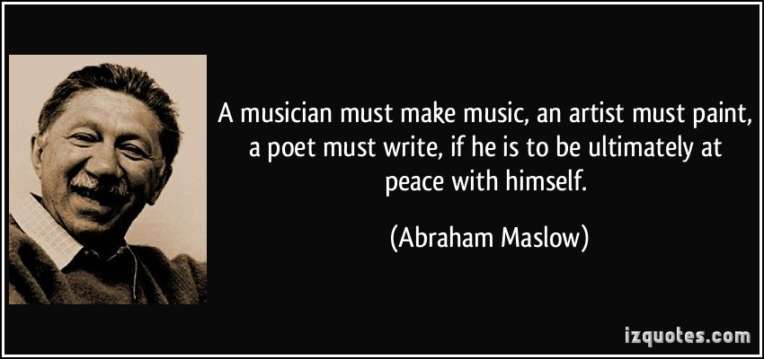

Slide 27
Some Self-Actualizing People from History
Abraham Lincoln
Thomas Jefferson
Mahatma Gandhi
Albert Einstein
Eleanor Roosevelt
William James
Benedict Spinoza

Slide 28
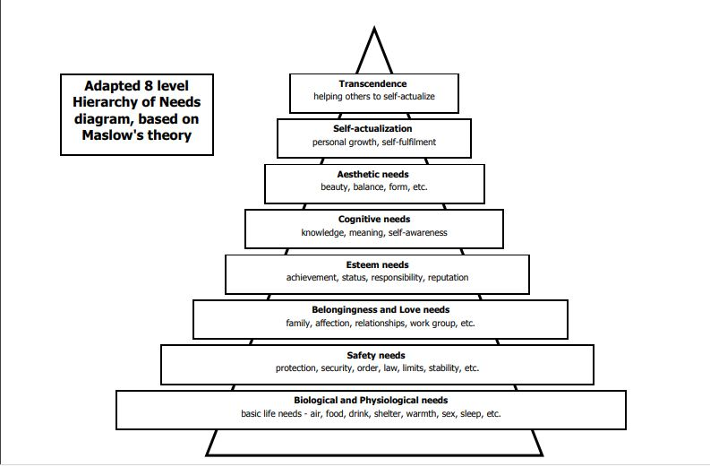

Slide 29
However in 1960’s and 1970’s the five stage model has been changed during the development of the theory and marked it to eight stage model
Additional needs are as follow:
Cognitive Needs: rich experience , self fulfillment , realizing personal potential and seeking personal growth .
Aesthetic Needs : search for beauty , appreciation .
Transcendence Needs :being helpful to others to achieve self actualization

Slide 30
Merits Of Maslow’s Motivation Theory
(i) Maslow’s theory of motivation helps the managers in understanding how to motivate ^{the employers.}
(ii) Maslow’s theory of motivation theory is very simple, common and easily ^{understandable.}
(iii) It accounts for both inter-personal and intra-personal variations in human ^{behavior.}
(iv) Maslow’s theory of motivation is dynamic because it presents motivation as a changing force; changing from one level of needs to the other

Slide 31
Criticism Of Theory
Researchers have proved that there is lack of hierarchical structure of needs as suggested by Maslow, though every individual has some ordering for his need ^{satisfaction.}
Some people may be deprived of their lower level needs but may still strive for self actualization needs. The example of MAHATMA GANDHI is one of the most important.
There are always some people to whom, the need for self-esteem is more prominent than ^{social needs.}
Another problem is that there is a lack of direct cause and effect relationship between need and behaviour. One particular need may cause different type of behaviour indifferent persons. On the other hand, as a particular individual behaviour may be due to the result of different needs. Thus, need hierarchy is not as simple as it appears to be.

