Slide 1

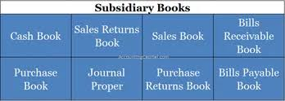

FINANCIAL ACCOUNTING
- CH. 2 BASICS OF ACCOUNTING

Slide 2
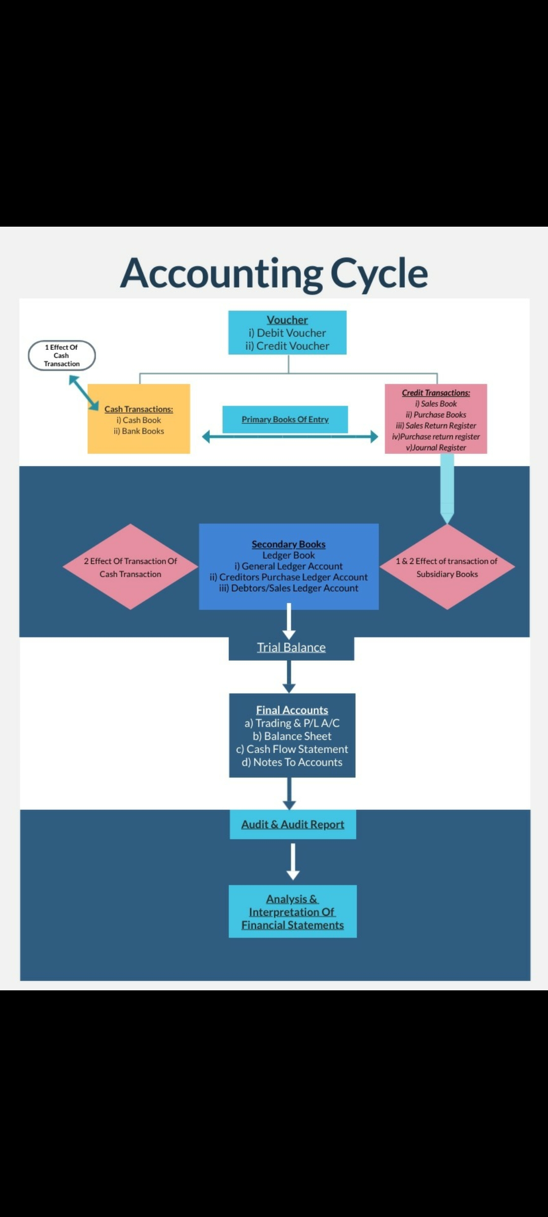

Slide 3
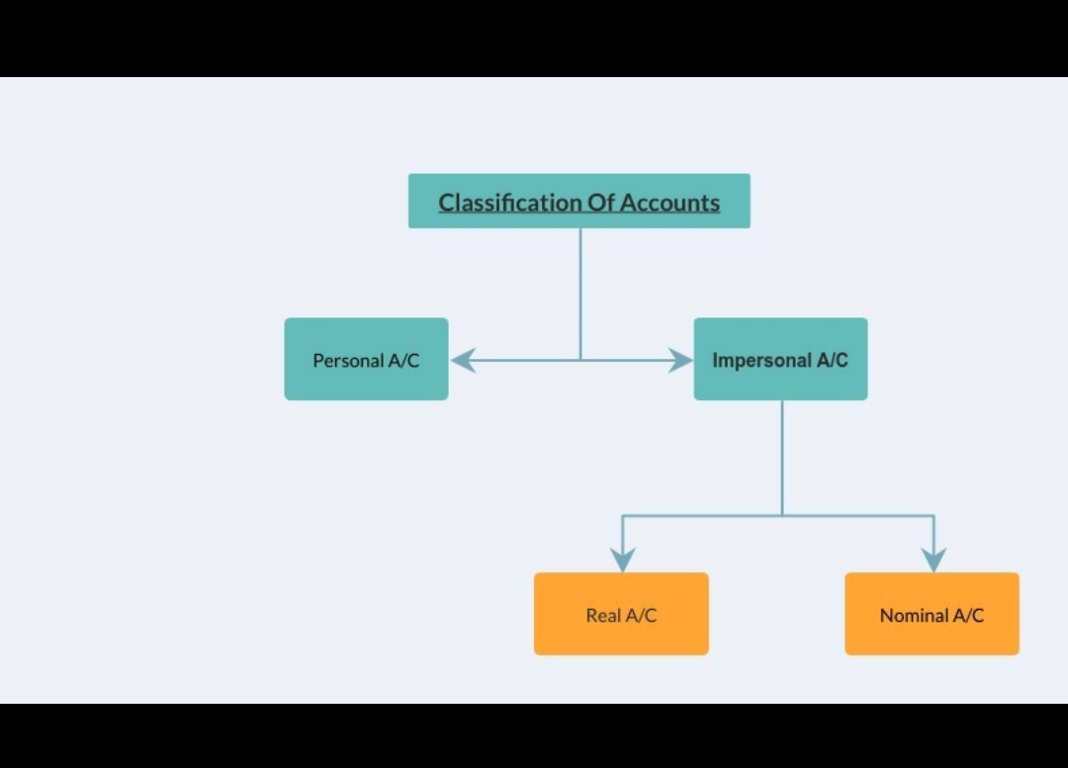

Slide 4
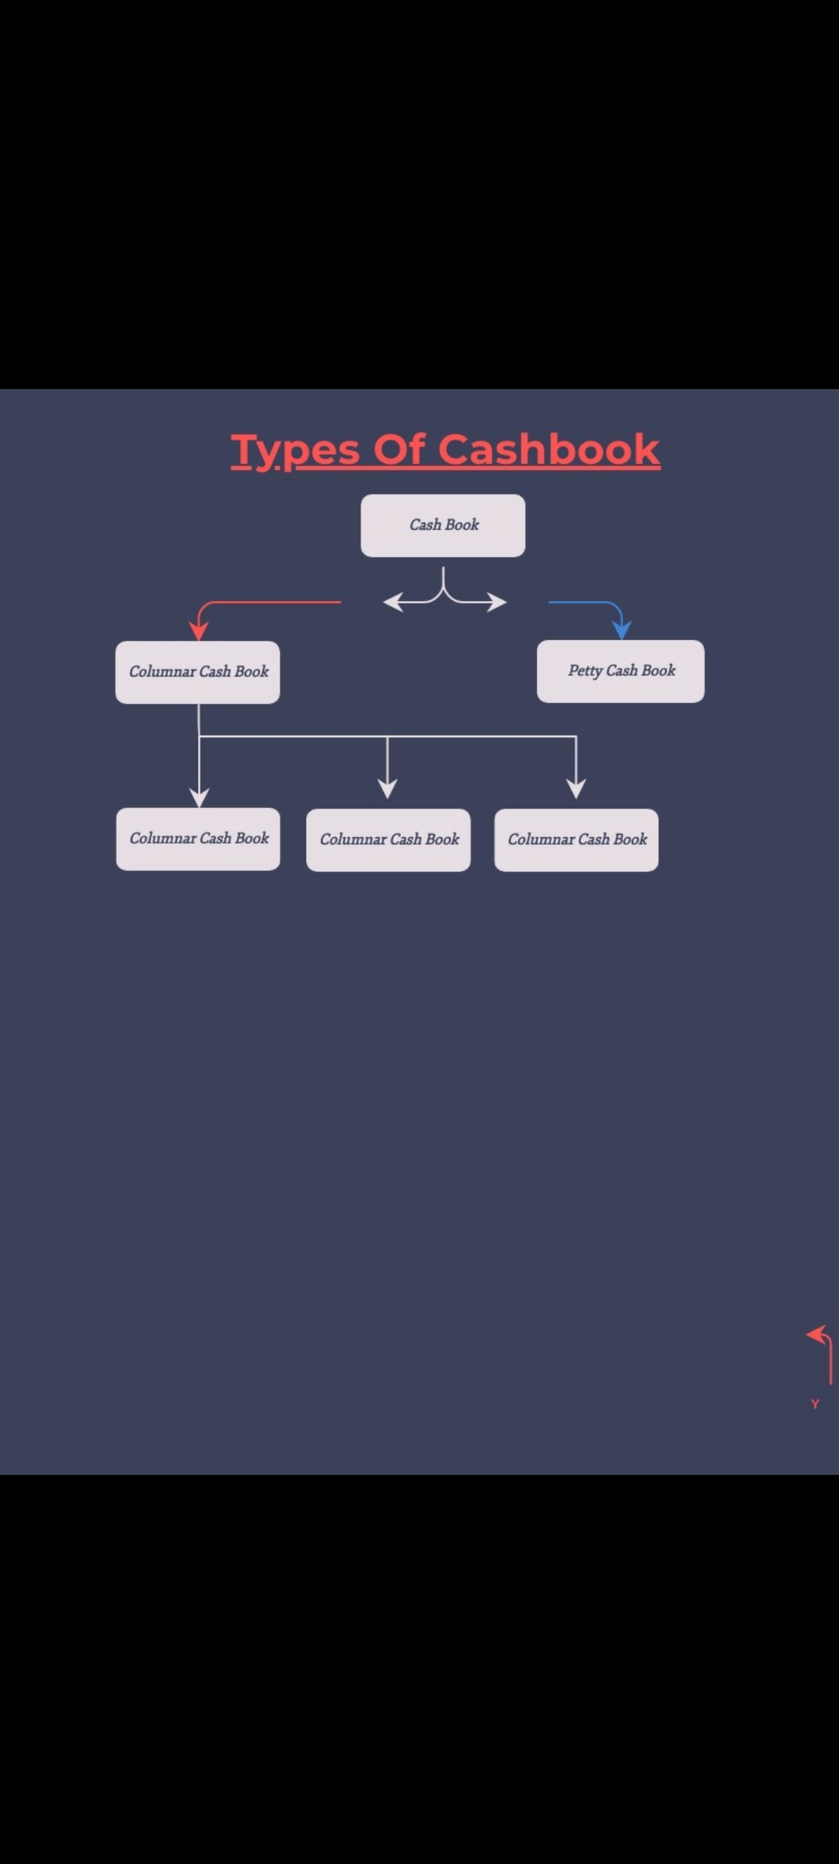

Slide 5
Subsidiary books
PURCHASE REGISTER
SALES REGISTER
SALES RETURN REGISTER
PURCHASE RETURN REGISTER
BILLS RECEIVABLE REGISTER
BILLS PAYABLE REGISTER
JOURNAL REGISTER

Slide 6
Format of Purchase Register
Sr.no | Date of goods received | Inv. date | Inv. no | Name of party supplied | Particulars | AMT. | Vat | Total amt. | L.F.
1.
 |  |  |  |  | Total
Format of Sales Register
Sr.no | Outward invoice | Name of Customers | Particulars | Amount | Vat | Total Amt. | L.F.
 | 1
 |  |  | Total

Slide 7
Format of Purchase Return Register
Date | Debit note no. | Name of customers | Particulars | Amount | Vat | Total amount | L.F.
 | 1
 |  |  | Total
Format of Sales Return Register
Date | Credit note no. | Name of Customers | Particulars | Amount | Vat | Total amount | L.F.
 | 1
 |  |  |  | Total

Slide 8
Bills Receivable
Date | Bill no. | Name of Customers | Particulars | Amount | L.F.
 | 1
 |  |  | Total
Bills Payable
Date | Bill no. | Name of Supplier | Particulars | Amount | L.F.
 | 1
 |  |  | Total

Slide 9
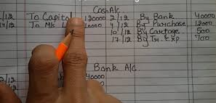
Ledger Books
Types of ledger books
General ledger
Debtors ledger
Creditors ledger

Slide 10
(i) “T” Format of Ledger
(Name) Account
Dr.
Cr.
Date | Particulars | J.F. | Amount | Date | Particulars | J.F. | Amount
x | To Bal b/f. |  | X | X | By Y A/c. |  | X
x | To X A/c |  | X | X | By bal. c/f. |  | X
 | Total |  | x |  |  |  | X
(ii) Journal Format or Ledger Account
Date | Particulars | L.F. | Debit | Credit | Balance
 | To/By Opening Balance |  |  |  | X
 | To/By

Slide 11
Trial Balance
Definition – Trial balance is a summarized statement of all ledger and cash book balance on a certain date
Difference in trial balance
Error of partial omissions
Error of commissions
Error of wrong amount postings
Casting error
Error in carrying ledger balance from ledger to trial balnce

Slide 12
Methods of preparing trial balance
Balance Method
Total Method
Compound method
Specimen of the trial balance
Name of the concern
Trial balance as on (date)
Name of the ledger account | L.F. | Debit (Balance or total) | Credit (Balance or total)

