Slide 1

THAKUR COLLEGE OF SCIENCE & COMMERCE
DEPARTMENT OF
COMMERCE
MODULE II
AGENCY
&
CLIENT

Slide 2

Client – agency relationship means relationship between the advertiser & the ad – agency .
This relationship starts when the client contracts work to the agency
Cordial relation with trust & confidence is essential to get maximum from ad agency & the agency can also work with free hand .
AGENCY
&
CLIENT
RELATIONSHIP

Slide 3


Slide 4


Slide 5
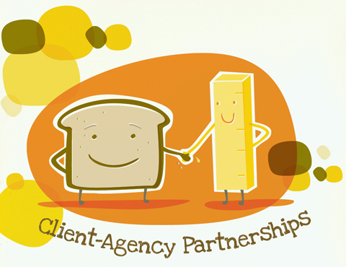

Slide 6
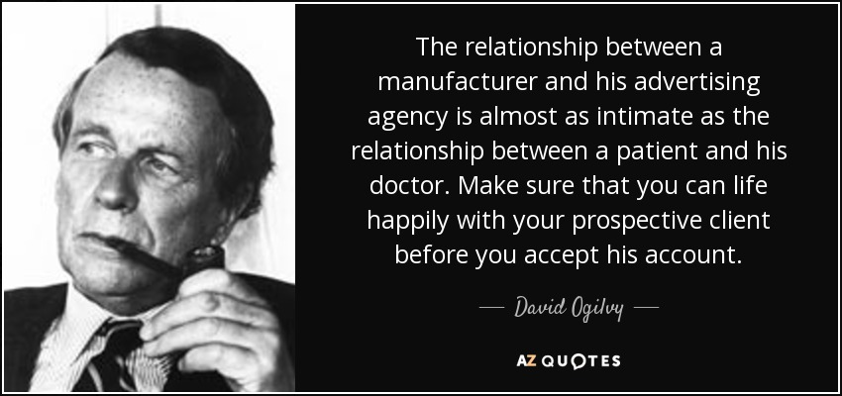

Slide 7
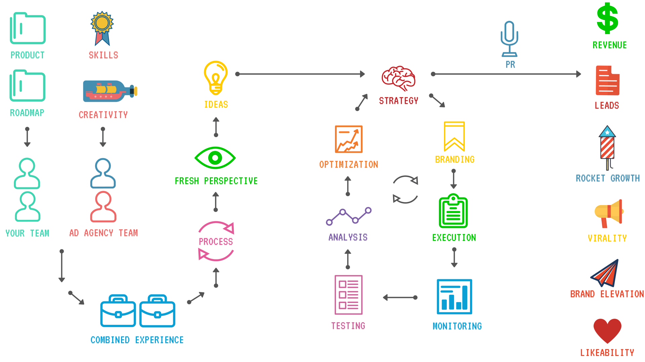
Agency – Client collaboration
workflow

Slide 8
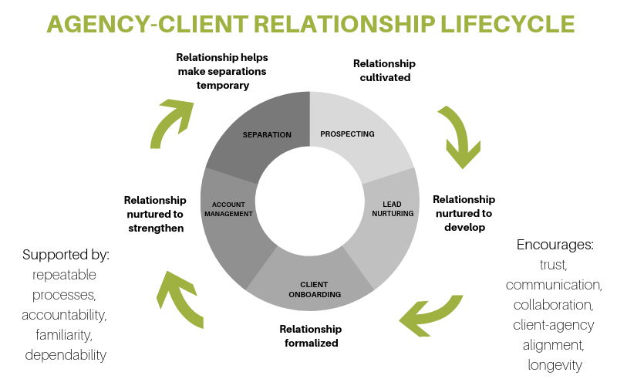

Slide 9
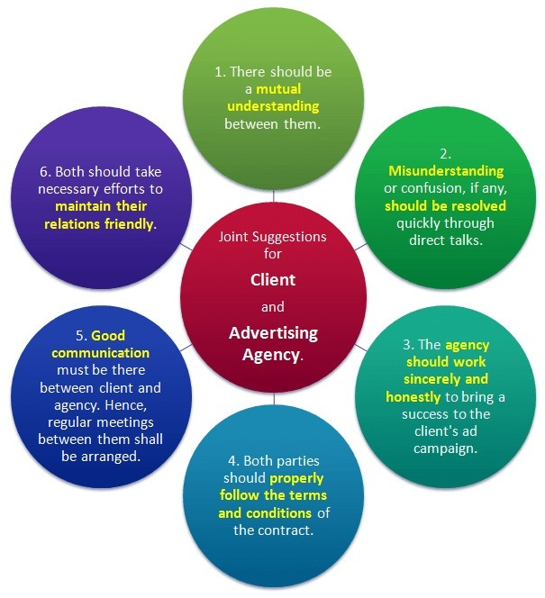

Slide 10
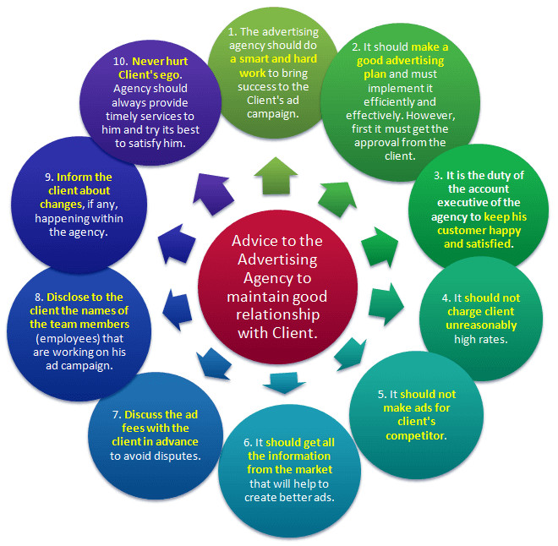

Slide 11
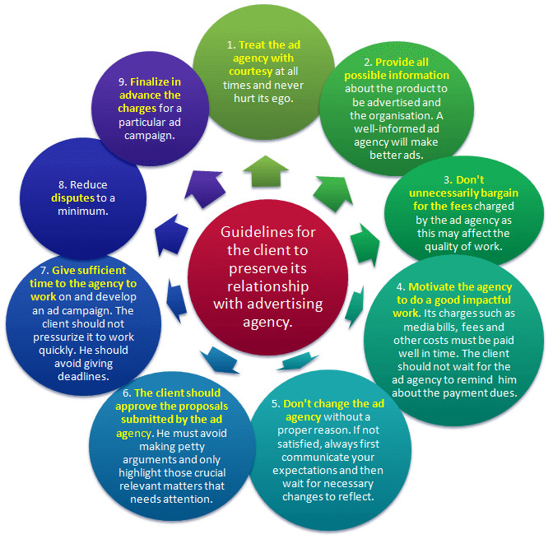

Slide 12
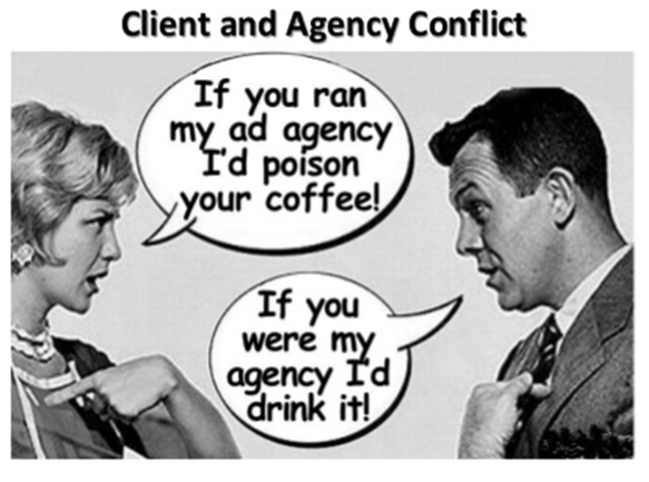

Slide 13
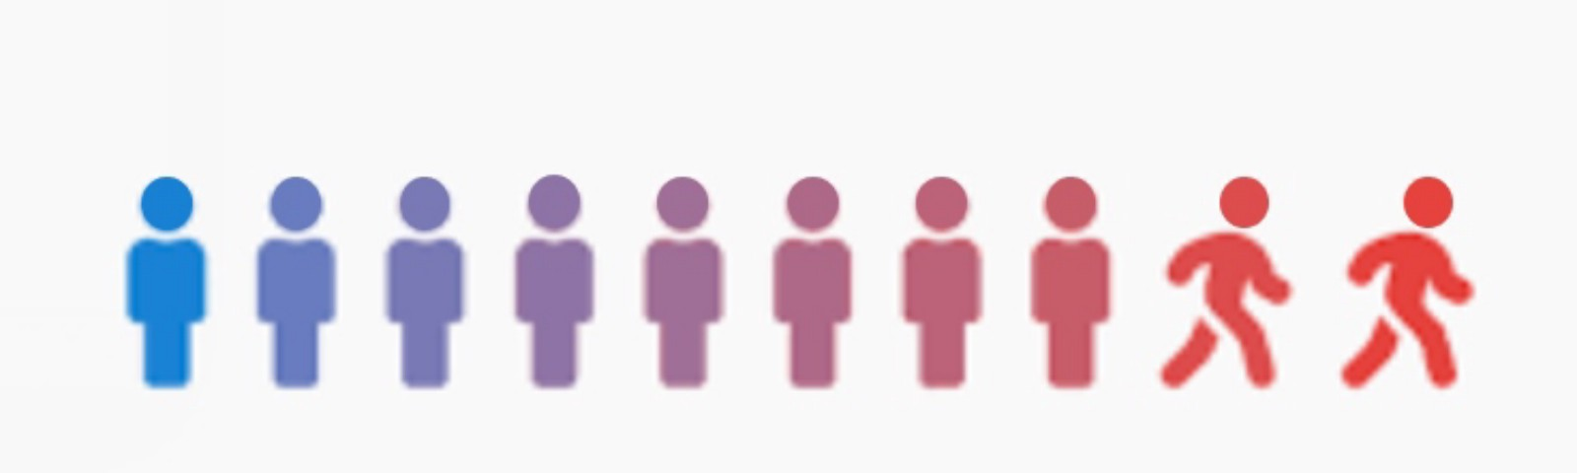
CLIENT TURNOVER
Client Turnover means clients changing their advertising agencies. It means clients close their accounts with the existing agencies & switch over to other agencies. Client Turnover has negative effect on the agency as it adversely affects its image and also its revenue.

Slide 14
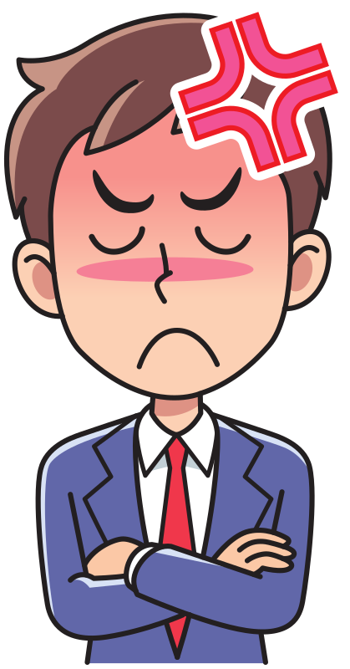
REASONS OF CLIENT
TURNOVER
POOR QUALITY OF SERVICE
CHANGE
IN PERSSONEL
HIGHER
RATES
CHANGE
IN
LOCATION
PERSONAL
CONFLICT
DISSATISFACTION
DEARTH
OF CONFIDENCE
POOR
ADVERTISING
CAMPAIGN
COMPETING ACCOUNT

Slide 15

WAYS OF AVOIDING CLIENT TURNOVER
RESPECT TO THE CLIENT
RIGHT COMPENSATION
CREDIT TO THE CLIENT
MEETINGS
RAPPORT
PROACTIVENESS
SORTING OUT DIFFERENCE
SERVICE ON TIME

Slide 16

CREATIVE PITCH
A Creative Pitch is a presentation that describes the concepts that a company (such as an agency ) proposes to use to create a media program or promotional message
It refers to the presentation by Ad agency people to a prospective account.

Slide 17
LOCATE CLIENT
RESEARCH
FOLLOW-UP
MAKING THE PITCH
DISCUSSION WITH THE CLIENT
PREPARING OUTLINE OF PITCH
STEPS INVOLVED IN PREPARING CREATIVE PITCH

Slide 18
THANK YOU !

