Slide 1

THAKUR COLLEGE OF SCIENCE & COMMERCE
DEPARTMENT OF COMMERCE
MODULE IV

Slide 2
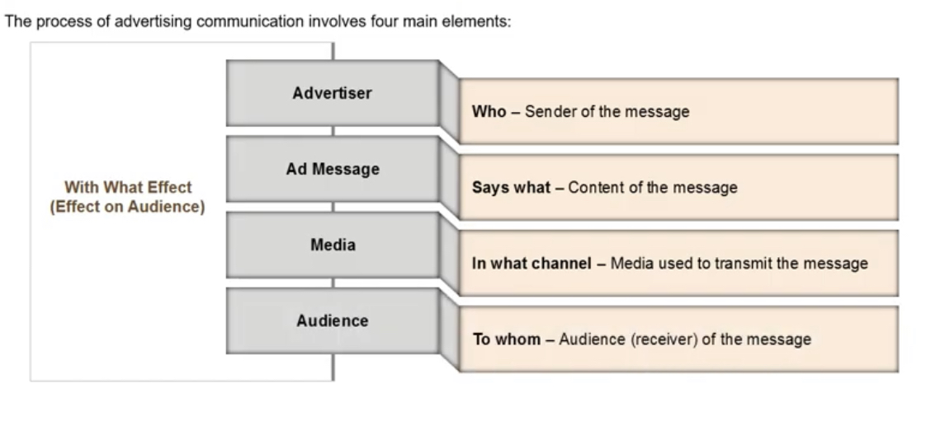
ADVERTISING AS A COMMUNICATION PROCESS

Slide 3
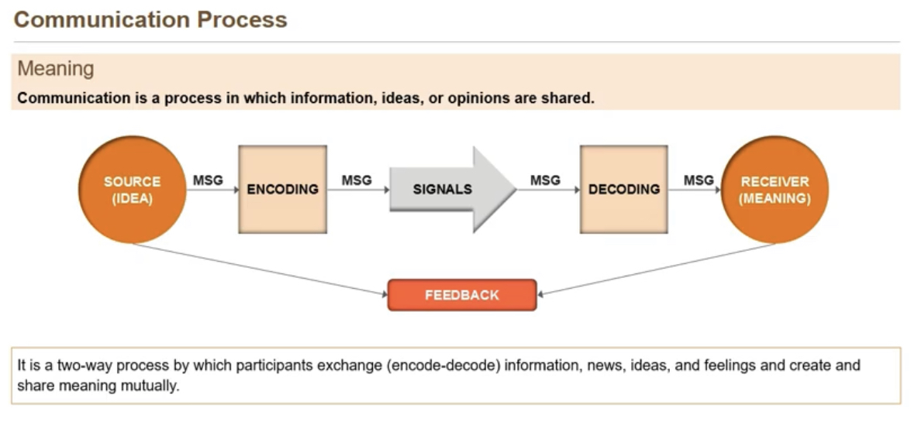

Slide 4
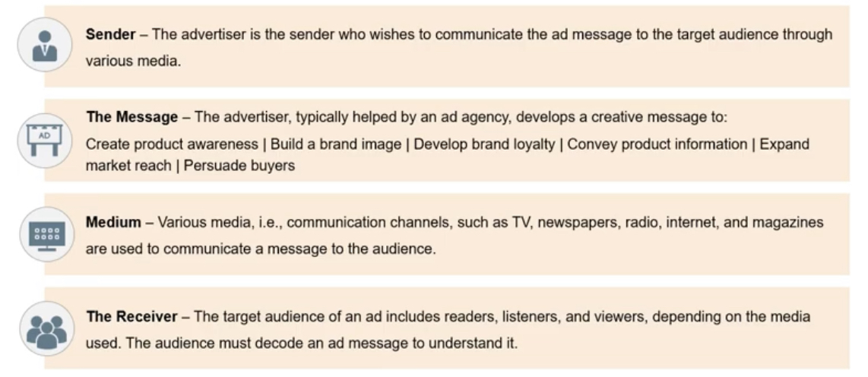
COMMUNICATION PROCESS INVOLVES

Slide 5
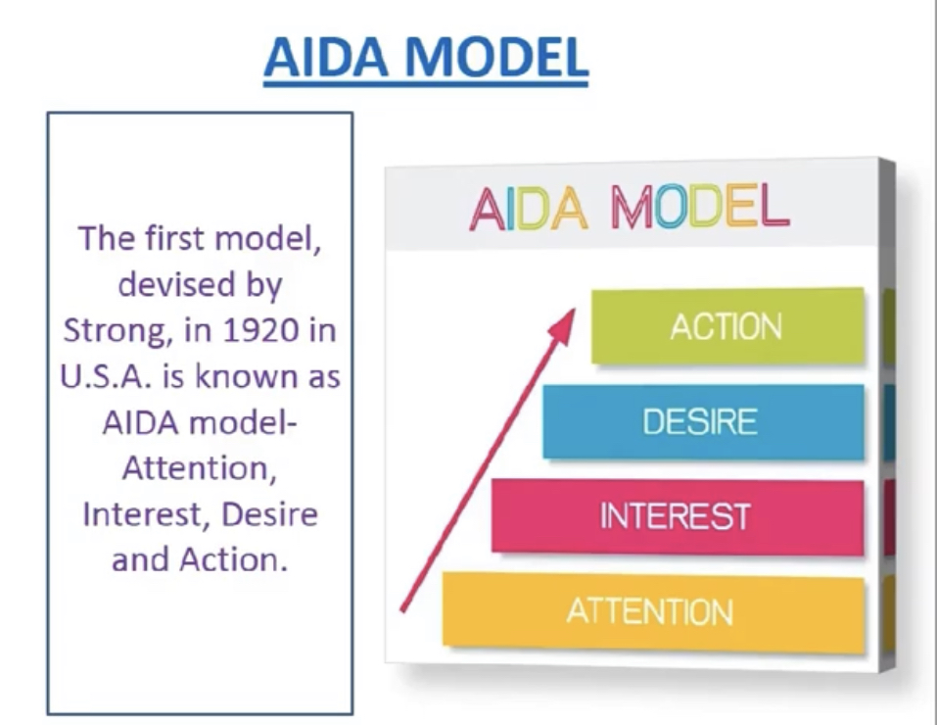

Slide 6
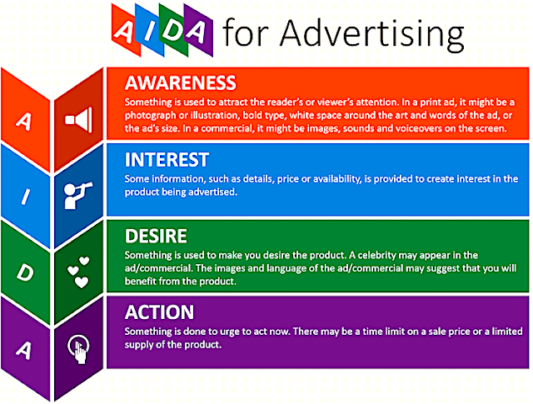

Slide 7
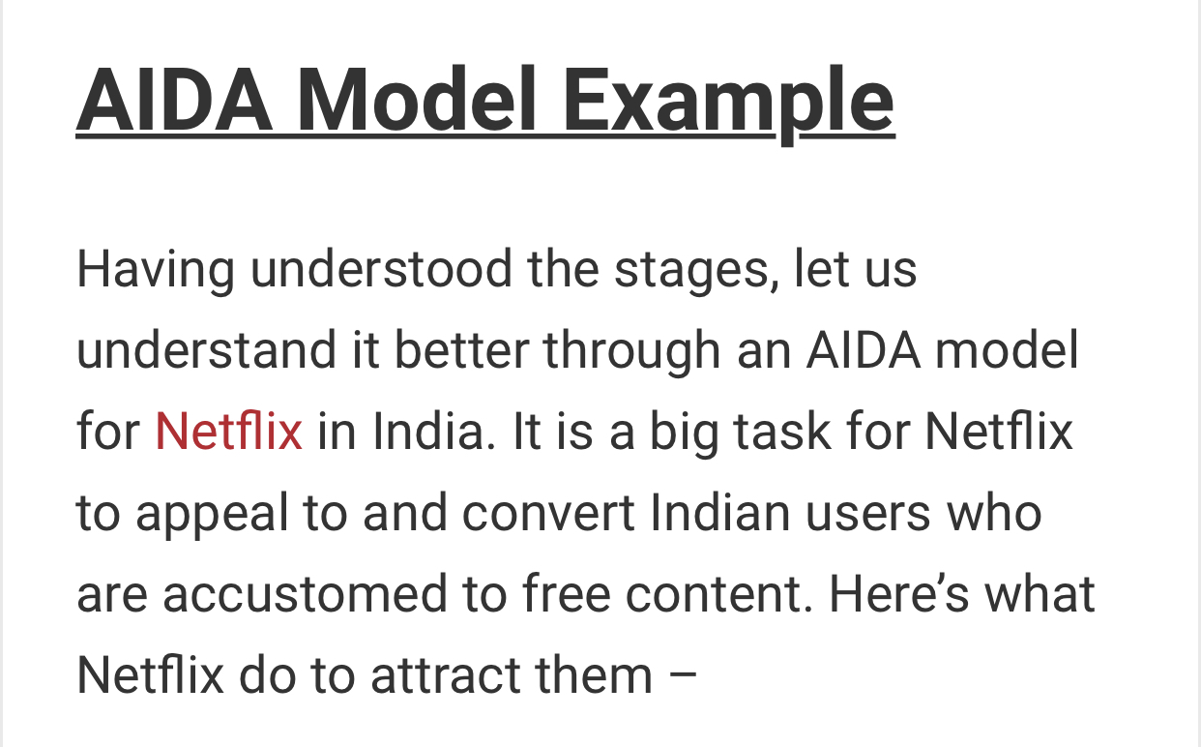


Slide 8
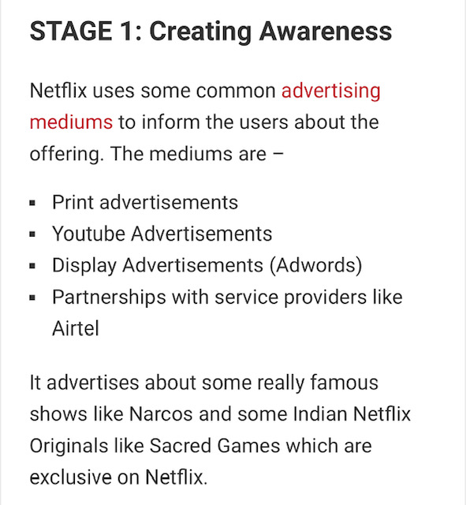


Slide 9
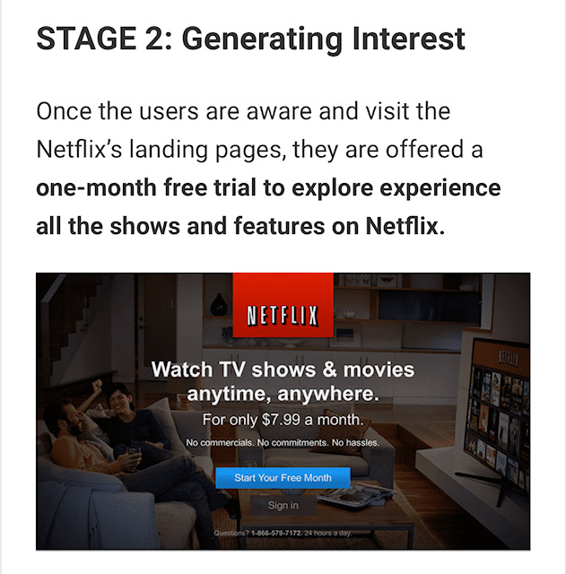

Slide 10
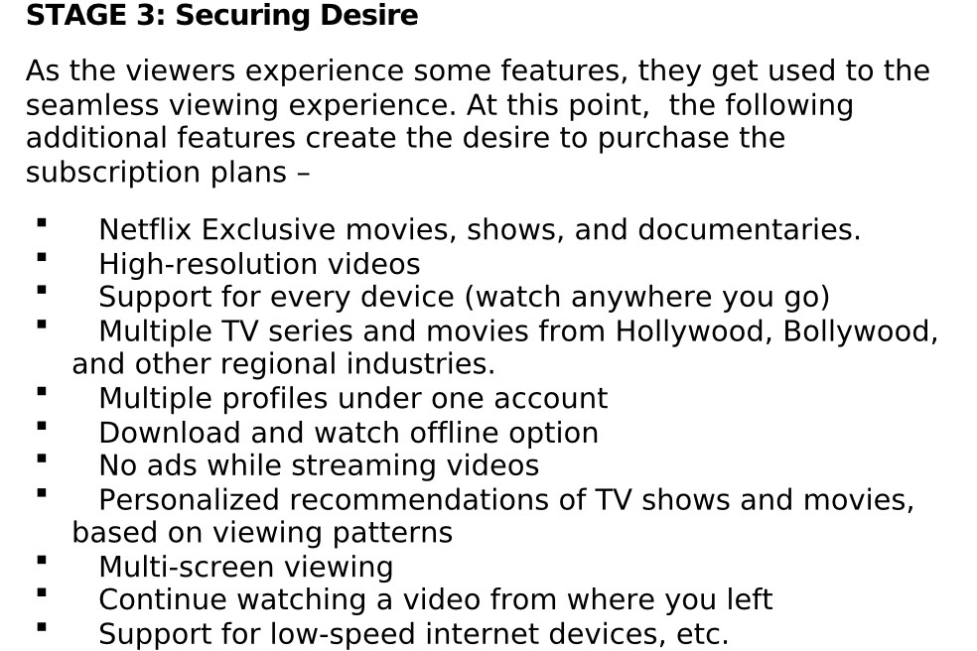

Slide 11
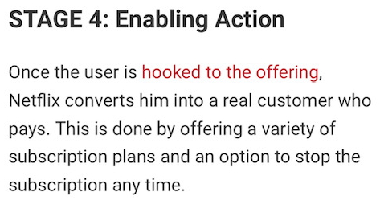


Slide 12

.
What Is Brand Image?
An image is the set of beliefs, ideas, and impression that a person holds regarding an object. – Kotler
A simple definition of brand image could be – the customers’ perception of the brand based on their interactions and experience with the brand or their beliefs of what the brand could be
Importance Of Brand Image
Every Company strives to build a strong image as it helps in fulfilling their business motives. A strong brand image has the following advantages –
More profits as new customers are attracted to the brand.
Easy to introduce new products under the same brand.
Boosts the confidence of existing customers. Helps in retaining them.
Better Business-Customer relationship

Slide 13

WAYS OF DEVELOPING BRAND IMAGE

Slide 14
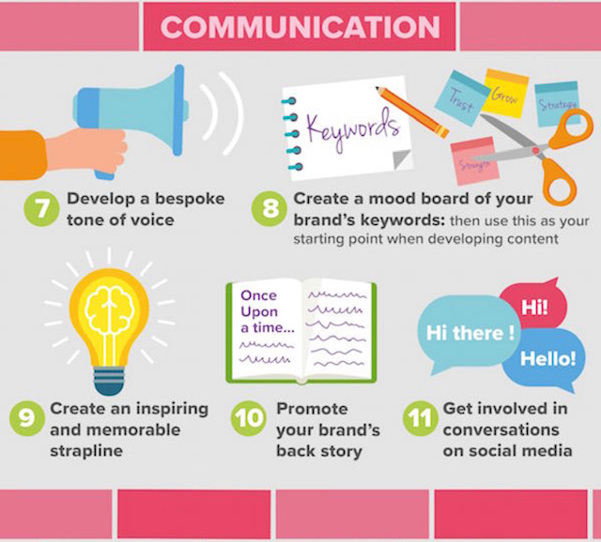

Slide 15
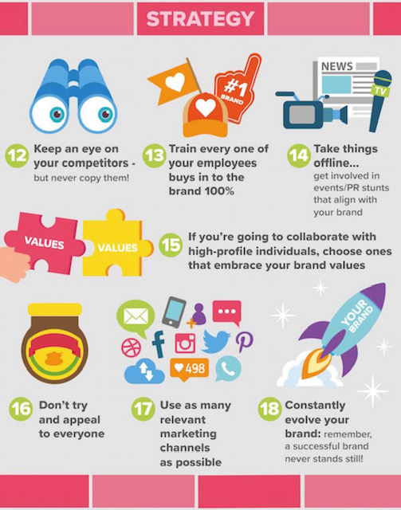

Slide 16
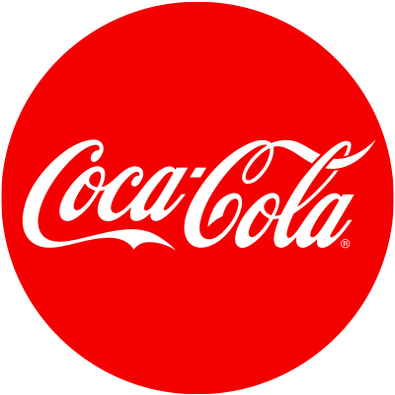



Examples Of Brand Image
Coca-Cola is a brand known for a product best used at the time of happiness, joy, and good experience. It is the ‘original cola’ and has a ‘unique taste’
McDonald’s has an image of an inexpensive brand that serves the food very quickly.
The brand image of Nike is different from other apparel brands. It’s considered to be a cult brand which deals only in sportswear.
Woodland Shoes are solid and are an ideal choice for outdoors. They last very long.

Slide 17
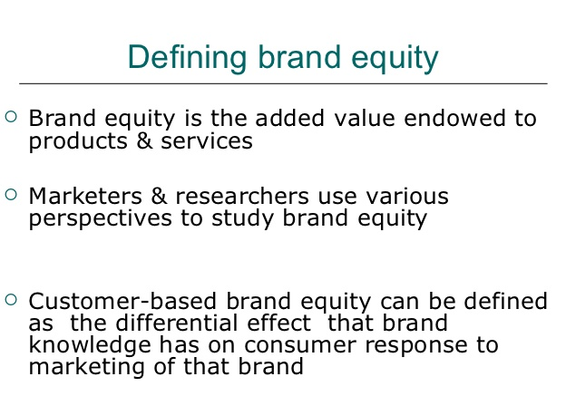


Slide 18
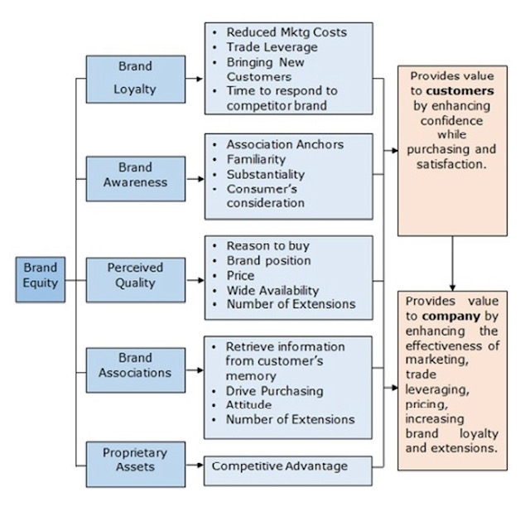

Slide 19
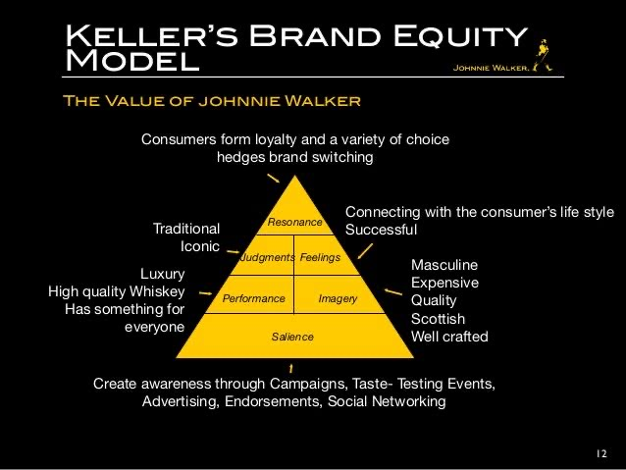

Slide 20
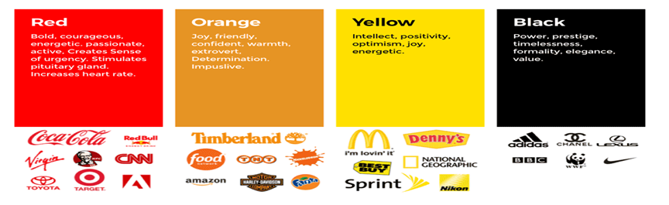
BRAND EQUITY

Slide 21
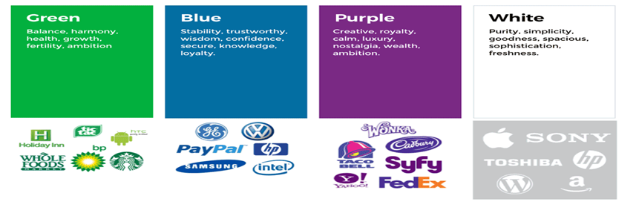
BRAND EQUITY

Slide 22
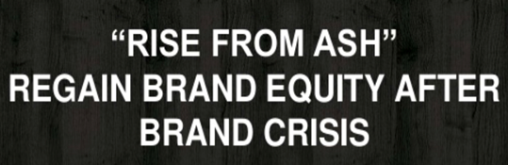

MANAGING BRAND CRISIS
Brand crisis is a form of product- harm crisis where the negative event centers on one particular brand or a set of brands belonging to the same
Following are the ways to manage brand crisis:
Restore consumer trust
Undertake Public Relation exercise
Appoint a spokesperson
Use social media
Issue of news release
Focus on facts
Mention procedures & practise
Interact with stakeholders

Slide 23
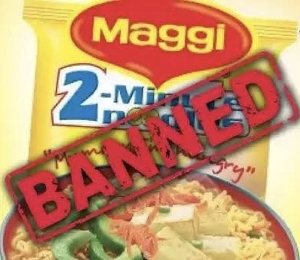
Maggi was India’s Five most trusted brands in 2014
2016 Maggi recevied notice from Food-Safety Commissioner of Uttar Pradesh , claiming , the package of noodles had been found to contain Lead which was seven times above the permissible limit & they recalled the batch
FSSAI – Food Safety And Standards Authority of Indian put a temporary ban on Maggi for unsafe & hazardous for human consumptions.
There were protest in India : Packets of Maggi noodles and photos of filmstars endorsing Maggi were burnt
(half a billion dollars loss)

Slide 24
THANK YOU !

