Slide 1




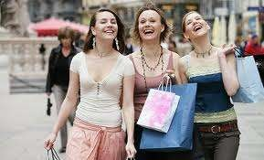


Slide 2
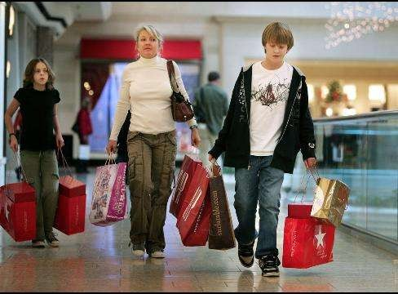
A customer is
The term customer refers to the purchaser of a product or service whereas the term consumer refers to the end user of a product or service.

Slide 3




Slide 4
Factors influencing consumer behavior
Cultural
Social
Personal
Psychological

Slide 5
personality

Slide 6
Contd..
Schiffman
(2008) as that the unique
dynamic organization of characteristics
of a particular
person, physical and which influence
psychological,
behaviour and responses to the social and physical environment.
related to the heredity and the experience of early childhood.

Slide 7

psychographic
Activities
Interests
Opinions

Slide 8
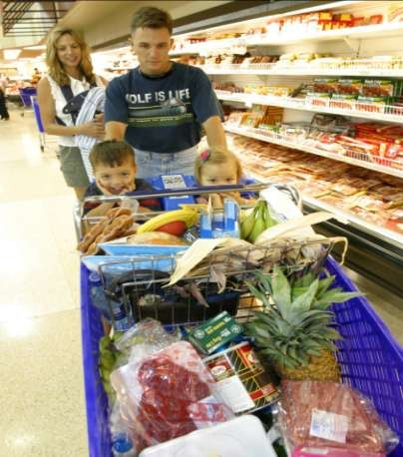
Family
helps shape an individual's attitudes and behaviours
develop political and religious beliefs, lifestyle choices, and consumer preferences

Slide 9

society
outside influences of others

Slide 10

Attitude and life styles
“the patterns in which people live and spend time and money.”
Beliefs and feelings

Slide 11
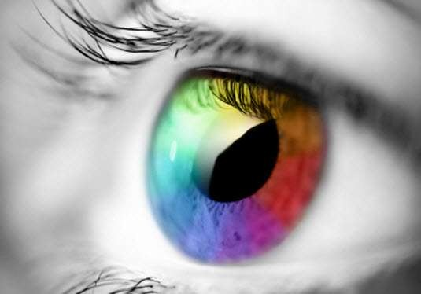
Values of perception
Organization,
Identification,
Interpretation

Slide 12
The organization, identification and interpretation of sensory information in order to represent and understand the environment.
can be shaped by learning, memory and expectations.

Slide 13
CONSUMER BEHAVIOUR MODELS

Slide 14
Types of CB Models
Consumer Buying Behavior Models
Black Box Model
John Howard Model
Engel-Kollat- Blackwell Model
Howard Sheth Model
Nicosia Model

Slide 15
Black Box Model
Consumers make many decisions every day. Most large companies research consumer buying decisions in great detail to answer questions about what consumers buy where they buy, how and how much they buy, when they buy, and why they buy. Marketers can study actual consumer purchases to find out what they buy, where, and how much. Buy learning about they whys of consumer buying behavior is not so easy – the answers are often locked deep within the consumer’s head.

Slide 16
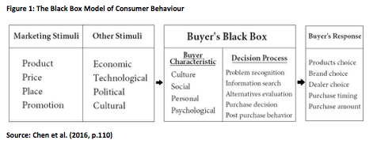

Slide 17
Nicosia model
Proposed by Francesco Nicosia in 1970s
Incomplete in a number of aspects, very reductionist
Variables in the model have not been clearly defined

Slide 18
A number of assumptions have been made that question the validity of this model, for instance:
  What type of consumer are we talking about?
The company and the consumer have an
existing relationship? What type?
Is this for a new product? Is this the first exchange the consumer has had with the producer?

Slide 19
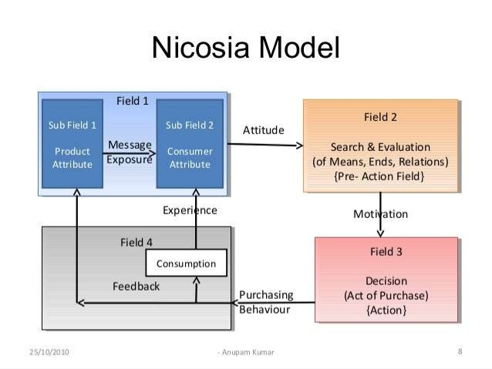

Slide 20

example
Four-wheelers

Slide 21
Engel, Blackwell and minard model
Information input
Information processing
Decision process stage
Variables influencing decision making process

Slide 22
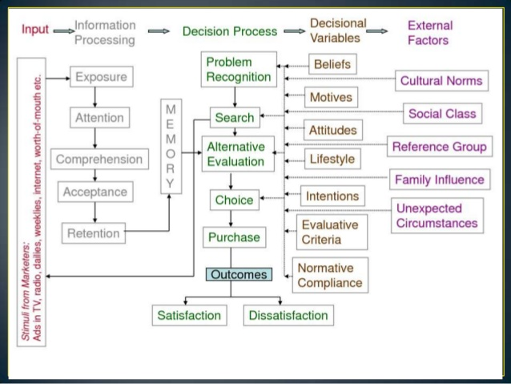

Slide 23
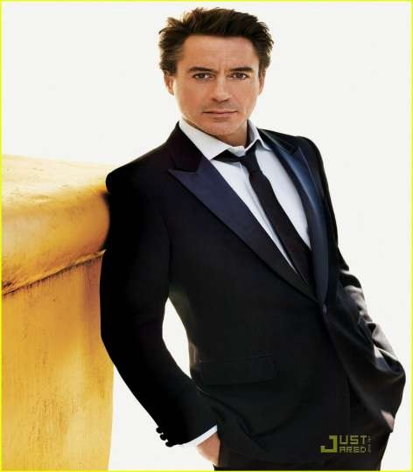
example
Garment sector
  Social class
  Family
  Lifestyle
  Personality
  Beliefs
  attitudes

Slide 24
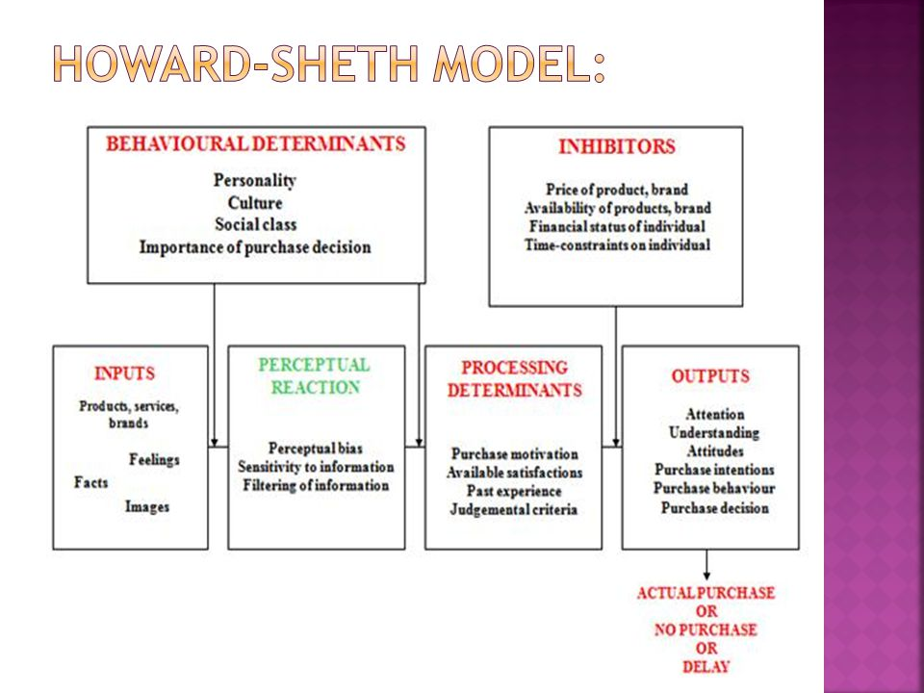

Slide 25
