Slide 1
TYBCOM
Business Economics

Slide 2
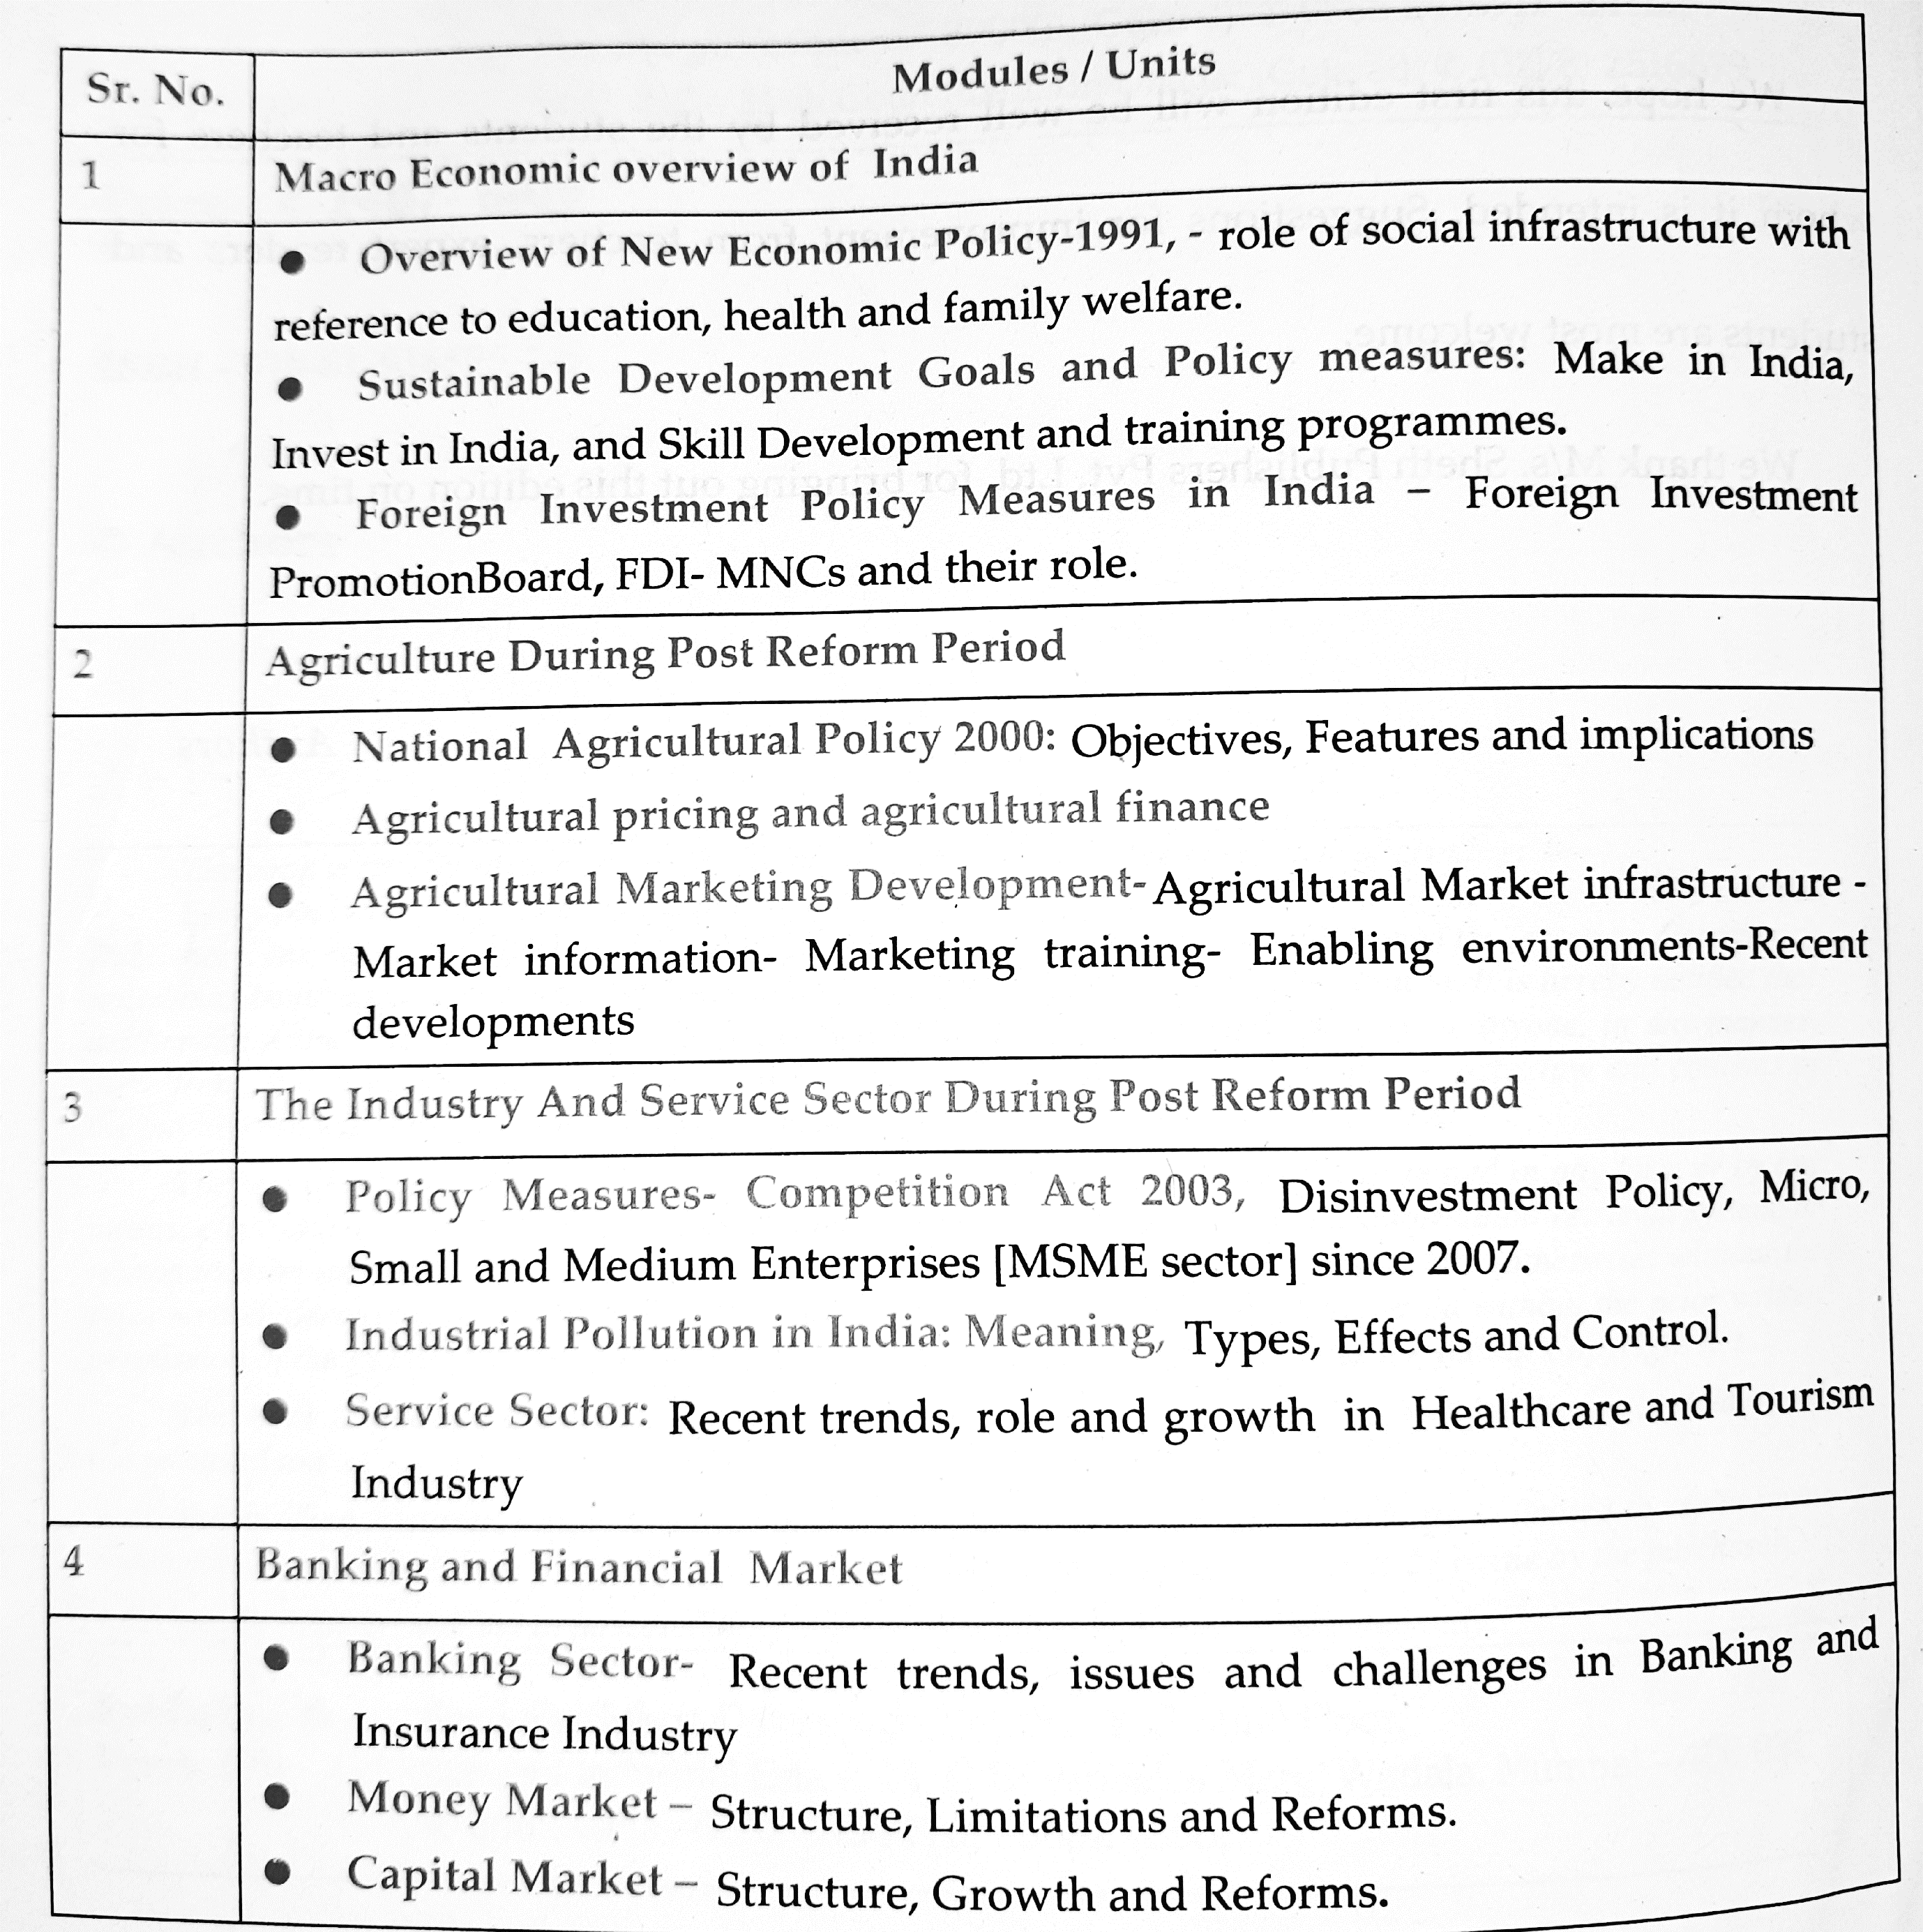

Slide 3
Indian economic policy after independence was a mix of capitalism and socialism.
In this system, India became a socialist society with a strong public sector but also with private property and democracy.
As part of it, India adopted a centralised planning approach.
Policy tended towards protectionism, with a strong emphasis on import substitution, industrialisation under state monitoring, state intervention at the micro level in all businesses especially in labour and financial markets, a large public sector, business regulation.

Slide 4
Drawbacks of Pre-1991 economic policy
1.Licence raj:
The “Licence Raj” or “Permit Raj” was the elaborate system of licences, regulations and accompanying red tape that were required to set up and run businesses in India between 1947 and 1990.
2.Import substitution: Import substitution is a trade and economic policy which advocates replacing foreign imports with domestic production. It is based on the premise that a country should attempt to reduce its foreign dependency through the local production of industrialized products and was intended to promote self reliance. But this meant the monopoly of Indian industries and lack of incentive for them to improve the quality of products which hampered consumer interests.

Slide 5
The year 1991 saw a financial crisis on the government that acted as a catalyst for economic reforms. The crisis was due to several factors like the gulf war that pushed up oil prices and lower remittances from gulf, foreign reserves at all time low, hyperinflation occurring at the same time.

Slide 6
Liberalization measures:
1. De-regulation of industrial sector: removal of licenses, deregulation of sectors for private entry, removal of price controls, De - reservation commodities meant for small scale industries.
2. Financial sector reforms – reduced role of RBI from regulator to facilitator, removal on foreign borrowing limits, foreign investment was allowed, private banks were allowed.

Slide 7
3. Tax reforms – rates were lowered for direct and indirect taxes to improve voluntary disclosure and compliance and procedures were simplified.
4. Foreign exchange reforms: devaluation of rupee, market determined exchange rates.
5. Trade and investment policy reforms: with the aim to increase international competitiveness of Indian economy and infuse foreign capital and technology the liberalization of trade and investment regime was done. Import licenses and export duties were removed also quota on imports were abolished.

Slide 8
Privatization measures:
1. Government ownership of private companies was removed by outright sale of P.S.U or removal of government from managements of these companies.
2. Disinvestment which meant selling a part of the equity to private sector was started as private capital and managerial capabilities could be effectively utilized to improve working of P.S.Us.
3. P.S.Us were granted status of Navratnas and Maharatnas to grant operational autonomy to them.

Slide 9
Globalization:
1. Outsourcing became an outcome of Indian policies. The foreign companies hired cheap Indian talent. The growth of IT industry further fueled this. The low wage rates and availability of degree of skill and accuracy also influenced this phenomenon.
2. World Trade Organization [W.T.O] was founded as a successor to General Agreement on Trade and Tariff [G.A.T.T] in the Uruguay convention. India was a founder member and has been instrumental in deciding policies. W.T.O aims to reduce tariff and non tariff barriers amongst nations and ensure all countries take advantage of world’s trade.

Slide 10
Infrastructure is generally defined as the physical framework of facilities through which goods and services are provided to the public. Its linkages to the economy are multiple and complex, as it affects production and consumption directly, creates positive and negative spillover effects and involves large inflow of expenditure.
Social infrastructure refers to the core elements of social change (like schools, colleges, hospitals and nursing homes) which serve as a foundation for the process of social development of a country. Social development focuses on human resource development, implying the development of skilled personnel as well as healthy and efficient human beings.

Slide 11
Role of Social Infrastructure
Education:
According to Education Commission, 1966, “Education as an investment in human resource plays an important role among the factors that contribute to economic growth.”

Slide 12
Educational Policy in India
Before 1976, education was exclusively the responsibility of states; the Central government was only concerned with certain areas like co-ordination and determination of standards in technical and higher education, etc. In 1976, through 42nd Constitutional amendment, education became a joint responsibility.
The 86th Constitutional Amendment Act, 2002 made Right to Education a fundamental right under article 21-A, making education free and compulsory for the children between the age of 6-14.
Also, national education policy has been amended from time to time, e.g. in 1968, 1986, 1992 and 2020.

Slide 13
The national policy on education envisaged that free and compulsory education of satisfactory quality should be provided to all children up to the age of 14 years before the commencement of 21st century.
The target of universalizing elementary education has been divided into three broad parameters i.e. universal access, universal retention and universal achievement during the Eighth Five year Plan (1992-1997).
As a result of the efforts made by the Central government and State governments, 94 per cent of country’s rural population have Primary schools within one km and 84 per cent have upper primary schools within three km. This has resulted in: (i) Enrolment of children of 6-14 years of age in primary and upper primary schools has gone up steadily since independence to 87 and 50 per cent respectively; (ii) Significant improvements have taken place in enrolment of girls and SCs/STs; and (iii) number of primary and upper primary schools have gone up from 2.23 lakh in 1950-51 to 7.75 lakh in 1996-97. Accordingly the number of teachers in primary and upper primary schools has also gone up from 6.24 lakh to 30.84 lakh during this period.

Slide 14
The Central and State governments have over a period of time, evolved strategies to check drop-out rates and improve levels of achievements in the schools the key elements of which include : (i) Creating parental awareness and community mobilisation; (ii) involvement of communities and PRls (73rd and 74th Constitutional Amendments); (iii) economic incentives; (iv) improvement in the content and process of schooling (Minimum levels of learning); (v) District primary Education Programme initiative; and (vi) national Programme of nutritional Support to Primary Education (Mid-day Meals Scheme).

Slide 15
The District Primary Education Programme (DPEP) was launched in 1994 as a major initiative to achieve the objective of Universalisation of Primary Education (UPE). The programme took a holisitc view of primary education development and tried to operationalise the strategy of UPE through district specific planning with emphasis on decentralised management, participatory processes, empowerment and capacity building at all levels. The programme was implemented through the State level registered societies.

Slide 16
National Programme of Nutritional Support to Primary Education:
A National programme of Nutritional Support to primary Education commonly called the Midday Meals Scheme Launched on 15 August 1995 aimed at improving enrolment, attendance and retention while simultaneously impacting on the nutrition status of students in primary classes. The programme envisaged provision of cooked meals/ progressed food for children studying in classes I-V in all government, local body and government aided primary, schools.

Slide 17
Rashtriya Madhyamik Shiksha Abhiyan, 2009
Sakshar Bharat Abhiyan, 2009
Rashtriya Ucchatar Shiksha Abhiyan, 2013 (CSS)
National Vocational Education Qualification Framework

Slide 18
Recent developments: On June 24, 2019 during a Lok Sabha session, Union HRD minister, Dr Ramesh Pokhriyal 'Nishank', introduced a number of reforms to imporve teaching sector in the country.
In order to focus on quality education, the Central rules to the Right of Children to Free and Compulsory Education (RTE) Act, 2009 have been amended to include reference on class-wise, subject-wise learning outcomes.
The National Council of Educational Research and Training (NCERT) conducts periodic national surveys of learning achievement of children in classes 3, 5, 8 and 10. Four rounds of National Achievement Survey (NAS) have been conducted so far for class 5 and three rounds for classes 3 and 8. These reveal improvement in learning achievement levels of pupils, in identified subjects from first round to fourth round.

Slide 19
Section 23(2) of the RTE Act has been amended to extend the period of in-service training for untrained elementary teachers to March 31, 2019 in all the states and UTs.
The National Institute of Open Schooling (NIOS) was entrusted to conduct this training through ODL (Open Distance Learning) mode.
The Central Government has launched an integrated scheme for school education named as Samagra Shiksha, w.e.f. 2018-19 which subsumes the three erstwhile Centrally Sponsored schemes of school education i.e Sarva Shiksha Abhiyan (SSA), Rashtriya Madhyamik Shiksha Abhiyan (RMSA), and Centrally Sponsored Scheme on Teacher Education (CSSTE).

Slide 20
The Government has launched Rashtriya Aavishkar Abhiyan (RAA) programme on 09.07.2015, to motivate and engage children of the age group of 6-18 years in science, mathematics and technology through observation, experimentation, inference drawing, model building, etc. both through inside and outside classroom activities.
A single point repository of e resources called e- PATHSHALA containing NCERT textbooks and various other learning resources has been developed for showcasing and disseminating all educational resources including textbooks, audio, video, periodicals, and a variety of other print and non-print materials.

Slide 21
MHRD has launched a Massive Open Online Courses (MOOCs) platform popularly known as SWAYAM (Study Webs of Active learning for Young Aspiring Minds) on July 9, 2017. The portal is offering various online courses for school education and higher education. NCERT is developing course modules for Massive Open and Online Course (MOOCs) for school education system in 12 subject areas (accountancy, business studies, biology, chemistry, economic, history, geography, mathematics, physics, political science, psychology and sociology) for classes 9-12.
A programme for utilization of satellite communication technologies for transmission of educational e-contents through 32 National Channels i.e. SWAYAM PRABHA DTH-TV has been launched. Central Institute of Educational Technology (CIET)-NCERT is the national coordinator for one DTH TV channel i.e., Kishore Manch (#31) and has started feeding a 24x7 educational TV channel by July 9, 2018.

Slide 22
Health:
As per the Rural Health Statistics (RHS) 2020, as on 31.3.2020 the status of public health facilities function in the Country is as under:
1,57,921 Sub Centres (SCs),
30,813 Primary Health Centres (PHCs),
5,649 Community Health Centres (CHCs),
1193 Sub-divisional Hospitals (SDHs) & 810 Districts Hospitals (DH) in the country
There is a shortfall of 46140 SCs (24%), 9231 PHCs (29%) and 3002 CHCs (38%) across the country as per the Rural Health Statistics (RHS) 2020.

Slide 23
It was not until 1983 that India adopted a formal or official National Health Policy. Prior to that health activities of the state were formulated through the Five year Plans and recommendations of various Committees.
in the 1950s and the 1960s, the focus was on managing the epidemics. Widespread national-level campaigns were started to overcome the loss by malaria, smallpox, tuberculosis, leprosy, filaria, cholera and others.

Slide 24
The structure of public healthcare delivery system remained unchanged in first two Five Year Plans and urban areas received major share of resources. By the end of second plan, there was one Primary Health Unit per 140,000 rural populations and one hospital for 320,000 rural populations. On the contrary, in urban areas, the ratio for hospital and dwellers was 1:36,000 and 1:440 for hospital bed per population. Clearly, the health disparities were quite high.
The Third Five Year Plan(1962-67) proposed the establishment of medical colleges, research institutes and training centres for doctors, nurses and auxiliary staff. Though the family planning programme started in 1951, it was actively pursued in this period.

Slide 25
The Fifth Five Year Plan was landmark as it acknowledged the widening gap between rural and urban areas with respect to all health indicators. It thus focused on accessibility of health services in the rural areas through the Minimum Needs Programme.
The Sixth Five Year Plan was influenced by the international declaration ‘Health for all by 2000 AD’. Many radical measures were suggested by sixth and seventh plan but the action taken was minimal.
Finally, in 1983, the first National Health Policy (NHP) was announced. It aimed to achieve the goal of universal health care that is affordable and as per the needs of the people. Emphasis was laid on preventive, promotive and rehabilitative primary health care; decentralization and community participation and increased role of private investors.

Slide 26
The 9th FYP came up with innovative strategies such as evolving state-specific strategies, integration of medical education and health, provision of PHC in slums, horizontal and vertical integration of programmes and improvement of disease surveillance.
In the Eleventh Five Year Plan, the central theme with respect to the health sector is ‘inclusive growth’. It envisaged the provision of healthcare facilities in rural areas through National Rural Health Mission (NRHM). The Twelfth Five Year Plan was prepared after the consultation of public. It called for Universal Health Coverage through Essential Health Package and to assess the social determinants of health. Major thrust areas were reducing out of pocket expenditure (OOP), ensuring accessibility of vaccines, medicines and technology, increasing staff, AYUSH (Ayurveda, Yoga and Naturopathy, Unani, Siddha and Homeopathy) doctors, disaster management areas, nutrition promotion, improve sanitation and provide safe drinking water facilities.

Slide 27
The National Health Policy 2017 came after 14 years gap and therefore the context of health changed in many ways. The growing number of non-communicable diseases and infectious diseases; rise of private sector; increased expenditure on health and rising economic growth enabling enhanced fiscal capacity have shaped the 2017 policy. The policy aims at providing health care in an ‘assured manner’ to all. There is shift from sick-care to wellness and wellbeing of individuals. The Make in India model governs the manufacturing of drugs and devices. AYUSH is given special emphasis, especially yoga.

Slide 28
Under the National Health Mission, the government has launched several schemes like:
1. Reproductive, Maternal, Newborn, Child and Adolescent Health (RMNCH+A) programme essentially looks to address the major causes of mortality among women and children as well as the delays in accessing and utilizing health care and services. It also introduces new initiatives like the use of Score Card to track health performance, National Iron + Initiative to address the issue of anemia across all age groups and the Comprehensive Screening and Early interventions for defects at birth, diseases, and deficiencies among children and adolescents.
2. Rashtriya Bal Swasthya Karyakram (RBSK) is an important initiative aiming at early identification and early intervention for children from birth to 18 years to cover 4 ‘D’s viz. Defects at birth, Deficiencies, Diseases, Development delays including disability. Early detection and management diseases including deficiencies bring added value in preventing these conditions to progress to its more severe and debilitating form
3. The Rashtriya Kishor Swasthya Karyakram
The key principle of this programme is adolescent participation and leadership, Equity and inclusion, Gender Equity and strategic partnerships with other sectors and stakeholders. The programme enables all adolescents in India to realize their full potential by making informed and responsible decisions related to their health and well-being and by accessing the services and support they need to do so.

Slide 29
4. The government of India has launched Janani Shishu Suraksha Karyakaram to motivate those who still choose to deliver at their homes to opt for institutional deliveries. It is an initiative with a hope that states would come forward and ensure that benefits under JSSK would reach every needy pregnant woman coming to government institutional facility.
• Since the rate of deaths in the country because of communicable and non-communicable diseases is increasing at an alarming rate, the government has introduced various programmes to aid people against these diseases.
In India, approximately about 5.8 million people die because of Diabetes, heart attack, cancer etc each year. In other words, out of every 4 Indians, 1 has a risk of dying because of a Non- Communicable disease before the age of 70.
According to the World Health Organisation, 1.7 million Indian deaths are caused by heart diseases.

Slide 30
5. National AIDS Control Organisation was set up so that every person living with HIV has access to quality care and is treated with dignity. By fostering close collaboration with NGOs, women’s self-help groups, faith-based organizations, positive people’s networks, and communities, NACO hopes to improve access and accountability of the services. It stands committed to building an enabling environment wherein those infected and affected by HIV play a central role in all responses to the epidemic – at state, district and grassroots level.
6. Revised National TB Control Programme is a state-run tuberculosis control initiative of Government of India with a vision of achieving a TB free India. The program provides, various free of cost, quality tuberculosis diagnosis and treatment services across the country through the government health system.

Slide 31
7. National Leprosy Eradication Programme was initiated by the government for Early detection through active surveillance by the trained health workers and to provide Appropriate medical rehabilitation and leprosy ulcer care services.
8. The Government of India has launched Mission Indradhanush with the aim of improving coverage of immunization in the country. It aims to achieve at least 90 percent immunization coverage by December 2018 which will cover unvaccinated and partially vaccinated children in rural and urban areas of India.
9. In order to address the huge burden of mental disorders and the shortage of qualified professionals in the field of mental health, Government of India has implemented National Mental Health Program to ensure the availability and accessibility of minimum mental healthcare for all in the foreseeable future.

Slide 32
10. Pulse Polio is an immunization campaign established by the government of India to eliminate polio in India by vaccinating all children under the age of five years against the polio virus.
11. The Pradhan Mantri Swasthya Suraksha Yojana (PMSSY) was announced with objectives of correcting regional imbalances in the availability of affordable/ reliable tertiary healthcare services and also to augment facilities for quality medical education in the country by setting up of various institutions like AIIMS and upgrading government medical college institutions.
12. Since there are huge income disparities, therefore, the government has launched several programmes in order to support the financially backward class of the country. As about 3.2 crore people in India fall under the National Poverty line by spending on healthcare from their own pockets in a single year. The most important programme launched by the government is Rashtriya Arogya Nidhi which provides financial assistance to the patients that are below poverty line and are suffering from life-threatening diseases, to receive medical treatment at any government run super specialty hospital/ institution.

Slide 33
13. National Tobacco Control Programme was launched with the objective to bring about greater awareness about the harmful effects of tobacco use and about the Tobacco Control Laws and to facilitate the effective implementation of the Tobacco Control Laws.
14. Integrated Child Development Service was launched to improve the nutrition and health status of children in the age group of 0-6 years, lay the foundation for proper psychological, physical and social development of the child, effective coordination and implementation of policy among the various departments and to enhance the capability of the mother to look after the normal health and nutrition needs through proper nutrition and health education.
15. Rashtriya Swasthya Bima Yojana is a government-run health insurance programme for the Indian poor. It aims to provide health insurance coverage to the unrecognized sector workers belonging to the below poverty line and their family members shall be beneficiaries under this scheme.

Slide 34
The National Health Policy, 2017
The policy, which aims at providing healthcare in an “assured manner” to all, will address current and emerging challenges arising from the ever changing socio-economic, technological and epidemiological scenarios.
The government aims in shifting focus from “sick-care” to “wellness”, by promoting prevention and well-being.
It intends on gradually increasing public health expenditure to 2.5% of the GDP.

Slide 35
To strengthen health systems by ensuring everyone has access to quality services and technology despite financial barriers. The policy proposes increasing access, improving quality and reducing costs. It proposes free drugs, free diagnostics and free emergency and essential healthcare services in public hospitals.
To focus on primary health care: The policy advocates allocating two-thirds (or more) of resources to primary care. It proposes two beds per 1,000 of the population to enable access within the golden hour (the first 60 minutes after a traumatic injury).
To reduce morbidity and preventable mortality of non-communicable diseases (NCDs) by advocating pre-screening.
To promote Prime Minister Narendra Modi’s ‘Make in India’ initiative by using drugs and devices manufactured in the country.
It highlights AYUSH (Ayurveda, Yoga & Naturopathy, Unani, Siddha and Homeopathy) as a tool for effective prevention and therapy that is safe and cost-effective. It proposes introducing Yoga in more schools and offices to promote good health.
Reforming medical education.

Slide 36
Key targets:
Increase Life Expectancy at birth from 67.5 to 70 by 2025.
Reduce infant mortality rate to 28 by 2019.
Reduce Under Five Mortality to 23 by 2025.
Achieve the global 2020 HIV target (also termed 90:90:90; 90 per cent of all people living with HIV know their HIV status, 90 per cent of all people diagnosed with HIV infection receive sustained antiretroviral therapy and 90 per cent of all people receiving antiretroviral therapy will have viral suppression)

