Slide 1
Frankfurt School
Theodor Adorno and Max Horkheimer

Slide 2
The term Frankfurt School informally describes the works of scholarship and the intellectuals who were the Institute for Social Research (Institut für Sozialforschung), an adjunct organization at Goethe University Frankfurt, founded in 1923.

Slide 3
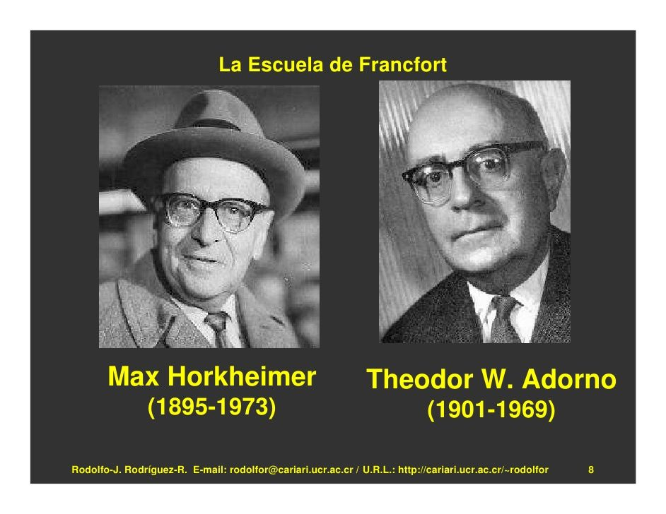
Max Horkheimer and Theodor Adorno

Slide 4
Culture Industry
The term culture industry was coined by Theodor Adorno (1903–1969) and Max Horkheimer (1895–1973).
It was presented in the chapter "The Culture Industry: Enlightenment as Mass Deception", of the book Dialectic of Enlightenment (1947)

Slide 5
Popular culture is like to a factory producing standardized cultural goods—films, radio programmes, magazines, etc.—that are used to manipulate mass society into passivity.
Consumption of the easy pleasures of popular culture, made available by the mass communications media, makes people -
Docile
Content,
Homogeneous
no matter how difficult their economic circumstances.

Slide 6
Examples
Lot of content during lockdown
Whatsapp forwards
Films-Sequel-prequel, cross overs
Web Series- more…more and more
Songs
An insatiable appetite for content

Slide 7
The inherent danger of the culture industry is the cultivation of false psychological needs that can only be met and satisfied by the products of capitalism.
Adorno and Horkheimer especially perceived mass-produced culture as dangerous to the more technically and intellectually difficult high arts.
In contrast, true psychological needs are freedom, creativity, and genuine happiness, which refer to an earlier demarcation of human needs, established by Herbert Marcuse.

Slide 8
References
https://www.marxists.org/reference/archive/adorno/1944/culture-industry.htm
https://www.youtube.com/watch?v=vMiF9Bv-72s
https://www.youtube.com/watch?v=X2YNeG9k_S4

