Slide 1
GST Sem VI
TYBAF
Dr. Nishikant Jha

Slide 2
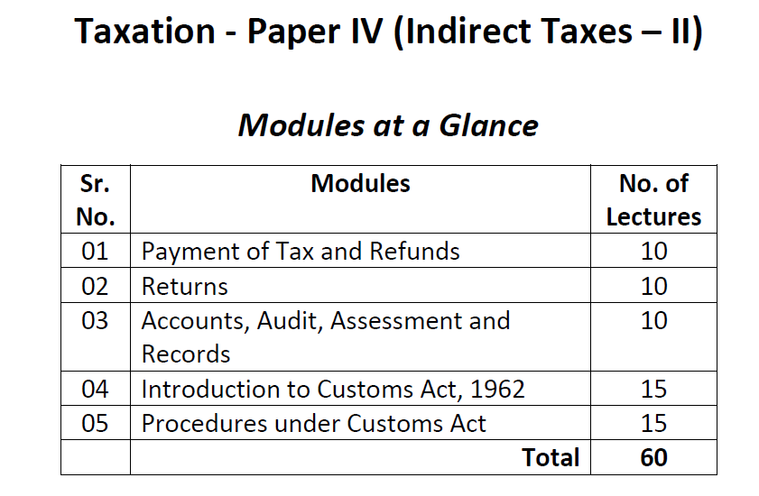

Slide 3
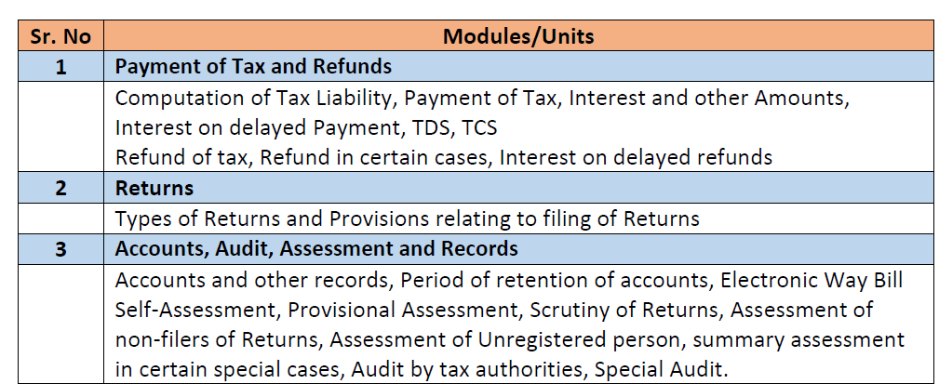

Slide 4
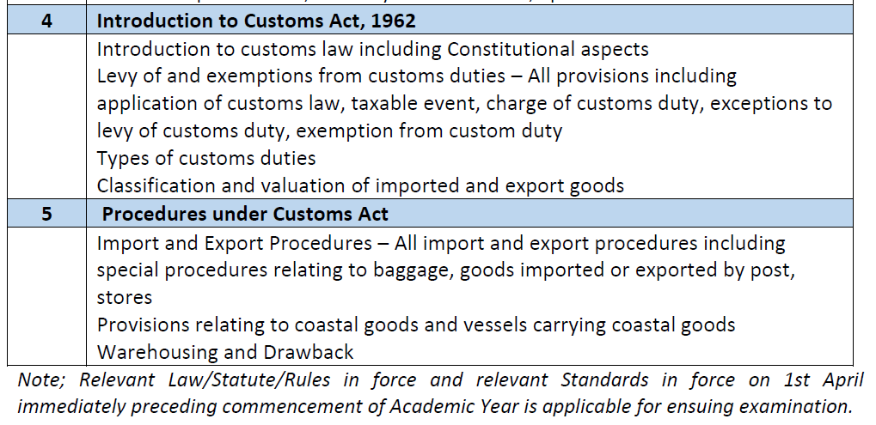

Slide 5
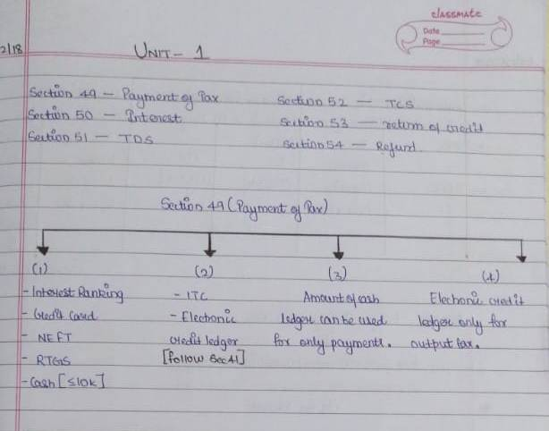

Slide 6
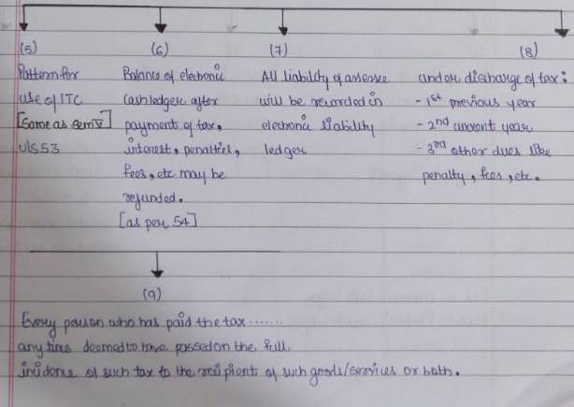

Slide 7
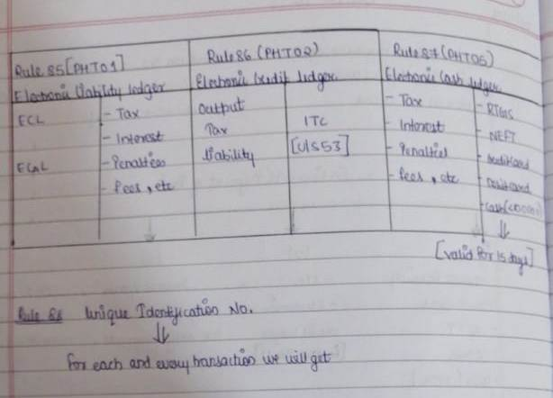

Slide 8
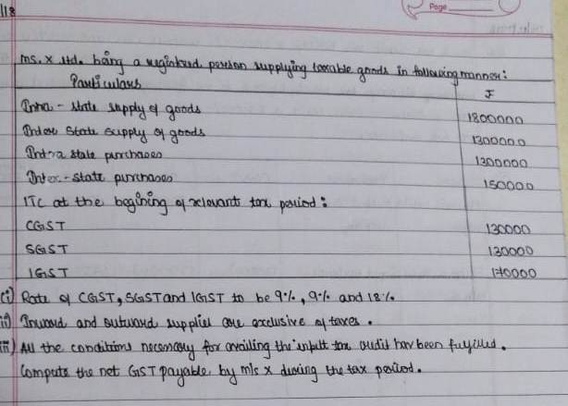

Slide 9
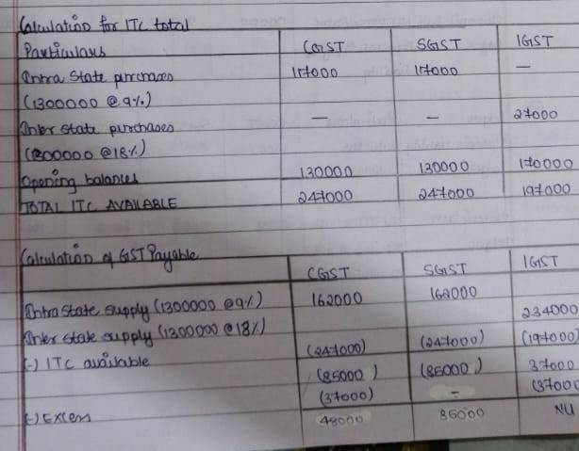

Slide 10
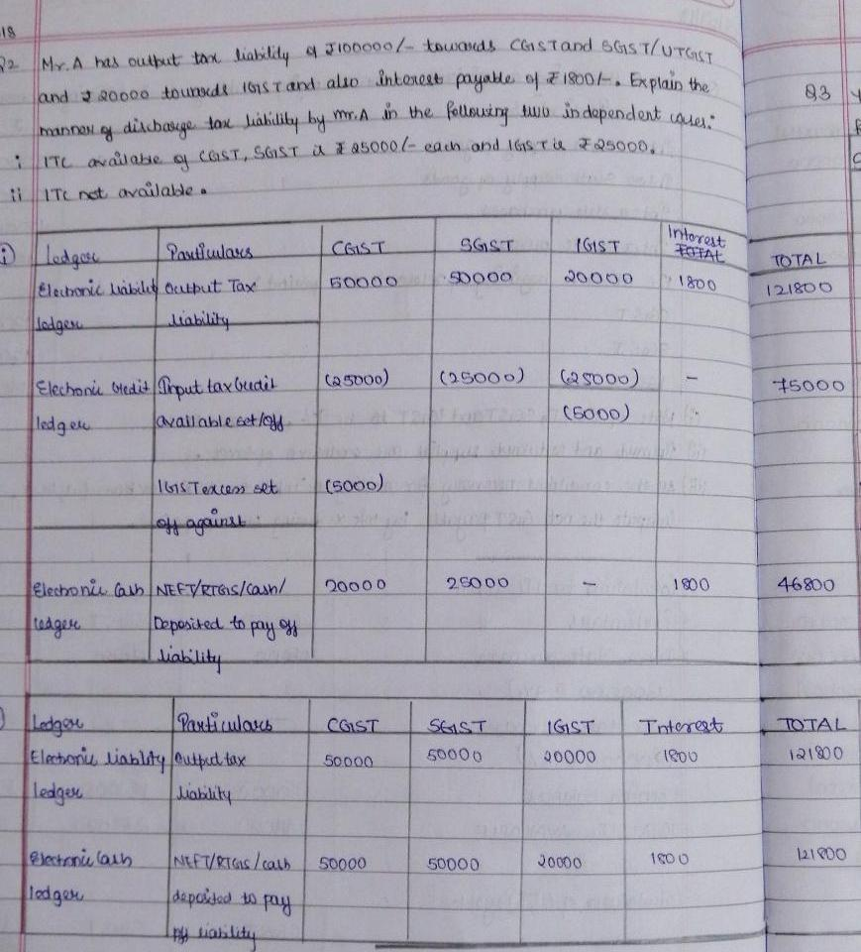

Slide 11
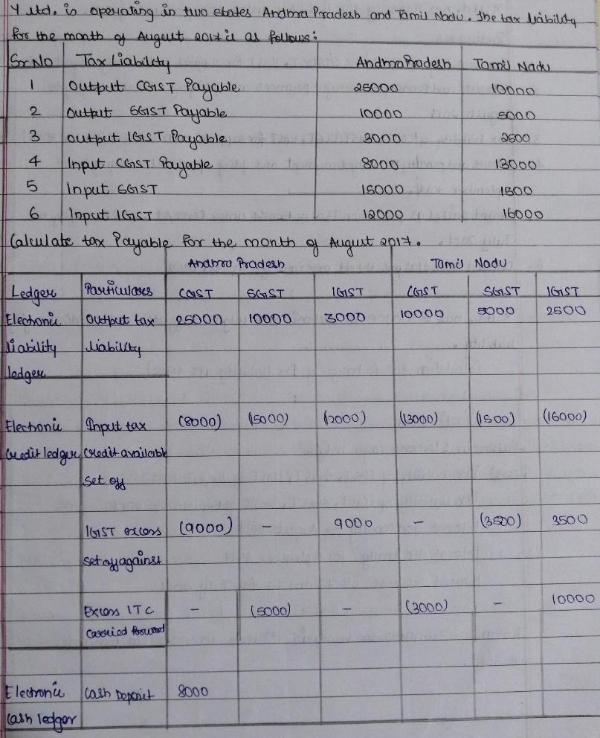

Slide 12
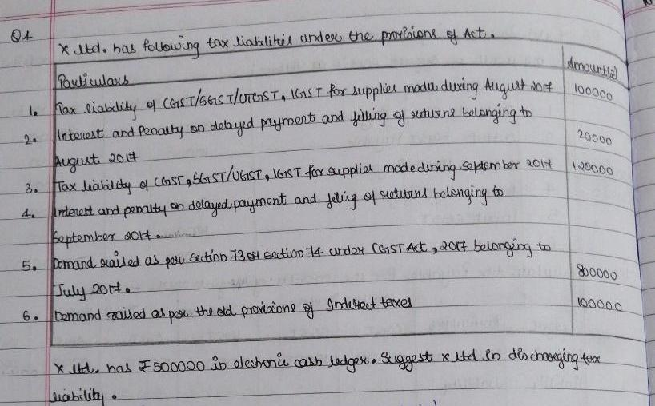

Slide 13
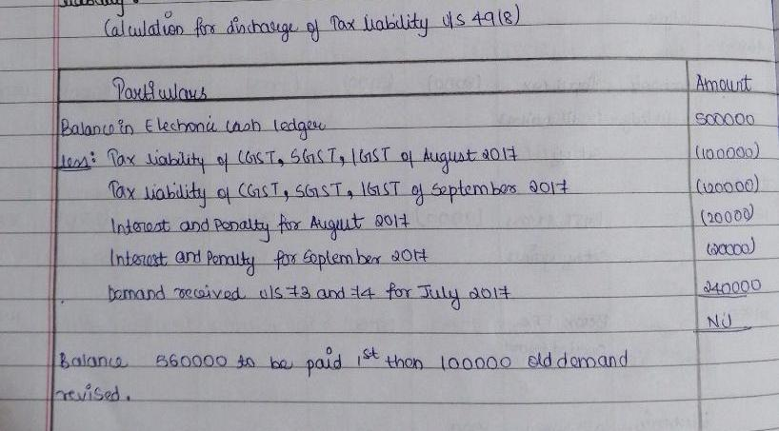

Slide 14
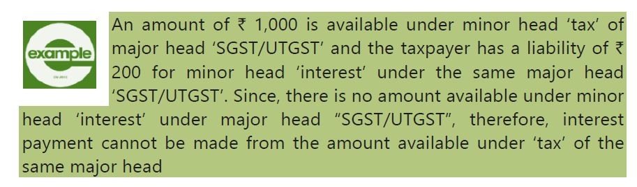
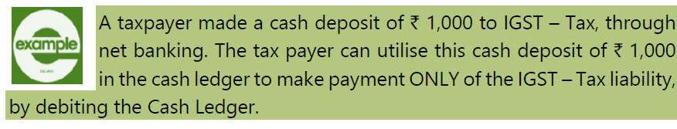

Slide 16
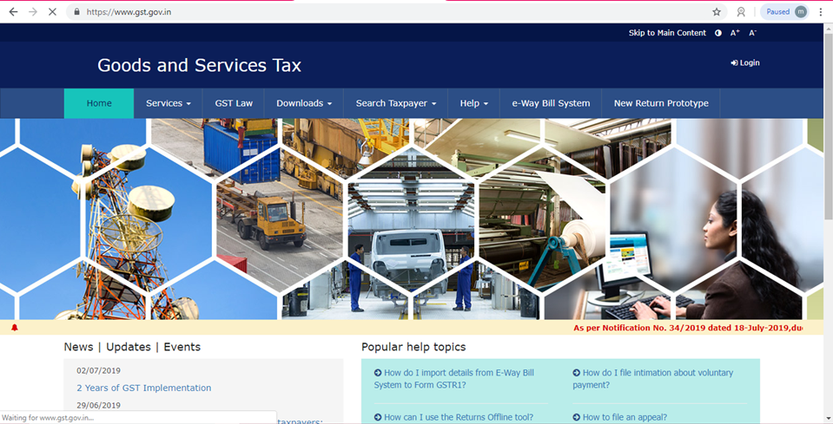

Slide 17
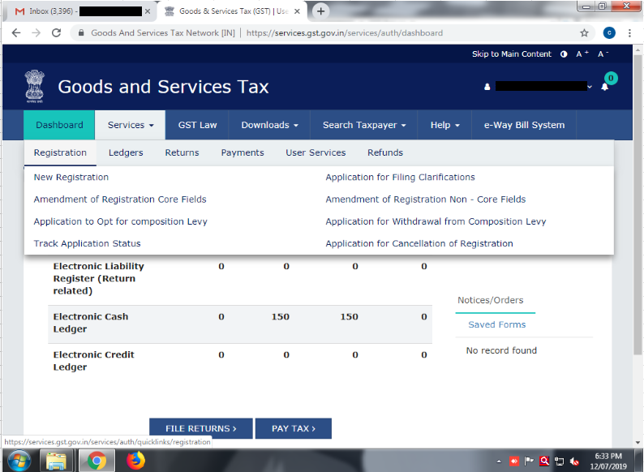
Registration in GST

Slide 18
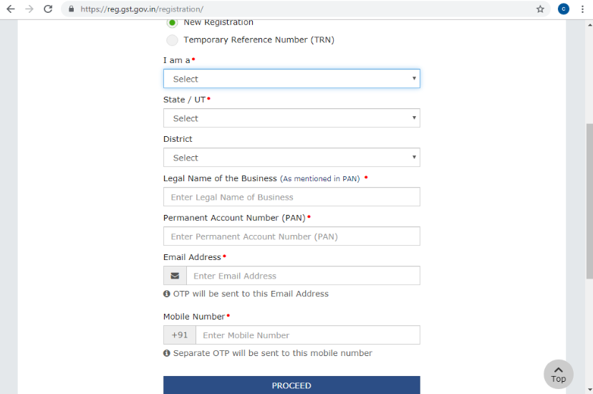

Slide 19
Following documents are required for GST registration.
1.PAN Card of the Business and Applicant.
2.Valid Indian Phone Number and Email address.
3.Proof of Place of business.
4.Any document in support of the ownership .
5.Electricity bill, consent letter, municipal khata.
6.For every additional place of business in the state, proof of such additional place of business.
7.Valid bank account number from India.
8. HSN list of Goods and Services
9. Proof of appointment of Authorized Signatory (Letter of Authorization or copy of board resolution)
10. Authorized Signatories photo (soft copy)
- For Companies and LLP’s, it is important to have digital signature (class 2 digital signature) of the person who is authorised to sign the GST application
- Incorporation certificate (for Company)
- Other regulatory registration details such as Professional Tax, State Excise License details (If applicable)

Slide 20
GST Returns
We file the following returns in GST
Gstr1
Gstr 3b
Gstr 4

Slide 21
GSTR 1
GSTR-1 is a monthly or quarterly return that should be filed by every registered dealer. It contains details of all outward supplies i.e sales.The due dates for GSTR-1 are based on your turnover.
Businesses with sales of upto Rs. 1.5 crore will file quarterly returns.
Quarter Due date
Other taxpayers with sales above Rs. 1.5 crore have to file monthly return.
Period Dates
Oct-Dec 2018 | 31st January 2019
Jan- Mar 2019 | 30th April 2019
December 2018 | 11th January 2019
January 2019 | 11th February 2019
February 2019 | 11th March 2019
March 2019 | 11th April 2019

Slide 22
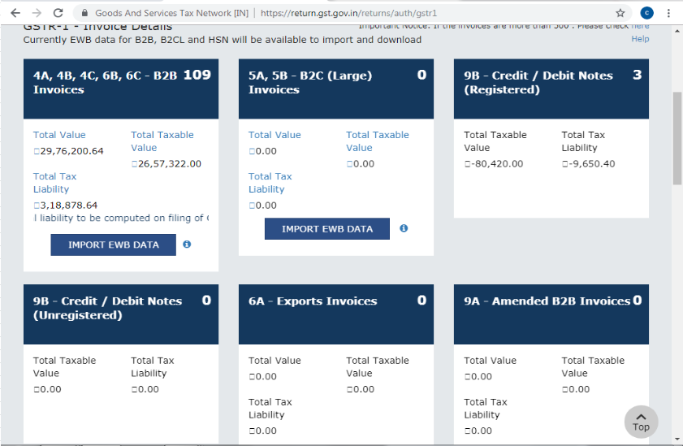

Slide 23
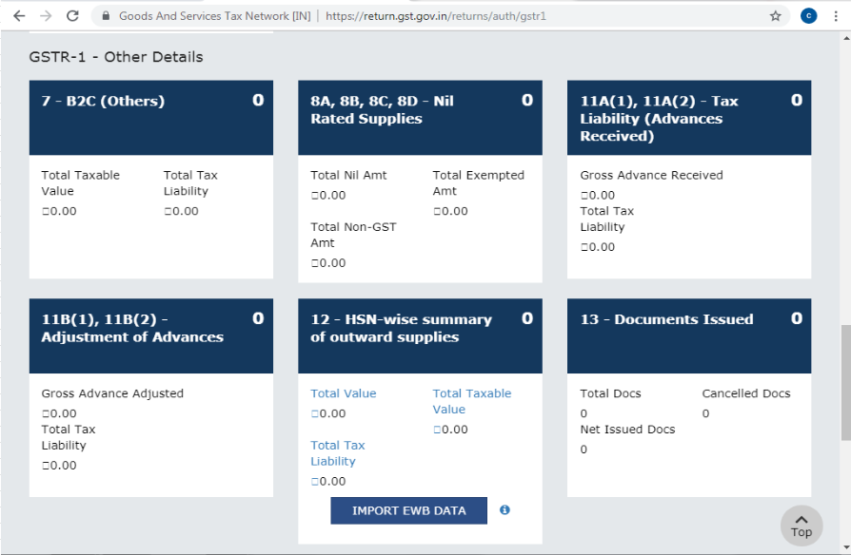

Slide 24
GSTR 4
The GSTR 4 is a return under GST that needs to be filed once every 3 months by registered tax payers who have signed up for the composition scheme . They would be required to pay taxes at fixed rate without any input tax credit facilities.
This scheme can be opted by any taxpayer whose turnover is less than Rs. 1.5 crore*.

Slide 25
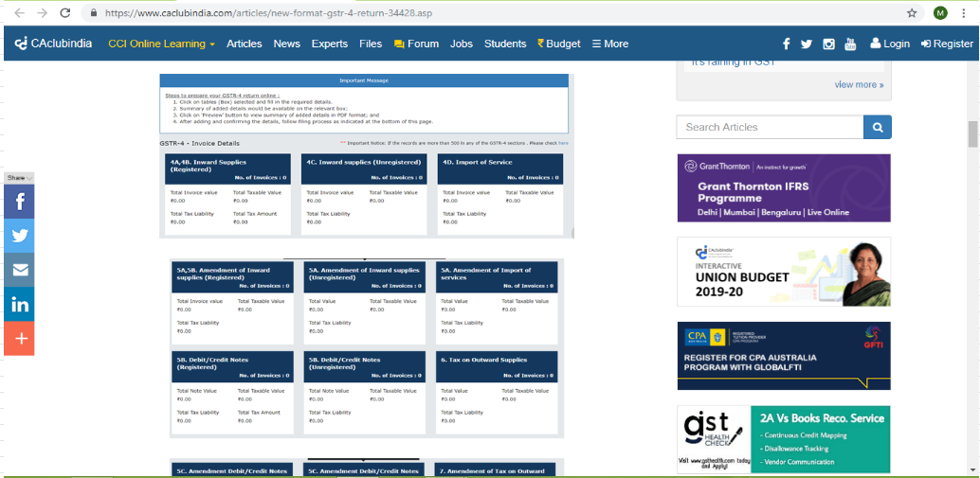

Slide 26
GSTR 3B
Every registered person has to file gstr 3b every month except for composition scheme .
Details regarding sales ,sales return (credit note), purchase ,purchase returns( debit note) has to be filed.
After utilising the Input Tax Credit on purchases,the final tax liability has to be paid through GST challan.

Slide 27
GSTR 3B due date
It needs to be filed on or before 20th of the following month.
If payment is made after 20th
interest @ 18% for the no. of days after 20th is charged
interest
= tax liability*18/100*no of days/365
Month | Due date
gstr 3b for july | 20th august
gstr 3b for jan | 20th february
Late fees per day
cgst | Rs 25
sgst | Rs 25
igst | Rs 50

Slide 28
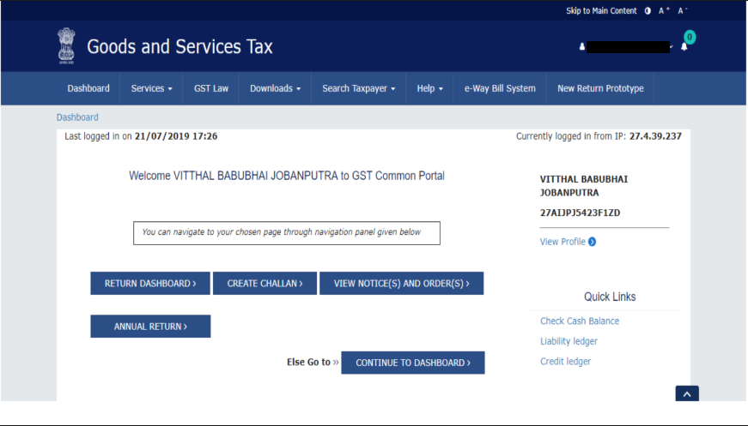

Slide 29
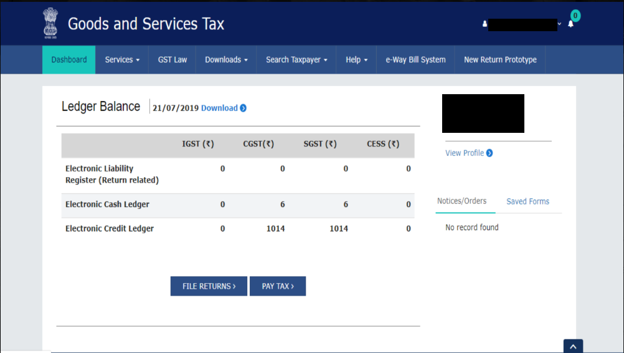

Slide 30
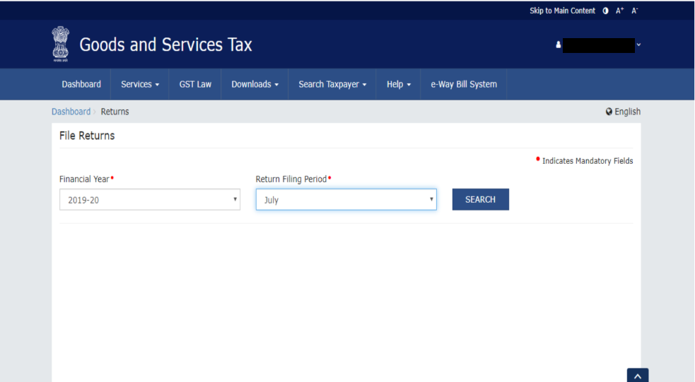

Slide 31
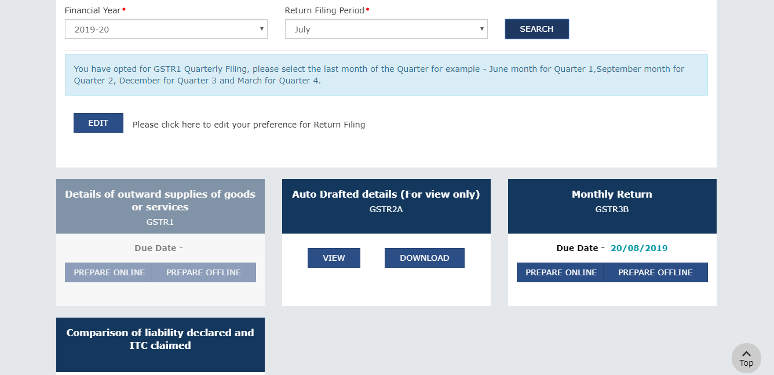

Slide 32
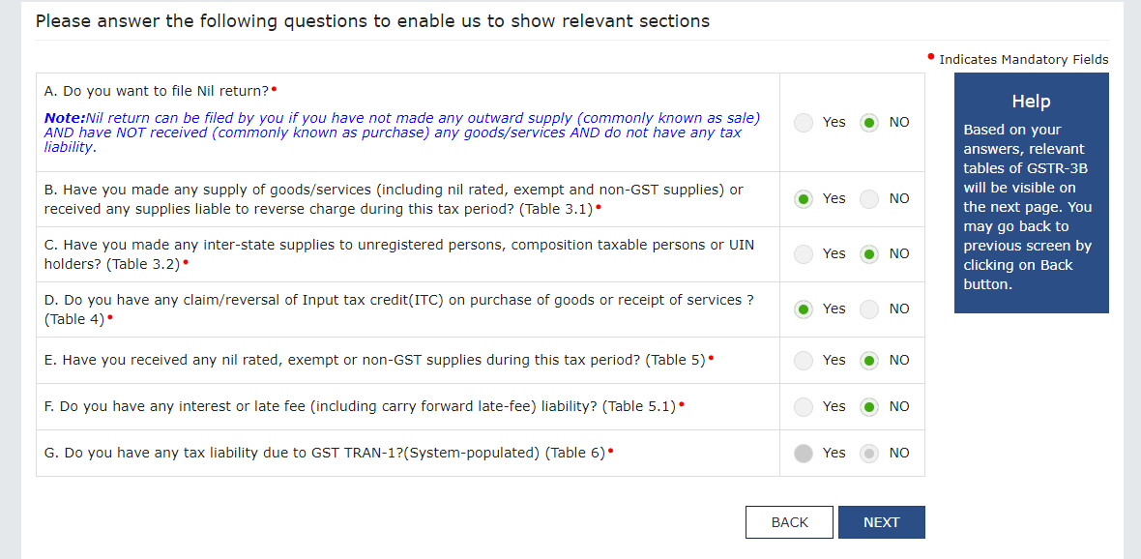

Slide 33
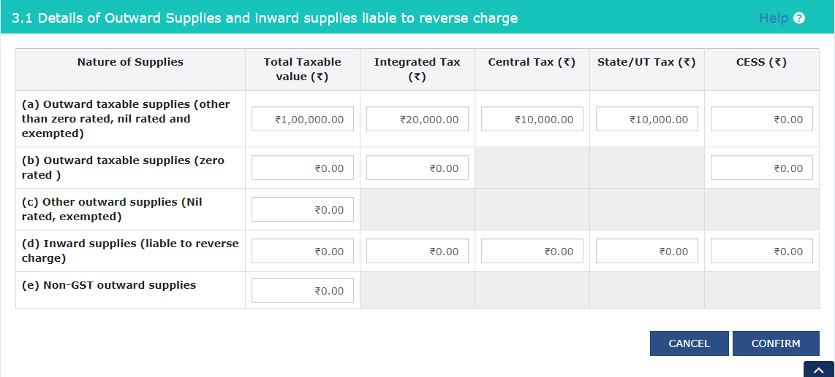

Slide 34
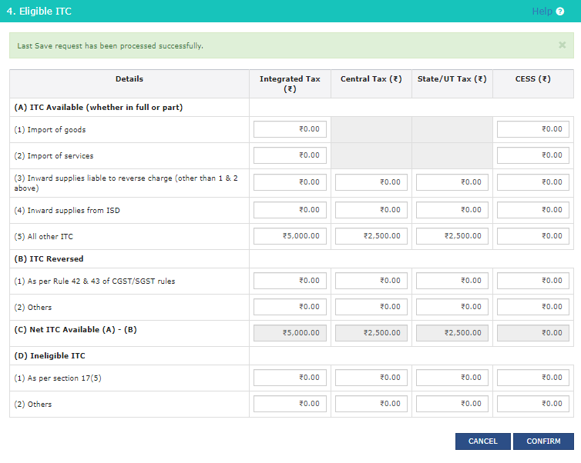

Slide 35
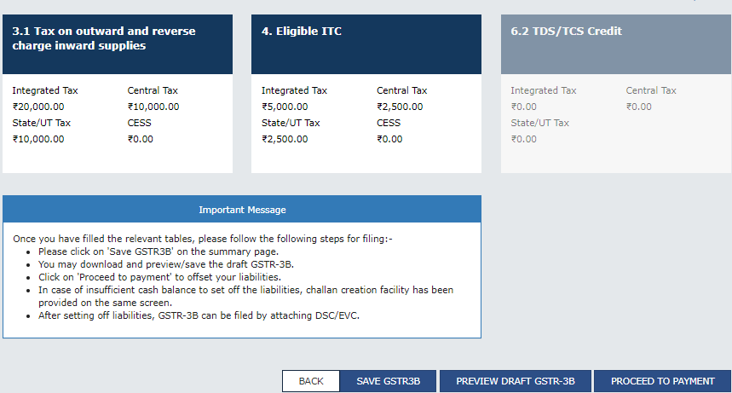

Slide 36
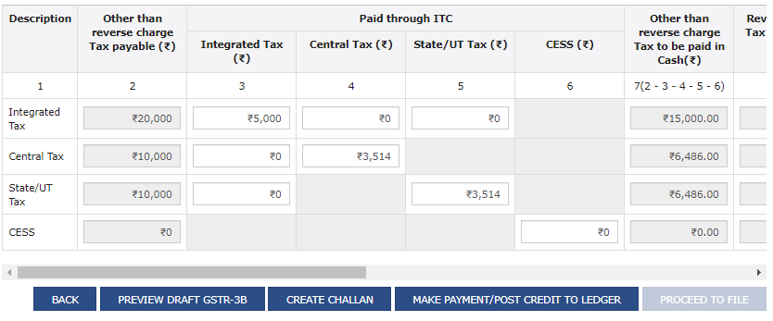

Slide 37
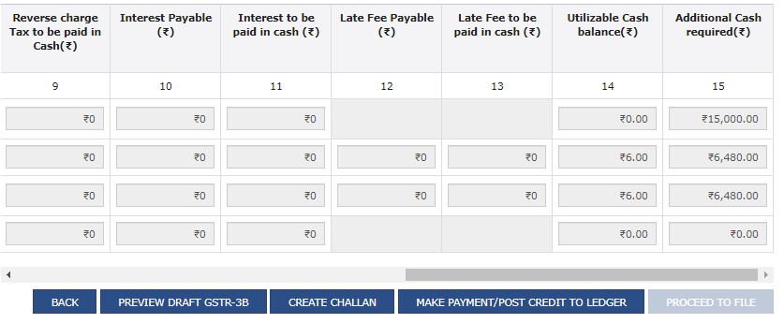

Slide 38
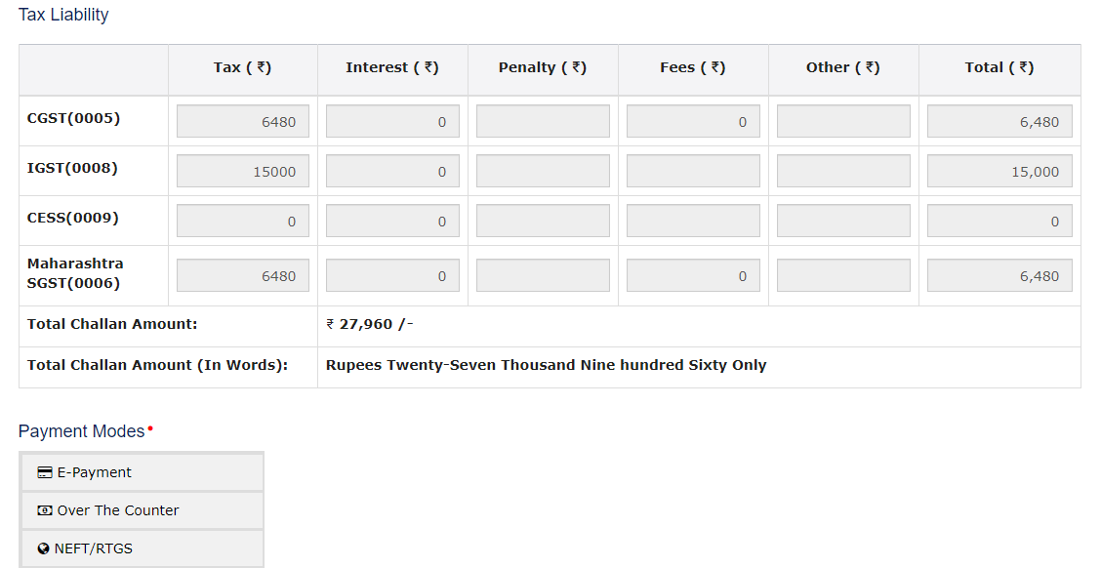

Slide 39
GST ledgers
electronic liability ledger
The liabilities of a taxpayer under GST is maintained in the electronic liability register. In the electronic liability register the tax due on filing a GST return, interest, penalty and demands are maintained
electronic cash ledger
Whenever the taxpayer makes a GST payment through online banking, credit or debit card, wire transfer or over the counter payment, the amount paid is reflected in the electronic cash ledger. GST tax payment of over Rs.10,000 must be made through banking channels only.
electronic credit ledger
All the taxes paid by the taxpayer on the inputs would be recorded in the electronic credit ledger.
cgst credit
sgst credit
igst credit

Slide 40
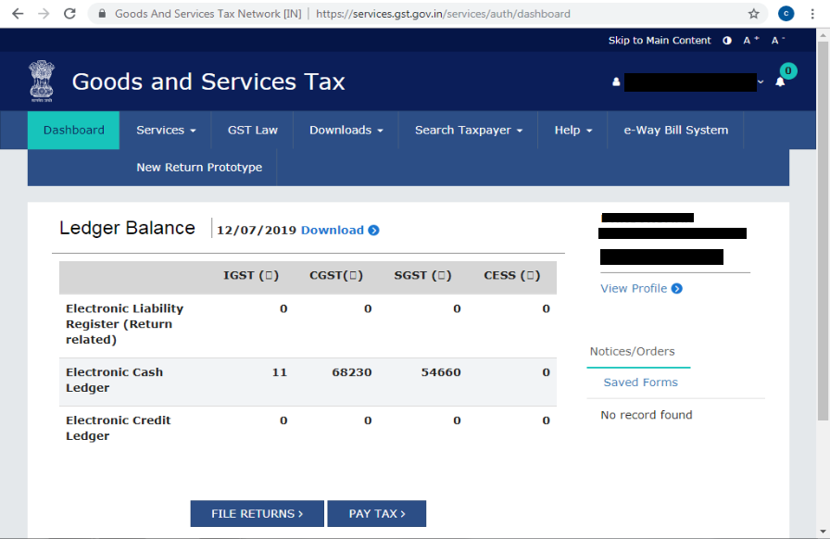

Slide 41
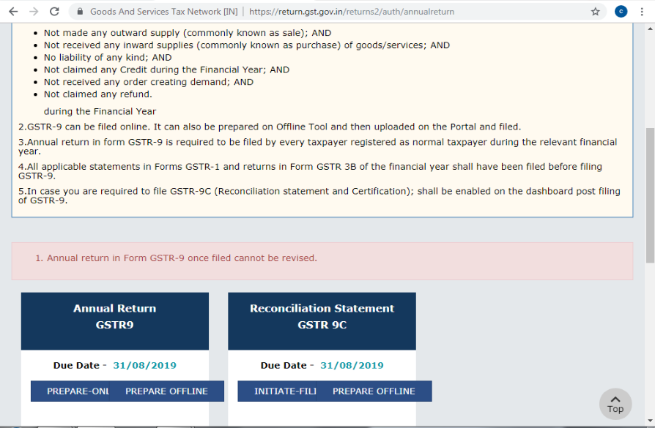

Slide 42
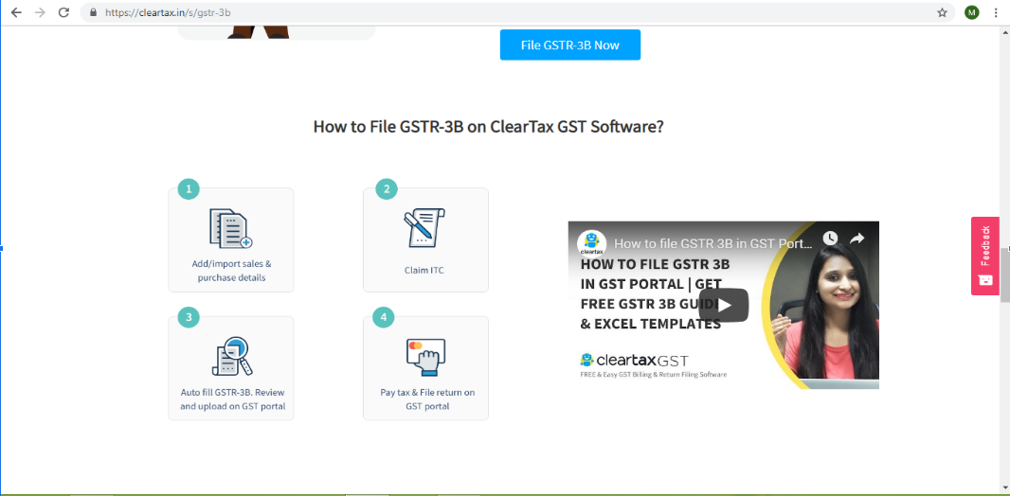

Slide 43
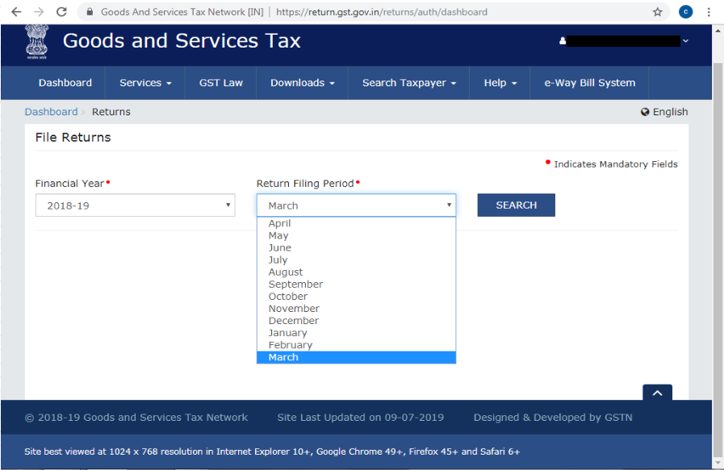

Slide 44
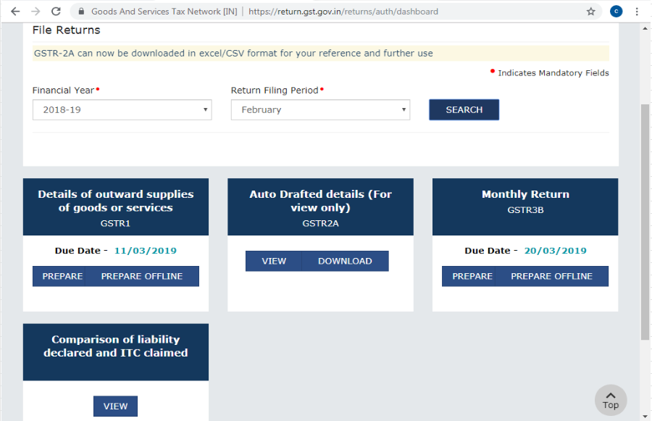

Slide 45
