Slide 1
UNIT-2
UTILITY CONCEPT AND THEORIES
UTILITY CONCEPT AND CARDINAL MEASUREMENT OF UTILITY

Slide 2
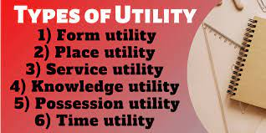
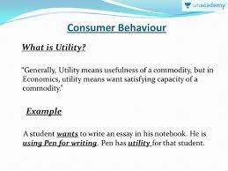
UTILITY CONCEPT
Utility refers to want satisfying power of a commodity. It is the satisfaction, actual or expected, derived from the consumption of a commodity.
In the words of Prof. Hobson, “Utility is the ability of a good to satisfy a want”.

Slide 3
Total Utility (TU):
Total Utility (TU):
Total utility refers to the total satisfaction obtained from the consumption of all possible units of a commodity. It measures the total satisfaction obtained from consumption of all the units of that good. For example, if the 1st ice-cream gives you a satisfaction of 20 utils and 2nd one gives 16 utils, then TU from 2 ice-creams is 20 + 16 = 36 utils. If the 3rd ice-cream generates satisfaction of 10 utils, then TU from 3 ice-creams will be 20+ 16 + 10 = 46 utils
TU_{n} = U₁ + U₂ + U₃ +……………………. + U_{n}
Where:
TU_{n} = Total utility from n units of a given commodity
U₁, U₂, U₃,……………. U_{n} = Utility from the 1st, 2nd, 3rd n^{th} unit
n = Number of units consumed

Slide 4
Marginal Utility (MU):
Marginal utility is the additional utility derived from the consumption of one more unit of the given commodity. It is the utility derived from the last unit of a commodity purchased. As per given example, when 3rd ice-cream is consumed, TU increases from 36 utils to 46 utils. The additional 10 utils from the 3rd ice-cream is the MU.
In the words of Chapman, “Marginal utility is addition made to total utility by consuming one more unit of a commodity”.
MU can be calculated as: MU_{n} = TU_{n} – TU_{n-1}
Where: MU_{n} = Marginal utility from n^{th} unit; TU_{n} = Total utility from n units;
TU_{n-1} = Total utility from n – 1 units; n = Number of units of consumption
MU of 3rd ice-cream will be: MU₃ = TU₃ – TU₂ = 46 – 36 = 10 utils One More way to Calculate MU
MU is the change in TU when one more unit is consumed. However, when change in units consumed is more than one, then MU can also be calculated as:
ATU
MU = Change in Total Utility/ Change in number of units = ∆TU/∆Q

Slide 5
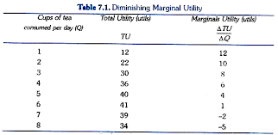
Total Utility is Summation of Marginal Utilities:
Total utility can also be calculated as the sum of marginal utilities from all units, i.e.
TU_{n}= MU₁ + MU₂ + MU₃ +……………………… + MU_{n} or simply,
TU = ∑MU
The concepts of TU and MU can be better understood from the following schedule and diagram:

Slide 6
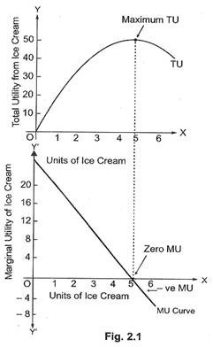

Slide 7
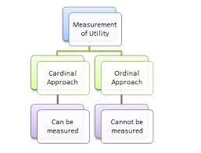
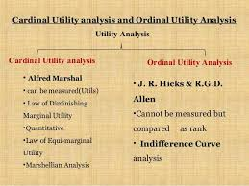
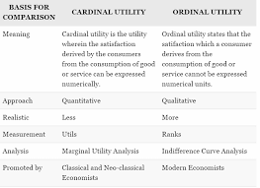
MEASUREMENT OF UTILITY

Slide 8
CARDINAL MEASUREMENT
According to classical economists, utility can be measured, in the same way, as weight or height is measured. For this, economists assumed that utility can be measured in cardinal (numerical) terms. By using cardinal measure of utility, it is possible to numerically estimate utility, which a person derives from consumption of goods and services.
But, there was no standard unit for measuring utility. So, the economists derived an imaginary measure, known as ‘Util’.
Utils are imaginary and psychological units which are used to measure satisfaction (utility) obtained from consumption of a certain quantity of a commodity.

Slide 9
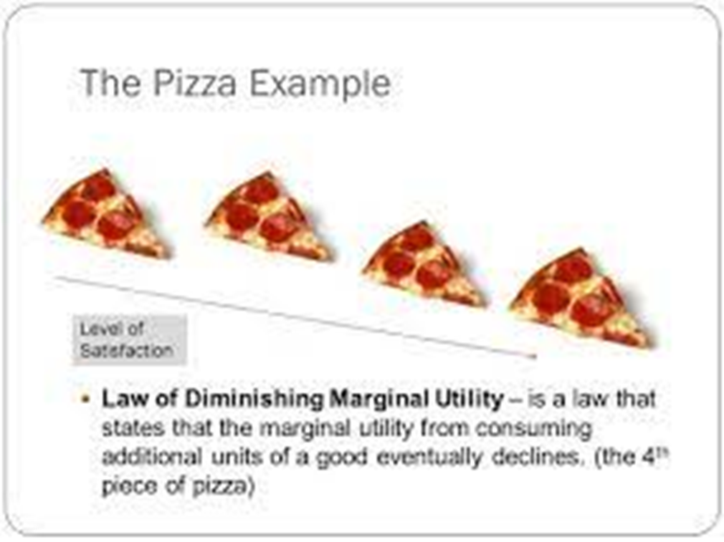
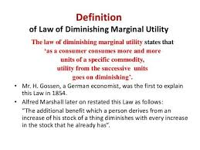

Slide 10
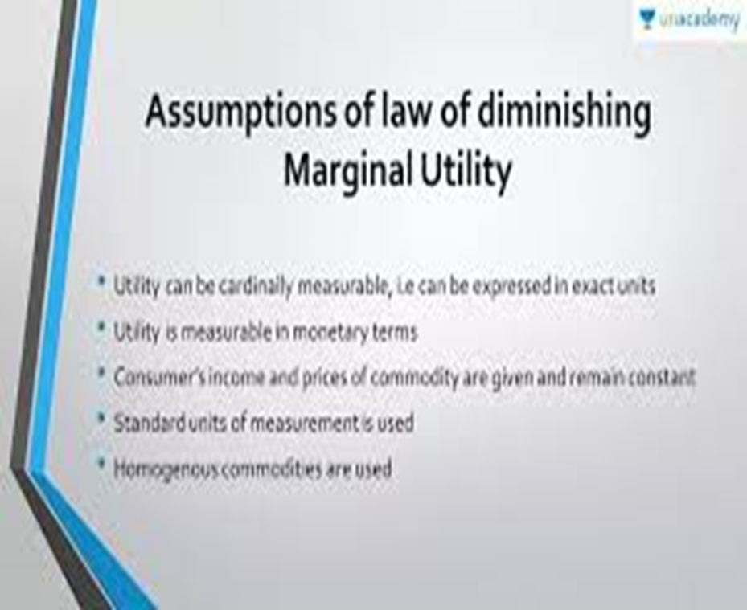
Total Utility is Summation of Marginal Utilities:
Total utility can also be calculated as the sum of marginal utilities from all units, i.e.
TU_{n}= MU₁ + MU₂ + MU₃ +……………………… + MU_{n} or simply,
TU = ∑MU
The concepts of TU and MU can be better understood from the following schedule and diagram:

Slide 11
Limitation to the law of DMU
Irrational assumption of identical unit.
No time gap between consumption
Cardinal measurement is not possible
Subjective concept
Not applicable to invisible goods
Mum can be constat
Applicable to one commodity only
Exceptions of the law of DMU
Hobbies
Miser is not a ratonal consumer
Music
Drunkards
Reading.
Notes:
Limitation to the law of DMU

Slide 12
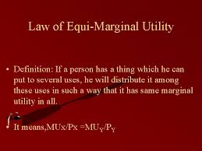
Law of Equi-Marginal Utility
This law is based on the principle of obtaining maximum satisfaction from a limited income. It explains the behavior of a consumer when he consumes more than one commodity.
The law states that a consumer should spend his limited income on different commodities in such a way that the last rupee spent on each commodity yield him equal marginal utility in order to get maximum satisfaction.
Suppose there are different commodities like A, B, …, N. A consumer will get the maximum satisfaction in the case of equilibrium i.e.,
MU_{A} / P_{A} = MU_{B} / P_{B} = … = MU_{N} / P_{N}
Where MU’s are the marginal utilities for the commodities and P’s are the prices of the commodities.
Assumptions of the Law
There is no change in the price of the goods or services.
The consumer has a fixed income.
The marginal utility of money is constant.
A consumer has perfect knowledge of utility.
Consumer tries to have maximum satisfaction.
The utility is measurable in cardinal terms.
There are substitutes for goods.
A consumer has many wants.

Slide 13
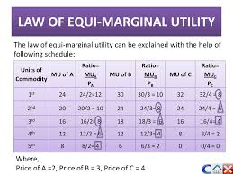

Slide 14
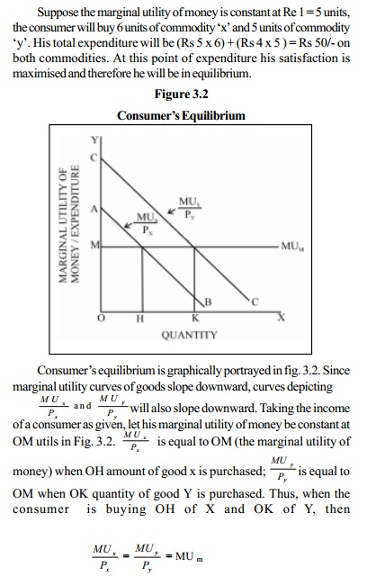
Importance of the Law
This law is helpful in the field of production. A producer has limited resources and tries to get maximum profit.
This law is helpful in the field of exchange. The exchange is of anything like some goods, wealth, trade, import, and export.
It is applicable to public finance.
The law is useful for workers in allocating the time between the work and rest.
It is useful in case of saving and spending.
It is useful to look for substitution in case of price rise.
Limitation of the Law
There are some limitations to this law. They are
The law is not applicable in case of knowledge. Reading books provides more knowledge and has more utility.
This law is not applicable in case of fashion and customs.
This law is not applicable for very low income.
There is no measurement of utility.
Not all consumer care for variety.
The law fails when there are no choices available for the good.
The law fails in case of frequent price change.

Slide 15
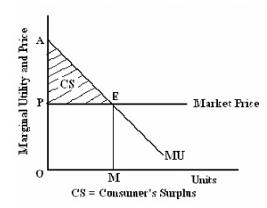
Marshall defines Consumer's surplus as follows:
'The excess of price which a person would be willing to pay rather than go without the thing, over that which he actually does pay, is the economic measure of this surplus of satisfaction. It may be called consumer's surplus.'
Measurement
Consumer's Surplus for a single commodity is measured as follows:
Consumer's surplus = Potential price - Actual price

Slide 16
Importance of Consumer's Surplus
Consumer's Surplus is useful to the Finance Minister in formulating taxation policies. It is also helpful in fixing a higher price by a monopolist in the market, based on the extent of consumer's surplus enjoyed by consumers.
Consumer's Surplus enables comparison of the standard of living of people of different regions or countries. This comparison helps to distinguish consumption levels between the people, who are living in rich countries and poor countries. For example, a middleclass person in New York enjoys more consumers' surplus than a similar person in Chennai. Alfred Marshall has stated that a middle class person in a modern city enjoys more consumer's surplus than a king of the Medieval Ages.

Slide 17

THE PARADOX OF VALUE / THE DIAMOND– WATER PARADOX
DEFINITION “THE PARADOX OF VALUE (ALSO KNOWN AS THE DIAMOND– WATER PARADOX) IS THE APPARENT CONTRADICTION THAT, ALTHOUGH WATER IS ON THE WHOLE MORE USEFUL, IN TERMS OF SURVIVAL, THAN DIAMONDS, DIAMONDS COMMAND A HIGHER PRICE IN THE MARKET”
3. HISTORY • IT WAS FIRST PRESENTED BY THE ECONOMIST ADAM SMITH IN THE 1700S. • CARL MENGER PUBLISHED THE NEW THEORY OF VALUE IN 1871 • IN THE SAME YEAR ENGLISH ECONOMIST WILLIAM STANLEY JEVONS INDEPENDENTLY PUBLISHED A SIMILAR THEORY
4. EXPLANATION • GETTING ENOUGH WATER TO SUSTAIN LIFE TYPICALLY HAS A LOW PRICE, WHILE A PIECE OF DIAMOND JEWELRY HAS A HIGH PRICE • WHY DOES AN ECONOMY PUT A MUCH LOWER VALUE ON SOMETHING VITAL TO SUSTAINING LIFE COMPARED TO SOMETHING THAT SIMPLY LOOKS SHINY AND SPARKLES? • MENGER BELIEVED THAT VALUE IS COMPLETELY SUBJECTIVE: A PRODUCT’S VALUE IS FOUND IN ITS ABILITY TO SATISFY HUMAN WANTS. • THE ACTUAL VALUE DEPENDS ON THE PRODUCT’S UTILITY IN ITS LEAST IMPORTANT USE. • IF THE PRODUCT EXISTS IN ABUNDANCE, IT WILL BE USED IN LESS-IMPORTANT WAYS.

Slide 18
• AS THE PRODUCT BECOMES MORE SCARCE, HOWEVER, THE LESS-IMPORTANT USES ARE ABANDONED, AND GREATER UTILITY WILL BE DERIVED FROM THE NEW LEAST-IMPORTANT USE. • THIS IDEA RELATES TO ONE OF THE MOST IMPORTANT LAWS IN ECONOMICS, THE LAW OF DEMAND, WHICH SAYS THAT WHEN THE PRICE OF SOMETHING RISES, PEOPLE WILL DEMAND LESS OF IT.) • SMITH NOTED THAT, EVEN THOUGH LIFE CANNOT EXIST WITHOUT WATER AND CAN EASILY EXIST WITHOUT DIAMONDS • DIAMONDS ARE, POUND FOR POUND, VASTLY MORE VALUABLE THAN WATER
6. • WATER IN TOTAL IS MUCH MORE VALUABLE THAN DIAMONDS IN TOTAL BECAUSE THE FIRST FEW UNITS OF WATER ARE NECESSARY FOR LIFE ITSELF • BUT, BECAUSE WATER IS PLENTIFUL AND DIAMONDS ARE SCARCE, THE MARGINAL VALUE OF A POUND OF DIAMONDS EXCEEDS THE MARGINAL VALUE OF A POUND OF WATER. • AT LOW LEVELS OF CONSUMPTION, WATER HAS A MUCH HIGHER MARGINAL UTILITY THAN DIAMONDS AND THUS IS MORE VALUABLE.
PEOPLE USUALLY CONSUME WATER AT MUCH HIGHER LEVELS THAN THEY DO DIAMONDS AND THUS THE MARGINAL UTILITY AND PRICE OF WATER ARE LOWER THAN THAT OF DIAMONDS. • IN HIS WORKS, SMITH POINTS OUT THAT PRACTICAL THINGS THAT WE USE EVERY DAY OFTEN HAVE LITTLE OR NO VALUE IN EXCHANGE. • ON THE OTHER HAND, THINGS THAT OFTEN HAVE THE GREATEST VALUE IN THE MARKET HAVE LITTLE OR NO PRACTICAL USE.
ALTERNATIVE CASE • IF ONE IS DYING OF THIRST, THEN THIS PARADOX MIGHT NOT MAKE SENSE. • THE MARGINAL UTILITY FROM ANOTHER DRINK OF WATER WOULD BE MUCH HIGHER THAN THE ADDITIONAL SATISFACTION OF OWNING A DIAMOND.
15. GRAPH SHOWING WATER-DIAMOND PARADOX

Slide 19
