Slide 1
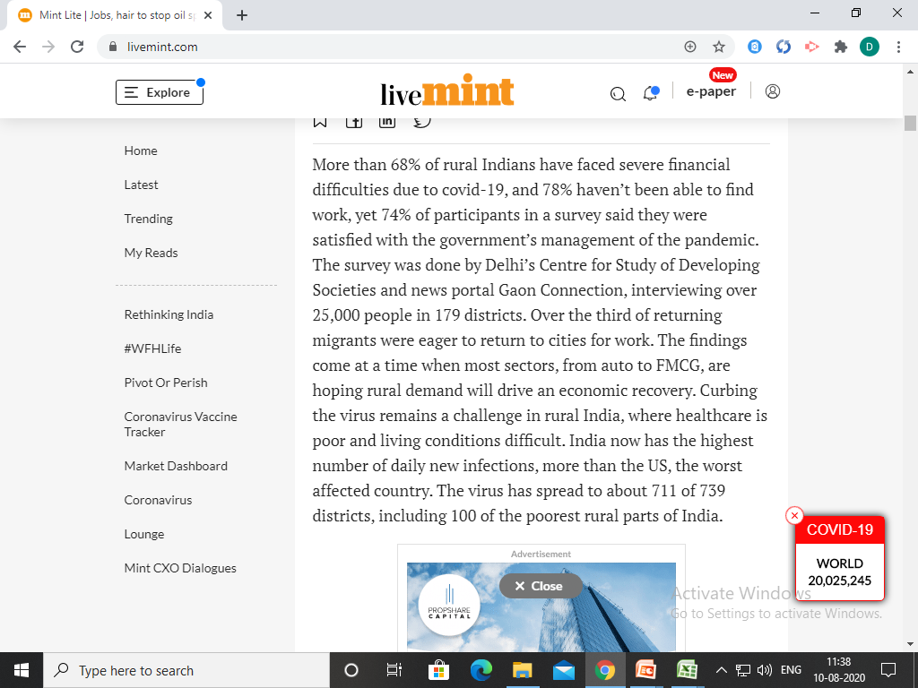

Slide 2
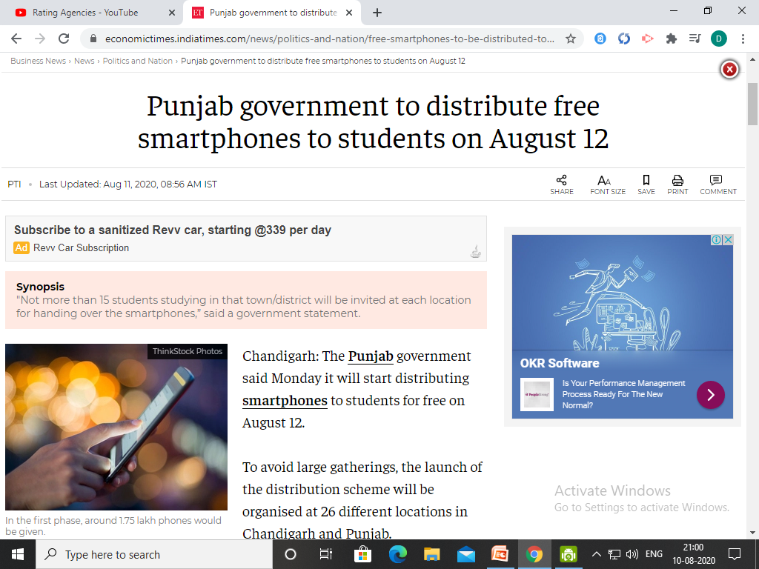

Slide 3
Let’s Revise Previous Lecture....
Bases of Market Segmentation
Geographical Segmentation
Personal Segmentation
Sociographic Segmentation
Psychographic segmentation
Behavioural Segmentation

Slide 4

COORDINATION

Slide 5

Meaning of coordination
Integration of activities or actions of the subordinates by the superior
Synchronization or interlinking of activities
Different than cooperation
An essence of management.

Slide 6
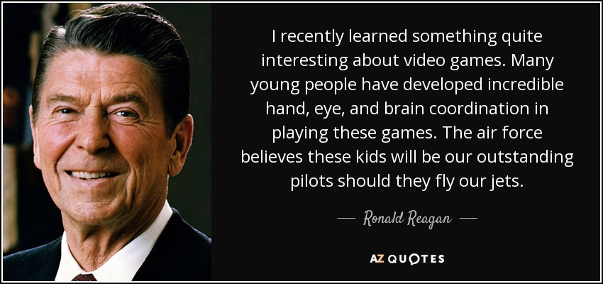

Slide 7
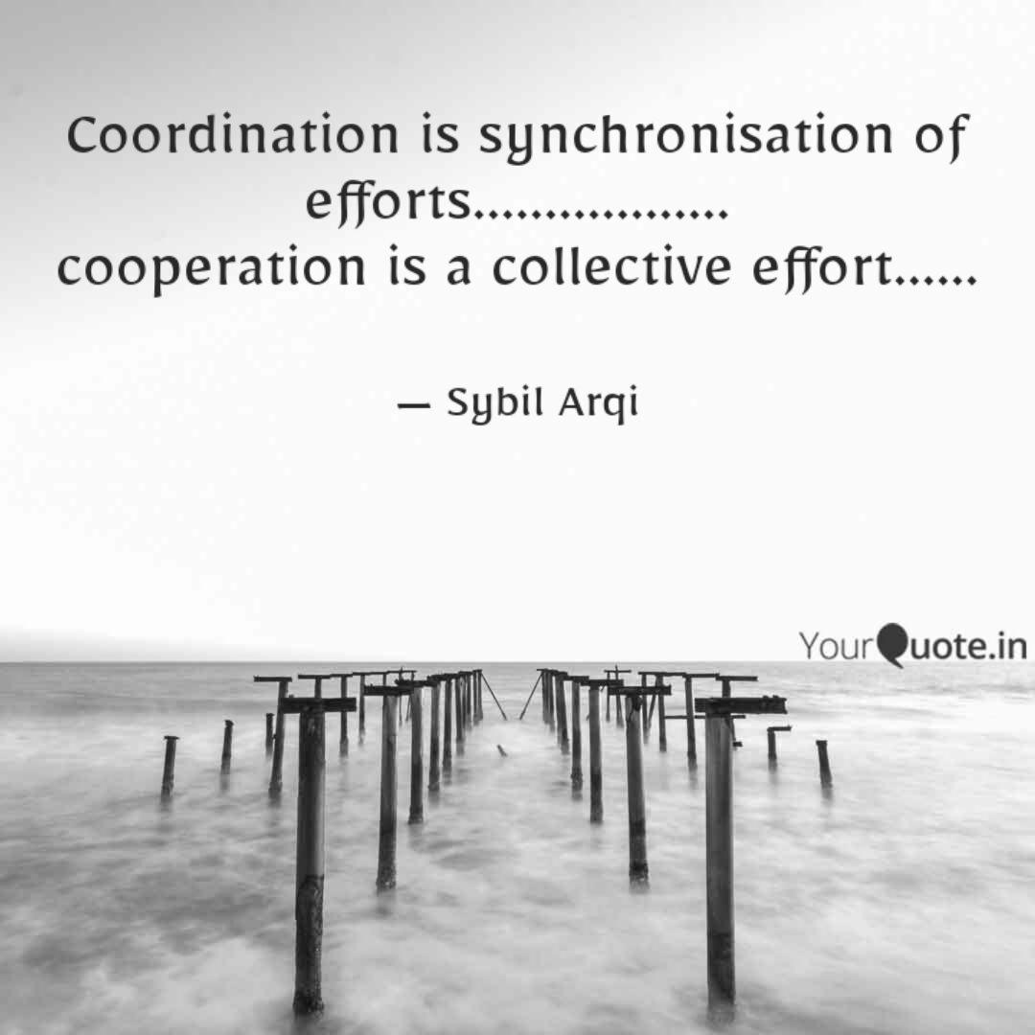

Slide 8
Importance of coordination
Division of Work
Division of work leads to specialization
Greater division of work more need for coordination
Ensures synchronization of activities
Avoid duplication of work

Slide 9
Importance of coordination
2. Interdependence of Units
Coordination required due to interdependence
of activities
Performance of one unit affects on other units
Efforts of all the units need to be integrated

Slide 10
Importance of coordination
3. Integration of Individual and Group Goals
Coordination in large organization is complicated
Each individual is unique and has different needs
Individual does not act rationally
Coordination is required.

Slide 11
Importance of coordination
4. Essence of Management
Required in planning, organizing and controlling
Makes planning more purposeful

Slide 12
Importance of coordination
5.Smooth Functioning
Departments and people work smoothly.
Improve overall efficiency

Slide 13
Importance of coordination
6. Enhance Morale of employees
Coordination develops orderly arrangement of resources
Provides job satisfaction to employees

Slide 14
Importance of coordination
7. Achievement of Goals
Integration of individual and organizational objectives
Help to achieve organizational goals
8. Higher Efficiency
Greater result at lower cost
Reduced wastage and optimum use of resources

Slide 15
Summary
Integration of activities or actions of the subordinates by the superior
Importance of Coordination
Ddivision of Work
Interdependence of Units
Integration of Individual and Group Goals
Essence of Management
Smooth Functioning
Enhance Morale of employees
Achievement of Goals
Higher Efficiency

Slide 16
Thank YOU

