Slide 1
Theory
Theories are constructed in order to explain, predict and master phenomena (e.g. relationships, events, or the behavior). In many instances we are constructing models of reality.
A theory makes generalizations about observations and consists of an interrelated, coherent set of ideas and models.

Slide 2
Defining Theory
Theories …are set of statements asserting relationships among classes of variables (Bowers & Courtright).
“ Explanations and predictions of social phenomena… relating the subject of interest…to some other phenomena” (Bailey).
“Any conceptual representation or explanation of a phenomenon” (Steve Littlejohn).
“Sets of ideas of varying status and origin which may explain or interpret some phenomenon” (Denis McQuail).

Slide 3
Mass Communication and Theory
  So little agreement about what constitutes a generally accepted theory of mass communication?
  Communication’ itself carries many problems. Either ‘mass media’ or ‘communication’ would cover a dozen disciplines and raise a thousand problems. –several hundred theories.
  Personalized and ever-evolving and dynamic.

Slide 4
Agenda Setting
Gatekeeping
Framing
Priming

Slide 5
Gatekeeping Theory

Slide 6
Gatekeeping is one of the media’s central roles in public life:
People rely on mediators to transform information about billions of events into a manageable number of media messages. This process determines not only which information is selected, but also what the content and nature of messages, such as news, will be.

Slide 7
Gatekeeping Theory describes the powerful process through which events are covered by the mass media, explaining how and why certain information either passes through gates or is closed off from media attention.

Slide 8
History and Orientation
Kurt Lewin was apparently the first one to use the term "gatekeeping," which he used to describe a wife or mother as the person who decides which foods end up on the family's dinner table. (Lewin, 1947).
The gatekeeper is the person who decides what shall pass through each gate section, of which, in any process, there are several. Although he applied it originally to the food chain, he then added that the gating process can include a news item winding through communication channels in a group.

Slide 9
McCombs and Shaw pointed out that the gatekeeping concept is related to the newer concept, agenda-setting. (McCombs et al, 1976).

Slide 10
White (1961) was the person who seized upon Lewin's comments and turned it solidly toward journalism in 1950.
In the 1970s McCombs and Shaw took a different direction and they found that the audience learns how much importance to attach to a news item from the emphasis the media place on it.

Slide 11
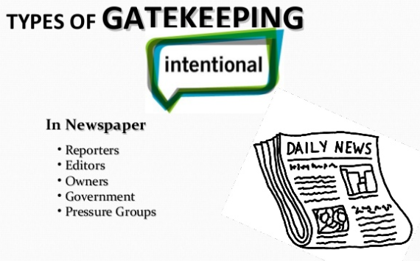
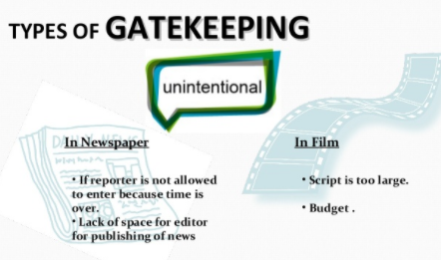
Types of Gatekeeping

Slide 12
Core Assumptions and Statements
The gatekeeper decides which information will go forward, and which will not.

Slide 13
Gatekeepers are able to control the public’s knowledge of the actual events by letting some stories pass through the system but keeping others out.
Gatekeepers can also be seen as institutions or organizations. In a political system there are gatekeepers, individuals or institutions which control access to positions of power and regulate the flow of information and political influence.
Gatekeepers exist in many jobs, and their choices hold the potential to color mental pictures that are subsequently created in people’s understanding of what is happening in the world around them.

Slide 14
Media gatekeeping showed that decision making is based on principles of news values, organizational routines, input structure and common sense.

Slide 15
The gatekeeper’s choices are a complex web of influences, preferences, motives and common values.

Slide 16
Gatekeeping can also be dangerous, since it can lead to an abuse of power by deciding what information to discard and what to let pass.

Slide 17

Source: White (1964)
Related to gatekeeping in media. For gatekeeping in organizations this model is not recommended.

Slide 18
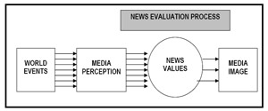
Selective Gatekeeping. Galtung and Ruge selective gatekeeping theory suggests that news from around the world are evaluated using news values to determine their newsworthiness. (After Mc Quail and Windahl 1993, p. 166)

Slide 19
Framing theory

Slide 20
Framing theory - or theories about framing - today represent one of the most common research approaches in the field of communication and media studies.
The origins of the frame metaphor lie in other fields like cognitive psychology, anthropology (Bateson) and sociology (Goffman).
A frame specifies the relationship between a number of connected elements in a text, helping us to define or interpret what is going on, making sense out of events
Notes:
20

Slide 21
History and Orientation
The concept of framing is related to the agenda-setting tradition but expands the research by focusing on the essence of the issues at hand rather than on a particular topic.
Media focuses attention on certain events and then places them within a field of meaning.
A frame in social theory consists of a schema of interpretation—that is, a collection of anecdotes and stereotypes—that individuals rely on to understand and respond to events.
In simpler terms, a person has, through his lifetime, built a series of mental emotional filters. They use these filters to make sense of the world. The choices they then make are influenced by their frame or emotional filters.

Slide 22
Core Assumptions and Statements
The media draws the public attention to certain topics, it decides where people think about, the journalists select the topics. This is the original agenda setting ‘thought’.
In news items occurs more than only bringing up certain topics. The way in which the news is brought, the frame in which the news is presented, is also a choice made by journalists.
Thus, a frame refers to the way media and media gatekeepers organize and present the events and issues they cover, and the way audiences interpret what they are provided. Frames are abstract notions that serve to organize or structure social meanings.
Frames influence the perception of the news of the audience, this form of agenda-setting not only tells what to think about, but also how to think about it.

Slide 23
Core Assumptions and Statements
Framing is a quality of communication that leads others to accept one meaning over another. It is a skill with profound effects on how organizational members understand and respond to the world in which they live. It is a skill that most successful leaders possess, yet one that is not often taught.
According to Fairhurst & Sarr (1996) framing consists of three elements: language, thought and forethought. Language helps us to remember information and acts to transform the way in which we view situations.
To use language, people must have thought and reflected on their own interpretive frameworks and those of others. Leaders must learn to frame spontaneously in certain circumstances.
Media products are human products, constructs that the audience take for granted.

Slide 24
Fairhurst and Sarr (1996) describe a lot of possibilities to frame situations:
a) Metaphor: To give an idea or program a new meaning by comparing it to something else.
b) Stories (myths and legends): To frame a subject by anecdote in a vivid and memorable way.
c) Traditions (rites, rituals and ceremonies): To pattern and define an organization at regular time increments to confirm and reproduce organizational values.
d) Slogans, jargon and catchphrases: To frame a subject in a memorable and familiar fashion.
e) Artifacts: To illuminate corporate values through physical vestiges (sometimes in a way language cannot).
f) Contrast: To describe a subject in terms of what it is not.
g) Spin: to talk about a concept so as to give it a positive or negative connotation.

Slide 25
Media frames (Todd Gitlin, 1980)
“What makes the world beyond direct experience look natural is a media frame”.
“Frames are principles of selection, emphasis, and presentation composed of little tacit theories about what exists, what happens and what matters”
“Thus for organizational reasons alone, frames are unavoidable, and journalism is organized to regulate their production”
Notes:
25

Slide 26
Gaye Tuchman: News as frame
News is a window of the world. Through its frame, American learn of themselves and others, of their institutions, leaders, and life styles, and those of other nations and their peoples…
…The view through a window depends upon whether the window is large or small, has many panes or few, whether the glass is opaque or clear, whether the window faces a street or a backyard. (Making News, 1980)
Notes:
26

Slide 27
Defining framing
“Frames are organizing principles that are socially shared and persistent over time, that work symbolically to meaningfully structure the social world” (Stephen D. Reese (2001: 11) in Reese, Gandy & Grant (eds.):
“To frame is to select some aspects of a perceived reality and make them more salient in a communicating text” (Robert Entman 1993: 52)
“The essence of framing is selection to prioritize some facts, images or developments over others, thereby unconsciously promoting one particular interpretation of events (Norris, Kern & Just 2003)
Notes:
27

Slide 28
How frames work
“The frame suggests what the controversy is about, the essence of the issue” (Gamson & Modigliani 1989, in Vreese: 27)
Frames are ..interpretative packages that give meaning to an issue (Gamson & Modigliani, 1989: 3)
Framing involves implicit information between the lines, the frame provides a context for the interpretation of a news message
Notes:
28

Slide 29
Journalistic tools in framing the news
Choosing the news angle
Selecting the sources (and avoiding others)
Formulating the headline, the lead of a news story and selecting the visual image
Culture bound narratives: formulating a new episode in a longer and well known story.
Notes:
29

Slide 30
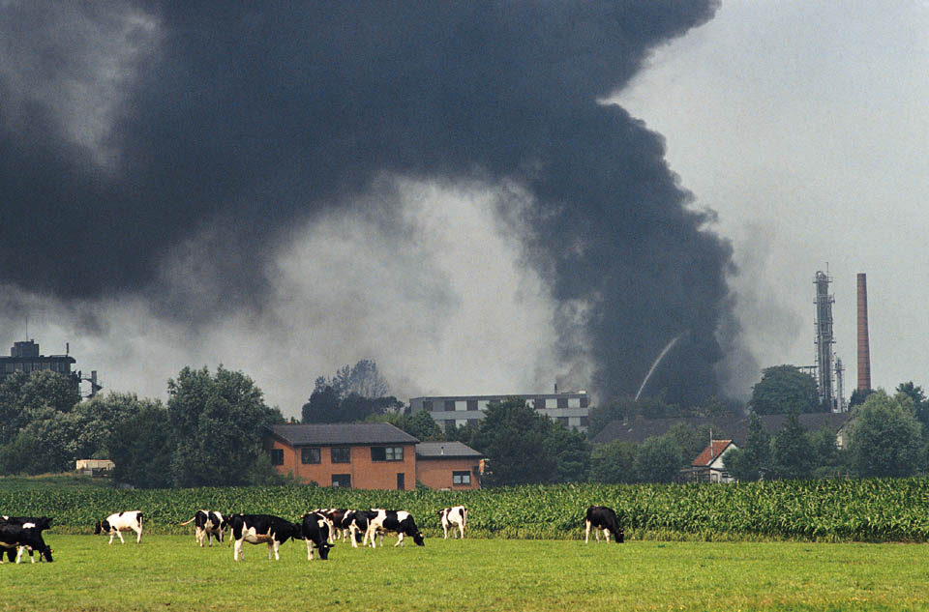

Slide 32
Two frames:
(Iyengar, 1990)
Episodic frame
  Personal circumstances of a poor individual or family
  More common
Thematic frame
  Abstract, impersonal approach that looks at general poverty trends and public assistance

Slide 33
Episodic or thematic framing?
Shanto Iyengar (1991): Is anyone responsible? How television frames political issues.
Predominantly episodic or thematic news stories. Key word search of different topics (like crime and terrorism, unemployment and poverty).
Experimental study: how did the groups react to different types of framing?
Conclusion: In the long run episodic framing contributes to the trivialization of the public discourse
Notes:
33

Slide 34
Those exposed to episodic frames in an experiment were more likely to blame the poor for their own poverty and to perceive them as responsible for improving their socioeconomic status.
Those exposed to thematic frames tended to make structural attributions for poverty and to regard the government as responsible for social change.

Slide 35
Episodic vs. Thematic –
Episodic
  Presents a portrait
  Appears as random event
  Focuses on the story of a person, Psychological
  Invokes personal responsibility
  Better information
Thematic
  Presents a landscape
  Details about trends
  Looks interaction of events- systems
  Invokes social or government responsibility
  Better Policies

Slide 36
Cultivation Theory
George Gerbner

Slide 37
History and Orientation
With the decline of hypodermic needle theories a new perspective began to emerge: the stalagmite theories.
Black et. al. used the metaphor of stalagmite theories to suggest that media effects occur analogously to the slow buildup of formations on cave floors, which take their interesting forms after eons of the steady dripping of limewater from the cave ceilings above. One of the most popular theories that fits this perspective is cultivation theory.
Cultivation theory was an approach developed by Professor George Gerbner, dean of the Annenberg School of Communications at the University of Pennsylvania.

Slide 38
History and Orientation
He began the 'Cultural Indicators' research project in the mid-1960s, to study whether and how watching television may influence viewers' ideas of what the everyday world is like.
Cultivation research is in the 'effects' tradition. Cultivation theorists argue that television has long-term effects which are small, gradual, indirect but cumulative and significant.
Cultivation theory in its most basic form, suggests that television is responsible for shaping, or ‘cultivating’ viewers’ conceptions of social reality.

Slide 39
The combined effect of massive television exposure by viewers over time subtly shapes the perception of social reality for individuals and, ultimately, for our culture as a whole.
Gerbner argues that the mass media cultivate attitudes and values which are already present in a culture: the media maintain and propagate these values amongst members of a culture, thus binding it together. He has argued that television tends to cultivate middle-of-the- road political perspectives. Gerbner called this effect ‘mainstreaming’.
Cultivation theorists distinguish between ‘first order’ effects (general beliefs about the everyday world, such as about the prevalence of violence) and ‘second order’ effects (specific attitudes, such as to law and order or to personal safety). There is also a distinction between two groups of television viewers: the heavy viewers and the light viewers.

Slide 40
The focus is on ‘heavy viewers’. People who watch a lot of television are likely to be more influenced by the ways in which the world is framed by television programs than are individuals who watch less, especially regarding topics of which the viewer has little first-hand experience.
Light viewers may have more sources of information than heavy viewers. ‘Resonance’ describes the intensified effect on the audience when what people see on television is what they have experienced in life. This double dose of the televised message tends to amplify the cultivation effect.

Slide 41
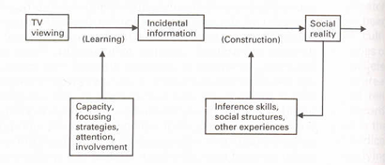
Cultivation Theory
Source: Hawkins and Pingree (1983)

Slide 42
Cultivation Theory
How much TV do you watch?
What is your perception of the possibility of violence in your life?
Connection?
  Does TV create a perception of a “mean and scary world”?
TV “dominates the environment of symbols”
  Used to be: home and religion

Slide 43
Cultivation Theory
Does TV influence the young with regards to violence?
What about comic books, fiction, movies etc.?
  Gerbner says TV’s influence is unique
Gerbner created a “violence index”
  Included auto crashes, cartoons, natural disasters
  Stable for two decades of tracking

Slide 44
Cultivation Theory
By high school graduation, the average viewer has seen 13,000 violent deaths
Violence is not equally represented
  Race, age, gender, class
    Underrepresented in depiction, overrepresented in violence
Cultivation Theory was developed “in the wild”
  Can’t study in isolation: time, lack of control groups
  Defined users: “heavy”: Four or more hours/day; “light”: two or fewer hours/day

Slide 45
Cultivation Theory
Most people watch just to watch, particularly heavy users
  Light users more selective
Cultivation Differential: difference in percent giving the “television answer” regarding perception of violence in the real world. Four attitudes:
  Personal chances of involvement with violence
  Fear of walking alone at night
  Perceived activity/number of police
  General mistrust of people

Slide 46
Cultivation Theory
Chances of involvement with violence:
  Heavy: 1 in 10
  Light: 1 in 100
  Actual:1 in 10,000
Fear of walking alone at night:
  Heavy: 10X the actual
  Women more than men

Slide 47
Cultivation Theory
Perceived activity/number of police:
  Heavy: 5/100 people are involved in law enforcement
  Actual (and light users): 1/100
General mistrust of people:
  “Mean world syndrome”
    People are selfish, uncaring
    Do it to others before they do it to you

Slide 48
Cultivation Theory
Two mechanisms enable cultivation:
  Mainstreaming: TV homogenizes the audience; heavy viewers share meaning and perspectives
    Radio and other media segment the audience
    TV doesn’t reflect the mainstream, it is the mainstream
  Resonance: when TV reality reflects a personal experience, it amplifies the importance of that experience

Slide 49
Cultivation Theory
Critique:
  Is Gerbner’s definition of TV violence overstated?
  What about his methods?
    Causation supported?
  Is the number of hours a good measure?
  Are politics involved with the theory or critics of the theory?

Slide 50
Uses and Gratifications Approach

Slide 51
Originated in the 1970s as a reaction to traditional mass communication research emphasizing the sender and the message. Stressing the active audience and user instead. Psychological orientation taking needs, motives and gratifications of media users as the main point of departure.
In 1974, Katz, Blumler and Gurevitch realized that most Uses and Gratification studies were most concerned with:
  The social and psychological origins of
  needs which generate
  Expectations of mass media or other sources, which lead to
  differential patterns of media exposure (or engagement in other activities), resulting in
  need gratifications and
  other consequences, perhaps mostly unintended ones (Severin and Tankard, 1997).

Slide 52
Blumler made some interesting points why Uses and Gratifications cannot measure an active audience. "The issue to be considered here is whether what has been thought about Uses and Gratifications Theory has been an article of faith and if it could now be converted into an empirical question such as: How to measure an active audience?" (Blumler, 1979).
A medium will be used more when the existing motives to use the medium leads to more satisfaction.

Slide 53
The notion of active audience has conflated an extraordinary range of meanings, including:
  Utility -- Mass communication has uses to people.
  Intentionality -- Media consumption is directed by prior motivation.
  Selectivity -- Media behavior reflects prior interests and preferences.
  Imperviousness -- The lessened ability of media to influence an stubborn audience.
  Cognitive needs -- Acquiring information, knowledge and understanding.
  Affective needs -- Emotion, pleasure, feelings.
  Personal integrative needs -- Credibility, stability, status.
  Social integrative needs -- Family and friends.
  Tension release needs -- Escape and diversion

Slide 54
Uses and gratifications theory attempts to explain the uses and functions of the media for individuals, groups, and society in general. There are three objectives in developing uses and gratifications theory:
  to explain how individuals use mass communication to gratify their needs. “What do people do with the media”.
  to discover underlying motives for individuals’ media use.
  to identify the positive and the negative consequences of individual media use.
At the core of uses and gratifications theory lies the assumption that audience members actively seek out the mass media to satisfy individual needs.

Slide 55
Bandura’s Social Learning Theory

Slide 56
Social learning theory focuses on the learning that occurs within a social context.
It considers that people learn from one another, including such concepts as observational learning, imitation, and modeling.
Television was a source of behavior modeling.
Violence is often expressed as an acceptable behavior, especially for heroes who have never been punished. Since aggression is a prominent feature of many shows, children who have a high degree of exposure to the media may exhibit a relatively high incidence of hostility themselves in imitation of the aggression they have witnessed.

Slide 57
(Bandura, 1986) says that people learn by:
• Observing what other people do;
• Considering the consequences experienced by those people;
• Rehearsing what might happen in their own lives if they followed the other peoples’ behavior;
• Taking action by trying the behavior themselves;
• Comparing their experiences with what happened to the other people;
• Confirming their belief in the new behavior.

Slide 58
Hundreds of studies of the effects of TV violence on children and teenagers have found that children may:
become "immune" to the horror of violence
gradually accept violence as a way to solve problems
imitate the violence they observe on television; and
identify with certain characters, victims and/or victimizers

Slide 59
Social Learning Theory:
Important concepts
Efficacy => Confidence in one’s ability to carry out a behavior. Grows
with direct personal experience and with explicit experience gained by
observing real people or characters in a drama.
Role model => Real person or fictional character who demonstrates new
behaviors and whom others choose to copy.
Parasocial interaction => Audience members behave as if fictional
characters were real people, talking back to them during the broadcast or
sending them letters and gifts.

