Slide 1

Unit IV
Directing and Controlling

Slide 2
Motivation
Meaning of Motivation
Motivation derived from the word “motive”
Definition by Michael Jucious
“ Motivation is the act of stimulating someone or oneself to get a desired course of action, to push the right button to get a desired reaction”

Slide 3
Features of Motivation
Motivation is an act of managers
Continuous process
Positive or Negative
Goal Oriented
Complex in Nature

Slide 4
Features of Motivation
6. Motivation is an art
7. Different from job satisfaction

Slide 5
Importance of Motivation
Higher efficiency
Innovation
Corporate Image
Team Work
Optimum Resources

Slide 6
Importance of Motivation
Reduction in Absenteeism
Reduction in Labour Turnover
Better Relations
Improved Morale
Reduction in Accidents

Slide 7
Motivational Factors
Monetary Factors
Non monetary Factors
Salaries or wages
Bonus
Incentives
Special Individual incentives
Status or job title
Appreciation and recognition
Delegation of Authority
Job security
Working Conditions
Job enrichment
Workers participation
https://www.youtube.com/watch?v=SzDOFKkktcw

Slide 8
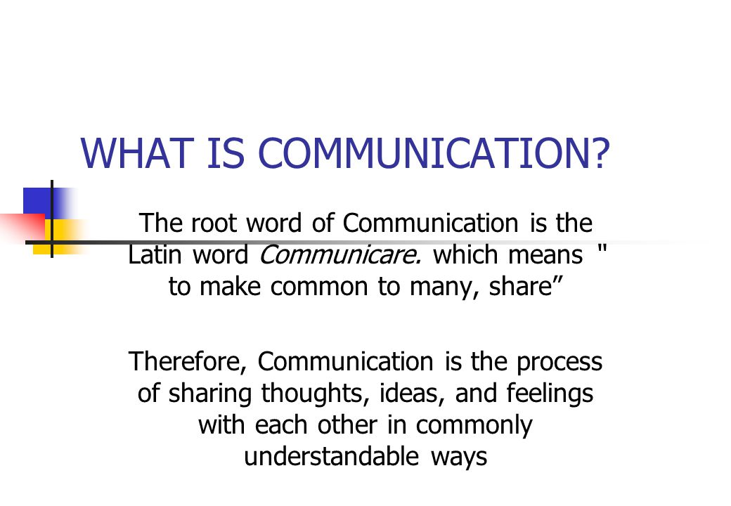

Slide 9
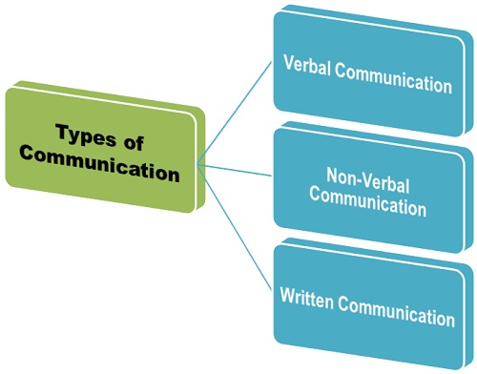
https://youtu.be/akfatVK5h3Y

Slide 10
Importance of Communication
Oral communication
Written Communication
Non verbal Communication
Instant Feed back
Persuasive in Nature
Confidential information
Saves Time
Less Expensive
Legal Evidence
Permanent Record
Accurate and Precise
Wide Circulation
Attracts attention
Better Recall
Create Impact
Educational Value

Slide 11
Barriers to Communication
Physical Barriers
Semantic or Language
Organisational Barriers
Noise
Defects in Communication System
Time and Distance
Wrong selection of Medium
Temperature and Humidity
Misinterpretation of words
Difference in Language
Use of Jargon
Status barrier
Information overload
Lack of planning
Goal Conflicts
Offensive style of communication

Slide 12
Barriers to Communication
Personal Barriers
Cross Culture
Difference perception
Closed Mind
Poor retention
Emotions
Filtering
Wrong assumption
Impatience
Rambling ( aimless talk)
Colours
Body language

Slide 13
LEADERSHIP
To lead and guide the subordinates
Definition
“Leadership is the ability to secure desired actions from a group of followers voluntarily without the use of coercion”

Slide 14
Nature and Characteristics of Leadership
Presence of followers
Common interest
Willing cooperation
Discipline

Slide 15
Nature and Characteristics of Leadership
5. Dynamic Process
6. Active participation
7. Superior knowledge and skills
8. Goal Oriented

Slide 16
Functions of Leadership
Goal Setting
Securing willing participation
Motivates Subordinates
Organises resources

Slide 17
Functions of Leadership
5. Developing Moral
6. Encourages initiative
7. Developing team spirit
8. Representation

Slide 18
Qualities of Good Leader
1. Good Personality
2. Intelligence
3. Initiative
4. Self Confidence

Slide 19
Qualities of Good Leader
5. Innovative
6. Self Confidence
7. Communication Skill
8. Coach and Guide

Slide 20
Qualities of Good Leader
9. Proper judgement
10. Human Skills
11. Discipline
12. Decision Making

Slide 21
Qualities of Good Leader
13. Patience
14. Delegation

Slide 22
Leadership Styles
Autocratic Style
Bureaucratic Style
Consultative style
Participative style

Slide 23
Leadership Styles
5. Laissez faire Style
6. Paternalistic Style
7. Sociocratic Style
8. Neurocratic Style
9. Situational Style

Slide 24
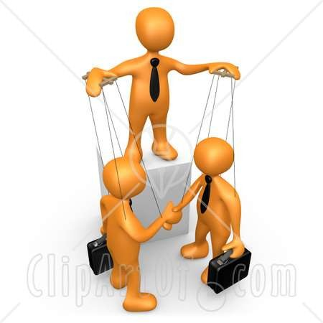
Controlling

Slide 25
to monitor actual performance and take corrective measures if required.
Definition
"Controlling is the process of ensuring that actual activities conform to the planned activities.”
- James Stoner

Slide 26
Characteristics of Controlling
1. Control Involves Measurement
2. Continuous process
3. Influences Employees
4. Universal

Slide 27
Essentials of good Controlling System
5. Simplicity
6. Motivating
7. Control by Exception
8. Economical

Slide 28
Characteristics of Controlling
5. Facilitates Direction
6. Goal oriented

Slide 29
Essentials of good Controlling System
1. Focus on Objective
2. Suitability
3. Prompt
4. Flexibility

Slide 30
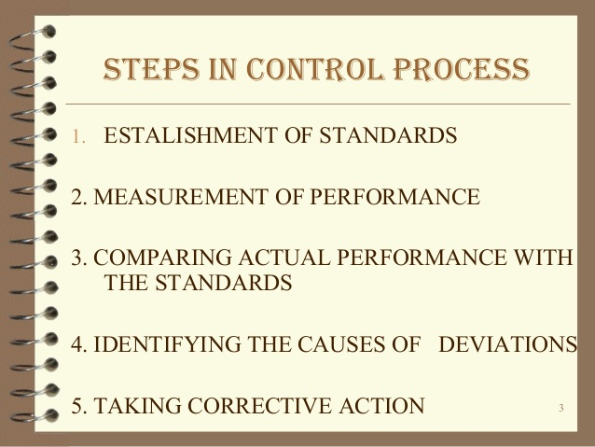

Slide 31
Techniques of Controlling
1. Budgetary control
2. Management Audit
3. PERT and CPM
Program Evaluation and Review Technique
Critical Path Method

Slide 32
Techniques of Controlling
4. Management by Objectives
5. Direct Supervision
6. Self Control
7. Break Even point
8. Management Information system

