Slide 1
Features of Schumpeter Theory
High degree of risk and uncertainty in Schumpeterian World
Highly motivated and talented individual
Profit is merely an part of objectives of entrepreneurs
Progress under capitalism is much slower than actually it is
It is leadership rather than ownership which matters.
It is leadership rather than ownership which matters.

Slide 2
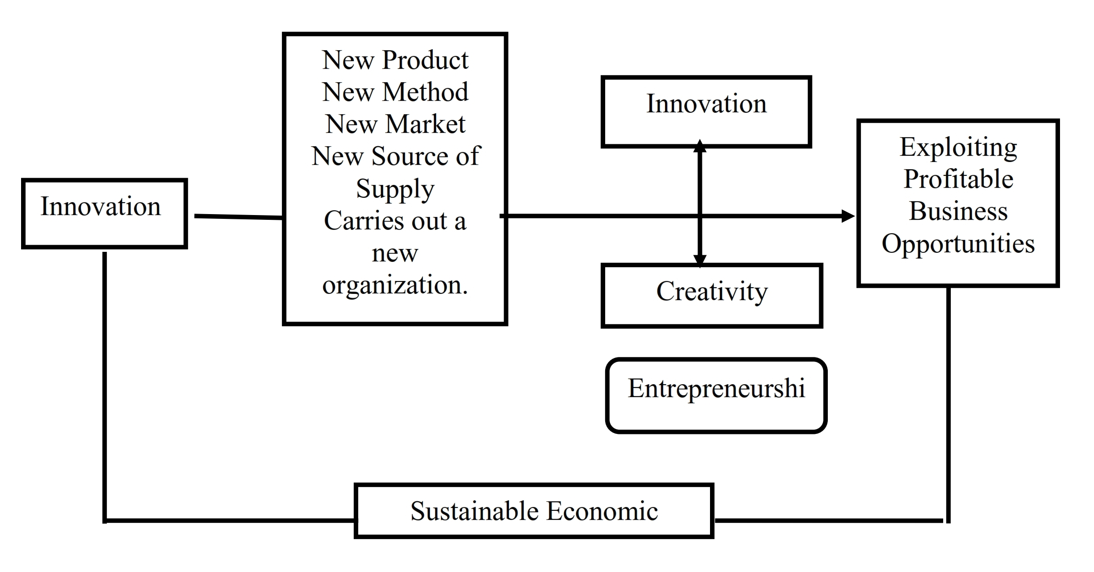

Slide 3
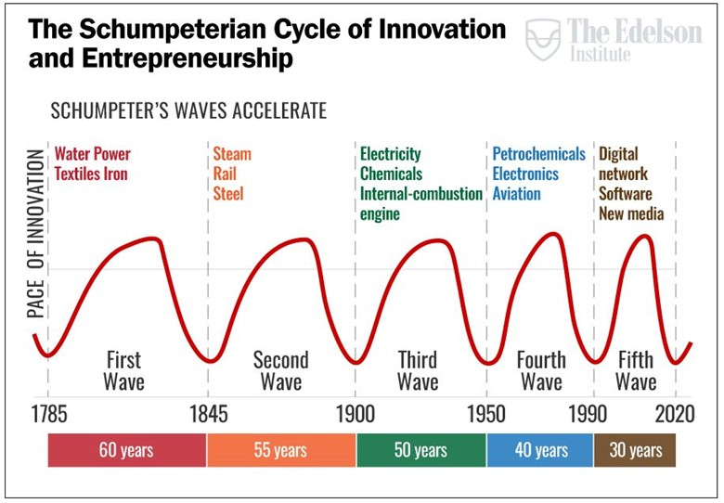

Slide 4
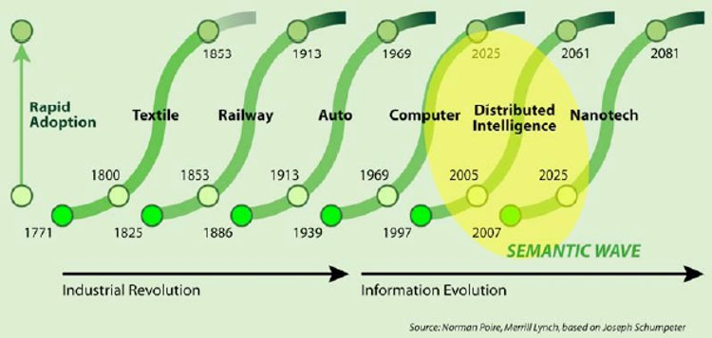

Slide 5
2. X-Efficiency Theory
Economist Harvey Leibenstein, a Harvard professor who studied the psychological aspects of economics, first used the term.
A
B
C
D
Let's say that companies A, B, and C together own about 90% of the market for Mobile phones.
They are large companies that compete fiercely on price and service.
Company D is a tiny company that is also trying to sell phones, but it is not doing so profitably.

Slide 6
Despite the fact that the market for phones is competitive, Company D isn't much of a competitor and the employees know that.
According to the theory, the employees don't work as hard at Company D because of this. They know that being more efficient won't make a difference. That is, their x-efficiency falls.
D

Slide 7
Company A is the only manufacturer of widgets in the market. It has a monopoly.
This scenario, under the theory, leads to the same situation that Company D was in:
Because employees know that nothing foreseeable will change the company's market share, they become less productive.
A

Slide 8
Sr.No | Maximum Output | Actual Output | Gap
1 | 100 | 70 | 30
2 | 100 | 80 | 20
3 | 100 | 90 | 10
Difference is due to inefficient utilization of resources – x-efficiency
Entrepreneur has to fill this gap

Slide 9
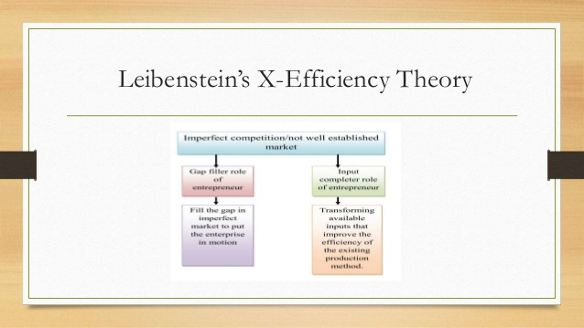

Slide 10
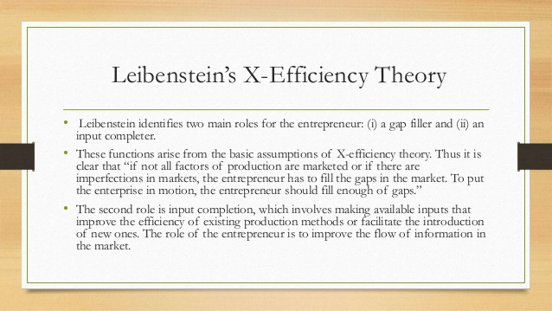

Slide 11
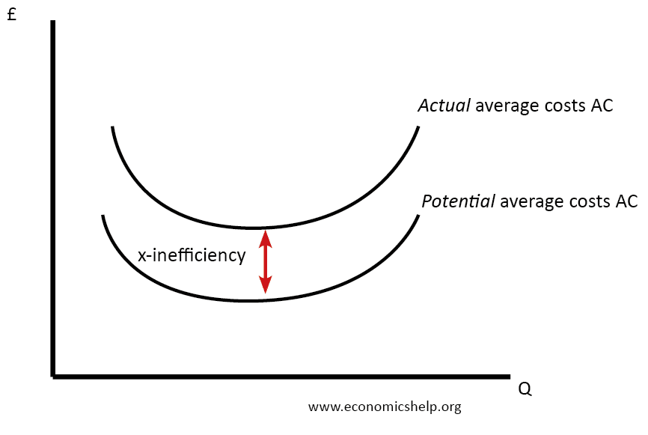

Slide 12
Sr.No | Potential Avg Cost | Actual Avg Cost | Gap
1 | 100 | 175 | 75
2 | 100 | 150 | 50
3 | 100 | 125 | 25
Difference is due to inefficient utilization of resources – x-efficiency
Entrepreneur has to fill this gap

Slide 13
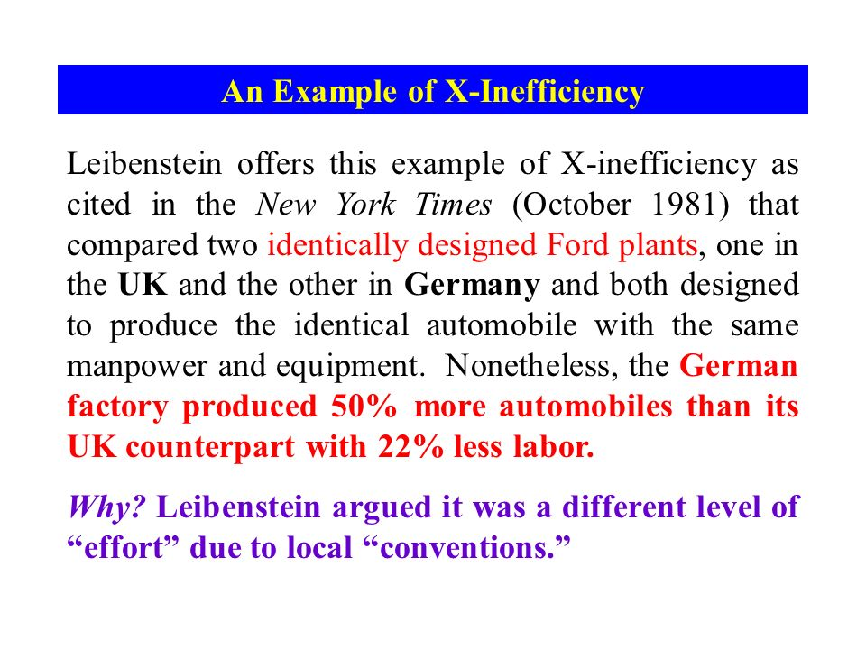

Slide 14
Traits of Entrepreneurship
Recognizing the market trends
Develop goods/processes in demand but not in supply
Develop profitable activities
Routine Entrepreneurship – Normal business function
Innovative Entrepreneurship – Markets are imperfect - Gap filler and Input completion

Slide 15
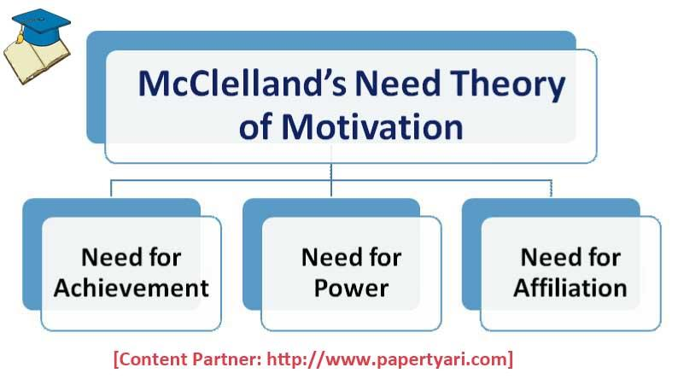

Slide 16
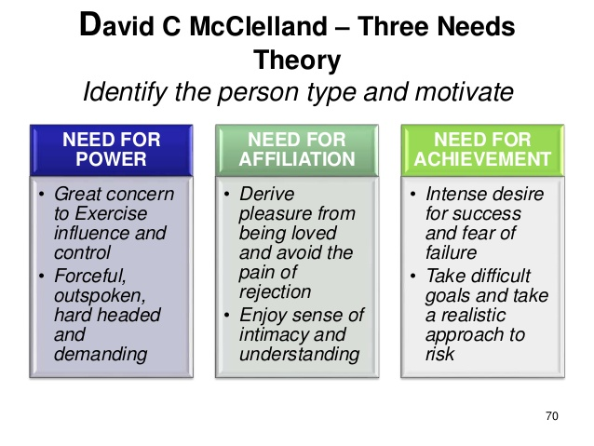

Slide 17
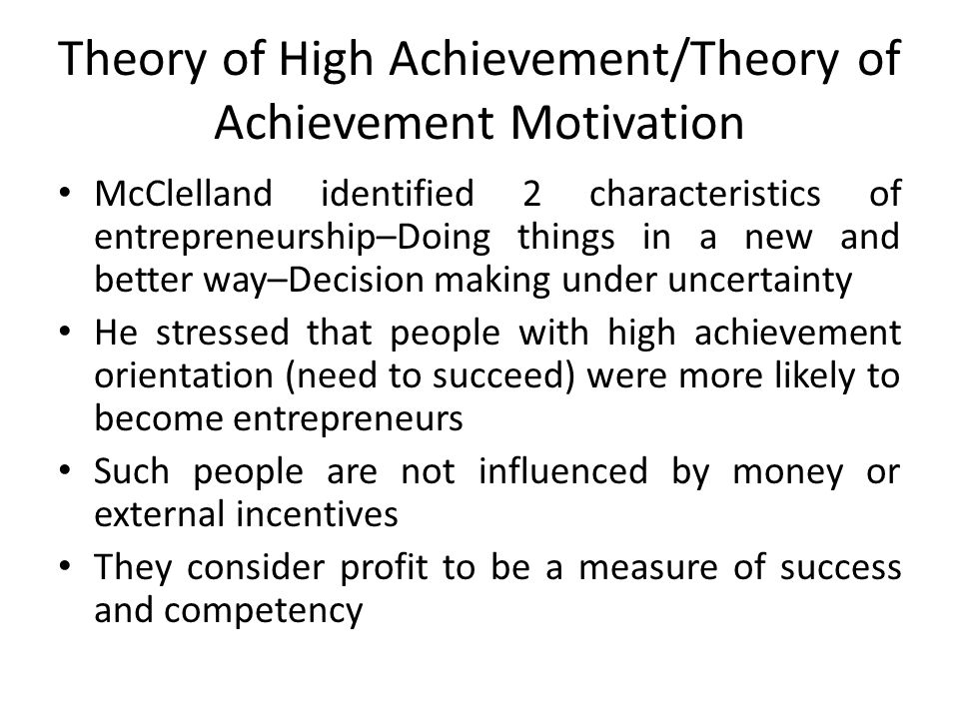

Slide 18
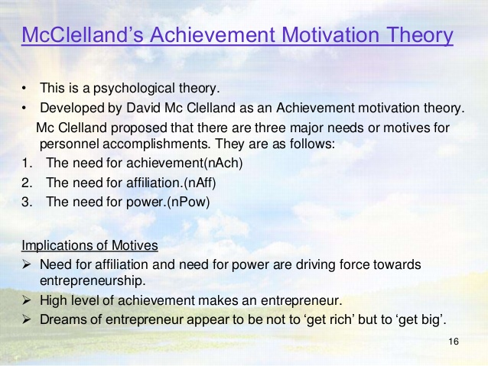

Slide 19
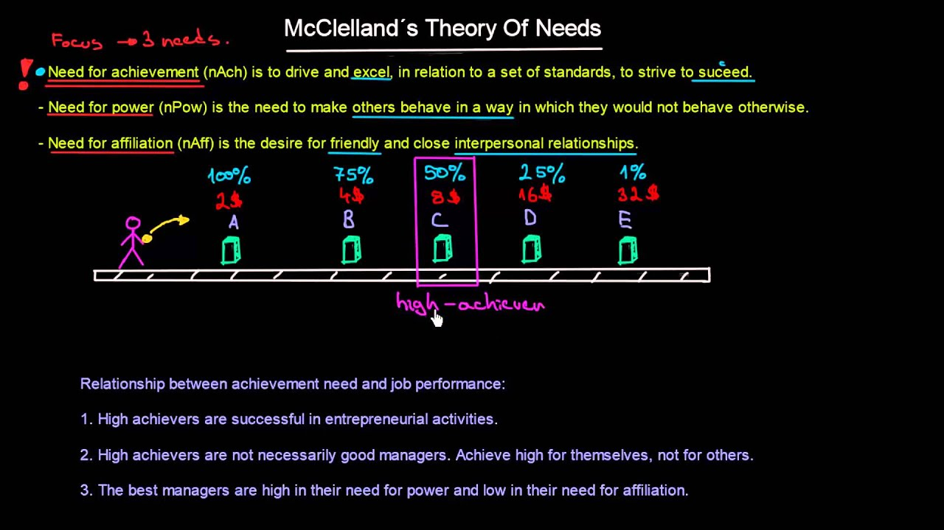
Low rewards
Gambling

Slide 20
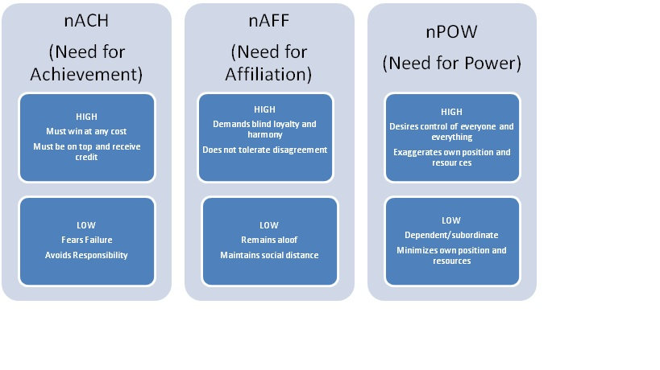

Slide 21
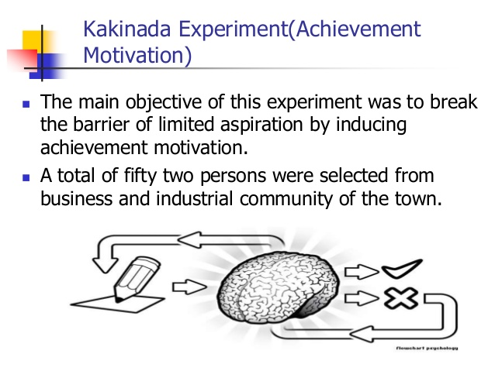

Slide 22
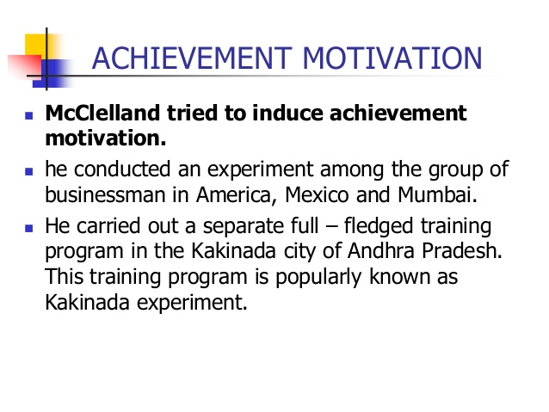

Slide 23
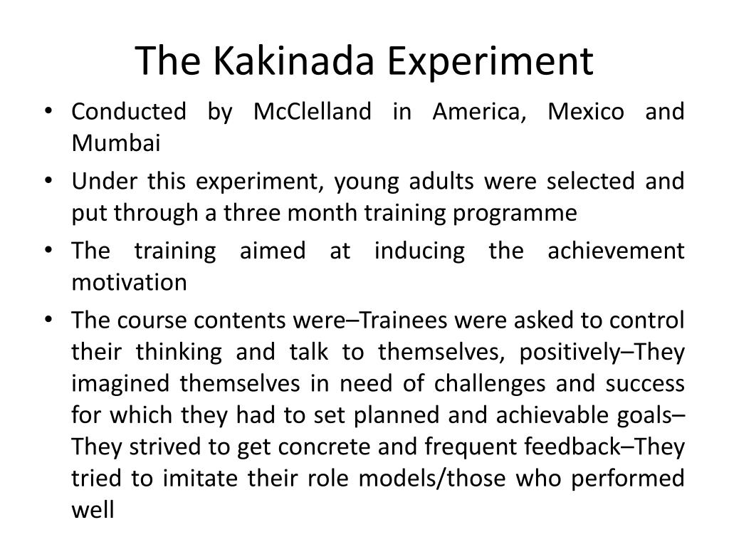

Slide 24
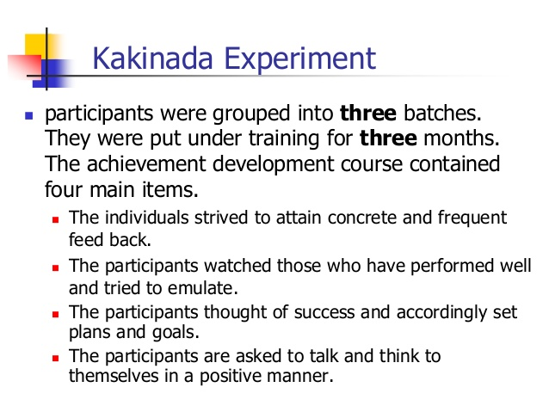

Slide 25
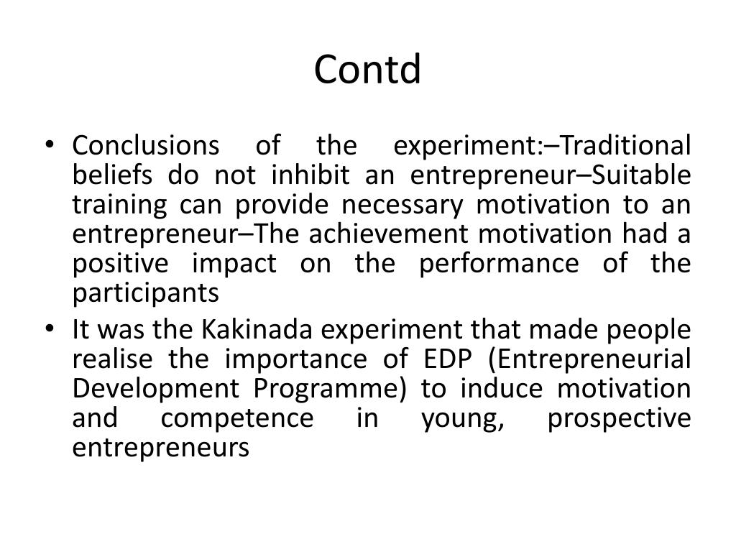

Slide 26
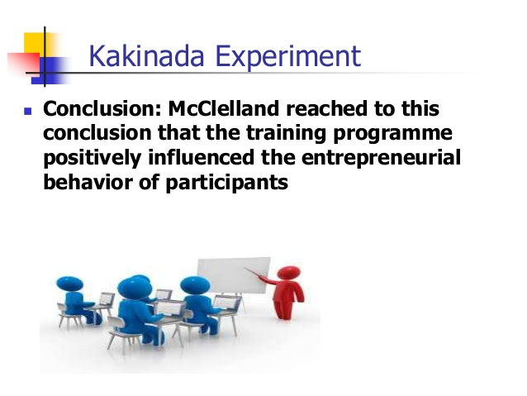

Slide 27
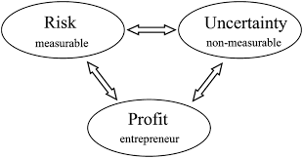

Slide 28
TWO TYPES OF RISK
Insurable Risks:
These are predictable/measurable and which are insurable for – fire, theft, flood, accident etc (which are the risks in business).
Non Insurable Risks (Uncertainty):
These are unforeseeable risks or cannot be measured/identified. For instance, competitive risks, technical risks, risk of government risk arising out of business cycle.

Slide 29
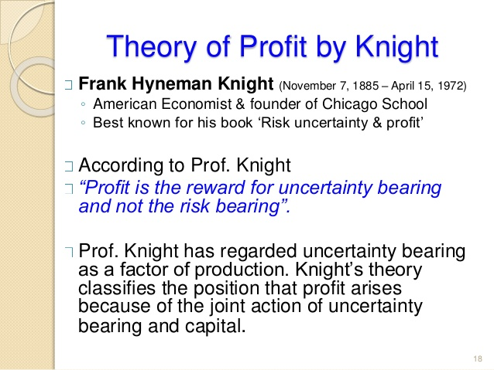

Slide 30
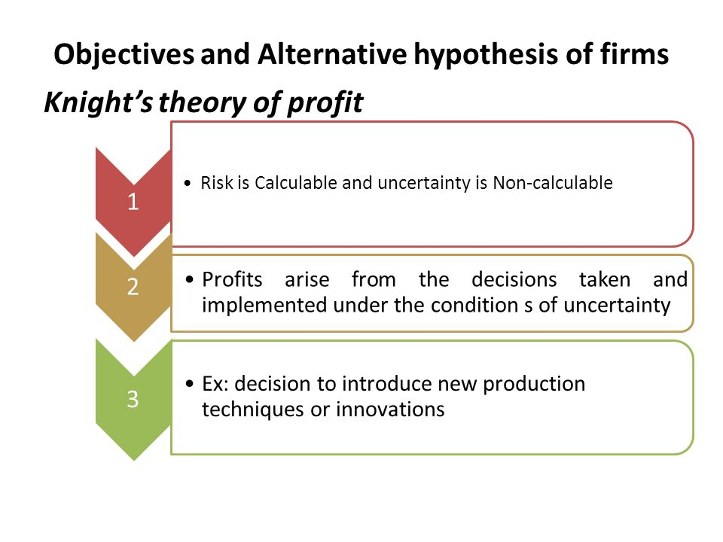

Slide 31
There is no provision for insurance against the commercial losses which may arise due to price decisions, output, product variation etc.
Entrepreneurs claim profit as rewards for undertaking these non-insurable risks or uncertainties.
According to Knight uncertainty in production can be thought of as factor of production like other factors say land, labour, capital etc.
The price for undertaking this uncertainty is, therefore, considered as part of cost of production.

Slide 32
HAGEN THEORY
One important theory of entrepreneurial behaviour has been propounded by Hagen which is referred to as the withdrawal of status respect
Hagen considers the withdrawal of status, of respect, as the trigger mechanism for changes in personality formation.
Status withdrawal occurs when members of some social group perceive that their purposes and values in life are not respected by the groups in the society they respect, and whose esteem they value.

Slide 33
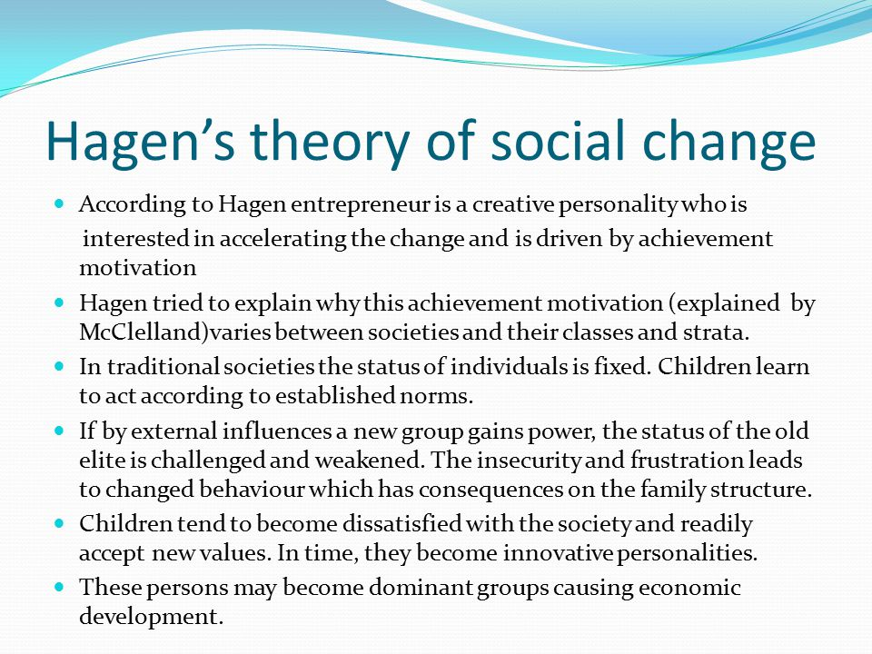

Slide 34
Hagen further postulates that withdrawal of status respect would give to four possible reactions and create four different personality types:
Retreatist: Entrepreneur who continues to work in society but remains indifferent to his work or status.
Ritualist: One who works as per the norms in the society but with no hope of improvement in the working conditions or his status.
Reformist: One who is a rebellion and tries to bring in new ways of working and new society.
Innovator: An entrepreneur who is creative and try to achieve his goals set by himself.

Slide 35
The creativity of a disadvantaged minority group is the main source of entrepreneurship.
He developed this thesis from the case of the samurai community of Japan.
Traditionally, this community had enjoyed a high status of which it was deprived later.
To regain this lost prestige, it became more active and vigorous and gave rise to many entrepreneurs

