Slide 1

Commercial Banking & Customer Banker Relationship

Slide 2
Commercial Bank
“A Bank collects money from those who have it to spare or who are saving it out of their income & it lends this money to those who require it.” – Crowther
“A bank organized chiefly to handle the everyday financial transactions of businesses.”
“An institution of the keeping, lending and exchanging, etc. of money.” - Dictionary

Slide 3
Commercial Banks are the oldest Banking Institution in the organised sector.
They constitute a large part of the Banking System in India.
They cater to the needs of Commerce, Trade, Industries, Agriculture, Small & medium Business, Transport & other activities with network of branches throughout the Country.

Slide 4
Commercial Banking commands a major share in the total banking organisation.
Commercial Banks are governed by the Banking Regulation Act,1949.
Commercial Bank runs on commercial line that is to earn profits.
Commercial Bank accepts deposits from the public , makes funds available to those who need them & helps in the remittance of money from one place to another.

Slide 5
Commercial banks make money by providing loans and earning interest income from those loans.
A growing number of commercial banks operate exclusively online, where all transactions with the commercial bank must be made electronically.

Slide 6
Types of Commercial Banks
Commercial Bank
Scheduled Bank
Public Bank
Non Schedule Bank
Private Bank
Foreign Bank

Slide 7
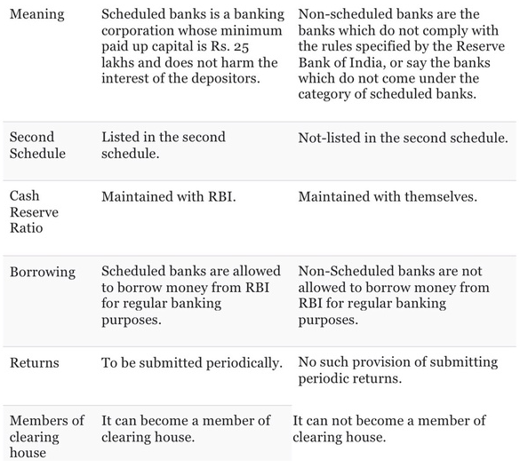
SCHEDULED BANKS
NON - SCHEDULED BANKS

Slide 8
Importance of Commercial Banks
Accelerating the Rate of Capital Formation
Provision of Finance and Credit
Developing Entrepreneurship
Promoting Balanced Regional Development
Help to Consumers
Promote Savings Habits

Slide 9
https://www.youtube.com/watch?v=5ld2x94RuH0

Slide 10
Significance of Commercial Banks:
(i) They promote savings and accelerate the rate of capital formation.
(ii) They are source of finance and credit for trade and industry.
(iii) They promote balanced regional development by opening branches in backward areas.
(iv) Bank credit enables entrepreneurs to innovate and invest which accelerates the process of economic development.

Slide 11
Significance of Commercial Banks:
(v) They help in promoting large-scale production and growth of priority sectors such as agriculture, small-scale industry, retail trade and export.
(vi) They create credit in the sense that they are able to give more loans and advances than the cash position of the depositor’s permits.
(vii)They help commerce and industry to expand their field of operation.
(viii) They make optimum utilisation of resources possible.

Slide 12
Features of Banking
Dealing in Money
Deposits must be withdraw able
Dealing with Credit
Middle man
Commercial in Nature
Risk Transformation
Size Transformation
Nature of Agent

Slide 13
Evaluation of Commercial Banking in India.
1786
The General Bank of India (Estd.)
1806
The Bank of Bengal
1840
The Bank of Bombay “Presidency Banks”
1846
The Bank of Madras
1860
Concept : Limited Liability
Upto 1900
The Punjab National Bank Ltd. & Allahabad Bank Ltd.
1900
Total Bank : 20
(Presidency Bank : 03, Joint Stock Banks :09 & Foreign Bank : 03 )

Slide 14
1910
Swadeshi Movement : The Bank of Baroda & The Central bank of India
1921
3 Presidency Banks were merged to form The Imperial Bank of India.
- 1925
Many Banks Failed. (Investigation Initiated)
1947
648 Commercial Banks (97 Schedule Banks & 551 Non Schedule Banks)
1955
Recommendation of the India Rural Credit Survey Committee (SBI Act) passed & Imperial Bank of India was renamed as State Bank of India.
1959
SBI (Subsidiary) Act Passed to take 8 State Associated Bank.
1968
National Credit Control Council : Assess the demand for Bank Credit.

Slide 15
1969
Total Banks declined to 89 (73 Schedule & 16 Non Schdule )
1969
14 Banks were Nationalized
1980
6 more Banks were Nationalised
1985-86
MICR Technology & Health Code System for Bank Loans Introduced.
1991
Narasimham Committee Report on Financial Sector Reforms.
1994-95
Debt Recovery Tribunal was Estd.
2002
Worldwide Revolution in ICT changes in Banking Sector.

Slide 16
2002-08
Modern Day Banking & Innovations : 24x7 Banking, Tele banking, E-banking
2008
State Bank of Saurashtra got merged with SBI
State Bank of Indore was merged with SBI.
1st APril2017
State Bank of Bikaner & Jaipur, State Bank of Hyderabad , State Bank of Mysore, State Bank of Travancore, State Bank of Patiala & Bhartiya Mahila Bank was merged with SBI.
2010
Placed in Top 50 Bank list in World with 37 Cr.+ Customer base, 24,000+ Branches & 59,000+ ATM across India.

Slide 17
Phases of Indian Banking System
The Pre-Independence Phase i.e. before 1947
Second Phase from 1947 to 1991
Third Phase 1991 and beyond

Slide 18
The Pre-Independence Phase i.e. before 1947
This phase is characterized by the presence of a large number of banks (more than 600).
Banking system commenced in India with the foundation of Bank of Hindustan in Calcutta (now Kolkata) in 1770 which ceased to operate in 1832.
After that many banks came but were not successful like:
(1) General Bank of India (1786-1791)
(2) Oudh Commercial Bank (1881-1958) – the first commercial bank of India.

Slide 19
Whereas some are successful and continue to lead even now like:
(1) Allahabad Bank (est. 1865)
(2) Punjab National Bank (est. 1894, with HQ in Lahore (that time))
(3) Bank of India (est. 1906)
(4) Bank of Baroda (est. 1908)
(5) Central Bank of India (est. 1911)
While some others like Bank of Bengal (est. 1806), Bank of Bombay (est. 1840), Bank of Madras (est. 1843) merged into a single entity in 1921 which came to be known as Imperial Bank of India.

Slide 20
Imperial Bank of India was later renamed in 1955 as the State Bank of India.
In April 1935, Reserve Bank of India was formed based on the recommendation of Hilton Young Commission (set up in 1926).
In this time period, most of the bank were small in size and suffered from a high rate of failures. As a result, public confidence is low in these banks and deposit mobilization was also very slow. People continued to rely on the unorganized sector (moneylenders and indigenous bankers).

Slide 21
Second Phase from 1947 to 1991
Broadly the main characteristic feature of this phase is the Nationalization of the bank.
With the view of economic planning, nationalization emerged as an effective measure.
Need for nationalization in India:
(a) The banks mostly catered to the needs of large industries, big business houses.
(b) Sectors such as agriculture, small-scale industries and exports were lagging behind.
(c) The poor masses continued to be exploited by the moneylenders.
Following this, in the year 1949, 1st January the Reserve Bank of India was nationalized.

Slide 22
Fourteen commercial banks were nationalized on 19th July 1969. Smt. Indira Gandhi was the Prime Minister of India, during in 1969. The following banks are nationalized:
Central Bank of India, Bank of India, Punjab National Bank, Bank of Baroda, United Commercial Bank, Canara Bank, Dena Bank, United Bank, Syndicate Bank, Allahabad Bank, Indian Bank, Union Bank of India, Bank of Maharashtra , Indian Overseas Bank
Six more commercial banks were nationalized in April 1980. These are mentioned below:
Andhra Bank, Corporation Bank , Bank of India, Oriental Bank of Commerce , Punjab & Sindh Bank, Vijaya Bank.
Meanwhile, on the recommendation of the Narasimham committee, Regional Rural Banks (RRBs) were formed on Oct 2, 1975. The objective behind the formation of RRBs was to serve the large unserved population of rural areas and promoting financial inclusion.
With a view to meet the specific requirement from the different sector (i.e. agriculture, housing, foreign trade, industry) some apex level banking institutions were also set up like:(a) NABARD (est. 1982), (b) EXIM (est. 1982) , (c) NHB (est. 1988) , (d) SIDBI (est. 1990)

Slide 23
Third Phase 1991 and beyond
This period saw remarkable growth in the process of development of banks with the liberalization of economic policies.
Even after nationalization and the subsequent regulations that followed, a large portion of masses is untouched by the banking services.
Considering this, in 1991, the Narasimham committee gave its recommendation i.e. to allow the entry of private sector players into the banking system.
Following this, RBI gave license to 10 private entities, out of which few survived the market demands, which are- ICICI, HDFC, Axis Bank, IndusInd Bank, DCB.

Slide 24
In 1998, the Narsimham committee again recommended the entry of more private players. As a result, RBI gave a license to the following newbies:
(a) Kotak Mahindra Bank (2001)
(b)Yes Bank (2004)
In 2013-14, the third round of bank licensing took place and in 2015, IDFC bank and Bandhan Bank emerged.
In order to further financial inclusion, RBI also proposed to set up 2 new kinds of banks i.e. Payment Banks and Small Banks.
In 2015, RBI gave in-principle licence to 11 entities to launch Payments Bank and granted 'in-principle' approval to the 10 applicants to set up Small Finance Banks.

Slide 25
Functions of Commercial Banks
Primary Function:
Also called as Traditional or Core Functions.
1. Receiving Deposits
2. Lending Funds
Secondary Function:
Commercial banks provides wide variety / range of Financial & Non Financial Services.
1. Agency Functions / Services
2. General Utility Services.

Slide 26

Primary Function
Receiving Deposits
Time Deposits
Demand Deposits
Lending of Funds
Overdraft
Fixed Deposits
Recurring Deposits
Savings a/c
Current a/c
Cash Credits
Loans & Advances
Disc. BOE

Slide 27

Receiving Deposits
One of the basic functions of a commercial banks.
Receives deposits from individuals, households , corporate & non corporate customers, Government & other agency.
It mobilises savings in the country for productive purpose.
Offers variety of deposits to suits the requirement of customers needs.

Slide 28
1A. Time Deposits
Fixed Deposits:
Deposits by customers for a specified time period.
Period : 7 days to 10 years.
Fixed Rate of Interest
Recurring Deposits :
It is combination of savings + fixed deposits.
A fixed amount is invested on monthly basis for fixed
period of time.
Period : 6 months to 120 months
Preferred by salaried person or individuals with
regular income.

Slide 29
1B. Demand Deposits
Savings Bank Account:
Intended for small scale savers.
Minimum Balance Requirements.
Minor Accounts
High Liquidity & Safety.
Current Account:
Primarily for Businessmen, Firm, Companies.
Withdrawal at any time.
Transactions by help of Cheques.
No Interest
Facility : Overdraft, Transfer of Funds & Utility services.

Slide 30

2. Lending of Funds
Main business of commercial bank is to lend money.
Bank earn income in the form of interest through granting loans & advances of various kinds.

Slide 31


Overdraft
1. An arrangement between a banker & customer.
2. Allow to withdraw over & above credit balance in current account.
3. Short term funds , repayable with interest.
Cash Credit
1. Short term cash loan to corporate.
2. Arrangement by which a banker allows customer to borrow money up to specified amount against security.
3. Most common form of borrowings by corporate.

Slide 32


Loan
1. A contractual promise between the bank & customer.
2. Promise to return over a period of fixed tenure along with interest.
3. Requires a guarantee/ security.
Discounting of Bills of Exchange
1. Advance granted to customer by discounting BOE.
2. Payment made after deducting interest / commission.
3. Relay on Creditworthiness of the parties.

Slide 33


Slide 34


Secondary Function
Agency Services
Payment Services
General Utility Services
Safe Custody
Merchant Banking
Fund Remittance
Collection Services
Letter of Credit
Forex
ATM
Plastic Cards
Ebanking

Slide 35
Agency Functions
The bank acts as an agent for customer.
Collection & Payment of Cheques, Bills, Promissory notes.
Execution of standing orders.
Purchase & Sale of Securities.
Acting as Executor, Administrator, Attorney & Trustee.
Remittance of funds

Slide 36




General Utility Functions
Safe Custody
Bank accepts various instruments for safe custody.
Strong Rooms Services.
Merchant Banking
Offers Financial , Technical & Managerial Services
Advisory Services
Letter of Credit
Foreign Exchange
Personal as well as commercial letter of credit.
International Trade Services.
Guarantee to Importer.
International Currency Service.
Payment & Collection Services.
Cards, Cheques & Remittance Services.

Slide 37



ATM
Banking Service based on Telecommunication.
Withdrawal & Deposit Services.
Plastic Cards
Debit Cards : Withdrawal from savings account based on credit available.
Credit Cards : Withdrawal based credit limit sanctioned by bank.
E - Banking
Virtual Bank Services.
Add on services.
At convenience of Customer.
Various mode : Telebanking, Mobilebanking, Netbanking etc.

Slide 38
Other Services
Lease Financing
Factoring
Housing Finance
Underwriting of Securities
Gift & Travel Cheques
DMAT Services
Insurance Products

Slide 39


Slide 40
Retail Banking
Retail banking, also known as Consumer banking, refers to the offering of banking services to retail customers instead of institutional customers, such as companies, corporations and/or financial institutions.
A banking in which all necessities of general public are coordinated to satisfy the customers.

Slide 41
Retail banking provides financial services to individual people as opposed to large institutions.
Services offered include savings and checking accounts, mortgages, personal loans, debit/credit cards, and certificates of deposit (CDs).
Many financial services companies aim to be the one-stop-shop retail banking destination to their individual consumers.
Retail banks can be local community banks or the divisions of large commercial banks.
In the digital age, many Fintech companies offer retail banking services purely through the Internet and mobile apps.

Slide 42
Features of Retail Banking
Multiple Products
Multiple Delivery Channels
Multiple Customer Groups
Large Number of Small Customers
Diverse & Competitive

Slide 43
Reduction of Risk
Reduction of NPA
Products offering
Deposits
Loans
Consumer Oriented
Variety of Products
Better Returns
Non Financial Services
Utility Services
Technology Usage
Value Added Services
Importance

Slide 44


Slide 45
Corporate Banking
Corporate banking refers to the aspect of banking that deals with corporate customers.
Corporate banking is a subset of business banking that involves a range of banking services that are offered only to corporate. The services include the provision of credit, cash management facilities, etc.

Slide 46


Slide 47
Corporate banking is the tailor-made financial services that financial institutions offer to corporations in the context of corporate financing and raise capital.
It is also referred as Wholesale Banking.
Normally supply capital for business ventures & construction activities on a long term basis.

Slide 48
Features of Corporate Banking
Services to Corporate
Products Offered
Different Services
Banking Services to Smaller Group
Industrial Purpose

Slide 49
Characteristics of Corporate Banking
Clientele
Authority
Liability
Credit rating
Bankers
SOURCE : https://corporatefinanceinstitute.com/resources/knowledge/finance/corporate-banking/

Slide 50
Corporate Banking Services
Traditional Finance
Term Loans
Bank Guarantees
Modern Services
Funding
Working Capital
Non Funding

Slide 51
Modern Services
Funding Services
Loan Syndication
Project Finance
Non Funding Services
Letter of Credit
Bank Guarantees
Consortium Finance
Loans, Overdrafts , Bill Discounting
Investments
Risk Management
Consultancy & Advisory Services

Slide 52
Corporate Banking Services
Credit
Treasury services
Fixed asset requirement financing
Employer services
Commercial services
SOURCE : https://corporatefinanceinstitute.com/resources/knowledge/finance/corporate-banking/

Slide 53
Need and Importance of Corporate Banking
Safe Accounting
Professionalism
Managing Expansion
Loan Accessibility
Tax Audit
Bills of Exchange
SOURCE: https://www.ilearnlot.com/corporate-banking-meaning-characteristics-importance-and-advantages/61014/

Slide 54
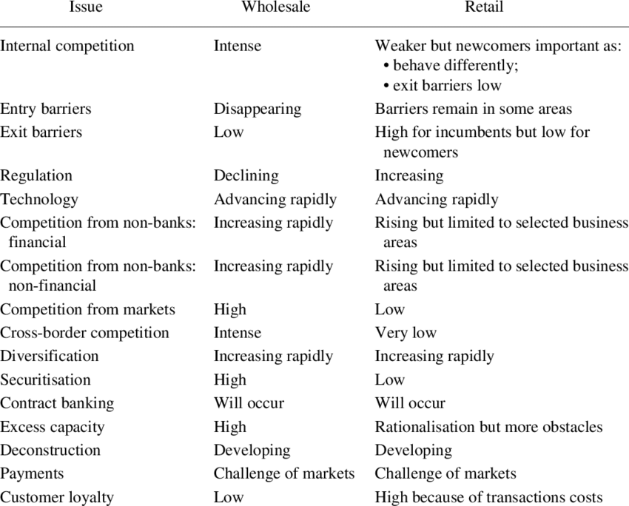

Slide 55
Rural Banking
Regional Rural Banks (RRBs) are Indian Scheduled Commercial Banks (Government Banks) operating at regional level in different States of India.
They have been created with a view of serving primarily the rural areas of India with basic banking and financial services.
RRBs may have branches set up for urban operations and their area of operation may include urban areas too.
The area of operation of RRBs is limited to the area as notified by Government of India covering one or more districts in the State.

Slide 56
Overview
Occupies a significant position in the structure of Indian Banking System.
India : Agrarian Economy.
1970 : Financial Need of Rural India was served by Money Lenders.
SBI took initiative to develop Rural Financial Services.
1972 : The Banking Commission Report.
1975 : Economic Programme.(Narasimhanm Committee)

Slide 57
Regional Rural bank Act, 1976.
New Guidelines by RBI in 2011.
Time Frame : By Sep. 2012, RRB services in village with population of 5000 or more.
Rural Finance: Co-operative Banks , Local Development Banks, RRB , Local Area Banks & NABARD.

Slide 58
Co-operative Banks
Play a important role.
70% of Rural Credit
Regional Rural Banks (RRB)
Estd. to promote , regulate & develop Rural Economy.
Agriculture, Trade, Commerce &Industry.
Short Term Credit
Agriculturists, Small Farmers & SSI
Small & Marginal Farmers, Agri. Labours & Small Entrepreneurs.

Slide 59
Local Development Banks
Provides Long Term Loans to Agriculturists.
Loans
Purchase of Tractors, Pump Sets, Electronic Motors
Digging & Construction of Wells.
Called as “Agriculture & Rural Development Bank”
Purchasing Tools, Equipments, Cattle & making Permanent land improvement.
Fencing of Land
Redemption of Old Debts.
Other construction activities.

Slide 60
Local Area Bank (LAB)
Union Budget 1996-97
Commercial Banks in the private sector.
Objectives
Providing an Institutional mechanism for promoting rural & semi urban savings.
For providing credit for viable economic activities in the local area.
Help RRB & other Co-operative banks

Slide 61

Estd. in July 1982. (National Bank for Agriculture and Rural Development )
Apex Institution concerned with the policy , planning & operation in the field of Agriculture & other Rural Economic Activities.
Function : Coordination of the activities of different agencies in the filed of Agriculture & Rural Credit.
1996-97 : Set up the Rural Infrastructure Development Funds.

Slide 62
Features of Rural Banking
Services to Poor
Purpose
Low Rate of Interest
Variety of Products
Challenges

Slide 63
Products & Services
Deposits
Loans & Advances to Agriculture & Allied Activities
Loans & Advances to MSME’s
Kisan Credit Card
No Frills Accounts, Jan Dhan Yojana Accounts.
Insurance Facilities
Financial Inclusion

Slide 64
t
RRBs also perform a variety of different functions.
1. Providing banking facilities to rural and semi-urban areas.
2. Carrying out government operations like disbursement of wages of MGNREGA workers, distribution of pensions etc.
3. Providing Para-Banking facilities like locker facilities, debit and credit cards, mobile banking, internet banking , UPI etc.
4. Small financial banks.

Slide 65
Significance of Rural Banking
70% Indian resides in Village.
Agriculture is primary activity.
Rural Economy : 50% GDP Contributor.
Lots of scope for Rural banking & Financial Inclusion.
Reducing dependence on Informal Sources.
Self Help Groups, Micro Finance.
“Banking with Poor.”

Slide 66


Slide 67
Banking Ombudsman
RBI has introduced a Scheme of Ombudsman from June 14th, 1995 to protect the interest of the customers as well as to redress their grievances.
It is one of the Landmark Event in the History of Indian Banking.

Slide 68
Objectives of the Scheme
To resolve & settle complaints relating to the provision of banking services.
To resolve disputes between a bank & its constituents as well as between one bank & another bank through the process of Conciliation, Mediation & Arbitration.
To make available an expeditious & cost effective grievance redressal mechanism to bank customers as well as to bankers themselves.

Slide 69
General Power & Duties
To receive complaints relating to the provision of banking services.
To consider such complaints & facilitate their satisfaction or, i ) Settlement by Agreement, or
ii) Settlement by Recommendation, or
iii) Settlement by an Award as the case may be in accordance with the provision under the scheme.
The ombudsman has all power of a Court.

Slide 70
Specific Powers & Duties
Claims in respect of unauthorised , fraudulent withdrawals from deposit accounts.
Complaints relating to deposits.
Complaints from Indian Exporters regarding delay in receipt of export proceeds, handling of export bills, collection of bills etc.

Slide 71
Specific Powers & Duties
Non payment or delayed payment of Cheques, Drafts, Bills, etc.
Non issue of drafts to customers as well as to outsiders.
Non adherence to prescribed working hours by branches.
Failure to honour guarantee or Letter of Credit commitments by the bankers.

Slide 72


Slide 73
Amendment in 2002 (14th June 2002) : Scheme now covers Commercial Banks, Regional Rural banks & Schedule Primary Cooperative Banks.
Banking Ombudsman Scheme 2006 (Dec. 28th 2005)
Revised Scheme in 2009 : The scope of Banking Ombudsman Scheme has been expanded to include deficiencies arising out of interest banking.
23rd Feb. 2018 : Ombudsman Scheme for NBFC launched.

Slide 74
Nature of Complaints
Unsolicited Credit Cards
Charging of Annual Fee in spite of being offered the card free.
Authorisation of loans over phone.
Non settlement of Insurance Claims

Slide 75
Nature of Complaints
Dispute over wrong billing.
Abusive calls.
Non adherence of prescribed working hours.
Delay in payment of pension / wrong pension calculation.
Refusal / delay in sanctioning educational loans, micro – small & medium enterprise loans.

Slide 76
TRUE OR FALSE
1. Banking Ombudsman scheme introduced by SBI.
2. Dispute over wrong billing can be part of ombudsman.
3. NABARD directly gives loans to rural customers.
4. Overdraft facility is given to savings account.
5. RBI appoint person as Banking Ombudsman.

