Slide 1
Consumer Behaviour – Unit III
https://www.youtube.com/watch?v=SnHhzLktYJw&t=362s - learning
https://www.youtube.com/watch?v=5Upn2fY7-NY psychology
https://www.youtube.com/watch?v=8LqqVfPduTs – psychology 2
https://www.youtube.com/watch?v=2gIWSW8ikNA
Dr.Rupal Shroff
TCSC
https://www.youtube.com/watch?v=PnGaKYUAtQw - perception

Slide 2
Syllabus – Unit III
Environmental Determinants of Consumer Behaviour
Family Influences on Buyer Behaviour,
Roles of Different Members,
Factors Affecting the Need of the Family - Family Life Cycle Stages
Social Class and Influences
Group Dynamics & Consumer Reference Groups,
Social Class & Consumer Behaviour - Reference Groups, Opinion Leaders and Social Influences In-group versus Out-group Influences, Role of Opinion Leaders in Diffusion of Innovation and in Purchase Process.
Cultural Influences on Consumer Behaviour Understanding Cultural and Sub-cultural Influences on Individual, Norms and Their Role, Customs, Traditions and Value System

Slide 3
Family Influences on Buyer Behaviour

Slide 4
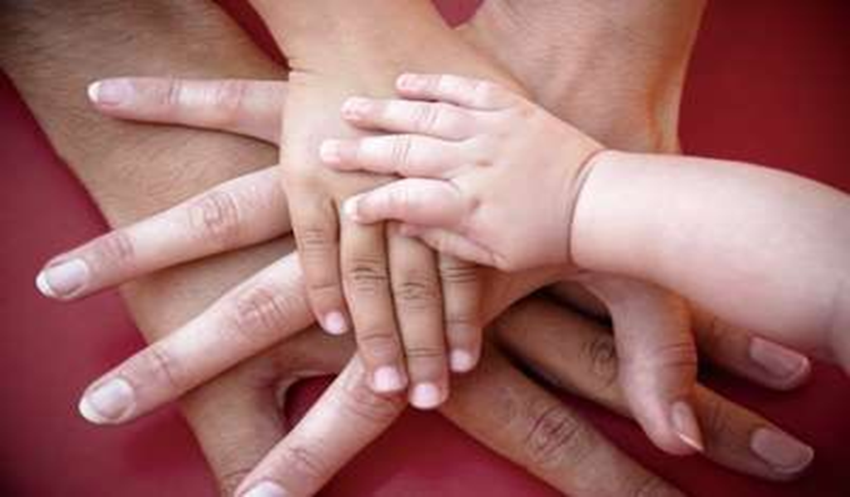
Family

Slide 5
Family
A group of 2 or more persons related by blood, marriage, adoption, relationship and residing together as a household.
Marketers recognize that families operate as units in terms of consumption behaviour, specially with FMCG markets

Slide 6
What is a Family?
Family
  is defined as a group of two or more people (one of whom is a householder) related by birth, marriage or adoption and residing together
Household:
  Is a family and any unrelated person residing in the same house and consuming food from a common kitchen at least once a day
  Two types of household:
    Family Household
    Institutional Household e.g. Hostel
All families are households but all households are not families

Slide 7
Types of Family
Traditional Family Types:
  Married Couple:
    Simplest type of family consisting of husband and wife
  Nuclear Family:
    Consist of Husband Wife and at least one child
  Extended Family:
    Consist of a nuclear family with at least one grand parent
  Joint Family:
    Blood relatives and their spouses with kids staying together
New Modes of Family
  Blended Family:
    A family in which either or both partner were previously married
  Single Parent Family:
    A family in which only one of the parent is present
  Unmarried Family:
    Parents, unmarried, but living together
  Communal Family:
    A group of families living together and sharing responsibility

Slide 8
Types of Family
Family of Orientation
  Consist of one’s parents and elders
  Provides orientation towards
    Social: Religion, Politics, Economics
    Emotional: Self Worth, Ambition, Love and Care
Family of Procreation
  Consist of one’s spouse and children
  Most important buying unit in a market
The influence of Family of Orientation decreases with Age

Slide 9
Functions of a Family
Provides Economic Well Being
Provides Emotional Support
Provides Suitable Life Style
Provides Social Relationships
Provides Morals and Ethical Values
Provides Religious Values
Provides Interpersonal Skills

Slide 10
Why is it Important ?
Influential in consumption decisions
Influential in purchase decisions
Make several joint purchase decisions
Prime target market for goods and services
It helps to devise our marketing strategies

Slide 11
Types of Family Decisions
Husband Dominated Decisions
  Husband takes the purchase decisions
  Traditionally in products like Automobiles, Alcohol, Insurance
Wife Dominated Decisions
  Wife takes the purchase decisions
  Traditionally in products like household maintenance items, food and kitchen appliances
Joint Decision Making
  Both husband and wife make the decision
  Traditionally in School choice, living room furniture, vacations
Child Dominated Decision Making
  Child makes the “final product” decision
  Traditionally on children related items
Unilateral Decision Making
  Taken by any member of the family
  Traditionally on Personal Care items, low priced goods
These Traditional Roles are Changing

Slide 12
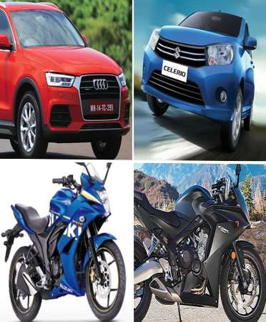
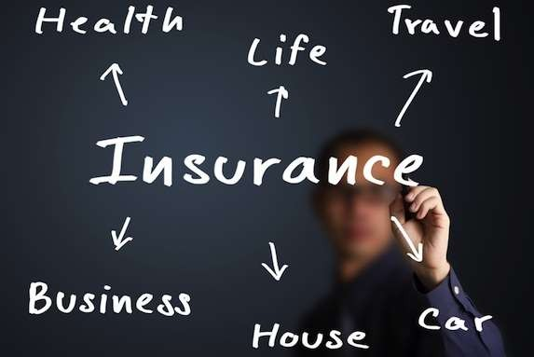
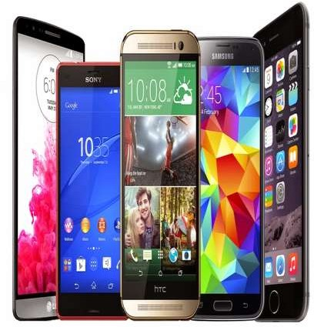
HUSBAND DOMINATED DECISIONS

Slide 13
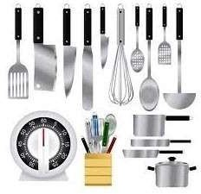
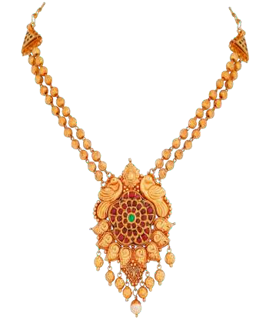

WIFE-DOMINATED DECISIONS

Slide 14

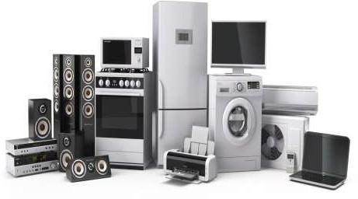
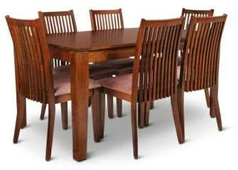
JOINT DECISIONS

Slide 15
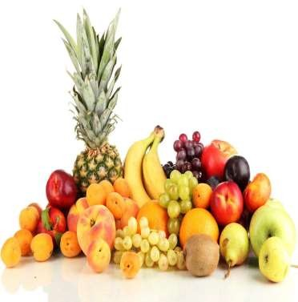
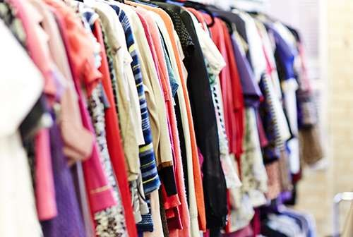
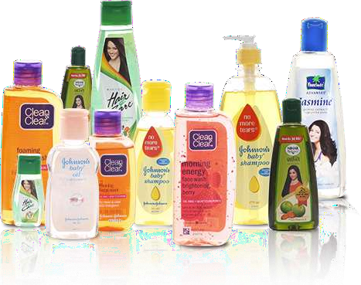
AUTONOMIC DECISIONS

Slide 16
Children’s Influence on Family Decision Making
Pressure: the child demands, threatens
Exchange: the child promises something in exchange
Rational: the child uses logical arguments and factual evidences
Consultation: the child seeks parents involvement in the decisions
Integration: the child tries to get the parents in a good mood first and then make the request

Slide 17
CHILDREN'S ARE THREE MARKETS
Children's as influencer
Items for themselves (Toy, electronics, clothing)
Items for homes (food and beverage preferences)
Service for the entire family (vacations, restaurants)
Children's as a primary market
Clothes, movie, video games, snacks, sweets
Children as future consumers
Future consumers are full aware of brands and markets should focus on building relationship with them

Slide 18
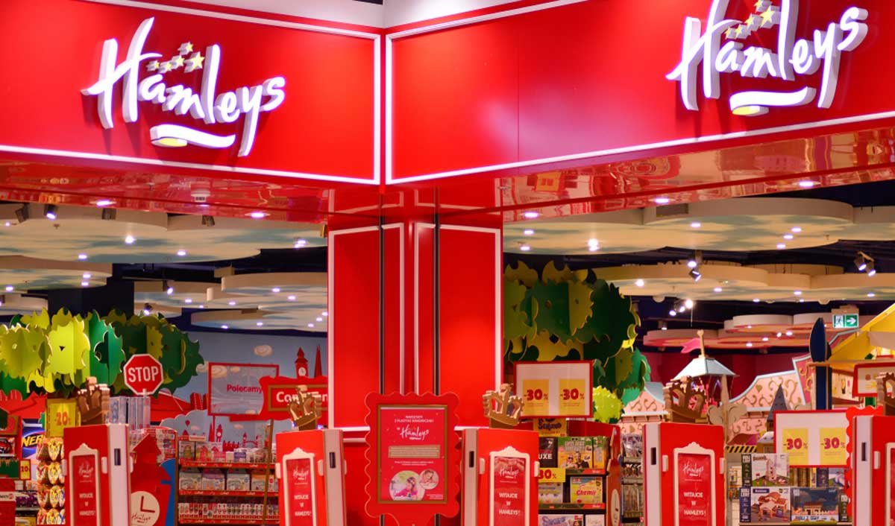
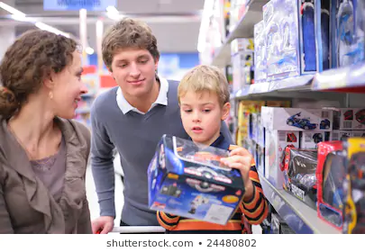
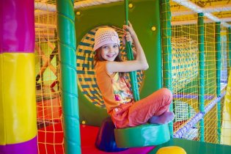
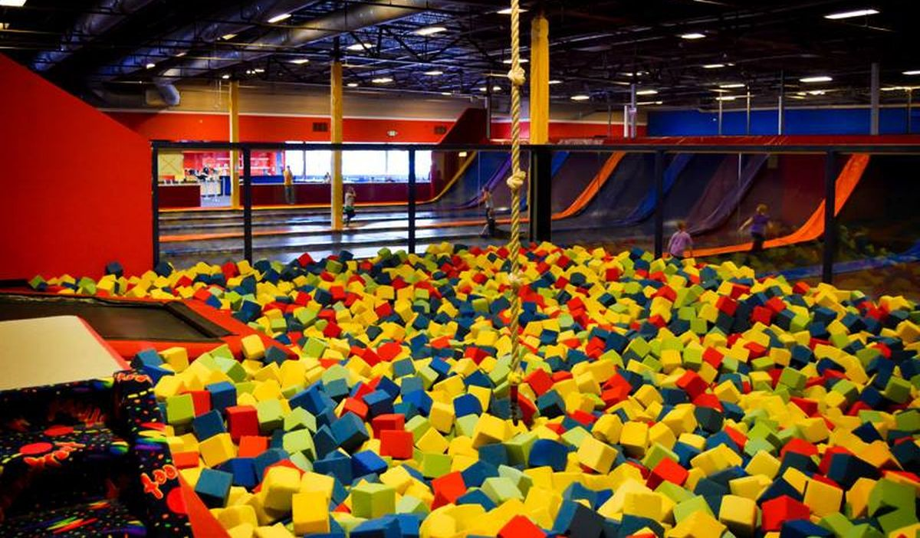

Slide 19
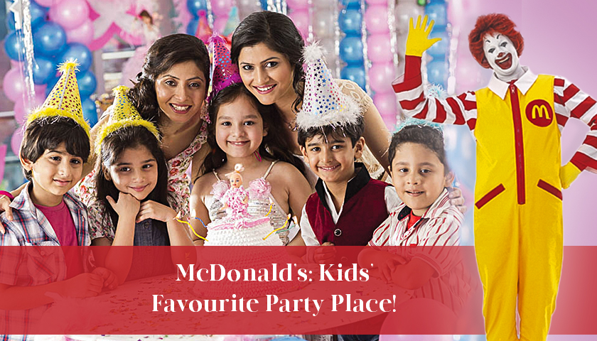

Slide 20
Family Influences on Buyer Behaviour
Cultural
Social
Emotional
Functional
Financial

Slide 21


Eight Roles in the Family Decision- Making Process
ROLE | DESCRIPTION
Influencers | Family member(s) who provide information to other members about a product or service
Gatekeepers | Family member(s) who control the flow of information about a product or service into the family
Deciders | Family member(s) with the power to determine unilaterally or jointly whether to shop for, purchase, use, consume, or dispose of a specific product or service
Buyers | Family member(s) who make the actual purchase of a particular product or service
Preparers | Family member(s) who transform the product into a form suitable for consumption by other family members
Users | Family member(s) who use or consume a particular product or service
Maintainers | Family member(s) who service or repair the product so that it will provide continued satisfaction.
Disposers | Family member(s) who initiate or carry out the disposal or discontinuation of a particular product or service

Slide 22
Household Decision Making Process
Influencer (Children)
Communication targeted at Children
Initiator (Parents, Children)
Decision Maker (Parents, Children)
Purchaser (Parents)
Communication targeted at Parents
User (Parents, Children)
Information
Gathering

Slide 23
Conflict Resolution
Family Decisions are bound to create conflict
Conflicts are resolved by:
  Bargaining:
    Reaching a compromise on which product to buy
  Impression Management:
    Misrepresentation of facts in order to create favorable impressions
  Use of Authority:
    Claiming superior authority to resolve the conflict
  Reasoning:
    Using logical arguments to resolve the conflict
  Playing on Emotions:
    Using emotions to resolve the conflict
  Additional Information:
    Getting additional Data or Third Party Information

Slide 24
Family Life Cycle Stages
https://www.youtube.com/watch?v=Mk8AMV0gpk0

Slide 25
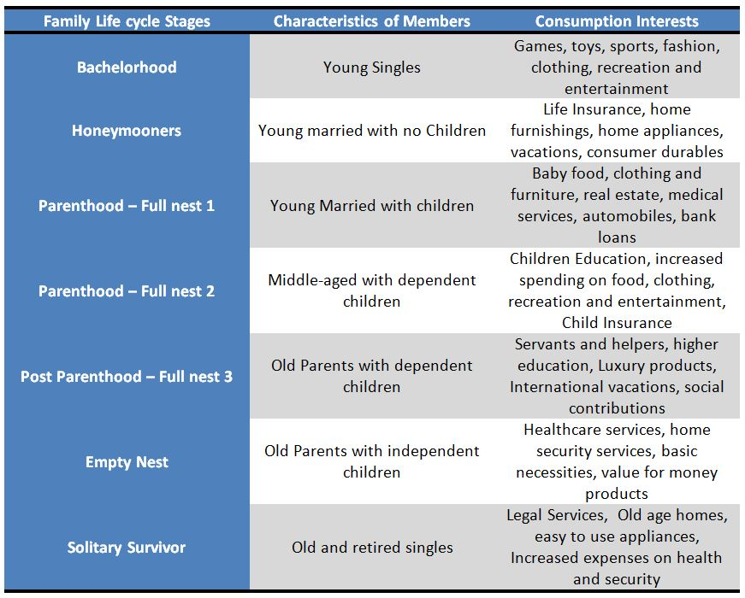

Slide 26
Family Life Cycle (1/2)
Stage 1 :Bachelorhood
  Few Financial Burdens
  Fashion and Recreation Oriented
Stage 2: Newly Married Couple
  Financially better off
  Highest purchase rate of consumables and durables
  Romantically inclined
Stage 3 : Parenthood
Elementary school stage
  Youngest child < 6 years of age
  Low Liquid Assets
  High purchase of baby food & baby oriented products
High school stage
  Youngest child >= 6 years of age
  Financially better off
College Phase
  All children still financially dependent
  High family influence on purchases
  Major expense on higher education

Slide 27
Family Life Cycle (2/2)
Stage 4: Post Parent Hood
  Head of the family in labour force
  No Dependent Children
  Expenditure in self development
Stage 5 :Dissolution :
Solitary Survivor – II
  Single Surviving head of family in labor force
  Supported by family and friends
  Have high expendable income
  Spent on loneliness reducing products and services
Solitary Survivor – II:
  Single Surviving wife
  Low levels of income and savings
  Expenditure on medical products, security, affection

Slide 28
Factors affecting the Need of the Family
Social Needs
Economic Needs
Psychological Needs
Physical Needs
Cultural Needs
Emotional Needs
Security Needs
Affiliation Needs
Occupation of Family
Education Standards
Stage in FLC

Slide 29
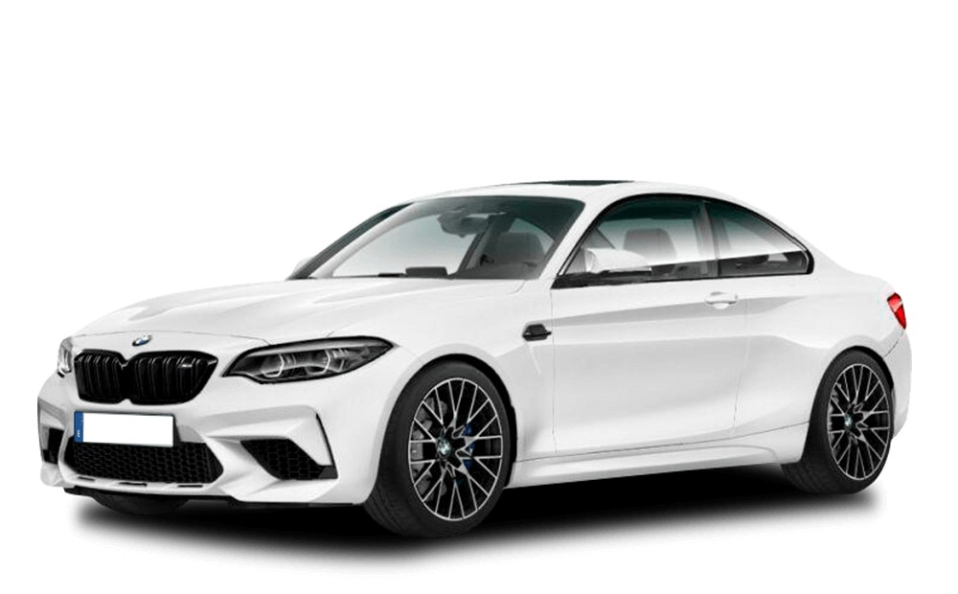
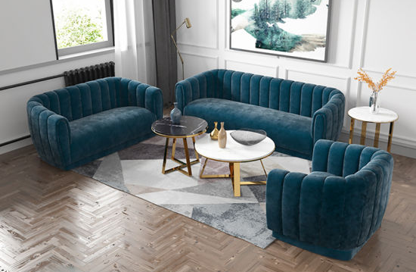
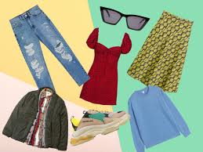
Social Needs - Many social gatherings, friends, community groups, romantic attachments, social status is high ------- Needs are more

Slide 30
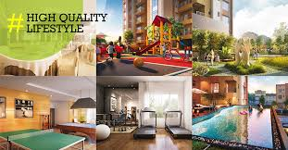
Economic Needs - Include housing, food, transportation, healthcare etc.
Income Lifestyle Need
Double Income – prefer EMI

Slide 31
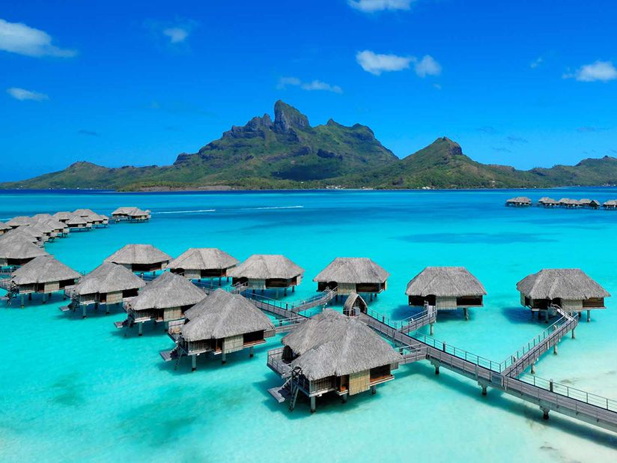

Psychological Needs – includes state of mind, attitudes, values & personality ---- how an individual perceives information
Eg. Esteem, prestige, power, affection, learning
Vacations – Exotic vacations or piligrimage
Ares of shopping – Mall or Roadside

Slide 32
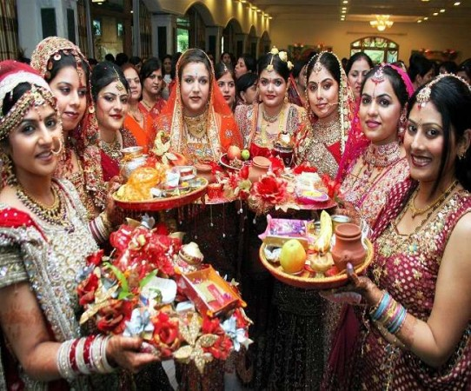
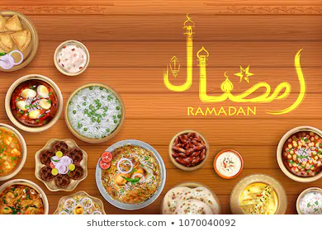
Physical Needs – food, clothing, healthcare, physical comforts needed..
Cultural Needs – pujas, religious gatherings, norms & values

Slide 33
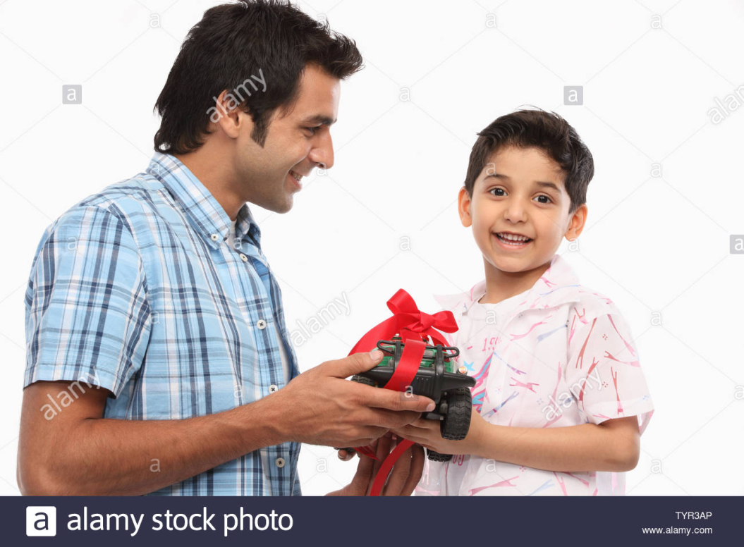
Emotional Needs – appreciation, feeling of being wanted & loved
Eg. Birthday parties, gifts for children, Gifts

Slide 34
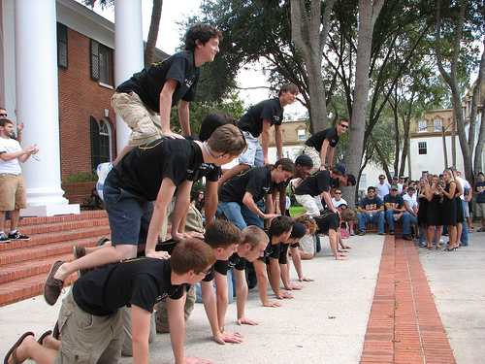
Security Needs – CCTV Mobile, Insurance
Affiliation Needs – for a warm & caring relationship, Cricket Club Memberships, Reading Club

Slide 35
Occupation of Family Members
Education Standards – If the lady of house is educated needs are more
Stage in FLC

Slide 36
Non Traditional Family Life Cycle
Sequence I | Sequence II | Sequence III | Sequence IV
Young married couples with children Young divorced parent Single parent with older children Older, unmarried | Young divorced couple without children Middle-aged married couple without children Older married couple without children. | Young married couple with children Middle-aged divorced parent Middle-aged married parent with children and stepchildren. | Young unmarried couple without children Middle-aged married couple without children Older married couple without children Widow.

Slide 37
Questions to think……
If you are the marketing manager of an instant noodles making company, which stages of family life cycle will you target and how?
Do you think emotions play a role in family purchases? Justify your answer with the help of suitable examples
  "Husband and wife are more likely to take joint decision during early stages of family life cycle". Explain the rationale behind this.

Slide 38
 | Social Class
 |  | The division of members of a society into a hierarchy of distinct status classes, so that members of each class have either higher or lower status than members of other classes.

Slide 39
Social Class
People in a society are placed in different strata based on their status; each of these strata may be referred to as social class.
Schiffman defines social class as “the division of /members of a society into a hierarchy of distinct status classes, so that members of each class have relatively the same status and members of all other classes have either more or less status”.

Slide 40
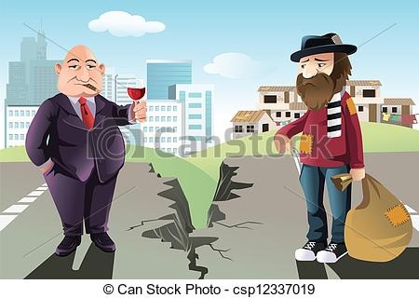

Slide 41
Features/Characteristics of Social Class
Hierarchical
Generates a feeling of equality within class
Summation of traits in a sub-culture
Homogeneous within a class
Mobile and dynamic
Associated with prestige & exhibits status
Measured by a weighted function of ones occupation + wealth + Income + education + status +prestige
It is continuous

Slide 42
Types of Social Class
Upper Class
Middle Class
Lower Class

Slide 43
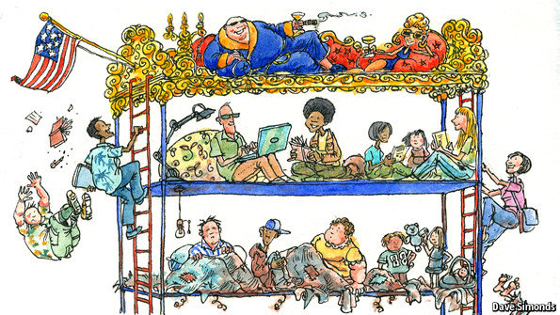

Slide 44
Types of Social Class – Upper Class
Wealthy
Sponsor charity events
Quality & Brand concious
Luxurious lifestyle
New products fancy them
Sensitive to fluctuations in valuation of their assets
Prefer foreign brands

Slide 45
Types of Social Class – Middle Class
Large no of population
Employees, high earners
purchasing power
Marketers love them, best target audience
Imitate upper class – fast growing segment
All products are mostly targetted here
Leading role in India consumption market
Love Debit / Credit card usage

Slide 46
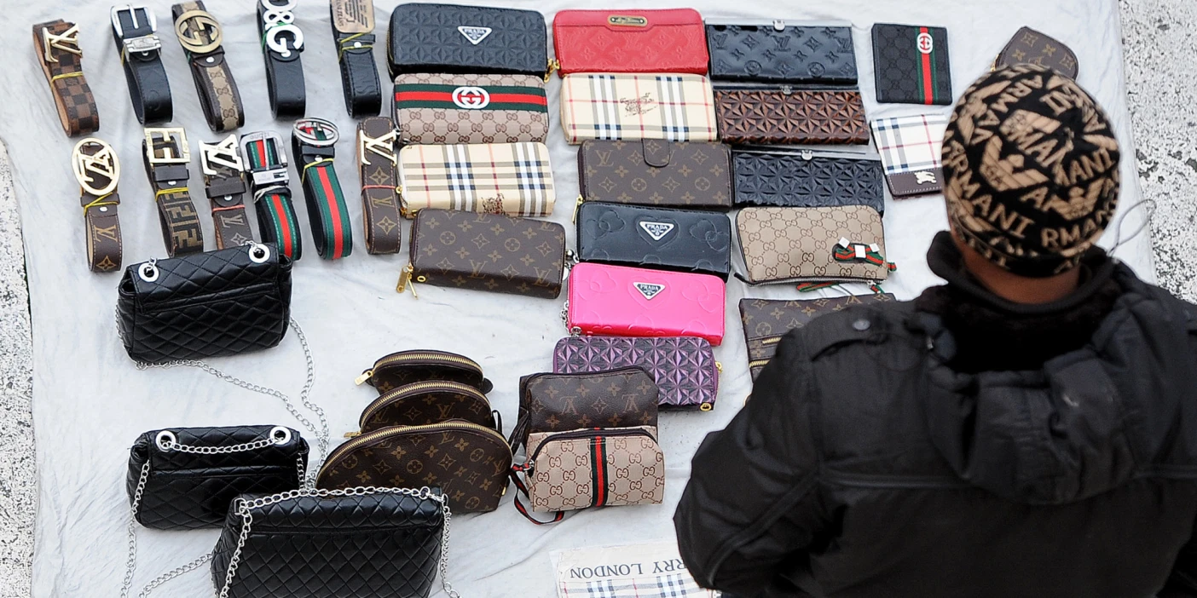
Middle Class buying imitates of foreign brands

Slide 47
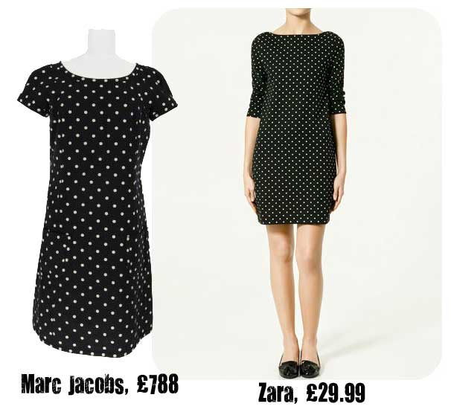
Why Marketers love the Middle Class

Slide 48
Types of Social Class – Lower Class
White Collar workers
Unskilled, small businesses
Heavy Demand for basic necessities
Look for cheap substitutes
Conservative, bargains, prefer sub-standard products
Quantity conscious

Slide 49


Influences of Social Class
Products purchased
Lifestyle Class Self-image Personality
Marketers use different Advertising & promotion strategies for different classes

Slide 50
Social Class influences hobbies & Interests
Upper Class Clubs, Cards, Golf, Chess
Middle Class Malls, theatres
Lower Class Television
Spending and Credit pattern
Upper Class invest in Insurance, Shares, Real Estate
Middle Class prefer EMI
Lower Class lookout for second hand stuff

Slide 51
Social Class influences Savings
Upper Class Property, Stock, Business
Middle Class Fixed Deposits
Lower Class Little Cash, Recurring deposits, post-office
Spending and Food
Upper Class Foreign foods, Cooks at home, restaurants
Middle Class Imitate the Upper Class
Lower Class Basic staple food

Slide 52
Group Dynamics
https://www.youtube.com/watch?v=OdnR9knF_3A
https://www.youtube.com/watch?v=uL6x99-VSBA

Slide 53
Group Dynamics
Group dynamics contains two terms: group and dynamics.
Group is basically a collectivity of two or more persons.
Dynamics comes from Greek word meaning FORCE.
Thus, “Group dynamics is concerned with the interactions of forces among group members in a social situation.”

Slide 54
Group dynamics means how individuals form groups, and how one persons purchasing influences the other individual’s actions.
Now-a-days marketers use the concept of group dynamics or personal influence often as this exceeds the power of company’s promotional efforts.
“A group may be defined as two or more people who interact to accomplish either individual or mutual goals”

Slide 55


Two or more people
Shared goals
Group
People see themselves As members
There is interaction
Among members

Slide 56

Group
Formal
Informal
Command
Interest
Task
Friendship

Slide 57

The people often join groups since the groups give the members a stability and enhances their achievement capacity. The main reasons to join a group are:
Have a sense of security
Have a status
Develop Self-esteem
Power
Goal achievement

Slide 58
Features of Group Dynamics
Consists of 2 or more persons
A formal social structure run by rules / norms
All members mostly have common interests
Face to face interactions
Members are emotionally connected having common goals
Members are mutually dependant on one another
Members feel recognised
Members enjoy self-definition

Slide 59
A. Primary Group and Secondary Group:
If a person interacts on regular basis with other individuals, then these individuals can be considered a primary group. Interaction can be with members of the family, with the colleagues, with neighbours etc., this means whose opinions are valued by that person.
On the other hand, if a person interacts only occasionally with others, or whose opinions are not important, then this type of group is called secondary.

Slide 60
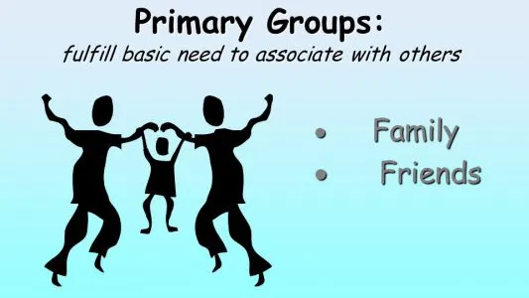
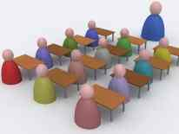

Slide 61
Formal Group and Informal Group:
If a group has a highly defined structure, specific roles and authority levels and specific goals then this is called a formal group. For example, in an organization, a list of all employees (defined structure), Managing Director, Manager, Assistants etc., (specific roles and authority levels), this shows a formal group.
On the other hand, if a group is more loosely defined, then it is an informal group. For example, four five girls who become friends in the school and now meet only once a month. For the marketer, informal social groups are more important because of loosely defined structure a more conducive environment is available for exchange of information to the members.

Slide 62

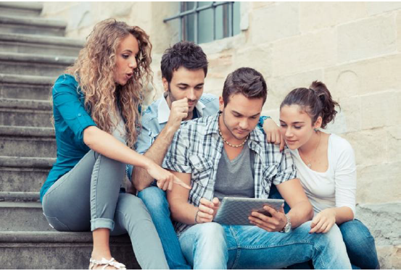

Slide 63
B. Membership Group and Symbolic Group:
Membership Group is a group to which a person belongs or would qualify for membership. For example, college alumni association, IMA, association of doctors, tennis club etc.
Symbolic group is a group in which an individual is not likely to receive membership even if he/ she acts like a member by adopting that group’s values, behaviour and attitude.
For example, for youngsters cricketers like Sachin Tendulkar, Sourav Ganguly etc. may constitute a symbolic group. They try to identify with these players by imitating their behaviour like the style or sometimes by purchasing specific brand of bat, gloves, dress, ball etc.

Slide 64
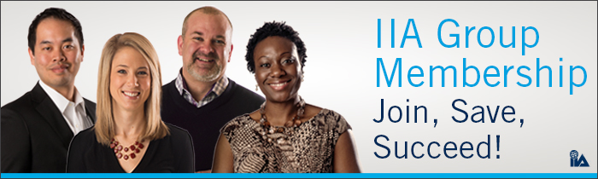
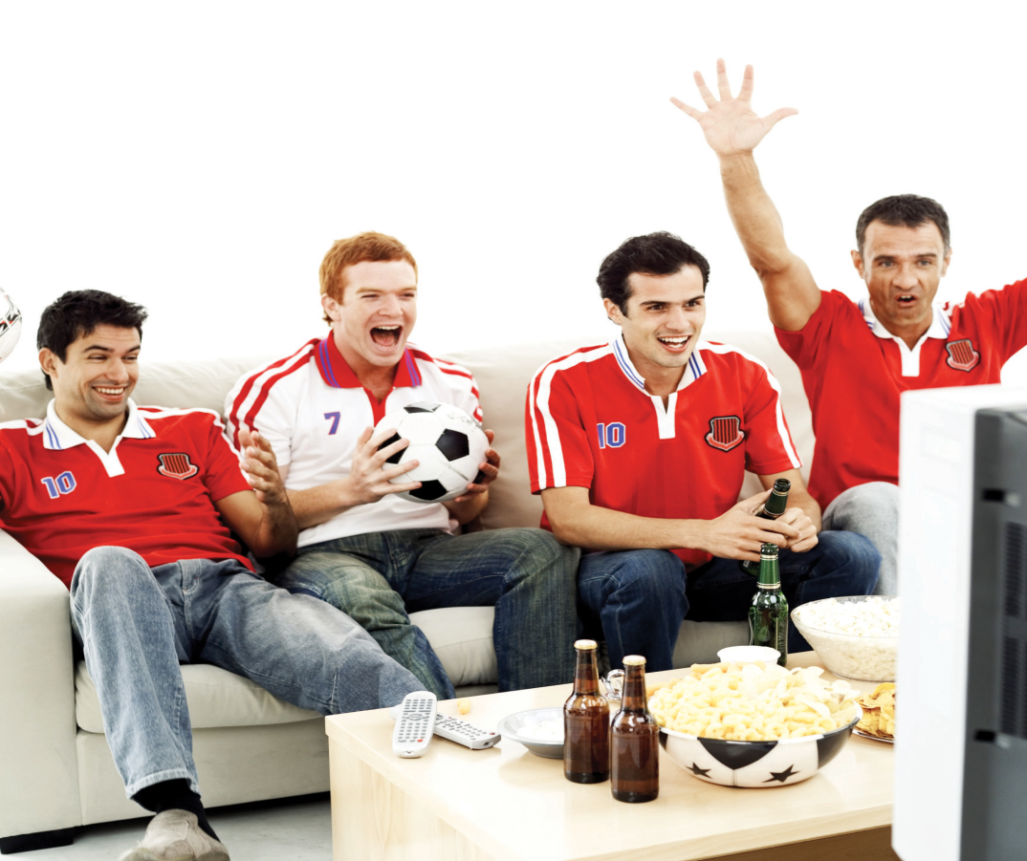

Slide 65
In Groups & Out Groups
Ingroups – Members have common object / common interest
WE feeling
Formed on basis of friendship, culture, interest
Eg. College friends groups
Out Group – Groups other than In-Groups are Out-Groups
Does not identify with them
THEY Feeling

Slide 66


Slide 67
Relevance of Group Dynamics to Marketers
Consumers Trust Reference Groups - clothing, accessories, vehicles, restaurants or club memberships, are symbolic of what he thinks is acceptable.
Branded Upbringings Make Lifetime Buyers
Consumers Buy Peer Status - For example, a high-end watchmaker may release a limited edition luxury watch for its targeted consumers followed by a more affordable version of the product, under the same brand name, for a wider market.
Cause Affiliations and Purchasing - company’s association with a charitable cause or heroic deed may compel the consumer to purchase the company’s brand just to show support. People favor brands that resonate with what they believe in and what they think like-minded believers accept.

Slide 68
Reference Groups

Slide 69
Reference Groups
Any person/ group that serves as a point of comparison for an individual in forming either general / specific values, attitudes/ specific guide for behaviour

Slide 70
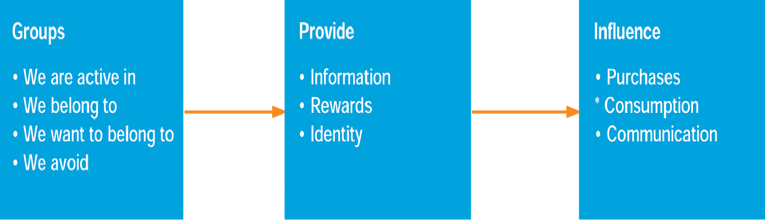
Reference Group influences

Slide 71
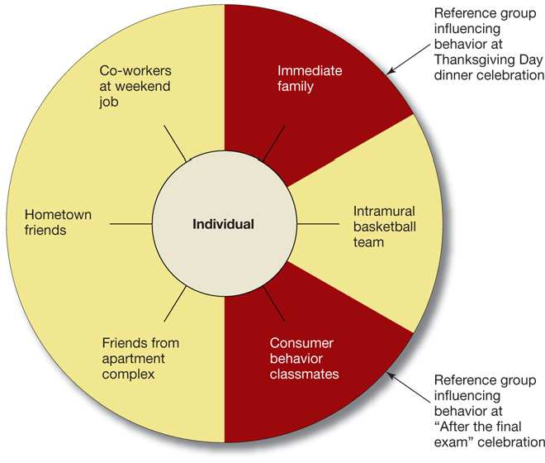
Reference Group Influence
Reference Groups Change as the Situation Changes
14-71

Slide 72
Types of Reference Groups
Primary
Secondary
Normative
Comparative
Contactual
Aspirational
Disclaimant
Avoidance

Slide 73
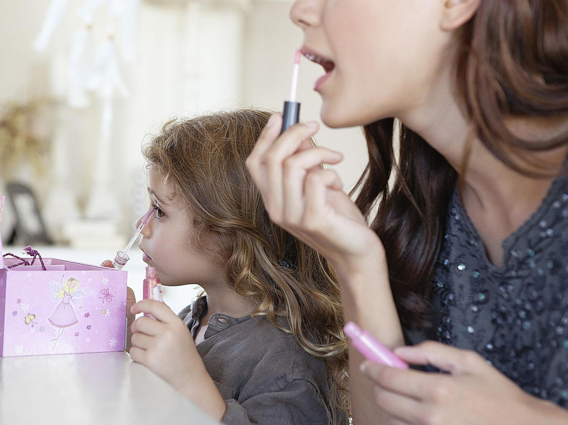
Primary Reference Group
Face to face interactions
Someone you see and idoilise
Small, emotionally connected
Usually family member, friend
Someone who you have seen
sucessful

Slide 74
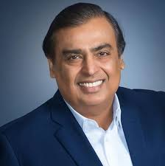
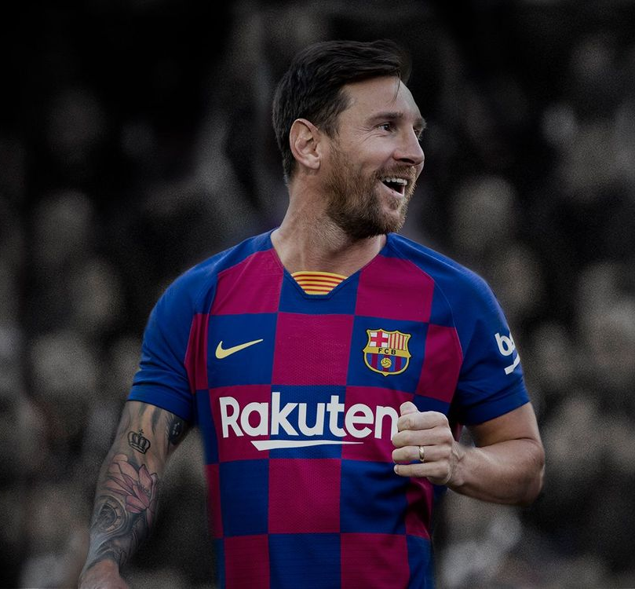
Secondary Reference Group
Indirect Influence
Try and find contact
Celebrities, religuous Gurus, Sportsperson
Someone you wish to be

Slide 75
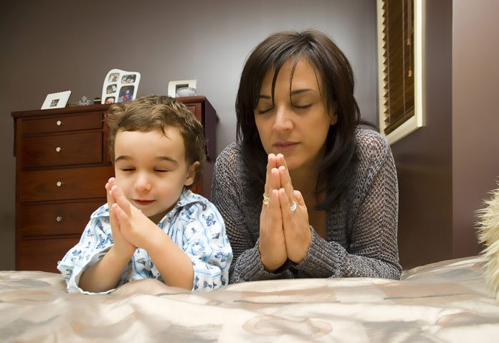
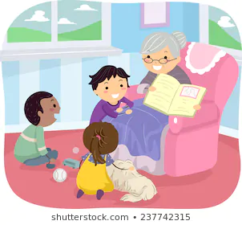
Normative Reference Group
Influence general / broadly defined values / behaviour
Mother teaching child ethical behaviour
Teacher educating student

Slide 76
Contractual Reference Group
Formal or Informal reference group
Regular face –to-face contact with this group
Tends to agree with the values, attitudes & standards of the group
Since he is influenced with the group, it is shown in his buying behaviour
Eg. Red Bull

Slide 77
Avoidance Reference Group
Does not want to be a part of the group
Avoids, Stays away
No face-to-face contact
Does not approve of value attitudes and behaviours
Does not buy products endorsed by this group
Eg. Drugs, Cigarettes

Slide 78
Disclaimant Reference Group
Is a part of the group but does not believe in Group’s values
He does not want to be a part of the group since he feels he does not belong there
Opposes their values, attitudes etc.

Slide 79
Factors that influence Reference Group Influence
Information & Experience – Well-informed & experienced consumers are self-dependant & self-supportive. Do not need reference group influences
Credibility – of the Opinion Leader / Influencer
Power Groups – When reference groups is powerful, reliable it is able to influence individuals
Social Approval – When individual looks for social approval, he obeys & conforms to the advice given by reference groups
Visibility & Public display of expensive products – status symbol
– the more the public display / visibility ---- the more the influence

Slide 80





Factors Affecting Reference Group Influence
Most people tend to follow society’s expectations regarding how to look/act (change in beliefs/actions towards societal norms )
Conformity
Group’s Power and
Expertise
Capacity to alter the actions of others
Relevant Information & Experience
Mahindra Resorts – information,experience and
credibility
Product Conspicuousness
Visibilty / tangibility of a product – Standees at a Cricket Game, Business Chaupal
Personality
Characteristics
Gullible, Out-going

Slide 81
Marketing Appeals by Reference Groups
Appeal by Celebrity
Celebrities, Sportsmen, TV Personalities endorse certain products /brands
Eg. Testimonials, educating the brand & influencing
Shows credibility
High appeal & attraction
Celebrity personality and image is commonly used.

Slide 82
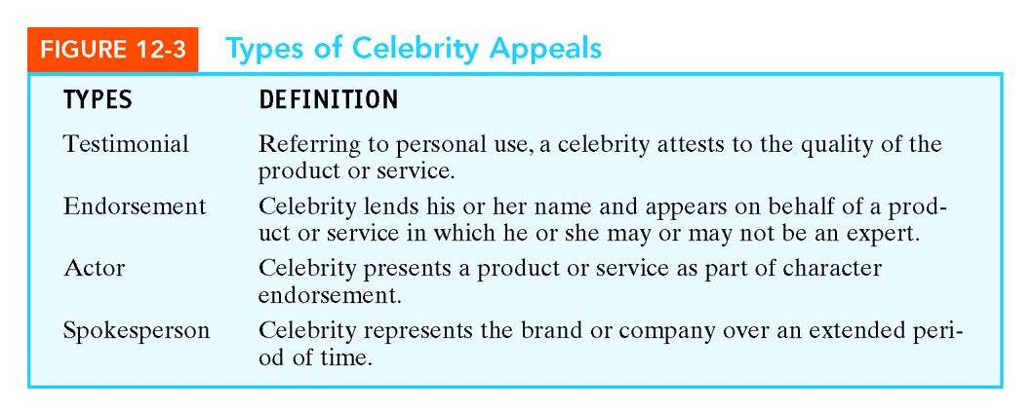

Slide 83
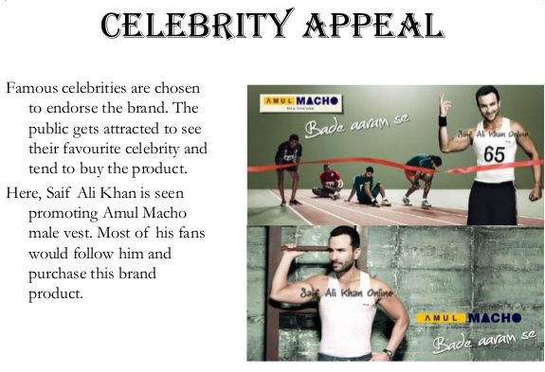
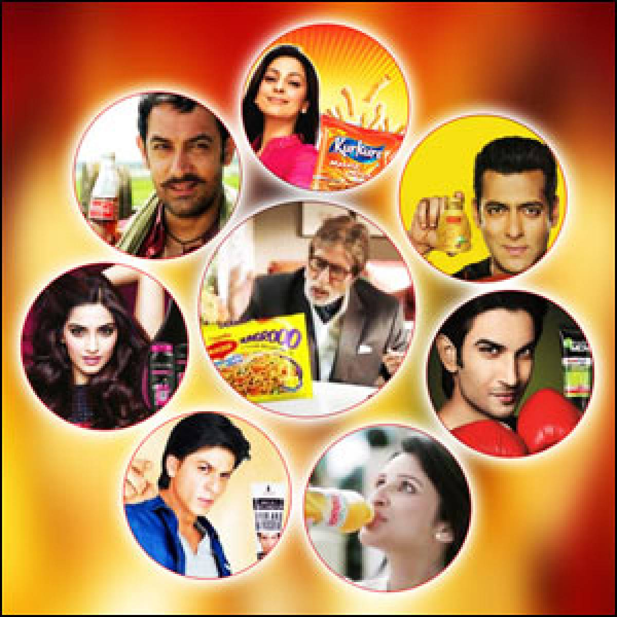

Slide 84
Appeal by Experts
 A second type of reference group appeals used by marketers is the expert, a person who, because of his or her occupation, special training, or experience, is in a unique position to help the prospective consumer evaluate the product that the advertisement promotes.
 e.g. An ad for a quality frying pan may feature the endorsement of a chef.

Slide 85
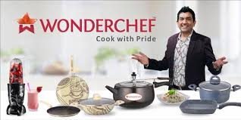

Slide 86
Appeal by Common Man
 A reference group appeal that uses the testimonials of satisfied customers is known as the common-man approach.
 The advantage is that it demonstrates to prospective customers that someone just like them uses and is satisfied with the good or service being advertised.
 The common man appeal is especially effective in public health announcement (such as antismoking or high B.P. messages), for most people seem to identify with people like themselves when it comes to such messages.

Slide 87
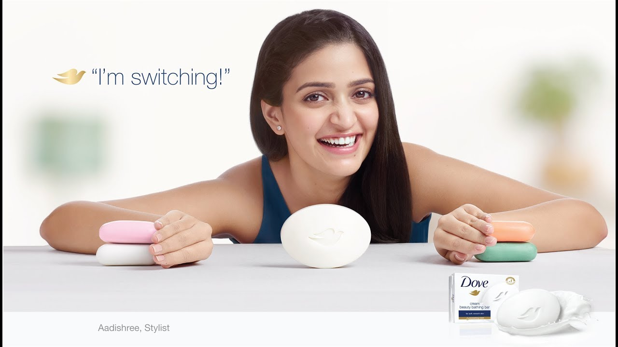

Slide 88
Appeal by Executive & Employee Spokesperson
 The popularity of this type of advt. probably is due to the success and publicity received by a number of executive spokespersons.
 Like celebrity spokespersons, executive spokespersons seem to be admired by the general population because of their achievements and the status implicitly conferred on business leaders.
 e.g. Ratan Tata, K. Birla, Mukesh Ambani etc.

Slide 89
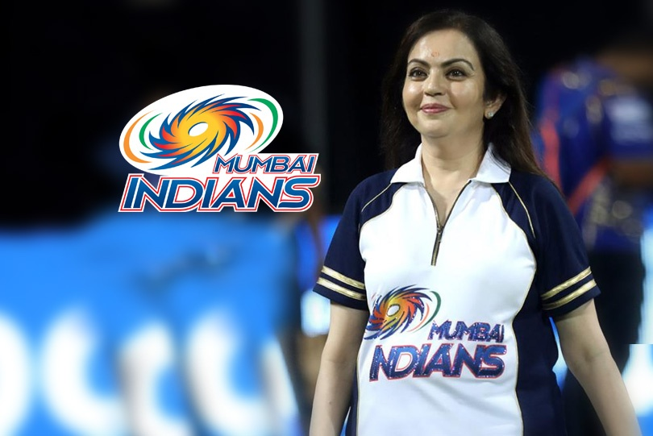

Slide 90
Appeal by Trade or Spokes Character
 These are often employed as attention grabbers, acting as spokespersons to promote children’ products.
 Trade characters are intended to bond a child to a brand so that the child’s brand awareness might form the basis of brand preference either immediately or later in life.
 e.g. Animated characters used by marketers in advertisements for children products

Slide 91
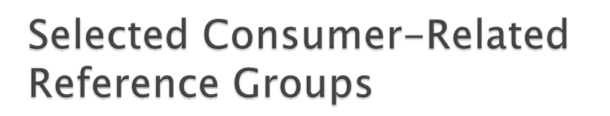
 Friendship Groups
 Shopping Groups
 Work Groups
 Virtual Groups or Communities
 Brand Communities
 Consumer-action Groups

Slide 92
Opinion Leaders in Consumer Behaviour
An opinion leader is a well-known individual or organization that has the ability to influence public opinion on the subject matter for which the opinion leader is known. Opinion leaders can be politicians, business leaders, community leaders, journalists, educators, celebrities, and sports stars.

Slide 93
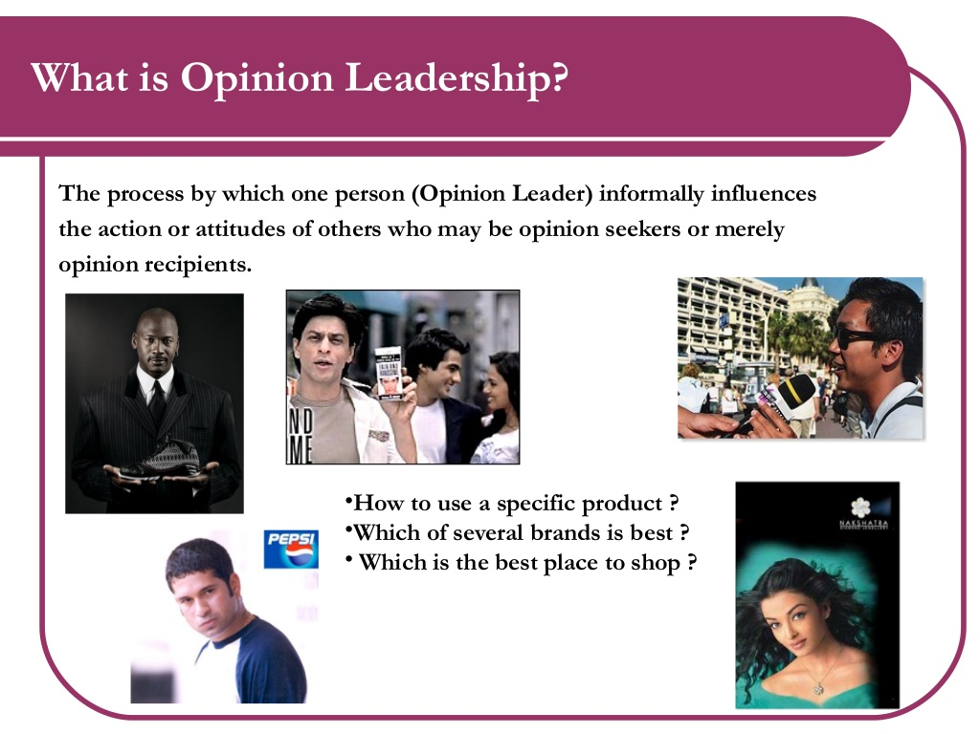

Slide 94
Opinion Leaders
Opinion Leaders are sought –
People look up to them for choice of a Brand
Help to make wise decisions
Successful in their careers
Operate with a clear understanding of consumer needs
Believed to be in similar social, economic and cultural conditions

Slide 95


Slide 96
Role of Opinion Leaders
Authority Figure – role model, expert
Trend setter & Influencer
Consumers are always looking for some opinion / favourability towards acceptance of new products
An important link between Marketer & Consumers
They communicate informally about product / brand. Talk about persoanl experiences, usage etc
Marketers design their product package considering satisfaction of Opinion Leaders _____ Targetting Opinion Leaders is a valuable marketing strategy
Diffusion of Innovation

Slide 97


Slide 98
Diffusion of Innovation
Spread of a new product / innovation from its source to consumers.
It is related to acceptance or rejection of an innovation

Slide 99
Diffusion of Innovations
Diffusion Process
The diffusion process is the manner in which innovations spread throughout a market.
Form most innovations, the diffusion process appears to follow a similar pattern over time:
  a period of relatively slow growth
  followed by a period of rapid growth
  followed by a final period of slower growth

Slide 100
Culture in Consumer Behaviour

Slide 101











CULTURE & CONSUMER BEHAVIOUR

Slide 102

What is Culture?
Culture is the complex whole that includes knowledge, belief, art, law, morals, customs and any other capabilities and habits acquired by humans as members of society.

Slide 103










Relationship between Culture and Buyer Behaviour
Norms - specify ranges of appropriate behaviour
Penalties for violating cultural norms

Slide 104




Health Drinks
Psychographic example

Slide 105







Cricket Vs. Football

Slide 106





Slide 107



Target market
URBAN MOTHER
RURAL MOTHER

Slide 108


Nuclear Family
Joint Family
Husband has to go for work
Mother is left alone to take care of the baby
Lot of other people in the family to take care of the baby

Slide 109
Culture in Consumer Behaviour
Complex system of laws, values, beliefs, morals, customs associated with our behaviour
Features:
Culture is learned
Dynamic
Shared from one generation to another
Helps Markets to adapt to varied customs to sell
Satisfies Needs
Symbolic – conveys meaning without using words
Differential – not universal

