Slide 1
SECURITY ANALYSIS & PORTFOLIO MANAGEMENT
MODULE 3

Slide 2
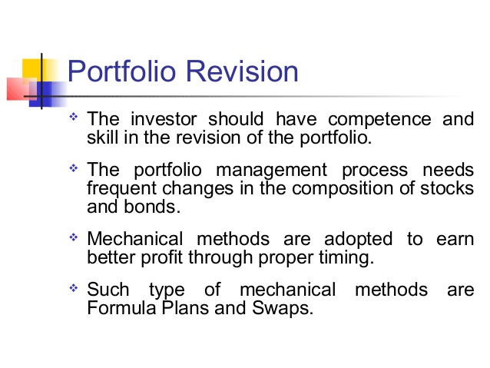
PORTFOLIO REVISION-MEANING

Slide 3
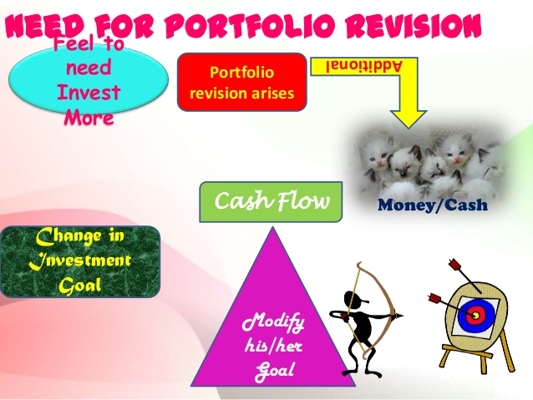
PORTFOLIO REVISION-NEEDS

Slide 4
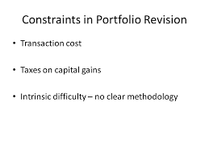
PORTFOLIO REVISION- CONSTRAINTS

Slide 5

PORTFOLIO REVISION- STRATEGIES

Slide 6
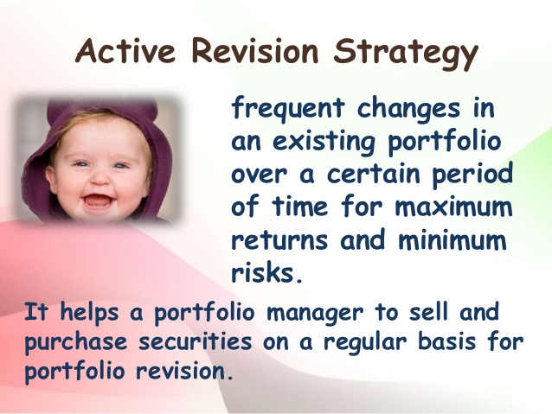

Slide 7
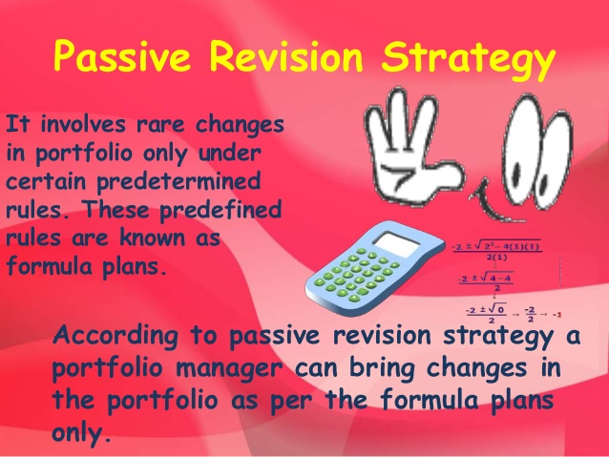

Slide 8
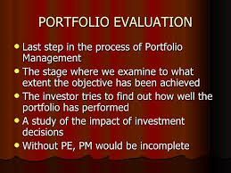
PORTFOLIO EVALUATION-MEANING

Slide 9
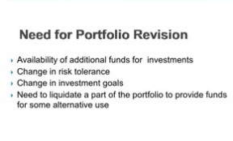
PORTFOLIO EVALUATION-NEED

Slide 10
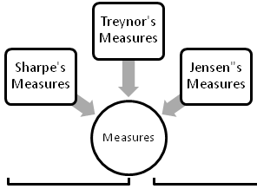
PORTFOLIO EVALUATION-MEASURING RETURN

Slide 11
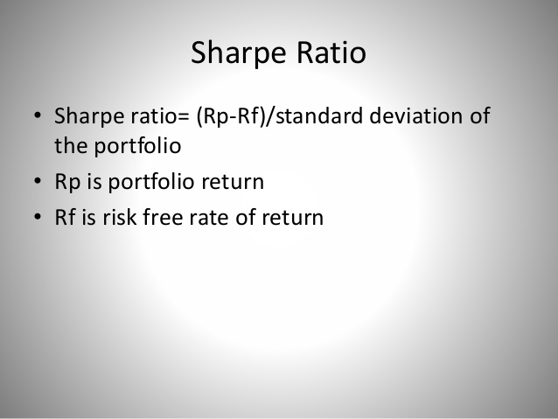

Slide 12
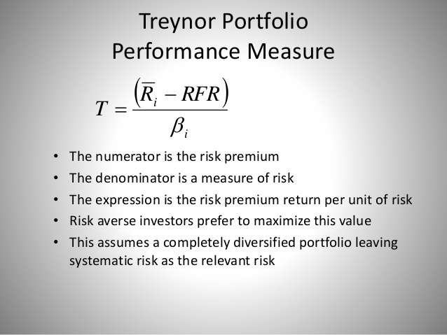

Slide 13
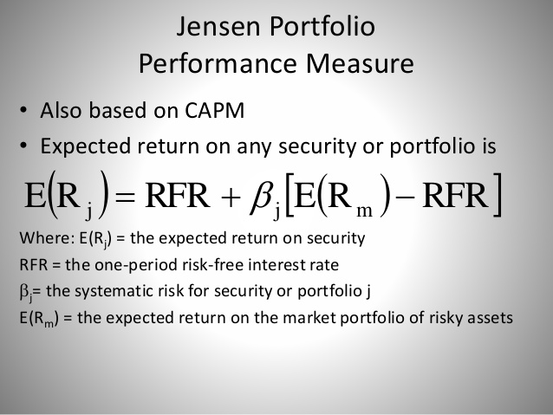

Slide 14


