Slide 1

MANAGEMENT-II
(MANAGEMENT APPLICATION)
TYBAF: SEM-V
-By Mr. Hasim Khan

Slide 2
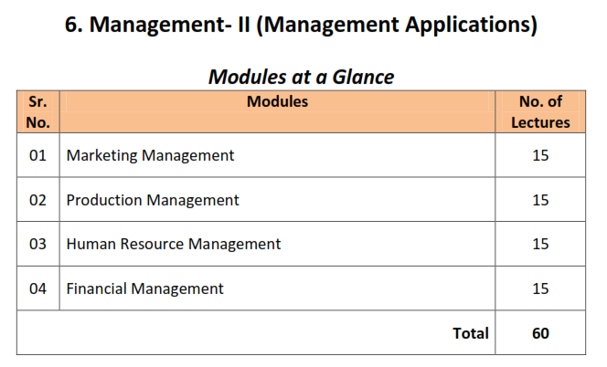
SYLLABUS

Slide 3
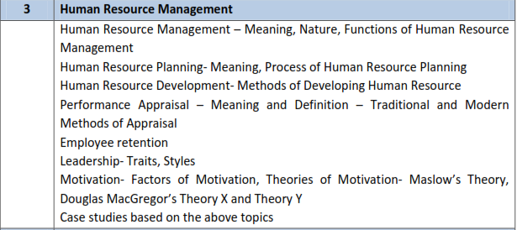
UNIT-III: HUMAN RESOURCE MANAGEMENT

Slide 4
MEANING AND DEFINITION OF HRM
Human Resource Management is a management function concerned with hiring, motivating, and maintaining workforce in an organization. Human resource management deals with issues related to employees such as hiring, training, development, compensation, motivation, communication, and administration. Human resource management ensures satisfaction of employees and maximum contribution of employees to the achievement of organizational objectives.
Definition of Human Resource Management
According to Storey (1995), “Human Resource Management is a distinctive approach to employment management which seeks to achieve competitive advantage through the strategic deployment of a highly committed and capable workforce, using an array of cultural, structural and personnel techniques.”
According to Armstrong (1997), Human Resource Management can be defined as “a strategic approach to acquiring, developing, managing, motivating and gaining the commitment of the organization's key resource – the people who work in and for it.”
According to George R. Terry, “Human resources management is concerned with the obtaining and maintaining of a satisfactory and satisfied work force

Slide 5
NATURE OF HRM
Process
Multidisciplinary Approach
Universal Application
Continuous in Nature
Objectives Oriented
Long-term Benefits
Development of Team Spirit
Key Elements
Integrated Use of Subsystems
Development of Employees’ Potentialities

Slide 6
FUNCTIONS OF HRM
Acquisition Functions/Selection
Placement Function
Performance Appraisal
Promotion
Training and Development
Career Development
Compensation Function
Labour Function
Employees Welfare
Employees’ Health and Safety
Human Resource Planning

Slide 7
HUMAN RESOURCE PLANNING: MEANING
Human resource planning (HRP) is the continuous process of systematic planning ahead to achieve optimum use of an organization's most valuable asset—quality employees.
Human resources planning ensures the best fit between employees and jobs while avoiding manpower shortages or surpluses.
There are four key steps to the HRP process. They include analyzing present labor supply, forecasting labor demand, balancing projected labor demand with supply, and supporting organizational goals.
HRP is an important investment for any business as it allows companies to remain both productive and profitable.

Slide 8
HUMAN RESOURCE PLANNING: PROCESS
Review of Organizational Objectives
HR Requirements Forecast
HR Supply Forecast
Comparison
No Differences
Differences
Motivating the Manpower
Monitoring HR Requirements

Slide 9
HUMAN RESOURCE DEVELOPMENT: MEANING
Human Resource Development (HRD) is a series of organized activities, conducted within a specialized time and designed to produce positive behavioral changes.
This is the definition according to Dr. Leonard Nadler, who first introduced the concept in the United States in 1969. Dr. Nadler was a pioneer in the field of HRD, and one of its premier thought leaders.
Simply put, HRD is the training and development provided by an organization to increase the employees’ knowledge, skills, education and abilities.
Specifically, Business Dictionary defines HRD as ‘the part of human resource management that specifically deals with training and development of the employees. Human resource development includes training an individual after he/she is first hired, providing opportunities to learn new skills, distributing resources that are beneficial for the employee’s tasks, and any other developmental activities.’

Slide 10
HUMAN RESOURCE DEVELOPMENT: METHODS
On-the-job Methods
Off-the-job Methods
Job Rotation
Planned Progression
Coaching
Counseling
Understudy Position
Junior Boards
Assessment Centers
Business Games
Classroom Methods
Simulation
Committees
Conferences
Readings and References
Seminars and Workshops

Slide 11
PERFORMANCE APPRAISAL: MEANING AND DEFINITION
A performance appraisal is a regular review of an employee's job performance and overall contribution to a company.
Also known as an annual review, performance review or evaluation, or employee appraisal, a performance appraisal evaluates an employee’s skills, achievements, and growth--or lack thereof.
Companies use performance appraisals to give employees big-picture feedback on their work and to justify pay increases and bonuses, as well as termination decisions. They can be conducted at any given time but tend to be annual, semi-annual, or quarterly.
Performance appraisal is a systematic, periodic and so far as humanly possible, the impartial rating of an employee’s excellence in matters pertaining to his present job and to his potentialities for a better job. ” —Edwin B, Flippo

Slide 12
METHODS OF PERFORMANCE APPRAISAL
TRADITIONAL METHODS
MODERN METHODS
Check List
Confidential Reports
Critical Incident Method
Ranking Methods
Graphic Rating Scale
Narrative Essay
Role Analysis
Assessment Center
Management by Objectives (MBO)
Behaviorally Anchored Rating Scale (BARS).
360 Degree Appraisal
Human Resource Accounting (HRA)

Slide 13


EMPLOYEE RETENTION
Employee retention is a phenomenon where employees choose to stay on with their current company and don’t actively seek other job prospects.
The opposite of retention is turnover, where employees leave the company for a variety of reasons.
Retention is defined as the process by which a company ensures that its employees don’t quit their jobs.
Every company and industry has a varying retention rate, which indicates the percentage of employees who remained with the organization during a fixed period.

Slide 14
LEADERSHIP: MEANING
Leadership is a process by which an executive can direct, guide and influence the behavior and work of others towards accomplishment of specific goals in a given situation. Leadership is the ability of a manager to induce the subordinates to work with confidence and zeal.
Leadership is the potential to influence behavior of others. It is also defined as the capacity to influence a group towards the realization of a goal. Leaders are required to develop future visions, and to motivate the organizational members to want to achieve the visions.
According to Keith Davis, “Leadership is the ability to persuade others to seek defined objectives enthusiastically. It is the human factor which binds a group together and motivates it towards goals.

Slide 15
LEADERSHIP TRAITS (Characteristics)
Good Personality
Intelligence
Initiative
Innovative
Self Confidence
Communication Skills
Coach and Guide
Proper Judgment
Human Skills
Administrative Skills
Discipline
Patience

Slide 16
LEADERSHIP STYLE
Autocratic Style
Bureaucratic Style
Consultative Style
Participative Style
Laissez-faire Style
Paternalistic Style
Sociocratic Style
Neurocratic Style
Situational Style

Slide 17
MOTIVATION: FACTORS OF MOTIVATION
MONETARY FACTORS
NON-MONETARY FACTORS
Salaries or Wages
Bonus
Incentives
Special Individual Incentives
Status or Job Title
Appreciation and Recognition
Delegation of Authority
Working Conditions
Job Security
Jon Enrichment
Workers Particiption

Slide 18
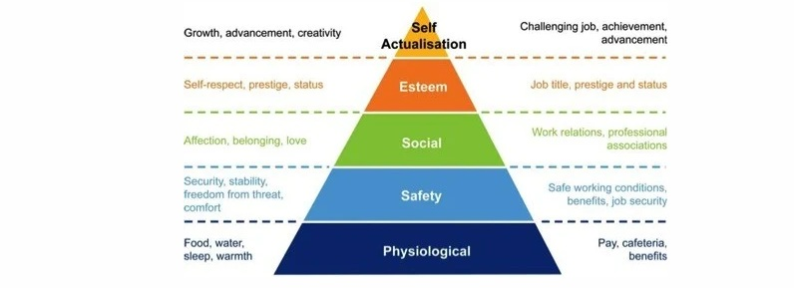
Maslow’s Theory of Motivation

Slide 19
Douglas MacGregor’s Theory X and Theoy Y
In the 1960s, social psychologist Douglas McGregor first explained in his book, "The Human Side of Enterprise," the two styles of management – authoritarian (Theory X) and participative (Theory Y).
If you believe that your team members dislike their work and have little motivation, then, according to McGregor, you'll likely use an authoritarian style of management. This approach is very "hands-on" and usually involves micromanaging people's work to ensure that it gets done properly. McGregor called this Theory X.
On the other hand, if you believe that your people take pride in their work and see it as a challenge, then you'll more likely adopt a participative management style.
Managers who use this approach trust their people to take ownership of their work and do it effectively by themselves. McGregor called this Theory Y.

Slide 20
Douglas MacGregor’s Theory X and Theoy Y
Creativity
Responsibility
Activeness
Challenges
Followers/Leaders
Orthodox/Flexible
Opportunities
Lower/Higher Level Needs
Self Motivation
Nature of People
Leadership Style
Centralization v/s Decentralization

Slide 21
THANK YOU
KINDLY GIVE YOUR ATTENDANCE

