Slide 1
Thakur College of Science & Commerce
Department of Zoology
Academic Year – 2020-21
T.Y.B.Sc. Zoology
Semester – V
Applied Component Practical
Identification of Packaging Material in fishery
Dr. Vitthal T. Mohite

Slide 2
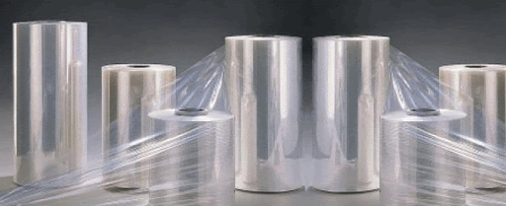
Polyolefin
Plastics. Plastics are organic polymeric materials that can be molded into the desired shape
A polyolefin is a type of polymer produced from a simple olefin as a monomer.
For example, polyethylene is the polyolefin produced by polymerizing the olefin ethylene.
Polypropylene is another common polyolefin which is made from the olefin propylene.
Polyolefins are extremely suitable and safe for packaging.
This is because they are 'chemically inert' materials, which means they do not interact with other materials.
The contents of polyolefin cannot absorb harmful chemicals, additives or by-products from the container.

Slide 3
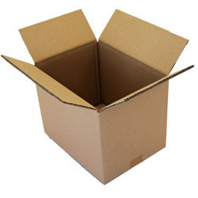
Master cartoon
The master carton is the large outer container that you see first when receiving a package.
It's often marked with the quantity of units inside and shipping
These cartons are specifically designed to be master packs for our popular small carton boxes for freight consolidation and to reduce the number of boxes during transport and delivery.
Choose the one that fits your needs and keep your items and their original packaging protected during the shipment.

Slide 4
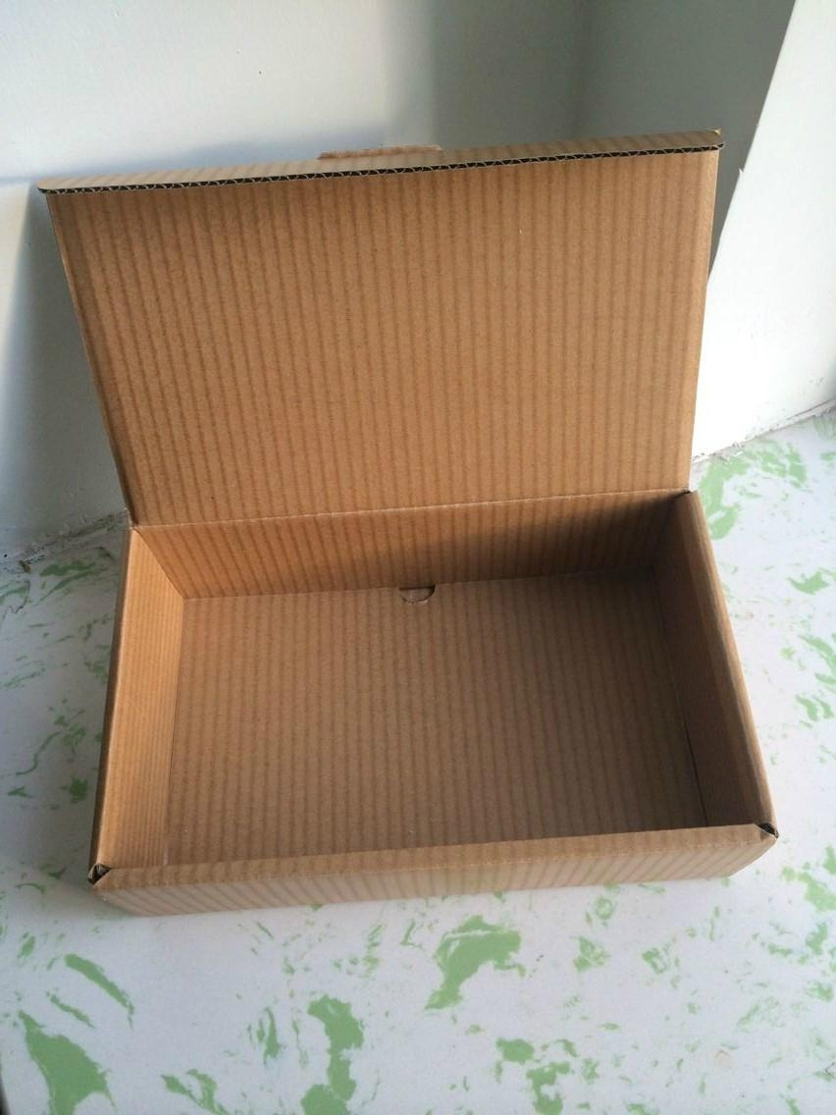
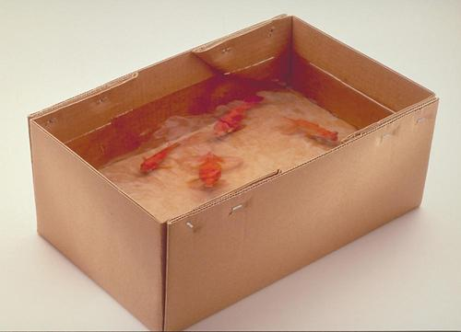
Wax Duplex Cartoon
Proper packaging for frozen :fish is essential for controlling the detrimental effects of oxygen and desiccation by barring the entry of air and escape of moistur.
Protect the contents from flavour contamination, entry of microorganisms, mechanical damage and exposure to light.
Fish packaging cartons are with their special properties such as bursting strength, puncture resistance, water proofness.
tearing, strength, tensile strength, elongation, moisture content, thickness, weight of the carton, dimension, wax content and saponifiable matter.

Slide 5
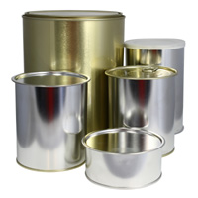
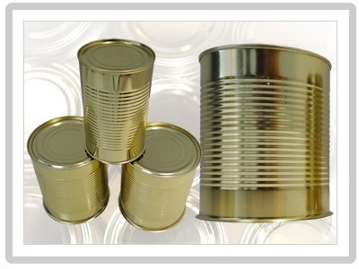
Simple Cans
Other fish that is canned includes tuna cod, mackerel, herring, and anchovy.
Tuna and most canned fish is cooked before it is canned.
Mackerel. Linked to lower blood pressure among males, mackerel is rich in protein and doesn't contain nearly as many calories as chicken or beef. ...
Sardines in Olive Oil. ...
Sardines in Soya Oil. ...
Sardines in Vegetable Oil. ...
Sardines in Water. ...
Light Tuna in Soya Oil. ...
Light Tuna in Water. ...
Tuna Salad With Black Eyed Peas.

Slide 6
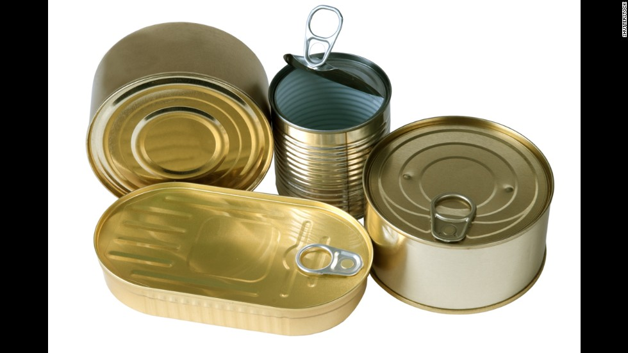
Coated Lacquered Cans
The inside of the can is coated with an epoxy coating, in an attempt to prevent food or beverage from coming into contact with the metal.
To prevent a protective coating is added to the inside of the can.
Preserve the taste and nutritional values of their filling for up to several years.
Coated with an organic layer that prevents chemical reactions between the can’s metal and the food.
Can coatings should withstand the production and sterilization processes.
It is universally applicable for fish and beverage types prevent chemical migration into fishes in quantities that endanger human health.
It preserve the fish and maintain its organoleptic properties over several years

Slide 7
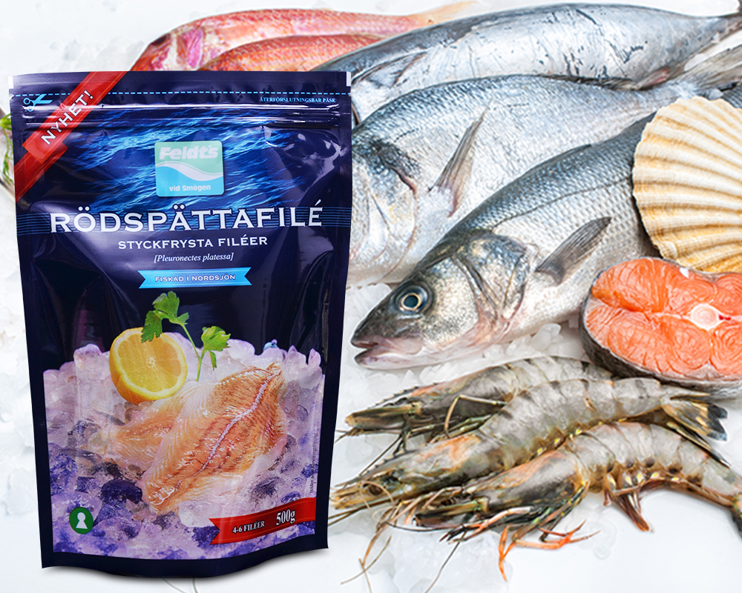
Retort pouches
The term 'retort pouch' is used to describe a flexible or semi-rigid package made from heat-resistant laminated plastic, into which food products are placed, sealed and sterilized at temperatures up to 121°C.
The resulting product is then sterile and shelf-stable.
The pouches are heat processed in an over pressure autoclave.
Work carried out CIFT has shown that oil sardines packed in retort pouches having composition polyester / aluminium foil / cast polypropylene remained in excellent condition even after a period of 3 years

Slide 8
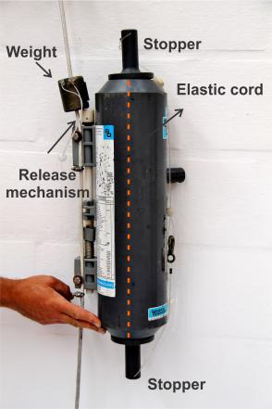
Niskin Water Sampler
Niskin bottles. Open Niskin bottles are attached to a cable and lowered to water depths where seawater samples are to be obtained for chemical analysis.
A metal messenger “trips” each bottle on the cable individually, causing it to fill with water and close securely.
A rosette cluster.
Water collecting bottles are arranged around a rigid, circular frame in a rosette pattern. Technicians are able to close the bottles individually as the array is lowered or raised through the water column.
Sampling Depths
Chemists must establish the exact sampling depth for each bottle.
Otherwise, the analytical work, no matter how accurate, is of limited use in determining the exact chemical structure of the water column.
A common technique is to measure the length of the cable between the ocean surface and the depth at which the bottle was triggered by the messenger.
However, the cable rarely hangs straight down, because of the drift of the ship relative to the bottles on the cable.
Depth corrections are applied by measuring the angle of the cable and by noting the difference between the temperature readings on the pressure-protected and unprotected thermometers mounted on the sampling bottles. (Temperature discrepancies are indicators of water pressure,which is a function of water depth).
When near-bottom water samples are collected, it is customary to attach a pinger(a pulsing sound source) to the free end of the cable.
Sound signals reflected off the sea floor and transmitted to the ship are used to determine the distance between the pinger and the bottom to within a meter or so

Slide 9
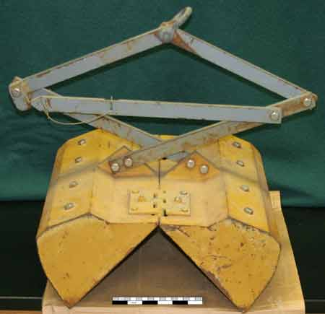
Peterson’s Grab
Since 1930, the Petersen grab has been used in fresh water for collecting macroscopic fauna in sand, gravel, marl, or clay and is ideal for comparing data collected by a previous Petersen grab.
It is not intended for salt water sampling and must be painted for protection if so used.
Since 1930 the Petersen grab has been used in fresh water for collecting macroscopic fauna in sand, gravel, marl, clay or clay combinations
Features
• Classic fresh water sampler in hard bottoms
• Zinc plated steel to prevent corrosion
• Large volume and sampling area
• Tapered scoop edges
• Safety pin lock
• Clamshell pivot
This is a deliberately heavy device for biting deep into hard bottoms and can hold up to 8 removable weights.
Vent holes permit water to flow through while the grab is lowered, minimising diagonal movement and reducing the frontal shock wave.
Jaws close clamshell- fashion. A safety-pin latch prevents the scoops from closing to help prevent injury.
The bayonet-style trip mechanism is designed to release only when the sampler is on the bottom and the cable is slack. Operation requires winch and crane due to the working weight.

Slide 10
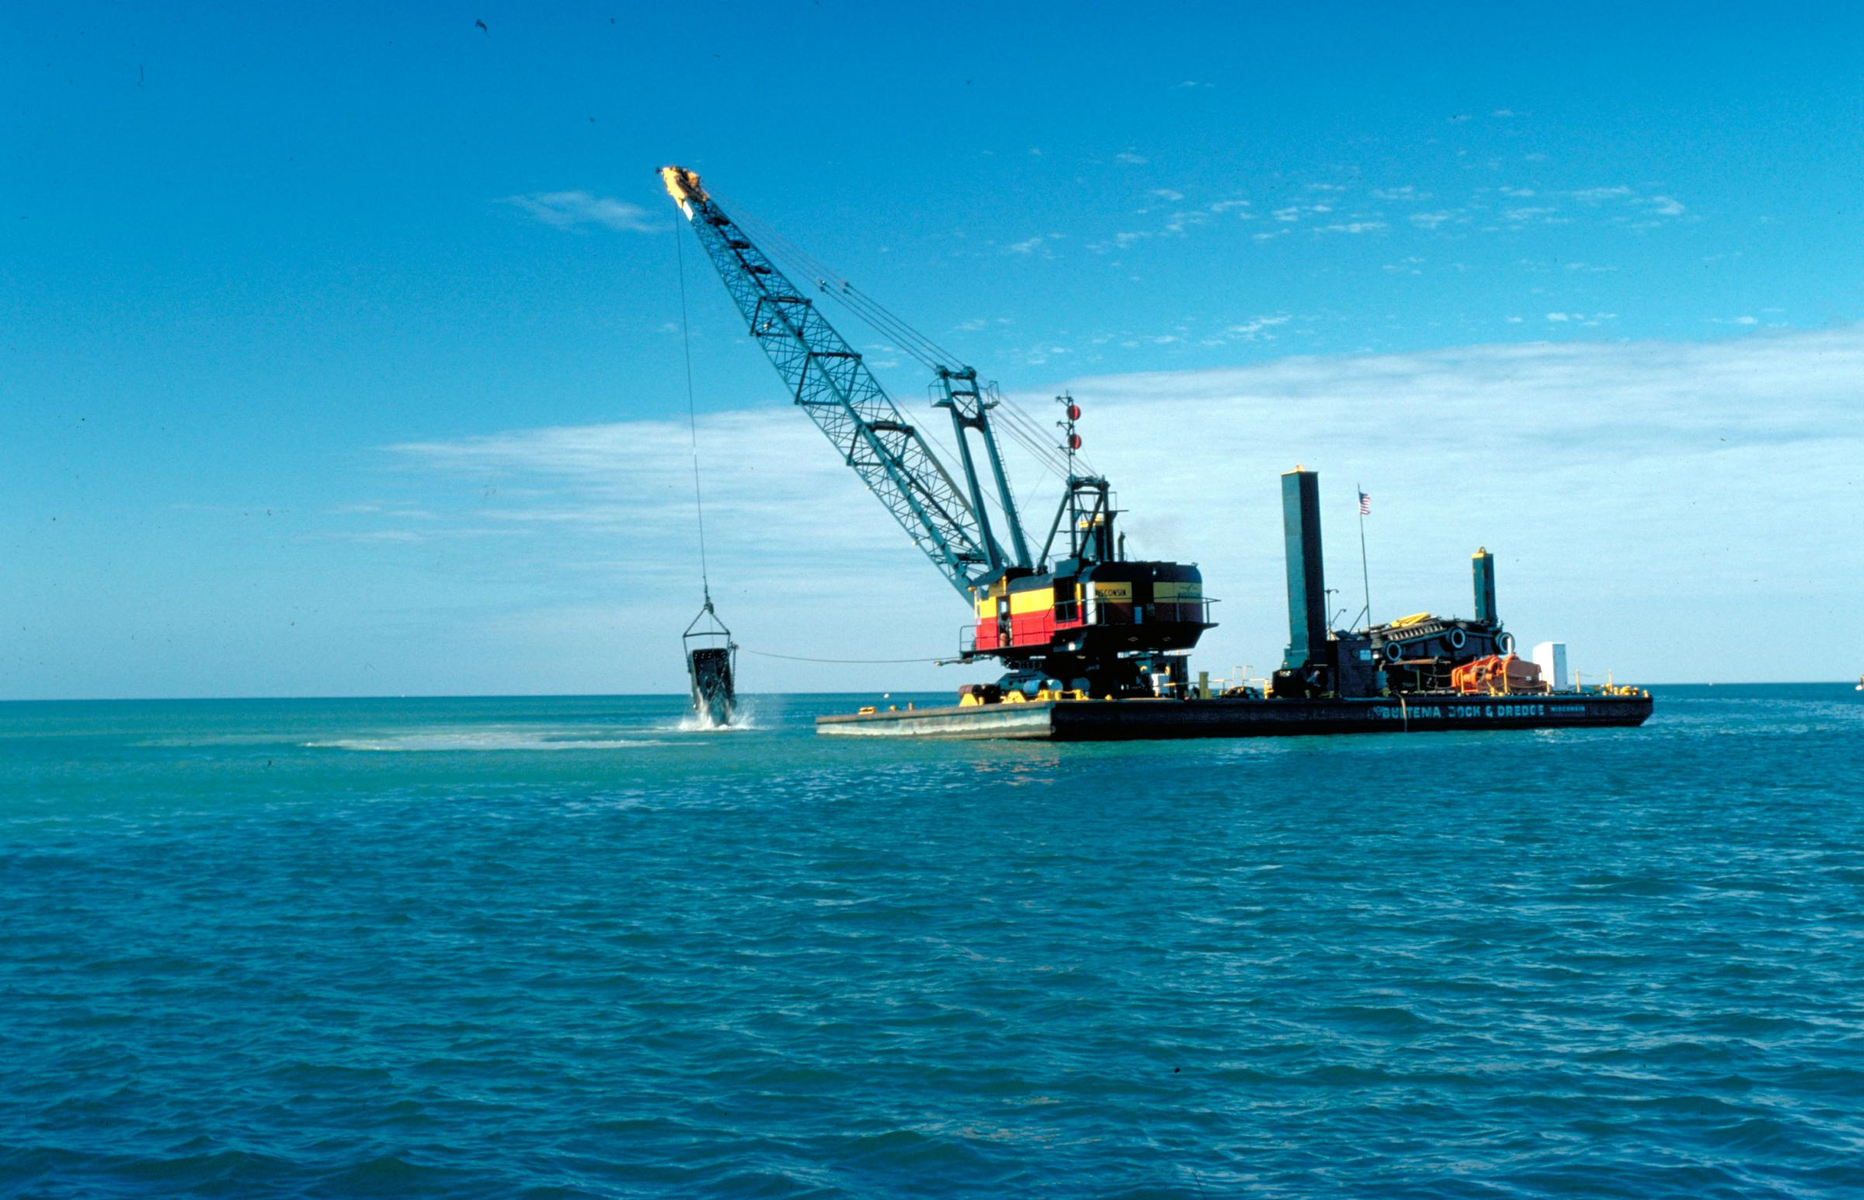
Dredge

