Slide 1




SO SHOULD YOU FOR ALL THE CLASSES.

Slide 2


Topic:
Balance of Payments (BOPs)

Slide 3
Balance of Payments
Balance of Payments (BOPs) can be defined as systematic record of all economic transactions between the residence of one country and the residence of another country during a given period of time.
It is a statistical record of the character and dimensions of the country’s economic relationships with rest of the world.

Slide 4

Balance of Payments
The Balance of Payments is merely a way of listing receipts and payments in international transactions for a country. – Bo Sodersten
It shows the country’s trading position, changes in its net position as foreign lender or borrower, and changes in its official reserve holding. – B.J. Cohen
The Balance of Payments of a country consists of the payments made, within a stated period of time between the residents of that country and the residents of the foreign country. –Department of Commerce, United States of America

Slide 5
Features of BOPs
Systematic record maintained with a period into consideration for all the economic transactions
The accounting procedure of double-entry bookkeeping (debits & credits)
A credit entry records an item or transaction that brings foreign exchange into the country/payment received from a foreign country, i.e. acquiring purchasing power which can be used in
A debit entry represents a loss of foreign exchange/payment made to a foreign country.
Credits is shown on the left side and Debits on the right side of the BOP
The representation of Balance of Payment is done vertically or horizontally with respect to the Principles of Double-entry Book-keeping.

Slide 6


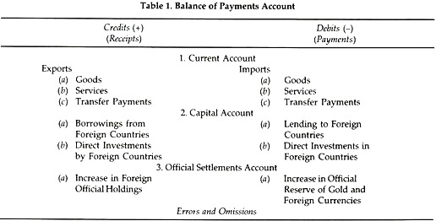


Slide 7
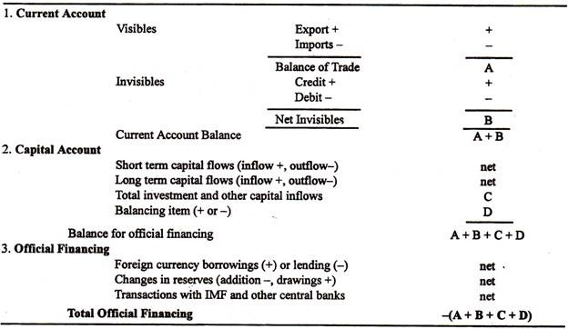

Slide 8
Balance of Payment
Current Account
Capital Account
Official Reserves Account/ Official Settlements Account
Errors and Omissions/Statistical Discrepancies
Merchandise Account/ Trade of Visible
Invisibles/ Trade of Intangibles
Trade of Tangible Goods
Trade of Services
Transfer Payments
Equity
Debt
FII/FPI
FDI
NRI Accounts
External Commercial Borrowings and Trade Credits
Export of goods
Import of goods
Costs of Travel, Transportation, Insurance
Gifts, Foreign Aid, Pension, Private Remittances, Charitable Donations

Slide 9
Current Account
Current Account of a country consists of all transactions relating to trade in goods and services and unilateral/unrequited transfers.
Current Account Includes
Merchandise—tangible goods
Services—include travel and tourism, royalties, transport costs, and insurance
Income from investments—interest and dividends
Unilateral transfers—include foreign aid, gifts, and retirement pensions

Slide 10
Capital Account
FOREIGN INVESTMENT:
(a) Foreign direct investment
(b) Portfolio investment
LOANS:
(a) Commercial borrowing
(b) Borrowing as external assistance
(c) Banking capital transactions
Capital Account shows international flow of loans and investments and represent a change in the country’s foreign assets and liabilities.

Slide 11
Capital Account
Autonomous capital : refers to those capital flows which take place because of economic considerations
Accommodating capital: It takes place to bring the BOP in equilibrium

Slide 12
BOP will Balance
BOP will always balance.
Receipts-R (Credit Side), Payments-P (Debit Side)
B=R-P
R>P = Surplus
R<P = Deficit
R=P = Balance

Slide 13
Balances of Balance of Payments
Balance of Payments
Equilibrium
Disequilibrium
Receipts=Payments
Surplus
Deficit
Receipts > Payments
Receipts < Payments
Balance

Slide 14
Different types of Balances in Balance of Payments
Balance of Trade Account
Difference between Export (X) and Import(M)
Surplus (X>M)
Balance of Current Account
Difference between Receipts (R) and Payments (P) of Current Account
Balance of Capital Account
Difference between Receipts (R) and Payments (P) of Current and Capital Account
Deficit (M>X)
Surplus (R>P)
Deficit (P>R)
Basic Balance
Difference between Receipts (R) and Payments (P) of Capital Account
Surplus (R>P)
Deficit (P>R)
Surplus (R>P)
Deficit (P>R)

Slide 15
Types of Disequilibrium
Short-Run Disequilibrium
Long-Run Disequilibrium
Cyclical Disequilibrium
Structural Disequilibrium

Slide 16
Causes and Measures to Correct Disequilibrium of BOP
Causes | Measures to Correct it
Appreciation Changes in foreign exchange rate | Exchange Rate equilibrium Currency depreciation
Inflation Trade cycle Huge development and investment programme | Deflation Domestic Price Control Devaluation Tighter Monetary policy and contractionary fiscal policy
Changes in export demand Imposition of High Tariff Import of essential goods and services Huge external borrowing and investment Reciprocal demand Cutthroat competition | Import of foreign capital Export promotion Import substitution
Population Growth Natural calamites Globalization Demonstration effect Structural adjustment | Social awareness and stability International cooperation

Slide 17
Special Drawing Rights (SDRs)
The SDRs is neither a currency nor a claim on the IMF. Rather, it is a potential claim on the freely usable currencies of IMF members. SDRs can be exchanged for these currencies.
The SDRs serves as the unit of account of the IMF and some other international organizations.
SDRs are both assets and liability of IMF.
Quota (the amount contributed to the IMF) of a country is denominated (expressed) in SDRs

Slide 18
SDRs
The currency value of the SDR is determined by summing the values in U.S. dollars, based on market exchange rates, of a SDR basket of currencies.
The SDR basket of currencies includes the U.S. Dollar, Euro, Japanese Yen, Pound Sterling and the Chinese Renminbi (included in 2016).
The SDR currency value is calculated daily (except on IMF holidays or whenever the IMF is closed for business) and the valuation basket is reviewed and adjusted every five years.
The current interest rate on credit 0.0050%

Slide 19
TEMPLATES OF BALANCE OF PAYMENTS
NUMERICAL UNDERSTANDING

Slide 20
Balance of Payments Account (in Crores Rupees )
Receipts (Credit) |  | Payments (Debit)
Current Transactions
Export of Goods | 900 | Import of Goods | 1000
Export of Services | 350 | Import of Services | 500
Income from Foreign Investments | 500 | Foreign Income from Investments at Home | 400
Unilateral Receipts | 300 | Unilateral Payments | 300
TOTAL | 2050 | TOTAL | 2200
Capital Transactions
Long term borrowings | 500 | Long term lendings | 550
Short term borrowings | 400 | Short term lendings | 280
Sale of Gold/Assets | 200 | Purchase of gold/assets | 100
TOTAL | 1100 | TOTAL | 930
 |  | Errors and Omissions | 20
TOTAL | 3150 | TOTAL | 3150

Slide 21
Balance of Payment Reconstituted (in Crores )
Particulars | Credit | Debit | Surplus/Deficit
Balance of Trade/Visibles | 900 | 100 | -100
Balance of Services/Invisibles | 350 | 500 | -150
Balance of Investment Income | 500 | 400 | +100
Balance of Unilateral Transfers | 300 | 300 | 0
Balance of Current Account | 2050 | 2200 | -150
Balance of Loan Transactions | 900 | 830 | 70
Balance of Monetary Gold | 200 | 100 | 100
Balance of Capital Account | 1100 | 930 | 170
Errors and Omissions Net |  |  | -20 +150
Balance of Payments | 3150 | 3150 | 0

Slide 22
Receipts (Credit) |  | Payments (Debit)
Autonomous visible exports | 1000 | Autonomous visible imports | 1100
Autonomous invisible exports | 350 | Autonomous invisible imports | 500
Autonomous unilateral transfer receipts | 300 | Autonomous unilateral transfer receipts | 300
Autonomous capital receipts from abroad | 1400 | Autonomous capital receipts to foreigners | 1250
Accommodating capital receipts from abroad | 100 | Accommodating capital payments to foreigners | 0
TOTAL | 3150 | TOTAL | 3150
Balance of Payments Account (in Crores Rupees )
Autonomous and Accommodating Transactions

Slide 23


Slide 24

Okay then.
See

