Slide 1
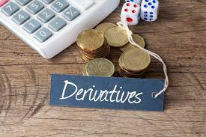
UNIT III
Introduction to Derivatives

Slide 2
???????
Commodity
Commodity Market / Exchange
Types of Commodity
Regulator
History
Need
Role of Information

Slide 3
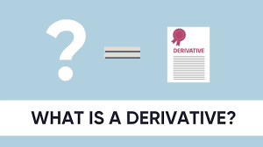

Slide 4
Introduction
A derivative is a financial instrument whose value depends upon the value of the underlying variables.
Price of currency, Stock, Commodity , Stock indices, Interest rates, etc.
A derivative is a contract between two or more parties whose value is based on an agreed-upon underlying financial asset, index or security..
https://www.investopedia.com/terms/d/derivative.asp

Slide 5
Common derivatives include futures contracts, forwards, options, and swaps.
Most derivatives are not traded on exchanges and are used by institutions to hedge risk or speculate on price changes in the underlying asset.
Exchange-traded derivatives like futures or stock options are standardized and eliminate or reduce many of the risks of over-the-counter derivatives
Derivatives are usually leveraged instruments, which increases their potential risks and rewards.
Derivatives can be used to either mitigate risk (hedging) or assume risk with the expectation of commensurate reward (speculation).
https://www.investopedia.com/ask/answers/12/derivative.asp

Slide 6
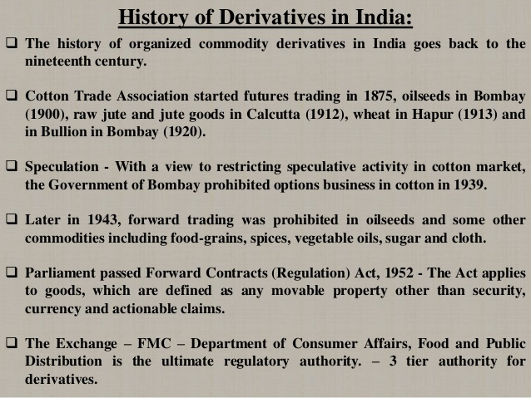

Slide 7
Objective
Risk & Uncertainties
Agriculture : Trade : Industry
Factors : Price of RM, Competition, Market Price, Government Policy, Technological Changes.
Economic Reforms : LPG
Opportunities : Market , Product, Technology
Threats : Competition , Market Practices
DD – SS Equation
New Business Environment

Slide 8
Types of Derivatives
Forward Contracts
Swaps
Future Contracts
Options Contracts
American Options
European Options

Slide 9
Forward Contracts
Simple Derivatives
Agreement to Buy & Sell an asset @ certain future time for designated price
X Traded at exchange
OTC product
Agreed Price = Delivery Price
X Cost to party ( Long/Buy, Short/Sell)
Gain / Loss
Settled @ maturity
Pay off : Buyer-> Price @ Maturity, Seller-> Delivery Price

Slide 10
Future Contracts
Exchange traded contract
Buy / Sell financial instrument / Physical commodities for future delivery at agreed price.
Asset : Currency, Int rate, Commodities, Forex, Live stocks
X specified delivery dates. ( Delivery Month)
Exchange specific certain standard features ( Qty, Qlty, Unit, Price, etc)
Online trading ( Transparency & Liquidity)
Future Price : DD & SS
Clearing House
Exchange keeps record of contract

Slide 11
Swaps Contracts
A contract where in 2 parties exchange 2 different streams of cash flows over a definite period of time through the mediation of a financial institution.
Portfolio of forward contracts
OTC Products & X exchange traded
Interest rate swap ( Floating Rate)
LIBOR : London inter bank offer rate
MIBOR : Mumbai inter bank offer rate

Slide 12
Options Contracts
Agreement between 2 parties, gives buyer of the option the right, but X obligation, to buy/sell an asset @ fixed price @ a given point in future.
Seller has the obligation to sell/ buy the asset to/from buyer & X right.
Obligation ----→ Premium
Underlying asset : Stock Indices, Currency, Bonds, Commodities.

Slide 13
Options Contracts
Call : Holder the right to buy @ certain date & price
Put : Holder the right to sell @ certain date & price
Contract Price : Exercise price / Strike price
Contract date : Exercise date / maturity
American Option V/s. European Option
Vanilla / Standard , Exotic Option

Slide 14
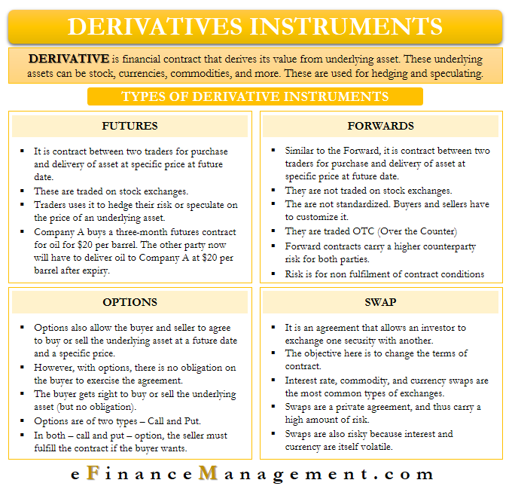

Slide 15
Products
1. FRA : Forward Rate Agreement
On interest rate
Exchange difference between market interest rate & decided interest rate on the date of execution.
Future borrowing
Buy / Sale deposits
Cash settled contracts
International Banks in euro- dollar market
Yet to become active instrument in India.

Slide 16
2. Commodity Derivatives
Forward , Future , Options, Swaps
( Options are X allowed in India)
3. Currency Derivatives
FOREX : Oldest market in India
OTC Market
Only authorised dealers offer this products
Exporter / Importers : Risk Management
Cross currency (Buy / Sale )
Base currency : US $
Yet to develop
Only corporate borrowers / depositors : approaches banks to hedge risk.

Slide 17
4. Stock market Derivatives
2000, SEBI permitted NSE & BSE : Index Future Trading
Individual securities ( Nov. 2001)
MF allowed to trade(For hedging & portfolio balancing)
BSE 30 Stock , NSE 50 Stock
Investor > Hedge : take opposite position
Hard to manipulate
Index option ( European Style ) : 3 month expiration cycle , are cash settled.
5. Credit derivatives
Credit is underlying asset
Payoff depends on : Event ( Default / bankruptcy, Natural Disaster)
Financial Loss : Absorb by other than lender
Inactive market in India.

Slide 18
Functions
Management of Risk
Price Discovery
Liquidity & Reduce transaction cost
Measurement of Market
Efficiency in trading
Speculation & Arbitrage
Hedging
Price Stabilisation
Gearing of value
Develop the complete markets
Encourage competition

Slide 19
 | Exchange Traded Derivatives | Over The Counter Derivatives
Meaning | Derivatives traded on a regulated exchange. | Derivatives traded over the counter, with no exchange in contract.
Nature | The contract are specified by the exchange. | The contracts terms are determined by buyer & seller.
Negotiation | No scope | Complete Scope
Structure | Centralised (Traded via exchange) | Decentralised (Traded via brokers)
Regulations | SEBI | No regulations
Risk | Credit & Default Risk taken over by exchange. | Absence of regulation & exchange increases the risk.
Scope | Large scope for big & small players. | Limited scope for small players.
Transparency | Highly Transparent | Visibility & transparency is lower

Slide 20
Financial Derivatives
The concept of varying quality of asset does not really exist as far as financial underlying are concerned.
The most common underlying assets includes Stocks, Bonds, Commodities, Currencies , Interest Rates & Market Indexes.
They are widely used as arbitrage instruments
They can be used to leverage by paying the margin money & not the full traded value. They can be used to protect holding.
They are efficient risk management instruments.
They can be used for hedging as well as to speculate on short term movements in the market.
Types : Forwards, Futures, Options, Currency Swaps, Interest Rate Swaps.

Slide 21
Commodity Derivatives
The bulky nature & physically existence f the underlying assets, physical settlement in commodity derivatives creates the need for warehousing.
The quality of underlying a contract can vary largely.. This is an important issue to be managed.
The underlying assets can be Metals, Agro Products, Energy Products.
Commodity derivatives allows investors to invest in non financial resources without actually owing it or spending to mach money on it.
They largely depends on the DD & SS , there by predicting the fluctuations in the value of the commodity derivatives is comparatively easier.
Types : Commodity : Forwards, Futures, Options , Swaps.

Slide 22
Commodity Specific Issues
Fragmented Land
Support Services
Weather Conditions
Low Cropping
Quality of Soil
DD for Commodity
Economic Policies
Social Factors
Import & Export Trends
Reserve Stock
Storage Facilities

Slide 23
Pricing Issues
MSP
Price Volatility
DD & SS Factor
Open Market Price
Role of Intermediaries
Black Marketing & Hoarding
Retail & Wholesale Trade
Subsidies (Govt. Policy)

Slide 24
Risk Management
Exposure Limit
Margins
Online & Offline Surveillance
MSP
Regulatory Acts
Contract Specification
Hedging

Slide 25
Type of Assets
An investment asset is an asset held for investment by a significant number of people or companies.
A consumption asset is an asset that is nearly always held to be consumed (either directly or in some sort of manufacturing process).
The forward/futures price can be determined from the spot price for an investment asset.
In the case of a consumption asset all that can be determined is an upper bound for the forward/futures price.

Slide 26
Basis | Investment Assets | Consumption Assets
Pricing | Pricing is influenced by Cost of funds invested. | Pricing is influenced by Cost of Storage.
Holding Cost | The holding cost is cost of financing minus dividends returns. | The holding cost is the cost of financing plus cost of storage & insurance purchased.
Storing | Storing & maintaining is relatively easy & cost effective. | Storing & maintaining is a Risky, tedious & expensive.
Assumption | Position assumed to be carried for longer period in anticipation of gains/ appreciation. | Position assumed to be carried for relatively shorter period, in anticipation of gains/ appreciation.

Slide 27
Cost of Carry Model
Cost of carry can be defined simply as the net cost of holding a position.
The most widely used model for pricing futures contracts, the term is used in capital markets to define the difference between the cost of a particular asset and the returns generated on it over a particular period.
It can also be defined as the difference between the interest generated on a cash asset and the cost of funds to finance that instrument.
In the commodity market, it is the cost of holding an asset in physical form, including insurance payments.

Slide 28
In the derivatives market, it includes interest expenses on margin accounts, which is the cost incurred on an underlying security or index until the expiry of the futures contract.
The cost also includes economic costs, such as the opportunity costs associated with taking the initial position.
Formula:
Futures price = Spot price + cost of carry
Or cost of carry = Futures price – spot price
Cost of carry is a factor in both direct investing and derivative markets.
Carrying costs detract from total return for direct investors.
In the derivative markets, carrying costs are a factor that influence derivative contract pricing.

Slide 29
cost-of-carry factors
Margin: Using margin can require interest payments, since a margin is essentially borrowing. As such, interest borrowing costs would need to be subtracted from total returns.
Short Selling: In short selling, an investor may want to account for foregone dividends as a type of opportunity cost.
Other Borrowing: When making any type of investment with borrowed funds, the interest payments on the loan can be considered a type of carrying cost that reduces total return.
Trading Commissions: Any trading costs involved with entering and exiting a position will reduce the overall total return achieved.
Storage: In markets where physical storage costs are associated with an asset, an investor would need to account for those costs. For physical commodities, storage, insurance, and obsolescence are the primary costs that detract from total returns.

Slide 30
F = Se ([r + s - c] x t)
F = the future price of the commodity
S = the spot price of the commodity
e = ‘base e’, a mathematical constant approximated to 2.718
r = the risk-free interest rate
s = the storage cost (as a percentage of the spot price)
c = the convenience yield
t = the time to delivery of the contract (as a fraction of one year)

Slide 31
Assumptions
The underlying asset is available in abundance in cash market.
There is no seasonal DD & SS in the underlying asset.
The storability of the underlying asset is not a problem ie the asset is carriable.
The underlying asset can be sold short.
No transaction costs are applicable.
No taxes are applicable.
The are no margin requirement.

Slide 32
CBOT
The Chicago Board of Trade (CBOT) is a commodity exchange established in 1848.
The Chicago Board of Trade originally traded only agricultural commodities such as wheat, corn, and soybeans.
Now it offers options and futures contracts on a wide range of products including gold, silver, U.S. Treasury bonds, and energy.
The Chicago Board of Trade was originally solely an open-outcry trading platform, where human traders met to haggle and agree on a market price for a commodity.

Slide 33
Winnipeg Commodity Exchange
The Winnipeg Commodity Exchange is the former name of a derivatives market based in Winnipeg, Manitoba, Canada now known as ICE Futures Canada. Futures and options contracts are electronically traded in western barley and canola (rapeseed).
The WCE began its existence as the Winnipeg Grain & Produce Exchange in 1887. In 1904, it introduced its first futures contracts. It was, and remains, Canada's only commodity futures exchange. It also formerly operated the Canadian Financial Futures Market.
In December 2004, WCE converted from the traditional "open outcry" method of trading to an electronic trading format. This made it the first commodity futures exchange in North America to go fully electronic. Until December 2007, futures were traded on the platform of the Chicago Board of Trade.
Since September 2007, the WCE has been a subsidiary of the Atlanta-based Intercontinental Exchange (ICE). Its quotes are now traded on the ICE platform.

Slide 34
NYMEX
The New York Mercantile Exchange (NYMEX) is the world's largest physical commodity futures exchange and is today part of the Chicago Mercantile Exchange Group (CME Group), which is the world’s leading and most diverse derivatives marketplace.
CME Group consists of four exchanges: Chicago Mercantile Exchange (CME), Chicago Board of Trade (CBOT), NYMEX, and the Commodity Exchange, Inc. (COMEX).
Each exchange lists wide range of futures products, commodities, and global benchmarks across major asset classes.
NYMEX is a commodities trading exchange that started in 1872 and was acquired by CME Group in 2008.
The exchange lists futures and options on various metals, energy, and agricultural commodities.
NYMEX was once an open-outcry market with trading pits, but like most exchanges today, it has become increasingly electronic.

Slide 35
LME
The London Metal Exchange (LME) is a commodities exchange that deals in metals futures and options. The LME is a non-ferrous exchange, which means that iron and steel do not trade there. Instead, tradable contracts include aluminum, copper, gold, silver, cobalt, and zinc.
Located in London, England, the LME is the world center for the trading of industrial metals, with more than three-quarters of all non-ferrous metal futures business transacted on the exchange.
The London Metals Exchange (LME) is one of the largest commodities exchanges in the world.
Futures and options contracts on metals like gold, silver, zinc, and copper are listed for trading on LME.
Hedgers and speculators are active on the metals exchange, with hedgers turning to futures and options to mitigate risk and speculators seeking to make short-term profits by taking on risk.
LME represents the only remaining physical commodities trading market in Europe, as the trend has been moving steadily to electronic trading and away from open outcry.

Slide 36
Dalian Commodities Exchange
The Dalian Commodities Exchange is located in Dalian, China and trades futures contracts on a wide variety of commodities. The exchange the largest trader of agricultural futures in the world.
The Dalian Exchange was established on February 28, 1993.
It is a non-profit, self-regulating entity with about 200 members and over 160,000 investors.
Through the nineties the exchange gained a reputation for financial integrity, risk management and functionality in the market, as well as for transparency and liquidity.
In 2013, the Dalian Commodities Exchange expanded from its role as an agricultural commodities exchange to include industrials, such as iron ore and coke coal. The exchange now has nearly 500,000 participants.
In 2015, the DCE was ranked 8th out of the leading global derivatives exchanges by the Futures Industry Association, as well as the largest futures market for oils, plastics, coal, metallurgical coke, and iron ore.

Slide 37
Shanghai Futures Exchange
The Shanghai Futures Exchange was formed from the amalgamation of the national level futures exchanges of China, the Shanghai Metal Exchange, Shanghai Foodstuffs Commodity Exchange, and the Shanghai Commodity Exchange in December 1999.
It is a non-profit-seeking incorporated body regulated by the China Securities Regulatory Commission.
The trading floor is located in Lujiazui, in the Pudong district of Shanghai. It currently trades futures contracts in copper, aluminium, zinc, natural rubber, fuel oil, and gold.
The Shanghai Metal Exchange (SHME), was established on 28 May 1992. SHME is a non-profit, self-regulating corporation.

Slide 38
Shanghai Futures Exchange
The exchange was created for trading in non-ferrous metals and currently contracts for several non-ferrous metals including copper, aluminum, lead, zinc, tin, nickel.
SHME is located in the city of Shanghai and its geographical location bridges the time gap between London Metal Exchange and New York Mercantile Exchange markets, thus enabling traders across the world to have a 24-hour access to futures contracts of non-ferrous metals.
SHME is currently the largest non-ferrous metals futures exchange in China and the third largest exchange of its kind in the world.

Slide 39
Osaka Dojima Commodity Exchange
Osaka Dojima Commodity Exchange (ODE) is a futures exchange based in Osaka, Japan. It started as the Osaka Grain Exchange in 1952.
In 1993 it merged with the Osaka Sugar Exchange and the Kobe Grain Exchange, taking the name Kansai Agricultural Commodities Exchange.
The exchange merged with the Kobe Raw Silk Exchange in 1997, becoming the Kansai Commodities Exchange (KEX), and with the Fukuoka Commodities Exchange in 2006. In February 2013 it took over the rice exchange from the Tokyo Grain Exchange and took its current name.

Slide 40
Singapore Exchange
The (SGX) is a full-service equities, fixed income, derivatives, commodities, and foreign currency exchange.
The exchange came into formation from the 1999 combination of three separate entities — Stock Exchange of Singapore, Singapore International Monetary Exchange and Securities Clearing and Computer Services Pte.
In 2000, the Singapore Exchange listed its shares for public investors and in 2008 it completed the acquisition of Singapore Commodity Exchange.

Slide 41
Malaysia Derivatives Exchange
The Malaysia Derivatives Exchange (MDEX), also known as Malaysian Distribution Exchange, is a limited share company formed during June 2001 in Malaysia through the merger of the Kuala Lumpur Options and Financial Futures Exchange (KLOFFE) and the Commodity and Monetary Exchange of Malaysia (COMMEX Malaysia). It is a subsidiary of the Kuala Lumpur Stock Exchange (KLSE).
MDEX is fully electronic, using the KLOFFE Automated Trading System (KATS). The exchange's most active contract is crude palm oil futures. It also trades futures and options on the KLSE Composite Index, three-month KLIBOR (Kuala Lumpur Interbank Offered Rate) futures, and five-year Malaysian Government securities futures.
All derivatives except crude palm oil are cash settled. The KATS system has two trading sessions, separated by a lunch break. Trading is done Monday through Friday, from 8:45 a.m. to 6 p.m.

